Slide 1
Unit 8.
Plate motion and driving forces [4 hrs]
  The plate-scale flow
  Absolute and relative motion of plates
  The plate mode of mantle convection
  Forces and stresses of plate tectonics

Slide 2
Key principles;
Types of plate boundaries;
Driving forces of plate motion;
Development of the theory;
Implications for biogeography;
Plate reconstruction;
Current plates;

Slide 3
Plate Motion
The motion of a series of rigid plates on a sphere can be complex. Each plate moves as an independent unit, in different directions and at different velocities than any other plates.
The geometry of a curved plate moving on a sphere was worked out more than 200 yr ago by the Swiss mathematician Leonhard Euler (1707-1783) and now provides the basis for analysing plate motion.

Slide 4
The basic analysis of this type of motion is illustrated in Fig. 17.19. In the figure, the motion of Plate 1, with respect to Plate 2, is a rotation around the axis AR (the axis of plate rotation), one pole of which is the point P (the pole of rotation).
Note that the pole of the plate rotation is completely independent of Earth's spin axis and has no relation to the magnetic poles.

Slide 5
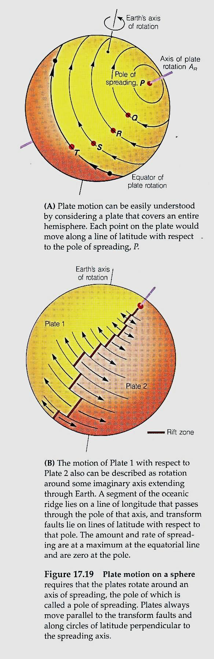

Slide 6
Several important facts about plate motion are immediately apparent from Figure 17.19.
First, different parts of a plate move with different velocities. Maximum velocity occurs at the equator of rotation, and minimum velocity at the poles of rotation.
This fact may best be understood by considering a plate so large that it covers an entire hemisphere.

Slide 7
All motion occurs around the axis of rotation. The pole of rotation has zero velocity because it is a fixed point around which the hemispheric shell moves.
Points Q, R, and S have progressively higher velocities, with a maximum velocity at point T, which lies on the equator of rotation.

Slide 9
Note also that transform faults lie on lines of latitude relative to the pole of rotation (Figure 17.19B).
This condition holds for most transform faults in nature, as can be seen on a physiographic map of the Atlantic (Fig.A). We can thus use the orientation of transform faults to locate the pole of rotation for each plate.

Slide 11
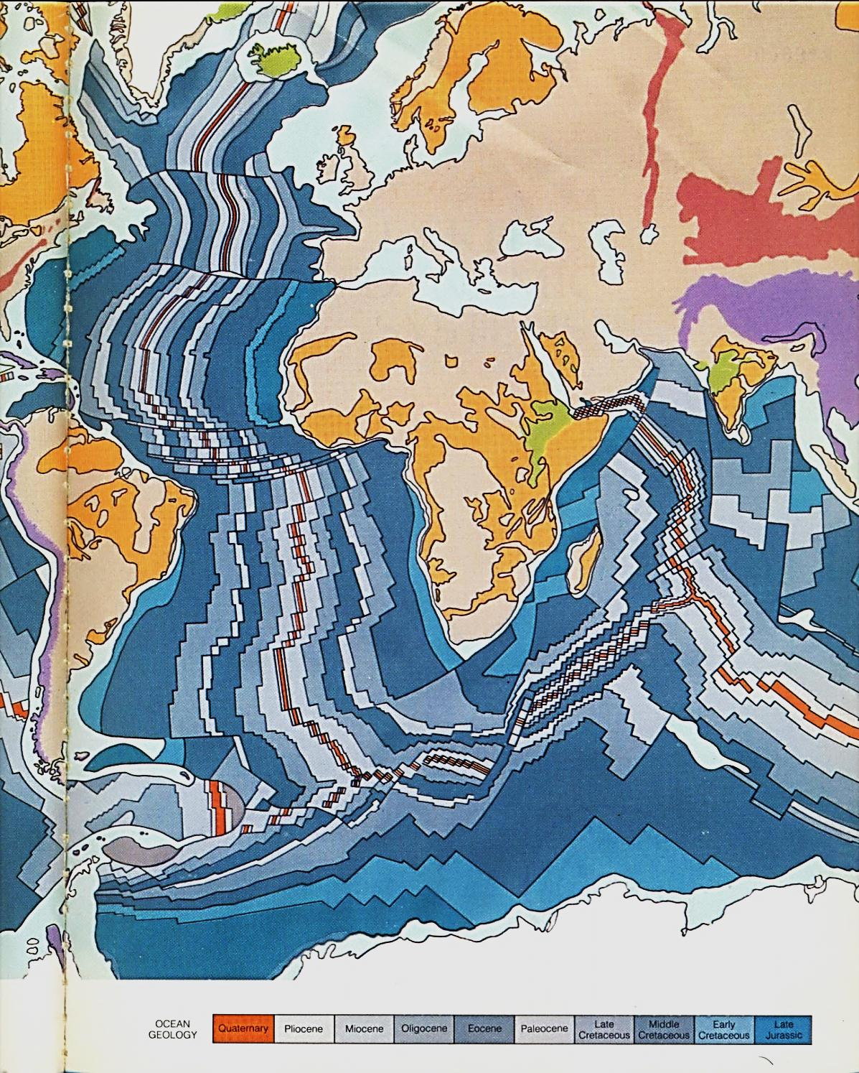
Fig. A

Slide 12
Spreading ridges are linear and are usually perpendicular to plate motion. They are commonly oriented along lines of latitude relative to the plate's pole of rotation.
It is important to understand that the poles of rotation do not necessarily lie on the plate in question (Figure 17.19).

Slide 13
The direction of movement of the major plates, in relation to their neighbors, can be determined in several ways.
As we have seen, the trends of the oceanic ridge and the associated transform faults are related to the location of the pole of rotation.

Slide 14
Plate Kinematics
(Movements of Plates)
Indications of movement are also drawn from
seismic data,
from the relative ages of different regions of the seafloor, and
from the ages of chains of volcanic islands and seamouns.
From these data, geologists have determined the motion of the present tectonic plates. This motion can be summarized using Figure 17.20.

Slide 15
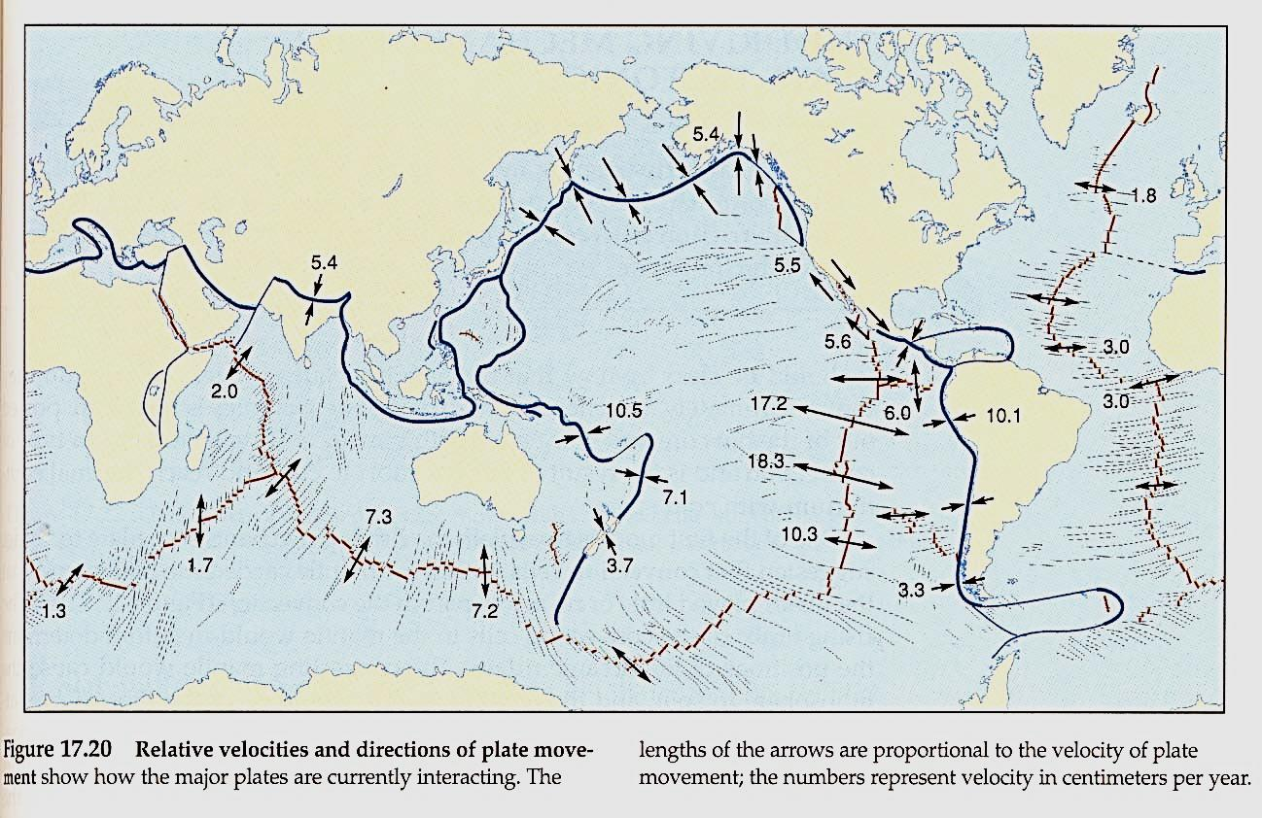

Slide 16
The Pacific plate is moving in a general northwesterly direction, from the East Pacific rise toward the system of trenches in the western Pacific.
It is bordered by several small plates along the subduction zone, so the relative motion at each trench differs from the general trend.
The American plates are moving westward from the mid-Atlantic ridge, converging with the Pacific, Cocos, and Nazca plates. The Australian plate is moving northward,

Slide 18
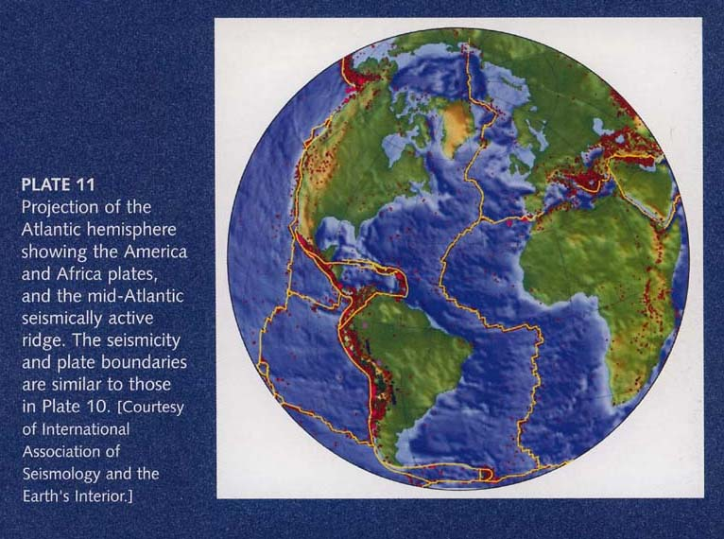

Slide 19
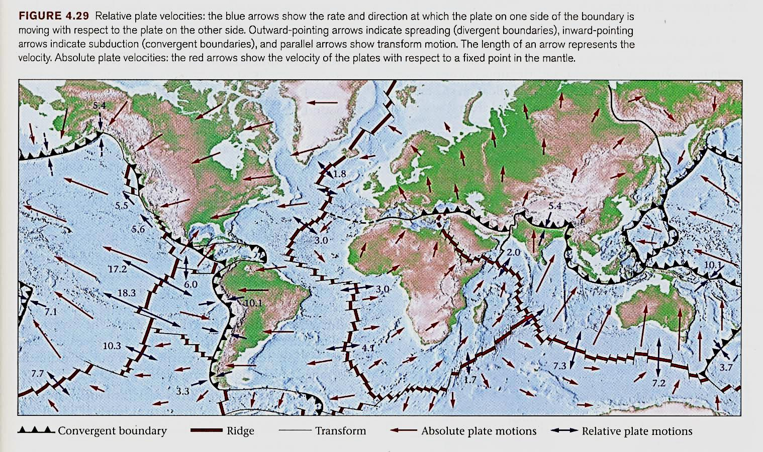

Slide 20
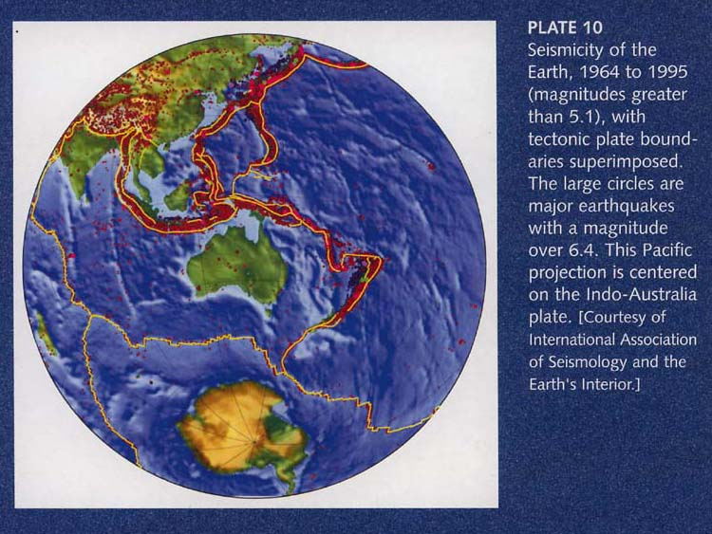

Slide 21
Africa and Antarctica, however, present a different situation. Both are nearly surrounded by ridges, and they have no associated subduction zones to accommodate the new lithosphere generated along the ridges.
Africa moves very slowly north, toward the convergent boundary in the Mediterranean area, but this movement does not accommodate the east-west spreading from the Atlantic and Indian ridges.

Slide 22
The African and Antarctic plates are apparently being enlarged as new lithosphere is generated at their margins. Without subduction zones, the ridges surrounding these plates must be moving outward in relation to Africa and Antarctica

Slide 23
The African and Antarctic plates illustrate a very important point: Plate margins are not fixed but can move as much as the plates themselves can.
If two divergent plate margins are not separated by a subduction zone, new lithosphere is formed at each spreading axis, but none is destroyed between them. The plate between the ridges is continually enlarged, so the ridges themselves must move apart.

Slide 24
Another important change is in the lengths of plate margins. An oceanic ridge is essentially a fracture in the lithosphere that can grow longer.
A good example is the ridge in the Atlantic Ocean. It has grown and lengthened considerably since spreading began to separate South America from Africa.

Slide 25
The Velocity of Plate Motions
How fast do plates move? It depends on the frame of reference. To illustrate this concept, imagine two cars speeding in the same direction down the highway.
From the viewpoint of a tree along the side of the road, car A zips (goes) by at 100 km an hour, while car B moves at 80 km an hour. But relative to car B, car A moves at only 20 km an hour.

Slide 26
Likewise, geologists use two different frames of reference for describing plate velocity (velocity = distance/time).
If we describe the movement of plate A with respect to plate B, then we are talking about relative plate velocity.
But if we describe the movement of both plates relative to a fixed point in the mantle, then we are speaking of absolute plate velocity.

Slide 27
If we assume that the position of a mantle plume does not change much for a long time, then the track of hot-spot volcanoes on the plate moving over the plume provides a record of the plate's absolute velocity and indicates the direction of movement (Fig. 10.50, Fig. 4.29).

Slide 28
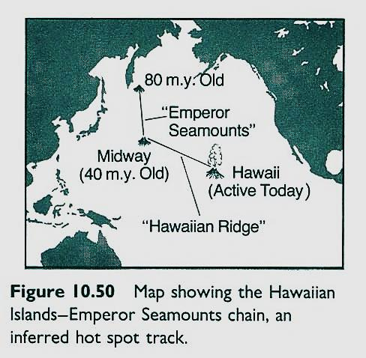

Slide 30
Plates move at 1 to 15 (up t0 18) cm/y, about the rate that our fingernails grow. We can describe the "relative motion" of one plate with respect to another, or the "absolute motion" of a plate with respect to the underlying asthenosphere.

Slide 31
Working from the calculations described above, geologists have determined that relative plate motions on Earth today occur at rates of about 1 to 15 cm per year. But these rates, though small, can yield large displacements given the immensity of geologic time. At a rate of 10 cm/y, a plate can move 100 km in a million years.
Can we detect such slow rates? Until the last decade, the answer was no.

Slide 32
Now the answer is yes. Satellites orbiting the Earth are providing us with the global positioning system (GPS). Geologists can use an array of GPS receivers to monitor plate displacements of mm per year (Fig. 4.30).
In other words, we can now see the plates move!

Slide 33
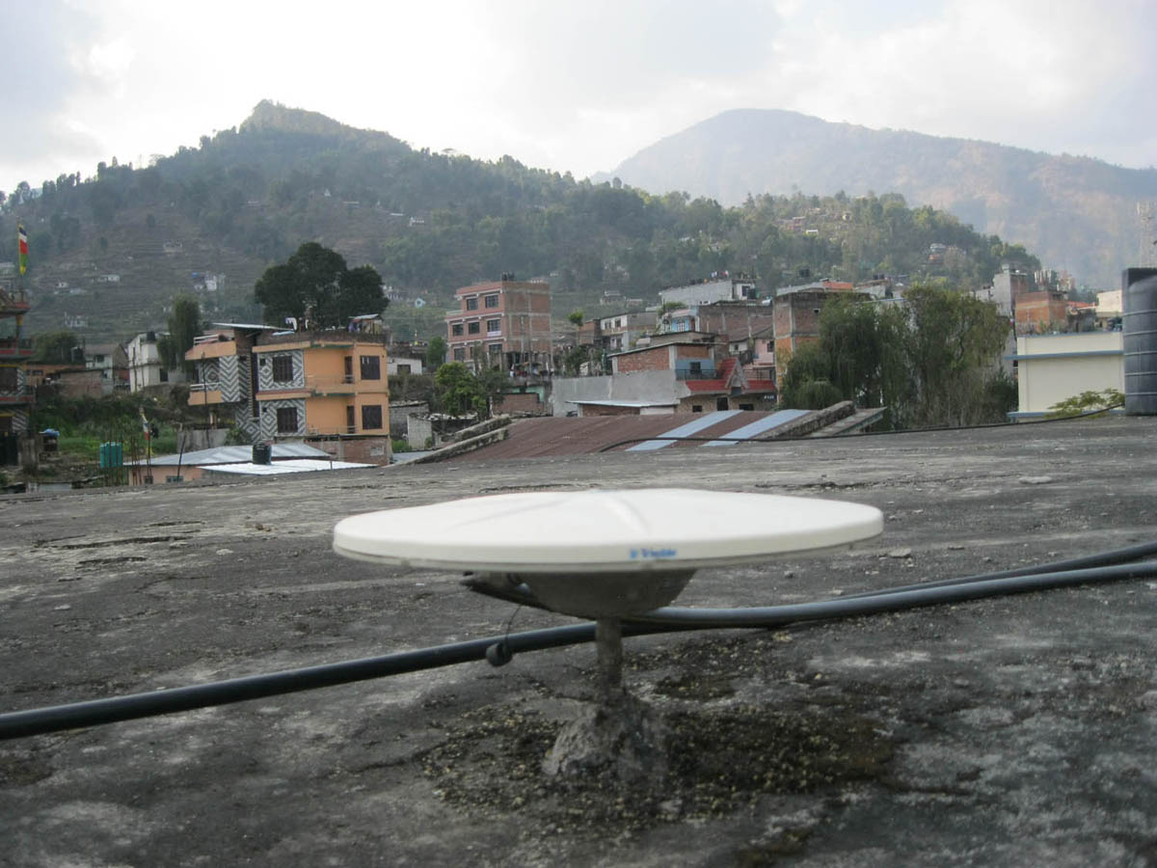
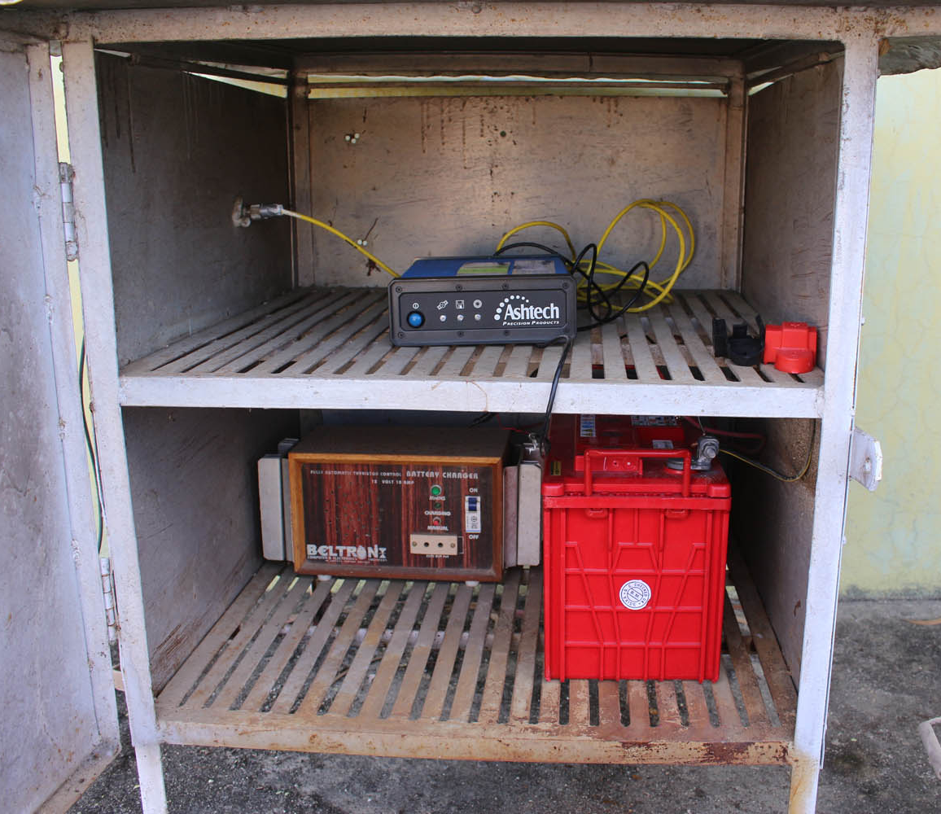

Slide 34


Slide 35
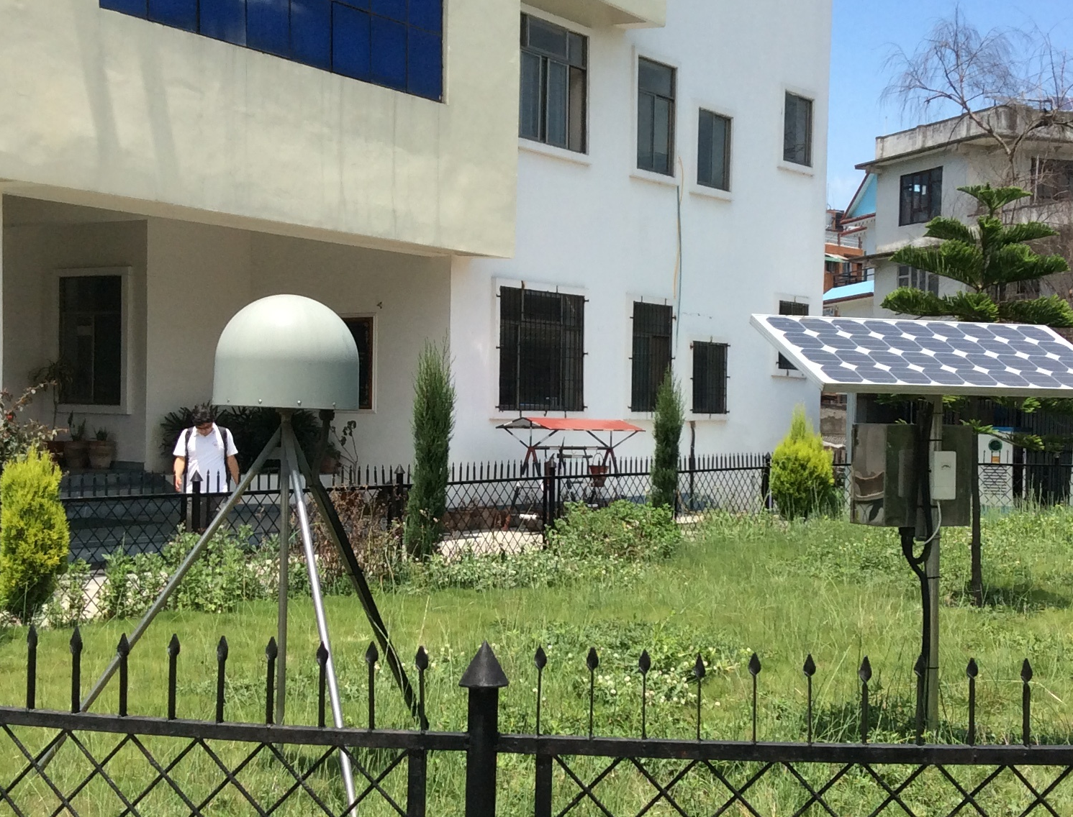

Slide 36


Slide 37
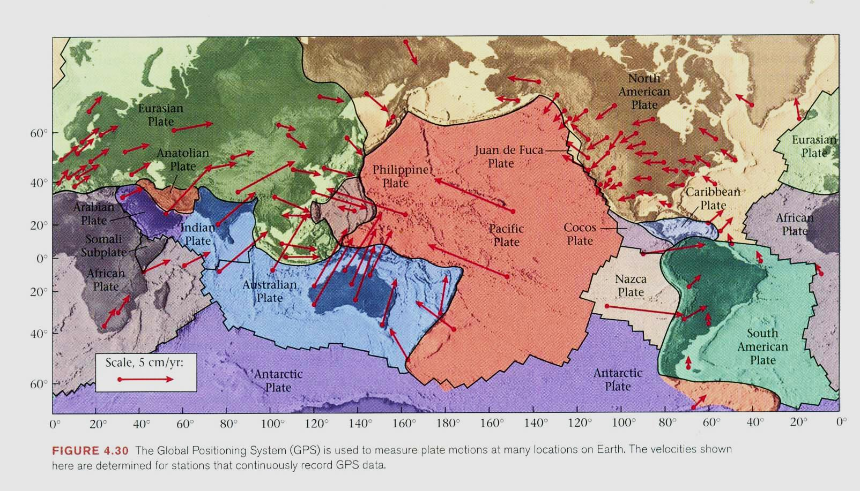

Slide 38
Relative Velocity of Plate Motion
Magnetic reversals on the ocean floor provide a timing mechanism to measure the relative velocity of plate motion.
The results show that plates move at different rates, ranging from 1 to 18 cm/yr.

Slide 39
The velocity of movement of one plate relative to another can be measured by dating the magnetic reversals on the seafloor, using the time scale of magnetic stratigraphy (Fig. 17.9).
The timing system is the oscillation of Earth's magnetic field. For at least 2 billion years, Earth's magnetic field has switched back and forth between "normal" polarity (as exists today) and reverse polarity, in which the north and south poles are reversed.

Slide 40
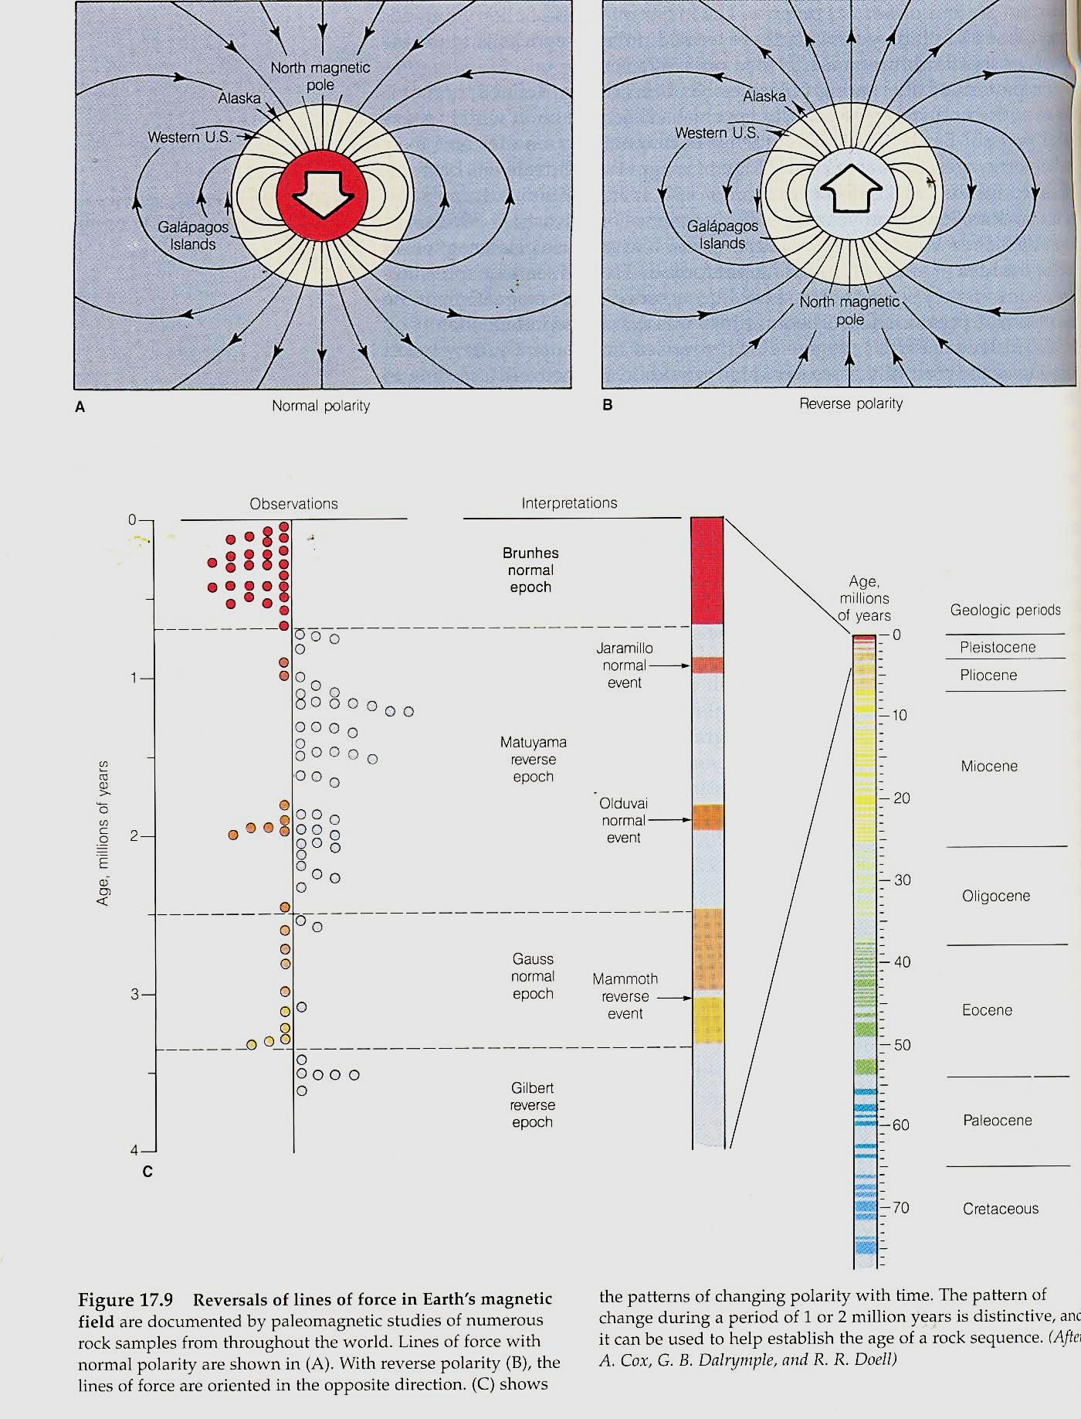
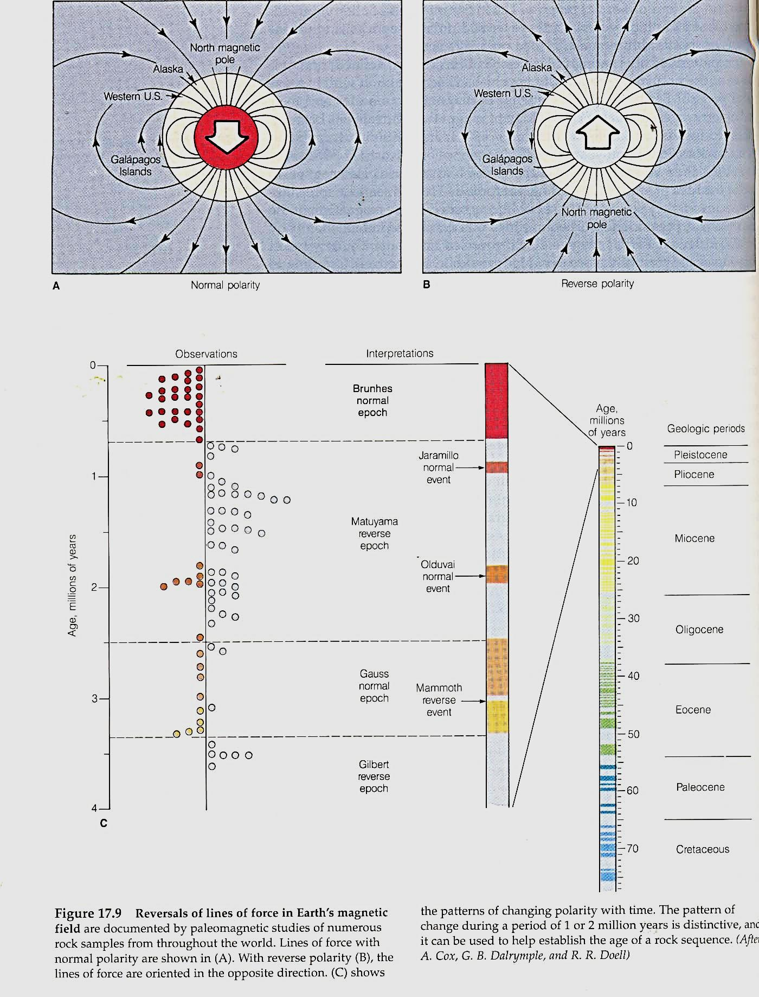

Slide 42
The switching back and forth between these two states has been at irregular intervals, some as short as 20,000 years, others longer than 10 million years.
The pattern of this "irregularly ticking clock" is known and calibrated by radiometric dates. Thus, the pattern of magnetic reversals in the rocks on the sea floor can be used to establish magnetic time lines (isochrons), in finding the age of the rocks on the seafloor.

Slide 43
The pattern of magnetic reversals has been worked out for most of the seafloor and shows an incredible record of plate motion. As seen in Fig. 17.11, magnetic time lines are symmetrical about the ridge that formed them.
The distance from the ridge axis to any isochron shows the amount of seafloor created during that interval of time. Thus, the wider the band, the faster the rate of plate movement.

Slide 44
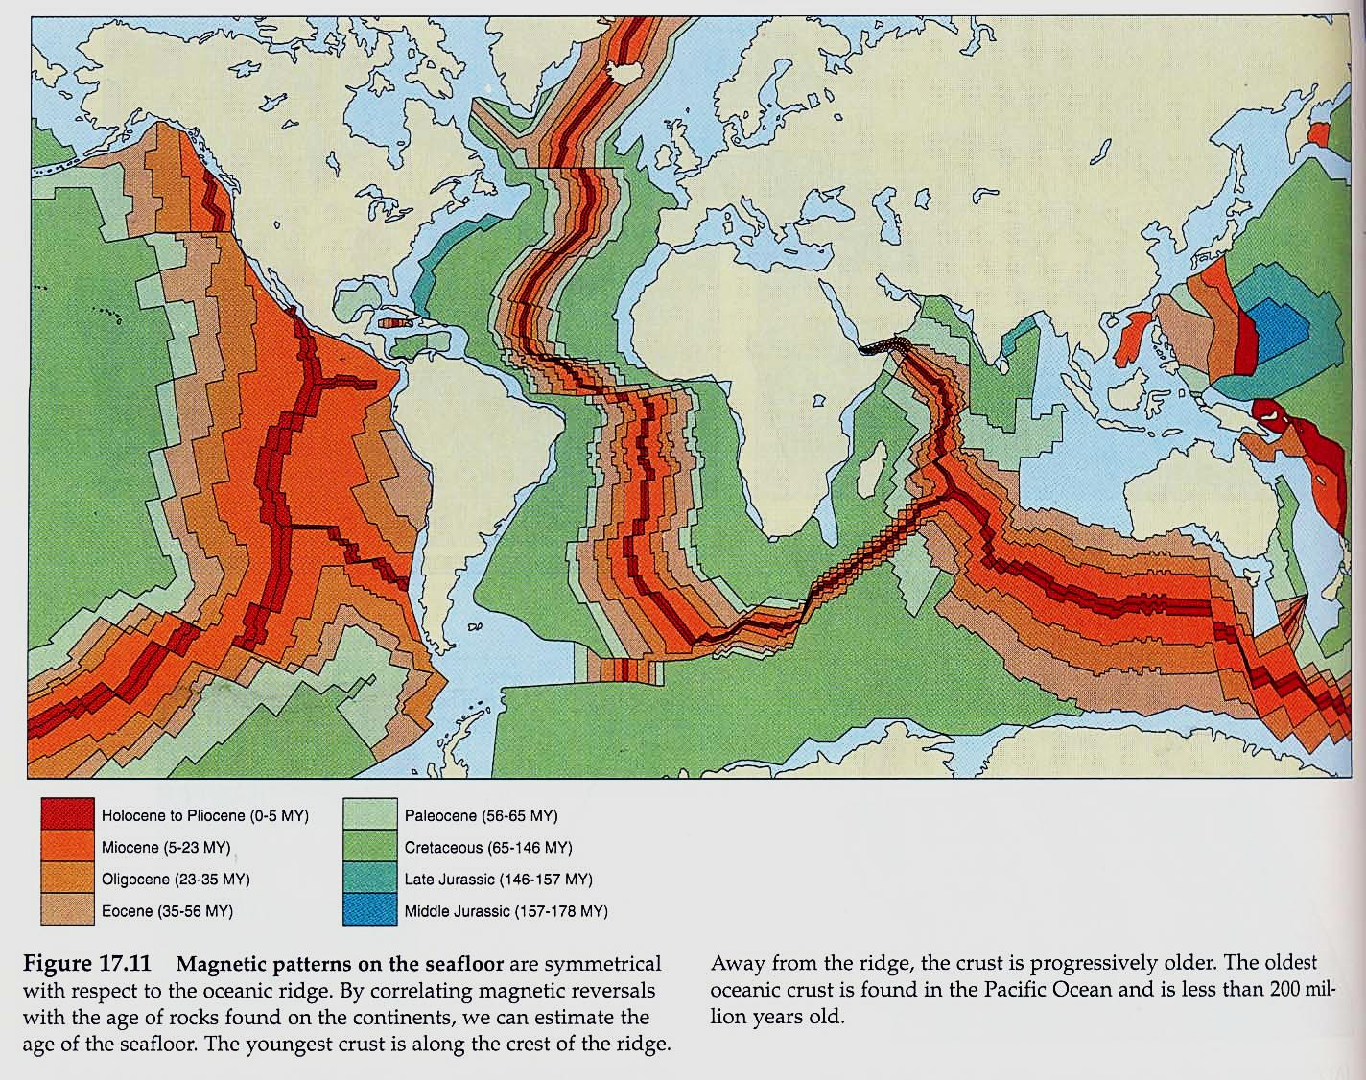

Slide 45
It is apparent from Fig. 17.20 that the plates are moving at significantly different rates. The Pacific, Nazca, Cocos, and Indian plates are moving at a higher rate than the North American, African, Eurasian, and Antarctic plates.

Slide 47
The fastest-moving plates are those in which a large part of the plate is being subducted, and the slower-moving plates are those that lack subducting boundaries or that have large continental blocks embedded in them.

Slide 48
Determining Absolute Motions of Plates
Absolute motions of plates were very difficult to determine. But Jason Morgan proposed that fixed hot spots in the mantle may constitute absolute points of reference for describing plate motions (Morgan, 197I, 1972).
A hot spot is regarded as a thermal plume (Fig. 18.22), probably of deep mantle origin, that sears (burns) the overriding lithosphere.

Slide 49
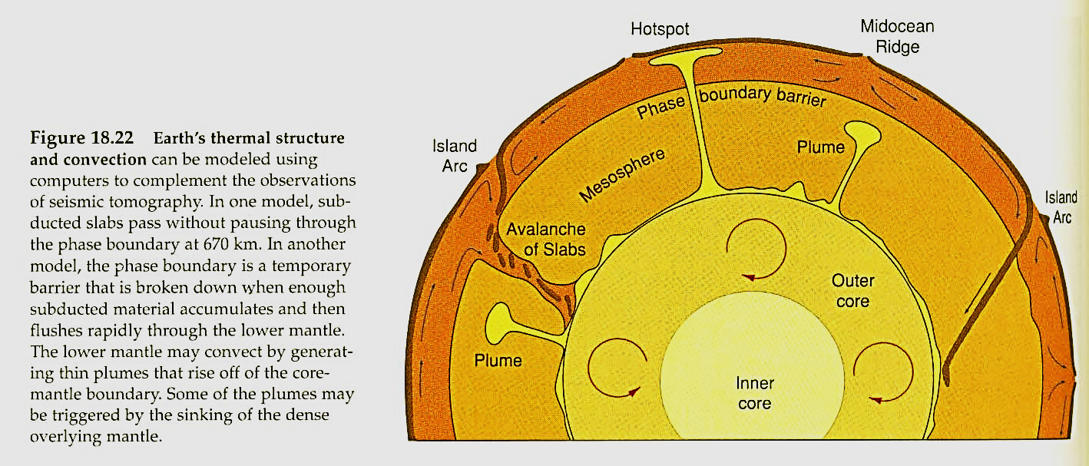

Slide 50
An image that comes to mind in visualizing hot spots is one of slowly passing an old phonograph record over a blowtorch, thus steadily melting and blistering the record along the line of movement (Fig. 10.47).
The path of movement of plates over hot spots is recorded in the form of a linear scar of volcanoes in the lithosphere (Fig. 10.48).

Slide 51
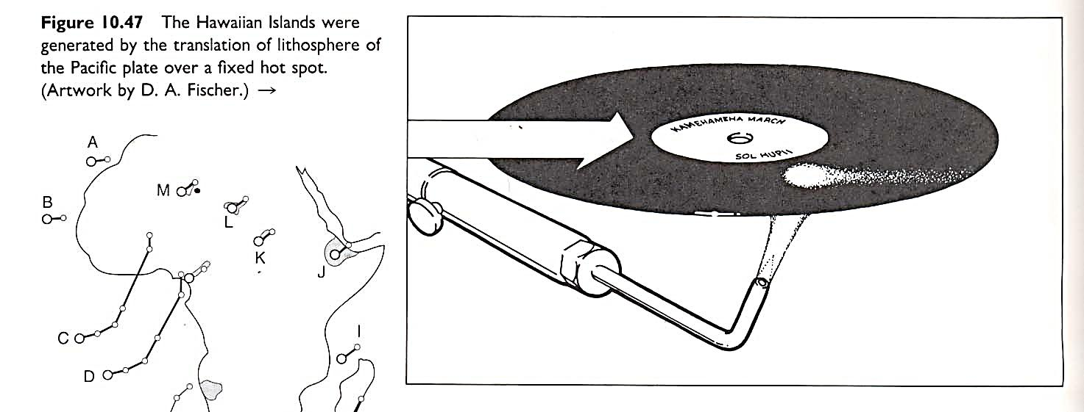

Slide 52
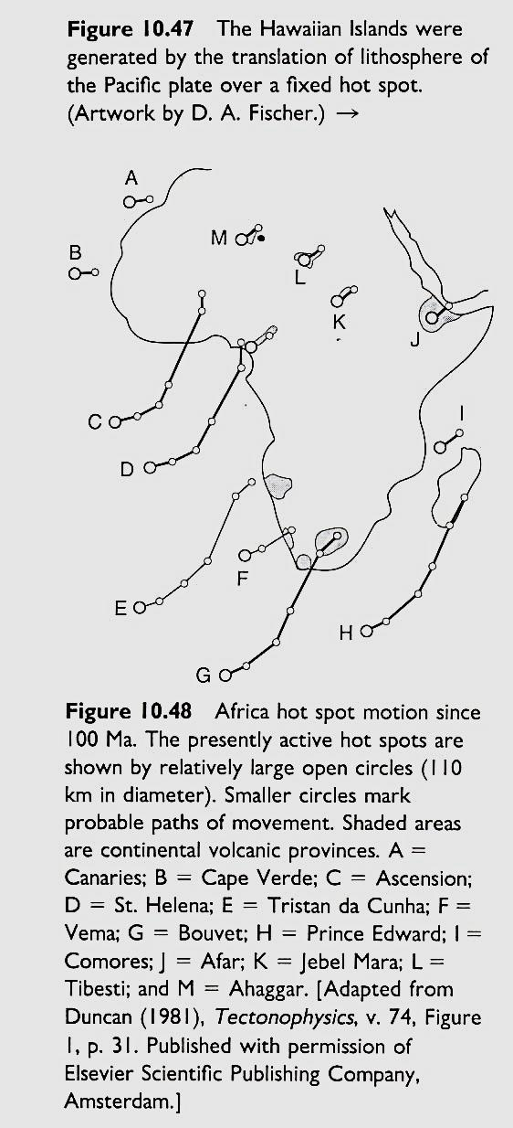

Slide 53
The ages and mapped locations of the volcanic rocks yield the time-and-place data necessary to unravel absolute motions.
Continental flood basalts and large oceanic plateaus represent the initial massive outpourings of basaltic lava produced when an ascending mantle plume burns a hot spot into the overlying plate. (Fig. 10.49).

Slide 54
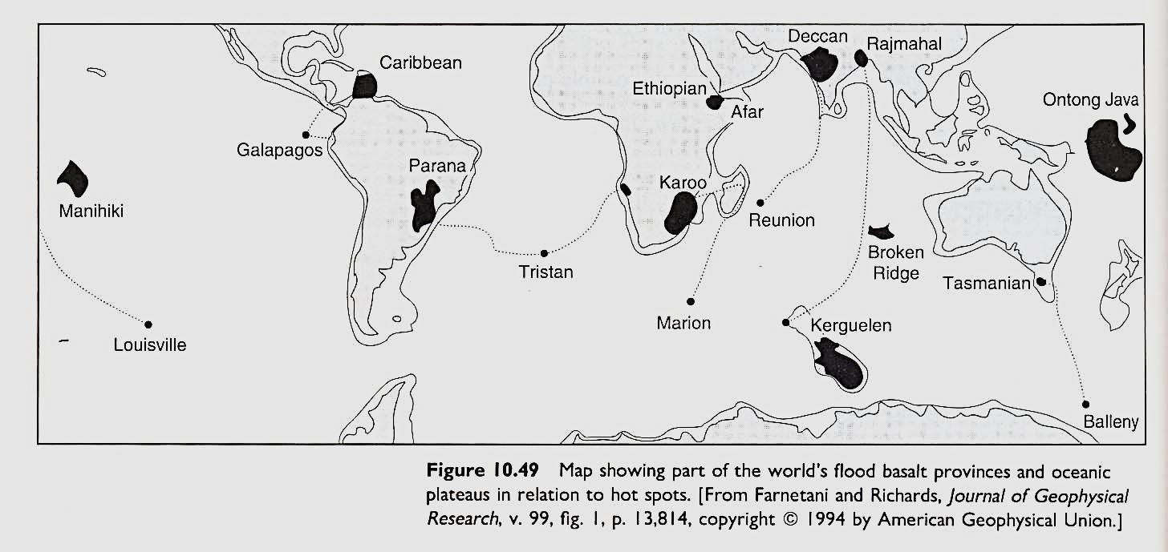

Slide 55
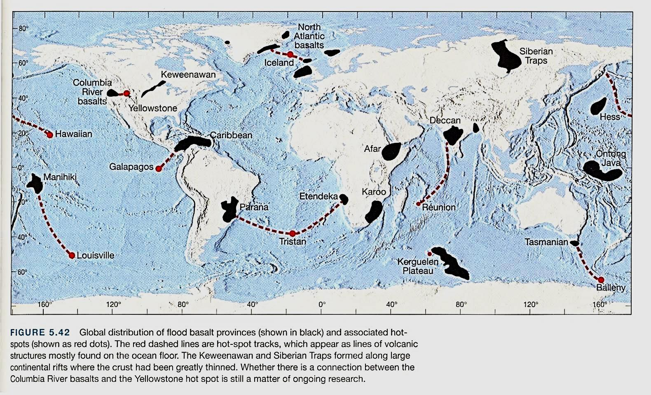

Slide 56
A fascinating geological record of the passing of a plate over a hot spot is the Hawaiian Islands-Emperor Seamounts chain in the Pacific Ocean (Fig. 10.50).
Oriented west-northwest, the Hawaiian Islands systematically increase in age from east to west. The island of Hawaii, at the eastern end of the chain, lies directly above the hot spot and thus still contains active volcanoes. In contrast, the Midway Islands, at the western end of the chain, are composed of 40 Ma volcanic rocks.

Slide 58
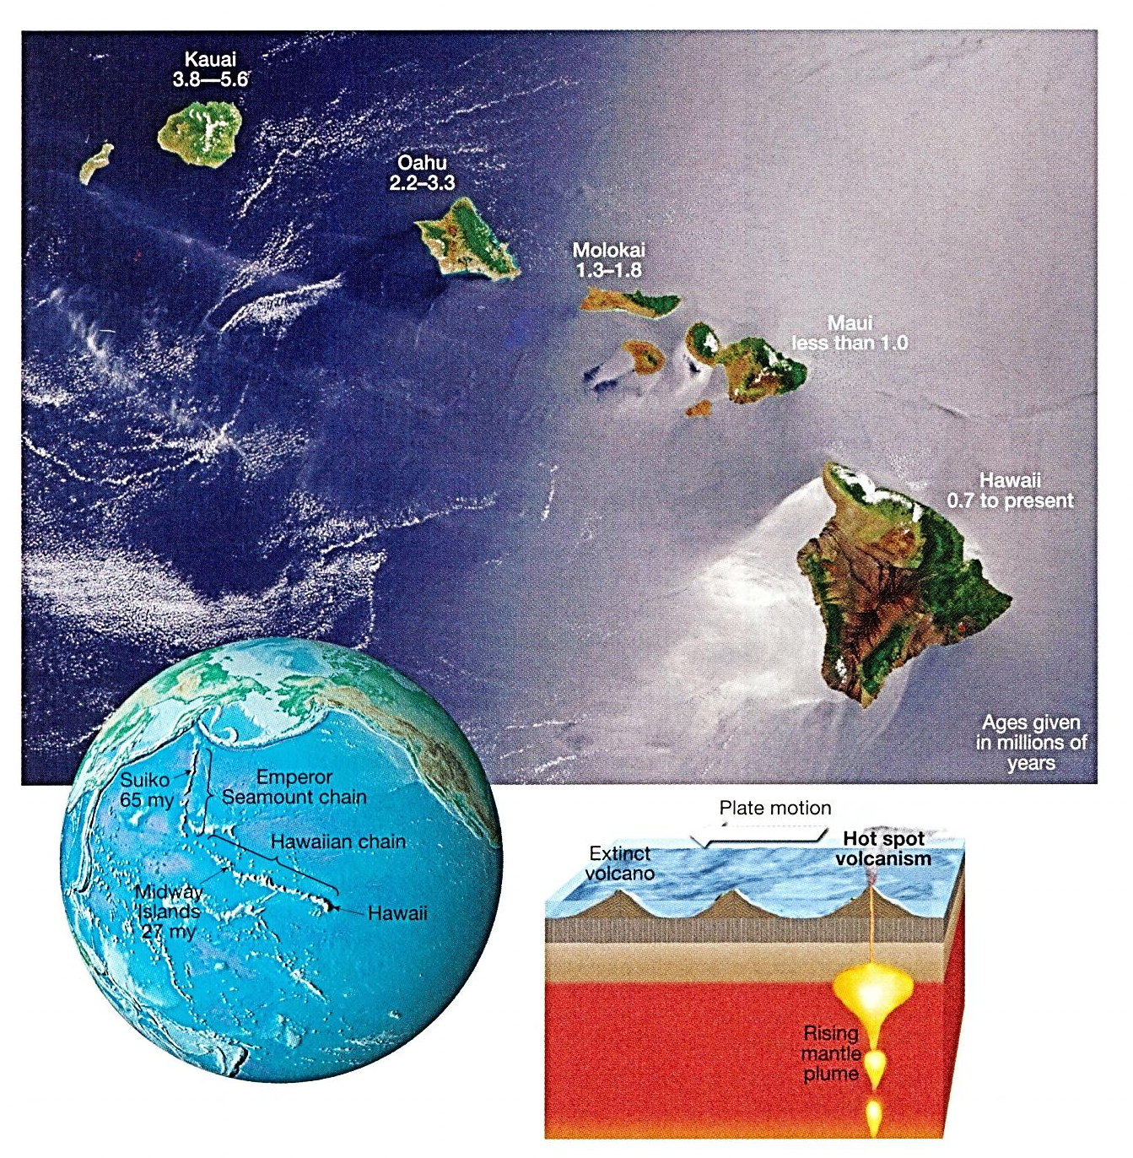
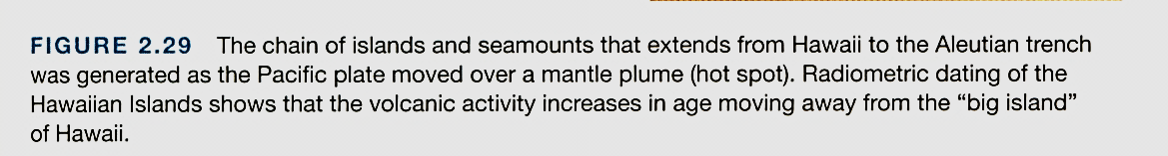

Slide 59
The Midway Islands formed when that part of the lithosphere was located where Hawaii is located today.
Knowing that the distance between Hawaii and the Midway Islands is 3000 km, the actual relative movement of the Pacific plate with respect to the fixed hot spot in asthenosphere can be determined. The average velocity is 3000 km/40 m.y. (7.5 cm/yr).

Slide 60
Hot spots also can show up under continental lithosphere. At Yellowstone National Park, massive outpourings of hundreds to thousands of cubic kilometers of rhyolite and ash flows have been released unheard of in recorded historic times
The source of this massive volcanism is ascribed to the passage of the North American plate across a mantle hot spot.

Slide 61
The passage of the North American plate across the hot spot produced voluminous silicic centers as far back as 16 Ma in northern Nevada and southeastern Oregon-the original "Yellowstone National Park."
Progressively older silicic volcanic deposits extend along a SW-NE track at rates of 4.5 cm/yr along the 800 km-long Snake River Plain of Idaho, (Fig. 10.51)

Slide 62
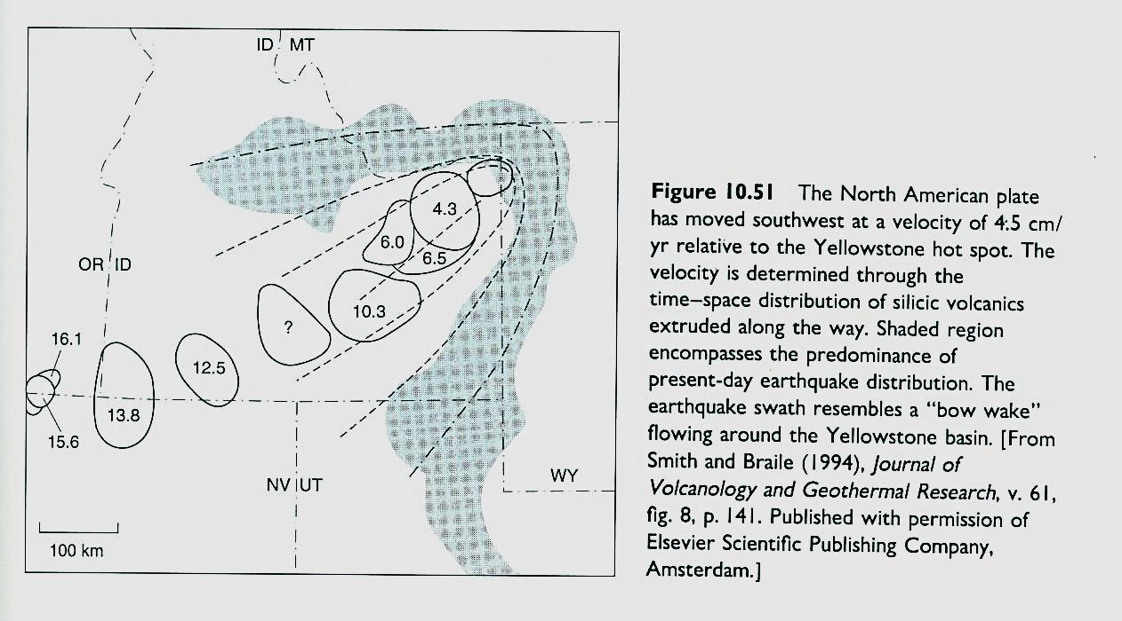

Slide 63
GPS (Global positioning System)
In addition to measuring plate velocities by magnetic reversals, current plate motion can be measured directly, using satellites and lasers.
A narrow beam of light is emitted from an Earth-bound laser and bounced off an orbiting satellite whose position is known precisely. The light is collected at the surface of Earth again, and the elapsed time is determined.

Slide 64
This method allows the location of the laser to be determined to within a centimeter. If the locations of several such stations on different plates are repetitively determined, the relative motion between plates can be accurately measured.
The velocities and directions measured in this fashion are well correlated With those measured by geologic means.

Slide 65
Thank you

