Slide 1
Petrofabrics of
metamorphic processes and deformation
Deformation Mechanism and Microstructures
(Davis et al., 2010)

Slide 2
Textures, structure and Micro-structures
Normally we use the term texture to refer to small-scale features in a rock that are penetrative, meaning that the texture occurs in virtually all of the rock body at the microscopic scale.

Slide 3
Structures are larger-scale features that occur on the hand sample, outcrop, or regional scale.
Materials scientists, use "texture" to refer strictly to preferred orientations and IUGS suggests usage of micro-structures for textures.

Slide 4
Deformation of crystalline solids involves a number of processes, several of which may work in unison. The dominant processes at any particular time depends on both:
Intrinsic rock factors (mineralogy; grain size and orientation; and the presence, composition, and mobility of intergranular fluids) and,
Externally imposed factors (temperature, pressure, deviatoric stress, fluid pressure, and strain rate).

Slide 5
The main principal deformation mechanisms can be arranged into five general categories as follows:
  Microfracturing, cataclasis and, frictional sliding
  Mechanical twinning and Kinking
  Creeps (three creeps):
      Diffusion Creep (Intra-crystalline deformation of a plastic type )
      (i) volume diffusion creep
      (ii) Grain-boundary Creep
      (iii) Superplastic creep)
      B. Dissolution Creep (Pressure solution )
      C. Dislocation creep

Slide 6
  The above mechanisms are sometimes aided by other important processes, including recrystallization, that lead to less-strained lattices

Slide 7
Textures of
metamorphic rocks
(petrofabric)

Slide 8
1. Textures of Contact Metamorphism
Contact metamorphism occurs in aureoles around intrusive bodies, and is a response of cooler country rocks to the thermal ± metasomatic effects of the intrusion.
The textures of contact metamorphism are typically developed at low pressures, and thus under conditions of low deviatric stress.

Slide 9
Crystallization (including recrystallization) may therefore occur in a near-static environment. There may be some minor stress due to pressure or forceful intrusion, but contact metamorphism is typically characterized by a lack of preferred mineral orientation.
Many minerals are equidimensional, rather than elongated, and the elongated minerals that do form are orientated randomly.

Slide 10
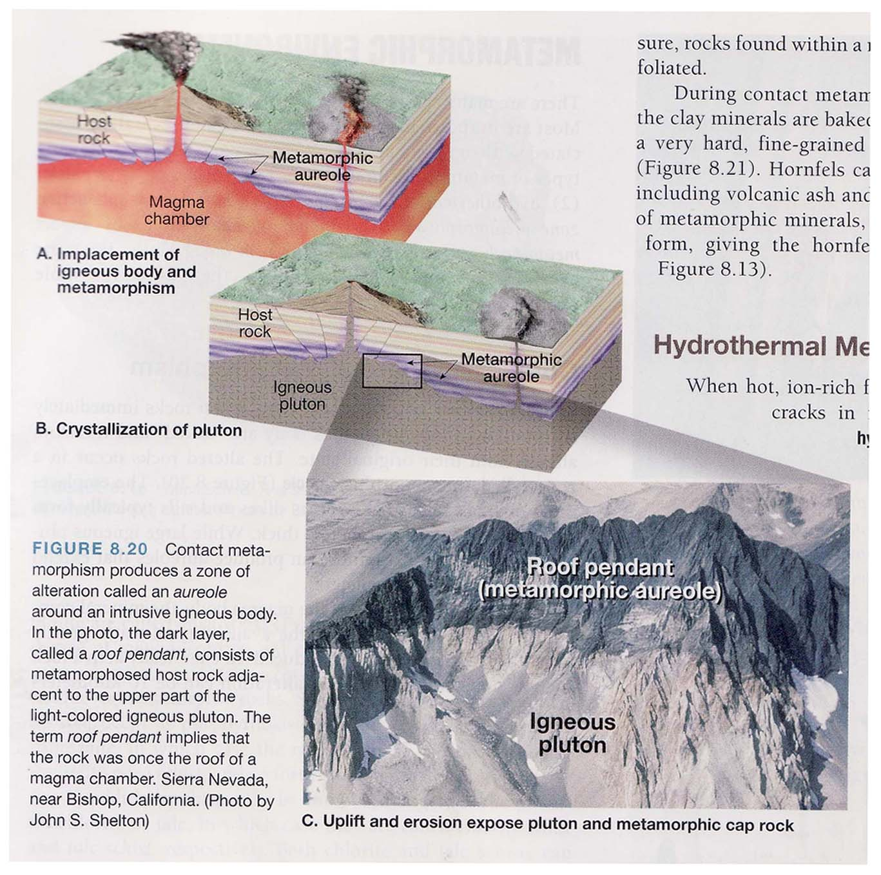

Slide 11
Contact metamorphism produces a zone of alternation called an aureole around an intrusive igneous body, In the photo, the dark layer, called a roof pendant (suspended or hanging), consists of metamorphosed host rock adjacent to the upper part of the light-colored igneous pluton. The term roof pendant implies that the rock was once the roof of a magma chamber. Sierra Nevada, California USA).

Slide 12
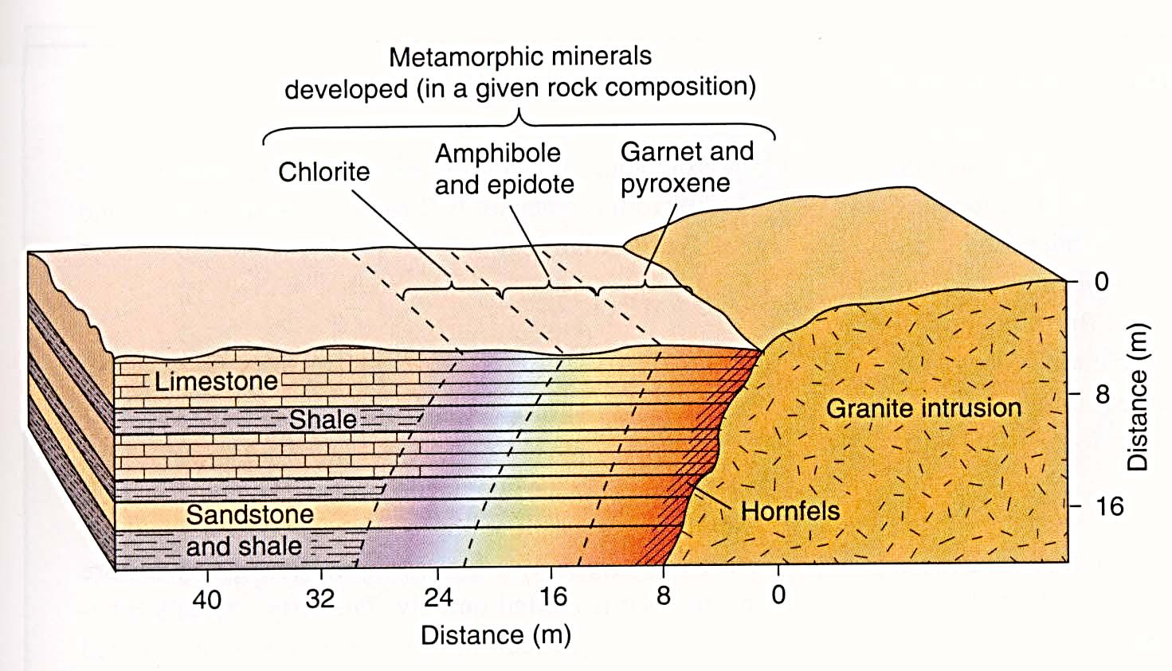
Metamorphic effects adjacent to a hot intrusion: contact metamorphism. Metamorphic minerals are developed depending on the protolith composition.

Slide 13
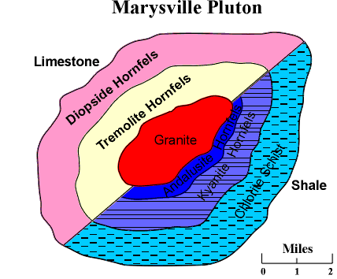
Contact Metamorphism
Marysville Pluton

Slide 14
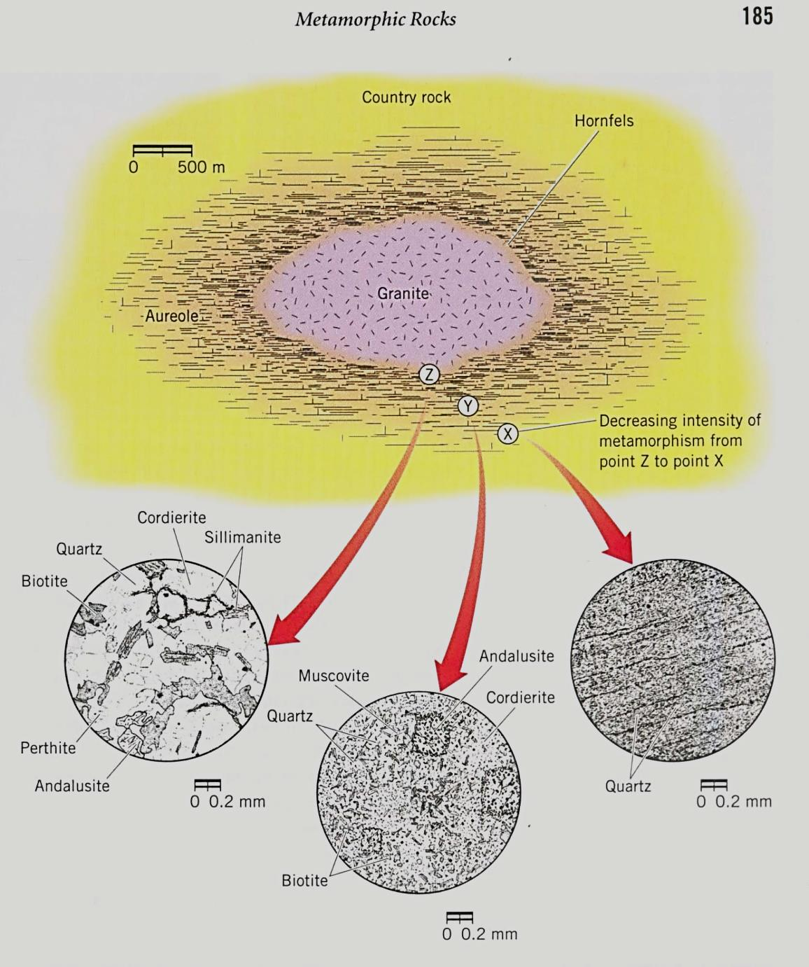
Contact or Thermal metamorphism

Slide 15
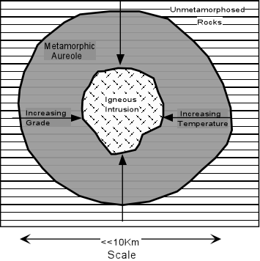
Contact Metamorphism

Slide 16
2. REGIONAL OROGENIC METAMORPHIC TEXTURES
The textures discussed here are more appropriately called dynamothermal textures, because they occur in any situation where deformation and heat are combined.
The majority of dynamothermal rocks are found in ancient orogenic belts, so we will concentrate on this setting.

Slide 17
Orogenic belts are complex tectonic environments where plate convergence produces a number of deformational and thermal patterns.
We can envision an orogeny as a long-term mountain building process, such as the Appalachian Orogeny, or the Alpine Orogeny.

Slide 18
Orogenies are not continuous, however, and an orogeny may comprise more than one tectonic event, which are believed to result most commonly from short-term changes in plate motion, such as accelerated subduction rate or micro-continent accretion.

Slide 19
Tectonic events, in turn, may consist of more than one deformation phase.
A deformation phase, according to Passchier and Trouw (1996), is a distinct period of active deformation with a specific style and orientation.
Metamorphism accompanies many of these deformational processes

Slide 20
Metamorphic events typically last 1 to 10 Ma, but multiple events in an orogen may span over 1 Ga.
Metamorphism may accompany only some deformational events, and the style of deformation and grade of metamorphism may vary in both time and space within a single orogen.

Slide 21
Deformation tends to break minerals down to smaller grains and subgrains, whereas the heat of metamorphism tends to build them back up again.
Such a complex set of processes allow for myriad (many) interactions and overprints between metamorphic mineral growth and deformation, making the study of textures in orogenic rocks a challenge.

Slide 22
Tectonites, Foliations, and Lineations
A tectonite is a deformed rock with a texture that records the deformation by developing a preferred mineral orientation of some sort.
The fabric of a tectonite is the complete spatial and geometrical configuration of its textural and structural elements.

Slide 23
Foliation
(Petrofabric)

Slide 24
Foliation
It is a general term for any planar textural element in a rock, whereas lineation similarly applies to linear elements.
Foliations and lineations can be subdivided into primary (pre-deformational) ones, such as bedding, and secondary (deformational) ones.
Minerals may be oriented by either dimensional preferred orientation (DPO) or lattice preferred orientation (LPO), or both.

Slide 25
A number of features can define a secondary foliation (Fig. 23-21), including platy minerals, linear minerals, layers, fractures, and flattened elements.
Metamorphic foliations are divided into:
cleavages (fine penetrative foliations),
Schistosity (coarser penetrative foliations), and
gneissose structure (poorly developed coarse foliations or segregated layers).

Slide 26
The nomenclature of cleavages suffers from the problem of an overabundance of terms that were used in different ways by different workers, and often confused the purely descriptive from the genetic aspects.
Powell (1979) proposed a classification of cleavages (including schistosity) that was purely descriptive, thereby allowing us a universal nomenclature unencumbered (not overburdened) by inferences about cleavage origins.

Slide 27
Continuous and spaced cleavage
The first step in characterizing a cleavage is to decide if the foliation elements are continuous or spaced.
In a continuous foliation, the aligned minerals define a foliation that does not vary across the area of the thin section (Figure 22-23).

Slide 28
In a spaced foliation, the fabric of the rock is separated into unfoliated microlithons separated by cleavage domains (fractures or concentrations of platy minerals).
Of course there is a continuum between these idealized end-members, and continuous cleavage grades through zonal to spaced cleavage (Figure 22-23). Fine-grained continuous cleavage may also be called slaty cleavage, because it typifies slates.

Slide 29
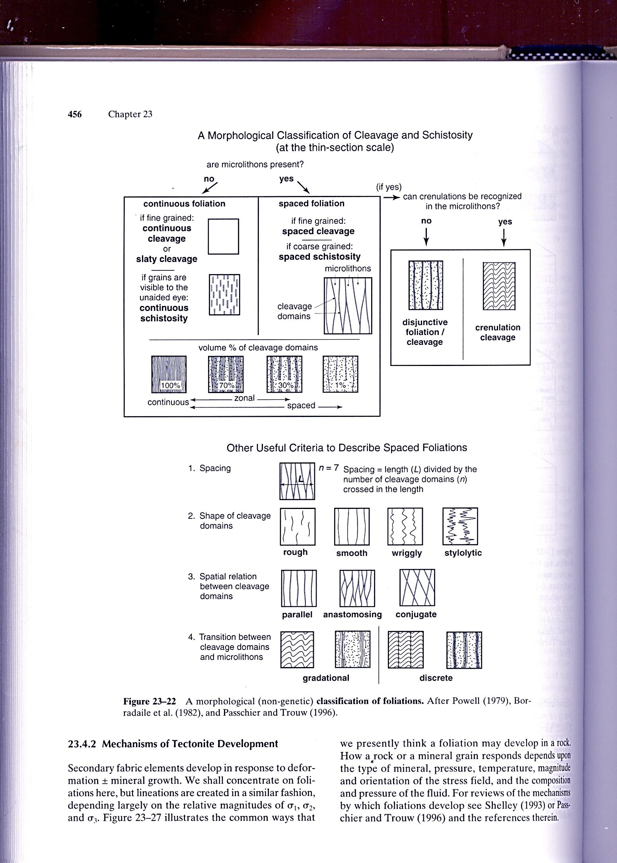

Slide 31
Phyllites have a slightly coarser continuous cleavage, and, when the individual aligned crystals become large enough to see with the unaided eye, the foliation is called a schistosity.

Slide 32
Foliation in Rocks
Types and classification of foliation
Mechanisms of fabric development in rocks
Axial-planar cleavages

Slide 33
CLEAVAGE, FOLIATION
NATURE OF CLEAVAGE
Foliation and cleavage are terms for penetrative tectonic planar structures in rocks.
Tectonic foliations go hand in hand with folds and lineations and form the most common type of structure encountered in metamorphic rocks, and their wide occurrence makes them particularly important for deciphering the deformation history of rocks.

Slide 34
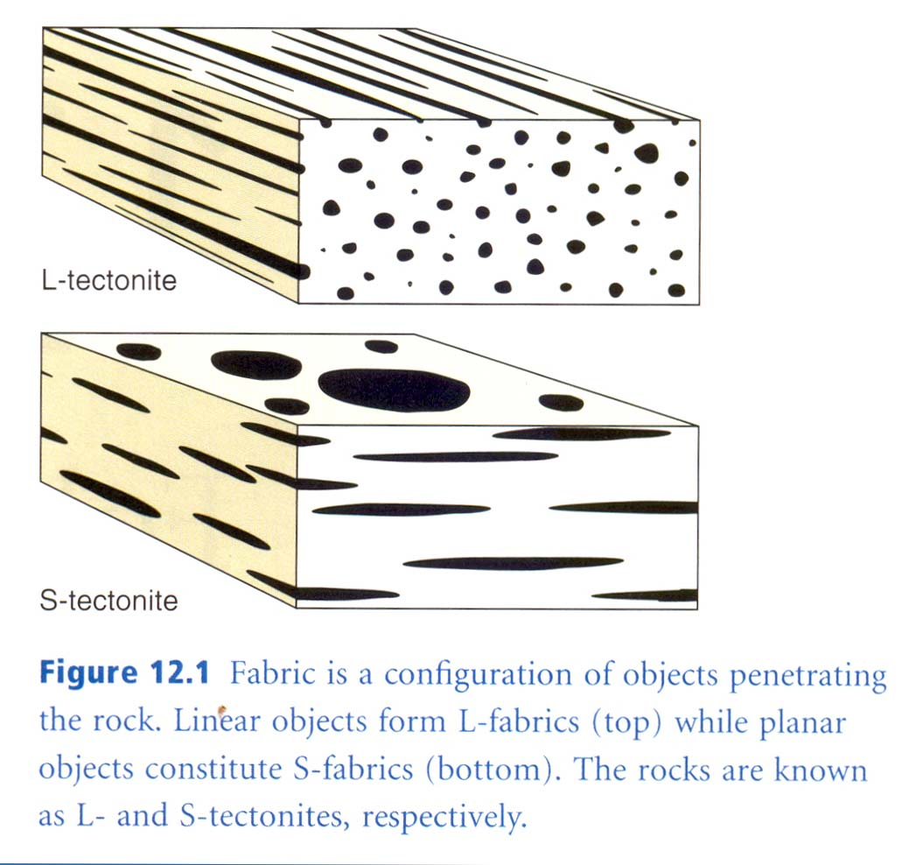

Slide 35
The term "cleavage" is difficult to define: it broadly refers to closely spaced, aligned, planar to curviplanar surfaces that tend to be associated with folds and oriented parallel to subparallel to the axial surfaces of folds (Figure 8.1).
The penetrative parallel surfaces can take many physical forms. Cleavage is commonly penetrative at both the outcrop and microscopic scales (Figure 8.2). It typically cuts bedding discordantly, without much regard to the orientation of bedding.

Slide 36
When a rock possessing cleavage is smacked (strike or slap) with a hammer, the rock will typically break along the cleavage.
The slabby, platy nature of cleaved outcrops sometimes misleads us into thinking that cleavage is akin to fracturing.
In truth, cleavage forms without apparent loss of cohesion, and in this respect alone cleavage surfaces are much different from fracture surfaces.

Slide 37
Foliation
Foliation is a planar arrangement of structural or textural features in any rock type, but particularly that resulting from the alignment of constituent mineral grains of a metamorphic rock of the regional variety along straight or wavy planes.
Foliation often occurs parallel to original bedding, but it may not be ostensibly related to any other structural direction.

Slide 38
Foliation is exhibited most prominently by sheety minerals, such as mica or chlorite.
Regional metamorphic rocks are usually subdivided into schist, slate, and gneiss on the basis of grain size and foliation type.

Slide 39
The schists, for example, exhibit strong foliation with partings along well-defined planes of medium-grained micas or hornblendes.
The gneisses, which are characteristically rich in feldspar and quartz, tend to be coarse-grained and less distinctly foliated. They do not split, or cleave, along their planes as schists do.

Slide 40
Foliation in geology refers to repetitive layering in metamorphic rocks. Each layer may be as thin as a sheet of paper, or over a meter in thickness.
The word comes from the Latin folium, meaning "leaf", and refers to the sheet-like planar structure.
It is caused by shearing forces (pressures pushing different sections of the rock in different directions), or differential pressure (higher pressure from one direction than in others).

Slide 41
The layers form parallel to the direction of the shear, or perpendicular to the direction of higher pressure.
Nonfoliated metamorphic rocks are typically formed in the absence of significant differential pressure or sheer.
Foliation is common in rocks affected by the regional metamorphic compression typical of areas of mountain belt formation (orogenic belts).

Slide 42
More technically, foliation is any penetrative planar fabric present in metamorphic rocks.
Rocks exhibiting foliation include the standard sequence formed by the prograde metamorphism of mudrocks; slate, phyllite, schist
and gneiss.

Slide 43
The slatey cleavage typical of slate is due to the preferred orientation of microscopic phyllosilicate crystals.
In gneiss the foliation is more typically represented by compositional banding due to segregation of mineral phases. Foliated rock is also known as S-tectonite in sheared rock masses.

Slide 44
Examples include:
(a) the bands in gneiss (gneissic banding),
(b) a preferred orientation of planar large mica flakes in schist (Schistocity),
(c) the preferred orientation of small mica flakes in phyllite (with its planes having a silky sheen, called phylitic luster - the Greek word, phyllon, also means "leaf"),

Slide 45
(d) the extremely fine grained preferred orientation of clay flakes in slate (called "slaty cleavage"),
(e) and the layers of flattened, smeared, pancake-like clasts in metaconglomerate.

Slide 46
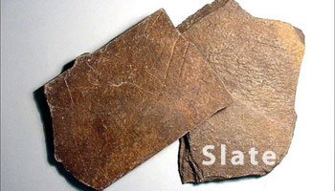

Slide 47
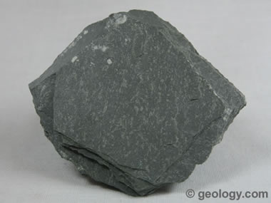

Slide 48


Slide 49
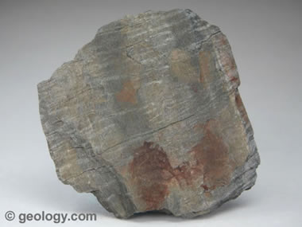

Slide 50
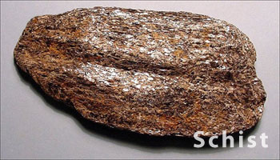
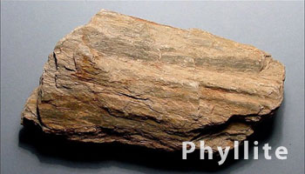

Slide 51
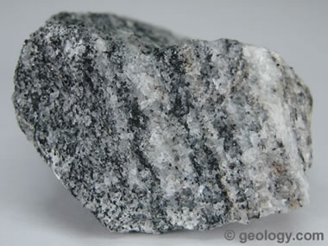

Slide 52
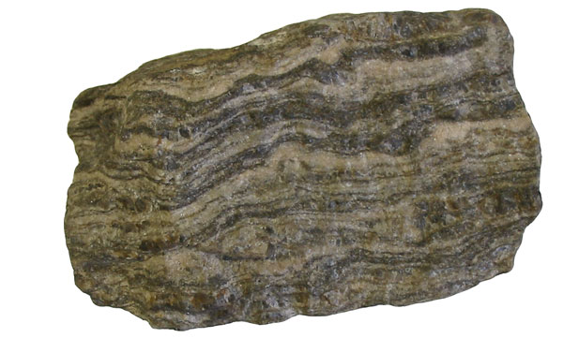

Slide 53
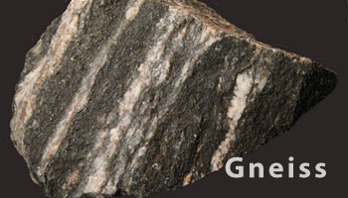

Slide 54
Domainal Character of Cleaved Rocks

Slide 55
Domainal Character of Cleaved Rocks
When any cleaved rock is examined closely, the property called cleavage is found to be an expression of systematic variations in mineralogy and fabric.
The term fabric refers to the total sum of grain shape, grain size, and grain configuration in a rock (Sander, 1930, 1970).

Slide 56
The systematic variations in mineralogy and fabric that give rise to cleavage are not primary features related to the formation of the rock.
Rather, they are expressions of the changes in mineralogy and fabric that were required to accommodate distortion of the rock body within which the cleavage is found.

Slide 57
The systematic variation in mineralogy and fabric in cleaved rock gives what may be called domainal structure, a kind of structural lamination composed of alternating
  cleavage domains, and
  microlithon domains (Figure 8.9).

Slide 58
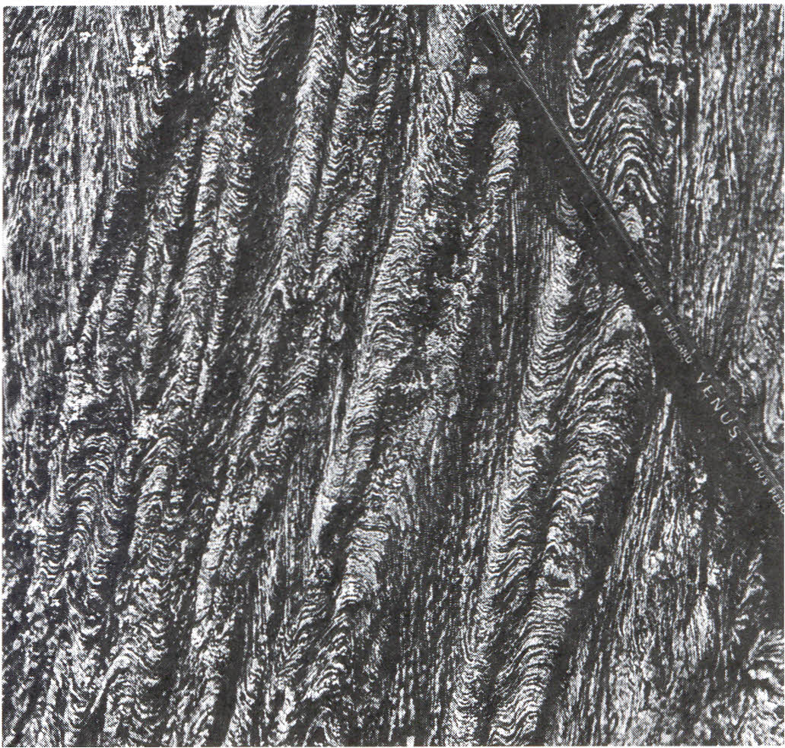
Figure 8.9 Excellent example of domainal structure in a quartz-mica schist exposed near Loch Leven. Inverness-shire Scotland. The cleavage domains are the dark. fine- grained micaceous zones. The microlithon domains are the light-colored. Coarser grained zones of crenulated laminae of quartz and mica.

Slide 59
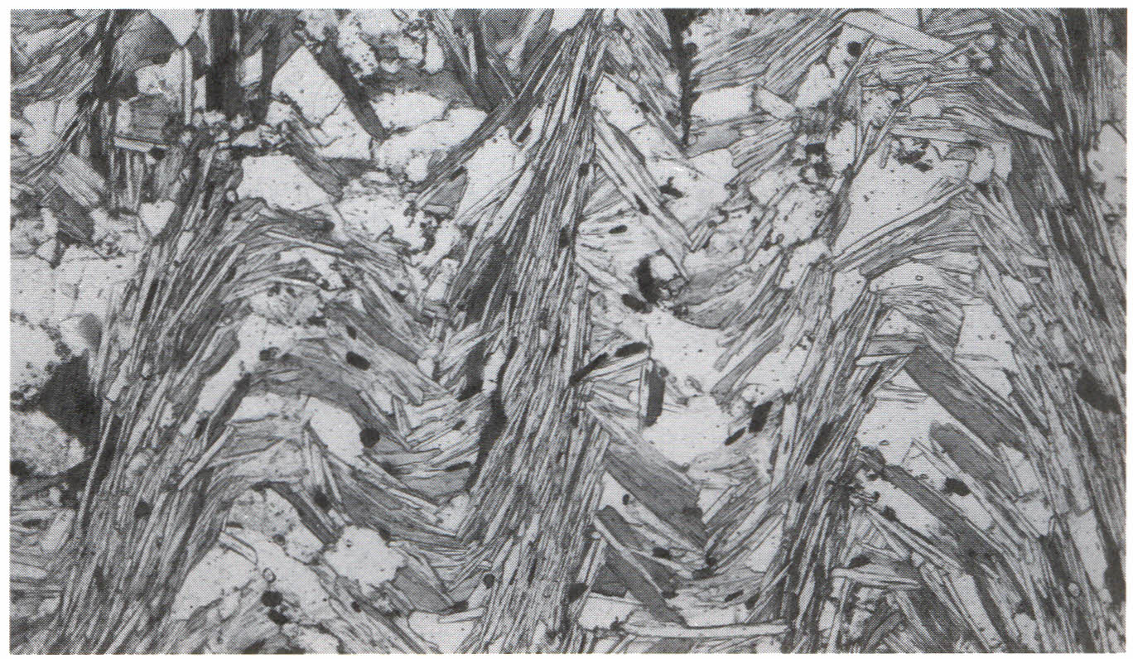
Figure 8.10 Photomicrograph showing domainal structure in mica schist. Oriented micas comprise cleavage domains. The cleavage domains separate microlithon domains of quartz. feldspar. and mica

Slide 60
Cleavage domains are thin, anastomosing (branching or braided) to subparallel, mica-rich laminae within which the fabric of the original host rock has been strongly rearranged and/or partially removed.
Minerals and mineral aggregates within cleavage domains show a strongly preferred dimensional and/ or crystallographic orientation.

Slide 61
Microlithon domains, or simply microlithons, are narrow lensoidal to trapezoidal slices of rock within which the mineralogy and fabric of the original host rock remain essentially preserved.
Unless the microlithons are composed of rock that contains a preexisting cleavage, minerals and mineral aggregates in microlithons tend to be equigranular, lacking a conspicuous preferred orientation.

Slide 62
Types of Cleavage
There are many ways to name and classify cleavage. Most classifications are now anchored in the insightful work of Dennis (1972) and Powell (1979).
Dennis and Powell subdivided cleavage into two classes on the basis of the scale at which the domainal character of cleavage can be recognized.

Slide 63
Disjunctive cleavage (spaced): meaning interrupted. The domainal structure (i.e., the distinction between cleavage domains and microlithons) can be seen with the unaided eye,
Continuous cleavage. The domainal character of a cleaved rock is too fine to be resolved without the aid of a petrographic or an electron microscope.

Slide 64
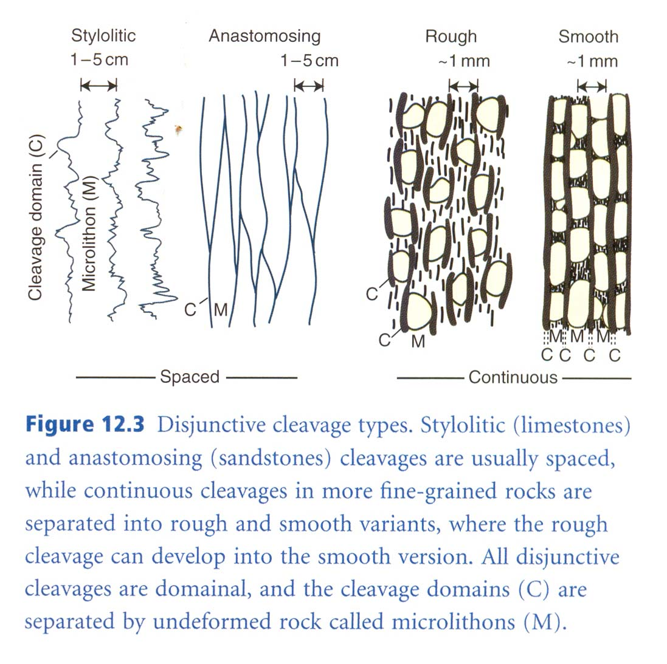

Slide 65
Continuous Cleavage
The main types of continuous cleavage are:
  Slaty cleavage,
  Phyllitic structure, and
  Schistosity.
All three are generally associated with strongly folded and distorted metasedimentary and metavolcanic rocks.

Slide 66
Slaty cleavage, phyllitic structure, and schistosity are reasonably similar in outcrop expression, but they differ in grain size and in the scale of development of domainal structure.
There is a complete gradation from slaty cleavage to phyllite and then schist, largely reflecting an increase in grain size.

Slide 67
Slaty cleavage is typically associated with very fine-grained (<0.5 mm) pelitic (shaley) rocks metamorphosed to low grade. Where slaty cleavage is well developed, it imparts to rocks an exquisite splitting property.
Indeed, the presence of slaty cleavage allows a rock to be cleaved into perfectly tabular, thin plates or sheets (Figure 8.11). Roofing slates owe their existence and usefulness to slaty cleavage.

Slide 68
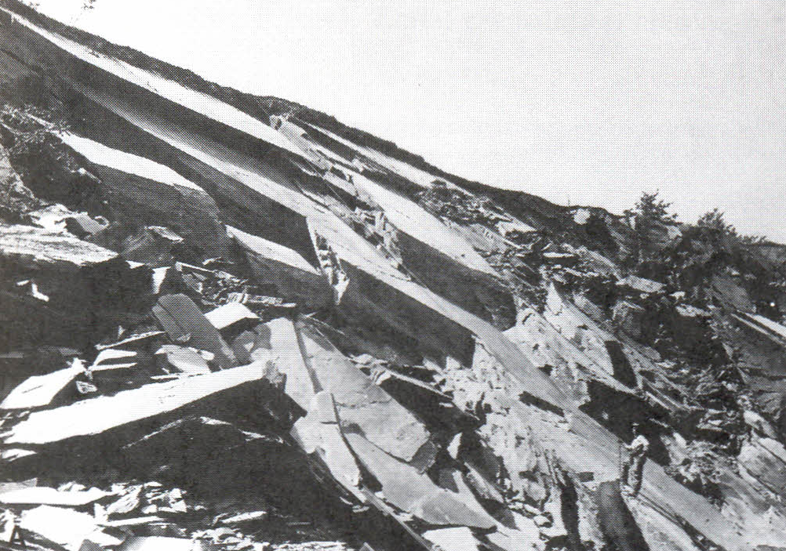
Figure 8.11 Slaty cleavage

Slide 69
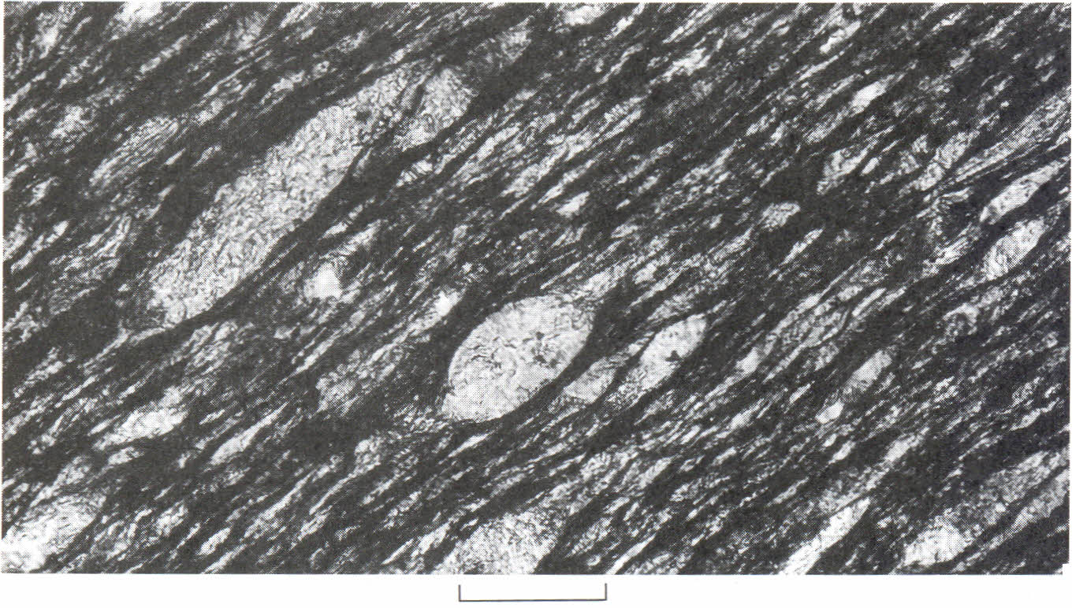
Figure 8.18 (Microphtograph) Domainal microfabric in slaty cleavage from the Ribagorzana Valiey area, Spanish Pyrenees. Mica-rich domains (M- domains) are the black laminae that 'anastomose' around large quartz grains and aggregates of the QF-domains.

Slide 70
The splitting capacity of schist is not nearly as elegant as that of slates, but it is nonetheless very pronounced (Fig. 8.13). Rocks with schistosity are typically medium-grained (1-10 mm), containing flakes of mica that are visible in hand specimen.
The most obvious outcrop characteristic of schistosity is the parallel, planar alignment of micas, including muscovite, biotite, chlorite, and sericite.

Slide 71
Schists seldom split cleanly and evenly when struck with a hammer. Instead, they break off in the form of discoidal to crudely tabular hand specimens or slabs. Many outcrops of schist have a lovely sheen (shine or glossy) (Figure 8.14).
Schistosity is best developed in pelitic metasedimentary rocks and certain volcanic rocks metamorphosed to medium or high grade.

Slide 72
Phyllitic structure is intermediate in grain size and overall character between slaty cleavage and schistosity.
In outcrop, phyllites display a soft, pearly, satiny luster. They glisten (shine) in the sun, but lack the distinct individual mica grains seen in schists. Phyllites exhibit the capacity to split neatly but not perfectly.

Slide 73
Disjunctive Cleavage
There are two main types of disjunctive cleavage:
  Crenulation cleavage (Secondary tectonic cleavage and
  Spaced cleavage (Fracture Cleavage)
Crenulation cleavage is very distinctive in that it cuts a host rock that possesses a preexisting continuous cleavage, especially phyllitic structure or schistosity (Figure 8.15). In rocks that contain crenulation cleavage, a preexisting continuous cleavage is typically "crenulated" into microfolds.

Slide 74
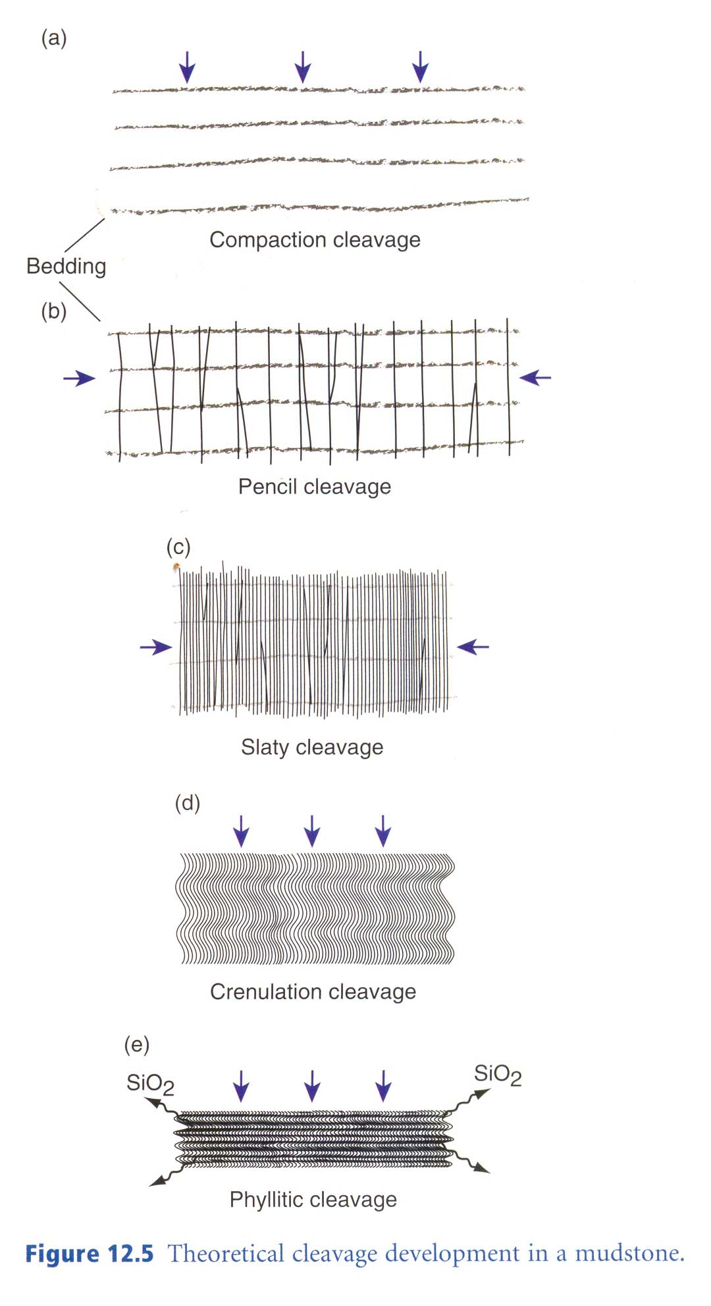

Slide 75
Two kinds of crenulation cleavage are recognized.
  Discrete; and
  Zonal .
Discrete crenulation cleavage is a disjunctive cleavage in which very narrow cleavage domains sharply truncate the continuous cleavage of the microlithons, almost like tiny faults (Figure 8.16A).

Slide 76
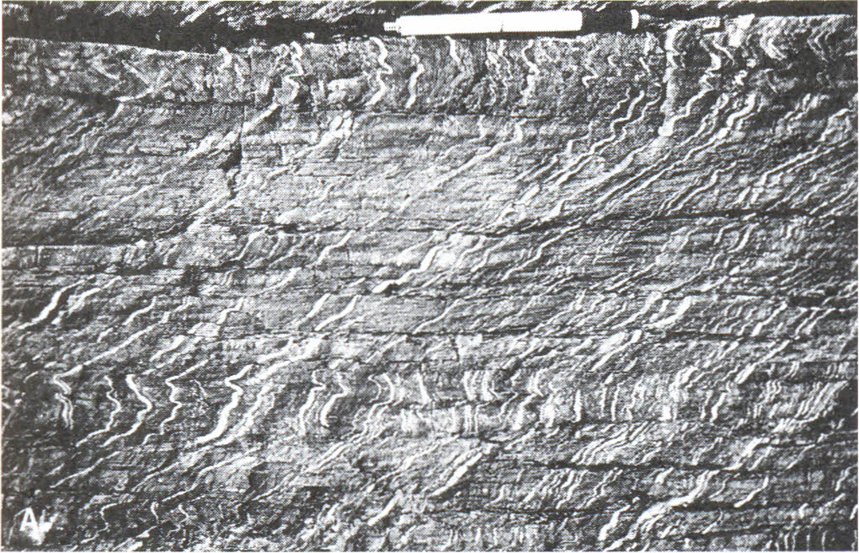
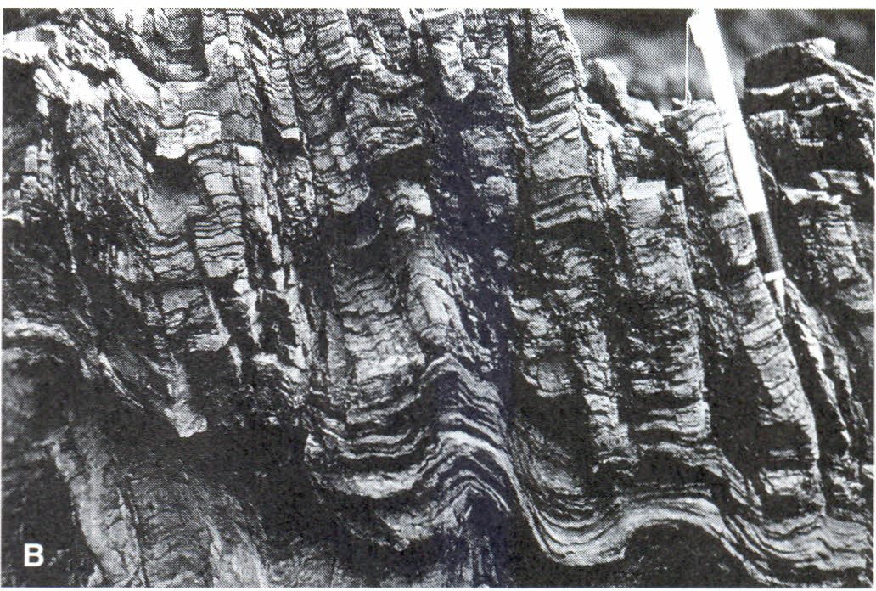
Figure 8.16 (A) Discrete crenulation cleavage in metamorphosed tuffaceous rocks (Thin white bands are calcite veins, formed during a deformation event. (B) Zonal crenulation cleavage in Mesozoic metasedimentary rocks.

Slide 77
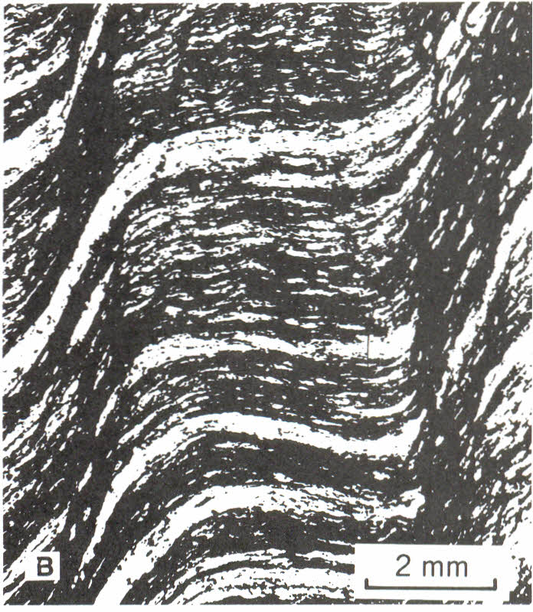
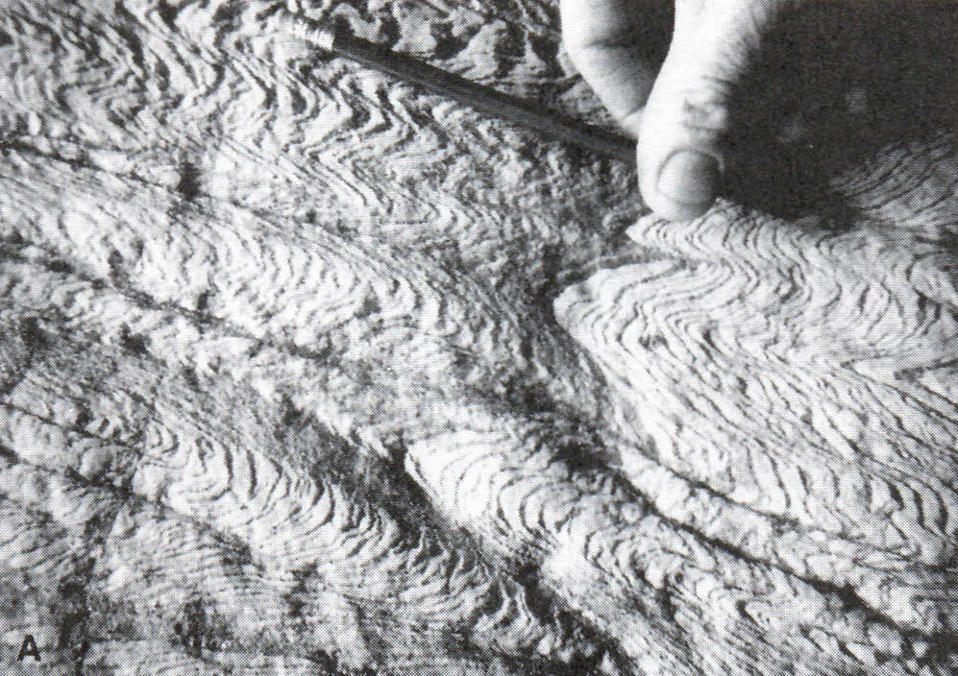
Figure 8.21 (A) Example of discrete crenulation cleavage. Folded schistosity is abruptly truncated along crenulation cleavage. Vishnu Schist in the Grand Canyon. (B) Photomicrograph of zonal crenulation cleavage (vertical) coincident with the steep limbs of asymmetric folds in schistosity. The zonal cleavage domains are carbonaceous and micaceous. They have a distinctively lower proportion of quartz than that of the initial fabric.

Slide 78
Spaced cleavage or Fracture cleavage

Slide 79
Fracture cleavage (spaced cleavage) is sometimes used to denote closely spaced fractures in unmetamorphosed or very low grade metamorphic rocks, particularly limestones and sandstones.
Fracture cleavage sometimes forms by fracturing of preexisting cleavage planes. Ordinary cleavage forms by contraction perpendicular to the cleavage planes. Fracture cleavage, as defined here, involves extension across the cleavage. It is therefore better classified as a small-scale fracture array in many cases.

Slide 80
Spaced cleavage
It is a second type of disjunctive cleavage. It consists of an array of parallel to anastomosing, stylolitic to smooth, fracture-like partings that are often occupied by clayey and carbonaceous matter.
Spaced cleavage is typically found in folded but unmetamorphosed sedimentary rocks, especially impure limestone and marl (Figure 8.17A,B). Spacing of the partings (i.e., the cleavage domains) ranges from 1 to 10 cm.

Slide 81
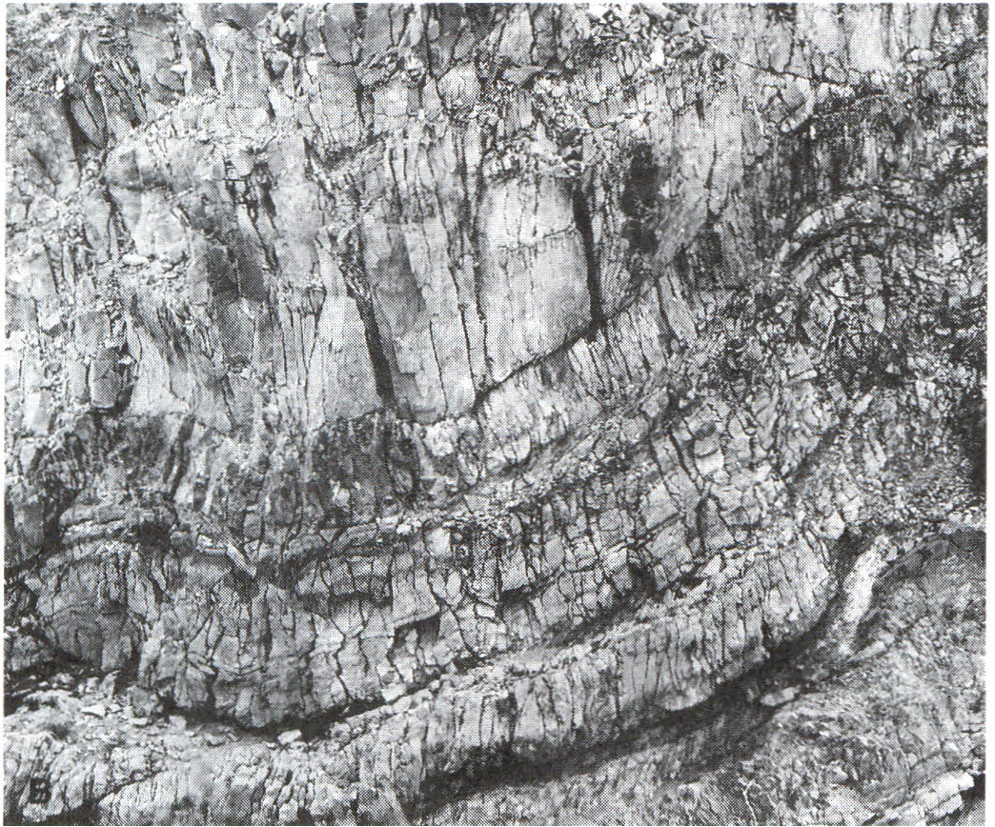
Figure 8.17 (B) Close-up view of the spaced cleavage, revealing clayey partings along cleavages.

Slide 82
Classification of Spaced Cleavage
Microscopic examination of cleavage domains in rocks cut by spaced cleavage reveals that they are fracture-like discontinuities lined with seams or films of clayey and/or carbonaceous material (Figure 8.22).
The spaced cleavage may be stylolitic , but more commonly it is anastomosing.

Slide 83
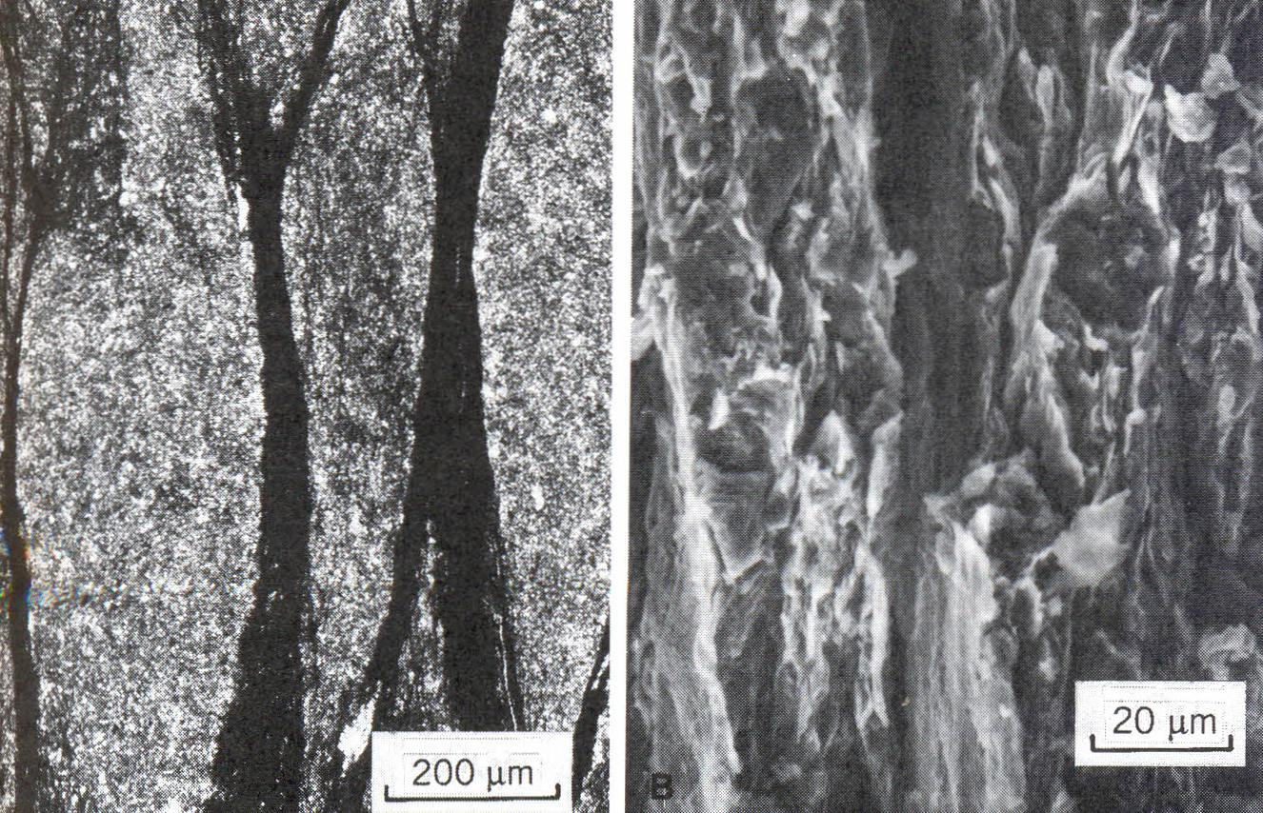
Figure 8.22 (A) Photomicrograph of anastomosing. dark. undulating spaced cleavage seams. (B) Scanning electron micrograph of the spaced cleavage seams. Composed of densely packed clays. theseseams are markedly straight in their trace expression (vertical). Clays in intervening microlithons are more loosely packed. not as
preferentially oriented.

Slide 84
Alvarez, Engelder, and Geiser (1978) designed a classification of spaced cleavage, one that provides the means to estimate shortening within a rock layer on the basis of the nature and spacing of cleavage surfaces. Their approach was to systematically correlate the properties of spaced cleavage with quantitative estimates of shortening deduced from bedding offsets, truncated fossils, and the degree of folding and thrusting of insoluble chert layers.

Slide 85
The categories of spaced cleavage are described as:
  weak,
  moderate,
  strong, and
  very strong
These correspond to shortening percentages of 0-4, 4-25, 25-35%, and greater than 35%, respectively.

Slide 86
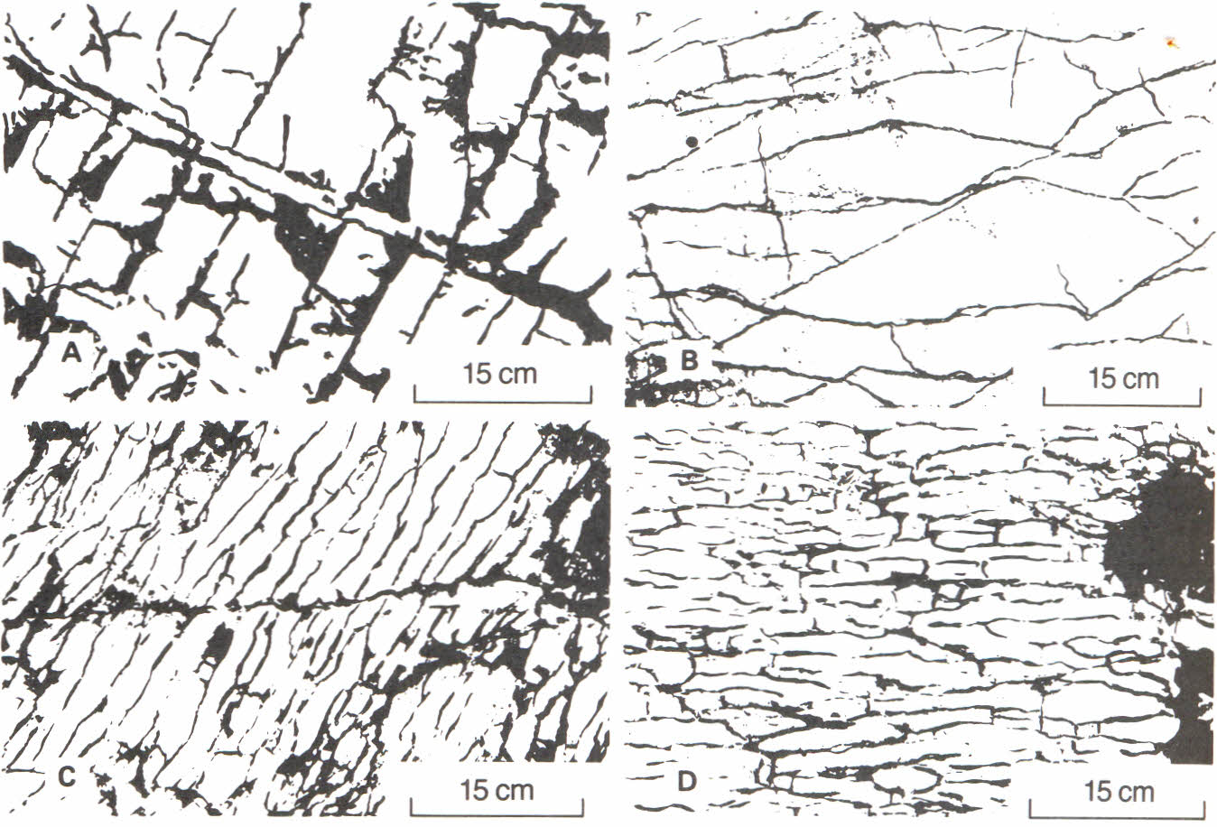
Figure 8.36 Geometry and spacing of moderate and strongly developed spaced cleavage. (A) Cross-sectional view of"moderate" cleavage; (B) expression of cleavage on the bedding surface. (C) Cross-sectional view of "strong" cleavage; (D) expression of cleavage on the bedding surface.

Slide 87
Lineations
Foliations generally occur when σ1> σ2 = σ3 and lineations generally occur when σ1= σ2 > σ3, or when shear smears out an object.
As shown in Fig 23-26, there are also several types of lineations. They usually result from the elongation of minerals or mineral aggregates (stretching Iineations).
Stretched pebbles in deformed conglomerates are a common example.

Slide 88
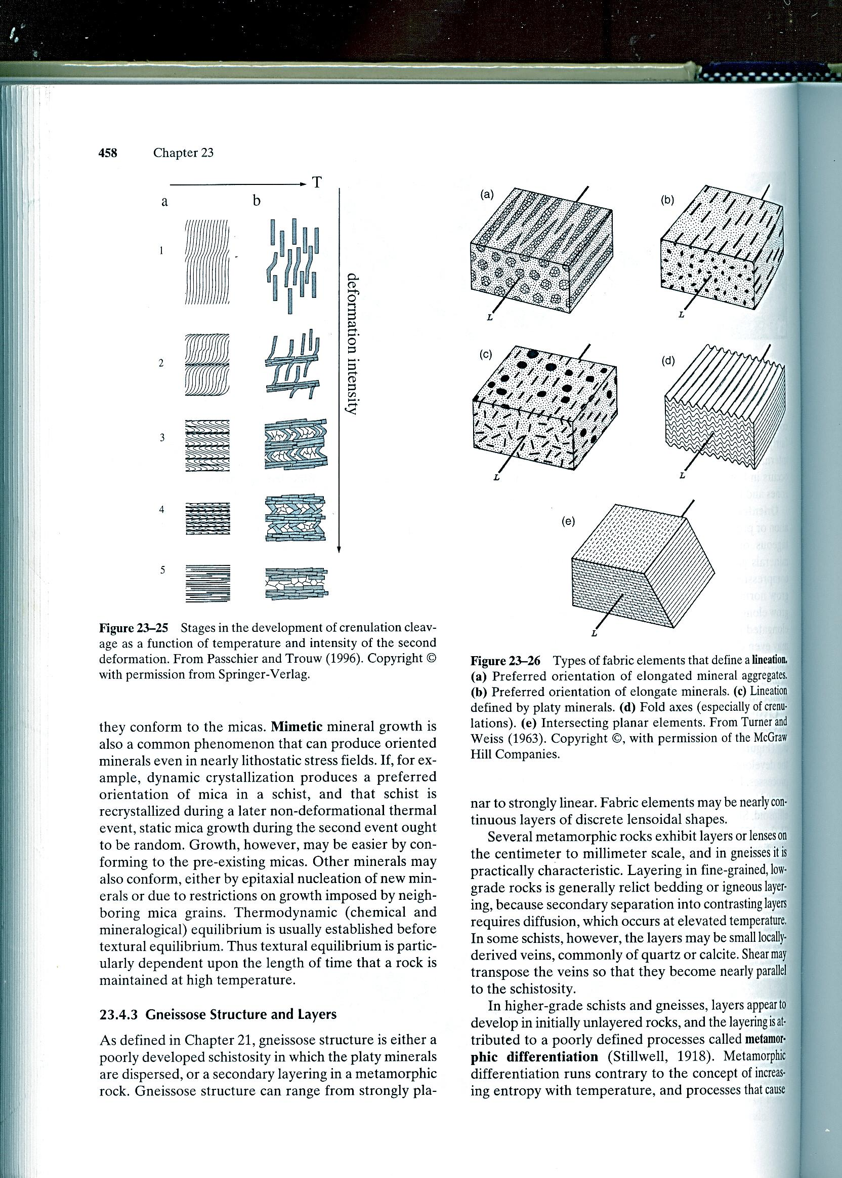

Slide 89
Lineations may also result from parallel growth of elongate minerals, fold axes, or intersecting planar elements (cleavage and bedding, or two cleavages).
Note in Fig 23-26c that, under some circumstances, planar minerals can create a linear fabric, just as linear minerals can create a planar fabric.

Slide 90
Mechanisms of Tectonite Development
Secondary fabric elements develop in response to deformation ± mineral growth.
We shall concentrate on foliations here, but lineations are created in a similar fashion, depending largely on the relative magnitudes of σ1, σ2, and σ3.
Fig. 23-27 illustrates the common ways that we presently think a foliation may develop in a rock.

Slide 91
Mechanism
Mechanical rotation
Oriented new mineral growth
Crystal-plastic deformation and recrystallization
Pressure solution and solution transfer

Slide 92
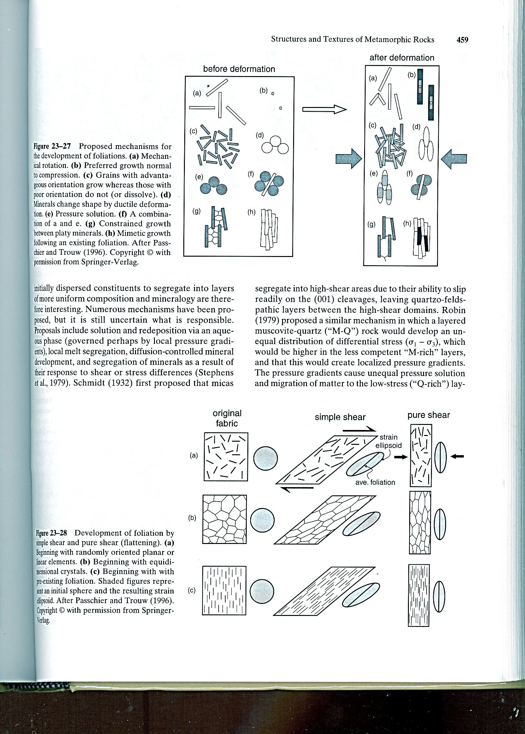

Slide 94
Gneissose structure and layers
Gneissose structure is either a poorly developed schistosity in which the platy minerals are dispersed, or secondary layering in a metamorphic rock.
Gneissose structure can range from strongly planar to strongly linear. Fabric elements may be nearly continuous layers of discrete lensoidal shapes.

Slide 95
Several metamorphic rocks exhibit layers or lenses on the cm to mm scale, and in gneisses it is practically characteristic.
Layering in fine-grained, low- grade rocks is generally relict bedding or igneous layering, because secondary separation into contrasting layers requires diffusion, which occurs at elevated temperature.

Slide 96
In higher-grade schists and gneisses, layers appear to develop in initially unlayered rocks, and the layering is attributed to a poorly defined processes called metamerphic differentiation (Stillwell, 1918).

Slide 97
Deformation vs. Metamorphic Mineral Growth
Following the lead of Sander (1930, 1950) and Turner and Weiss (1963), foliated rocks are called S-tectonites, and we can refer to the foliations as S-surfaces (as a short hand notation: S). Linear elements are L-tectonites (shorthand: L).

Slide 98
If two or more geometric elements are present, we can add a numeric subscript to denote the chronological sequence in which they were developed and superimposed.
S₀ and L₀ are reserved for primary structures, such as relict bedding or igneous layering, etc. S₁, S₂, S₃, etc. are then subsequently developed foliations whenever present. Similarly, L₁, L₂ and L₃ are successive secondary linear elements.

Slide 99
By using this notation we can conveniently describe the sequential development of fabric elements in a tectonite. D₁, D₂, D₃, etc. can be used to refer to deformational phases, and M₁, M₂, M₃, etc. to metamorphic events so that we can then relate fabric elements and the minerals involved to the events that ereated them, provided of course that we can determine the relationships on the basis of textures.

Slide 100
It may not always be possible to determine unequivocally the relationship between metamorphic mineral growth and deformation, but the following is intended to be a useful guide.

Slide 101
Pre-kinematic crystals
(Figure 23-34), when clearly recognizable, show the usual characteristics of minerals affected by later deformation, most of which are described above for high-strain rocks.
These include undulose extinction, cracked and broken crystals, deformation bands and twins, kink bands, pressure shadows, porphyroclasts with mortar texture or sheared mantles, etc.

Slide 102
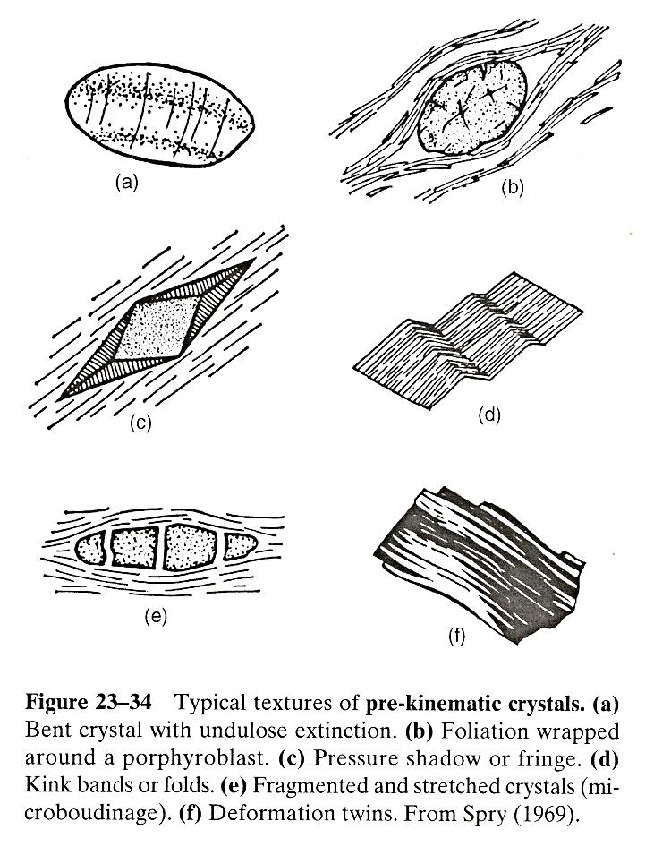

Slide 103
Pressure shadows (Fig 23-34c) occur when pressure solution dissolves a mineral (usually a matrix mineral) from high-stress areas (generally in the σ1 direction), and re-precipitates it in low-stress areas adjacent to a porphyroblast.

Slide 104
Post-kinematic crystallization
It means that metamorphic crystallization either outlasted deformation, or occurred in a distinct later thermal or contact event. When clearly distinguishable, both the previous deformation and the later mineral growth or recrystallization must be apparent.
Post-kinematic growth results in unstrained crystals. In many cases the crystals are randomly oriented, and cut across an earlier foliation (Fig 23-35b).

Slide 105
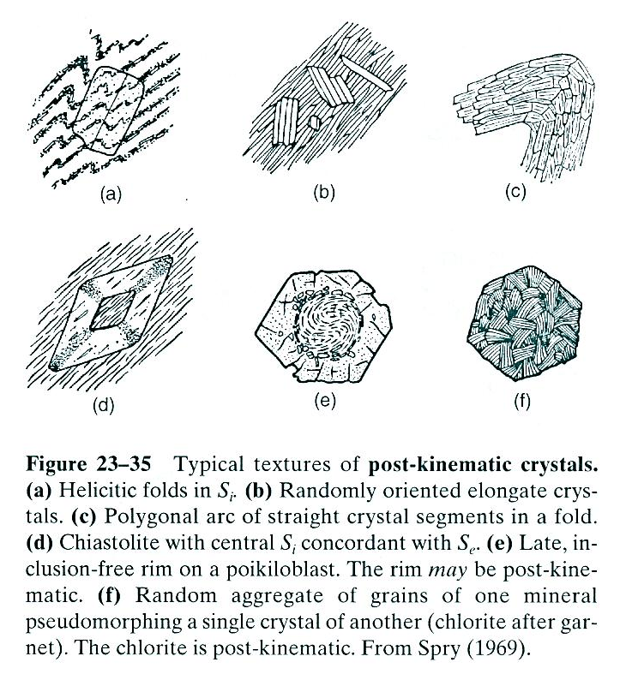

Slide 106
Syn-kinematic mineral growth
It is probably the most common type in orogenic metamorphism, because metamorphism and deformation are thought commonly to occur in unison. It is also the most difficult to demonstrate unequivocally.
A continuous schistosity, as illustrated in Figure 23-23, was probably generated by a process of dynamic (syn-kinernatic) recrystallization.

Slide 107
Aligned grains that are a mixture of bent crystals with undulose extinction and straight recrystallized grains support this conclusion, although they could also be an unlikely combination of pre-kinematic and post-kinematic crystallization.
It is probable, but largely a matter of faith, then, that syntectonic crystallization occurs during the development of a schistosity.

Slide 108
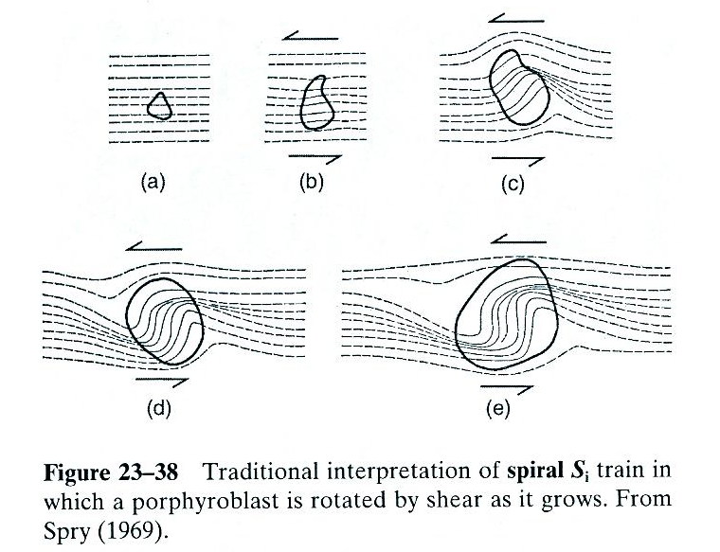

Slide 109
Petrofabric Analysis

Slide 110
Petrofabric Analysis
Proper study of tectonites usually requires that the hand specimen and thin section can be spatially related to the outcrop. This way we can use our textural observations to estimate the local or regional stresses.
Well-oriented samples are thus required. Techniques for collecting and recording oriented samples are described by Passchier and Trouw (1996, Chapter 10).

Slide 111
Laboratory work for Lattice Preferred rientations (LPO) requires a universal stage that permits a petrographer to orient a crystal in a thin section in three dimensions and to record the spatial orientation of the crystal axes.
The orientation of a sound statistical sampling of crystal axes can then be plotted on an equal-area stereonet, and the density distribution of points can be contoured to produce petrofabric diagrams.

Slide 112
Petrofabric diagrams are stereonets on which the orientations of fabric elements, such as the crystallographic c-axes of lattice-oriented quartz grains are plotted and contoured on the basis of point density (Fig. 23-31petrofabric diagrams)

Slide 113
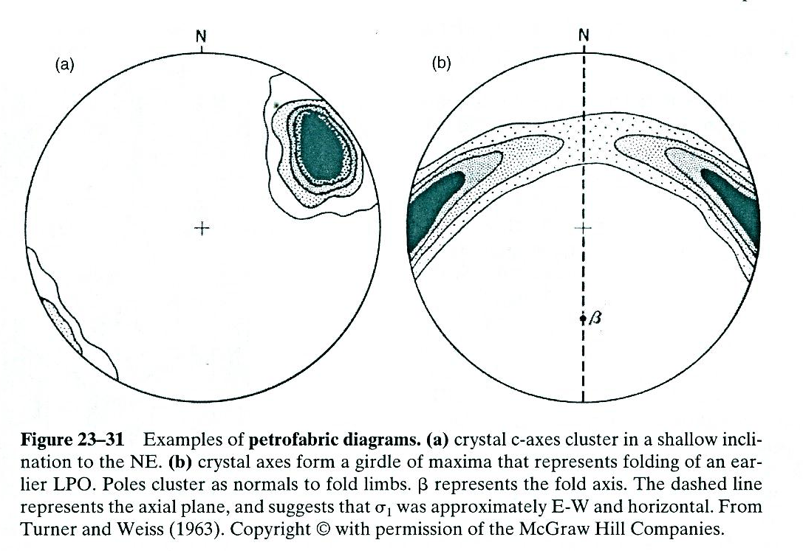

Slide 114
Thank you

