Slide 1
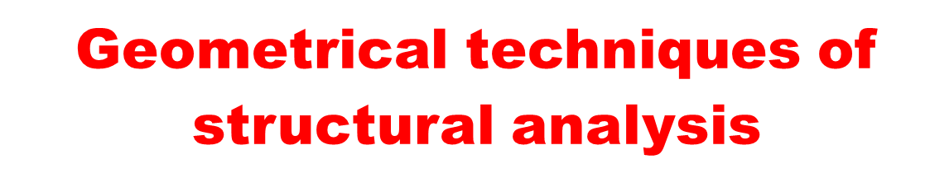

Slide 2
STEREOGRAPHIC PROJECTION
(A Spherical Projection)
Stereographic projection is a powerful method for solving geometric problems in structural geology. Stereographic projection differs from orthographic projection in a fundamental way.

Slide 3
What is a spherical projection?
A 2-D projection for describing the orientation of 3-D features.
A spherical projection shows where lines or planes that intersect the surface of a (hemi)sphere, provided that the lines/planes also pass through the center of the (hemi)sphere.

Slide 4
Orhographic projection preserves spatial relations among structures,
But stereographic projection displays gometries and orientations of lines and planes without regard to spatial relations.
It is used for representation of the orientation of planar features (e.g., bedding, fractures, crystal faces) and representation of the orientation of linear features (e.g., fold axes, lineations etc)

Slide 5
The use of stereographic projection is preferable to orthographic projection in solving many geometric problems, simply because of operations.
Solving for apparent dip, the trend, and plunge of the intersection of two planes, and angles between lines and planes in space can be carried out rapidly and accurately using stereographic projection.

Slide 6
Geometry of Projection
Think of stereographic projection as a procedure comparable to using a three-dimensional protractor. A two-dimensional protractor is simple to use.
Using a protractor we can plot trends of lines, measure angles between lines, construct normals (i.e., perpendiculars) to lines, and rotate lines by specified angles.

Slide 7
Stereographic projection permits the same kinds of operation, but in three-dimensional space.
Moreover, both lines and planes can be plotted and analyzed. Equipped with this a three-dimensional protractor (stereographic projection) , we can do the following:
  plot orientations of lines;
  plot orientations of planes;
  determine the orientation of the intersection of two planes.

Slide 8
We can also use a stereonet to:
  determine the angle between two lines;
  find the intersection between two planes (e.g. can find the fold axis if folding is cylindrical).
  determine the angle between two planes;
  measure the angle between a line and a plane; and

Slide 9
  rotate lines and planes in space about vertical, horizontal, or inclined axes.
  to find the restored orientation of a geologic feature such as a cross bed once it is rotated about some axis.
  bisect the angle between two planes

Slide 10
Some stereonet facts:
In contrast to mineralogy, structural geologists use lower hemisphere plots. Typically, it is as if you are looking into a hemispheric bowl sitting on the ground, and oriented along a N-S axis.
There are different types of stereonets (equal angle, equal area, polar). We should know which one we are using and why. One can recognize them by their distinct appearance.

Slide 11
Great circles look like lines of longitude, and represent where planes with a north-south strike but incrementally varying dips intersect the outer hemisphere surface.
Small circles look like lines of latitude, and represent where cones with a north-south horizontal axis and incrementally increasing apical angles intersect the outer hemisphere.

Slide 12
We can plot two types of features on a stereonet,
    a line (e.g. trend and plunge) and
    a plane (e.g. a strike and dip).
A line plots as a point and a plane plots as a great circle.

Slide 13
All elements plotted pass through the center of the hemisphere, and their projection reflects where the plane or line intersects the outer hemispheric surface. This means that information about relative position is not represented in the plot, only information about relative orientation (angle).
Planes are often represented by plotting their pole, which is the line perpendicular to that plane.

Slide 14
All the preceding operations would be simple if it were possible to assemble real lines and planes in space, like Tinkertoys, and measure their geometric properties directly.
Using stereographic projection techniques, we figuratively assemble lines and planes within a reference sphere.

Slide 15
Method of stereographic projects

Slide 16
The line or plane to be stereographically represented can be thought of as passing through the center of a reference sphere and intersecting its lower hemisphere (Figure 1.1 A).
Planes intersect the lower hemisphere in the form of great circles; lines intersect the lower hemisphere in points.

Slide 17
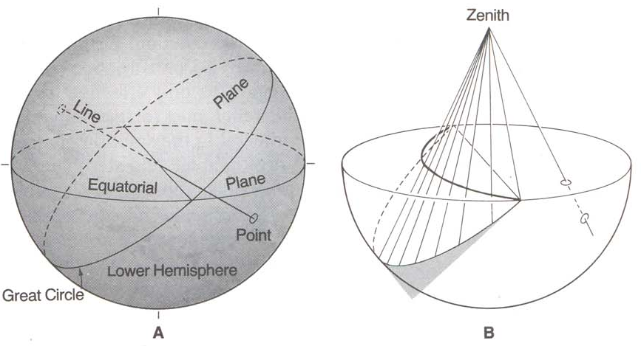
Fig. 1.1. The inherent 3D geometry of stereographic projection. (A) Projection of a plane through the centre of a reference sphere. The plane intersects the lower hemisphere of the reference sphere as a great circle. The line intersects the lower hemisphere as a single point. (B) Projection of intersection points from the lower hemisphere of the reference sphere to the zenith of the projection.

Slide 18
Stereographic projection of lines and planes to points and great circles constitutes a systematic reduction of three-dimensional geometry to two dimensions.
The "flattening" to two dimensions is achieved by projecting the lower hemisphere intersections to an equatorial plane of reference that passes through the center of the sphere (Figure 1.1 B).

Slide 19
This is the plane of stereographic projection. The lower hemisphere intersections are projected as rays upward through the horizontal reference plane to the zenith of the sphere.
Where the rays of projection pass through the horizontal reference plane, point or great-circle intersections are produced, and these are stereo grams or stereographic projections of lines and planes.

Slide 20
Steep-plunging lines stereographically project to locations close to the center of the horizontal plane of projection;
whereas shallow-plunging lines project to locations near the perimeter of the plane of projection (Figure 1.2 A).

Slide 21
Steeply dipping planes stereographically project as great circles that pass near the center of the plane of projection.
Gently dipping planes project as great circles passing close to the perimeter of the horizontal plane of projection (Figure1.2 B).

Slide 22
The distance that a great circle or point departs from the center of the plane of projection is a measure of the degree of inclination of the plane or line that has been stereographically plotted.
The trend of the line connecting the end points of the great circle corresponds to the strike of the plane that the great circle stereographically portrays (Figure1.2 C).

Slide 23
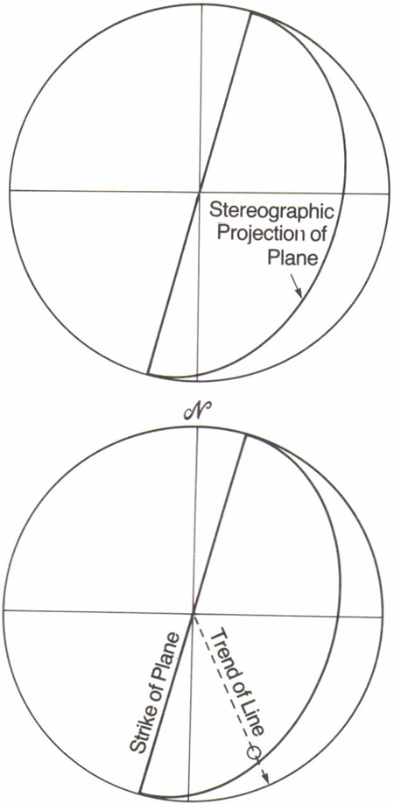
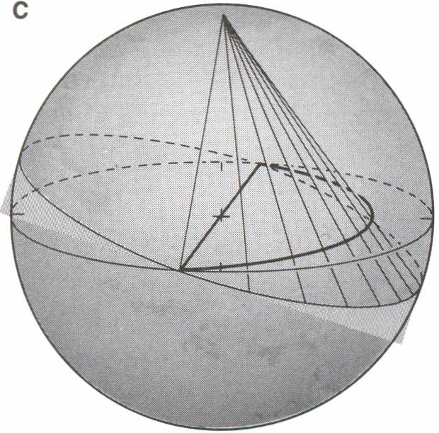
Stereographic projection of a steeply dipping plane

Slide 24
And the trend of a line connecting the center of the stereographic projection to a point representing a stereographically plotted line is the same as the trend of the line in space (Figure1.2C).

Slide 25
Principles of
stereographic projection

Slide 26
Construction of a stereonet

Slide 27
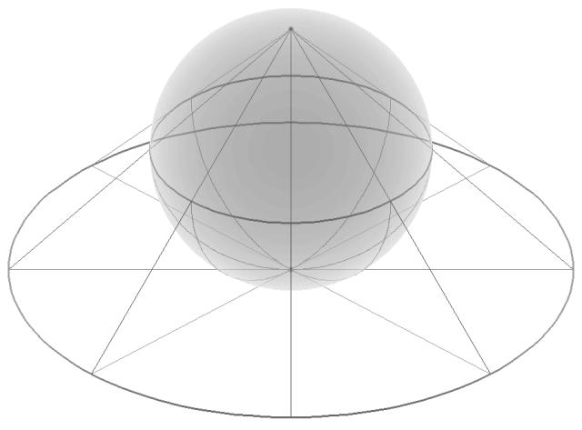

Slide 28
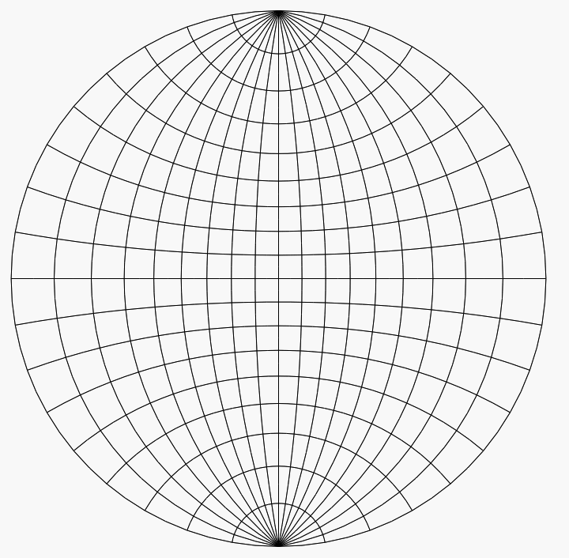
Stereonet or Wulff net

Slide 29
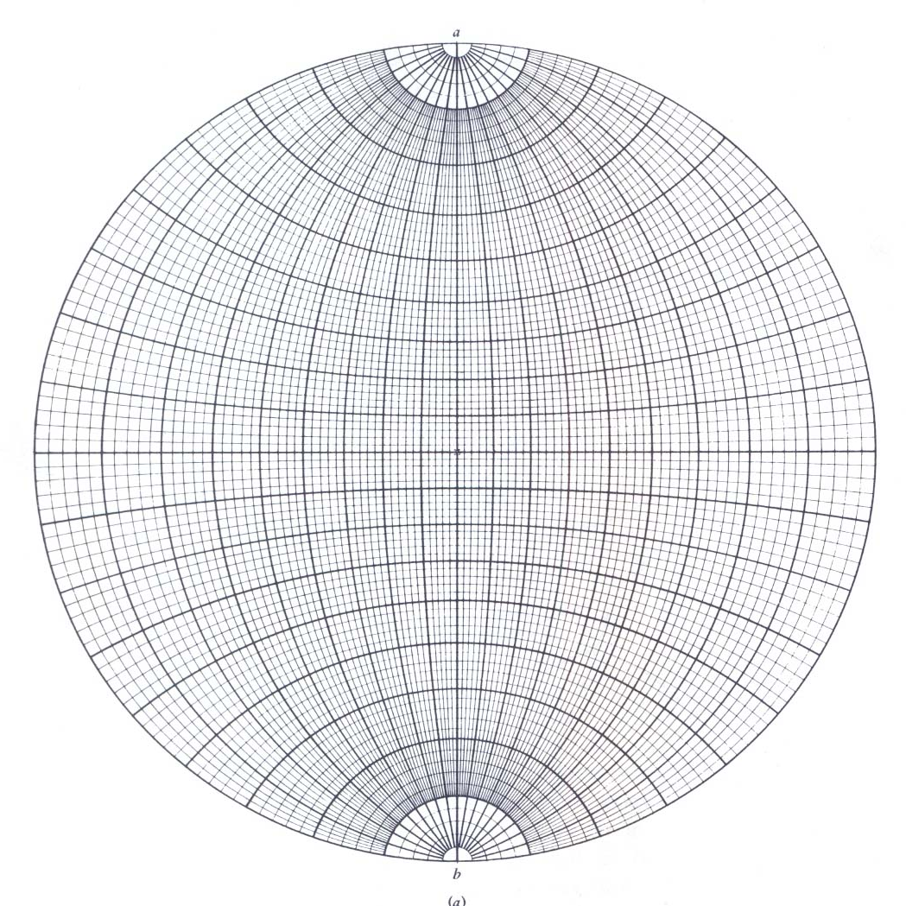
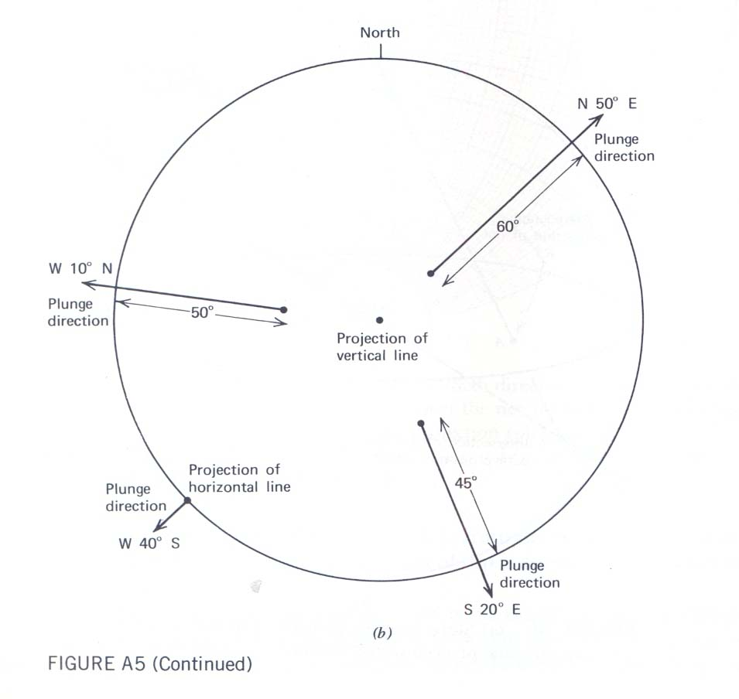
Stereonet or Wulff net

Slide 30
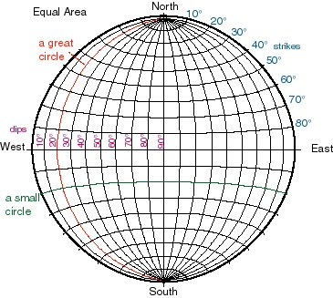

Slide 31
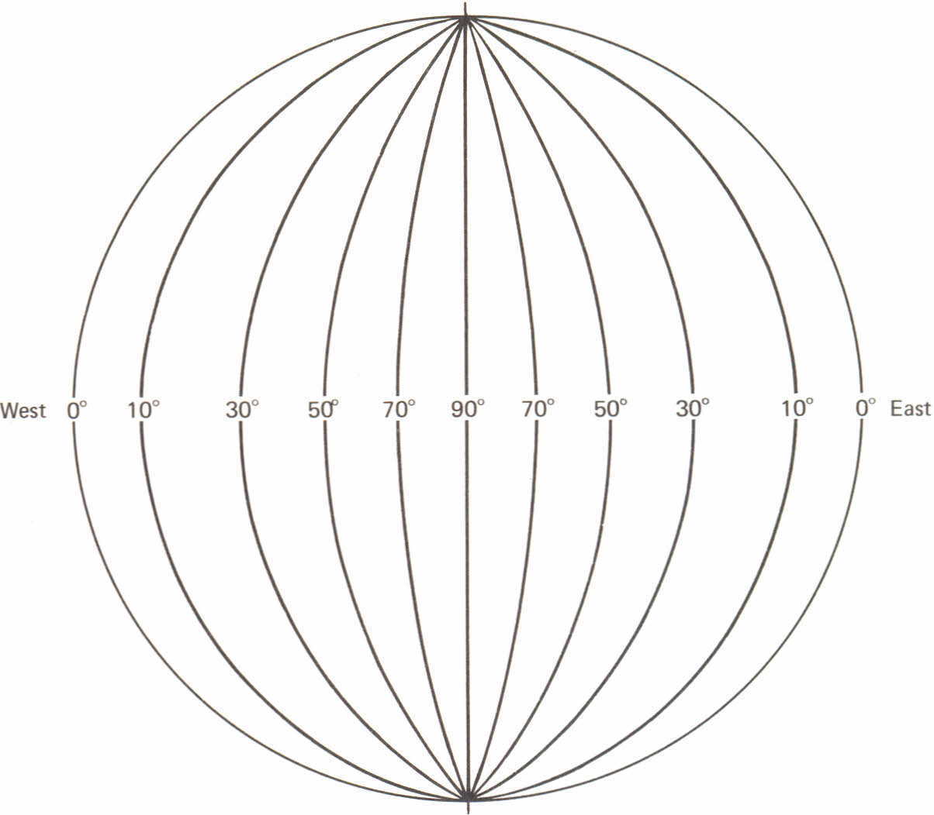

Slide 32
Great circle:
It is the intersection of the surface of a sphere with a plane that passes through the center of the sphere (e.g., lines of longitude)
Small circle:
It is the intersection of the surface of a sphere with a plane that does not pass through the center of the sphere (e.g., lines of latitude). A line rotated about an axis traces a small circle too.

Slide 33
The above is an equal area stereonet projection showing great circles as arcuate lines connecting the North and South Points and small circles as arcuate lines in a latitudinal type position.
The great circles represent north-south striking planes with dips in 10 degree increments. Those labelled with dip amounts on the left side, dip to the west. If the same plane was rotated about a vertical axis in the stereonet center, they would then retain their dip, but have a different strike.

Slide 34
The numbers in the upper right quadrant represent potential strike line positions from 10-80 degree, in 10 degree increments.
Small circles represent half of a conical surfaces with the apex at hemisphere center. They are hemisphere surface paths from one line being rotated about another line (the pole of rotation), both passing through the hemisphere center.

Slide 35
The line or plane to be stereographically represented can be thought of as passing through the center of a reference sphere and intersecting its lower hemisphere (Figure 1.1 A).
Planes intersect the lower hemisphere in the form of great circles; lines intersect the lower hemisphere in points.

Slide 36
Stereographic projection of lines and planes to points and great circles constitutes a systematic reduction of three-dimensional geometry to two dimensions.
The "flattening" to two dimensions is achieved by projecting the lower hemisphere intersections to an equatorial plane of reference that passes through the center of the sphere (Figure 1.1 B).

Slide 37
This is the plane of stereographic projection. The lower hemisphere intersections are projected as rays upward through the horizontal reference plane to the zenith of the sphere.
Where the rays of projection pass through the horizontal reference plane, point or great-circle intersections are produced, and these are stereo grams or stereographic projections of lines and planes.

Slide 38
Steep-plunging lines stereographically project to locations close to the center of the horizontal plane of projection;
whereas shallow-plunging lines project to locations near the perimeter of the plane of projection (Figure 1.2 A).

Slide 39
Steeply dipping planes stereographically project as great circles that pass near the center of the plane of projection.
Gently dipping planes project as great circles passing close to the perimeter of the horizontal plane of projection (Figure1.2 B).

Slide 40
The distance that a great circle or point departs from the center of the plane of projection is a measure of the degree of inclination of the plane or line that has been stereographically plotted.
The trend of the line connecting the end points of the great· circle corresponds to the strike of the plane that the great circle stereographically portrays (Figure1.2 C).

Slide 41
And the trend of a line connecting the center of the stereographic projection to a point representing a stereographically plotted line is the same as the trend of the line in space (Figure1.2C).

Slide 42
Stereographic Net, or Stereonet
In actual practice, stereographic projection of lines and plane is carried out through the use of a stereographic net, or stereonet for short (Figure 1.3).
A stereonet displays a network of great-circle and small-circle projections that occupy the equatorial plane of projection of the reference sphere.

Slide 43
Both the great circles and small circles are spaced at 2° intervals; every fifth one is darkened so that 10° intervals can be readily counted.
The great circles represent a family of planes of common strike whose dips range from 0° to 90°. The planes intersect in a horizontal line represented by the north-south line of the net.

Slide 44
The small circles may be thought of as the paths along which lines would move when rotated about a horizontal axis oriented parallel to the ordinate of the net.
The combination of small and great circles constitutes an orientation framework for stereographically plotting lines and planes.

Slide 45
There are two different kinds of stereonet:
  Wulff nets, and
  Schmidt nets
Constructions are carried out the same way on each (Phillips, 1971, p. 61). Structural geologists find the Schmidt net (Figure 1.3A) to be the most versatile, for various reasons.

Slide 46
Stereonet or Wulff net

Slide 47
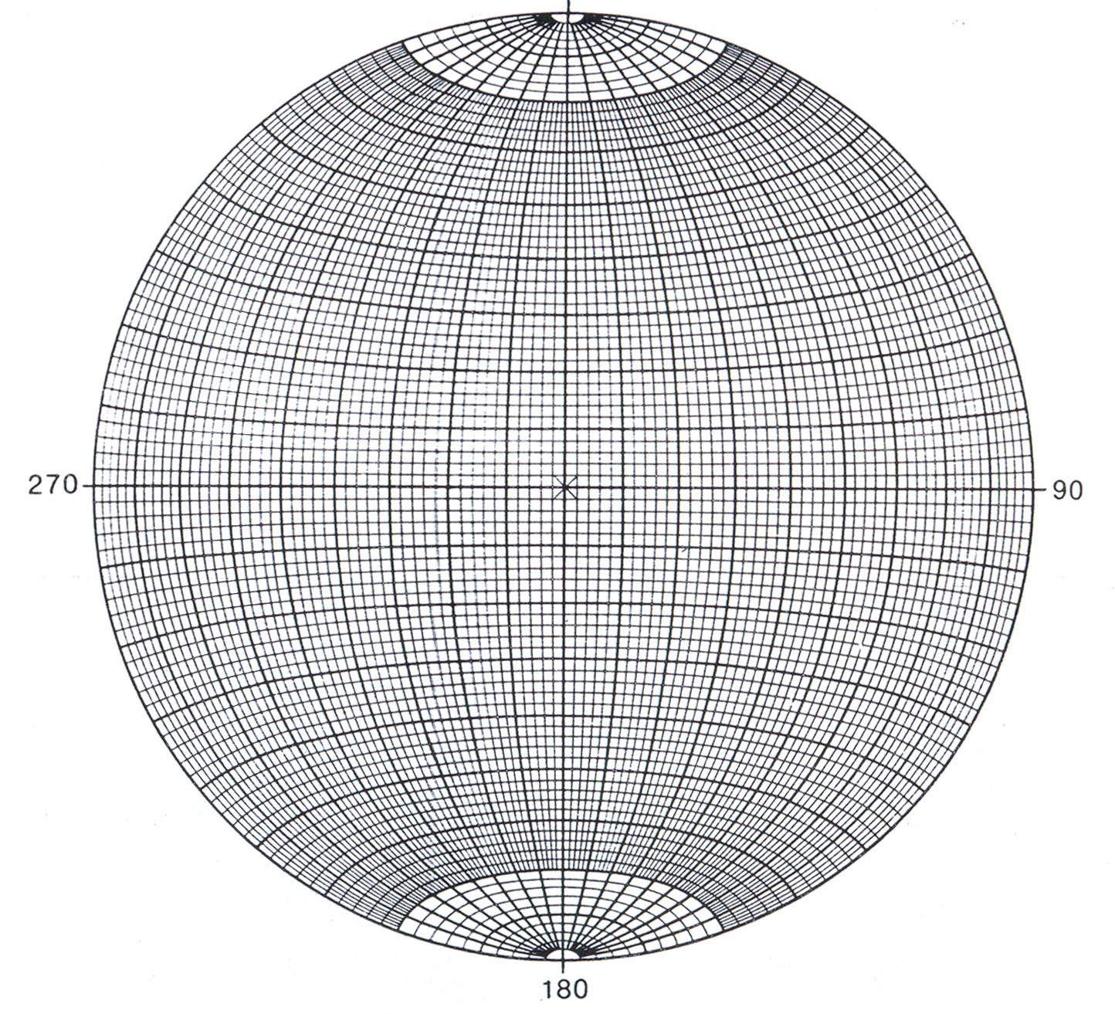
N
360
Schmidt Equal area net

Slide 48
Representation of lines and planes in a stereonet

Slide 49
Fig. 1.1. The inherent 3D geometry of stereographic projection. (A) Projection of a plane through the centre of a reference sphere. The plane intersects the lower hemisphere of the reference sphere as a great circle. The line intersects the lower hemisphere as a single point. (B) Projection of intersection points from the lower hemisphere of the reference sphere to the zenith of the projection.

Slide 50
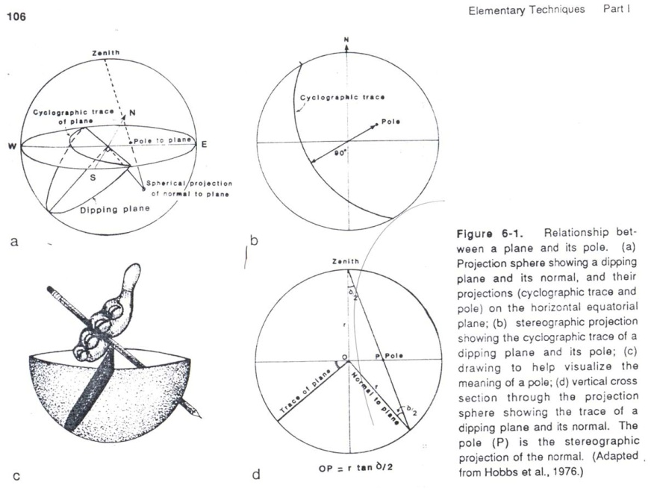

Slide 51
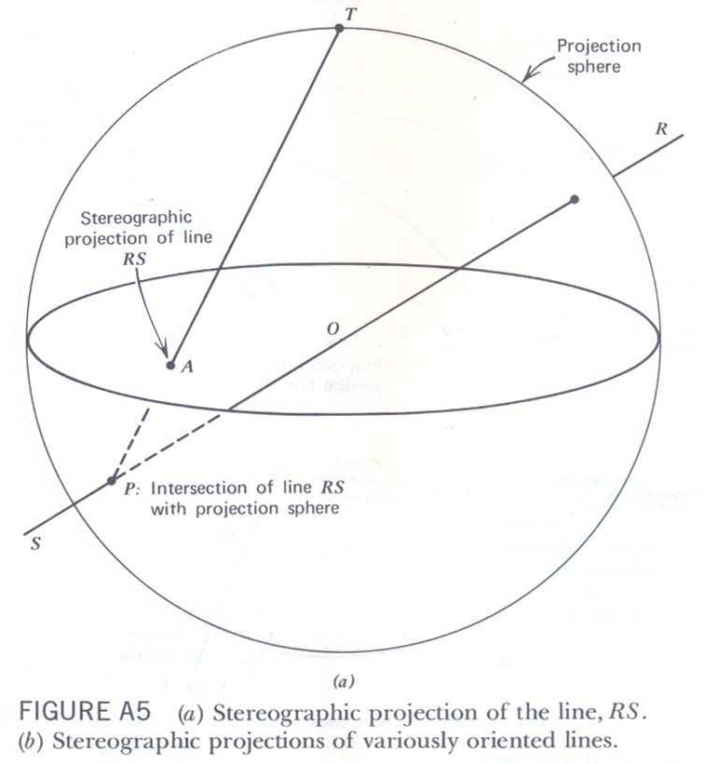

Slide 52
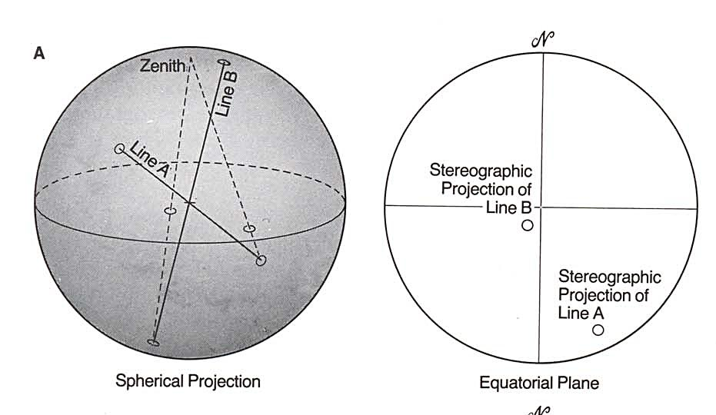
Fig. 1.2: the distance that a great circle or point lies from the centre of the equatorial plane of projection is a measure of the inclination of a plane or line. (A) Shallow plunging lines project close to the perimeter of the equatorial plane; steeply plunging lines project close to the centre. (B) great circles that represent the rientation of steeply dipping planes pass close to the centre of projection; shallow dipping planes are represented by great circles that pass close to the perimeter of the equatorial plane. © Stereographic representation of the strike of a plane and the trend of a line.

Slide 53
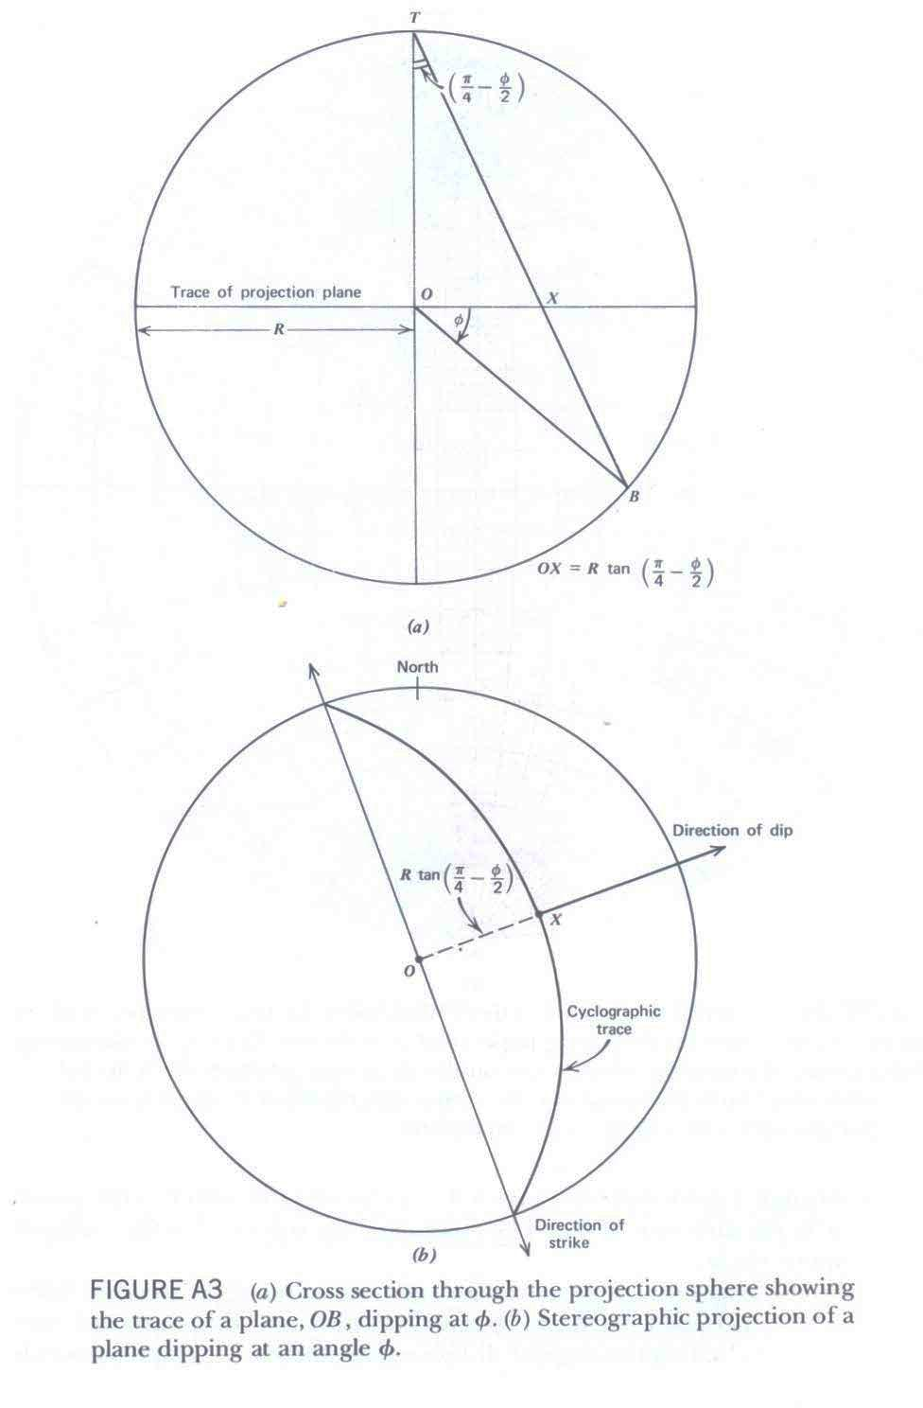

Slide 54
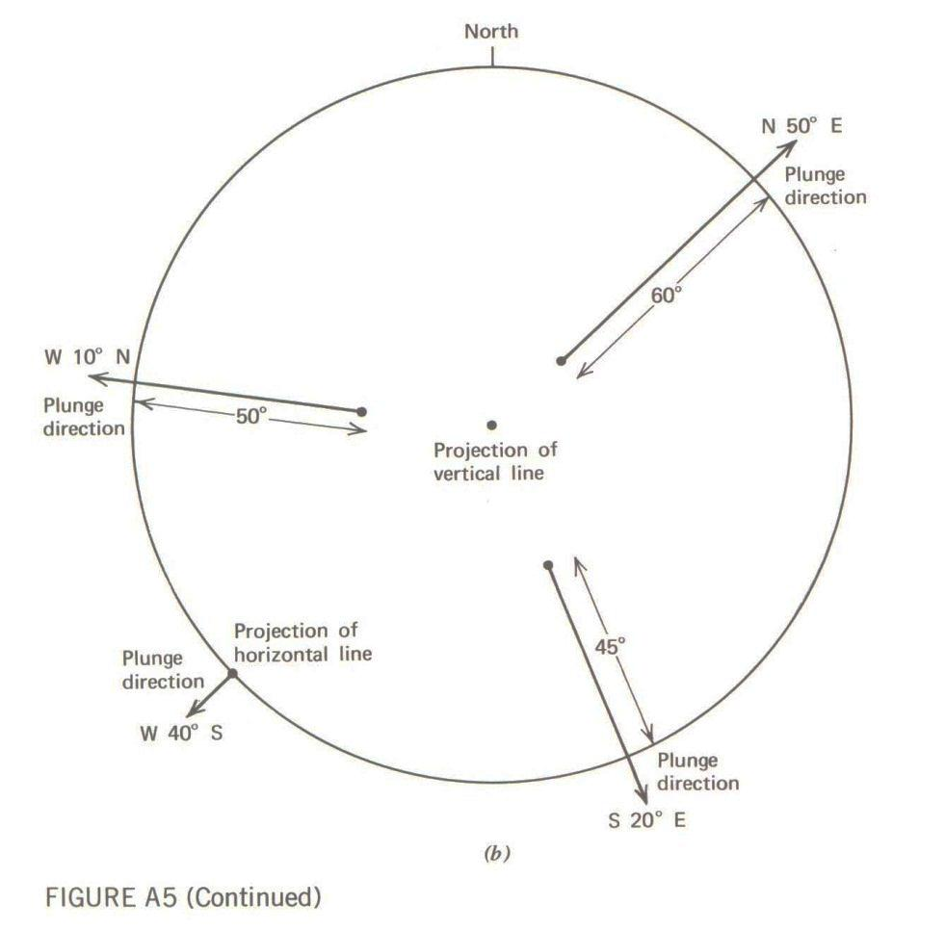

Slide 55
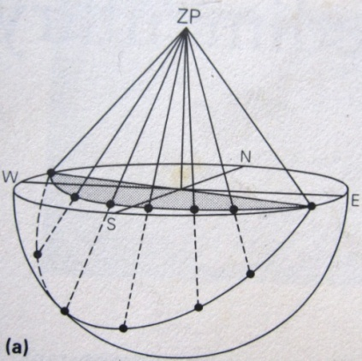

Slide 56
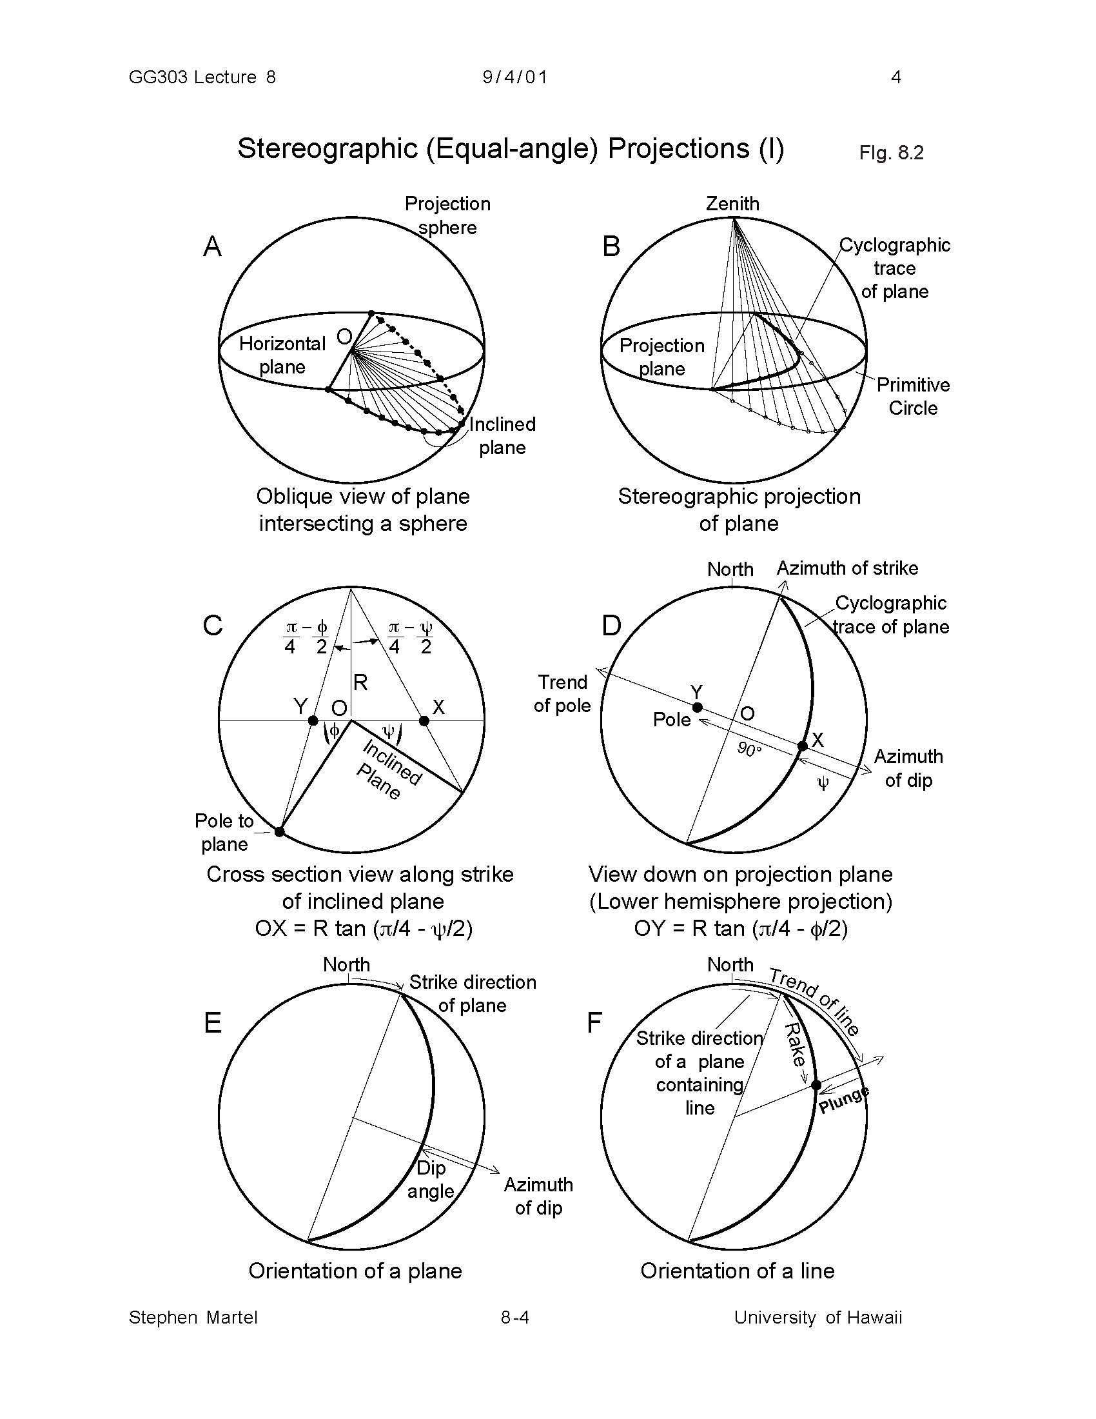
Principles of stereographic projection

Slide 57
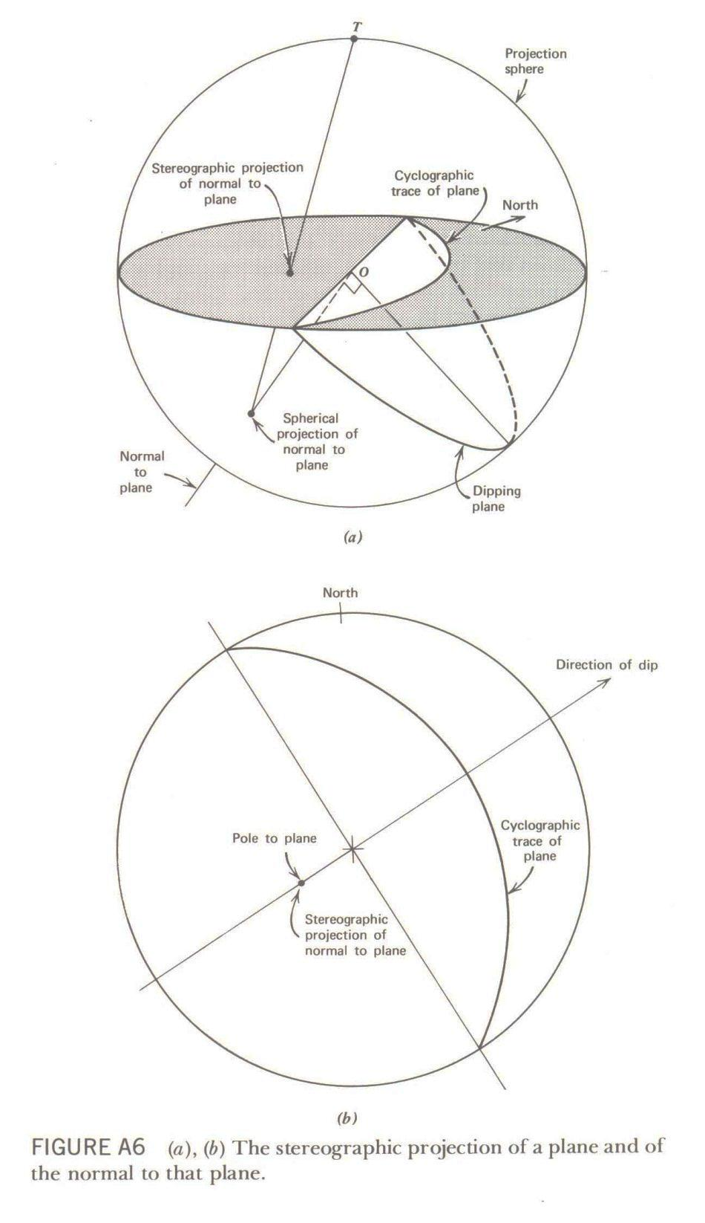
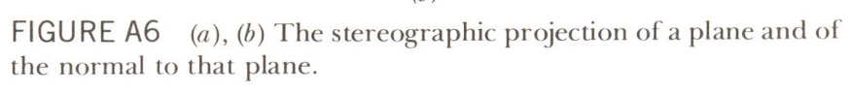

Slide 58
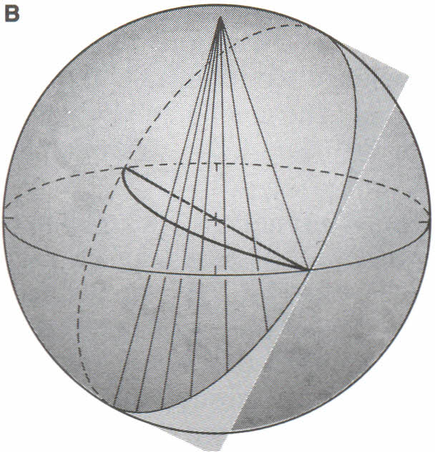
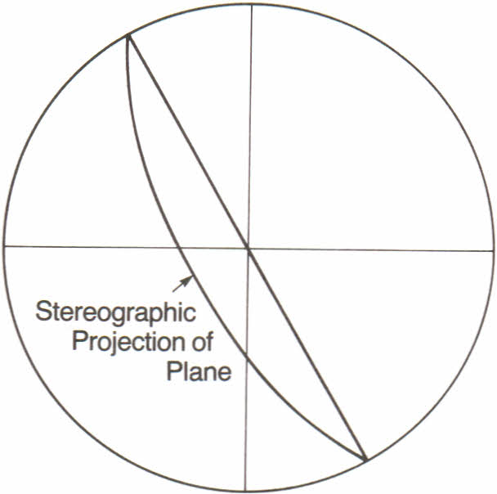
N
Stereographic projection of a steeply dipping plane

Slide 60
Stereographic projection of a steeply dipping plane

Slide 61
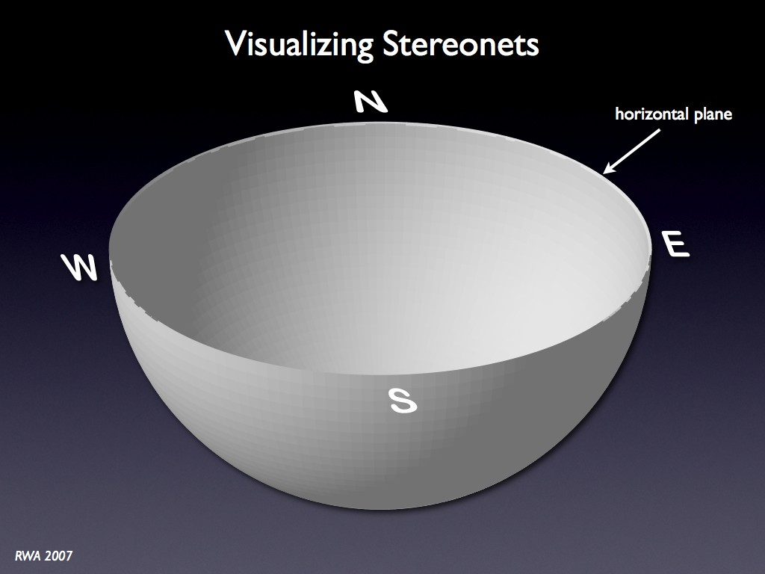

Slide 62
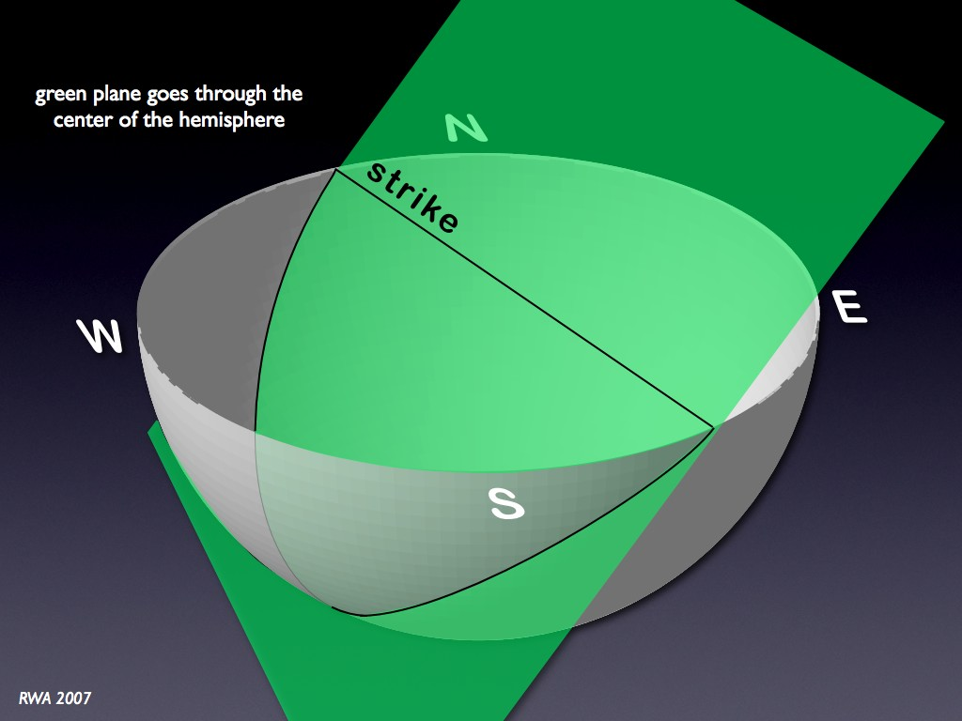

Slide 63
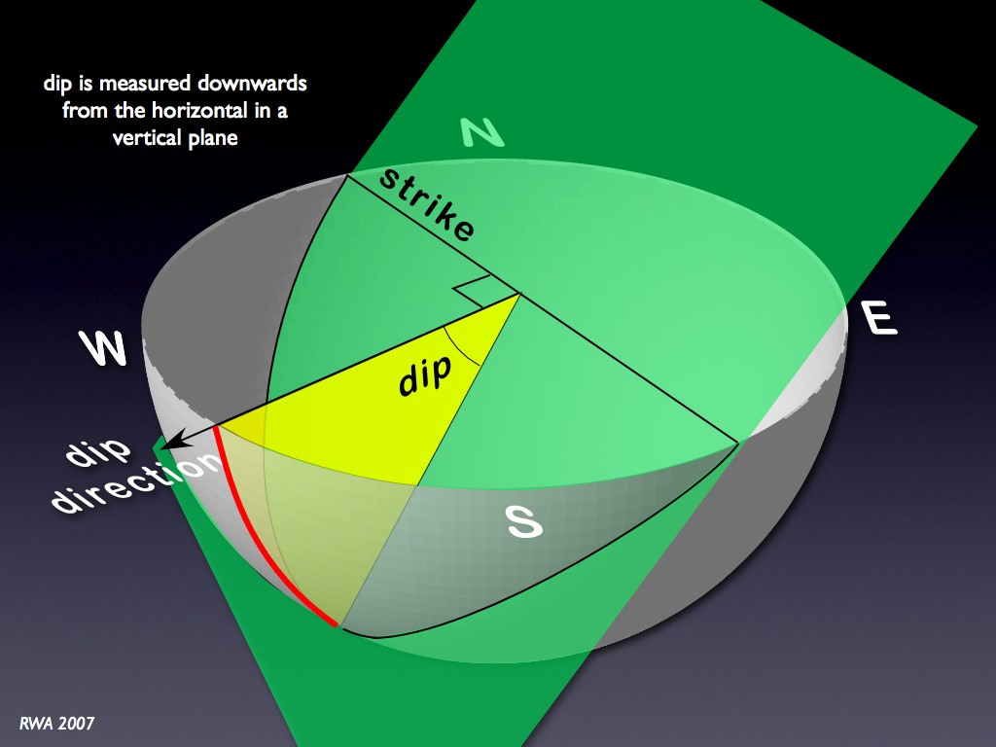

Slide 64
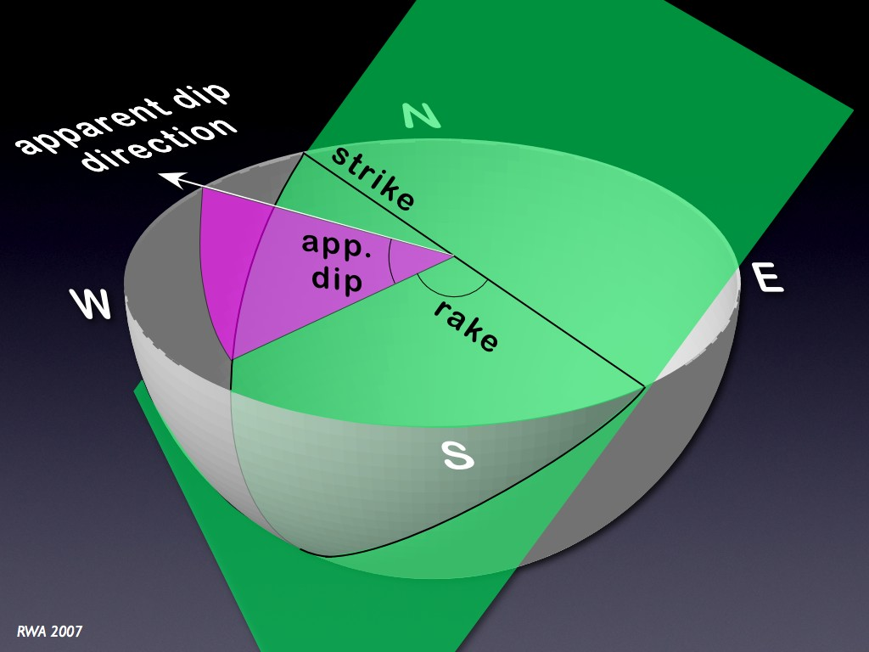

Slide 65
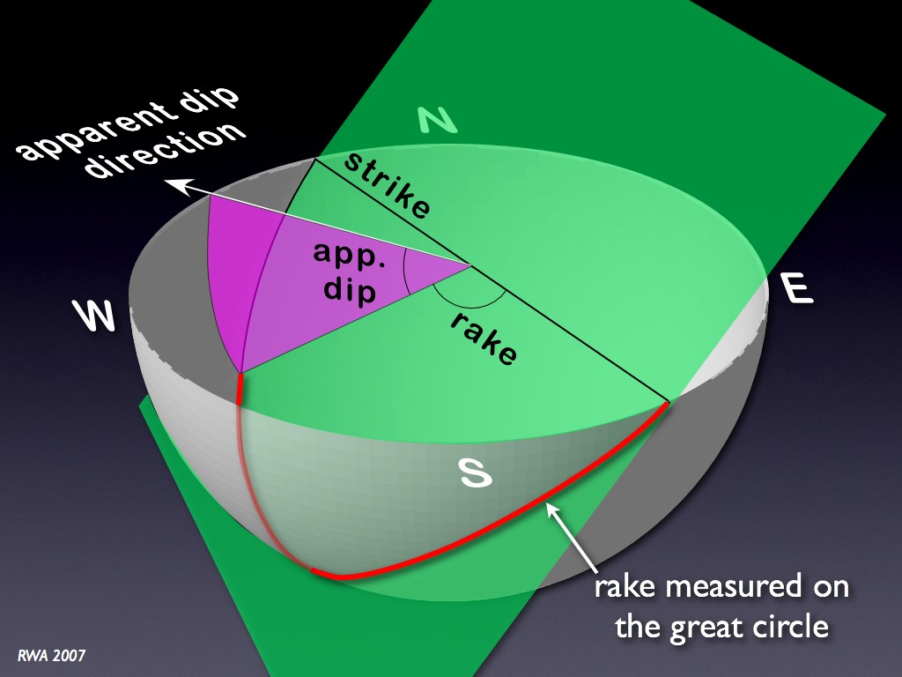

Slide 66
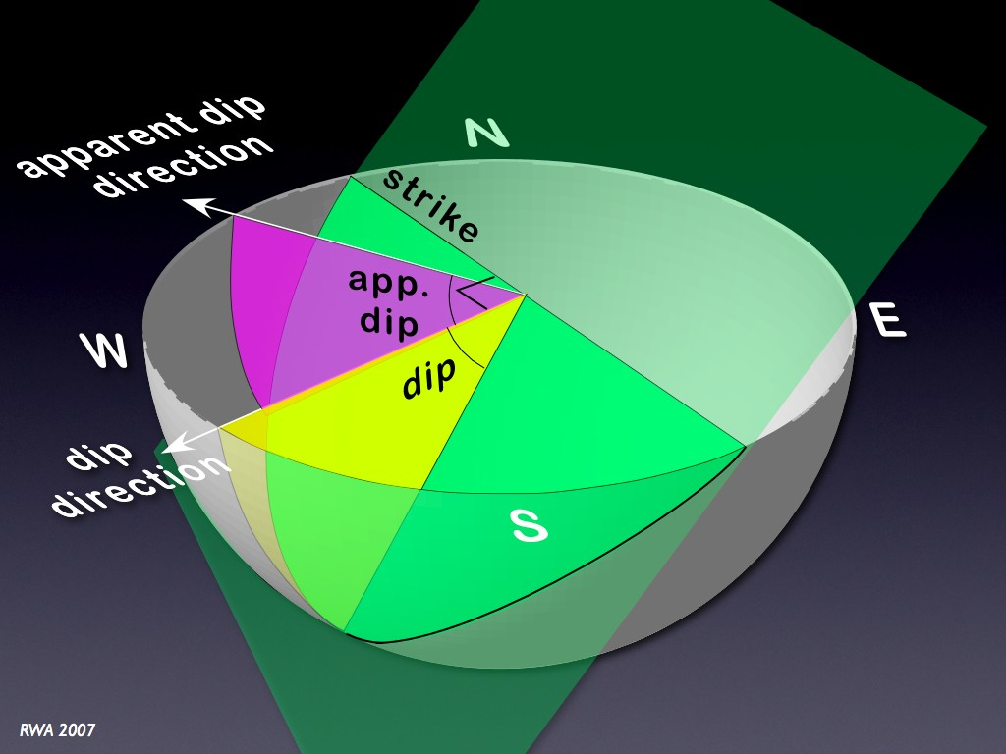

Slide 67
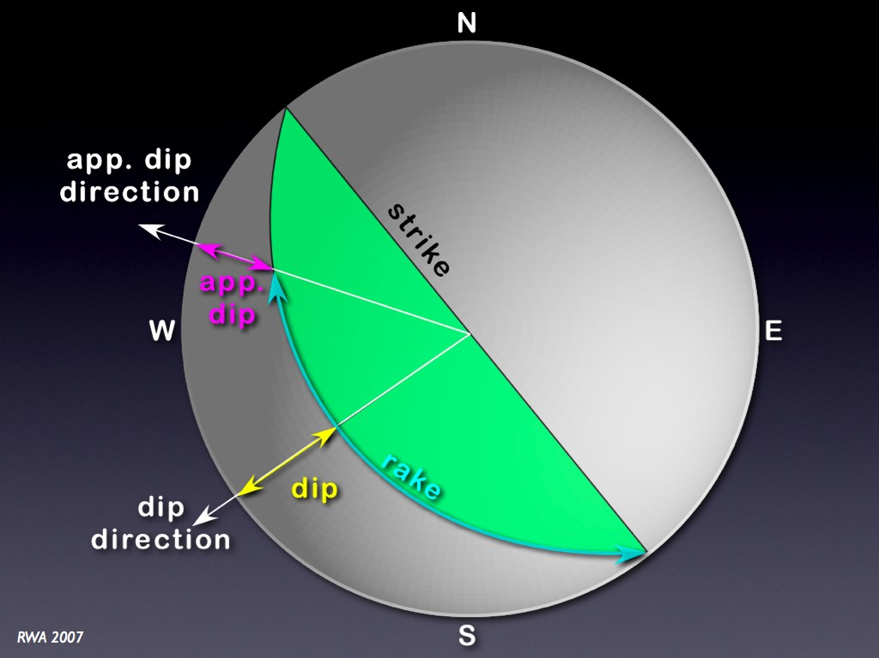

Slide 68
Preparing Stereo net for use

Slide 69
To prepare the Schmidt net for use, tape or glue it to a heavy backing, such as cardboard or Masonite. Insert a thumbtack through the backing and through the exact center of the net, taping the tack to the underside of the net so it cannot fall free (Figure1.4).
A sheet of tracing paper is placed on the net so that the paper, punctured by the thumbtack, can rotate about the tack.

Slide 70
A small square of clear tape applied to the back of the tracing paper, covering the area where the thumb tack will go through, prevents the paper from ripping during plotting.

Slide 71
All construction work is carried out on the tracing paper, which is oriented with respect to north by marking a north index at a point corresponding to the top of the north-south line.
This geographically orients the overlay for the constructions to be carried out.

Slide 72
Plotting the Trend and Plunge of a Line and
Strike and Dip of a Plane

Slide 73
Plotting the Trend and Plunge of a Line
Before any problems can be solved stereographically, it is necessary to learn how to represent the orientations of lines and planes on a stereonet. Lines are easiest to plot.

Slide 74
Consider a line that plunges 26° N40°E. To represent the trend and plunge of this line stereographically, first plot the trend, in degrees, on the outer perimeter of the stereographic net.).

Slide 75
The point representing a line plots away from the center of the spherical plot in the direction of the trend of the line.
The trend of a line is measured along a horizontal great circle.
The plunge of the line is measured along a vertical great circle by counting down from the horizontal plane.

Slide 76
To do this, measure east from north by 40° (Figure 1.5A). This can be accomplished simply by using the stereographic net as you would a protractor, counting clockwise from the north index on the tracing paper along the periphery of the net to 40°.
The 40° azimuth corresponds to the 40° smallcircle intercept on the perimeter of the net. Mark the point at 40° with a trend-index mark (t) (Figure1.5A)

Slide 77
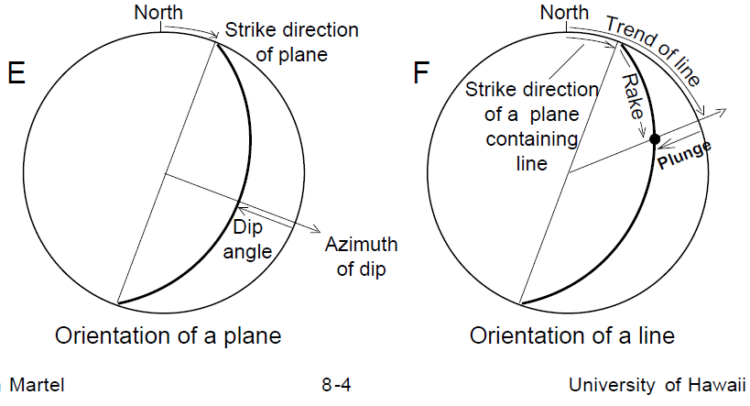

Slide 78
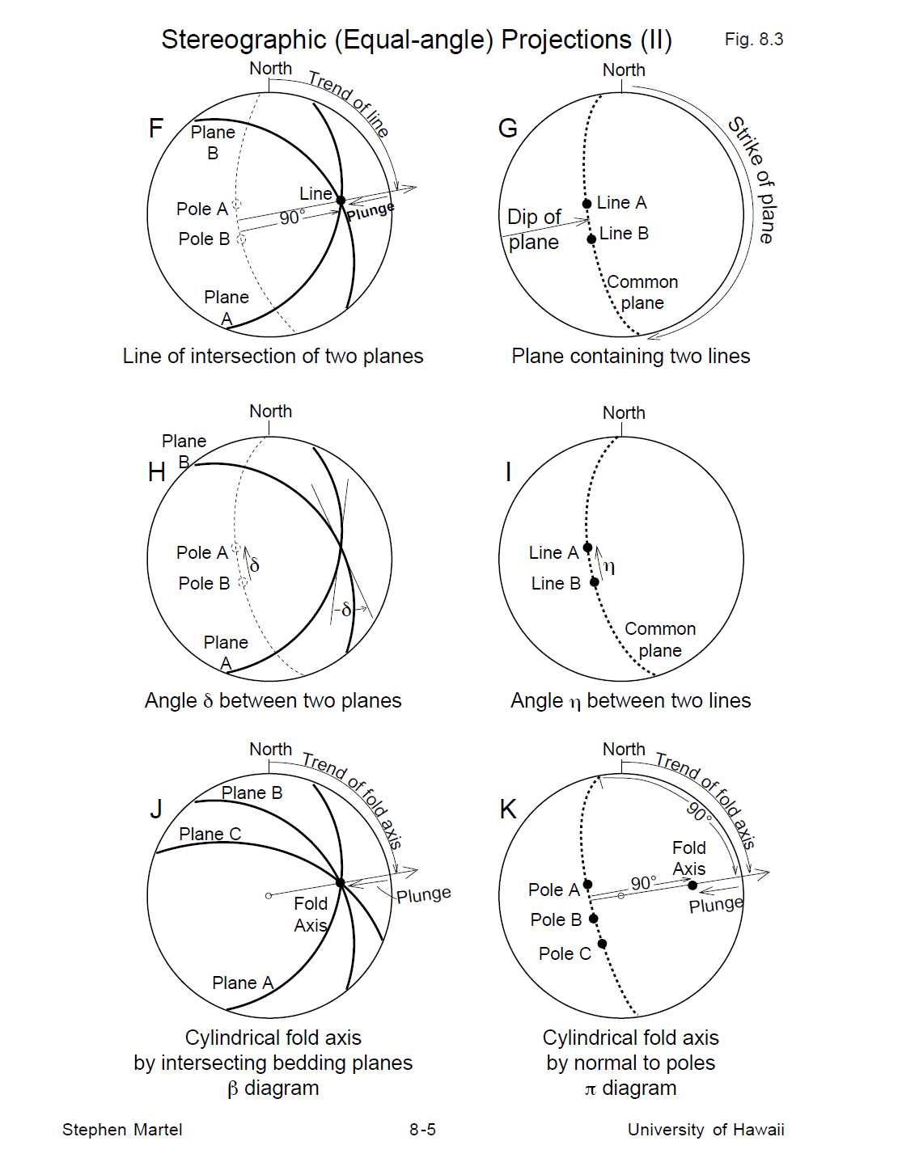

Slide 80
To plot the 26° plunge, first rotate the overlay clockwise until it comes to rest on the right end of the east-west line of the net (Figure 1.5B). This is one of two lines (the N-S axis being the other) where inclination can be directly measured and plotted.
The plunge is measured by counting 26° from the perimeter of the net along the east-west line toward the centre of the net. Point L represents the 26° plunging line (fig. 1.5B)

Slide 81
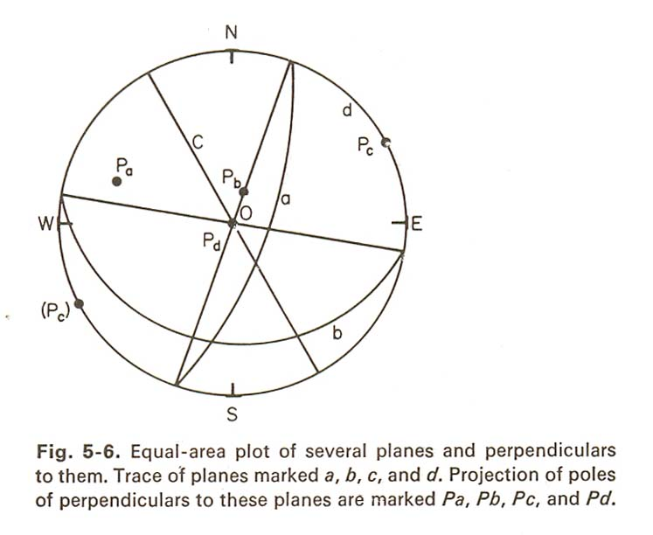

Slide 82
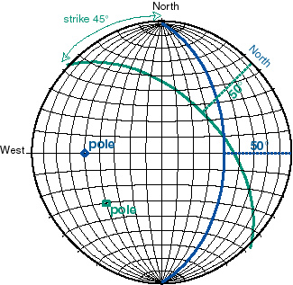

Slide 83
Thank you

