Slide 1


Slide 2
STEREOGRAPHIC PROJECTION
(A Spherical Projection)
Stereographic projection is a powerful method for solving geometric problems in structural geology. Stereographic projection differs from orthographic projection in a fundamental way.

Slide 3
What is a spherical projection?
A 2-D projection for describing the orientation of 3-D features.
A spherical projection shows where lines or planes that intersect the surface of a (hemi)sphere, provided that the lines/planes also pass through the center of the (hemi)sphere.

Slide 4
Orhographic projection preserves spatial relations among structures,
But stereographic projection displays gometries and orientations of lines and planes without regard to spatial relations.
It is used for representation of the orientation of planar features (e.g., bedding, fractures, crystal faces) and representation of the orientation of linear features (e.g., fold axes, lineations etc)

Slide 5
The use of stereographic projection is preferable to orthographic projection in solving many geometric problems, simply because of operations. E.g. solving for:
apparent dip,
the trend, and plunge of the intersection of two planes,
and angles between lines and planes in space
can be carried out rapidly and accurately using stereographic projection.

Slide 6
Geometry of Projection
Think of stereographic projection as a procedure comparable to using a three-dimensional protractor. A two-dimensional protractor is simple to use.
Using a 2-D protractor we can plot:
trends of lines,
measure angles between lines,
construct normals (i.e., perpendiculars) to lines, and
rotate lines by specified angles.

Slide 7
Stereographic projection permits the same kinds of operation, but in three-dimensional space.
Moreover, both lines and planes can be plotted and analyzed. Equipped with this a three-dimensional protractor (stereographic projection), we can do the following:
  plot orientations of lines;
  plot orientations of planes;
  determine the orientation of the intersection of two planes.

Slide 8
We can also use a stereonet to:
  determine the angle between two lines;
  find the intersection between two planes (e.g. can find the fold axis if folding is cylindrical).
  determine the angle between two planes;
  measure the angle between a line and a plane; and

Slide 9
  rotate lines and planes in space about vertical, horizontal, or inclined axes.
  to find the restored orientation of a geologic feature such as a cross bed once it is rotated about some axis.
  bisect the angle between two planes

Slide 10
Types of Stereonets

Slide 11
There are an assortment (range) of different types of stereonets :
    equal angle
    equal area
    Polar

Slide 12
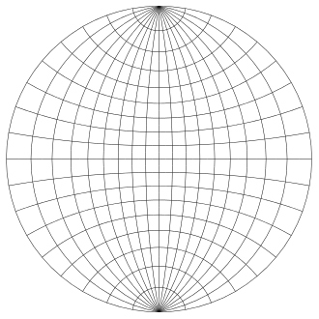
Wulff net or stereonet, used for making plots of the stereographic projection by hand

Slide 13
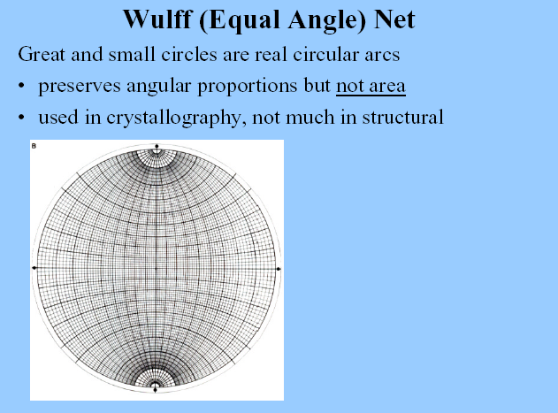

Slide 14
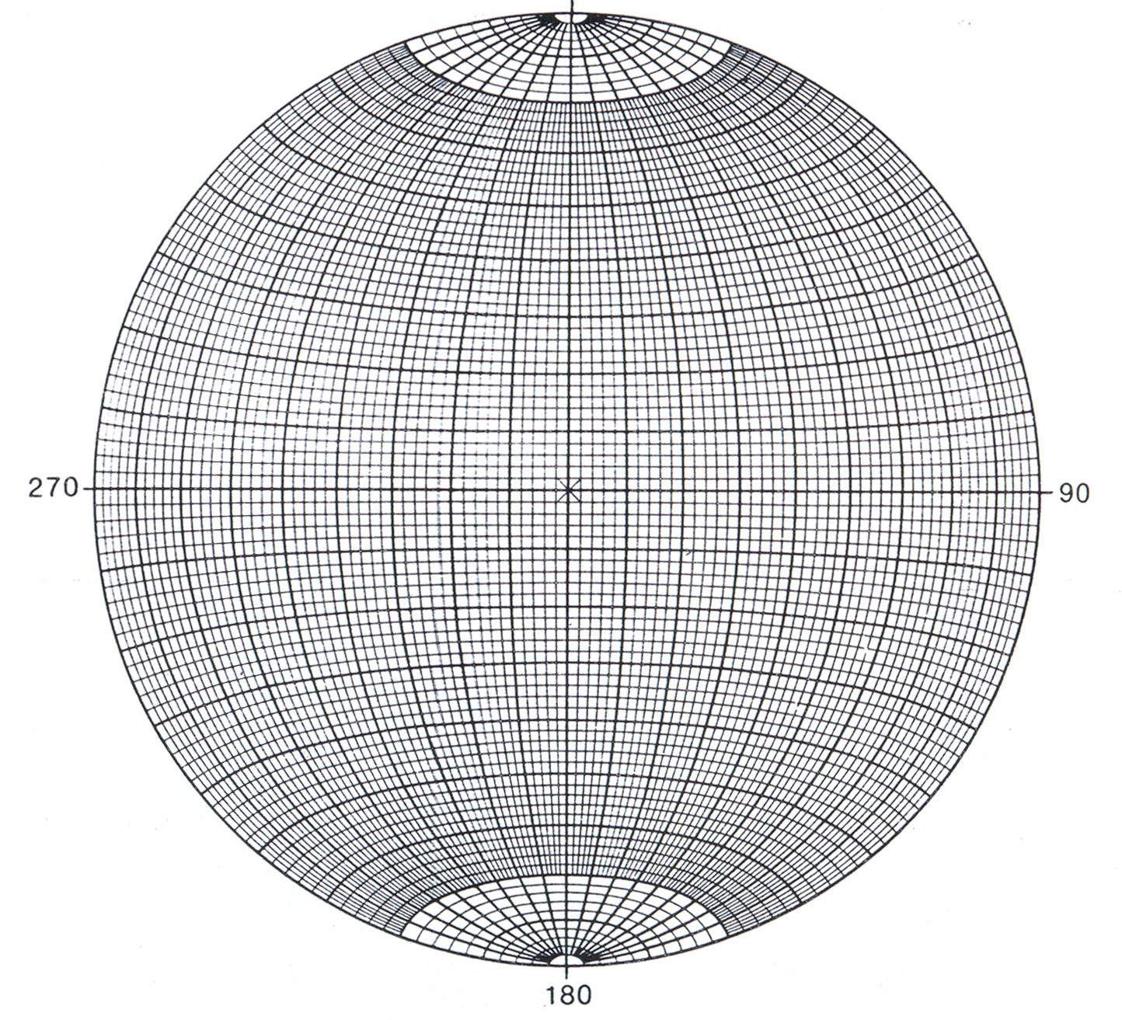
N
360
Schmidt Equal area net

Slide 15
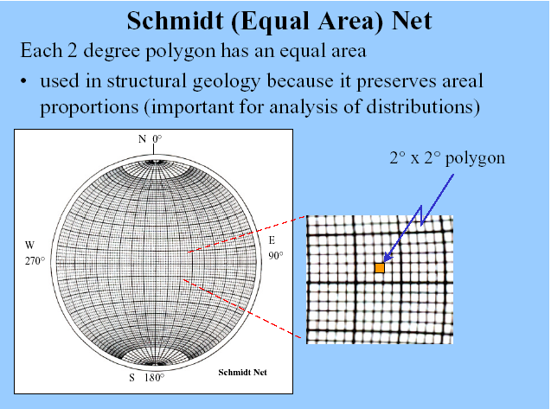

Slide 16
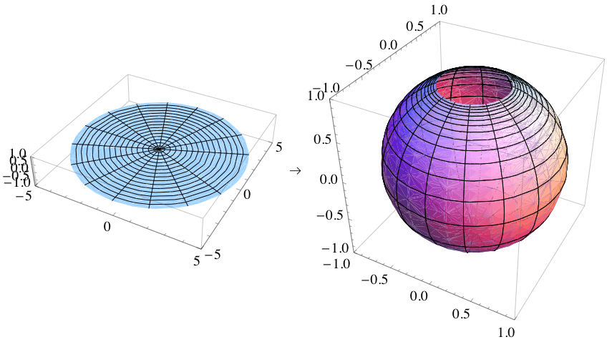

Slide 17
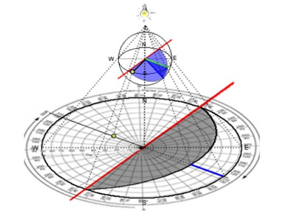

Slide 18
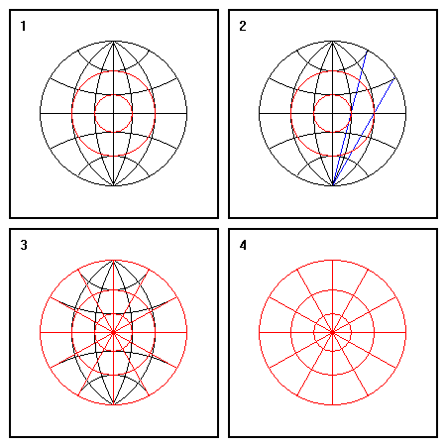
1. Small circles can be constructed using degree markings along the main meridian and equator as guides.
2. In the absence of a stereonet, radii of small circles can be constructed using the definition of the stereographic projection.
3. Great circles are simply radial lines. Construct them using the degrees on the primitive circle, or with a protractor.
4. Final result.

Slide 19
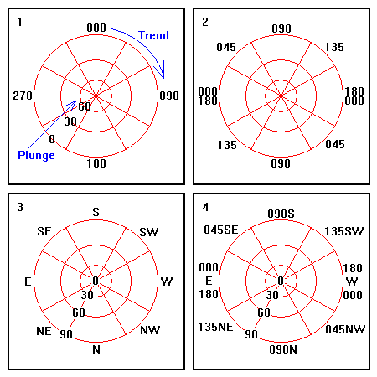

Slide 20
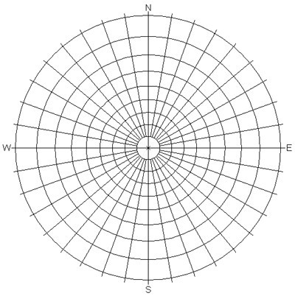

Slide 21
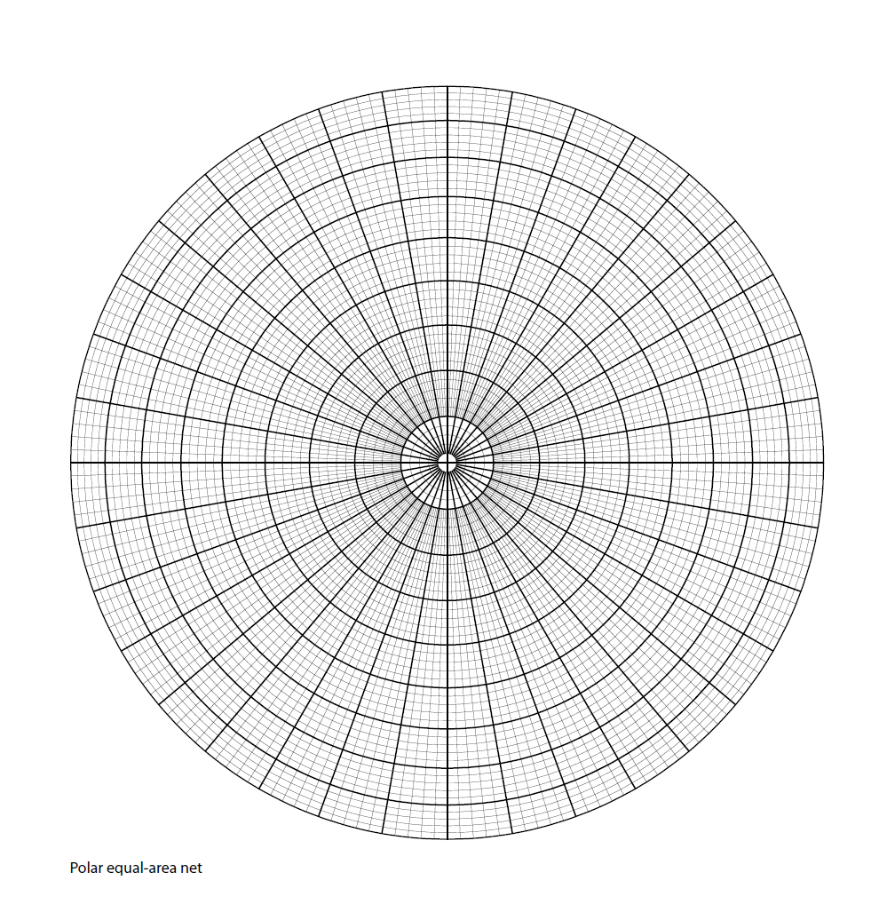

Slide 22
1. A polar stereonet is good for plotting large quantities of trend and plunge data directly. Mark off trends and plunges as shown.
2. A polar stereonet can also be used to plot poles to planes. The trend of a pole is 90 degrees from the strike of the corresponding plane. Strikes of planes are shown here.
3. Dip directions of planes are as shown.
4. A polar stereonet labeled for plotting poles.

Slide 23
Which Net Is Which?

Slide 24
Which Net Is Which?
There is sometimes confusion about the names assigned to different types of azimuthal projections. A stereographic projection is one type of azimuthal projection.
The terms Wulff net or stereonet refer only to grids drawn on a stereographic projection, and a stereogram refers only to a plot of points or curves on a stereographic projection.

Slide 25
An equal-area projection is a second type of azimuthal projection, An equal-area projection is not a stereographic projection.
The term Schmidt net refers to a grid drawn on an equal-area projection, and it is not the a stereonet.
The term stereonet should be used only with respect to a grid on a stereographic projection, and the term equal-area plot should be used for points or curves drawn on an equal-area projection.

Slide 26
In practice, however, geologists tend to use the term stereonet loosely, to refer to either a Wulff net or a Schmidt net.
A question often arises as to when it is appropriate to use a Schmidt net instead of a Wulff net, and vice versa for plotting data.
The Schmidt net must be used in the applications where the concentration of points on the plot are significant; thus, it is particularly applicable for analysis of a large number of measurements.

Slide 27
A Wulff net must be used where angles between structures on the net will be measured with a protractor.
The Schmidt net, therefore, has the most common application for problems in structural geology and is usually the net that geologists carry with them to the field.

Slide 28
Some stereonet facts

Slide 29
In contrast to mineralogy, structural geologists use lower hemisphere plots.
Typically, it is as if you are looking into a hemispheric bowl sitting on the ground, and oriented along a N-S axis.

Slide 30
There are an assortment (range) of different types of stereonets :
    equal angle
    equal area
    Polar
We should know which one we are using and why. One can recognize them by their distinct appearance.

Slide 31
Great circles look like lines of longitude, and represent where planes with a north-south strike but incrementally varying dips intersect the outer hemisphere surface.
Small circles look like lines of latitude, and represent where cones with a north-south horizontal axis and incrementally increasing apical angles intersect the outer hemisphere.

Slide 32
We can plot two types of features on a stereonet:
  a line (e.g. trend and plunge) and
  a plane (e.g. a strike and dip)
A line plots as a point and a plane plots as a great circle.

Slide 33
All elements plotted pass through the center of the hemisphere, and their projection reflects where the plane or line intersects the outer hemispheric surface.
This means that information about relative position is not represented in the plot, only information about relative orientation.

Slide 34
Planes are often represented by plotting their pole, which is the line perpendicular to that plane.
More complex structural features can be represented by plots of multiple elements. Some examples are:
    a) a fault plane, with the direction (line) of movement on it.

Slide 35
  b) a cylindrical fold, often viewed as a great circle distribution of poles to the layering being folded.
  c) a conical fold, often expressed as a small circle distribution of poles to the layering being folded.
  d) an angular unconformity, expressed as the difference between the orientation of the bedding above and below.

Slide 36
e) a population of joints or any other structural feature, often expressed as a data cloud with dispersion around some average value.
You can also use a stereonet to:
  find the intersection between two planes (e.g. the fold axis if folding is cylindrical).
  find the angle between two lines, two planes or a line and a plane.

Slide 37
  c. to find the restored orientation of a geologic feature such as a cross bed once it is rotated about some axis.
  d. bisect the angle between two planes (e.g. if you are trying to model kinematic axes or principal stresses associated with conjugate faults).

Slide 38
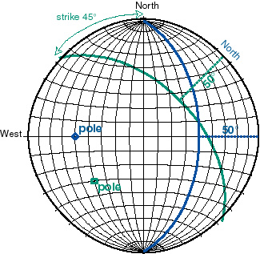

Slide 39
The above diagram shows the same plane in two positions.
The blue plane position is where North has been rotated so that the great circles all have a strike of N45W (315).

Slide 40
In this case the North position is designated in blue. In this position it is easy to trace out the great circle with the appropriate dip, here 50 degrees to the NE.
The green represents the plane's orientation when North is rotated back to its standard top-of-the-stereonet position.

Slide 41
Principles of
stereographic projection

Slide 42
The line or plane to be stereographically represented can be thought of as passing through the center of a reference sphere and intersecting its lower hemisphere (Figure 1.1 A).
Planes intersect the lower hemisphere in the form of great circles; lines intersect the lower hemisphere in points.

Slide 43
This is the plane of stereographic projection. The lower hemisphere intersections are projected as rays upward through the horizontal reference plane to the zenith of the sphere.
Where the rays of projection pass through the horizontal reference plane, point or great-circle intersections are produced, and these are stereo grams or stereographic projections of lines and planes.

Slide 44
Stereographic projection of lines and planes to points and great circles constitutes a systematic reduction of three-dimensional geometry to two dimensions.
The "flattening" to two dimensions is achieved by projecting the lower hemisphere intersections to an equatorial plane of reference that passes through the center of the sphere (Figure 1.1 B).

Slide 45
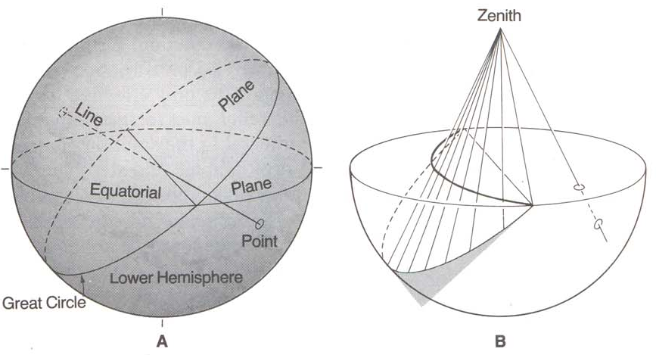
Fig. 1.1. The inherent 3D geometry of stereographic projection. (A) Projection of a plane through the centre of a reference sphere. The plane intersects the lower hemisphere of the reference sphere as a great circle. The line intersects the lower hemisphere as a single point. (B) Projection of intersection points from the lower hemisphere of the reference sphere to the zenith of the projection.

Slide 46
This is the plane of stereographic projection. The lower hemisphere intersections are projected as rays upward through the horizontal reference plane to the zenith of the sphere.
Where the rays of projection pass through the horizontal reference plane, point or great-circle intersections are produced, and these are stereograms or stereographic projections of lines and planes.

Slide 47
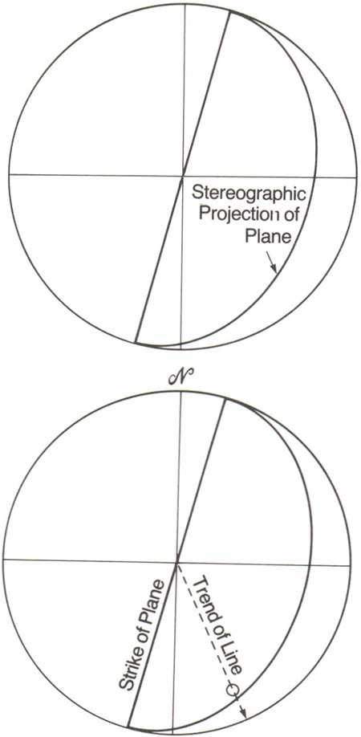
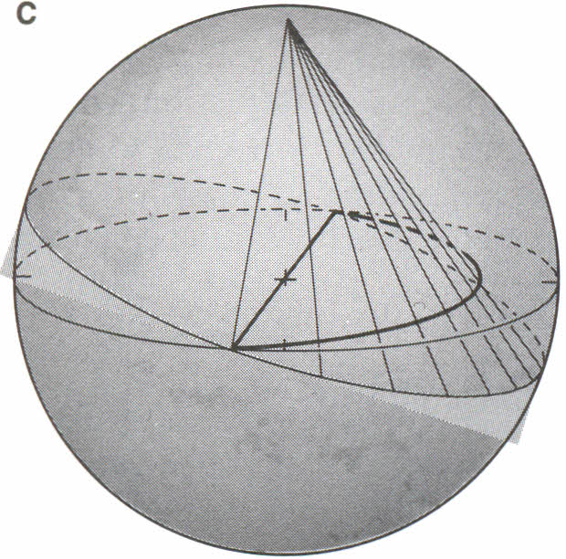
Stereographic projection of a gently dipping plane

Slide 48
Steep-plunging lines stereographically project to locations close to the center of the horizontal plane of projection;
whereas shallow-plunging lines project to locations near the perimeter of the plane of projection (Figure 1.2 A).

Slide 49
Steeply dipping planes stereographically project as great circles that pass near the center of the plane of projection.
Gently dipping planes project as great circles passing close to the perimeter of the horizontal plane of projection (Figure1.2 B).

Slide 50
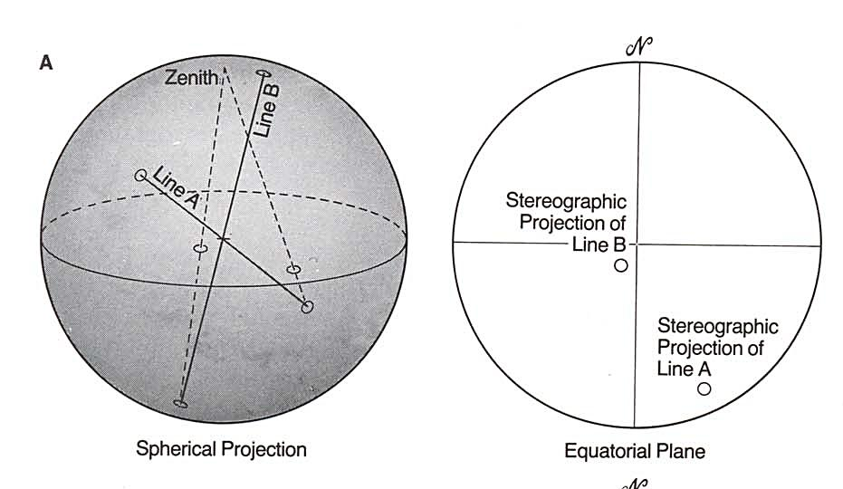
Fig. 1.2: the distance that a great circle or point lies from the centre of the equatorial plane of projection is a measure of the inclination of a plane or line. (A) Shallow plunging lines project close to the perimeter of the equatorial plane; steeply plunging lines project close to the centre. (B) great circles that represent the rientation of steeply dipping planes pass close to the centre of projection; shallow dipping planes are represented by great circles that pass close to the perimeter of the equatorial plane. © Stereographic representation of the strike of a plane and the trend of a line.

Slide 51
The distance that a great circle or point departs from the center of the plane of projection is a measure of the degree of inclination of the plane or line that has been stereographically plotted.
The trend of the line connecting the end points of the great circle corresponds to the strike of the plane that the great circle stereographically portrays (Figure1.2 C).

Slide 52
And the trend of a line connecting the center of the stereographic projection to a point representing a stereographically plotted line is the same as the trend of the line in space (Figure1.2C).

Slide 53
Stereographic Net or Stereonet
In actual practice, stereographic projection of lines and plane is carried out through the use of a stereographic net, or stereonet for short (Figure 1.3).
A stereonet displays a network of great-circle and small-circle projections that occupy the equatorial plane of projection of the reference sphere.

Slide 54
Both the great circles and small circles are spaced at 2° intervals; every fifth one is darkened so that 10° intervals can be readily counted.
The great circles represent a family of planes of common strike whose dips range from 0° to 90°. The planes intersect in a horizontal line represented by the north-south line of the net.

Slide 55
The small circles may be thought of as the paths along which lines would move when rotated about a horizontal axis oriented parallel to the ordinate of the net.
The combination of small and great circles constitutes an orientation framework for stereographically plotting lines and planes.

Slide 56
The distance that a great circle or point departs from the center of the plane of projection is a measure of the degree of inclination of the plane or line that has been stereographically plotted.
The trend of the line connecting the end points of the great· circle corresponds to the strike of the plane that the great circle stereographically portrays (Figure1.2 C).

Slide 57
And the trend of a line connecting the center of the stereographic projection to a point representing a stereographically plotted line is the same as the trend of the line in space (Figure1.2C).

Slide 58
The use of stereographic projection is preferable to orthographic projection in solving many geometric problems, simply because of ease of operations.
Solving for apparent dip, the trend and plunge of the intersection of two planes, and angles between lines and planes in space can be carried out rapidly and accurately using stereographic projection.

Slide 59
Orthographic projection, in contrast, requires the slow, careful construction of line drawings.
But, orthographic projection remains the only effective way to solve geometric problems when topographic relief, map relationships, and depth to structures in the subsurface are integral to the solution of structural problems.

Slide 60
In practice, we combine orthographic and stereographic projection techniques in ways that are practical, efficient, and complementary.

Slide 61
Construction of a stereonet

Slide 62
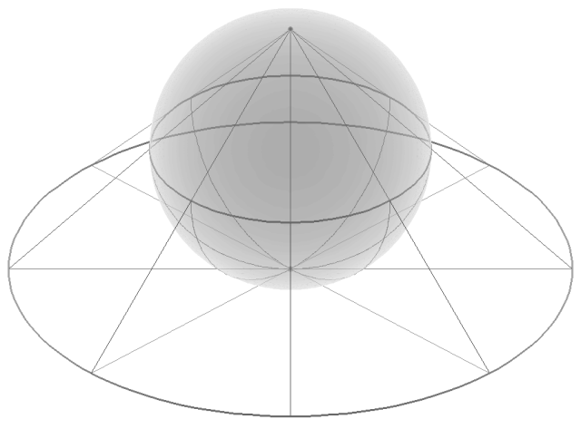

Slide 63
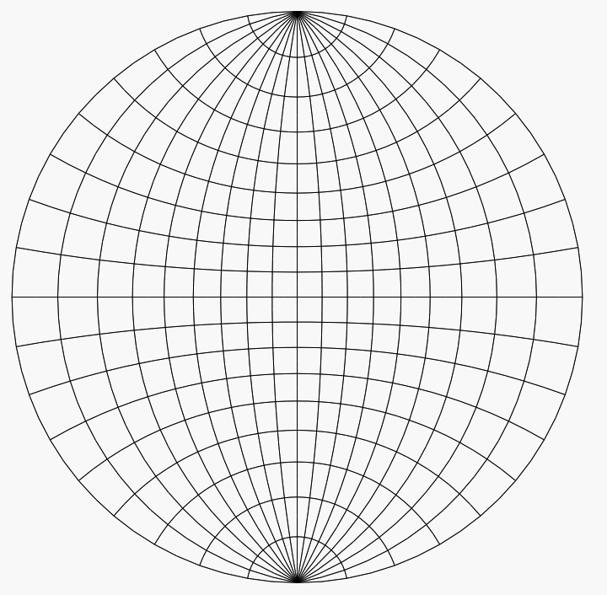
Stereonet or Wulff net

Slide 64
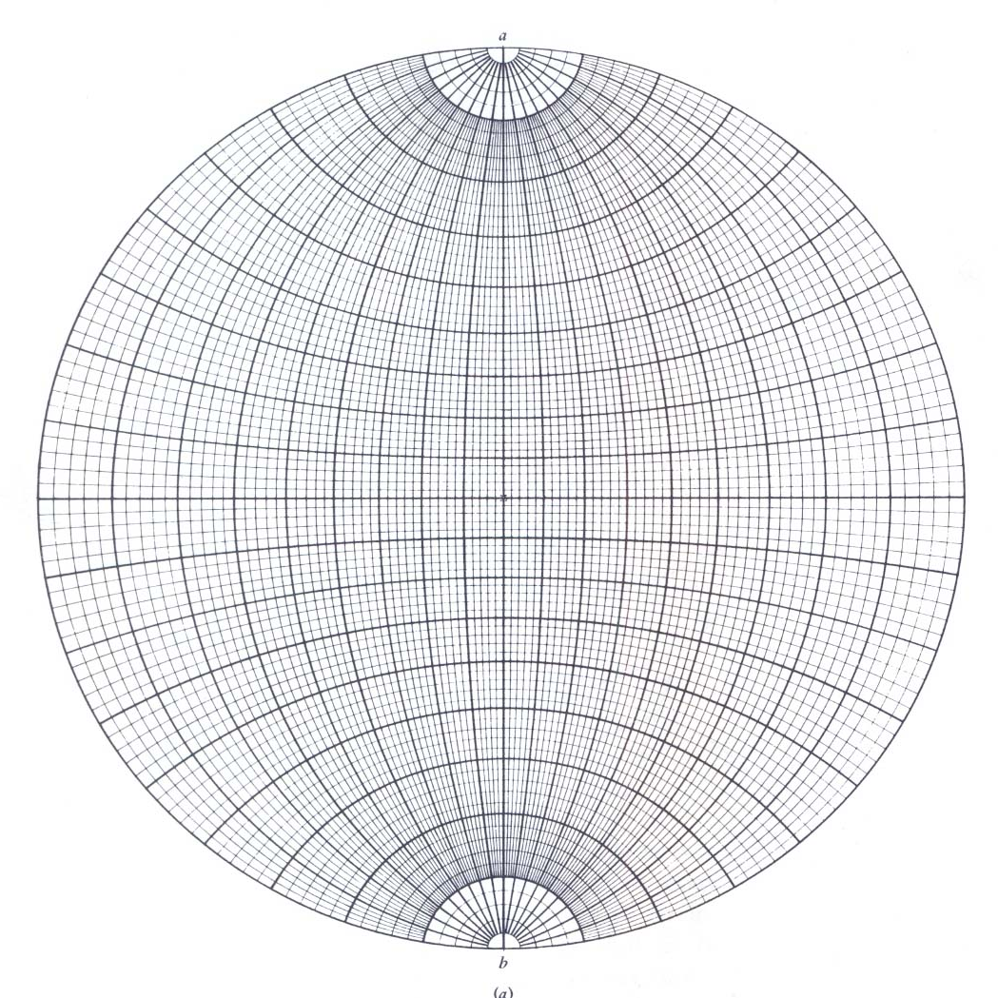
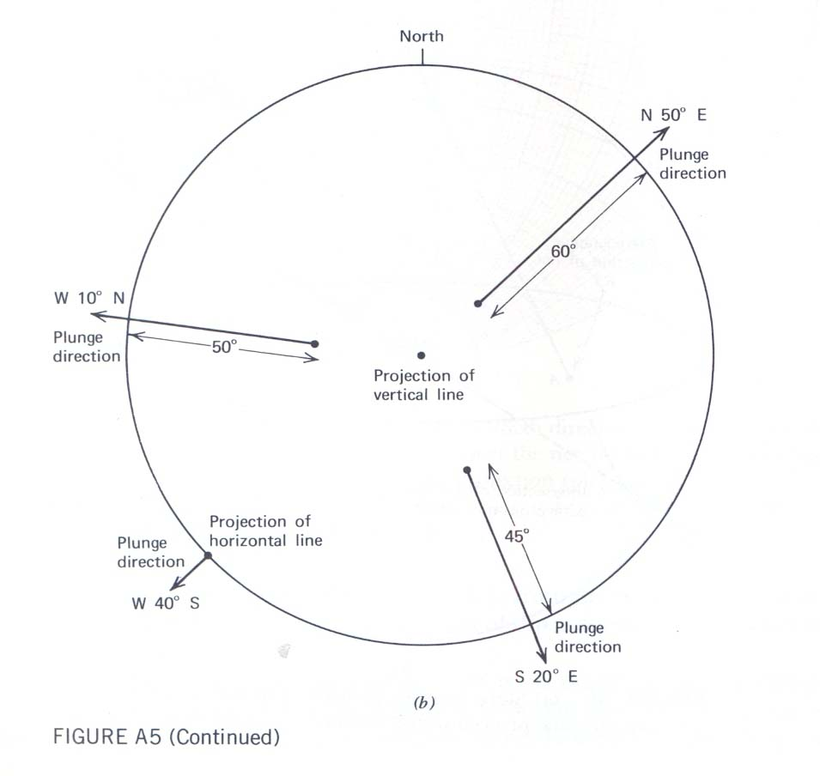
Stereonet or Wulff net

Slide 65
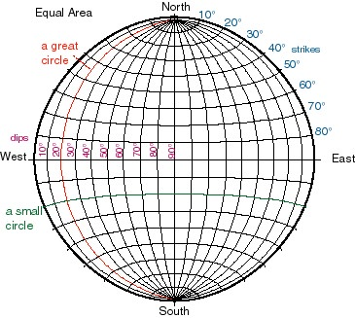

Slide 66
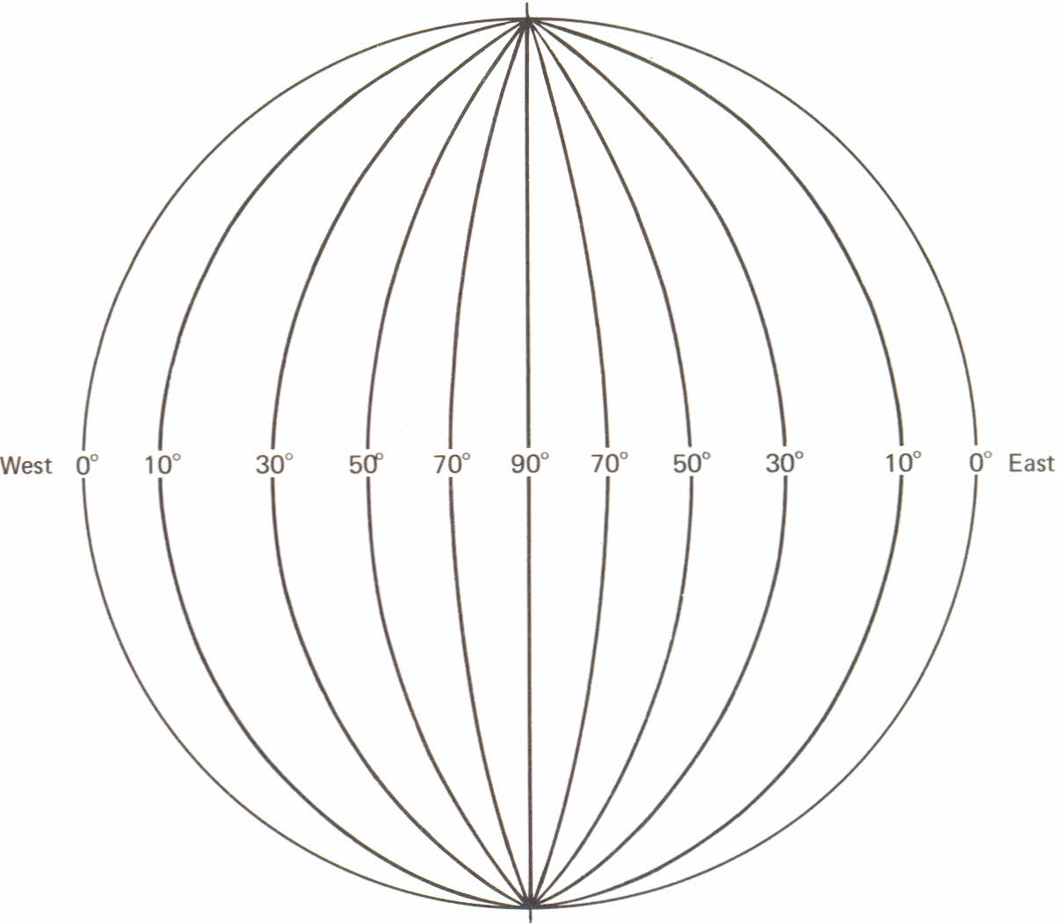

Slide 67
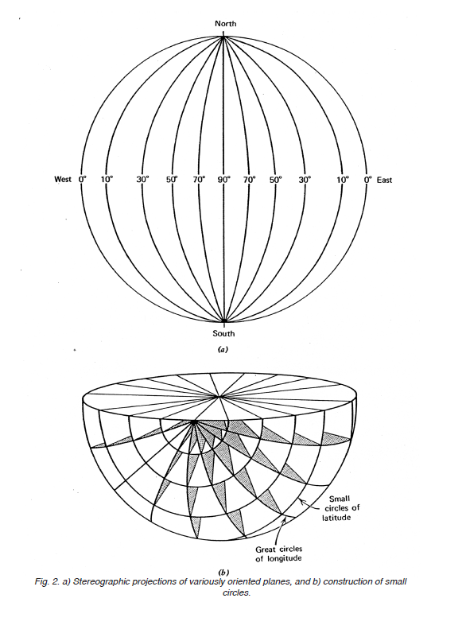

Slide 68
Great circles: It is the intersection of the surface of a sphere with a plane that passes through the center of the sphere (e.g., lines of longitude)
It look like lines of longitude, and represent where planes with a north-south strike but incrementally varying dips intersect the outer hemisphere surface.

Slide 69
Small circle:
It is the intersection of the surface of a sphere with a plane that does not pass through the center of the sphere (e.g., lines of latitude). A line rotated about an axis traces a small circle too.
It look like lines of latitude, and represent
where cones with a north-south horizontal
axis and incrementally increasing apical
angles intersect the outer hemisphere.

Slide 70
The numbers in the upper right quadrant represent potential strike line positions from 10-80 degree, in 10 degree increments.
Small circles represent half of a conical surfaces with the apex at hemisphere center. They are hemisphere surface paths from one line being rotated about another line (the pole of rotation), both passing through the hemisphere center.

Slide 71
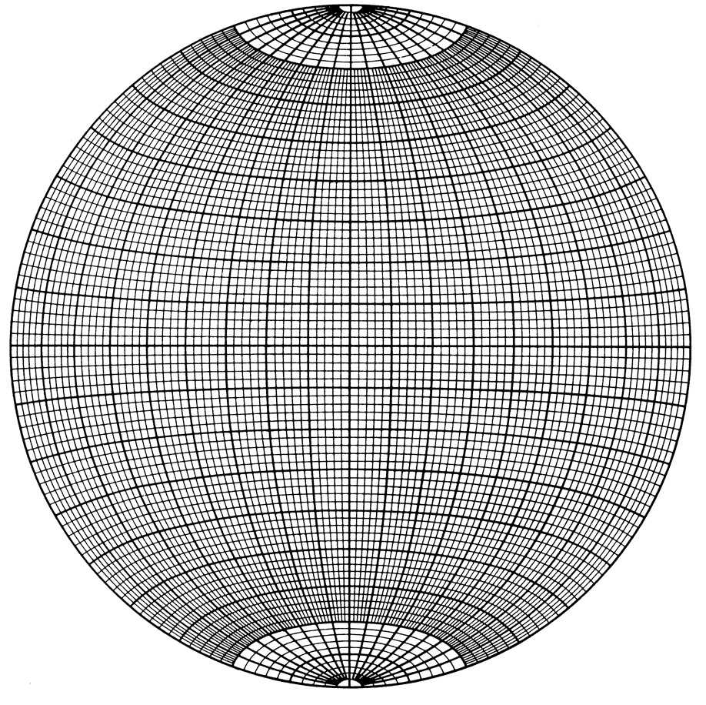
Equatorial circle = Primitive circle horizontal plane
Straight lines = vertical planes
0
20
40
60
80
80
60
40
20
0
Dip angles
Great circles = inclined planes
Notes:
71

Slide 72
Small circles
(Look like LATITUDES)
Great circles
(Look like LONGITUDES)
Notes:
72

Slide 73
N
20
40
Small circles = Paths of inclined lines around the N-S axis
60
80
W
E
S
Notes:
73

Slide 74
Equatorial circle = Primitive circle horizontal plane
Straight lines = vertical planes
0
20
40
60
80
80
60
40
20
0
Dip angles
Great circles = inclined planes
Notes:
74

Slide 75
We can plot two types of features on a stereonet,
    a line (e.g. trend and plunge) and
    a plane (e.g. a strike and dip).
A line plots as a point and a plane plots as a great circle.

Slide 76
All elements (lines or planes) plotted pass (stereographically) represented through the center of the hemisphere (the center of a reference sphere), and their projection reflects where the plane or line intersects the outer (intersecting lower hemisphere) (Figure 1.1 A).
Planes intersect the lower hemisphere in the form of great circles; lines intersect the lower hemisphere in points.

Slide 77
This means that information about relative position is not represented in the plot, only information about relative orientation (angle).
Planes are often represented by plotting their pole, which is the line perpendicular to that plane.

Slide 78
All the preceding operations would be simple if it were possible to assemble real lines and planes in space, like Tinker toys, and measure their geometric properties directly.
Using stereographic projection techniques, we figuratively assemble lines and planes within a reference sphere.

Slide 80
Stereographic projection of lines and planes to points and great circles constitutes a systematic reduction of three-dimensional geometry to two dimensions.
The "flattening" to two dimensions is achieved by projecting the lower hemisphere intersections to an equatorial plane of reference that passes through the center of the sphere (Figure 1.1 B).

Slide 81
Stereographic projection of planes

Slide 82
Fig. 1.1. The inherent 3D geometry of stereographic projection. (A) Projection of a plane through the centre of a reference sphere. The plane intersects the lower hemisphere of the reference sphere as a great circle. The line intersects the lower hemisphere as a single point. (B) Projection of intersection points from the lower hemisphere of the reference sphere to the zenith of the projection.

Slide 83
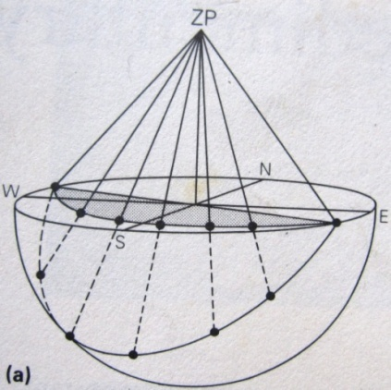

Slide 84
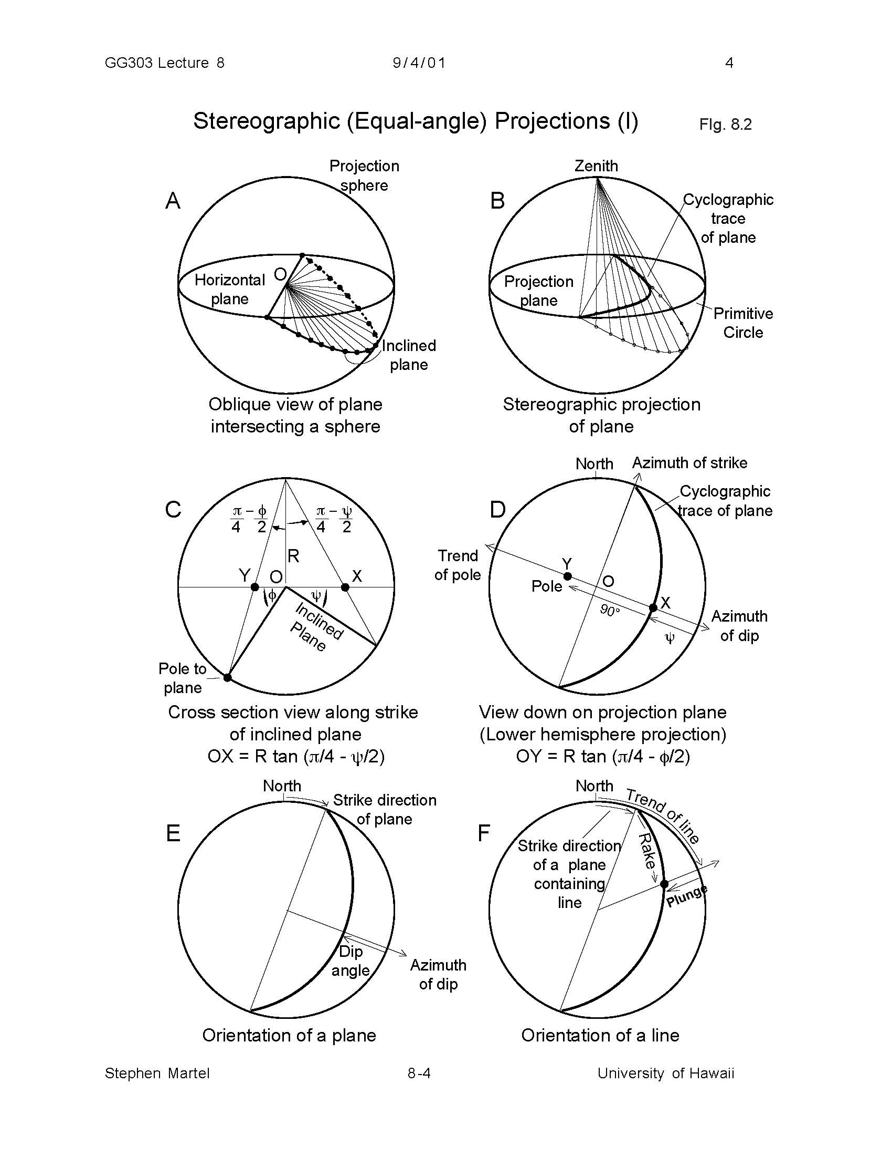
Principles of stereographic projection

Slide 86
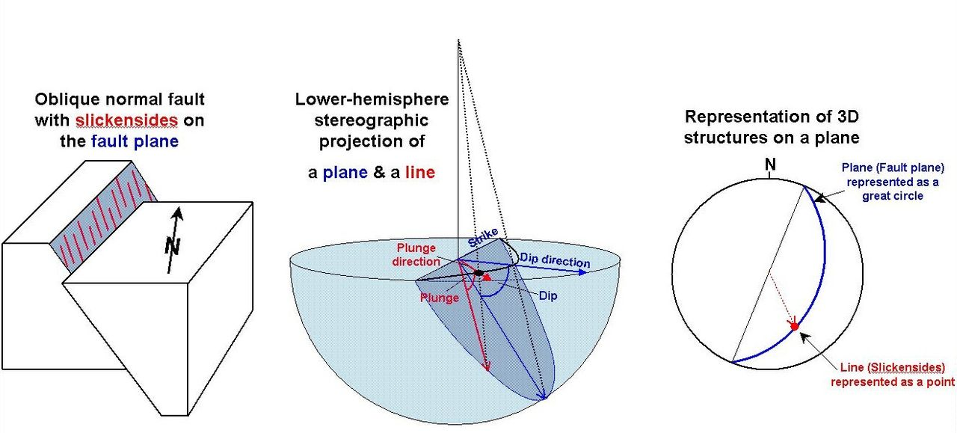

Slide 87
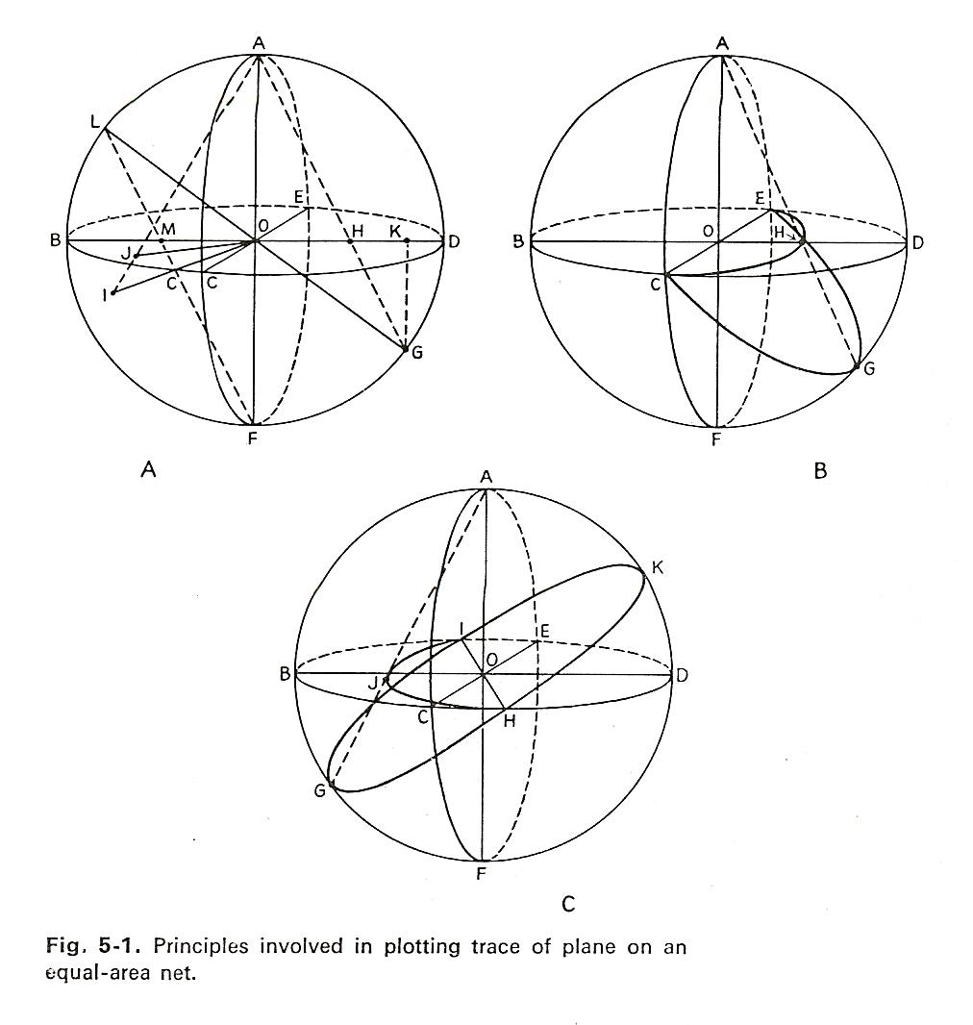

Slide 89
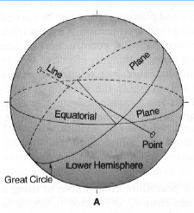
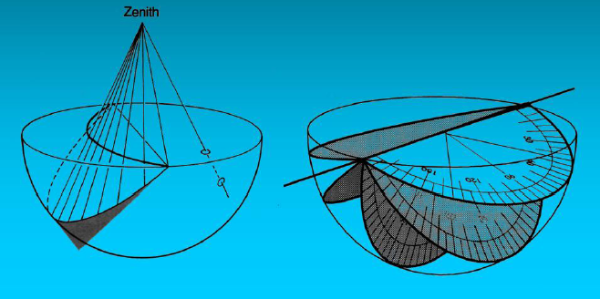
Sterionet projection of 3-D structural data
Sterionet projection of a plane

Slide 90
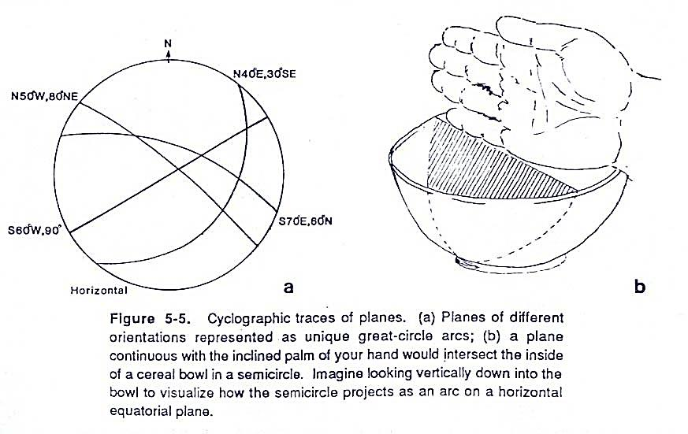

Slide 91
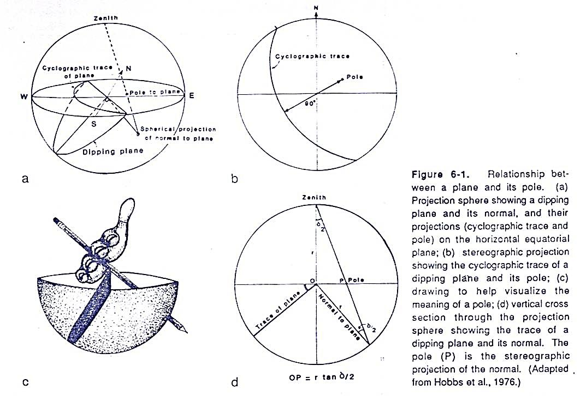

Slide 92
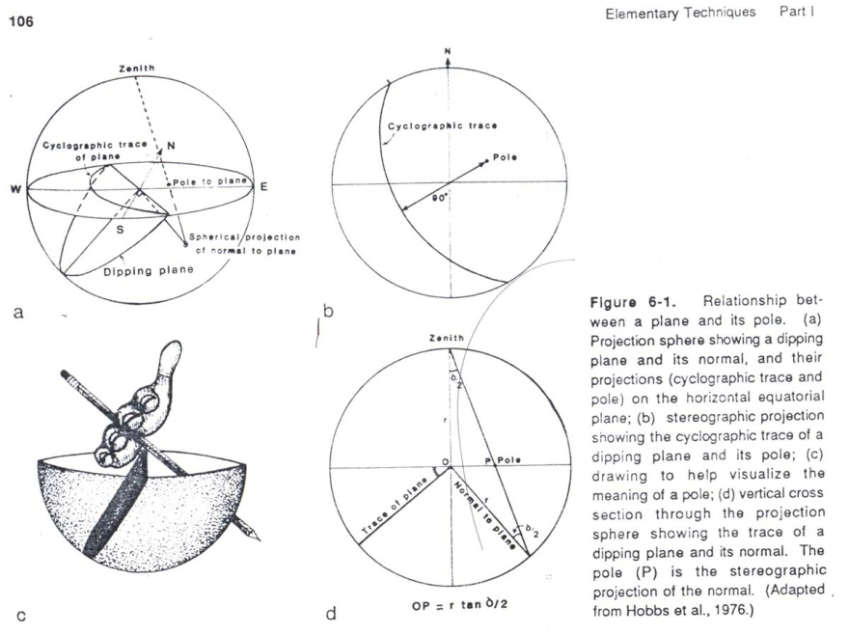

Slide 93
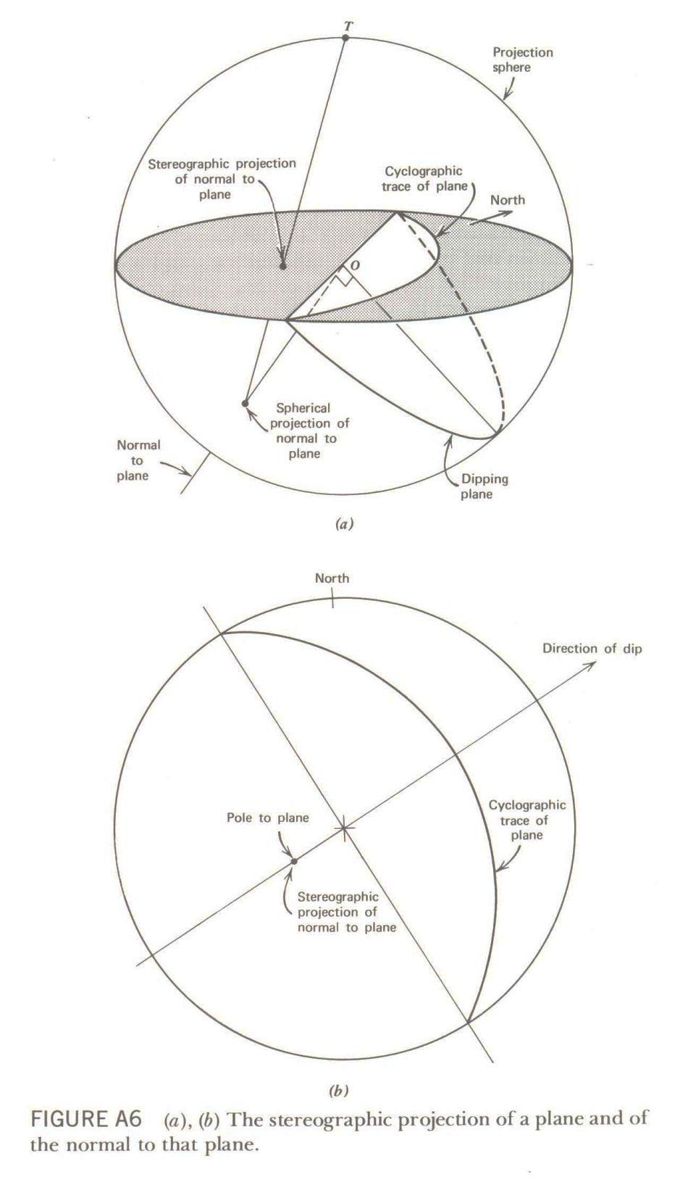
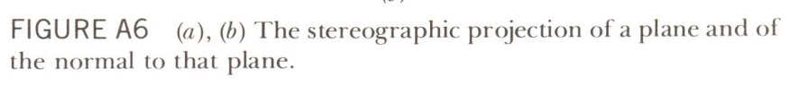

Slide 94
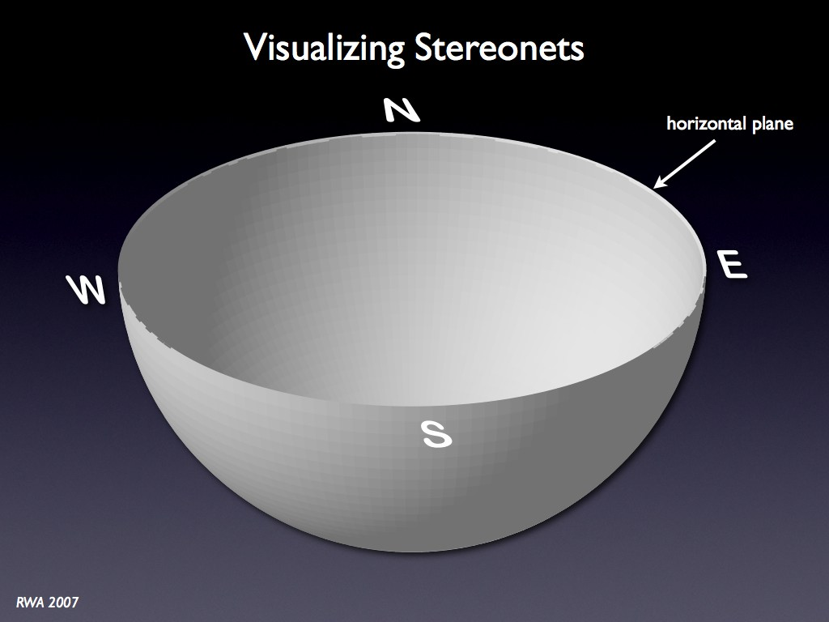

Slide 95
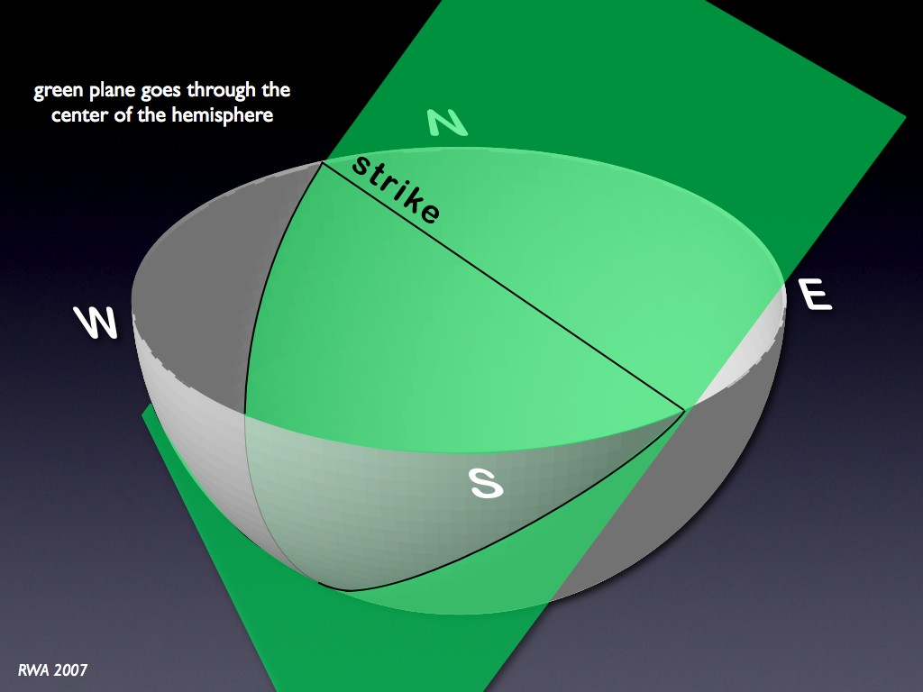

Slide 96
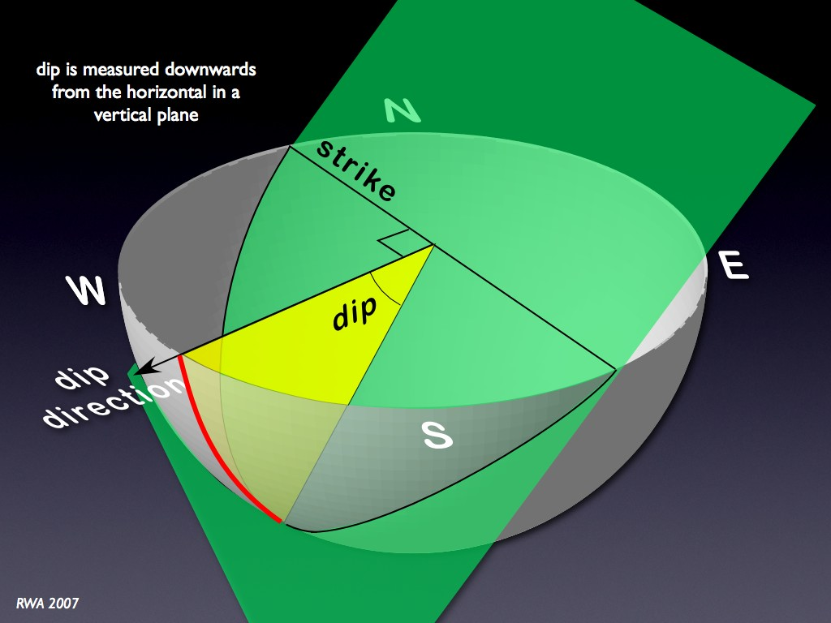

Slide 97
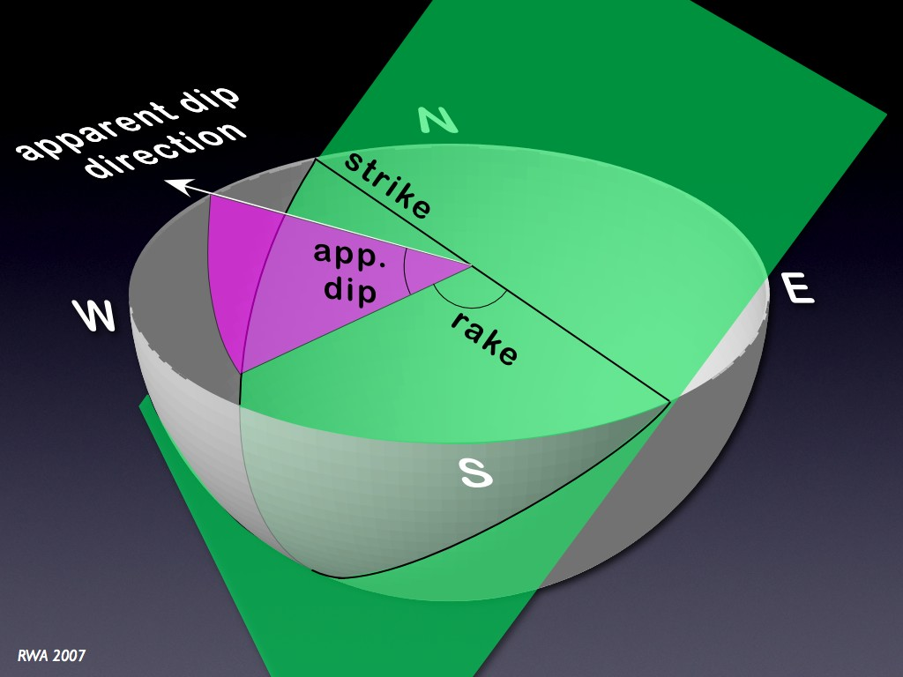

Slide 98
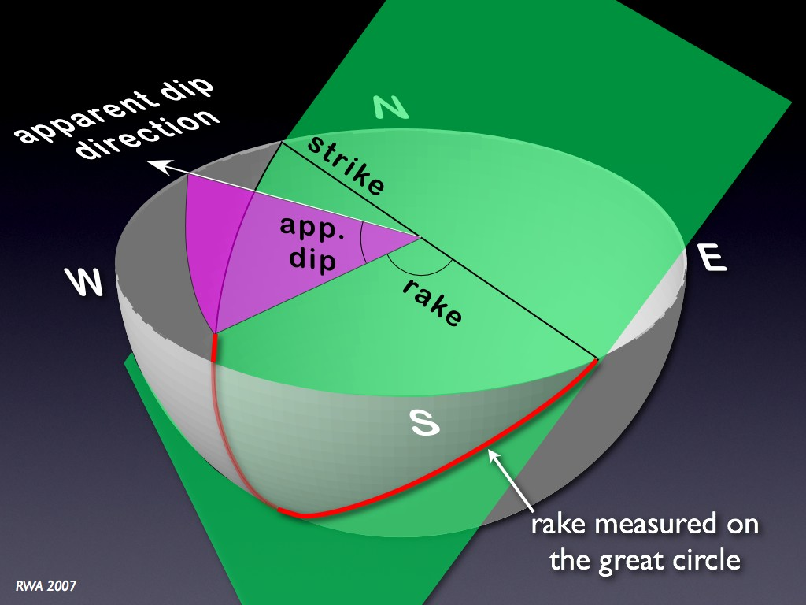

Slide 99
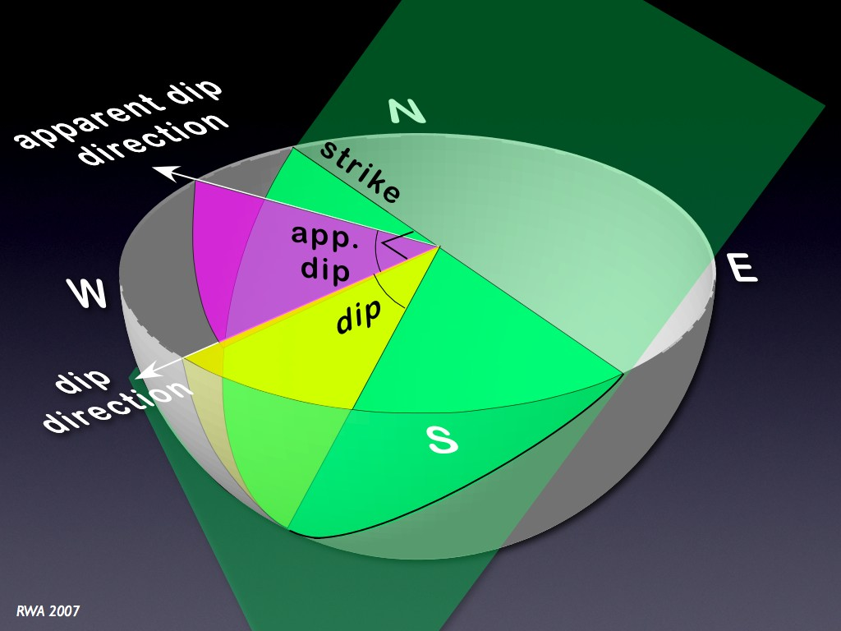

Slide 100
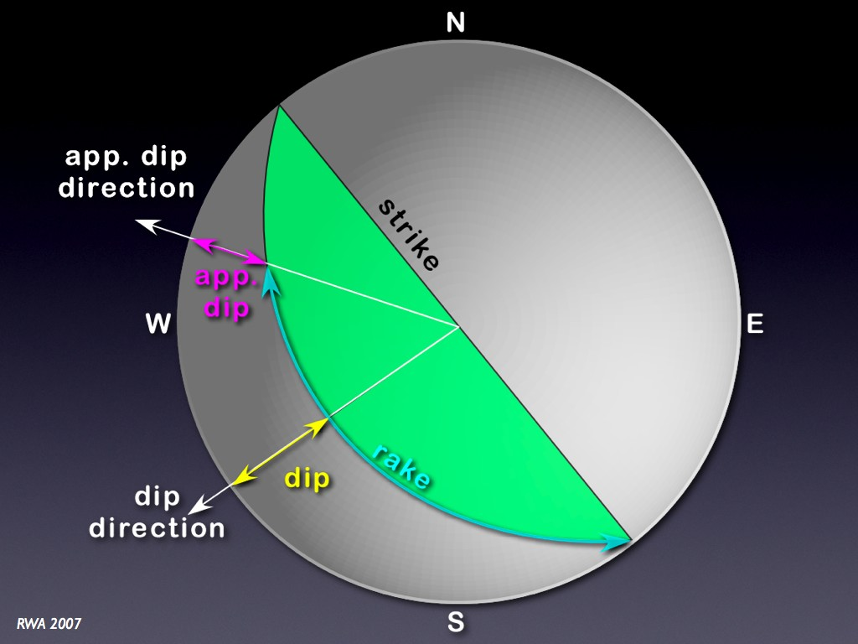

Slide 101
This is the plane of stereographic projection. The lower hemisphere intersections are projected as rays upward through the horizontal reference plane to the zenith of the sphere.
Where the rays of projection pass through the horizontal reference plane, point or great-circle intersections are produced, and these are stereograms or stereographic projections of lines and planes.

Slide 102
Steeply dipping planes stereographically project as great circles that pass near the center of the plane of projection.
Gently dipping planes project as great circles passing close to the perimeter of the horizontal plane of projection (Figure1.2 B).

Slide 103
The distance that a great circle or point departs from the center of the plane of projection is a measure of the degree of inclination of the plane or line that has been stereographically plotted.
The trend of the line connecting the end points of the great· circle corresponds to the strike of the plane that the great circle stereographically portrays (Figure1.2 C).

Slide 104
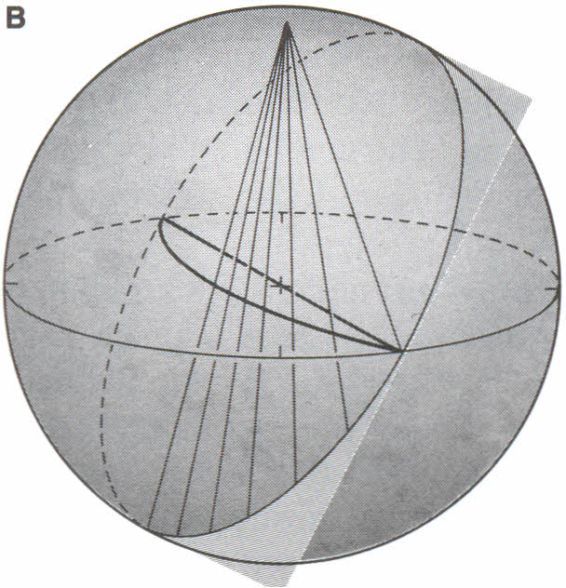
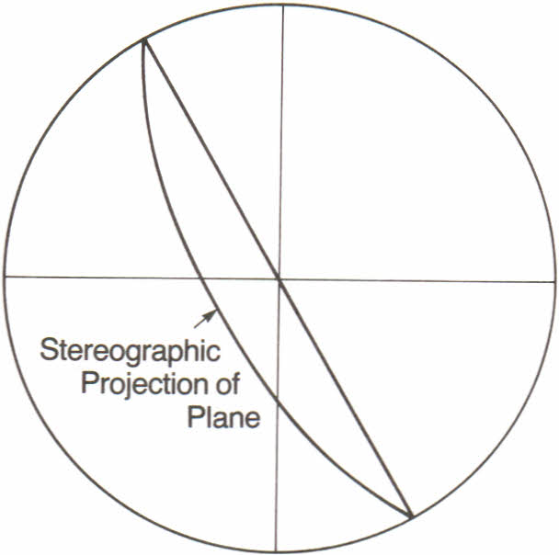
N
Stereographic projection of a steeply dipping plane

Slide 105
Stereographic projection of a gently dipping plane

Slide 106
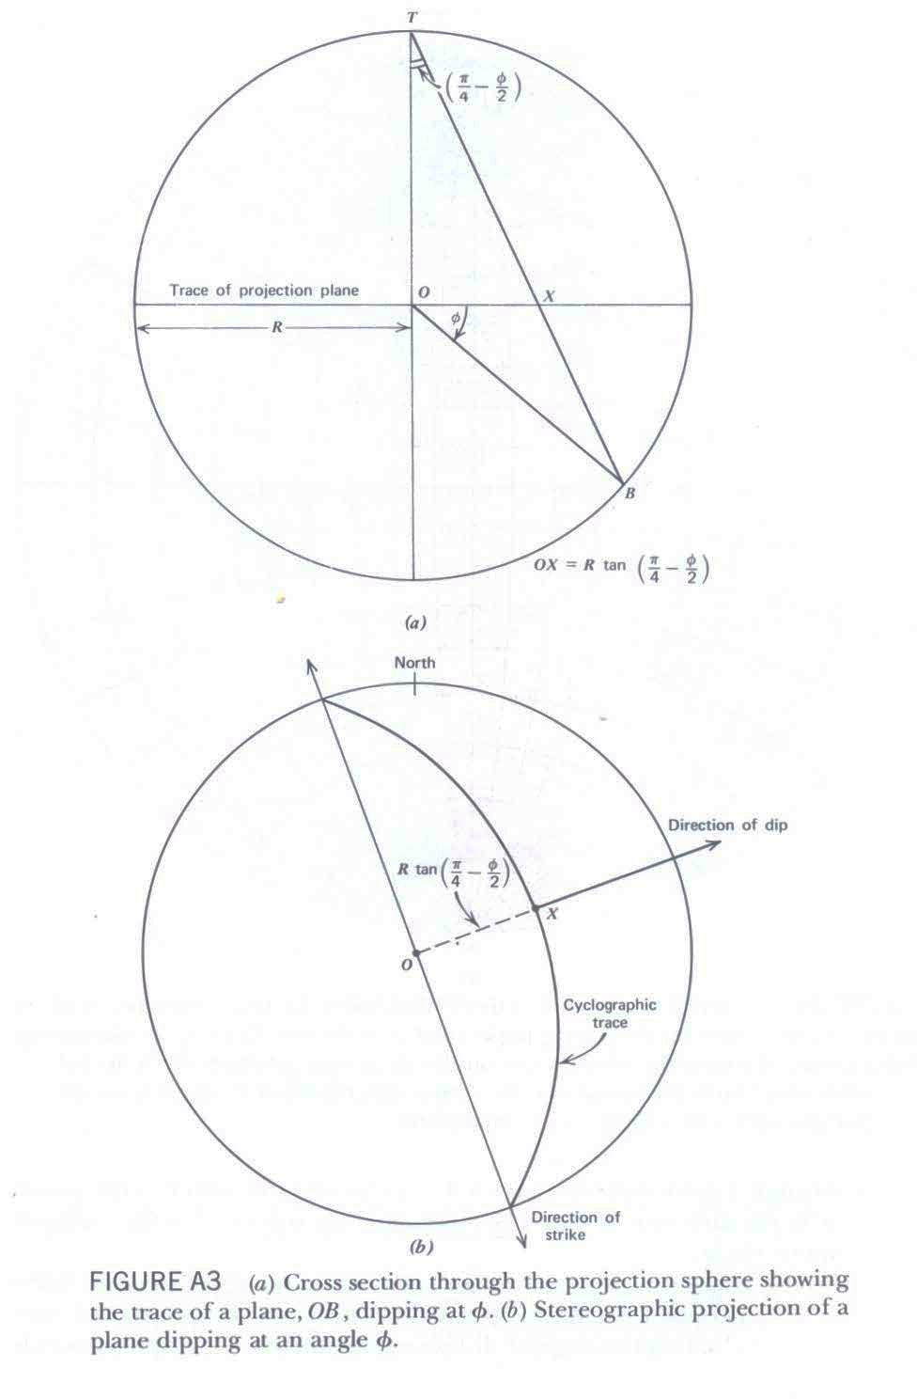

Slide 107
Stereographic projection of lines

Slide 108
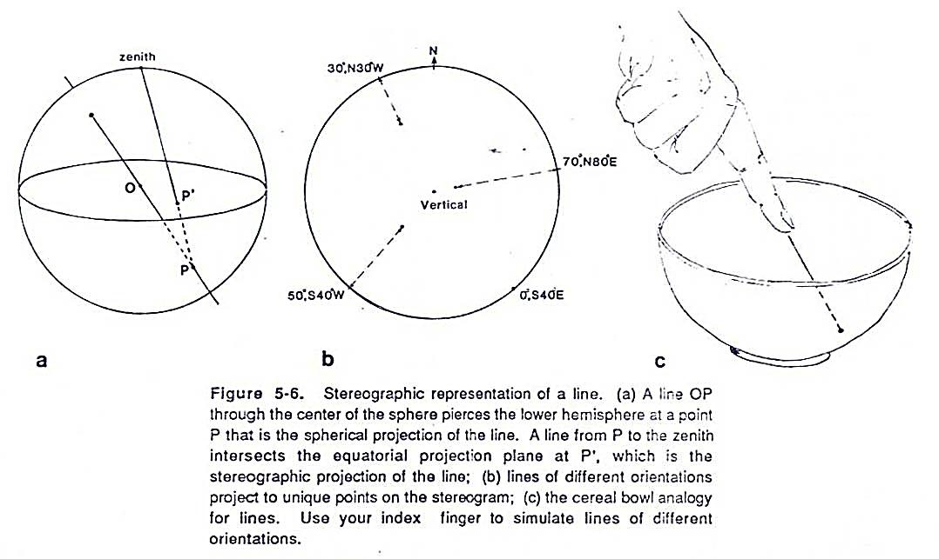

Slide 109
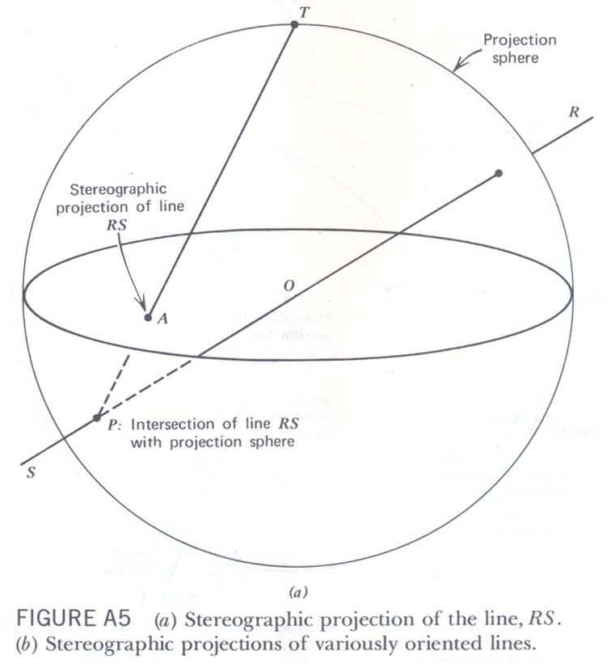

Slide 110
Fig. 1.2: the distance that a great circle or point lies from the centre of the equatorial plane of projection is a measure of the inclination of a plane or line. (A) Shallow plunging lines project close to the perimeter of the equatorial plane; steeply plunging lines project close to the centre. (B) great circles that represent the rientation of steeply dipping planes pass close to the centre of projection; shallow dipping planes are represented by great circles that pass close to the perimeter of the equatorial plane. © Stereographic representation of the strike of a plane and the trend of a line.

Slide 111
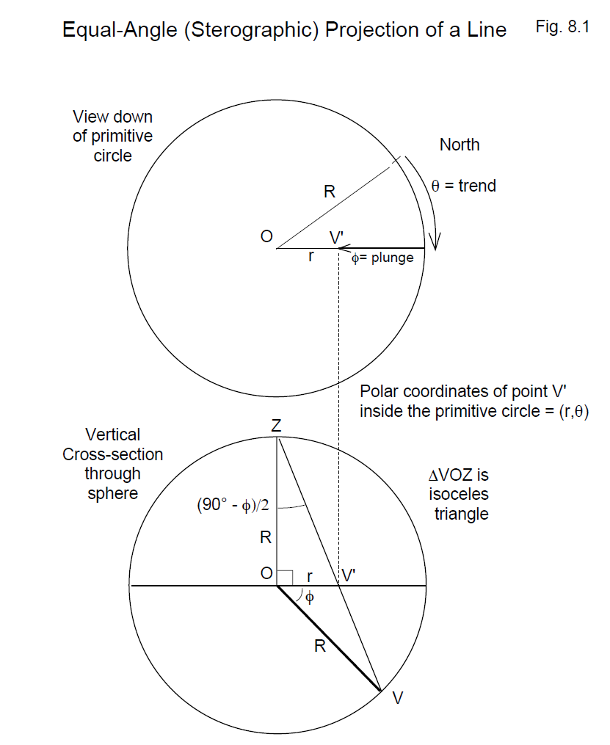

Slide 112
Steep-plunging lines stereographically project to locations close to the center of the horizontal plane of projection;
whereas shallow-plunging lines project to locations near the perimeter of the plane of projection (Figure 1.2 A).

Slide 113
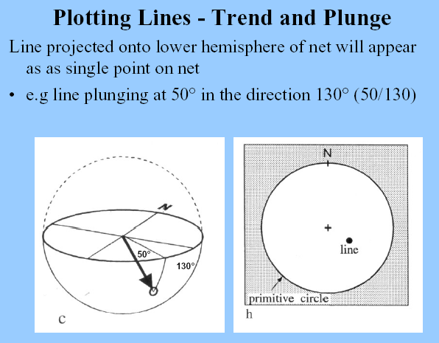

Slide 114
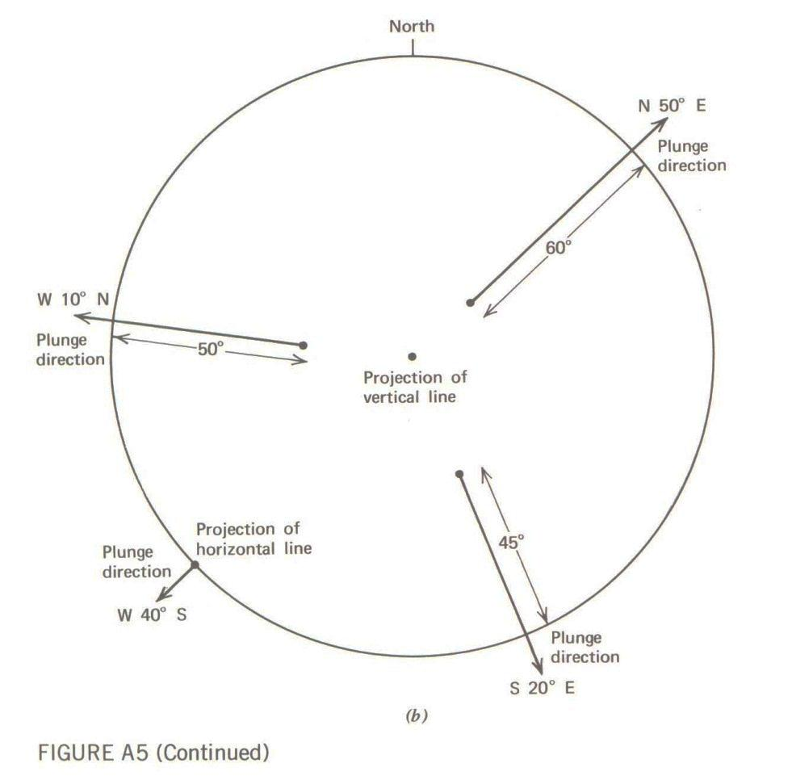

Slide 115
Representation of lines and planes in a stereonet

Slide 116
Preparing Stereo net for use

Slide 117
To prepare the Schmidt net for use, tape or glue it to a heavy backing, such as cardboard or Masonite. Insert a thumbtack through the backing and through the exact center of the net, taping the tack to the underside of the net so it cannot fall free (Figure1.4).
A sheet of tracing paper is placed on the net so that the paper, punctured by the thumbtack, can rotate about the tack.

Slide 118
A small square of clear tape applied to the back of the tracing paper, covering the area where the thumb tack will go through, prevents the paper from ripping during plotting.

Slide 119
All construction work is carried out on the tracing paper, which is oriented with respect to north by marking a north index at a point corresponding to the top of the north-south line.
This geographically orients the overlay for the constructions to be carried out.

Slide 120
Plotting the Trend and Plunge of a Line and
Strike and Dip of a Plane

Slide 121
Plotting the Trend and Plunge of a Line
Before any problems can be solved stereographically, it is necessary to learn how to represent the orientations of lines and planes on a stereonet.
Lines are easiest to plot.

Slide 122
Consider a line that plunges 26° N400E.
To represent the trend and plunge of this line stereographically, first plot the trend, in degrees, on the outer perimeter of the stereographic net).

Slide 123
The point representing a line plots away from the center of the spherical plot in the direction of the trend of the line.
The trend of a line is measured along a horizontal great circle.
The plunge of the line is measured along a vertical great circle by counting down from the horizontal plane.

Slide 124
To do this, measure east from north by 40° (Figure 1.5A). This can be accomplished simply by using the stereographic net as you would a protractor, counting clockwise from the north index on the tracing paper along the periphery of the net to 40°.
The 40° azimuth corresponds to the 40° small circle intercept on the perimeter of the net. Mark the point at 40° with a trend-index mark (t) (Figure1.5A)

Slide 126
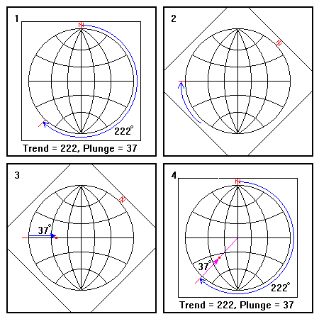
LINE

Slide 127


Slide 128


Slide 129
To plot the 26° plunge, first rotate the overlay clockwise until it comes to rest on the right end of the east-west line of the net (Figure 1.5B). This is one of two lines (the N-S axis being the other) where inclination can be directly measured and plotted.
The plunge is measured by counting 26° from the perimeter of the net along the east-west line toward the centre of the net. Point L represents the 26° plunging line (fig. 1.5B)

Slide 130


Slide 133
Plotting the Trend and Plunge
of a Line

Slide 135
LINE

Slide 136
Plotting the Trend and Plunge
of a Plane

Slide 137


Slide 138

PLANE

Slide 139


Slide 141
Intersecting Planes

Slide 142


Slide 143


Slide 144

Intersecting planes

Slide 145


Slide 146


Slide 147


Slide 148


Slide 149
Stereographic projections of
folded surfaces

Slide 150


Slide 152


Slide 153


Slide 157


Slide 160


Slide 161


Slide 162


Slide 164


Slide 165


Slide 166


Slide 167


Slide 168
Thank You

Slide 169
Hints on using
Allmendinger's software

Slide 170
Make sure you set your data format first (Data -> Set Data Format) before you enter data.
Save your entered data file so you can replot it if necessary.
In order to plot poles to planes, you need to have the program calculate them first (Operations -> Poles).

Slide 171
To contour data use the standard 1% option (Plot -> 1% Area Contour), but you can also do the Kamb plot for comparisons sakes.
You can ask the computer for a statistically computed great circle girdle estimate or the average orientation for a simple bullseye population (Plot -> Cylindrical Best Fit or Plot Mean Vector).
You can also visually pick your own girdle by using Plot -> Pick Great Circle.

Slide 172
You can't print plots directly from the program. You need to save the plot (it will be in a vector based Mac format known as pict), and then open it in Adobe Photoshop or Illustrator, or some other program, and plot it from there.
At this stage you can also label and alter the image.

Slide 173
Readings from pre-Pennsylvanian strata near Turner falls Oklahoma
This data uses the right hand rule (ask if you are unfamiliar).
270 | 20 | 280 | 72 | 330 | 34 | 320 | 60 | 274 | 74
334 | 15 | 278 | 32 | 315 | 60 | 315 | 32 | 245 | 1
270 | 80 | 275 | 82 | 304 | 70 | 310 | 66 | 285 | 10
280 | 78 | 271 | 81 | 330 | 32 | 286 | 70 | 305 | 68
270 | 15 | 276 | 74 | 278 | 83 | 298 | 64 | 320 | 48
270 | 32 | 300 | 12 | 278 | 78 | 345 | 20 | 312 | 58
270 | 75 | 282 | 14 | 296 | 12 | 275 | 78 | 315 | 65
307 | 46 | 316 | 74 | 316 | 38 | 245 | 10 | 286 | 70
296 | 64 | 326 | 60 | 292 | 42 | 312 | 64 | 300 | 80
315 | 60 | 301 | 4 | 300 | 62 | 276 | 78 | 335 | 32
345 | 35
314 | 15
275 | 82
264 | 80
266 | 4
292 | 80
280 | 68
245 | 10
292 | 42
284 | 20
300 | 14
282 | 14
326 | 60
330 | 30
300 | 72
335 | 32
278 | 83
276 | 78
328 | 38
292 | 42
320 | 60
291 | 74
276 | 78
264 | 82
245 | 10
330 | 30
312 | 64
286 | 70
330 | 32
240 | 18
286 | 70
330 | 32
278 | 32
296 | 72
252 | 22
264 | 70
218 | 30
216 | 68
266 | 40
266 | 6
298 | 60
270 | 19
124 | 67
207 | 6
266 | 6
266 | 40
220 | 38
266 | 40
201 | 38
252 | 22
216 | 32
215 | 20
234 | 14
248 | 68
120 | 40
90 | 20
90 | 28
90 | 30
80 | 44
74 | 40
42 | 25
28 | 40
100 | 72
120 | 26
92 | 22
10 | 45
20 | 40
30 | 48
28 | 40
80 | 44
100 | 72
84 | 70
74 | 40
112 | 27
42 | 72
60 | 18
106 | 78
114 | 46
98 | 24
141 | 22
117 | 46
119 | 40
174 | 26
167 | 28
132 | 24
122 | 20
134 | 68
134 | 50
129 | 71
134 | 63
142 | 64
114 | 68
115 | 80
141 | 84
121 | 87
132 | 16
120 | 18
137 | 80
136 | 28
112 | 18
132 | 21
128 | 20
121 | 40
130 | 74
138 | 68
134 | 68
129 | 70
109 | 68
120 | 80
145 | 86
140 | 40
115 | 75
115 | 72
138 | 52
130 | 74
105 | 74
16 | 18
140 | 80
120 | 15
84 | 20
136 | 49
125 | 40
124 | 50
138 | 58
90 | 30
60 | 38
120 | 24
120 | 60
130 | 74
124 | 70
120 | 80
120 | 75
136 | 80
120 | 58
112 | 68
134 | 16
104 | 204
134 | 30
172 | 18
120 | 58
105 | 65
140 | 70
135 | 65
137 | 17
115 | 75
170 | 85
112 | 32
100 | 32
120 | 40
128 | 45
120 | 40
134 | 68
126 | 78
130 | 74
138 | 74
115 | 75
117 | 84
140 | 55
140 | 83
32 | 30
112 | 56
84 | 20
111 | 20
132 | 32
118 | 22
162 | 58
137 | 80
124 | 16
121 | 40
121 | 5
108 | 68
130 | 72
129 | 71
115 | 75
145 | 86
142 | 55
120 | 15
140 | 54
110 | 50
123 | 46
122 | 24
126 | 20
132 | 68
105 | 76
119 | 72
148 | 85
134 | 16
136 | 50
112 | 10
141 | 44
128 | 58
146 | 68
124 | 22
120 | 40
126 | 45
118 | 18
118 | 45
132 | 68
114 | 74
118 | 76
120 | 80
38 | 55
40 | 34

Slide 174
285 | 82 | 314 | 15 | 282 | 14 | 291 | 74
280 | 80 | 275 | 82 | 326 | 60 | 276 | 78
320 | 40 | 264 | 80 | 330 | 30 | 264 | 82
282 | 14 | 266 | 4 | 300 | 72 | 245 | 10
306 | 66 | 292 | 80 | 335 | 32 | 330 | 30
314 | 88 | 280 | 68 | 278 | 83 | 312 | 64
311 | 66 | 245 | 10 | 276 | 78 | 286 | 70
300 | 71 | 292 | 42 | 328 | 38 | 330 | 32
286 | 70 | 284 | 20 | 292 | 42 | 240 | 18
345 | 35 | 300 | 14 | 320 | 60 | 286 | 70

Slide 175
330 | 32 | 270 | 19 | 215 | 20 | 28 | 40
278 | 32 | 124 | 67 | 234 | 14 | 100 | 72
296 | 72 | 207 | 6 | 248 | 68 | 120 | 26
252 | 22 | 266 | 6 | 120 | 40 | 92 | 22
264 | 70 | 266 | 40 | 90 | 20 | 10 | 45
218 | 30 | 220 | 38 | 90 | 28 | 20 | 40
216 | 68 | 266 | 40 | 90 | 30 | 30 | 48
266 | 40 | 201 | 38 | 80 | 44 | 28 | 40
266 | 6 | 252 | 22 | 74 | 40 | 80 | 44
298 | 60 | 216 | 32 | 42 | 25 | 100 | 72

Slide 177


Slide 178


Slide 179

Lower hemisphere of a sphere projected onto a flat surface
• a type of ‘3-dimensional protractor’
• allows analysis of structural data in 3-dimensions
• plot data on tracing paper overlaid on net

Slide 180



