Slide 1
Superposed folds
(Superimposed folding)
Ramsay, 1967; Twis and Morris, 2007;Fossen, 2010

Slide 2
From Ramsay, 1967, p.518
When layered materials are subjected to an inhomogeneous strain, folds are developed in the layers.
If the nature and orientation of the strain increments change during the history of the deformation, any previously folded rock layer may be subjected to refolding about different axial directions, and the axial surfaces of the original folds may take up some folded form.

Slide 3
In complexly deformed areas such as the central core regions of orogenic belts, folded layers of rock commonly display a geometry that indicates that earlier folds have been folded by one or more sets of later folds.

Slide 4
Such multiple foldings are referred to as superposed or superimposed folding, and the folds are called refolded folds.
The different sets of folds are called generations of folds (1st, 2nd or 3rd generation ect).

Slide 5
A first generation of folds is refolded by a second generation and by all subsequent generations.
In discussing superposed folds, we need a convenient notation to describe the successive surfaces and hinges formed. The terminology is illustrated in Fig. 13.36.

Slide 6
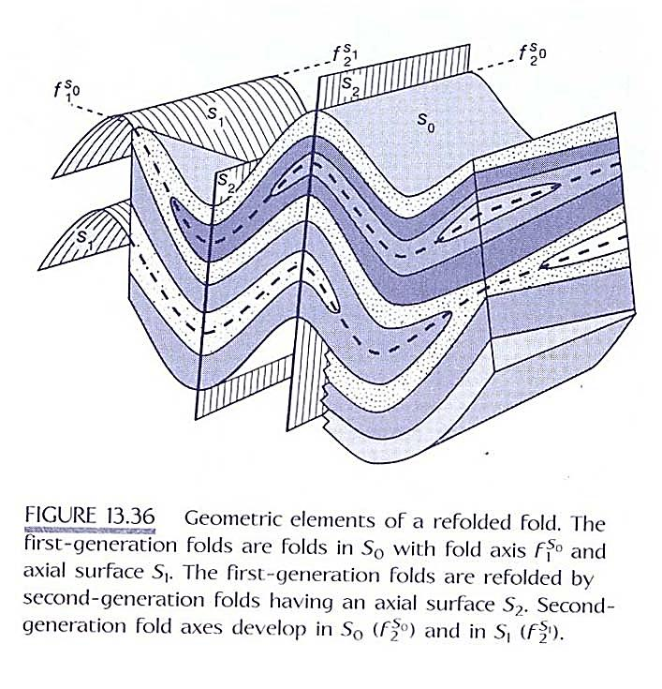

Slide 7
Surfaces are labeled S. Bedding is S₀, and the axial surfaces of first-, second- and higher-generations of fold which are assumed to form as planar surfaces, are designated S₁, S₂, and so on.
Fold hinges are labelled f. The fold hinges of successive generations are f₁,f₂, and so on.

Slide 9
It is also useful to include with the fold hinge symbol a designation of the surface being folded.
Thus the fold hinge f₁^{S}₀ means a first-generation fold hinge in the S₀ (bedding) surface.

Slide 10
Second-generation folds develop in the already folded bedding S₀ and in the first-generation axial surfaces S₁.
Thus second-generation fold hinges in these surfaces are labelled f₂^{S}₀ and f₂^{S}₁, respectively (Figure 13,36).

Slide 11
It is important to know the interpretation and significance of the geometric form of these complex compounded structures called superimposed or superposed folding.

Slide 12
Understanding of the geometry of idealized superposed folds has allowed complex sequences of superposed structures to be unravelled.
Here, briefly several types of superposed fold patterns are reviewed that are characteristic of rocks affected by multiple generations of folding.

Slide 13
Environment of superimposed folding
Superimposed folding is common in a number of geological environments; it may result from a number of different types of deformation processes.

Slide 14
Crossing orogenic belts:
Superimposed forms may develop where layered rocks are subjected to successive deformations separated by a very large time interval,
as for example, when a folded basement complex is subjected to a later orogenic deformation.

Slide 15
Examples are found in Swiss and French Alps, where a folded basement make up of pre-Alpine structural components was subjected to a further deformation during the Alpine movements (Fig. 10.1).

Slide 16
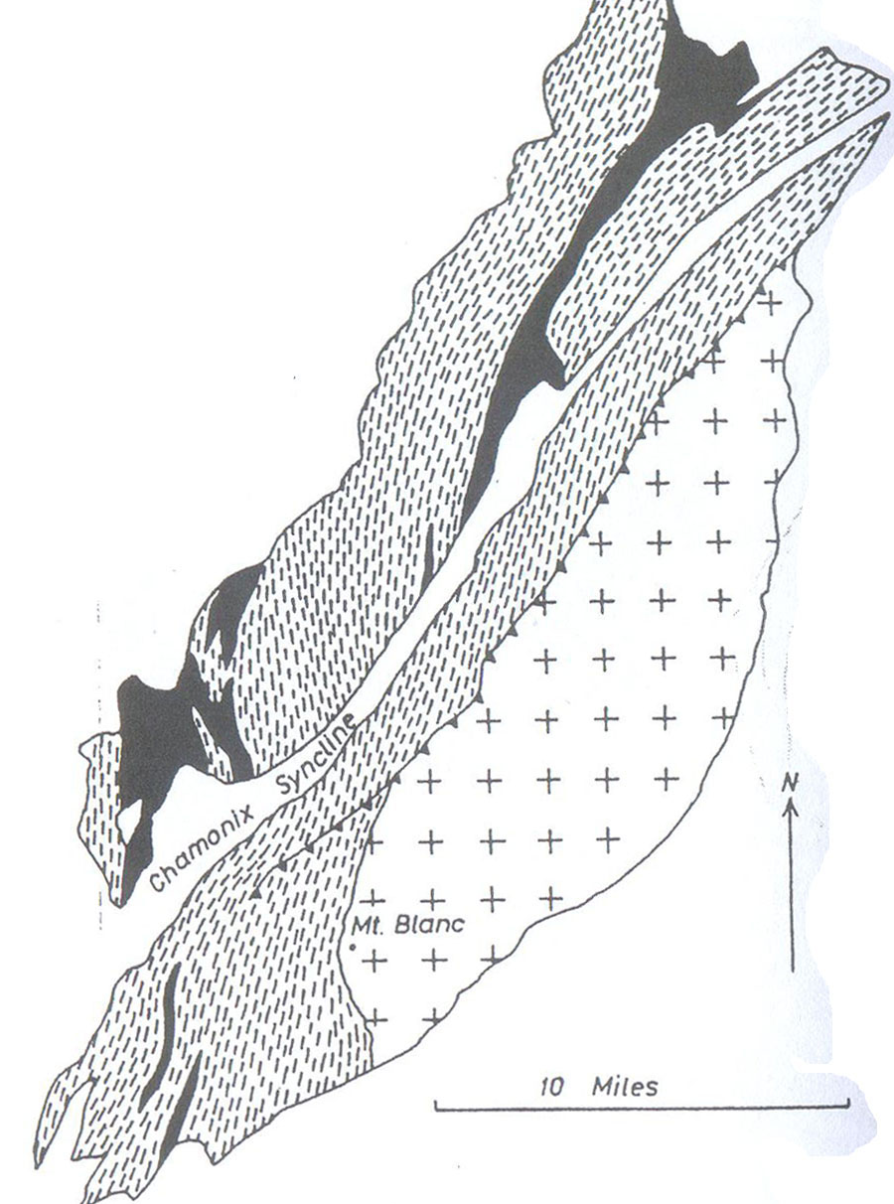
Fig. 10.1. Geological map of he Aiguilles Rouges and Mont Blanc massif(Switzerland and France) illustrating how the trends of the Alpine fold structures (e.g. Chamonix syncline) have been superimposed obliquely across the folded structures in the pre-Triassic basement
Ramsay, 1967) folding and Fracturing of Rocks)

Slide 17
Successive folding during a single progressive deformation:
During the progress of a single, continuous deformation it is general for there to be change of the orientation of the layering relative to the axes of the incremental strain ellipsoid.
This change leads to the oblique straining of any originally formed folds and perhaps to the development of superimposed folds structures with new axial directions and axial surfaces.

Slide 18
Simultaneous folding in several directions during one deformation:
If a competent layer is subjected to a constrictive layer of two dimensional strain as a result of a constrictive type of three-dimensional strain, it is possible for folding to be developed in several direction simultaneously.

Slide 19
Successive deformation phases in one orogenic cycle:
This very common phenomenon probably accounts for the most frequently developed examples of superimposed folding.
The total deformation within a orogenic cycle is generally built up of a series of separate pulsatory, compressive deformation.

Slide 20
Fold interference patterns
and refolded folds
In areas or regions affected by two or more deformation phases or episodes of deformation, a secondary set of folds may be superimposed on earlier folds.

Slide 21
Folds modified by a later fold phase are known as:
Refolded folds
and the resulting patterns are referred to as:
Fold interference patterns.
They show complex interference patterns in the field and on a geologic map.

Slide 22
The type of Fold interference patterns
depends in part on:
the mechanism of folding, and in part on
the relative orientations of the deformation for the first and second generations.

Slide 23
Consider the simple case shown in Fig. 8.7.
The first generation of folding, F₁, produced folds with east-west-striking axial surfaces (Fig. 8.7a).
The second generation of folding, F₂, produced folds with north-south-striking axial surfaces (Fig. 8.7b).

Slide 24
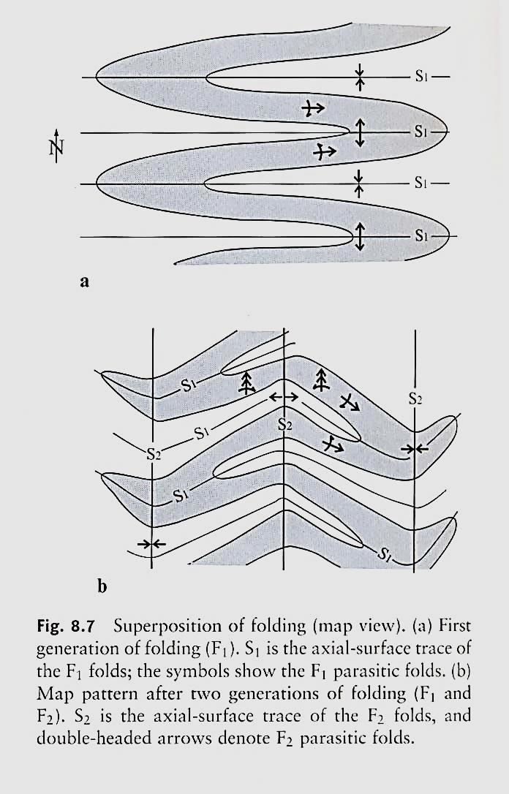
Map View
Fig. 8.7. Superposition of folding (map view). (a) First generation of folding (F1). S1 is the axial-surface trace of the F1 folds; the symbols show the F1 parasitic folds. (b) Map pattern after two generations of folding (F1 and F2). S2 is the axial-surface trace of the F2 folds, and double-headed arrows denote F2 parasitic folds.

Slide 25
It is clear that the east-west axial surfaces, S1, developed before the north-south axial surfaces, S2, because the SI traces have been folded while the S2 traces are straight.

Slide 26
3-D view of a refolded fold

Slide 27
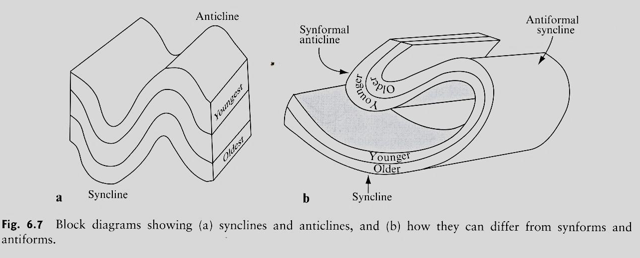

Slide 28
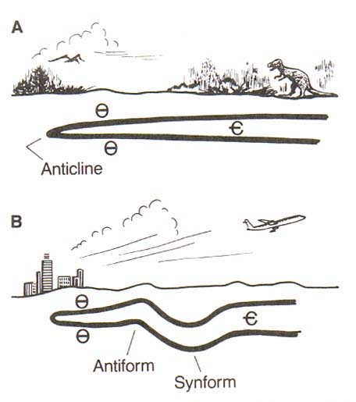
Ѳ
Є

Slide 30
  Three basic types of fold
  interference pattern
John Ramsay (1967) distinguished between three main patterns, based on the relative orientation of axial planes and fold axes
  Type 1 is the classic dome-and-basin structure.
  Type 2 is the so-called boomerang type (Figure 11.36), and
  Type 3 has been described as the hook-shaped type.

Slide 31
There is also a Type 0 pattern defined by two identical, but temporally separate fold systems.
The result of Type 0 interference is simply a tighter fold structure.
Various fold interference patterns, from simple to complex, can occur, depending on the initial orientation of the F1 fold hinge and its axial surface relative to the F2 fold.

Slide 32
Figure 8.8 shows the four basic patterns (including type 0) that result from fold superposition.
In each case the F2 fold has a vertical axial surface and a horizontal hinge line.
In a type 0 interference pattern (Fig. 8.8a), both fold generations have parallel hinge lines and axial surfaces.

Slide 33
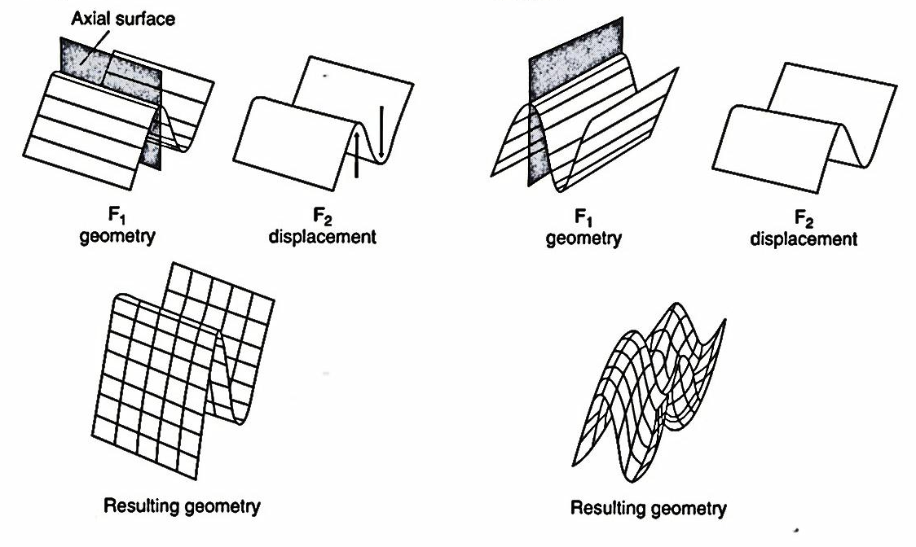
a Type 0
b Type 1
Fig. 8.8. Four basic patterns resulting from the superposition of folds. In each case the orientation of the F2 fold is the same, superposed on various oriented F1 folds. After Ramsey (1967)

Slide 34
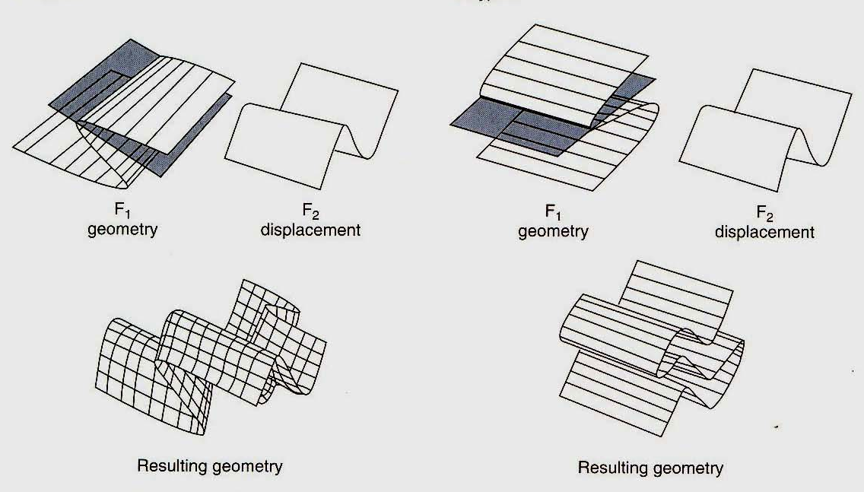
C Type 2
d Type 3
Fig. 8.8. Four basic patterns resulting from the superposition of folds. In each case the orientation of the F2 fold is the same, superposed on various oriented F1 folds. After Ramsey (1967)

Slide 35
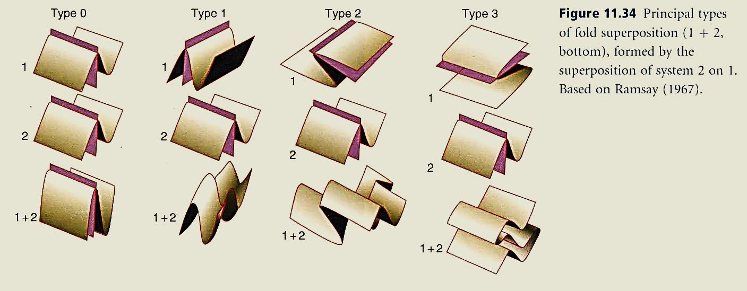
Fig. 11.34: Principal types of fold superposition (1+2), bottom), formed by the superposition of system 2 on 1. Based on Ramsay (1967). Figure from Fossen (2010)

Slide 36
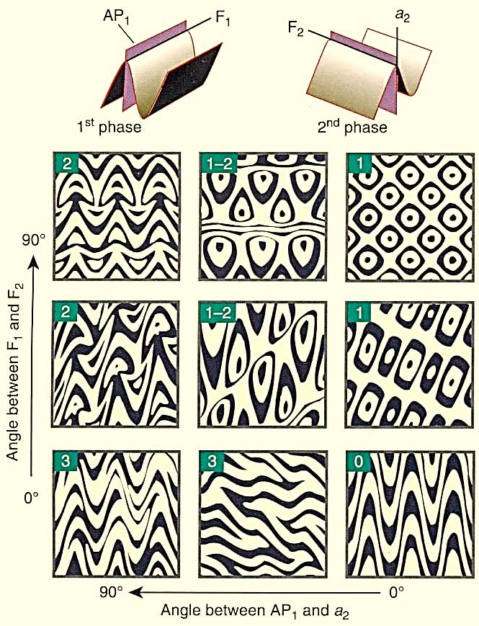
Fig. 11.35: Fold interference patterns of cylindrical folds, classified according to the relative orientations of fold axes (vertical direction) and the angle between the first axial plane and the direction a2 indicated in the upper part of the figure. The patterns are numbered 0-3 according to Ramsay (1967).

Slide 37
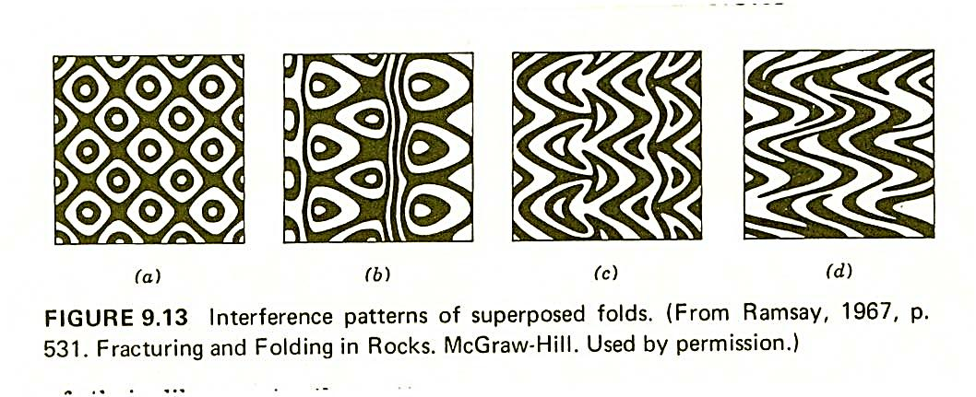

Slide 38
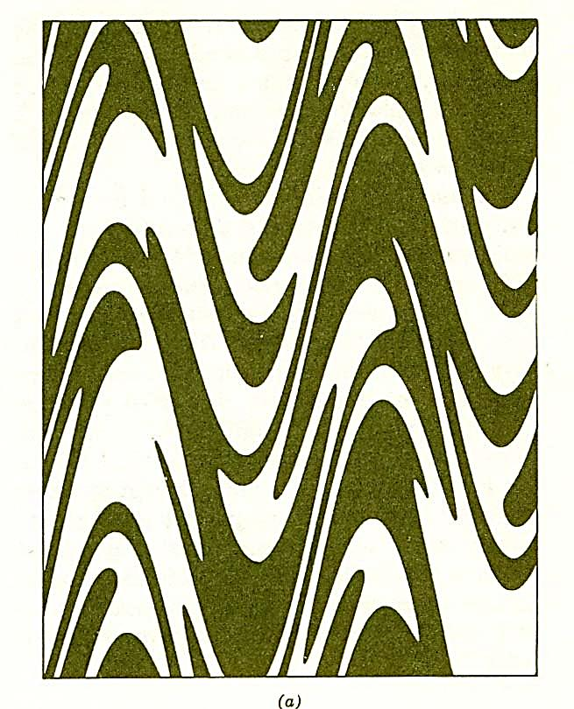
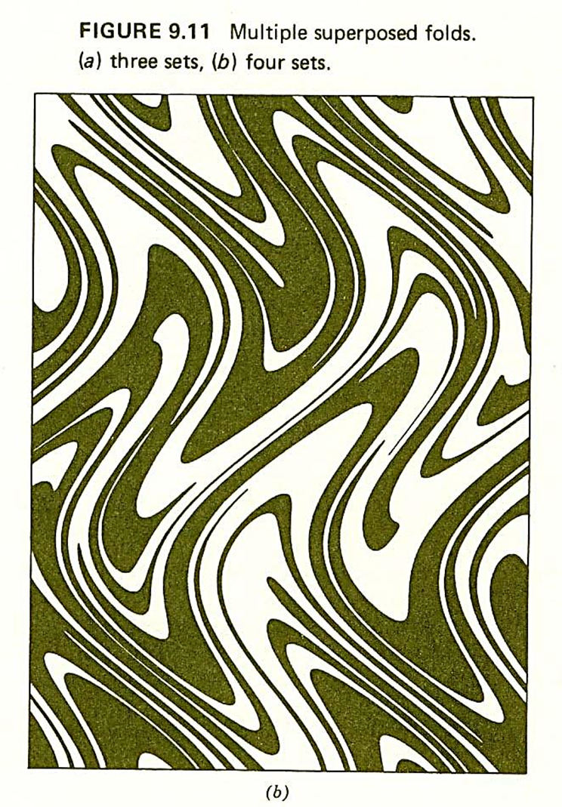

Slide 39
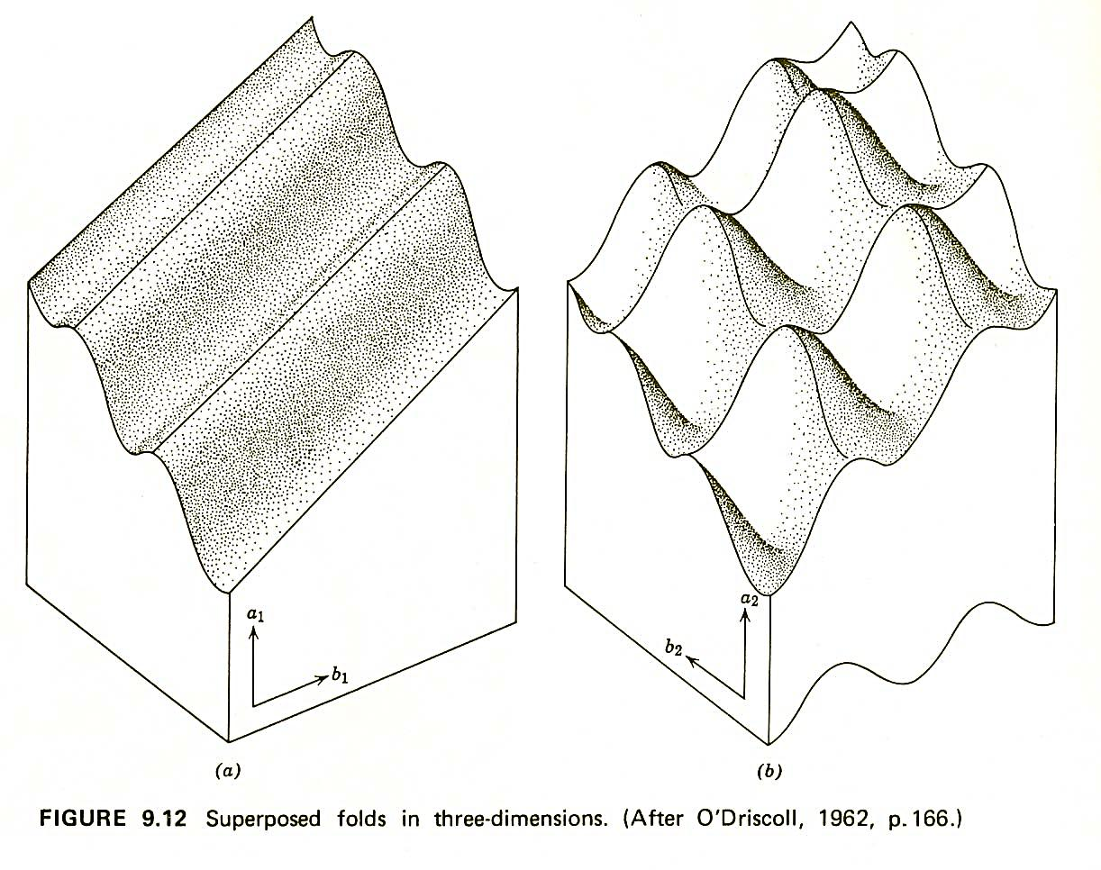

Slide 40
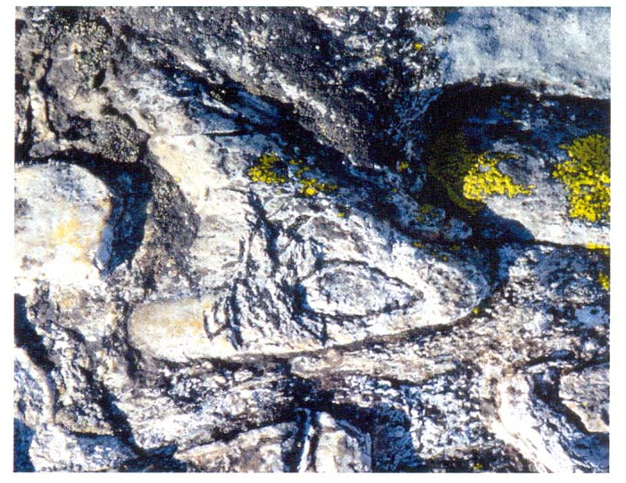
Fig. 11.36: Type 1-2 interference pattern in folded quartz schist

Slide 41
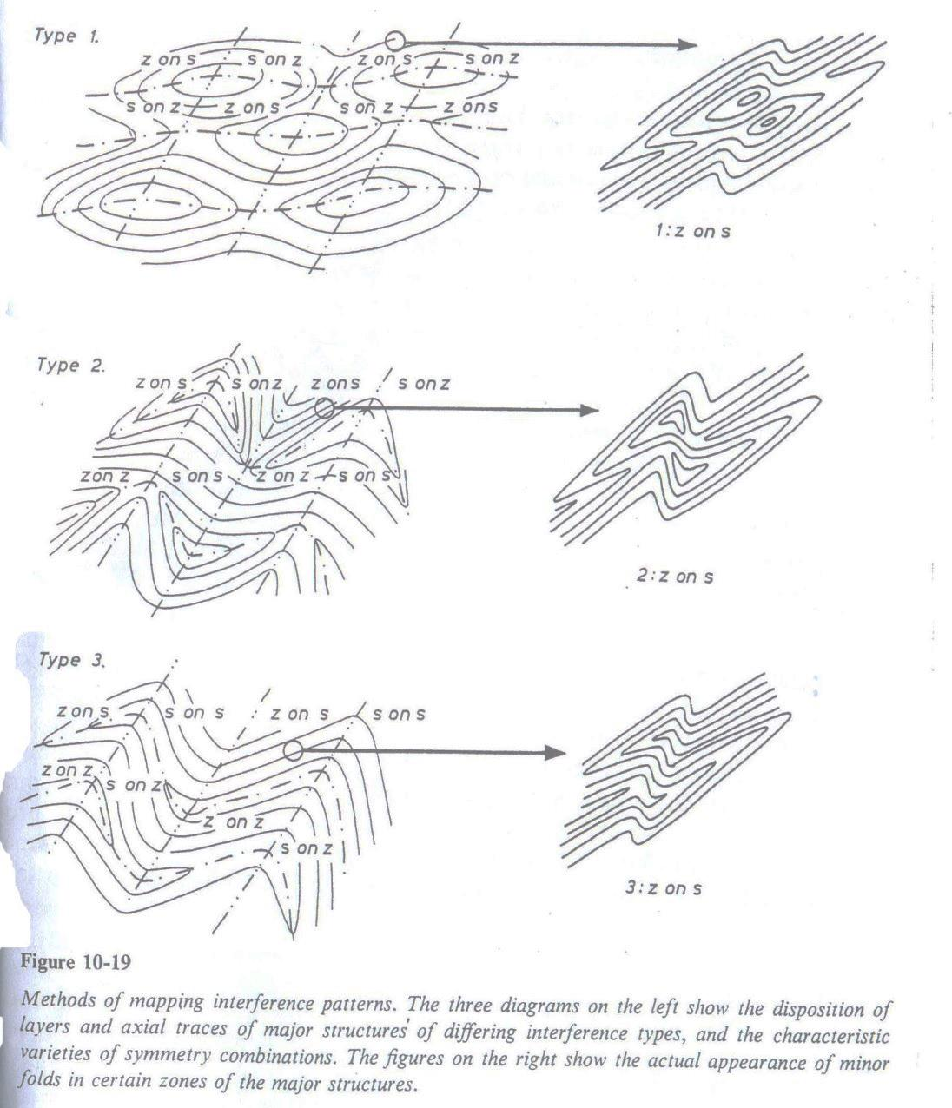
Ramsay, 1967, p. 536

Slide 42
The four patterns shown in Fig. 11.34 represent end-members in a spectrum of possible interference patterns, as indicated in Fig. 11.35.
Note that their appearance in outcrops also depends on the section through the fold structures as well as the folding mechanism, although the patterns shown in Fig. 11.35 are qualitatively useful for a range of orientations.

Slide 43
Fig. 11.34: Principal types of fold superposition (1+2), bottom), formed by the superposition of system 2 on 1. Based on Ramsay (1967)

Slide 44
Fig. 11.35: Fold interference patterns of cylindrical folds, classified according to the relative orientations of fold axes (vertical direction) and the angle between the first axial plane and the direction a2 indicated in the upper part of the figure. The patterns are numbered 0-3 according to Ramsay (1967).

Slide 45
In many cases it is possible to perform simple unfolding exercises to reconstruct the geometry of the first set of fold structures.
Interference patterns by definition arise from the overprinting of a second phase of deformation on an earlier set of deformation structures, and in most cases it is possible to determine their age relationship based on overprinting relations.

Slide 46
A typical overprinting relation is one axial plane cleavage being crenulated by the other (and therefore later) one.
The occurrence of such relationships, and fold interference patterns in general, is traditionally taken as evidence of polyphasal deformation.

Slide 47
However, it is important to understand that some fold interference patterns can result from a single period of non-steady-state flow, where the orientation of the ISA (Instraneous Stretching Axis) locally or regionally changes during the course of the deformation.
Also, folds and foliations are rotated internally, for example in a shear zone, during deformation and produce interference patterns.

Slide 48

Type 0 is so named because this type of superposed folding does not produce a recognizable interference pattern in the field.
From the fold geometry alone, we would not know that two episodes of folding had occurred.

Slide 49
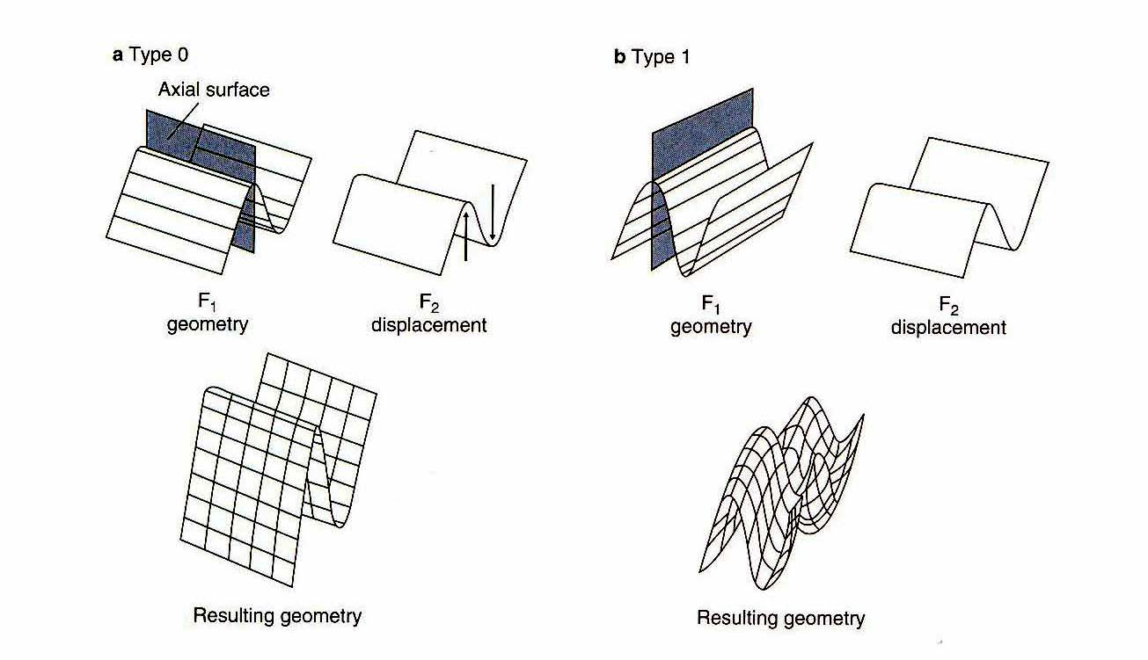
a Type 0
Fig. 8.8. Four basic patterns resulting from the superposition of folds. In each case the orientation of the F2 fold is the same, superposed on various oriented F1 folds. After Ramsey (1967)

Slide 50
Fig. 11.34: Principal types of fold superposition (1+2), bottom), formed by the superposition of system 2 on 1. Based on Ramsay (1967)

Slide 51
Type 1 involves two sets of upright folds:
The Fl hinge lines and axial surfaces are perpendicular to the F2 hinge lines and axial surfaces, resulting in a dome-and-basin (sometimes called "egg-carton") interference pattern (Fig. 8.8b).

Slide 52
b Type 1
Fig. 8.8. Four basic patterns resulting from the superposition of folds. In each case the orientation of the F2 fold is the same, superposed on various oriented F1 folds. After Ramsey (1967)

Slide 53
Fig. 11.34: Principal types of fold superposition (1+2), bottom), formed by the superposition of system 2 on 1. Based on Ramsay (1967)

Slide 54
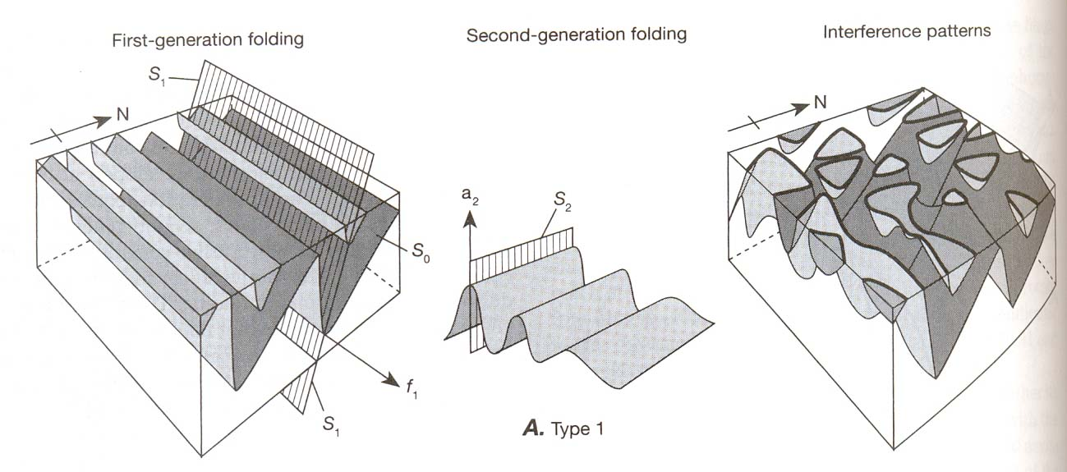
Fig. 13.37: Fold interference patterns. In each case, the left diagram shows first-generation folds in So and the axial surface S₁. The middle diagram shows the geometry of second-generation folding f₂ as it would appear in an initially horizontal surface. The right-hand diagram shows the superposition of the second-generation folding on the folds in the left-hand diagram, with the surface eroded down to a flat plane to reveal the characteristic outcrop patterns, which are shown in heavy lines (modified after Ramsay, 1967).
A. Type I interference folds, showing superposition of folds and dome-and-basin interference patterns. a₂ is at a small angle to S₁, and f₁ is at a high angle to S₂.

Slide 55
In type 2 interference folding, the F1 folds have subhorizontal axial surfaces (recumbent folds); the F1 hinge lines are oriented perpendicular to the F2 hinge lines.
This type of fold superposition results in complex mushroom-shaped and boomerang-shaped map patterns (Fig. 8.8c).

Slide 56
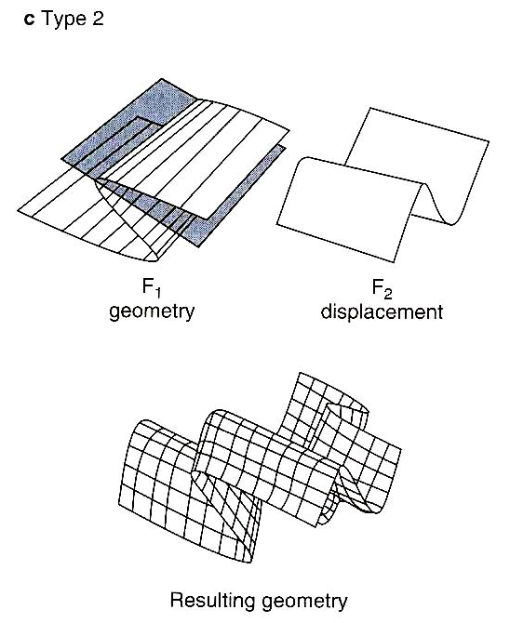
Fig. 8.8. Four basic patterns resulting from the superposition of folds. In each case the orientation of the F2 fold is the same, superposed on various oriented F1 folds. After Ramsey (1967)

Slide 57
Fig. 11.34: Principal types of fold superposition (1+2), bottom), formed by the superposition of system 2 on 1. Based on Ramsay (1967)

Slide 58
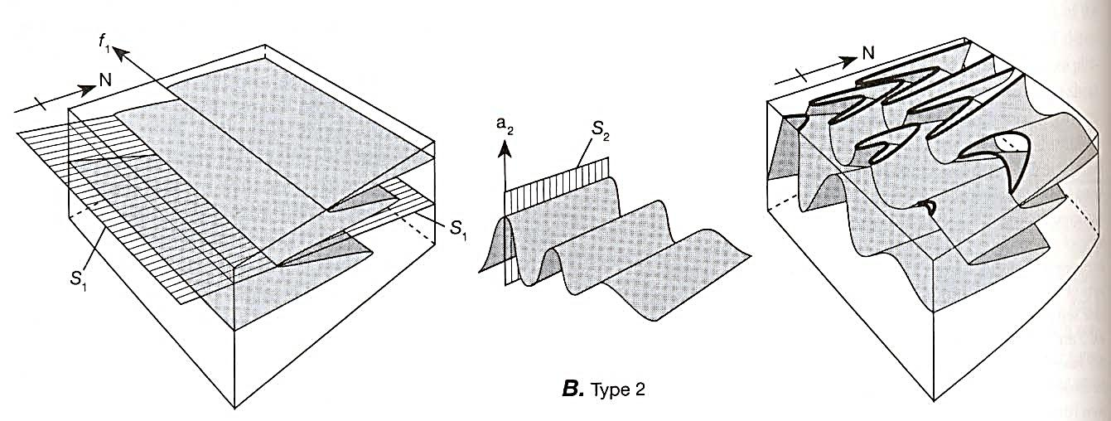
Fig. 13.37: Fold interference patterns. In each case, the left diagram shows first-generation folds in So and the axial surface S₁. The middle diagram shows the geometry of second-generation folding f₂ as it would appear in an initially horizontal surface. The right-hand diagram shows the superposition of the second-generation folding on the folds in the left-hand diagram, with the surface eroded down to a flat plane to reveal the characteristic outcrop patterns, which are shown in heavy lines (modified after Ramsay, 1967).
B. Type 2 interference pattern, showing arrow-head or mushroom-shaped patterns. a₂ is at a high angle to S₁, and f1 is at a high angle to S₂.

Slide 59
In type 3 interference folding, the F1 folds are also recumbent; however, in this case the F2 hinge lines are parallel to the Fl hinge lines (Fig. 8.8d).

Slide 60

Fig. 8.8. Four basic patterns resulting from the superposition of folds. In each case the orientation of the F2 fold is the same, superposed on various oriented F1 folds. After Ramsey (1967)

Slide 61
Fig. 11.34: Principal types of fold superposition (1+2), bottom), formed by the superposition of system 2 on 1. Based on Ramsay (1967)

Slide 62
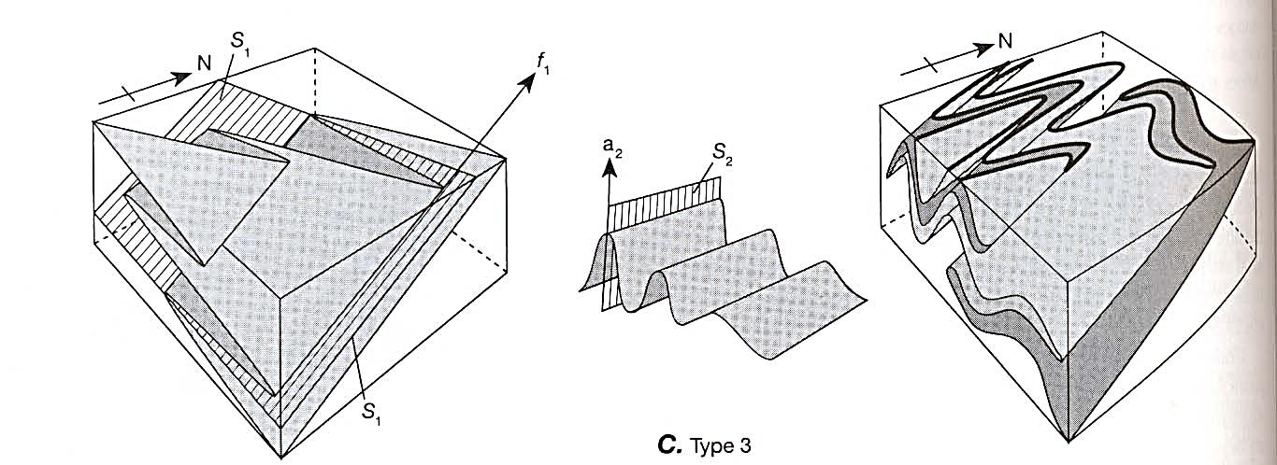
Fig. 13.37: Fold interference patterns. In each case, the left diagram shows first-generation folds in So and the axial surface S₁. The middle diagram shows the geometry of second-generation folding f₂ as it would appear in an initially horizontal surface. The right-hand diagram shows the superposition of the second-generation folding on the folds in the left-hand diagram, with the surface eroded down to a flat plane to reveal the characteristic outcrop patterns, which are shown in heavy lines (modified after Ramsay, 1967).
C. Type 3 interference pattern, showing the wavy outcrop pattern of the S₁ axial surface. a₂ is at a high angle to S₁, and f₁ is at a small angle to S₂.

Slide 63
Fig. 11.36: Type 1-2 interference pattern in folded quartz schist

Slide 64
iii. Interpretation of Fold Generations
It is important to remember that to describe a second generation of folds as being superposed on a first generation implies only a sequence of deformational events.
It says nothing about the interval of time between those events, and it does not necessarily imply that all folds of a particular generation developed at the same time every where.

Slide 65
Moreover, the same number of fold generations does not necessarily appear everywhere in a deformed area, so any possible correlation of deformational events from place to place is probably more reliable if it is based on the particular style of folding rather than on the local generation number.
These are very important restrictions on the interpretation of superposed folding.

Slide 66
The deformation associated with two generations of folding could be associated with two distinct orogenic events separated by tens or hundreds of millions of years, or they could be the result of separate phases of a single orogenic event.
In the latter case, different generations could represent separate chronological phases of a single orogeny, such as collision followed by strike-slip faulting.

Slide 67
Only by very careful age dating of mineral grains that can be shown to have crystallized during a particular deformational event can ambiguities of generations of deformation be resolved.

Slide 68
Thank you

