Slide 1
Subduction-related rock assemblages
(Arc system)
(Condie, 1997)

Slide 2
Arc systems
Numerous geologic environments are associated with subduction. In an idealized arc system, three zones are recognized:
    the arc-trench gap
    the arc, and
    the arc-rear area
(Hamilton, 1988).

Slide 3
From the ocean side landwards, a continental-margin arc (a) is characterized by the
(1) trench;
(2) an accretionary prism with overlying forearc basins;
(3) the volcanic arc with intra-arc basins;
(4) a fold-thrust belt; and a retroarc foreland basin
(Figure 3,16a).

Slide 4
An oceanic arc (island arc) (b), differs from a continental-margin arc primarily in the arc-rear area where it includes some combination of active and inactive back-arc basins and, in some instances, remnant arcs.
Each of these arc environments is characterized by different rock assemblages.

Slide 6
1. Trench (Arc-trench gap)
Trenches are formed where lithospheric slabs begin to descend into the mantle. Trench sediments are dominantly fine-grained graywacke turbidites with minor pelagic components.
Turbidity currents generally enter trenches at submarine canyons and flow along trench axes.

Slide 7
Sediments can be transported along trenches for up to 3000 km, as for example in the Sunda trench south of Sumatra where detritus from the Himalayas enters the trench on the north from the Bengal submarine fan (Moore et al., 1982).

Slide 8
Although most detrital sediment is clay or silt, sand and coarser sediments may be deposited in proximal facies.
Down-axis (parallel to the trench axis) changes in facies suggest that trenches are filled by a succession of radiating submarine fans. This longitudinal filling is supplemented by lateral infilling from side canyons.

Slide 9
If a trench forms near a continent, continental sources generally dominate, with volcanic arc sources of minor importance.
Most trench sediments, however, are derived from local arc volcanic and plutonic sources. Seismic reflection studies of trench sediments show hummocky topography in places suggestive of buried debris flows or submarine slumps.

Slide 10
Trench sediments may be preserved in the geologic record if they are added to the arc as faulted slabs in the accretionary prism.

Slide 11
Accretionary Prism
The accretionary prism (or subduction zone complex) consists of a series of steeply-inclined, fault-bounded wedges of sediment and volcanic rocks above a descending slab.
These wedges represent oceanic crust and trench sediments which have been accreted to the front of the arc.

Slide 12
Individual wedges in the accretionary prism decrease in age as the trench is approached (from the island arc side) (Figure 3.16).

Slide 14
Accretionary prisms are intensely deformed producing melange.
It is a mappable body of rock characterized by the lack of continuous bedding and the inclusion of fragments of rocks of all sizes (up to more than a kilometre across) contained in a fine-grained, deformed matrix.
Both sedimentary and tectonic processes can give rise to melange.

Slide 15
Olistostromes are melanges produced by gravitational sliding and accumulate as semi-fluid bodies that do not have bedding, but include associated turbidites.
Melange clasts may be exotic (derived from another environment) or native (reworked from the immediate environment) and are generally matrix supported (Figure 3.17).

Slide 16
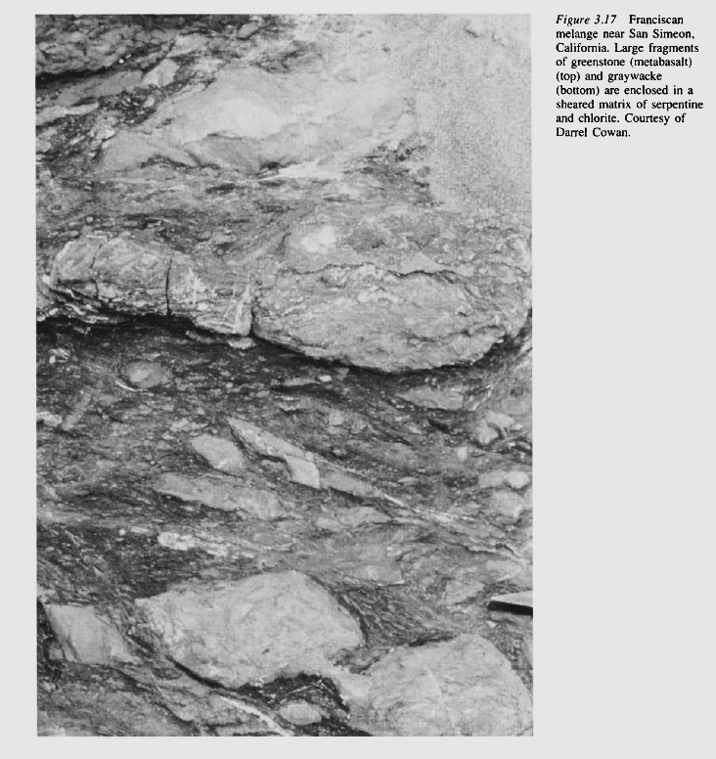

Slide 17
Clast lithologies include
    graywacke,
    mudstone,
    chert,
    basalt (greenstone) and
    other ophiolite lithologies,
    arc volcanics, and
    rare granitoids.

Slide 18
Melanges are commonly folded and may contain more than one cleavage or foliation. Sheared matrices are usually composed of serpentine and fine-grained rock and mineral fragments.
Although melanges are typical of accretionary prisms, they are formed by several different processes and occur in different tectonic environments (Cowan, 1986).

Slide 19
Tectonic melanges
Tectonic melanges are produced by compressive forces along the upper part of descending slabs at shallow depths.
Fragmentation and mixing of largely lithified rocks may occur along a migrating megashear zone subparallel to a subducting slab.

Slide 20
Fragments of oceanic crust and trench sediment are scraped off the descending plate and accreted to the overriding plate.
Olistostromes may be produced by gravitational slumping or debris flows on forearc basin.

Slide 21
Forearc basins
Forearc basins are marine depositional basins on the trench sides of arcs (Figure 3.16), and they vary in size and abundance with the evolutionary stage of an arc.
In continental-margin arcs, such as the Sunda arc in Indonesia, forearc basins range to 700 km in strike length.

Slide 23
They overlie the accretionary prism, which may be exposed as submarine hills within and between forearc basins.
Sediments in forearc basins, which are chiefly turbidites with sources in the adjacent arc system, range up to many kilometres in thickness.

Slide 24
Olistostromes can form in forearc basins by sliding and slumping from locally-steepened slopes. Forearc-basin clastic sediments may record progressive unroofing of adjoining arcs, as for instance shown by the Great Valley Sequence (Jur-Cret) in California.
Volcanism is rare in modern forearc regions and neither volcanic nor intrusive rocks are common in older forearc successions.

Slide 25
2. Arcs
Volcanic arcs range from entirely subaerial, such as the Andean and Middle America arcs, to mostly or completely submarine, such as many of the immature oceanic arcs in the Southwest Pacific.
Other arcs, such as the Aleutians, change from subaerial to partly submarine along strike.

Slide 26
Subaerial arcs include (lava) flows and associated pyroclastic rocks, which often occur in large stratovolcanoes.
Submarine arcs are built of pillowed basalt flows and large volumes of hyaloclastic tuffs and breccias.
Volcanism begins rather abruptly in arc systems at a volcanic front.

Slide 27
Both tholeiitic and calc-alkaline magmas characterize arcs, with basalts and basaltic andesites dominating in oceanic arcs.
Adesites and dacites often dominate in continental-margin arcs.
Felsic magmas are generally emplaced as batholiths, although felsic volcanics are common in most continental margin arcs.

Slide 28
Back-arc basins
Active back-arc basins occur over descending slabs behind arc systems (Figure 3.16) and,
commonly have high heat flow, relatively thin lithosphere and, in many instances, an active ocean ridge which is enlarging the size of the basin.

Slide 30
Sediments are varied, depending on basin size and nearness to an arc.
Proximal to arcs and remnant arcs, volcaniclastic sediments generally dominate, whereas in more distal regions, pelagic, hemipelagic, and biogenic sediments are more widespread.

Slide 31
During the early stages of basin opening, thick epiclastic deposits, largely representing gravity flows, are important. With continued opening of a back-arc basin, these deposits pass laterally into turbidites, which are succeeded distally by pelagic and biogenic sediments.
Discrete layers of air-fall tuff may be widely distributed in back-arc basins

Slide 32
Subaqueous ash flows may erupt or flow into backarc basins and form in three principal ways.
The occurrence of felsic welded ash flow tuffs in some ancient back-arc successions suggests that hot ash flows enter water without mixing and retain enough heat to weld (Figure 3.18a).

Slide 33
Fig. 3.18: Mechanism for the origin of sebaqueous ash flows. (a) Hot ash flow erupted on land flowing into water, (b) ash flow forms from column collapse; (c) ash turbidites develop from slumping of hyaloclastic debris.

Slide 34
Alternatively, submarine eruptions may eject large amounts of ash into the sea, which fall onto the sea floor forming a dense, water-rich debris flow, (b).
In the closing stages of eruption, small turbidity currents are deposited as thin-graded beds above the debris flows. In addition to direct eruption, slumping of unstable slopes composed of pyroclastic debris can produce ash turbidites, (c).

Slide 35
Remnant arcs
Remnant arcs are submarine aseismic ridges that are extinct portions of arcs which have been rifted away by the opening of a back-arc basin (Figure 3.16b).

Slide 36
They are composed chiefly of subaqueous mafic-volcanic rocks similar to those formed in submarine arcs.
Once isolated by rifting, remnant arcs subside and are blanketed progressively by deep-water pelagic and biogenic deposits and distal ash showers.

Slide 37
Retroarc foreland basin
Retroarc foreland basins form behind continental margin arc systems (Figure 3.16a), and are filled largely with clastic terrigenous sediments derived from a foldthrust belt behind the arc.
A key element in foreland basin development is the syntectonic character of the sediments (Graham et al., 1986).

Slide 39
The greatest thickness of foreland basin sediments borders the fold-thrust belt, reflecting enhanced subsidence caused by thrust-sheet loading and deposition of sediments.
Another characteristic feature of retroarc foreland basins is that the proximal basin margin progressively becomes involved with the propagating fold-thrust belt (Figure 3.19).

Slide 41
High- and low-stress subduction zones
Uyeda (1983) suggested that subduction zones are of two major types, each representing an end member in a continuum of types (Figure 3.20).
The relatively high stress type, (Peru-Chile arc type)
The low-stress type (Mariana arc type)

Slide 42
As exemplified by the Peru-Chile arc, it is characterized by:
a pronounced bulge in the descending slab,
a large accretionary prism,
relatively large shallow earthquakes, buoyant subduction (producing a shallow dipping slab),
a relatively young descending slab, and
a wide range in composition of calc-alkaline and tholeiitic igneous rocks .

Slide 43
(b) The low-stress type, of which the Mariana arc is an example, has:
little or no accretionary prism,
few large earthquakes,
a steep dip of the descending plate which is relatively old,
a dominance of basaltic igneous rocks, and
a back-arc basin .

Slide 44
Fig. 3.20 Idealized cross-section of (a) high and (b) low-stress subduction zones. After Uyeda (1983)

Slide 45
High-pressure metamorphism
Biueschist-facies metamorphism is important in subduction zones, where high-pressure, relatively low temperature mineral assemblages form.
Glaucophane and lawsonite, both of which have a bluish colour, are common minerals in this setting.

Slide 46
In subduction zones, crustal fragments can be carried to great depths (> 50 km), yet remain at rather low temperatures, usually < 500 °C.
A major unsolved question is how these rocks return to the surface.

Slide 47
One possibility is by the continual underplating of the accretionary prism with low-density sediments, resulting in fast, buoyant uplift during which high density pieces of the slab are dragged to the surface (Cloos, 1993).
Another possibility is that blueschists are thrust upwards during later collisional tectonics.

Slide 48
One of the most intriguing fields of research at present is seeing just how far crustal fragments are subducted before returning to the surface.
Recent discoveries of coesite (high-pressure silica phase) and diamond inclusions in pyroxenes and garnet from eclogites from high-pressure metamorphic rocks in eastem China record astounding pressures of 4.3 Gpa (about 150 km burial depth) at 740 °C.

Slide 49
Several other localities have reported coesite-bearing assemblages recording pressures of 2.5-3 Gpa.
Also, several new high-pressure hydrous minerals have been identified in these assemblages, indicating that some water is recycled into the mantle and that not all water is lost by dehydration to the mantle wedge.

Slide 50
Perhaps the most exciting aspect of these findings is that for the first time there is direct evidence that crustal rocks (both felsic and mafic) can be recycled into the mantle

Slide 51
Igneous rocks
The close relationship between active volcanism in arcs and descending plates implies a genetic connection between the two.
Subduction-zone related volcanism starts -abruptly at the voicanic front, which roughly parallels oceanic trenches and begins 200-300 km inland from trench axes adjacent to the arc-trench gap (Figure 3.23)

Slide 52
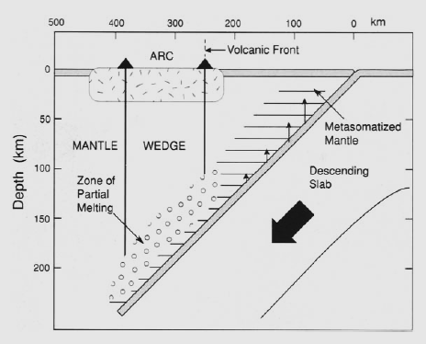
Figure 3.23 Cross-section of a subduction zone showing shallow devolatilization of descending slab (short vertical lines) and magma production in the mantle wedge

Slide 53
It occurs where the subduction zone is 125-150 km deep, and the volume of magma erupted decreases in the direction of subduction zone dip.
The onset of volcanism at the volcanic front probably reflects the onset of melting above the descending slab.

Slide 54
The decrease in volume of erupted magma behind the volcanic front may be caused by either:
  a longer vertical distance for magmas to travel or
  a decrease in the amount of water liberated from the slab as a function of depth.

Slide 55
The common volcanic rocks in most island arcs are basalts and basaltic andesites, whereas andesites and more felsic volcanics also become important in continental margin arcs.
Whereas basalts and andesites are erupted chiefly as flows, felsic magmas are commonly plinian eruptions in which much of the ejecta are in the form of ash and dust.

Slide 56
These eruptions give rise to ash flows and associated pyroclastic (or hyaloclastic) deposits.
Arc volcanic rocks are generally porphyritic containing up to 50 per cent phenocrysts in which plagioclase dominates.

Slide 57
The cores of arc systems comprise granitic batholiths as evidenced in deeply eroded arcs. Such batholiths, -which are composed of numerous plutons, range in composition from diorite to granite, with granodiorite often dominating.
In contrast to oceanic basalts, arc basalts are commonly -quartz normative, with high AI2O3 (16-20 per -cent) and low Ti02 (< 1 per cent) contents.

Slide 58
Igneous rocks of the tholeiite and calc-alkaline series are typical of both island arcs and continental-margin arcs. Arc granitoids are chiefly I-types, -typically meta-aluminous, with tonalite or granodiorite -dominating (Table 3.1).

Slide 60
Thank you

