Slide 1

THE UNIVERSITY OF ZAMBIA
SCHOOL OF MINES
GEOLOGY DEPARTMENT
GGY 4070
GEOLOGY OF EAST AFRICA RIFT VALLEY
BY:ANDREW SAKALA

Slide 2
THE EAST AFRICAN RIFT VALLEY
The East African Rift Valley (EAR) is a developing divergent plate boundary in East Africa.
Here the eastern portion of Africa, the Somalian plate, is pulling away from the rest of the continent, that comprises the Nubian plate. This extension has formed a rift valley.
The Nubian and Somalian plates are also separating from the Arabian plate in the north, thus creating a ‘Y’ shaped rifting system. These plates intersect in the Afar region of Ethiopia at what is known as a ‘triple junction’.

Slide 3
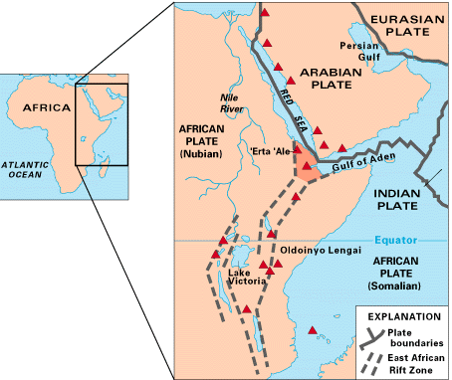

Slide 4
WHAT IS A RIFT VALLEY
It is a linear-shaped lowland between several highlands or mountain ranges created by the action of a geologic rift or fault.

Slide 5
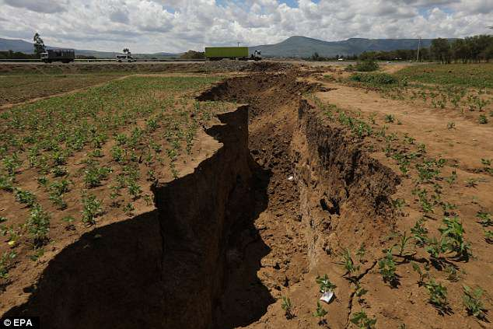

Slide 6
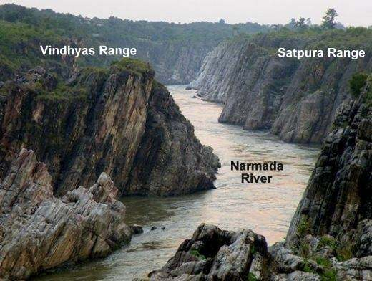

Slide 7
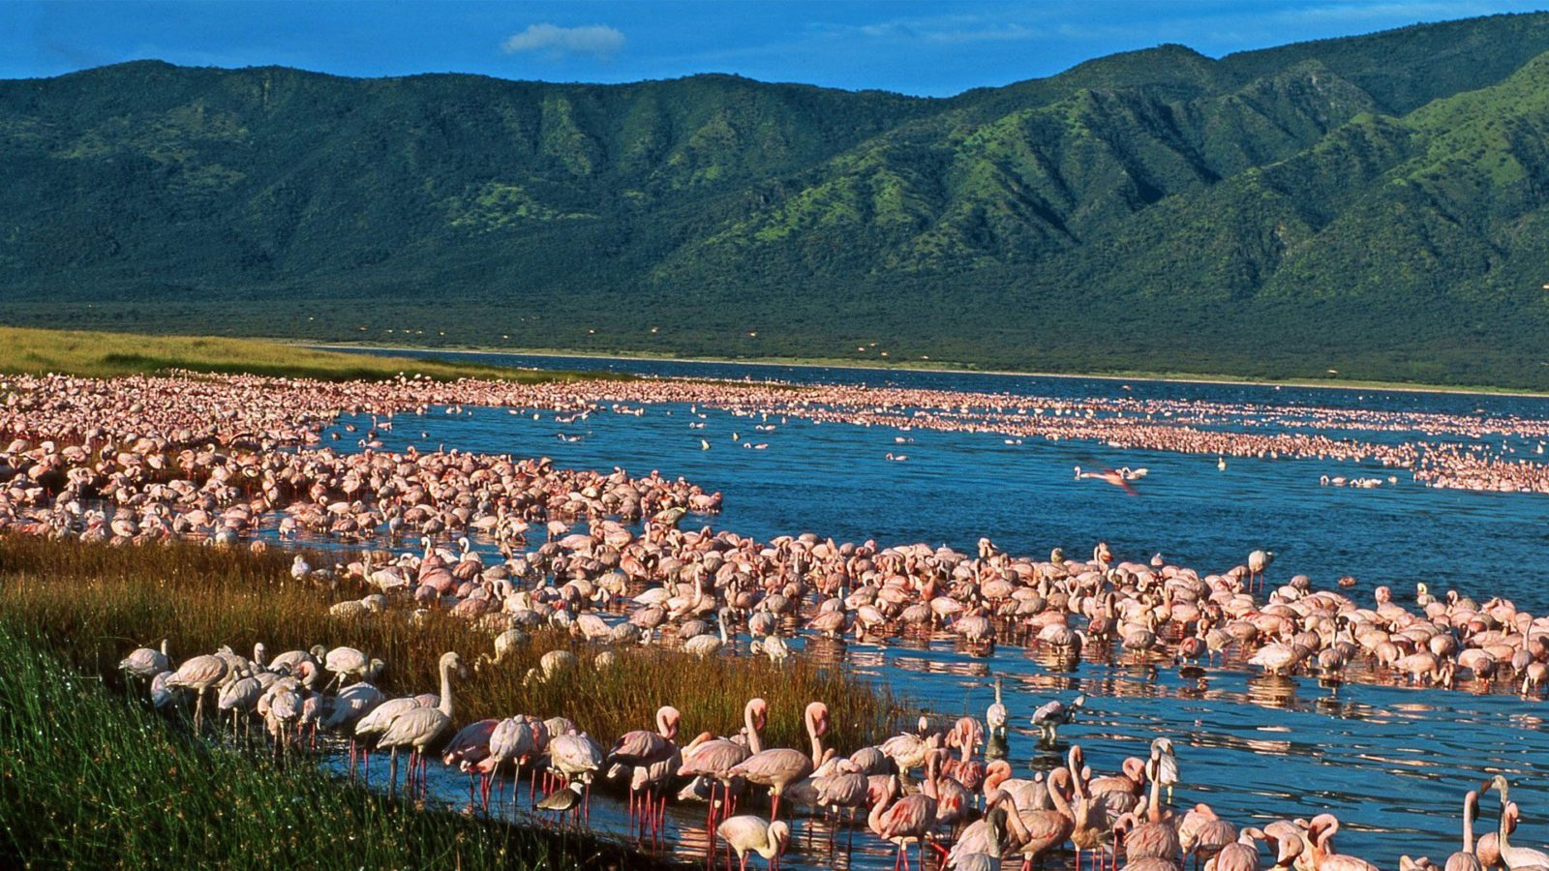

Slide 8
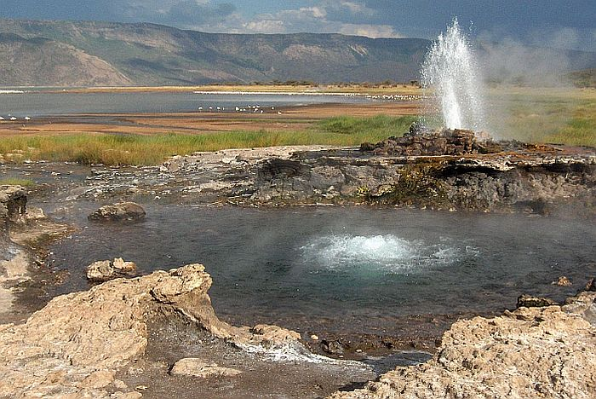

Slide 9
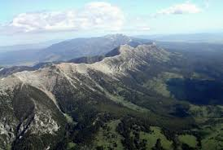

Slide 10
GEOLOGY
The rift valleys are a system of normal faults bordering a 40-60 km wide. The Kenya Rift diverges into splays towards north (Turkana) and south Tanzania. (Baker et al)
Domal uplift and extension causes the brittle crust to fracture into a series of normal faults giving the classic horst and graben structure of rift valleys.
In Djibouti and Ethiopia volcanic and rifting episodes are known to occur, involving magmatism and widening volcanic systems. The last occurred in 1978 (Ardukoba) and 2005 to 2008 (Dabbahu). Those are controlled by the rifting process:

Slide 11
THE RIFTING PROCESSES ARE CONTROLLED BY THE FOLLOWING;
Overstretched zone of weakness opens up along pre-existing faults and basalt intrudes into them at depth (dyking). Fissure eruptions may occur depending of magma supply.
The caldera (central) volcanoes of the rift are underlain by crustal magma chambers during some stages of their active periods. They erupt silicic magma when overpressure breaks their roof – either as large volume pyroclastic or smaller volume domes and flows. A variety of central volcanic activity is long lasting eruptions or lava lake activity of basaltic lava at their central crater.

Slide 12
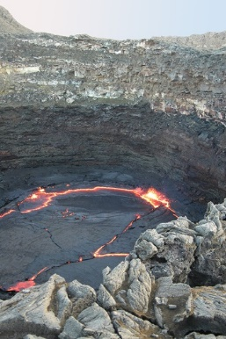

Slide 13
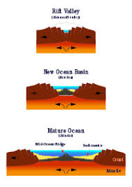

Slide 14
Spreading slows down from north to south from 2.6 cm/yr in the Red Sea to about 1 cm/yr in Afar to 0.7 cm/yr in the Ethiopian Rift and 0.5 mm/yr combined in the Western and Eastern Rifts across the Kenya Dome and gradually decreasing from there to the south.
For comparison: North-Atlantic has a spreading rate of 2.3 cm/yr and Iceland 1 cm/yr. Those are half-rates.

Slide 15
GEOLOGY DEVELOPMENT
The development sees four magmatic episodes correlating with tectonic phases beginning in the Miocene. The first appearance of the development phases was:
1). Early to middle Miocene. Early uplift. Alkali basalts, nephelinites.
2). Upper Miocene. Doming of about 300 m. Fissure eruptions. More basalts and phonolites. Off rift volcanoes of eastern Uganda.

Slide 16
3). Pliocene. Doming of about 1400 m. Main rifting. Graben faulting. Trachytes in rift floor (Southern Kenya Rift).
4) Quaternary. Major graben faulting, caldera volcanoes in axial zone Basalt volcanism in off-rift volcanoes beginning in Upper Pliocene

Slide 17
This sequence represents a progression from
1) incipient melting of the upper mantle associated with early uplift, through
2) extensive partial melting of the uppermost mantle and lower crust giving rise to phonolites to
3) and 4) pervasive partial melting of the lower crust due to lowering of the central rift segment into the heated zone causing trachyte outpourings (Bailey 1974).

Slide 18
The formation of rift fractures initiates magmatism, the volume and composition of the volcanics being controlled by the opening rates. At rates of less than 1 mm/yr there is little or no volcanism. At rates of 1-10 mm/yr alkaline to mildly alka line basalts appear accompanied by large volumes of peralkaline silicics and rates of 1-2 cm/yr correlate with large volumes of transitional basalts with subordinate peralkaline silicics.
The first eruptive rocks in the cycle, seen in Ethiopia and Kenya, were extensive alkali flood basalts generated from melts at depths of about or greater than 35 km. More saturated basalts (transitional between alkaline and tholeiitic) followed in the rifts generated at shallower depth. A final stage with full scale separation of the continental blocks and tholeiitic magmatism forming new oceanic crust has been reached in the Afar triangle

Slide 19
CONCLUSION
The EAR is mainly composed of Igneous rocks, Basalts and some Trachyte's.
Today the EAR remains above sea level however in the future, as extension continues along the rift, the rift valley will sink lower and lower eventually allowing ocean waters to flood into the basin. If rifting continues, new basaltic oceanic crust may form along the Centre of the rift producing a new narrow ocean basin with its own mid ocean ridge between the Nubian and Somalian plates.

Slide 20
ANY QUESTIONS?

