Slide 1

THE UNIVERSITY OF ZAMBIA
SCHOOL OF MINES
GEOLOGY DEPARTMENT
GGY 4070
KIMBERLITES
BY: ANDREW SAKALA

Slide 2
DEFINITION
Kimberlite is a type of peridotite consisting of a fine-grained matrix of calcite and olivine and containing phenocrysts of olivine, garnet, and sometimes diamonds.
It is also called blue ground, a dark-coloured, heavy, often altered and brecciated (fragmented), intrusive igneous rock that contains diamonds in its rock matrix.
It is named after the town of Kimberley in South Africa, where the discovery of an 83.5-carat (16.70 g) diamond called the Star of South Africa in 1869.

Slide 3
It is An ultramafic volcanic rock, dominated by olivine, diopside, and garnet etc. Its porphyritic in texture which occurs in dikes, and sills.
It is the principal primary host for diamonds, but only a small percentage of the known kimberlite occurrences are diamondiferous.
Kimberlite pipes are the most important source of mined diamonds today. The consensus on kimberlites is that they are formed deep within the mantle.

Slide 4
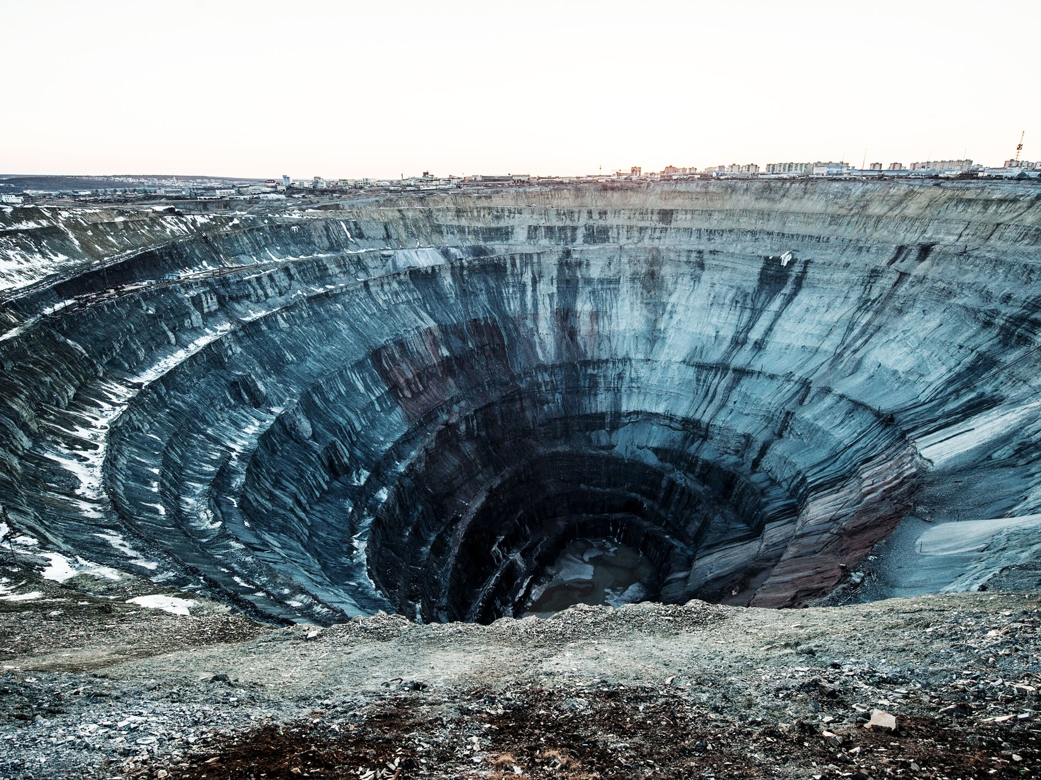

Slide 5
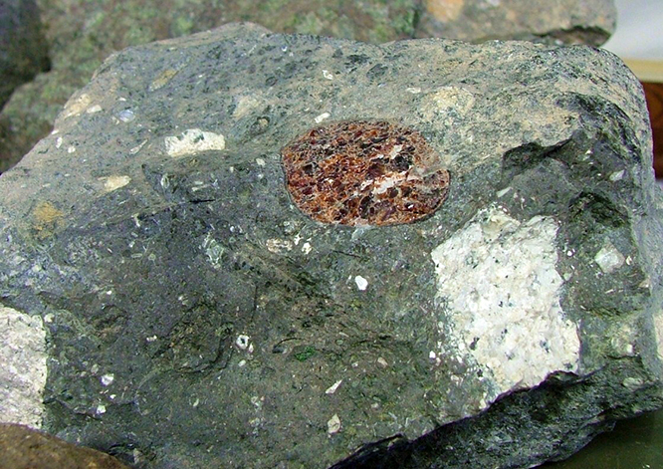

Slide 6
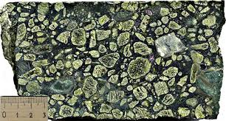

Slide 7
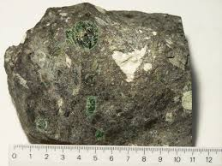

Slide 8
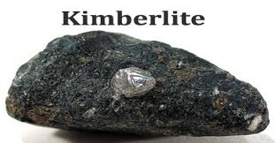

Slide 9
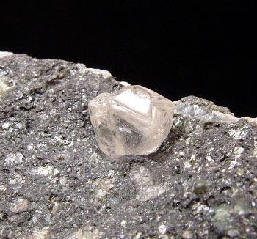
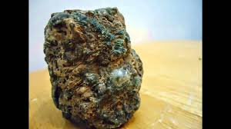

Slide 10
Occurrence
Kimberlites have been sporadically emplaced into stable nonorogenic continental platforms especially in Africa, since Proterozoic time.
In the Kimberley district, South Africa, it forms pipes and, occasionally, dikes.
Other occurrences include the dikes at Ithaca, N.Y., the Kimberley and Lake Argyle regions of Australia, and the lavas in the Iswisi Hills, Tanzania.
It occurs in the Earth’s crust in vertical structures known as kimberlite pipes as well as igneous dykes. Kimberlite also occurs as horizontal sills. It is this depth of melting and generation which makes kimberlites prone to hosting diamond xenocrysts. Its probable derivation from depths greater than any other igneous rock type, and the extreme magma composition that it reflects in terms of low silica content and high levels of incompatible trace element enrichment make an understanding of kimberlite petrogenesis important.

Slide 11
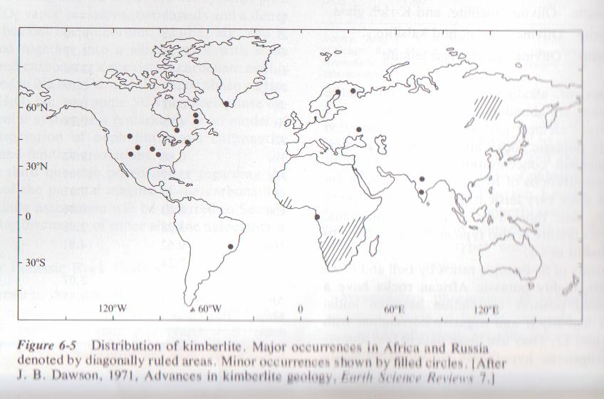

Slide 12
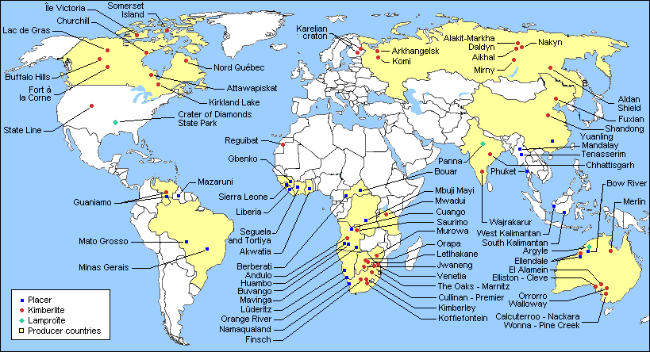

Slide 13
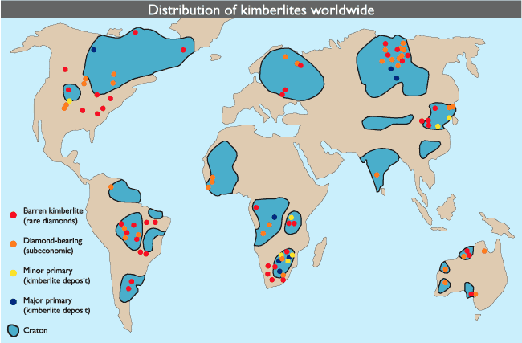

Slide 14
Properties of Kimberlite
There are various physical properties of Kimberlite like Hardness, Grain Size, Fracture, Streak, Porosity, Luster, Strength etc which defines it. The physical properties of Kimberlite rock are vital in determining its Kimberlite Texture and Kimberlite Uses.
It has conchoidal cleavage, specific gravity of 2.86-2.87. Kimberlite is translucent to opaque in nature whereas its toughness is not available.
Many kimberlite structures are emplaced as carrot-shaped, vertical intrusions termed pipes’. This classic carrot shape is formed due to a complex intrusive process of kimberlitic magma which inherits a large proportion of CO₂(lower amounts of H₂O) in the system, which produces a deep explosive boiling stage that causes a significant amount of vertical flaring (gradually become wider at one end).

Slide 15
Physical Properties
Grain Size
Fine to Coarse Grained
Fracture
Conchoidal
Streak
White
Porosity
Very Less Porous
Luster
Subvitreous to Dull
Cleavage
Conchoidal
Toughness
Not Available
Specific Gravity
2.86-2.87
Transparency
Translucent to Opaque
Density
2.95-2.96 g/cm³

Slide 16
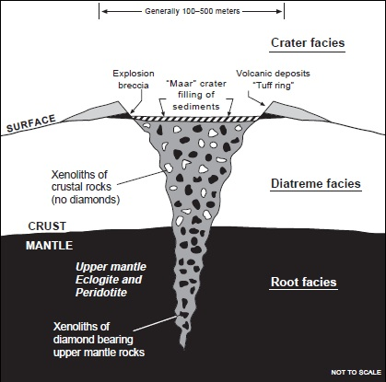
These dikes are thin, less than 10m, but may be as much as 14km long.

Slide 17
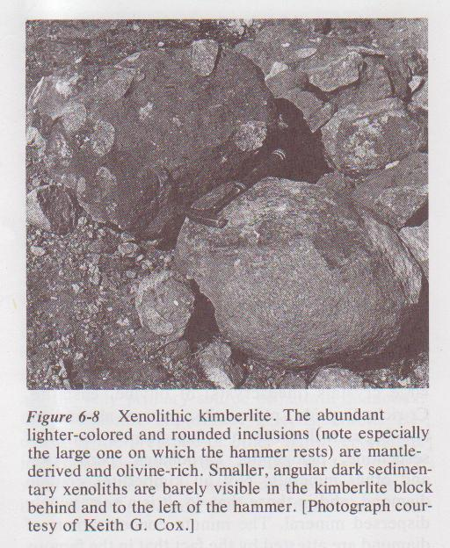

Slide 18
Not all kimberlites contain diamonds and in those that do, it is a very widely dispersed mineral.
The concentrations of diamond are attested by the fact that in the famous Kimberly mine, 24 million tons of kimberlite yielded only 3 tons of diamond.

Slide 19
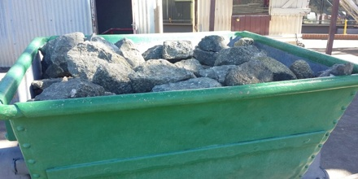
USES OF KIMBERLITES

Slide 20
A source for Diamonds
Kimberlite also uses in construction industry include As a flux in the production of steel and pig iron, As a sintering agent in steel industry to process iron ore, As dimension stone, Cement manufacture, For road aggregate, Making natural cement, Manufacture of magnesium and dolomite refractories.
Uses of Kimberlite in medical industry, it is a supplement for calcium or magnesium. Some types of rocks have exceptional properties and can be used in medical industry.

Slide 21
THANK YOU
ANY QUESTIONS?

Slide 22
carat (ct) is a unit of mass equal to 200 mg (0.2 g; 0.007055 oz) and is used for measuring gemstones and pearls.
A xenocryst is an individual foreign crystal included within an igneous body

