Slide 1
Basic Rock Blasting

Slide 2
Definition of Rock Blasting
Blasting – use of explosives for rock fragmentation
The action of breaking and displacing rock by means of explosives
In the field of blasting, the first operation to be carried out is rock drilling.
Blast-holes are drilled
Adequate geometry and distribution
Selection of explosives and initiating devices
Charging process and initiation.

Slide 3
Rock Blasting
Controlled use of explosives
Purpose of fragmenting the rock
  Loosening the in-situ rock
  Opening up - excavation
  Extraction of ore from the ore-body
  Easy movement of rock
Practiced in:
  Mining,
  Quarrying and
  Civil engineering.

Slide 4
Rock Blasting
Blasting is an essential part of the mining cycle
In virtually all forms of mining, rock is broken by drilling and blasting
Blasting technology is the process of fracturing rock
A calculated amount of explosive is used to fragment a predetermined volume of rock.

Slide 5
Trend in Rock Blasting
There have been steady developments in:
Explosives,
Detonating,
Delaying techniques and
Understanding of the mechanics of rock breakage by explosives

Slide 6
Blasting Techniques
Blasting is used in both open pit and underground mining operations
Good blast design and execution are essential to successful mining operations
Improper or poor practices in blasting can have a severely negative impact on the economics of a mine.

Slide 7
Rock Blasting
Blast optimisation depends on principal parameters including:
The rock’s characteristics;
The properties and quantities of explosives;
Blast geometry;
Blast size;
The priming method; and
The initiation sequence.

Slide 8
Blasting terminology

Slide 9
Free face:
This is an exposed rock surface towards which the explosive charge can break out.
Blast-hole diameter (D):
The relation between blast hole diameter and face height is approximately:
D = 0.001 to 0.02 H
Generally, the cost of drilling and blasting decreases as hole diameter increases.

Slide 10
Face height (H):
This is the vertical distance in metres between the top and floor of the bench.
Burden (B) :
This is the distance in metres from a blast hole to the nearest free face and has the following approximate relation:
B = 25D to 30D for hard rock
B = 30D to 35D for medium rock
B = 35D to 40D for soft rock.

Slide 11
Spacing (S):
This is the distance in metres between adjacent blast-holes and is measured perpendicular to the burden. Usually the relation between drilled burden and spacing is:
S = 1 to 1.8B
Hole angle (α ):
This is a hole inclination measured in degrees. If the strata conditions permit, inclined blast-holes allow better distribution of the explosives.

Slide 12
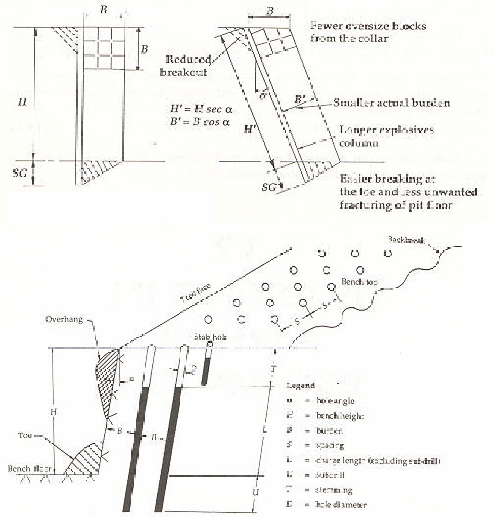
Blasting Terminology

Slide 13
Sub-drill (sub-grade drilling or over-drilling) (U): This is the extra depth drilled below the grade level to assure that the full face of the rock can be broken to the desired excavation level.
Usually U= 8 to 12D; alternatively it equals to B/3.
Charge length (L):
This is the explosive column in a blast hole and should be at least 20D in order to utilize fully the explosion-generated strain in the rock.

Slide 14
Stemming (T):
This is the inert material filled between the explosive charge and the collar of the blast-hole to confine the explosion gases.
The stemming material could be drill cutting, sand, mud or crushed rock.
A stemming length shorter than 20D usually causes fly rock, cut-offs and over break problems.
The stemming length should not be less than the effective burden B

Slide 15
Powder Factor or Specific Charge or Blasting Ratio:
This is the ratio between the mass of explosives required to break a given quantity of rock and is normally expressed in kg/m³ or kg/t³
Decoupling ratio
Can be defined as the ratio of the diameters of an explosive column and the blast-hole and is usually expressed as a percentage

Slide 16
Firing Patterns
In normal blasting all holes do not blast at the same time. Blasting is normally carried out as short delay blasting. The firing pattern has to be designed so that each blast-hole has free breakage

Slide 17
Blast Design
The best use of explosives is made when a blast:
Produces a clean break,
Gives good fragmentation,
Avoids excessive fly-rock,
Avoids vibration,
Produces less toxic gases.

Slide 18
Blast Design
The success of achieving these goals depends significantly on good blast design.
If the blast-holes are drilled as a staggered pattern on an equilateral triangular grid, the optimum distribution of the explosive’s energy is achieved.
Primary blasting
The initial action of breaking and displacing rock by means of explosives
Initial fragmentation of in-situ rock – rock mass

Slide 19
Secondary Blasting
Most primary blasting, whether on surface or underground, will leave some oversize boulders. The term oversize boulder may be defined as any boulder produced from primary blasting, which cannot be adequately handled by the standard loading and crushing equipment used in an operation. Its size varies from one operation to another, depending on the type of loading, conveying and crushing equipment in use.

Slide 20
Misfire - A blast that fails to detonate completely after an attempt at initiation; also the explosive material itself that failed to detonate as planned.
Magazine - Any building, structure, or container, other than an explosives manufacturing building, approved for the storage of explosive material
Initiation - The act of causing an explosive material to detonate or deflagrate.

Slide 21
Initiator - A detonator or detonating cord used to start detonation in an explosive material.
Primer - A unit, package, or cartridge of explosives used to initiate other explosives or blasting agents, and which contains: 1.) A detonator, or 2.) Detonating cord to which is attached a detonator designed to initiate the detonating cord.

Slide 22
Revision Questions
In blasting, differentiate between spacing and burden
Explain why the cost of drilling and blasting decreases as hole diameter increases
Given the face height of 2.85m, estimate the hole diameter
Drilling and blasting in 75MPa rock, estimate the hole diameter if over-drilling is 0.9m
If an 88mm diameter hole is charged with 64mm diameter cartridges, calculate the decoupling ratio
List five reasons why stemming is important in charging blast holes with explosives?

Slide 23
Key words
List
Differentiate
Explain
Estimate
calculate

Slide 24
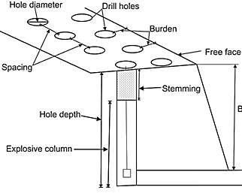
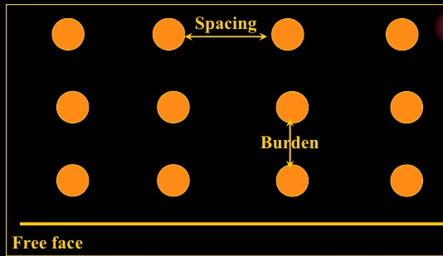
Burden and Spacing
In blasting, burden is referred to the distance in metres from a blast-hole to the nearest free face while spacing is the distance in metres between adjacent blast-holes and is measured perpendicular to the burden. Usually the relation between burden and spacing is: S = 1 to 1.8B
Diagram – clear and properly labeled

