Slide 1
Classification of Mining Methods
Based on feasibility studies, a mining method is selected for a particular ore-body
The mining methods are generically classified as:
Surface mining; and
Underground mining

Slide 2
Classification of Mining Method
Mining Method
Surface Mining
Techniques
Underground Mining
Techniques

Slide 3
Classification of Mining Method
Mining Method
Surface Mining
Techniques
Underground Mining
Techniques

Slide 4
Surface Mining
Mining Method Techniques
Open Pit
Open Cast
Quarrying
Auger Mining

Slide 5
Sequence of surface mine development
Plant layout
Land clearing
  Take into consideration environmental impact
Provision of stockpiles and waste-disposal dumps
Stripping of overburden
  To gain access to the deposit
Exploitation
  Ore extraction

Slide 6
Auger Mining
Auger mining is a method for surface highwall or outcrop recovery of coal by boring or excavating openings into the seam beneath the overburden
Recovering of coal from horizontal or nearly horizontal seams
Auger mining is usually on small-scale
Low-cost mining method

Slide 7
Auger Mining
Auger drills are mounted with cutter heads
20 to 60m in length
0.5 to 2.5m in diameter
Thin-Seam Miner (TSM)
Modern machine used in auger mining method
Modification of surface auger miner
TSM is a continuous miner

Slide 8
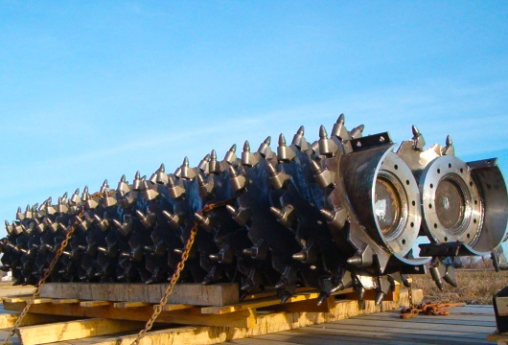
Auger drill cutter head

Slide 9
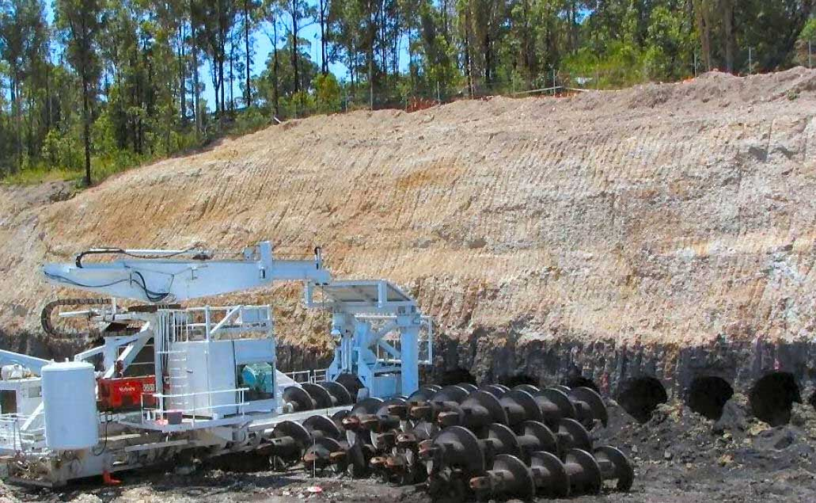
Auger mining

Slide 10
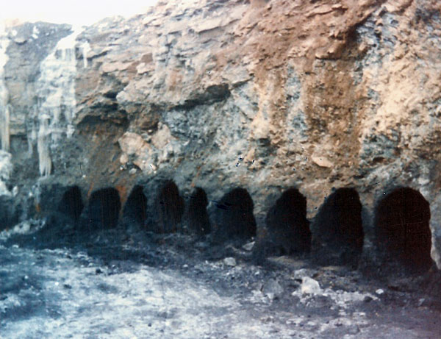
Auger mining

Slide 11
Quarrying
Quarrying of dimension stone
Quarries resemble open pits, but the benches (called faces) are lower and nearly vertical
In overall appearance, the highwall of a quarry is often of imposing height and steepness, some attaining a vertical dimension

Slide 12
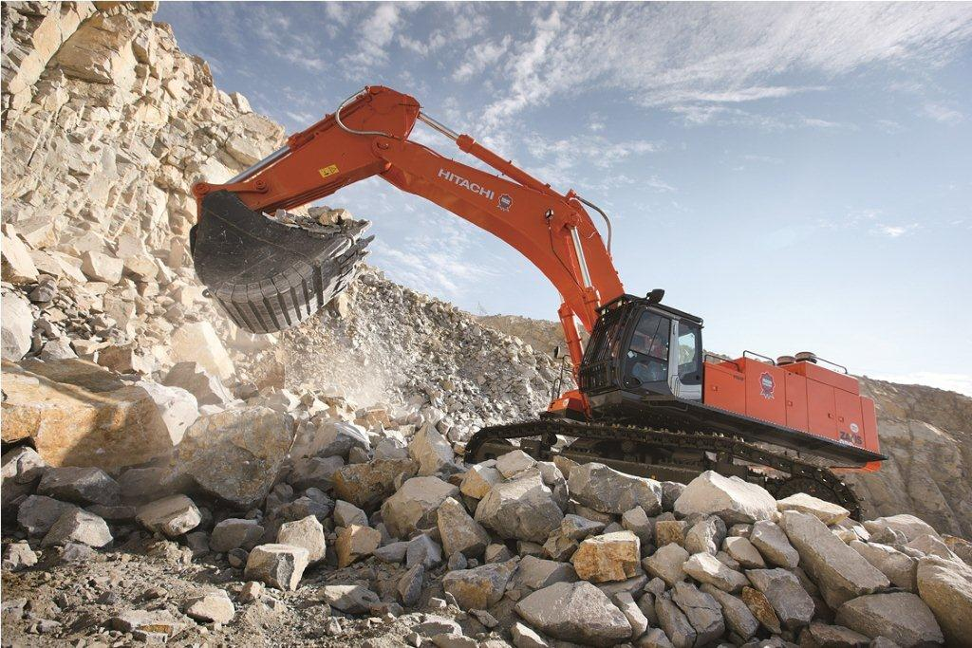
Quarrying

Slide 13
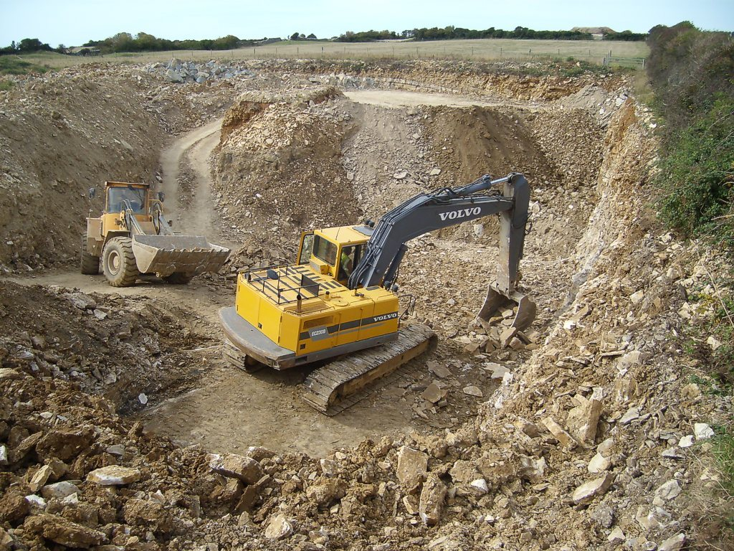
Quarrying

Slide 14
Open pit and open cast mining
Open pit and open cast methods employ a conventional mining cycle of operations to extract mineral:
Rock breakage
  Drilling and blasting
Materials handling

Slide 15
Open Cast Mining
Open cast mining is a surface exploitation method, used mainly for coal
Open cast resembles open pit
In open cast, overburden is not transported to waste dumps for disposal but cast or hauled directly into adjacent mined-out panels

Slide 16
Open Cast Mining
In open cast:
Materials handling consists of excavation and haulage (= casting), generally combined in one unit operation and performed by a single machine

Slide 17
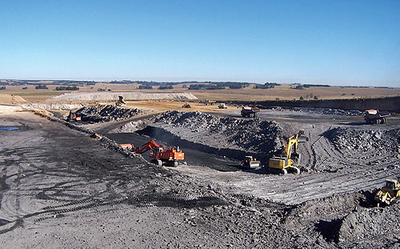
Open cast mining

Slide 18
Open Pit mining
In open pit mining:
Overburden is stripped and transported to a disposal area
Both stripping and mining are conducted from one or a sequence of benches

Slide 19
Open Pit Mining
Common large-scale surface mining
  Mechanised surface mining
Mechanical extraction
Bulk production
Provision of multiple benches

Slide 20
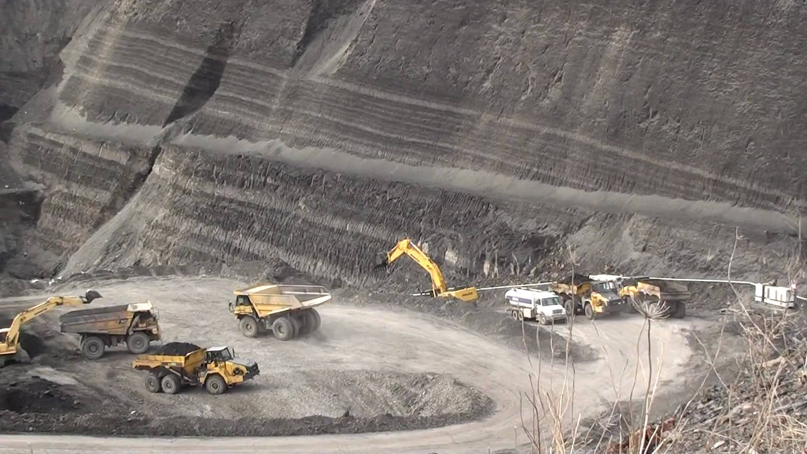
Open Pit mining

Slide 21
Open Pit Mining
The mining cycle of operations consists of:
Drilling
Blasting
Excavation
Haulage, and
Hoisting (for steep pits)

Slide 22
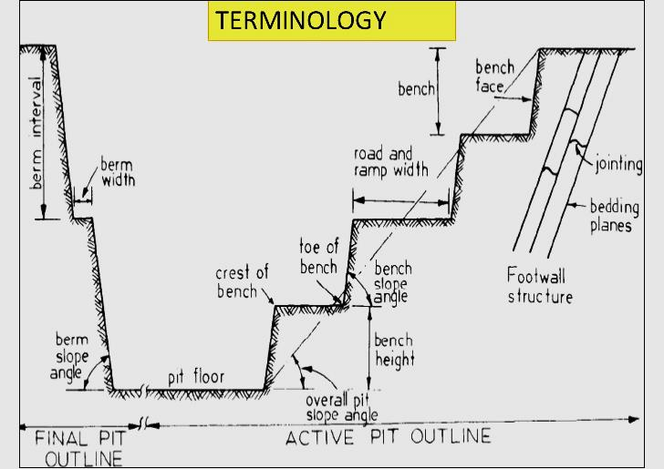

Slide 23
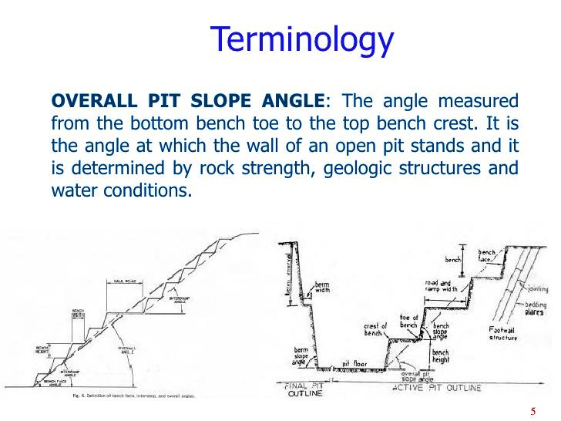

Slide 24
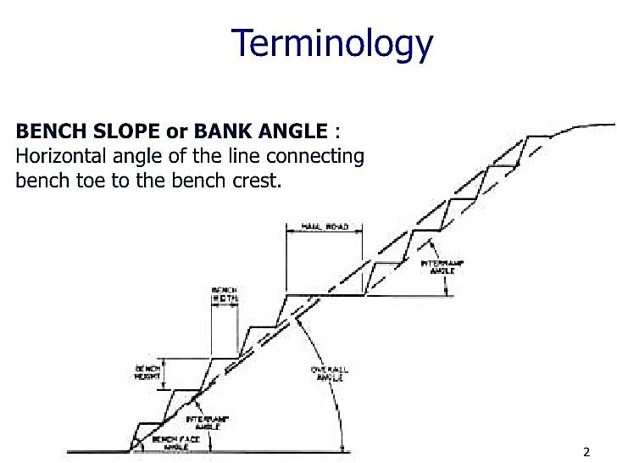

Slide 25
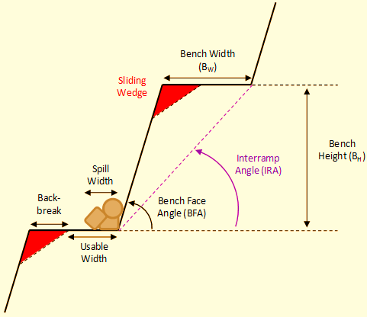
Terminology

Slide 26
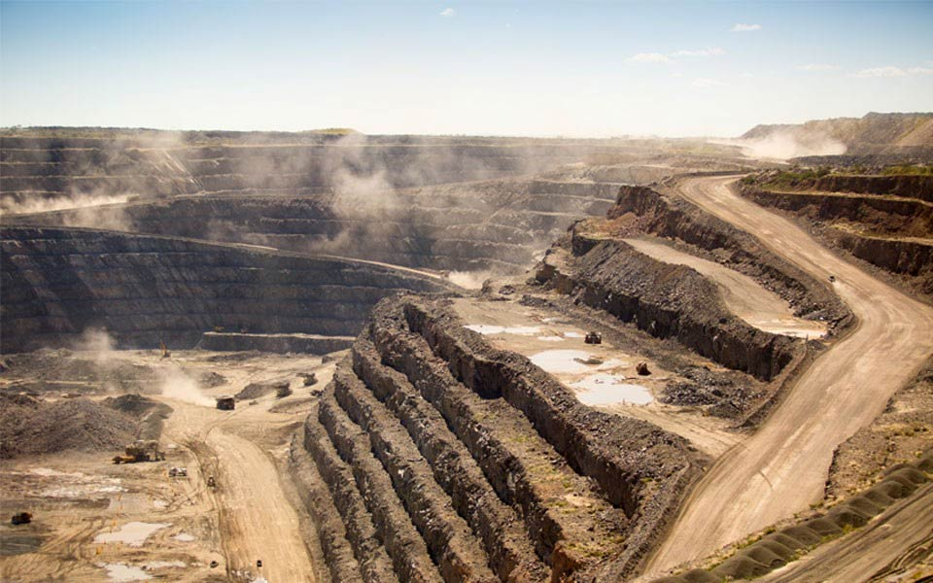
Open pit mining – benches and berms

Slide 27
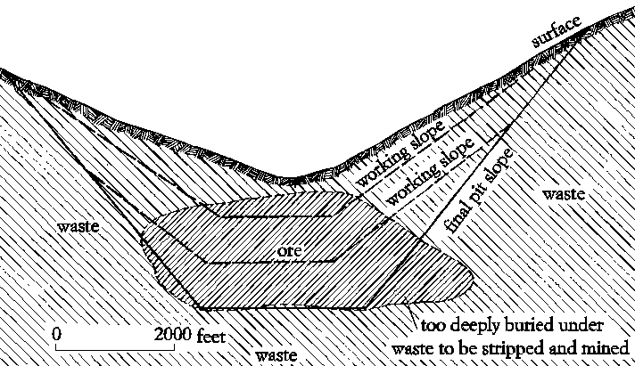
Terminology

Slide 28
Advantages of Open Pit Mining
High productivity
Low cost
High production rate
Early production
Low labour requirement
Relatively flexible
Suitable for large equipment
Simple development and access
Less support
Good health and safety

Slide 29
Disadvantages of Open Pit Mining
Limited by depth (<500m)
Limited by stripping ratio (0.8 to 4.0m³/tonne)
High capital investment
Large surface damage
Requires large deposit
Weather detrimental
Slope stability must be maintained
Must provide waste disposal

Slide 30
Pit Planning and Design
Factors considered include:
Geologic factors
Geologic conditions
Ore type
Hydrologic conditions
Topography
Metallurgical characteristics

Slide 31
Pit Planning and Design: Factors Considered
Economic factors
Ore grade and tonnage
Stripping ratio
Cutoff grade
Operating cost
Investment cost
Production rate

Slide 32
Pit Planning and Design: Factors Considered
Technological factors
Equipment
Pit slope
Bench height
Road grade
Pit limits

Slide 33
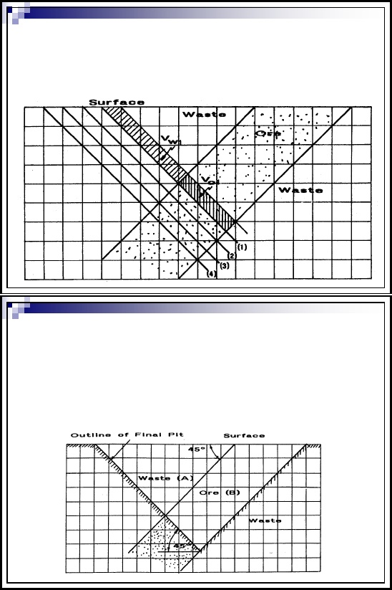
Open Pit Layout

Slide 34
Stripping Ratio
A stripping ratio is an important measurement related to the open-pit mining process.
It represents the amount of waste material, also known as overburden that must be moved in order to extract a given amount of ore.
Stripping ratio (SR) - Quantity of waste : Quantity of ore
  SR = waste (volume) / Ore (volume) or
  SR = overburden / ore or coal

Slide 35
Determination of the maximum allowable stripping ratio (SR_{max})
Break-even ratio
Based on economics
Establishes the pit limit
SR_{max} is defined as the ratio of overburden to ore at the ultimate boundary of the pit where profit margin is zero.
SR_{max} = (value of ore – production cost) / stripping cost

Slide 36
Maximum allowable stripping ratio (SR_{max}) enables:
Location the ultimate pit boundary or pit limit for:
Prevailing economic conditions and
Existing physical and geometric conditions.

Slide 37
Surface Mining Equipment
Selection of surface mining equipment
  Factors to be considered
Types of equipment

Slide 38
Surface Mining Equipment Selection
Factors to be considered:
The main operations
Ground preparation
Excavation
Loading
Transportation
In many cases, these are interdependent.
Production rate
Optimum cost per tonne

Slide 39
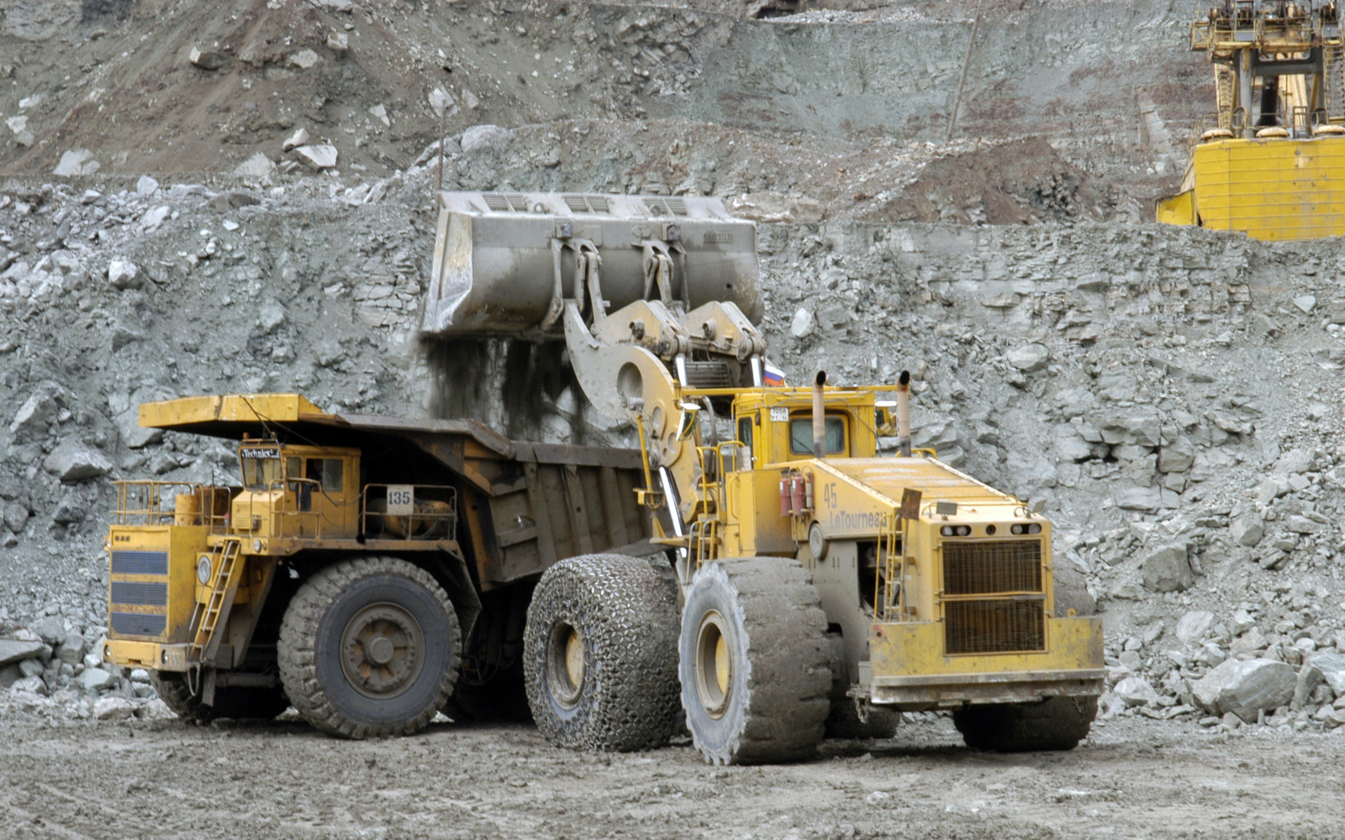
Surface mining equipment

Slide 40
Surface Mining Equipment Selection
Other factors to be considered include:
Diggability
Maneuverability
Power supply
Capacity
Machine geometry
Cost of equipment
Cycle time

Slide 41
Types of equipment:
Loaders
Excavators
Draglines
Scrapers
Trucks
Belt conveyors
Bulldozers
Shovels

Slide 42
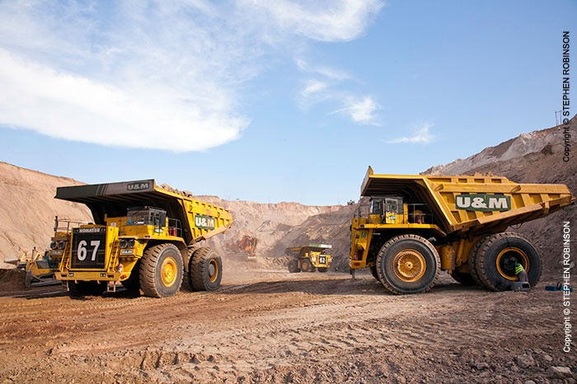
Open Pit Mining Equipment

Slide 43
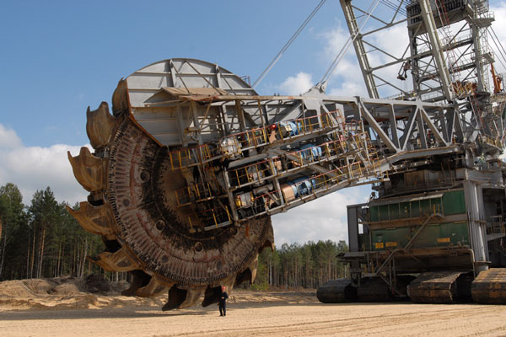
Bucket wheel excavator

Slide 44
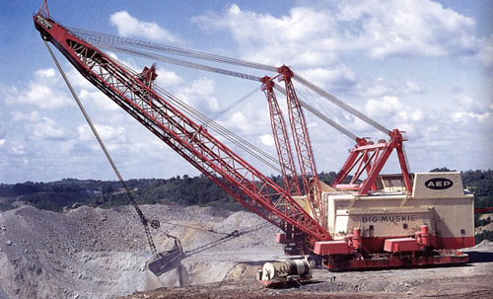
Walking dragline

Slide 45
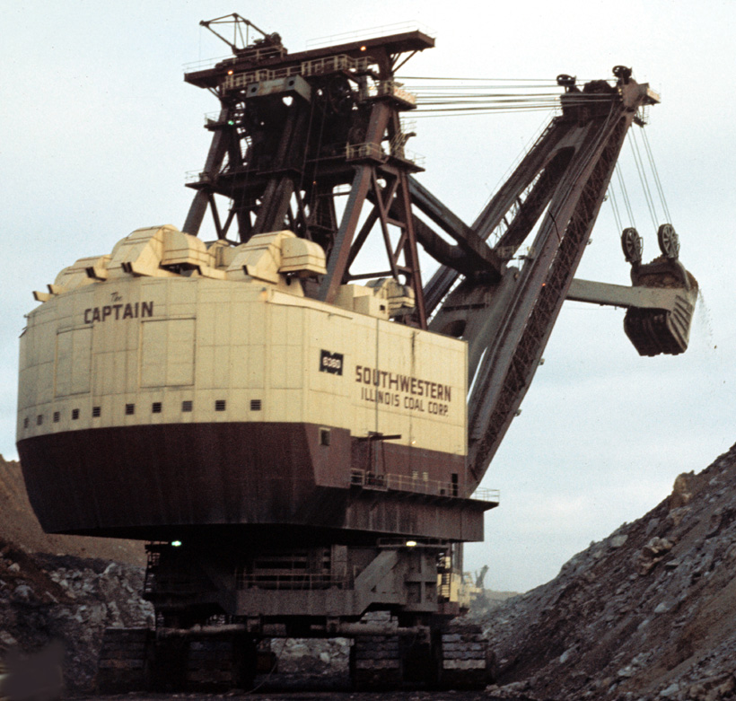
Stripping shovel

Slide 46
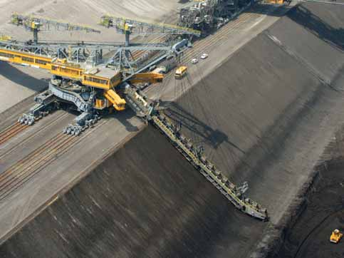
Bucket chain excavator

Slide 47
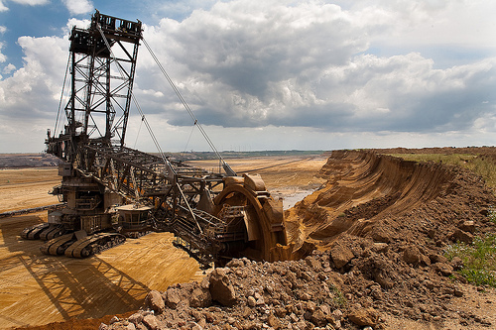
Bucket wheel excavator

Slide 48
Class work
What is an outcrop?
Describe five environmental concerns considered in surface mine planning?
Describe in details three advantages and three disadvantages of open pit mining
Give five examples of geologic conditions considered in in pit planning and designing
Differentiate between working pit slope and overall pit slope
6. Write brief notes on:
  Machine geometry
  Cycle time

Slide 49
7. Given the following per tonne:
  Drilling cost of ore-body = $13
  Blasting cost of ore-body = $15
  Transportation cost of ore = $21
  Drilling cost of overburden = $11
  Blasting cost of overburden = $13
  Transportation cost of waste = $17
  Value of ore = $132
Calculate the stripping ratio

Slide 50
  8. a) An open pit project has a cylindrical ore body
  with 110m height and 20m diameter, calculate the stripping ratio if the overburden is cone shaped with 29m diameter and 160m height.
b) If the cost of removing waste is as same as the
    cost of extracting ore, comment on viability of
    the project.
c) With help of diagrams, explain how the
profitability of the project can be improved.

