Slide 1
INTRODUCTION TO MINING ENGINEERING
By:
Dr. Sam Kangwa
Email: sam.kangwa@unza.zm

Slide 2
RECAP
Mining terminologies
2. Five stages of the life of a mine
  Prospecting
  Exploration
  Development
  Exploitation
  Mine closure / reclamation
3. Mineral resources and mineral reserves

Slide 3
RECAP
4. Classification of mining methods
5. Selection of mining methods
6. Surface mining
  Open pit mining
  Open cast mining
  Quarrying
  Auger mining
8. Underground mining and accessing underground
mineral deposits

Slide 4
RECAP
7. Underground mining
  Self-supported
    Room and Pillar
    Sublevel open stoping
  Artificially supported
    Cut and fill
    VCR
  Caving methods
    Block caving
    Sublevel caving

Slide 5
Tutorial or Revision Questions

Slide 6
In surface and underground mining, the primarily purpose is to extract mineral
Ore deposit has to be fragmented
In order to break the rock, there is need to drill blast holes place in explosives and blast

Slide 7
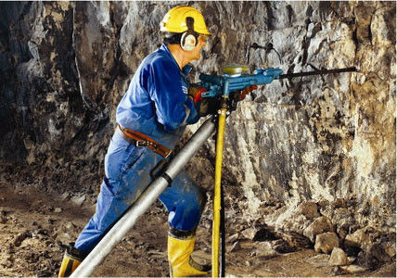
INTRODUCTION TO HARD ROCK DRILLING
MECHANICAL ROCK PENETRATION

Slide 8
BASIC PRINCIPLES OF DRILLING

Slide 9
Unit Operations of mining
There are two types of unit operations of mining:
Production operations
Auxiliary operations

Slide 10
Mining Unit Operation
The unit operations of mining are the basic steps used to produce mineral from the deposit, and the auxiliary operations that are used to support them. The steps contributing directly to mineral extraction are production operations, which constitute the production cycle of operations.

Slide 11
Unit Operations
Auxiliary operations include:
Support
Ventilation
Power supply
Pumping
Maintenance
Communication

Slide 12
Unit Operations
Units operations employed to produce minerals from deposits are:
Drilling
Blasting
Loading
Hauling
Production cycle = drill + blast + load + haul

Slide 13
Drilling
Drilling is the first unit operation employed to produce ore, therefore need to understand basic principles of drilling.

Slide 14
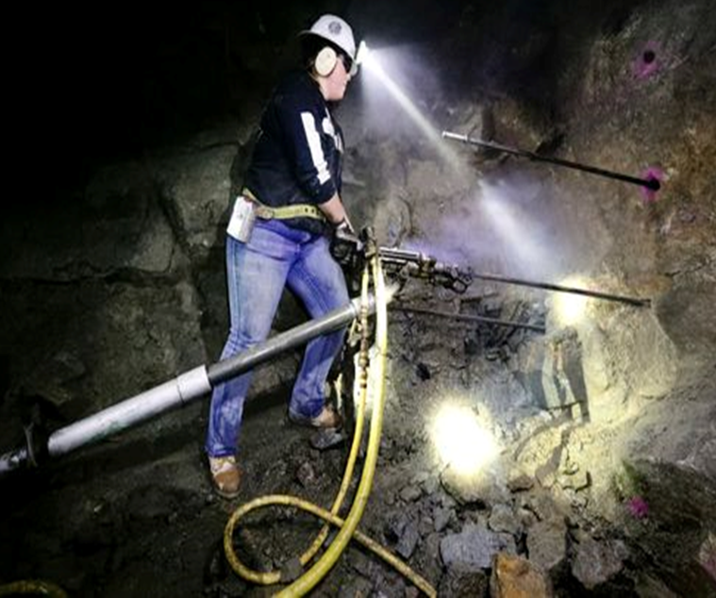
What is rock drilling?

Slide 15
Definition of rock drilling
Rock drilling:
Mechanical rock penetration
Process of cutting or boring rock
Energy must be applied to the rock by direct or indirect means to fragment the rock
Energy is generated by rock drills

Slide 16
Rock Drills
A rock drill is a drilling device designed specifically for penetrating rock.
A drill is a tool fitted with a cutting tool, usually a drill bit.
There are many types of rock drills including:
Electrical machines (electric drills)
Pneumatic drills (Compressed air machines)
Hydraulic drills

Slide 17
Rock drills can be hand-held or attached to drill rigs.
Hand-held drills are manually controlled by an operator

Slide 18
Hand- held rock Drills

Slide 19
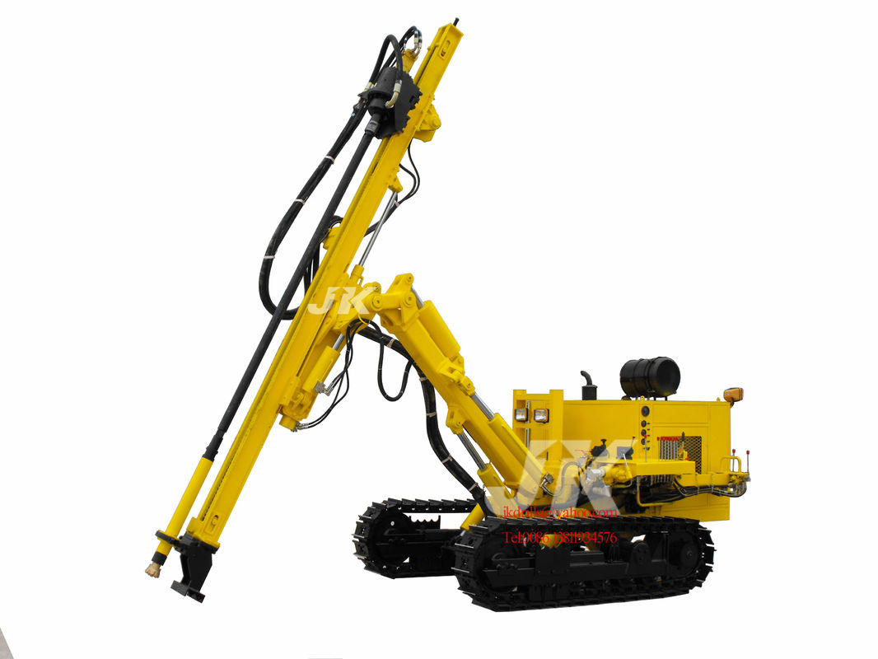
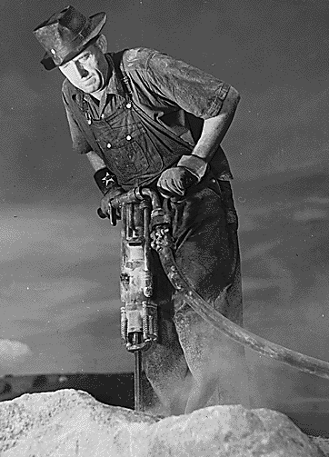
DTH Hydraulic Crawler Drill and Held-held Drill

Slide 20
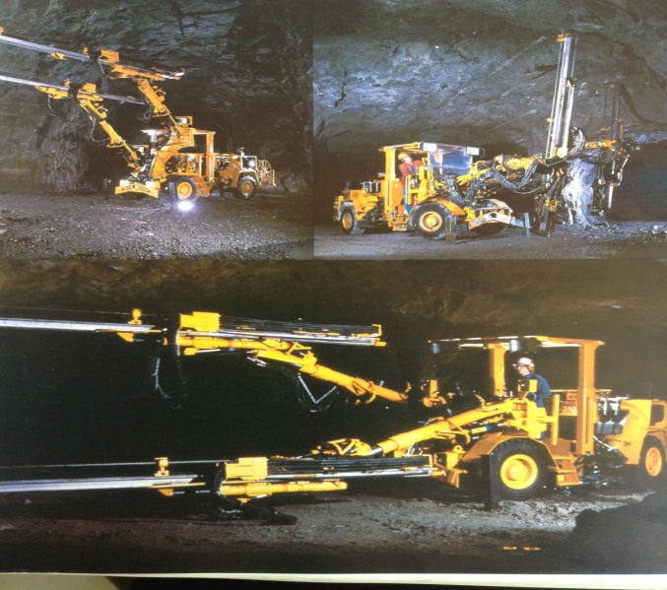
Boomer H120 Hydraulic Drilling Rig

Slide 21
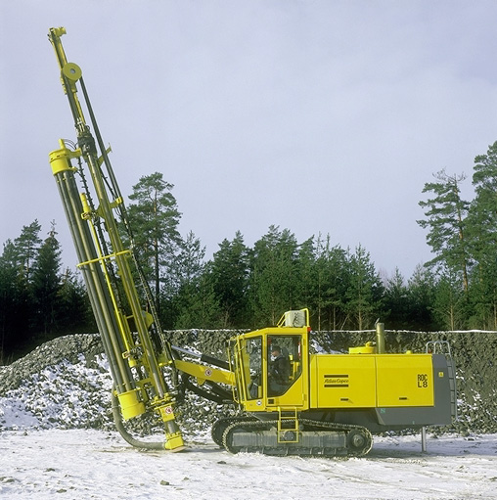
Rotary drill rig

Slide 22
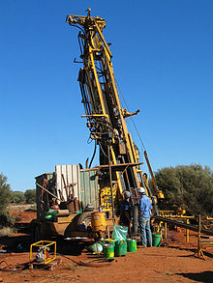
Core Drilling

Slide 23
Purpose of Drilling
The general purpose of holes drilled include:
Prospecting
Exploration
  Core drilling
Anchorage, and
Blast holes

Slide 24
Purpose of Drilling
For mining geologists, drill holes are specifically intended for:
Geological information
Establishment of stratigraphic column
Determination of presence of ore
Evaluation of ore and country rock
Estimation of tonnage and grade

Slide 25
Purpose of Drilling
For mining engineers, drill holes are intended for:
Anchorage or support systems
Drainage, and
Blast holes
  The main purpose

Slide 26
Blast-holes
The principle and economics of rock blasting in mining depends on the type and characteristics of drill-holes.
Explosives are loaded in the drill-holes and blasting techniques depends on:
Size of the blast-holes,
Depth, and
Spacing of drill-holes.

Slide 27
Blast-holes
The choice of explosives and the size of the most economics drill-hole size and drilling depth is dictated by the cost of drilling.
The cost of drilling depends on penetration and wear characteristics of the rock.

Slide 28
Drill Holes Characteristics
Drill holes are characterised by four factors:
Diameter
Length
Straightness
Stability

Slide 29
Classification of drilling according to energy used:
Drilling is mainly done by mechanical attack, other methods of cutting holes according to energy used include:
Thermal hydraulic
Electric and Electromagnetic
Sonic high frequency vibration
Light-laser system

Slide 30
Classification of Drilling
Classification according to principles of drilling:
Percussive action (hammer drills)
Rotary
Rotary-percussive

Slide 31
Trends in Drilling
Advanced Drilling Methods
Better technology
  Machine design
  Machine efficiency
  Less lose of energy
Modern equipment
  Automated
  Safe
  Environmental control

Slide 32
Trends in Drilling
Advanced Drilling Methods
Higher productivity
  Effective
  Low manpower
  High pay load
  High yield
Knowledge of mechanics of rock
  More knowledge of rock properties
  Properties affecting drilling

Slide 33
Trends in Drilling Equipment
Basic drilling tools
  Application of hammer and chisel
Hydraulic drilling equipment
ITH high pressure drilling equipment
Diesel powered drilling equipment
Electro-hydraulic drilling equipment

Slide 34
Automation of Drilling Equipment
Automated or computerized drilling
Eliminates the human factor
  Error in positioning and aligning
Rig orientates itself on its axis
Accurately collar and drill
Controls drilling parameters
Programmed coordinates, angles and depth
Optimum drilling of pattern of holes

Slide 35
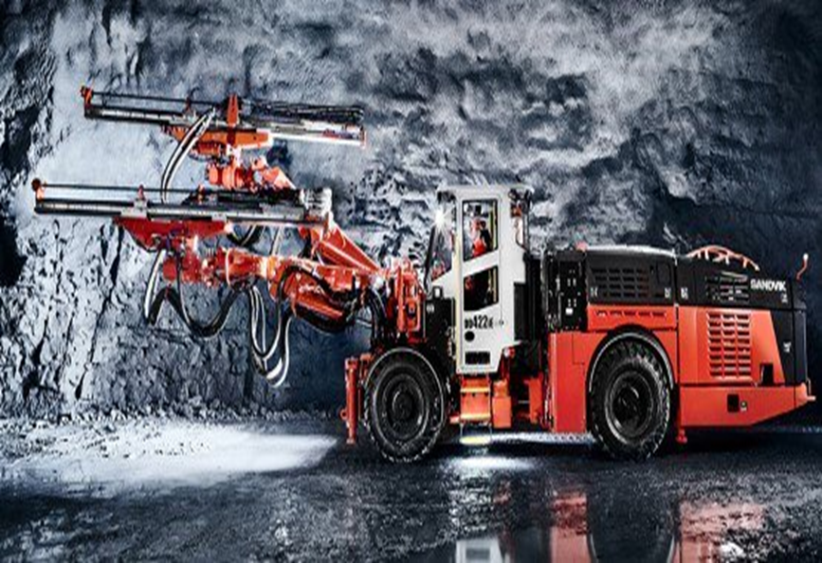
Automated Drilling rig

Slide 36
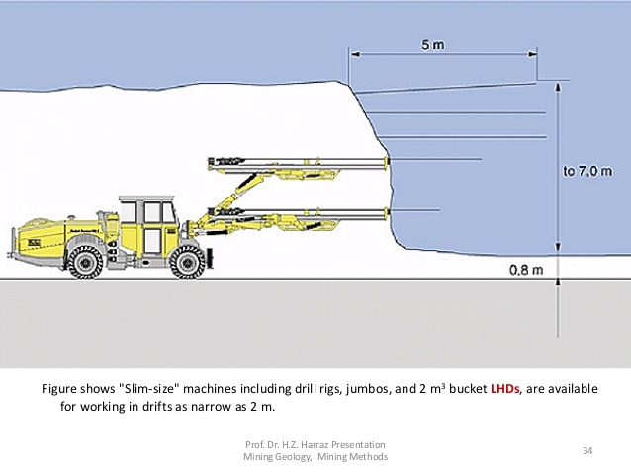
Drilling Rig

Slide 37
Factors Considered in Selection of Drilling Equipment
Length of holes
Diameter of holes
Rock characteristics
Drilling space
Source of drilling energy
Penetration rate
Safety

Slide 38
Factors Affecting Drilling Performance
1. Operating variables (controllable factors)
  Drill power
  Speed
  Thrust
  Bit and rod design
  Blow energy and frequency

Slide 39
Factors Affecting Drilling Performance
2. Rock factors (independent variables)
  Properties of rock
  Geologic conditions
  State of stress acting on the drill-hole
3. Service factors (external variables)
  Labour and supervision
  Power supply
  Job site

Slide 40
Performance Parameters
In selecting the optimal drilling system or evaluating drill performance, four parameters are measured or estimated:
Process energy
Penetration rate
Bit wear
Cost
  Ownership + Operating = Overall Cost

Slide 41
Revision Questions
Drilling technology has evolved from hand held pneumatic machines to automated drilling equipment. Explain how advanced drilling methods have affected the hole characteristics
List five units operations involved in stage four of the life of a mine
Describe four parameters considered in selection of optimal drilling system

Slide 42
Revision Questions
Explain how bit wear affects drilling performance
Describe physical and mechanical properties which affect drilling performance
Describe how rock strength properties relate to energy required for mechanical rock penetration?
With reference to drilling performance, differentiate between rock factors and service factors

