Slide 1
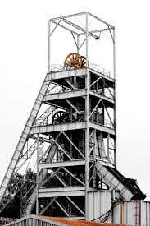
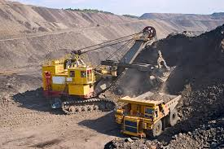
COURSE: MIN 2019
INTRODUCTION TO MINING
LECTURER – SAM KANGWA

Slide 2
Lecture: 1
Course outline
Assessment
References
Definitions
Stages in the life of a mine

Slide 3
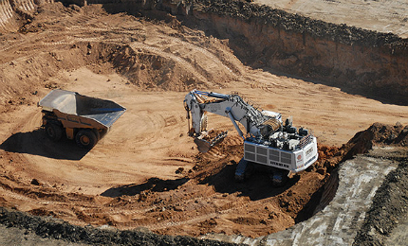
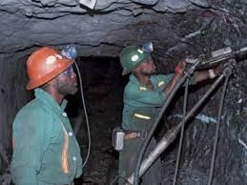
Stages in the life of a mine
Precursors to mining
  Prospecting
  Exploration
  Mineral resources
  Ore reserves estimation
Mining proper
Metallurgical processes
Post mining

Slide 4
What is Prospecting?
Prospecting is the initial stage in the life of a mine. It is the process of searching for valuable minerals which can be economically extracted.
Direct and indirect methods are used in prospecting
Direct methods include physical and geologic search
Indirect methods include geophysical and geochemical

Slide 5
Prospecting – Search for ore (mineral deposit)
  Prerequisite of geologic maps
  Regional approach - natural setting
  Locate favourable loci
  Aerial survey
  Spot anomaly

Slide 6
Mineral Exploration
Mineral exploration is the process of delineating and evaluation of ore deposits
Commercially viable concentrations of minerals to mine.
Mineral exploration is a much more intensive, organised and professional form of mineral prospecting.

Slide 7
Exploration
Exploration involves geological mapping and surveying. Various methods are employed in exploration including:
Geochemical exploration
Trenching and sampling
Core drilling and logging
Sampling and mapping

Slide 8
Exploration
Exploration is more precise than prospecting.
Exploration determines:
Size and value of the ore-body
Geometry
Extent
Worth of an ore
Mineral resource classification

Slide 9
Mineral Resource Classification
Classification of mineral resources is based on their geologic certainty and economic value.
Mineral deposits can be classified as:
Mineral resources that are potentially valuable, and for which reasonable prospects exist for eventual economic extraction.
Mineral reserves or Ore reserves that are valuable, legally, economically and technically feasible to extract.

Slide 10
Mineral Resource
A 'Mineral Resource' is a concentration or occurrence of material of intrinsic economic interest
Quality and quantity
Economic extraction.
Mineral Resources are further sub-divided, in order of increasing geological confidence, into:
Inferred,
Indicated and
Measured categories.

Slide 11
Resources
Resources may also make up portions of a mineral deposit classified as a mineral reserve, but have not been sufficiently drilled out to qualify for reserve status; or have yet to meet all criteria for reserve status.
Mineral reserves are resources known to be economically feasible for extraction. Reserves are either:
Probable Reserves or
Proved Reserves.

Slide 12
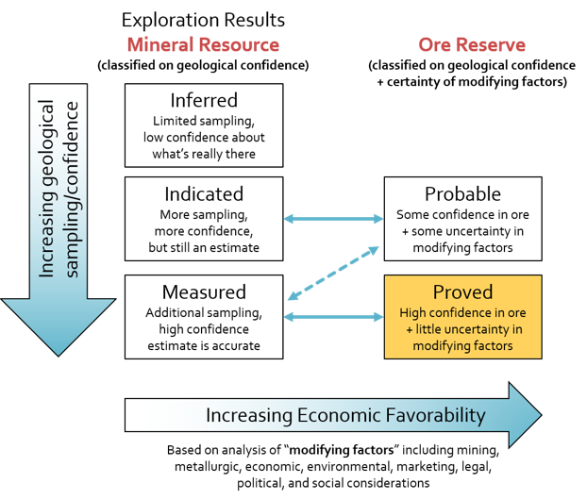

Slide 13
Resource into Reserves
Generally the conversion of resources into reserves requires the application of various modifying factors that include:
Mining and geological factors
Sufficient knowledge of the geology of the deposit
Extraction and mine plans based on ore models
Sufficient geotechnical information
Metallurgical factors
Assay data
Economic status – profitable for mineral processing

Slide 14
Other modifying factors include:
Political
Economic
Social
Technological
Legal
Environmental
(PESTLE factors)

Slide 15
Reserve Estimates
Estimation of defined mineral resources and reserves:
Extent of the ore body
Average grade
Tonnage
Mineral content

Slide 16
Reserve Estimates
Ore estimation is a process:
Begins with exploration
Feasibility studies
Continuous refining
Ore estimation determines if a mine has to be developed or not.

Slide 17
Reserve Estimates
Two general methods:
Classical
Geostatistical
Classical method employs two-dimensional
maps and is hand calculations. It is satisfactory
for small, uncomplicated ore bodies.
Geostatistical is digitalised method and may
require audit by another procedure.

Slide 18
Reserve Estimates
Raw data for reserve estimates is derived from sampling of the deposit.
The average grade of the deposit is based on assay of samples.
The tonnage of an ore deposit is calculated from the measurements of area and volume converted to tonnage.

Slide 19
Reserve Estimates - Tonnage
For regular ore deposit with known dimensions, an area can be calculated.
For irregular deposits, a planimeter, an integrating measurement device, can be used to determine the area.
Knowing the width of influence, the area can be converted to volume.
The tonnage can be calculated from the volume

Slide 20
Reserve Estimates - Tonnage
The estimated reserves need to be checked and modified by technical and economic realism.
At least three factors must be estimated:
Mining and processing recoveries
Waste dilution during mining
Cut off grade.
The incorporation of the above into estimated reserves, provide a much more accurate result.

Slide 21
Reserve Estimation
Use of:
Classical procedures - Polygon method
Triangle Method - modification of the polygon method
Section method - blocks of ore are outlined on regularly or evenly spaced cross sections of the ore body
Computer application in calculation of ore reserves and grade is used.

Slide 22
Ore Grade
The concentration of a valuable mineral within an ore.
Grade is the percentage of each valuable mineral in an ore.
The average grade of a block of ore is calculated from the average grades.
The most important factor in the profitability of a mine is usually the price of the metal.

Slide 23
Volume of ore body
The weight of a block of ore is estimated by first calculating the volume and then applying a factor to convert volume into tonnage.
Volume = Thickness x Area.
Tonnage = volume x specific gravity

Slide 24
End of lecture II
Class work

Slide 25
Class work
Q1. Differentiate between:
    Prospecting and exploration
    Mineral resources and mineral reserves
Q2. Explain how PESTLE factors affect the mining
industry operations
Q3. Describe what is involved in mine project
feasibility studies

Slide 26
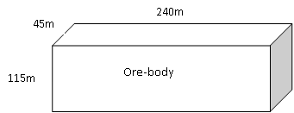
Q4. With reference to the copper ore-body below, calculate the tonnage and grade if refined copper is 72,000T, take SG as 2.5

Slide 27
Q5. Given a cylindrical-like ore body;
r = 164m, h = 387m and rock density of
2.5. Estimate the total tonnage of the ore-body.

Slide 28
Q6. With reference to an irregular ore-body ABCD and given AB = 430m; AD = 660 and the average ore-body thickness is 350m, estimate the total tonnage of the ore-body, state all assumptions (if any).
C
B
A
D

Slide 29
Q7. Estimation of Profit
a) Estimate the unit profit in mining and processing of 0.6% copper ore deposit if the selling price of copper in concentrate is US$1.63 per kg and overall unit costs are US$7.50 per tonne. Overall recovery is 92%
b) Calculate the cut-off grade for the same copper deposit
Method:
First calculate the value of the ore as:
Value = grade x recovery x price
Profit = value – cost
Cut-off grade = Cost / (price x recovery)

