Slide 1
Mine Materials Handling

Slide 2
Technology in materials handling has evolved from rudimental application of elementary equipment to application of advanced and automated equipment.
The earlier equipment included:
Use of sacks to transport material (ore and waste)
Use of pick and shovel to loosen material
Use of wheelbarrow to transport material
Use of wooden wagon for materials handling.

Slide 3
Fundamentals of equipment selection
The process of mine equipment selection is extremely important and sensitive as it often has a great impact on mining operations.
Factors considered include:
Capacity
Haul distances of both ore and waste;
  Cycle time
  Haulage Cycle = Load + Haul + Dump + Return
Operating room within the mine design (surface and underground);
Availability and cost of power, fuel and manpower.

Slide 4
Factors considered include:
5. Weather and environmental conditions;
6. Mine life versus capital requirements for a specific mining system;
7. Operating characteristics of the equipment;
Desired flexibility to production requirements and scheduling.
Safety
Modern materials handling equipment include:
Hoists or winders
Belt conveyors
Locomotives
Mechanised mine loading and hauling equipment

Slide 5
Mine Conveyor Belt System
Conveyor belt system is a conveying system of material. Friction force drives the belt to achieve continuous transportation.
The material on one end will be discharged on the other end driven through the belt, and then the delivery process is completed.
A belt conveyor system consists of two or more pulleys, with an endless loop of carrying medium—the conveyor belt—that rotates about them. One or both of the pulleys are powered, moving the belt.
The powered pulley is called the drive pulley while the unpowered pulley is called the idler pulley.

Slide 6
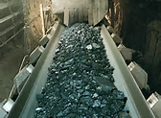
Conveyor Belt

Slide 7
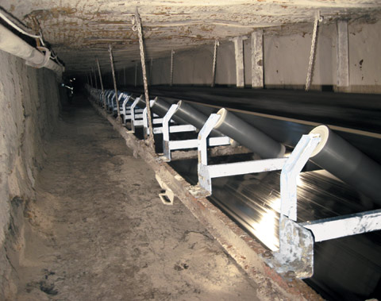
Belt Conveyor
The belt conveyor can stretch up to 50km

Slide 8
Belt Conveyor
Belt conveyors consist of a metal frame with rollers.
The force required to drive a belt conveyor is transmitted from the drive pulley by means of friction.
Power is produced by effective tension
The difference in tensions is supplied by the driving
power source.

Slide 9
Pulley Driving Belt

Slide 10
Belt Conveyor
Power is produced by effective tension (T_{e})
T_{e} = T₁ - T₂ = effective belt tension (ideal)
T₁ = tight-side tension at pulley
T₂ = slack-side tension at pulley
Wrap Factor, Cw is used in the determination of the effective (driving) belt tension.
T_{e} is directly a function of coefficient of friction and the values of T₁ and T₂

Slide 11
Single-pulley drive

Slide 12
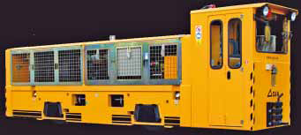
Materials handling for haulage system - Locomotive

Slide 13
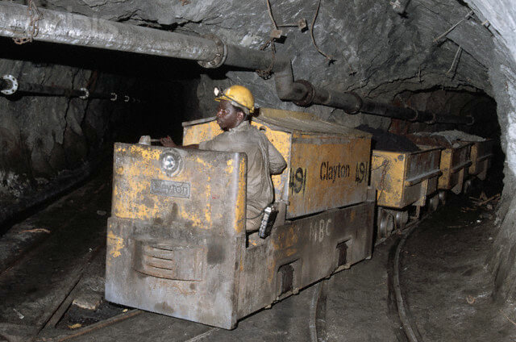

Slide 14
Locomotive Haulage
Locomotive haulages are mainly used for bulk material handling:
Ore
Waste rock
Mine equipment
Man riding
The main factors considered in selection of the type of locomotive include:
Tonnage to be hauled
Haul length
Gradient
Shape and cross-sectional area
Track gauge

Slide 15
The above factors will determine:
Weight of locomotive
Weight of train
Speed
Number of locomotives to be used
Classification of locomotives:
Battery powered locomotives
Electric locomotives
  Overhead trolley electric wire
Diesel locomotives

Slide 16
Locomotive force
The Force which a locomotive can exert is a function of its weight and is known as the Tractive Effort.
The locomotive can only exert this force if the friction between driving wheels and rails is sufficient and this depends upon the Coefficient of adhesion or static friction between the wheel and rail.

Slide 17
Locomotive Tractive Effort
Tractive effort is the pulling force - it is equal to the coefficient of friction times the weight of locomotive. Coefficient of friction is in the order of 0.25 for metal on metal
metal wheel on metal rail
Tractive effort is the force that a locomotive can apply to its coupler to pull a train.
In mathematical terms:
Tractive effort = tractive force + rolling resistance

Slide 18
Forces acting on a train
The dynamics of a train moving with speed v along a track inclined at an angle α to the horizontal are determined by the forces shown in the Figure.

Slide 19
Drawbar Pull
Drawbar pull is the pulling power exerted at the drawbar. It is the amount of horizontal force available to a locomotive at the drawbar.
Drawbar pull is the difference between tractive effort available and tractive effort required to overcome resistance at a specified speed.

Slide 20
Train
(Unbraked rolling stock)
Prime Mover
Locomotive
Rail
Mine Cars
Drawbar Pull
Driving Wheels

Slide 21
Mechanised Loading and Hauling Equipment

Slide 22
Mechanised Loading and Hauling
Most mining operations are mechanised.
Mechanised equipment is used for loading, hauling and dumping bulk materials.
Mechanised equipment is preferable because of high productivity.

Slide 23
Mechanised loading and hauling equipment include:
LHD – (Load-haul and dump) loader
Dozer
Front-end loader
Scoop
Wheel loader

Slide 24

Front-End Loader

Slide 25
Advantages of mechanised loaders
Versatility
High availability
High productivity
Lower initial cost
Adaptability
May be used for ore, waste or haulage cleaning
Not severely affected by moderate grade

Slide 26
Disadvantages:
Require good rock fragmentation
Costs of tires are high
Loaders depreciate quickly
Loaders reliability is (about 65%)
Loaders are limited to low muck-pile
Damage to truck body is common

Slide 27
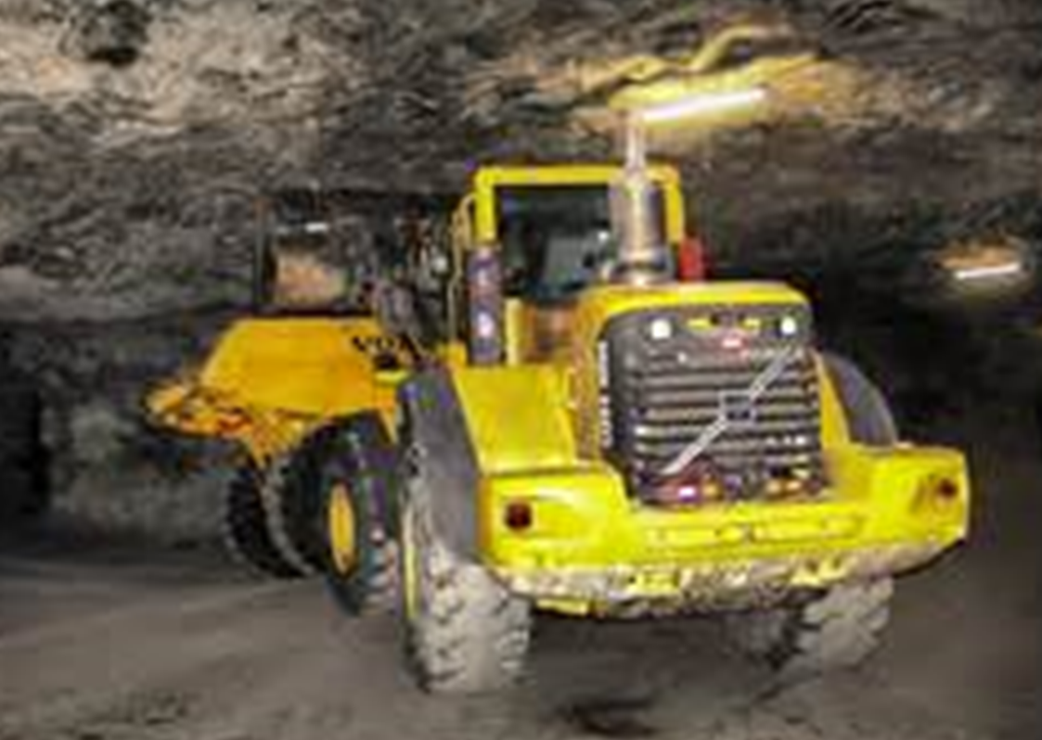
Wheel loader

Slide 28
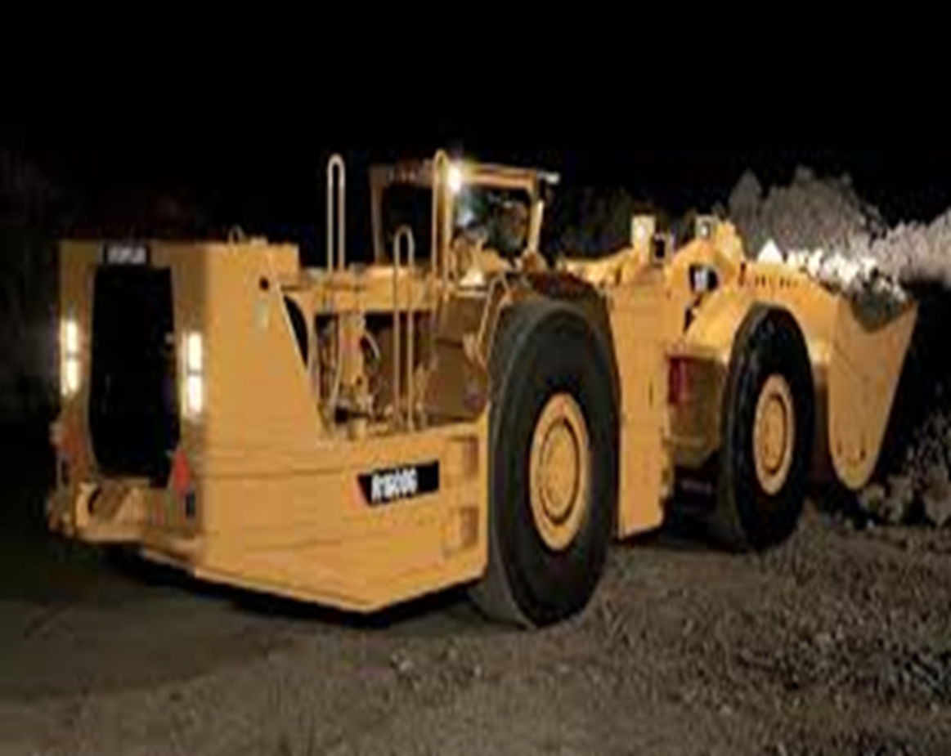
LHD

Slide 29
LHD : General description
LHDs vehicles combine characteristics of conventional front end loaders and dump trucks.
Design intent is to provide one vehicle that is capable of loading itself, hauling and dumping the load with one man.
The selection of LHDs is done based on:
Vehicle size - whether the LHD will fit into the haulage ways of the mine
Allowances for turning - to provide vehicle’s turning radius
Clearance must be provided for operator and auxiliary installations.

Slide 30
Other materials handling equipment include:

Slide 31
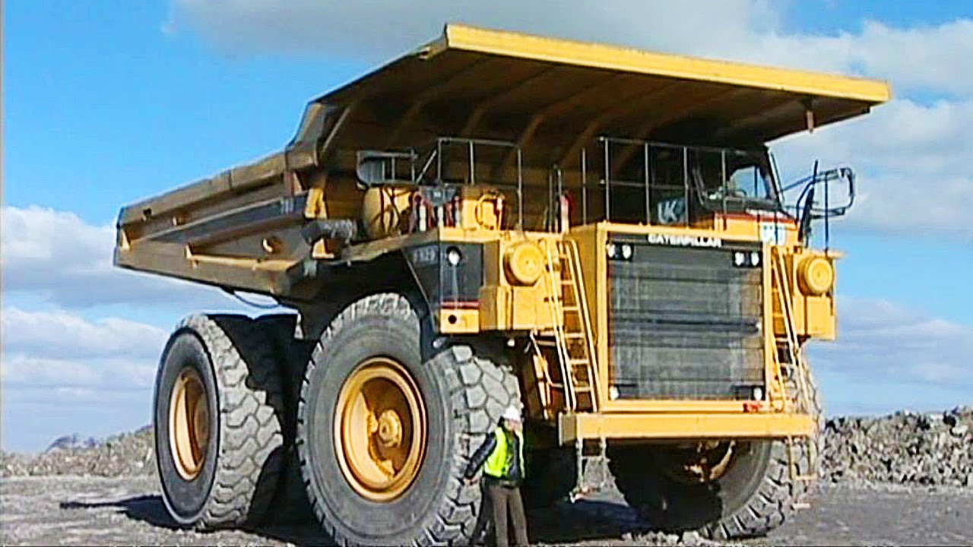
Dump truck

Slide 32
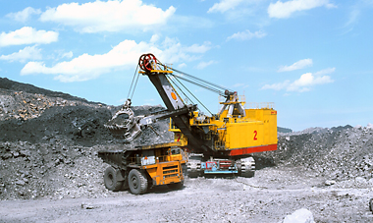
Dragline

Slide 33
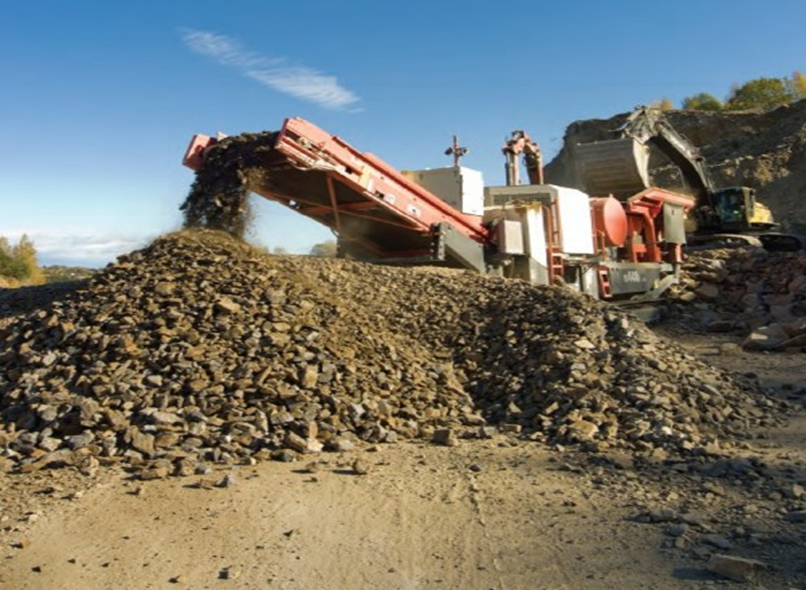
Conveyor belt on a crusher

Slide 34
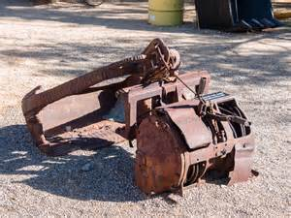
Slusher equipment

Slide 35
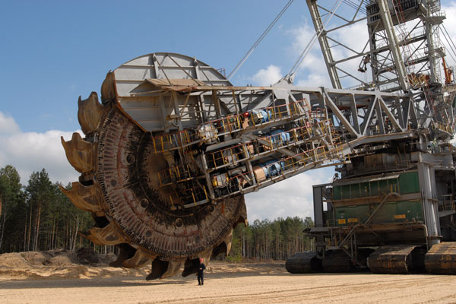
Bucket Wheel Excavator

Slide 36
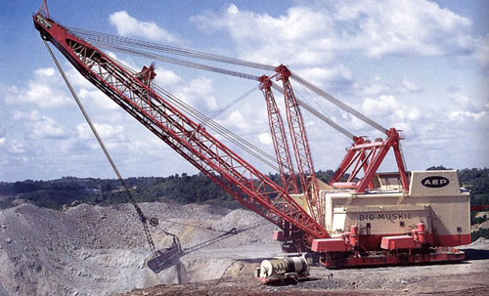
Walking dragline

Slide 37
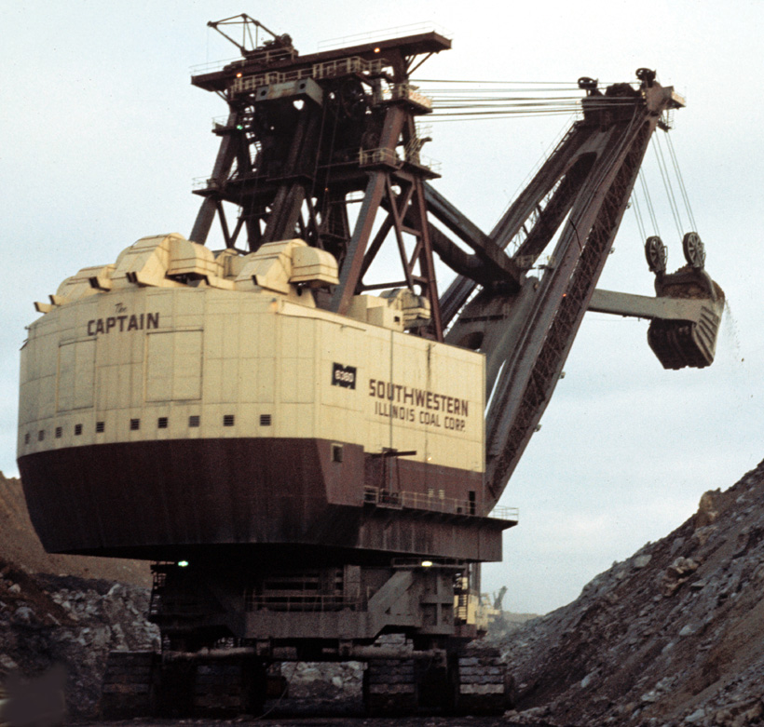
Stripping Shovel

Slide 38
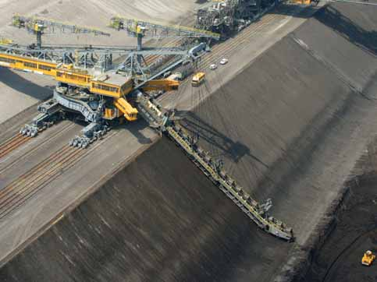
Bucket Chain Excavator

Slide 39
Revision Questions
Describe conditions which are suitable for the application of the following as mine materials handling equipment:
  Belt conveyor
  Locomotive
  Load-haul dump equipment
Calculate slack-side tension of the belt conveyor given effective tension as 49.2kN if the slack-side tension is a third of tight-side tension.

