Slide 1
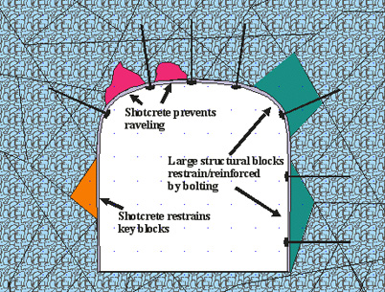
Rock Bolting as mine supporting system

Slide 2
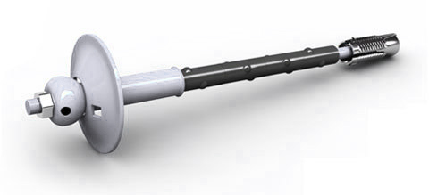
What is Rock Bolt
A rock bolt is a long steel rod anchored for stabilising mine excavations
It transfers load from the unstable exterior, to the confined (and much stronger) interior of the rock mass.

Slide 3
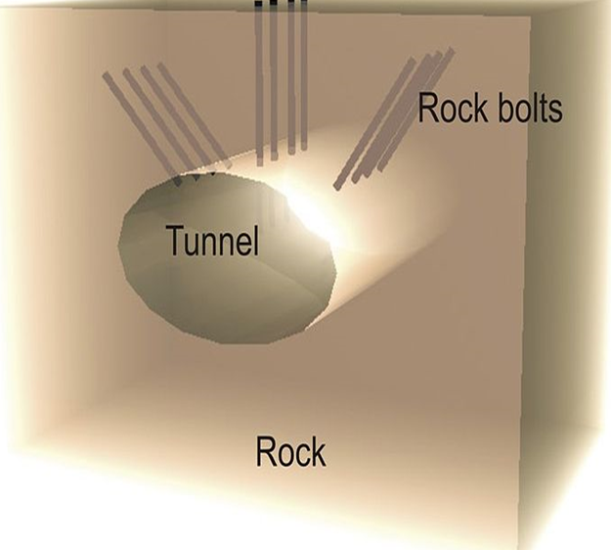
Concept of Rock Bolting
Rock bolts are installed in a pattern and the design of which depends on the:
  Rock Quality Designation (RQD) and
  The type of excavation.

Slide 4
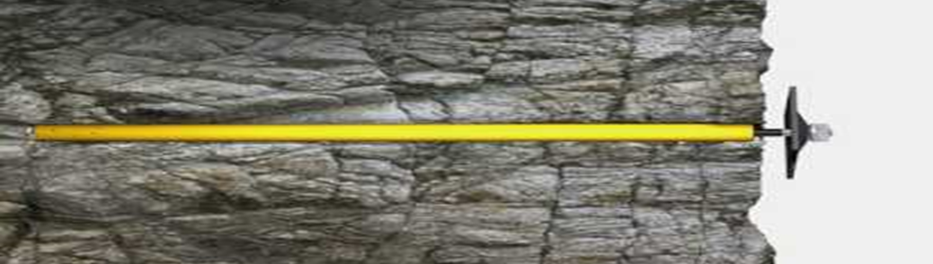
Rock bolting
Rock bolting is the process of inserting steel rod into a drilled hole to provide support to the excavation
Rock bolt reinforcement
  Applied in any excavation geometry,
  Simple and quick.

Slide 5
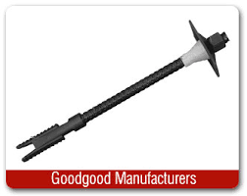
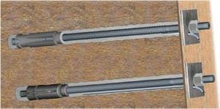
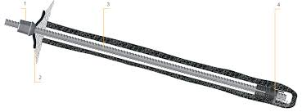
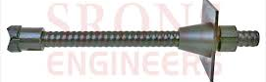
Types of Rock Bolts

Slide 6
There are three major ways of anchoring the rock bolts:
Mechanical,
Grouted, and
Friction.

Slide 7
Mechanical Rock Bolting
The most common form of mechanically anchored rock bolt uses an expansion shell.
A wedge attached to the bolt shank is pulled into a conical expansion shell as the bolt is rotated forcing the shell to expand against the wall of the borehole.
A preload can be applied to the rock surface by tensioning the bolt with an attached face plate, which is designed to distribute the load uniformly onto the surrounding rock.

Slide 8
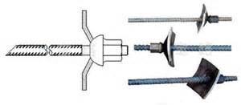
Mechanical Bolts

Slide 9
Grout Rock Bolting
The most common grout-anchored rock bolt is the fully grouted rebar, a threaded bar made of steel.
Cement or resin is used as the grouting agent.
A cable bolt is a reinforcing element made of steel wires or rope.
Steel rope is installed in the borehole with cement grout.

Slide 10
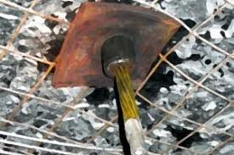
Cable bolt made of steel wires or rope

Slide 11
Grouted Bolts
Resin grouted rebar is used in areas which require more support than a point anchor bolt can give.
The rebar used is of similar size as a point anchor bolt but does not have an expansion shell.
Once the hole for the rebar is drilled, cartridges of polyester resin are installed in the hole.

Slide 12
Grouted Bolts
The rebar bolt is installed after the resin and spun by the installation drill.
This opens the resin cartridge and mixes it.
Once the resin hardens the drill spinning tightens the rebar bolt holding the rock together.
Resin grouted rebar is considered a permanent ground support with a lifespan of 20–30 years.

Slide 13
Friction Rock Bolting
Friction-anchored rock bolts represent the recent development in rock reinforcement techniques.
Frictional resistance to sliding is generated by a radial force against the borehole wall over the whole length of the bolt.

Slide 14
Friction Bolts
Friction stabiliser (or split set) is much easier to install than mechanical bolts or grouted bolts.
The bolt is hammered into the drill hole, which has a smaller diameter than the bolt.
Pressure from the bolt on the wall holds the rock together.
Once installed the friction increases by a factor of
3 - 4.

Slide 15
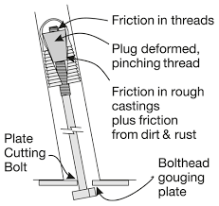

Friction Bolts

Slide 16
Swellex
Swellex is a rock bolt made of a welded tube.
Swellex is similar to friction stabilisers, except the bolt diameter is smaller than the hole diameter.
High pressure water is injected into the bolt to expand the bolt diameter to hold the rock together.

Slide 17
Swellex products

Slide 18
Mechanics of Swellex
The Swellex rock bolt is sealed at one extremity;
The other extremity is equipped with a special head bushing used for inflation.
The expansion of the bolt, inside the borehole, creates a friction and interlocking anchor, which provides full column support.

Slide 19
Mechanics of Swellex
Due to this anchorage mechanism, the Swellex bolt can adapt to a wide va­riety of rock conditions and provides good to excellent anchorage capacity.
The steel profile can adapt shear movements without failure.
Swellex support is quick, safe and high-performance device
Capacity: 120kN, 160kN, 240kN
Inflated to pre-determined pressure.

Slide 20
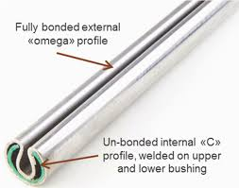
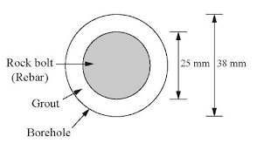
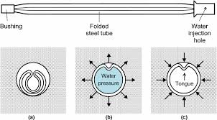
Swellex

Slide 21
Cable and wire mesh support
Wire mesh is used to support small pieces of loose rock and broken rock from falling.
Two types of wire mesh currently used in underground operations are chain-link mesh and weld mesh
Mesh is very economical and quickly installed. It is easy to attach to roof reinforcement with extra faceplates and nuts. It is easily repaired.
Mesh cannot carry excessive load of broken rock without failure. It is easily damaged by fly-rock from nearby blasts.

Slide 22
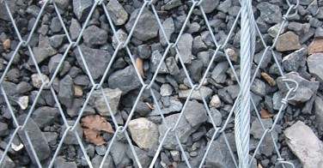
Cable bolt made of steel wires or rope

Slide 23
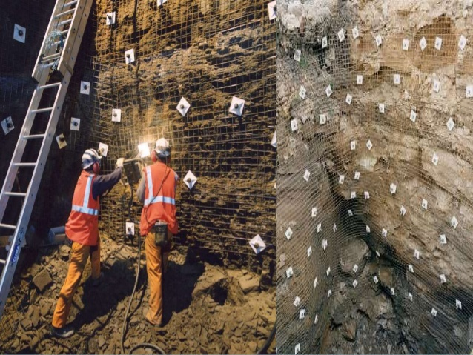
Rock Bolts and Wire Mesh

Slide 24
The capacity of mechanical rock bolt depends on the tension created when the bolt if mechanically rotated by the expansion bolt shell.
The force is created against the wall of the borehole as the shell expands.
The tension is calculate by applying the formula:
P = C * T
Where: P = Bolt tension; T = Torque; C = Factor for forged head bolts.

Slide 25
With reference to mine support mine system, explain the principle of rock bolting.
With reference to the table below:
  Estimate C Factor for 21mm forged rock bolt
  Plot tension (P) torque (T) graphs for the three bolts on the same graph paper
  With the help of graphs, explain the relationship between tension and torque in a rock bolt
  Select a suitable rock bolt for low stress rock condition and give reasons.
Bolt | Bolt diameter | C Factor | Bolt tension (kN)
1 | 16mm forged rock bolt | 50 | 5, 8, 11, 14, 17 and 20
2 | 19mm forged rock bolt | 40 | 5, 8, 11, 14, 17 and 20
3 | 21mm forged rock bolt | ? | 5, 8, 11, 14, 17 and 20

