Slide 1
Mine Excavations and
Timber Support Systems

Slide 2
Mine Excavations include:
Shafts
Adits
Portals
Crosscuts
Drives
Ramps
Raises
Ore passes
Pump chambers
Stopes
Open pits
Tunnels
Haulages
Winzes

Slide 3
Design of the mine excavation depends on:
1. The ground condition
  Stable
  Elastic or falling
  Squeezing
2. In-situ stresses
3. Rock mass strength.

Slide 4
Designing Mine Excavation
Excavating in elastic and competent ground condition can face two scenarios:
Where no supports are required
  A self-supporting condition, and
Where supports are required for stability
  Non-squeezing condition.
Excavating through the squeezing ground condition is a very slow and problematic process.
Rock mass around the opening loses its inherent strength under the influence of in-situ stresses

Slide 5
Excavation Methods
There are mainly two excavation methods used in the mine:
Conventional method
  Drilling and blasting
Unconventional method
  Boring method - use of excavating machines like a raise-borer
  No drilling and blasting

Slide 6
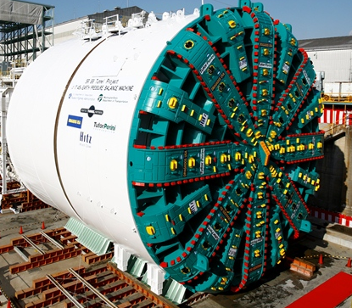
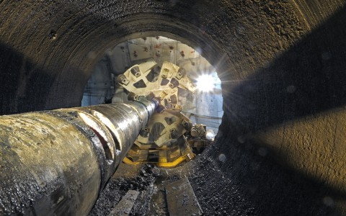
Raise borer or tunneling machine

Slide 7
Collapse of Mine Excavations
Collapse or failure of mine excavations depends on:
Mechanical properties of the rock including:
  Interaction between the joint orientation,
  Spacing and persistence of that rock mass.
Rock Quality Designation (RQD),
Volumetric Joint Count (Jv), and
Block Size Index (I_{b})

Slide 8
Causes of Collapse of Mine Excavations
Rock mass and material properties of the ground
Stress field
Size of the mine excavation
Shape of the mine excavation
Excavation method
  Drilling and blasting may cause vibration
Ground movement
Earthquakes
Seismic

Slide 9
Design and Stability of Mine Excavations
Designing of mine excavations requires knowledge of:
Stress field,
Stress concentrations around various shaped excavations,
Mechanical properties of the rock, and
Support system.
Stress and Strain
Rock Deformation

Slide 10
In-situ Stresses
Underground formations are confined and under stress.
The local stress state at depth for an element of formation.
The stresses can be divided into three principal stresses:
  σ₁ is the vertical stress
  σ₂ is the minimum horizontal stress
  σ₃ is the maximum horizontal stress

Slide 11
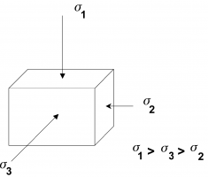
Three Principal Compressive Stresses

Slide 12
In-situ Stresses
The magnitude and direction of the principal stresses are important because:
They control the pressure required to create and propagate a fracture,
The shape and vertical extent of the fracture, The direction of the fracture, and
The stresses trying to crush and/or embed the propping agent during production.

Slide 13
Stress Applied to Rock
Rock can be subjected to several different kinds of stress including:
Lithostatic stress:
Rock beneath the earth's surface experiences equal pressure exerted on it from all directions because of the weight of the overlying rock.
Like the hydrostatic stress.

Slide 14
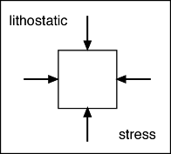

Slide 15
Stress Applied to Rock
Differential (deviatoric) stress:
In many cases, rock may experience an additional, unequal stress due to tectonic forces.
There are three basic kinds of differential stress:
Tensional stress (stretching)
Compressional stress (squeezing)
Shearing stress (side to side shearing)

Slide 16
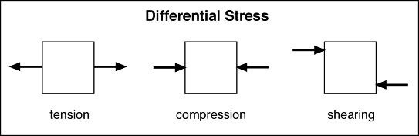

Slide 17
Rock responds to stress differently depending on:
Pressure,
Temperature (depth in Earth), and
Mineralogic composition of the rock.
Strain - rock deformation in response to Stress.
Rock undergoes plastic deformation when a differential stress is applied that is stronger than its yield strength.

Slide 18
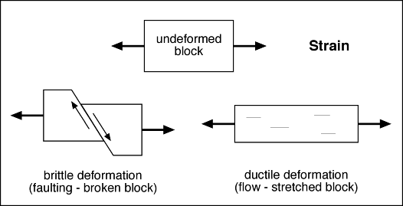
Rock response to stress

Slide 19
Concepts of Mine Support
Mine excavation support is:
A fundamental requirement
Intrinsic and standing support system is a critical safety component
Support systems depend on:
  Rock type
  Type and purpose of excavation
  Mining operations
  Nature of the deposit
  Working environment.

Slide 20
Trend in Support Systems
Several advancements in support technology have been made
Several systems have been developed
Cross pollination of support applications has grown.
Improvements in all three measures of support design; namely:
  Strength,
  Stiffness, and
  Stability.

Slide 21
Mine support systems include:
Pre-stressing devices,
Improved cribs, and
Free standing supports.
Mine support systems may be classified as:
Natural support
Artificial support
Active rock reinforcement, and
Passive rock support

Slide 22
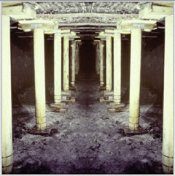
Mine Timber Support Systems

Slide 23
Timbering Support Method:
Timber - A collective term for underground wooden supports.
Timbering - The setting of timber supports in mine workings or shafts for protection against falls from roof, face, or rib.
To prevent collapse of mine excavations
Timber set - A timber frame to support the roof, sides, and sometimes the floor of excavations.

Slide 24
Properties of Timber Include:
Strength,
Density,
Thermal properties,
Durability,
Fire resistance,
Insulation,
Hardness,
Anisotropy,
Color variation.

Slide 25
Improving properties of timber
Timber properties may be improved by seasoning or soaking timber in preservative chemicals.
Seasoning is a process of reducing moisture content (MC)
Drying out the wood
Suitable moisture content (20% or less)
Green timber contains about 50% MC

Slide 26
Purpose of Seasoning:
Prevent fungal and insect attacks
Prevent splitting
Easier to work with
Timber becomes lighter, harder and stronger
  Resistance to decay and prolong life
The drying of timber can be achieved by two methods:
Natural seasoning
Artificial seasoning

Slide 27
Natural seasoning:
Direct action of wind, air and sun.
Takes 6 to 18 months
Slow process
Artificial seasoning:
Timber is placed in a heating chamber
Heating system under control
Quick process.

Slide 28
Timber support systems may be classified into:
Post or prop and caps support,
Square set timber support,
Stull timber support, and
Cribbing

Slide 29
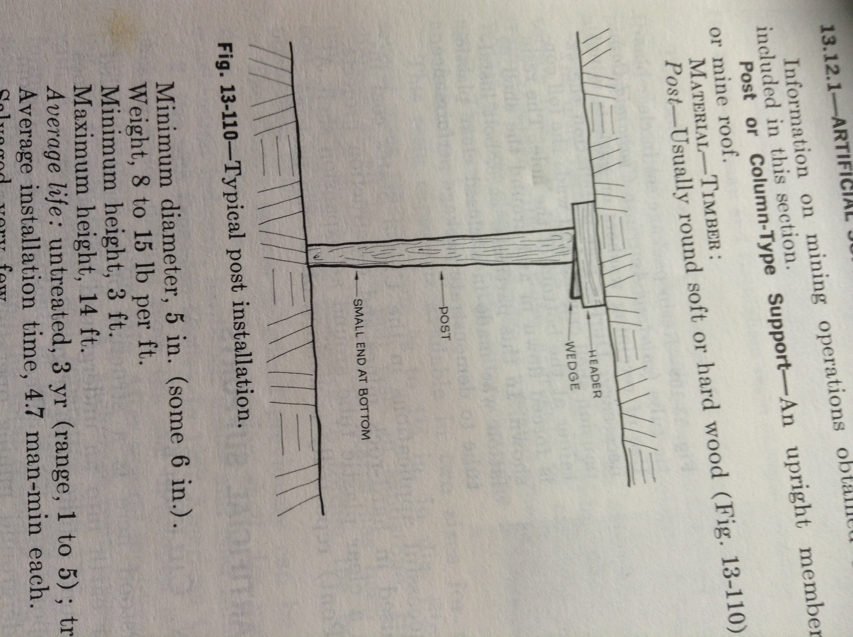
Timber Support – Post

Slide 30
Timber Support – Post or Prop

Slide 31
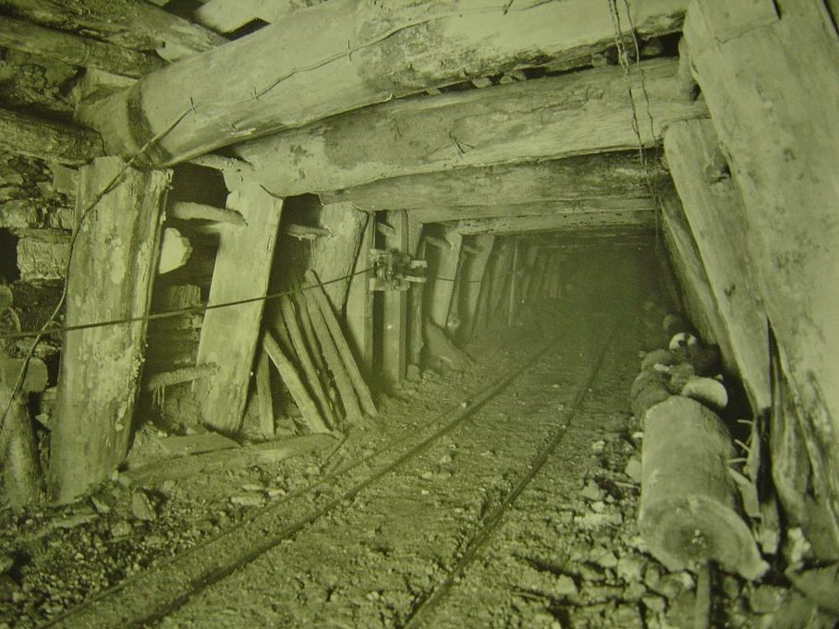
Timber Support

Slide 32
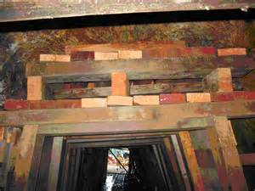
Cribbing

Slide 33
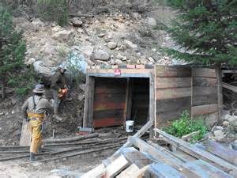
Cribbing

Slide 34
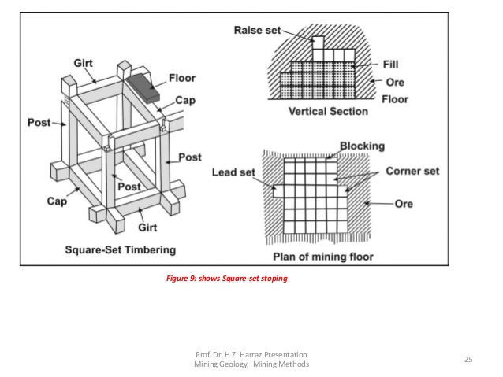

Slide 35
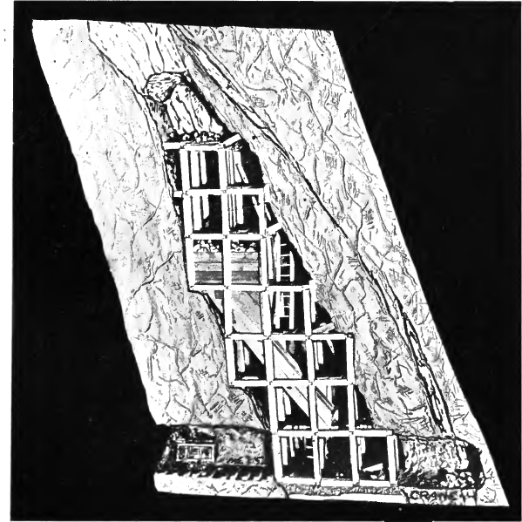
Timber Support - Stull

Slide 36
Revision Questions
Explain the advantages and disadvantages of conventional and raise boring excavation methods.
Differentiate between lithostatic and deviatoric stresses.
Explain briefly four classes of mine timber support systems.
In order to preserve and strengthen timber for mine support systems, two methods are applied:
    Timber seasoning, and
    Timber impregnation.
  Describe the process of timber impregnation and outline its advantages and disadvantages as compared to timber seasoning.

