Slide 1
Rock Blasting – Lecture 3

Slide 2
Classification of explosives

Slide 3


Initiating Explosives: These are used only as a charge in detonators and detonating cord.

Slide 4

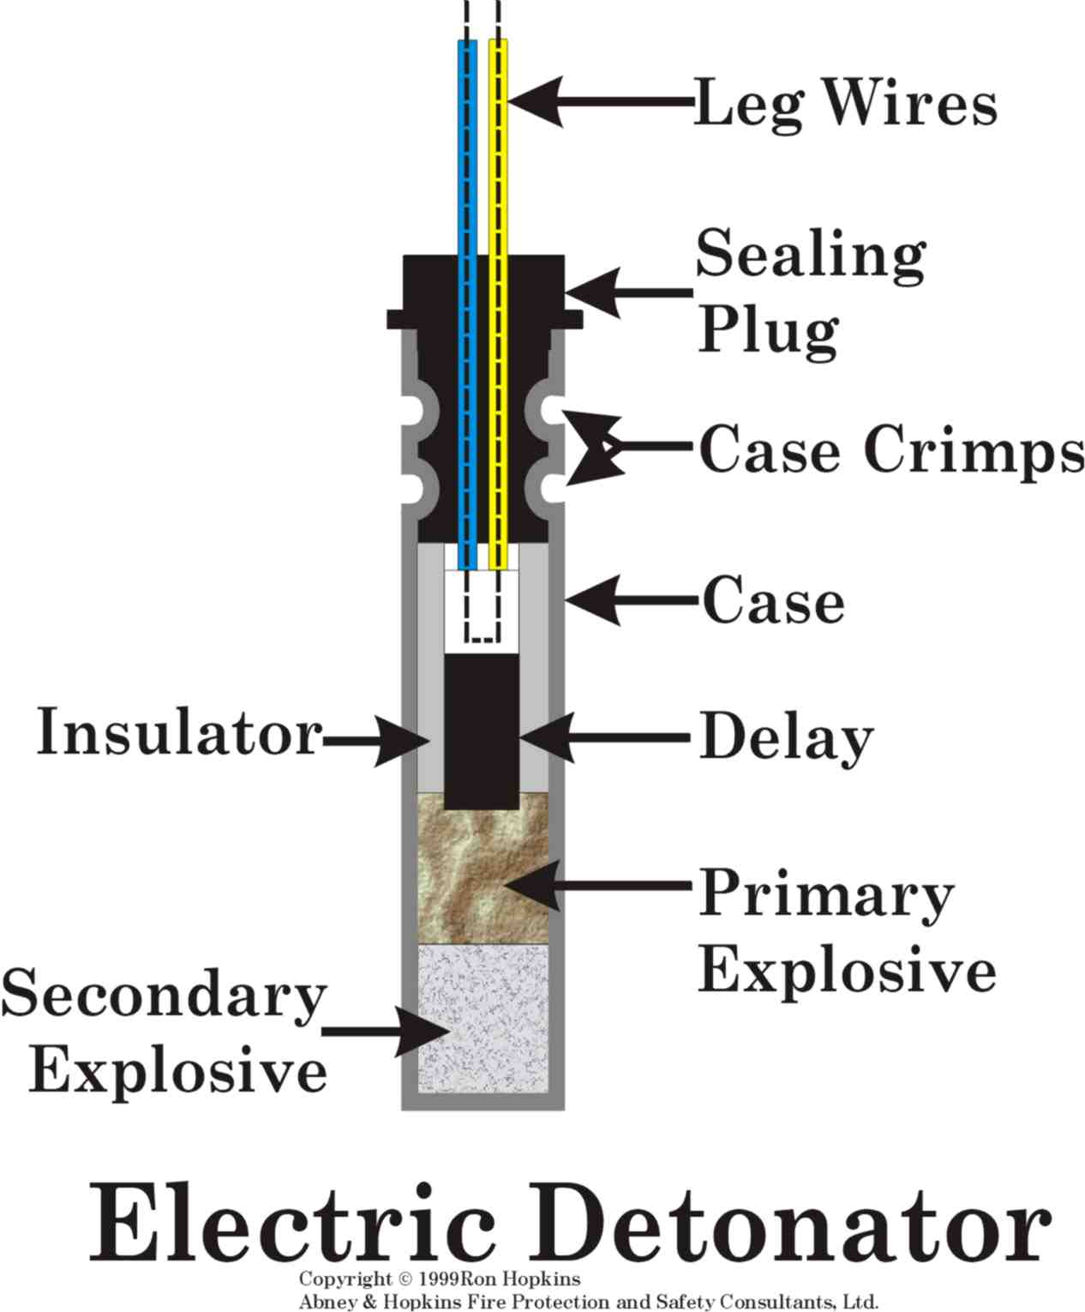

Example of Detonators

Slide 5
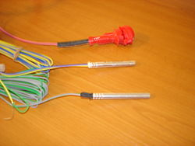
Nonel Detonator with 25ms Delay

Slide 6

High Explosives: The reaction of these explosives is supersonic and generates a high pressure shock wave, accompanied by rapid expansion of the reactive products. Examples; TNT, nitroglycerin and dynamites

Slide 7
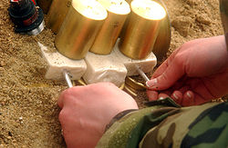
Inserting detonators into Explosives - Priming

Slide 8
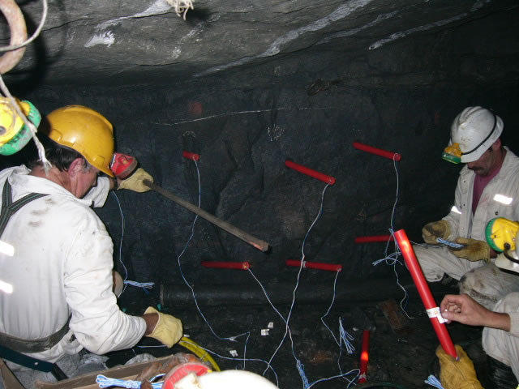
Charging Explosives – Placing Explosives in Blast-holes

Slide 9
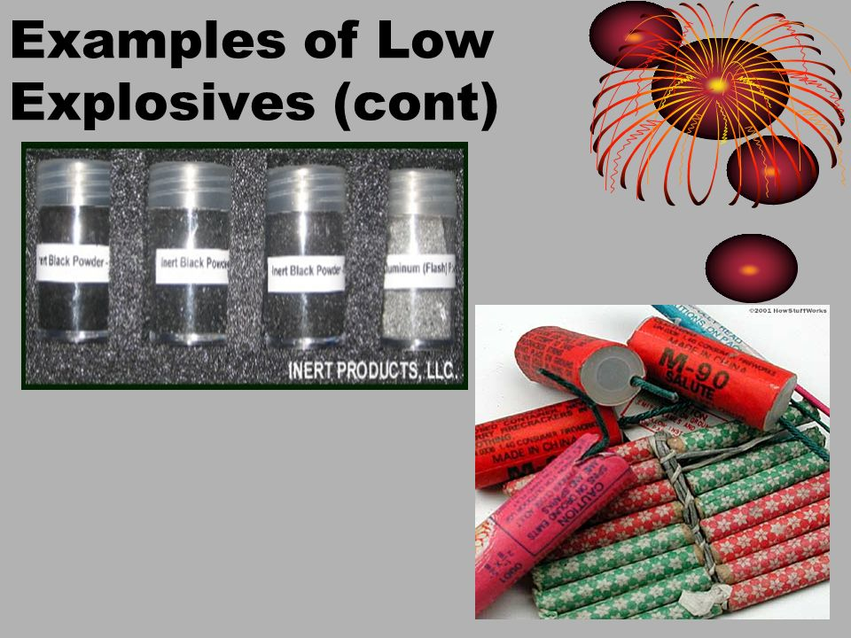

Slide 10
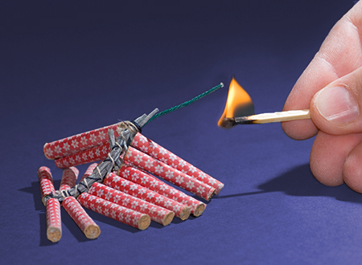
Low explosives (deflagrating): - VOD < 2000 m/s. Eg. Gun powder, fireworks

Slide 11
Blasting agents: A blasting agent consists primarily of inorganic nitrates and carbonaceous fuels, and may contain additional non-explosive substances such as powdered aluminum.
Blasting agents include:
Ammonium nitrate fuel oil (ANFO)
Bulk emulsions
Slurries
Water gels

Slide 12
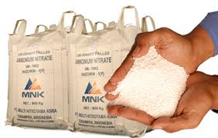


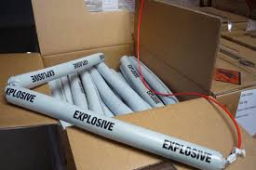
ANFO
Emulsion
Slurries
Water gels

Slide 13
Blast Design

Slide 14
In underground development, there is need to create free rock face for successful blasting.
Various “cuts” are used in creation of free rock face including:
Wedge cut or V cut
Burn cut
Pyramid or Diamond cut
Drag cut
Fan cut

Slide 15
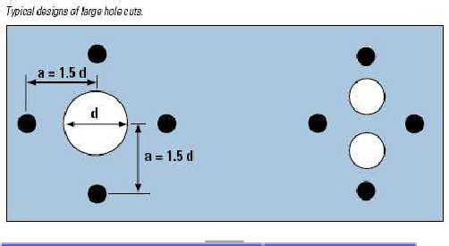
Typical Design of Large Hole Burn Cuts

Slide 16
Fictitious Hole
Fictitious Hole: D = d x √n
Where:
D = Fictitious empty large hole diameter
d = diameter of empty drilled large hole
n = number of drilled blast-holes

Slide 17
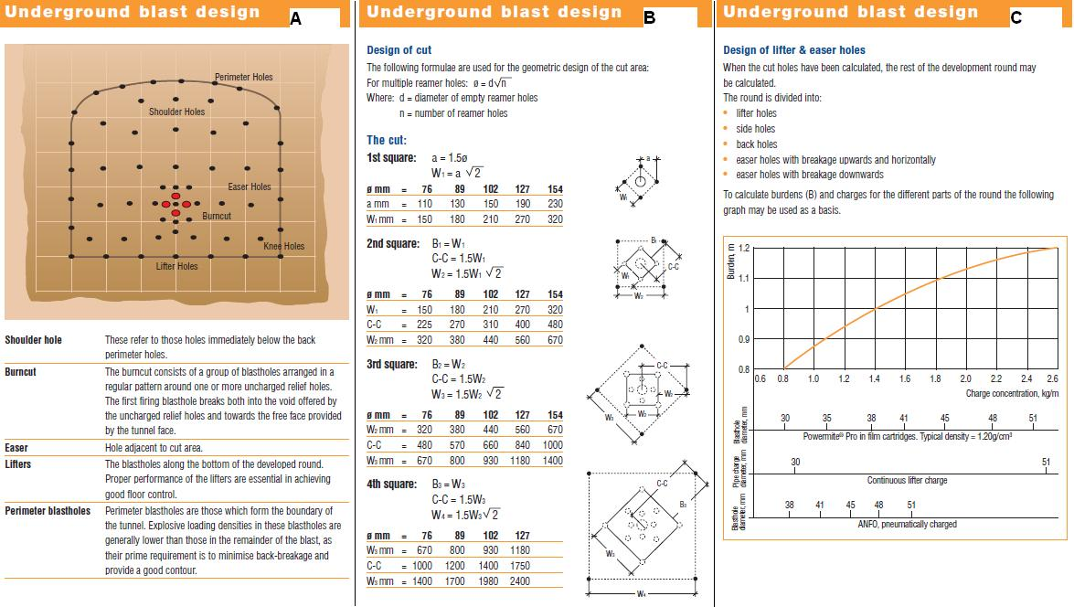
Blast design in a development end

Slide 18
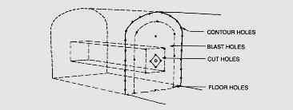
Blast design in a development end

Slide 19
Basic Blasting Theory

Slide 20
Detonation of an explosive
When an explosive detonates in a blast hole it rapidly transforms into gases at very high temperature and pressure - exothermic reaction
The chemical reactions take place and travels along the explosive column faster than the acoustic velocity.
- Chapman-Jouget (C-J) process.
Creates a shock condition
Shock loading onto the blast hole wall
Result in compressive stresses and crush the rock

Slide 21
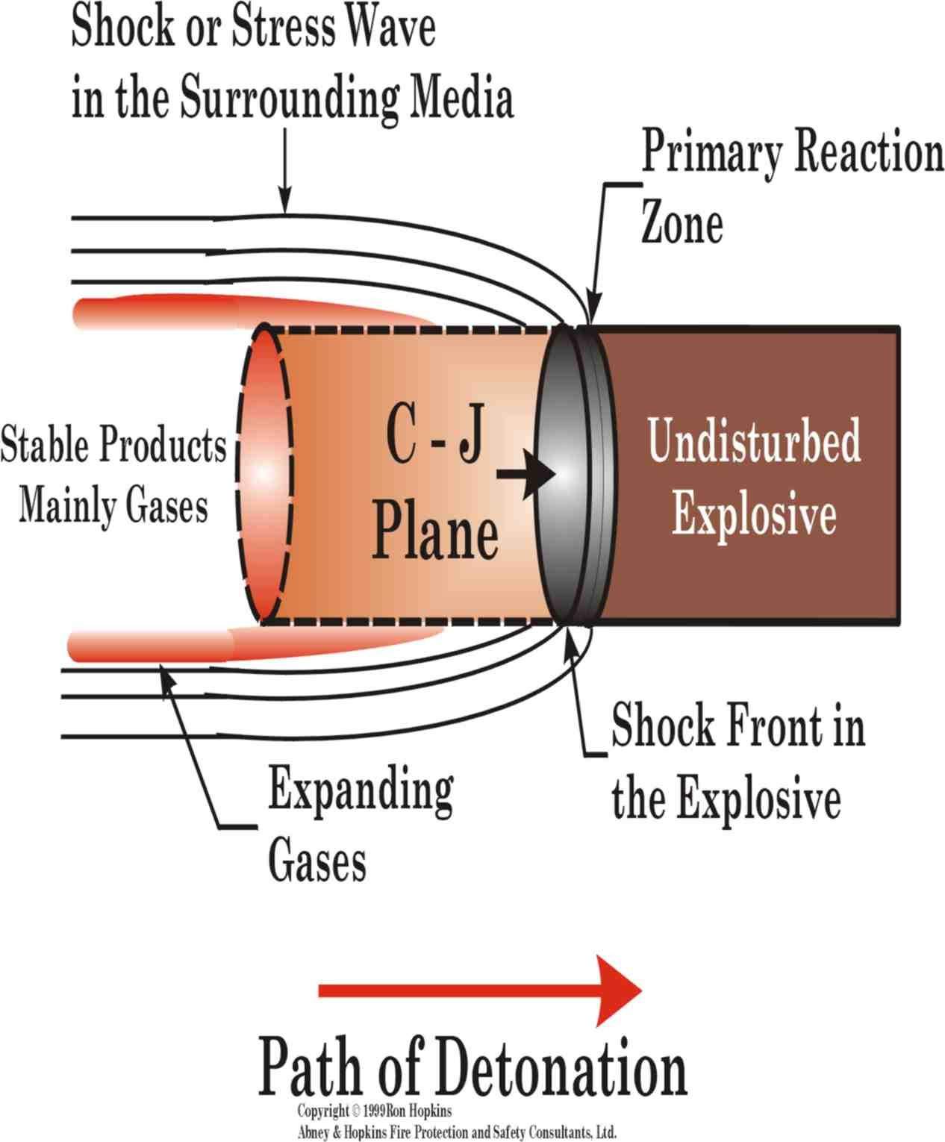

Slide 22
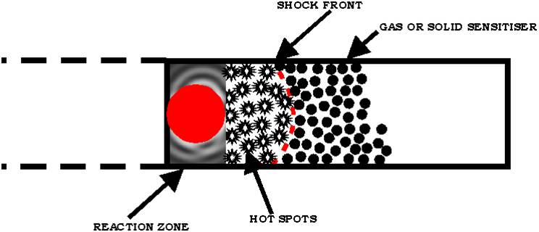
The energy liberated in the zone of chemical reaction continuously maintains a high pressure in the shock wave. Thus, detonation is a self-supporting process.
In an explosive charge, detonation creates an intense mechanical or thermal action

Slide 23
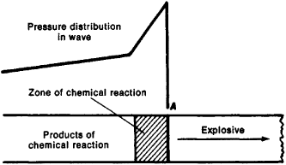
Diagram of a detonation wave: (A) shock wave front. The arrow shows the direction of propagation of the wave.

Slide 24
Blasting Theory
Compressive stress waves emanate in all directions from the blast-hole
Compressive stress waves reflect against a free rock face, causing tensile stresses in the rock mass
If the tensile strength of the rock is exceeded, the rock breaks in the burden area

Slide 25
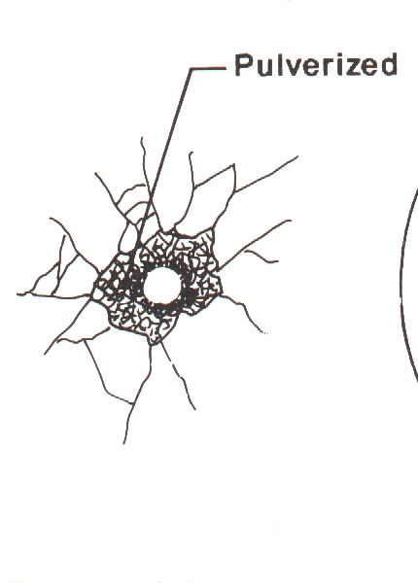
Blasting theory - Principal stages
The rock is affected by a detonating explosive in three principal stages, as follows:
In the first stage, starting from the initiating point, the blast-hole expands by the blast-hole walls. This is due to the high pressure upon detonation.

Slide 26
In the second stage,
Compressive stress waves emanate in all directions from the blast-hole with a velocity equal to the sonic wave velocity in the rock.
When these compressive stress waves reflect against a free rock face, they cause tensile stresses in the rock mass between the blast-hole and the free face.

Slide 27
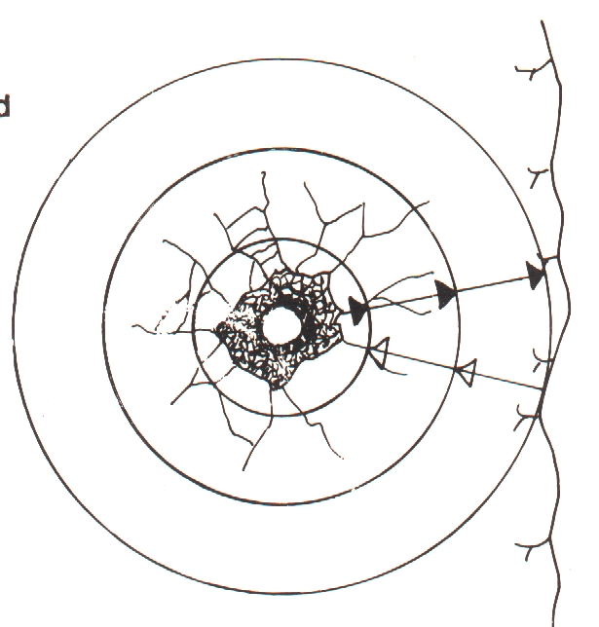
If the tensile strength of the rock is exceeded, the rock breaks in the burden area, which is the case in a correctly designed blast.

Slide 28
In the third stage,
The released gas volume “enters” the crack formation under high pressure, expanding the cracks.
If the distance between the blast-hole and the free face is correctly calculated, the rock between the blast-hole and the free face will yield and be thrown forward.

Slide 29
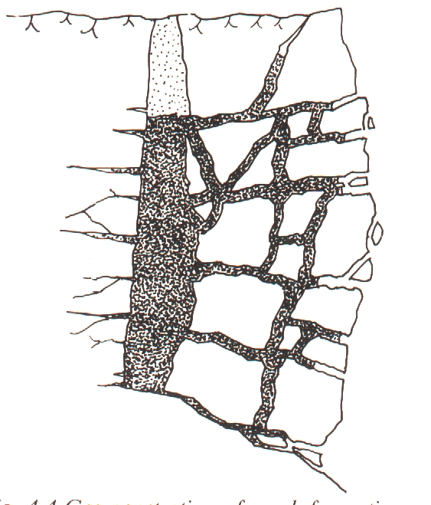
3rd stage

Slide 30
Explosive reaction
The explosives reaction in the blast hole is very fast and the effective work of the explosive is considered completed when the blast-hole volume has expanded to 10 times its original volume which takes approximately 5 milliseconds (ms).

Slide 31
Expansion of the blast-hole is related to time
From initiation of shockwave, the blast-hole expands to double its original volume (2Vo). The blast-hole will stay at this volume for relatively long time (0.1 to 0.4 ms) before radial cracks start to open.

Slide 32
Expansion vs time
Besides the natural cracks are new cracks formed mainly by interaction between the stress field around the blast hole and tensile stresses formed by reflection of the outgoing shockwave at the free face.
Reaction products expand from blast hole (which volume is now quadrupled) into the cracks. Fragmentation starts.
Gas expands further and accelerates the rock mass.

Slide 33
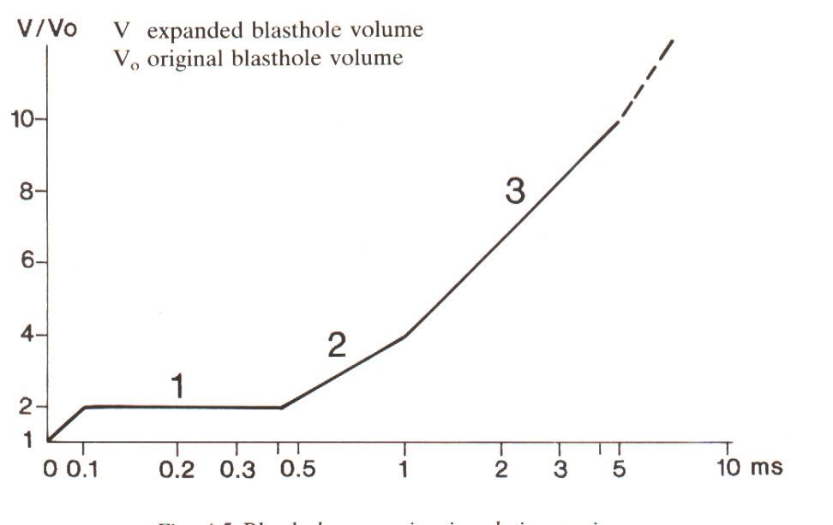

Slide 34
With reference to blasting, explain briefly:
  Priming, and initiation processes
Explain the two principles on which explosives are classified.
How is the rate of propagation of explosive chemical reaction affect pressure and shock wave distribution?
With help of diagrams, describe the basic blasting theory.
If a 3.0m by 3.0m drive is to be developed in rock with 250MPa strength, design a suitable drilling and blasting pattern for a good fragmentation, throw and an advance of not less than 3.0m.
Calculate the fictitious hole diameter, given spacing between uncharged and charged holes as 0.3m and number of blast-holes as 4.

