Slide 1
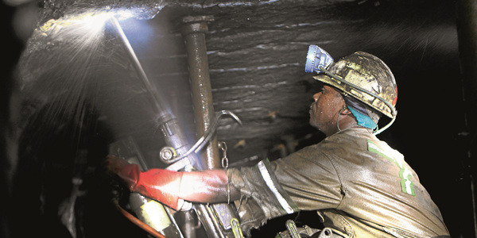
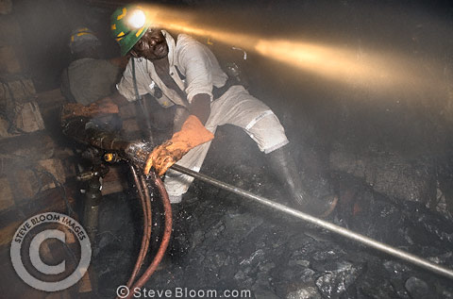
Concepts and principles of mechanical rock penetration

Slide 2
To appreciate the concepts and principles of drilling, one needs to understand:
Mechanics of rock penetration
Factors influencing penetration rate
Strength characteristics of rock
Rock type
  Homogeneous, Anisotropy, Isotropy

Slide 3
Drillability factors
  Intrinsic environmental factors
    Geologic conditions
  State of stress of rock
  Internal structure of rock and resistance to penetration
6. Engineering properties

Slide 4
Some terms related to rock disintegration include:
Force
Friction
Angle of friction
Torque
Resistance
Energy ; kinetic energy,
Compressive strength
Tensile strength
Stress
Shear stress
Strain
Stress/strain curve
Theories of elasticity
Thrust

Slide 5
Principles of Rock Disintegration
Rock drilling
For rock failure, energy is required
Enough energy to overcome rock strength
  Compressive strength (resistance)
Basically the energy (ɛ₁) is required to penetrate or disintegrate the rock. The energy to overcome resistance should equal to the compressive strength per unit area
Force is applied on the rock by the bit
Bit-rock interface - under stress

Slide 6
Fundamentals of mechanical rock penetration
Prime mover (drill) converts original form of energy into mechanical energy and the rod transmits the mechanical energy to the bit then to the rock:
Rotational effect creates torque
Percussive effect creates thrust
Torque and thrust create compressive stress
Bit and rock under compressive stress
The energy to overcome resistance should equal to the compressive strength per unit area
Compressive strength depends on Young’s modulus of a particular rock

Slide 7
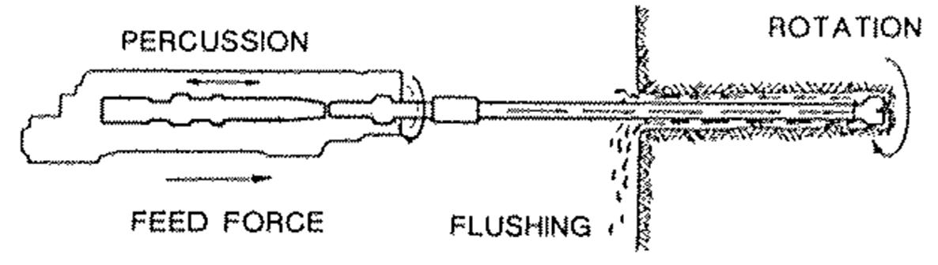
Fundamentals of rotary-percussive drilling
Percussion
Rotation
Feed or thrust load
Flushing

Slide 8
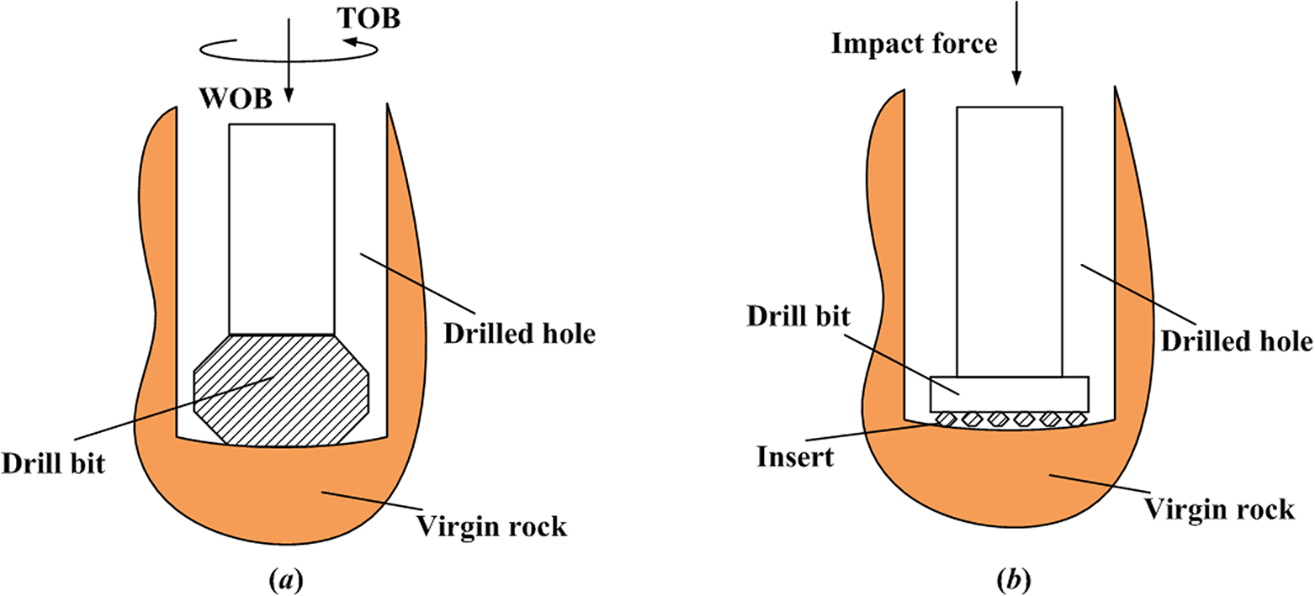
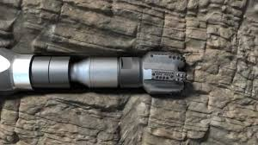
Bit-rock interface
Drill rod
Bit
Rock

Slide 9
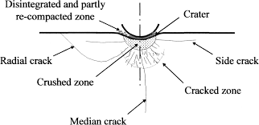
Bit-rock interface

Slide 10
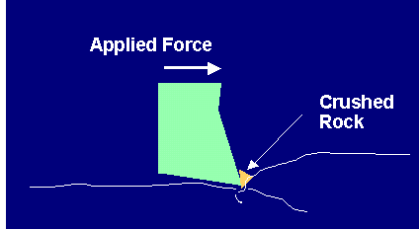
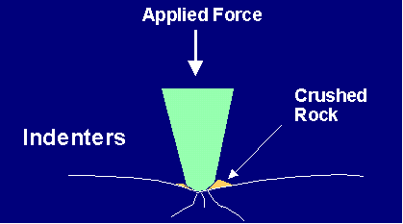
Principles of Rock Disintegration

Slide 11
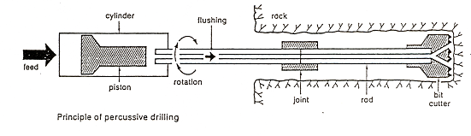
Functional Components of Drilling System

Slide 12
The Flushing Fluid
The circulation fluid is the flushing medium which is supplied through the flushing-holes in the drill steel and distributed through flushing-holes in the bit front.
The front of the bit has space for flushing the cuttings or chips rearwards.
The flushing medium may be air, water or mud.

Slide 13
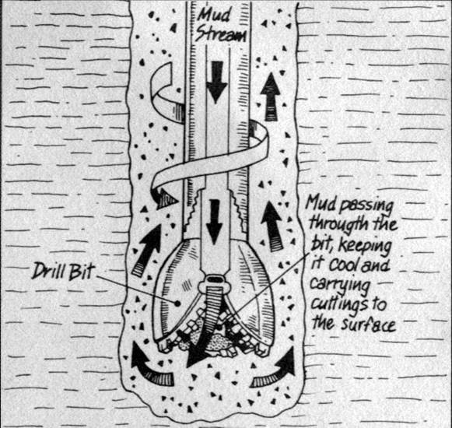
Principle of Drilling Fluid

Slide 14
The Circulation Fluid
Cleans the hole
Cools the bit and
Stabilises the hole
Supports the penetration through removal of cuttings
Air, water or sometimes mud is used for this purpose.

Slide 15
Drillability
Drillability means rate of drill bit penetration into rock [Tamrock..1983]. Schmidt R. L. [1972] defines drillability as the resistance of rock to penetration. Paithanker et al [1980] have shown that any stage of bit wear has a complex function of several rock properties, viz compressive strength, modulus of elasticity, density and coefficient of friction between rock and bit.

Slide 16
Factors Affecting Drillability
Factors affecting the rate of penetration (drillability) include:
Rock properties
Drilling parameters
  Thrust
  Torque
  Flushing

Slide 17
Rock properties influence on drillability
Among the important rock material properties having an over-all effect on the drilling techniques and drillability include:
Hardness
Abrasiveness
Texture
Structure

Slide 18
Degree of rock hardness related to compressive strength of rock
Hardness | Mohs Level | MPa
Extremely hard | 7 and above | 200 and above
Hard | 6 - 7 | 120 - 200
Medium hard | 4 - 6 | 60 - 120
Somewhat soft | 3 - 5 | 30 - 60
Soft | 2 - 3 | 10 - 30
Extremely soft | 1 - 2 | 10 and below

Slide 19
Consumption of drilling components
Drilling components including bits, rods, coupling sleeves, shank adapters wear out and become obsolete. The life-span of drilling components depends on:
Rock hardness
Abrasiveness
Texture
Structure
Hole diameter and length

Slide 20
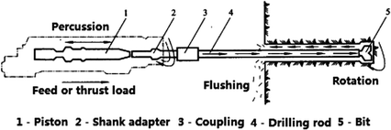
Drilling components

Slide 21
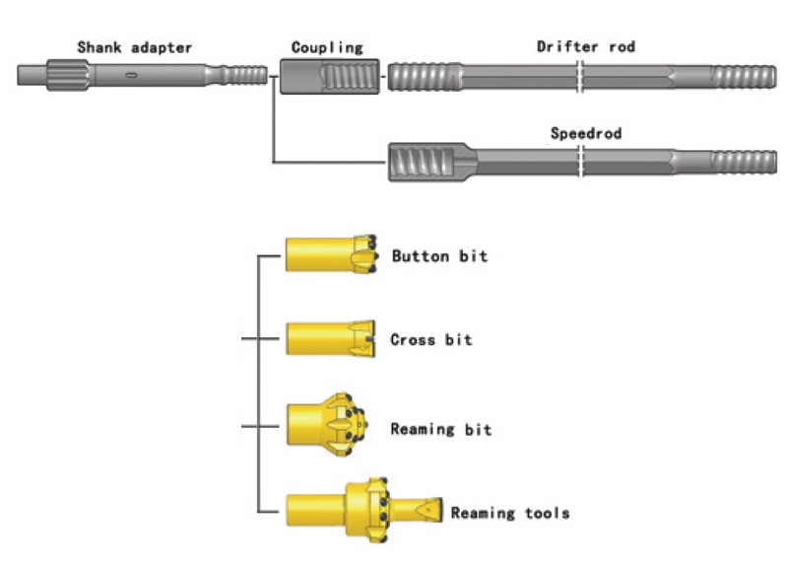
Drilling components

Slide 22
Example: Consumption of drilling components
Calculate the required bits, rods, coupling sleeves, shank adapters and production in cubic metres given:
Tunnel length = 300m
Tunnel area = 40m³
Depth of round = 4.6m (with 95% advance)
Number of holes = 55 holes per round
Average service life:
45mm button bit = 300m
Coupling sleeves= 1,600m
R38 rods = 1,600m
Shank adapters = 2,500m

Slide 23
Solution
Total drilled metres = Tunnel length x holes per round + 5% overdrill = (300 x 55) + (300 x 55 x 0.05) = 16,500 + 825 = 17,325m
Required bits = Total drilled metres/Average service life = 17,325/300 = 57.75 therefore 58 bits required
Required sleeves = 17,325/1,600 = 10.83; therefore 11 sleeves required
Required rods = 17,325/1,600 = 10.83; therefore 11 rods required
Required adapters = 17,325/2,500 = 6.93; therefore 7 adapters
Production = Area x Length = 40 x 300 = 12,000m³

Slide 24
    Q1: Calculate the required:
      Bits;
      Shank adapters
      Sleeves; and
      Rods
    Given:
    Production = 1,000,000 tonnes
    Density = 4 tonnes/m³
    Specific drilling = 0.5
    Average service life (life span) of:
    51mm button bit = 450m
    Shank adapters = 3,500m
    Sleeves = 250m
    R32 rods = 150 holes
    R32 rod length = 1.8m

Slide 25
Q2. In rock drilling, force of 15kN is applied on two circular bits with diameters 0.15m and 0.3m, calculate:
The stresses produced by each bit on the rock
Make comments on stresses produced
Which bit has high penetration rate
Q3. List five intrinsic environmental factors which affect the rate of rock penetration
Q4. With reference to stress/strain curve, explain the behavior of rock under drilling forces and why the rock behavour is different from steel under the same forces.

