Slide 1
Mine shafts and Hoisting Systems

Slide 2
Mine Shaft
Definition of a mine shaft
Functions of a mine shaft
Classification of mine shafts
Mine shaft design parameters
Process of shaft sinking
Mine shaft hoisting systems

Slide 3
Hoisting Systems
A hoist is a device used for lifting or lowering a load by means of a drum or lift-wheel around which rope wraps.
It may be electrically or pneumatically driven and may use chain, fiber or wire rope as its lifting medium.
The load is attached to the hoist by means of a lifting hook.

Slide 4
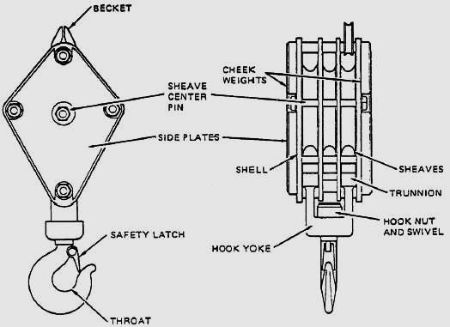
Hoist lifting hook

Slide 5
Hoisting Systems - Winders
In underground mining, a hoist or winder is used to raise and lower conveyances within the mine shaft.
Modern hoists are normally powered using electric motors, historically with direct current drives utilizing solid-state converters (thyristors), however modern large hoists use alternating current drives that are variable frequency controlled.

Slide 6
Types of Hoists
There are three principal types of hoists used in mining applications:
Drum hoist
Friction hoist
Blair multi-rope hoist

Slide 7
Drum Hoist
Drum hoists are common type of hoist used
When using a drum hoist the hoisting cable is wound
around the drum
Single-drum hoist can be used in smaller application
Double-drum hoists easily allow the hoisting of two
conveyances in balance (i.e. one skip being lifted
while a second skip is being lowered or counterweight

Slide 8
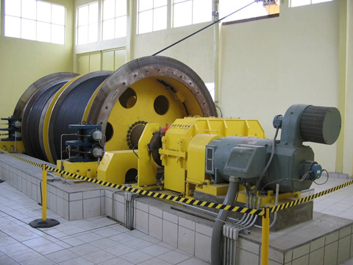
Drum winder

Slide 9
Drum Hoist – Advantages
Drum hoists require less routine maintenance
than a friction hoist
Maintenance regime is less sophisticated
Drum hoists can continue to operate if even the shaft
bottom gets flooded
Less shaft depth is required below the loading
pocket, unlike friction hoists where such flooding
could cover the tail ropes
Because drum hoists do not have tail ropes, the
hoisting system is more suited to slinging
beneath a conveyance.

Slide 10
Drum Hoist – Disadvantages
Drum hoists take up more space than a friction hoist
for the same service
Haulage cable must be accommodated on the
drum when the hoist is fully raised
Drum hoists require rapid fluctuations in power
demand, which can pose a problem if power is not
constantly and evenly generated

Slide 11
Friction (Koepe) Hoist
Friction hoist was invented in 1877 by Frederick
Koepe
Operates on the principle of preventing the rope
from slipping over the drive sheave
Friction (or Koepe) hoists are commonly used
Hoists are mounted on the ground above the
mine shaft, or at the top of the head-frame
Friction hoists utilise tail ropes and counterweights
Haulage rope not fixed to the wheel, but instead
passes around it

Slide 12
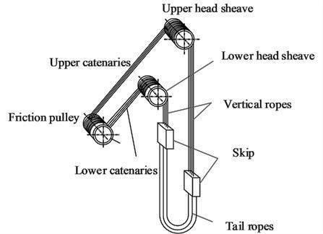
Friction winder

Slide 13
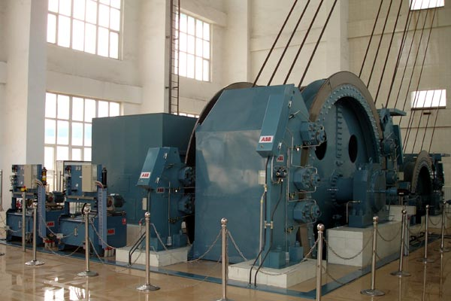
Friction winder

Slide 14
Friction (Koepe) Hoist
The tail ropes and weights offset the weight of the conveyance and hoisting rope, thereby reducing the required power of the hoisting motor by up to 30%
Friction hoists, unlike drum hoists, normally use
multiple ropes giving them a larger payload capacity
Require a larger safety factor, they are impractical
for very deep shafts.

Slide 15
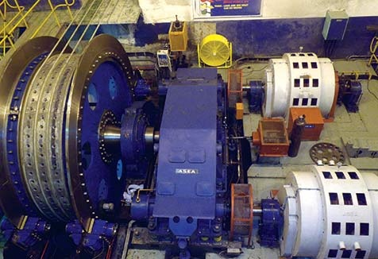

Slide 16
Advantages - Friction (Koepe) Hoist
Friction hoists are less expensive than new
drum hoists
The lead time for delivery is shorter
Multi-rope friction hoists have a larger lift capacity
than a drum hoist
A friction hoist is smaller in diameter than a drum
hoist for the same service
Easier to install than a drum hoist.

Slide 17
Disadvantages - Friction (Koepe) Hoist
Balanced friction hoists are not suitable for
hoisting from multiple loading pockets
Generally not suitable for deep shafts
Friction hoists can not operate at normal speeds if
the shaft bottom is flooded and water reaches the
tail ropes.

Slide 18
Design of Friction Hoist
Slippage occurs in friction-sheave hoist if the ratio of the rope tensions exceeds a theoretical limit, the relationship is:
T₁
T₂
≤
е^{µθ}

Slide 19
T₁
T₂
≤
е^{µθ}
Where:
T₁ = Rope tension
T₂ = Rope tension (slack)
е = Natural logarithmic
µ = Coefficient of friction (ranges from 0.45 to 0.50)
θ = angle of wrap from π radians (180º) to 1.3π
radians (240º)

Slide 20
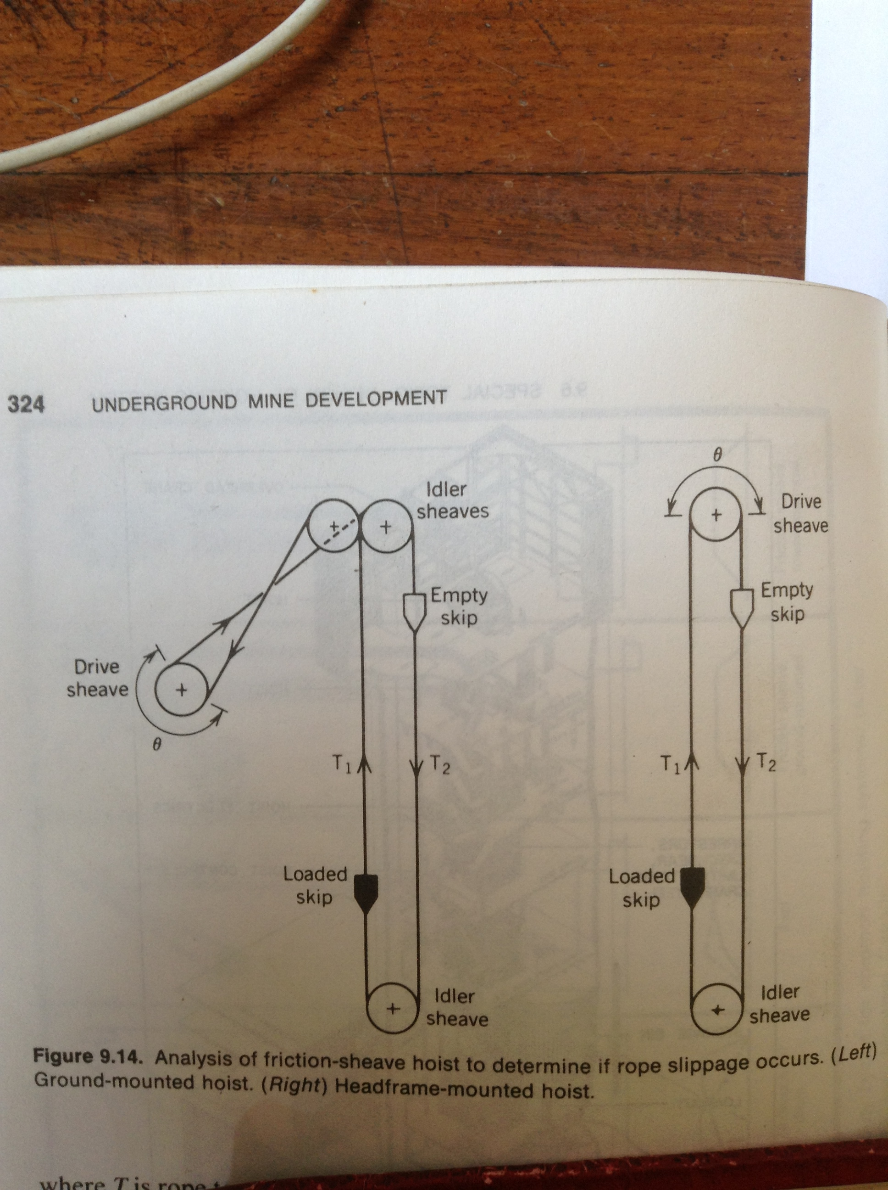

Slide 21
Blair Multi-Rope Hoist
The Blair multi-rope hoist is a variation of the double-drum hoist. It is used in extremely deep shafts as the second drums cable are used to balance the primary load.

Slide 22
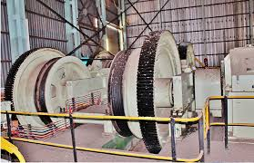
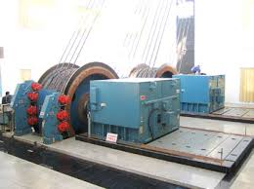
Blair Multi-Rope Hoist

Slide 23
Components of Hoist Plant
Head-frame consists:
Idler sheaves
Storage bins (ore and waste)
Skip dump mechanism
Hoist room
Hoist drum or sheave
Prime mover and brake systems
Winder ropes
In the shaft
Cage or skip
Loading boxes
Shaft guides

Slide 24
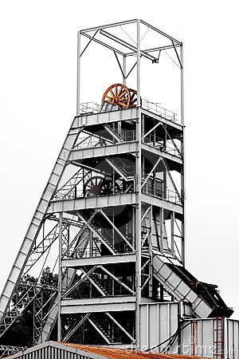
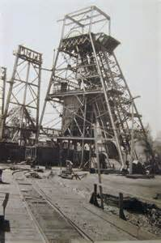
Mine Shaft Headgear

Slide 25
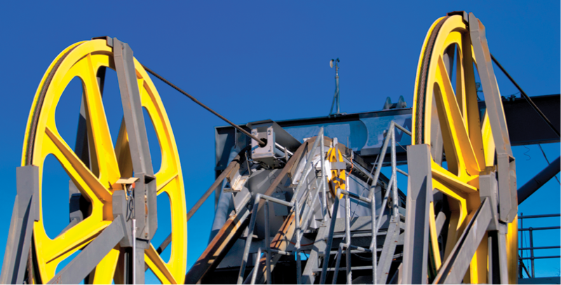
Shaft sheave wheels

Slide 26
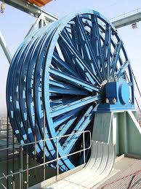
Winder idlers

Slide 27
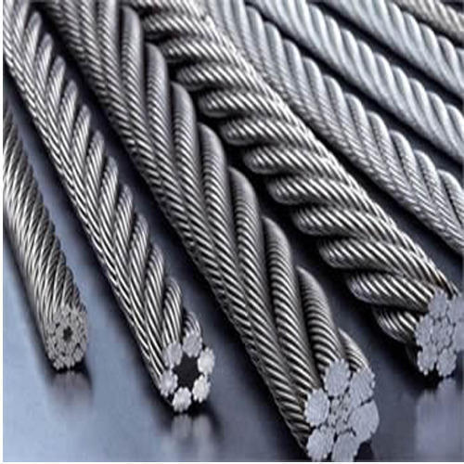
Winder wire ropes

Slide 28
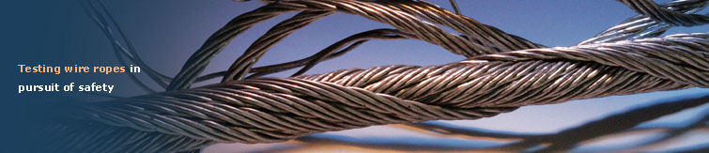
Wire Ropes

Slide 29
Selection of Wire Rope Size
Critical consideration – Factor of Safety which is determined taking into consideration the following:
Total weight
  including the weight of the rope
Strength of rope
Type of hoist
Depth
Personnel or material to be hoisted

Slide 30
Factor of Safety
The safety factor is the single most important
consideration when selecting a rope.
Rope life is a function of rope safety factor
A rope with a safety factor of less than 1.0 will
break
A rope with a safety factor of 1.2 is probably
operating in yield portion of the stress-strain
curve
Safety factor is an indication of the tensile
stress to which a rope is subjected.

Slide 31
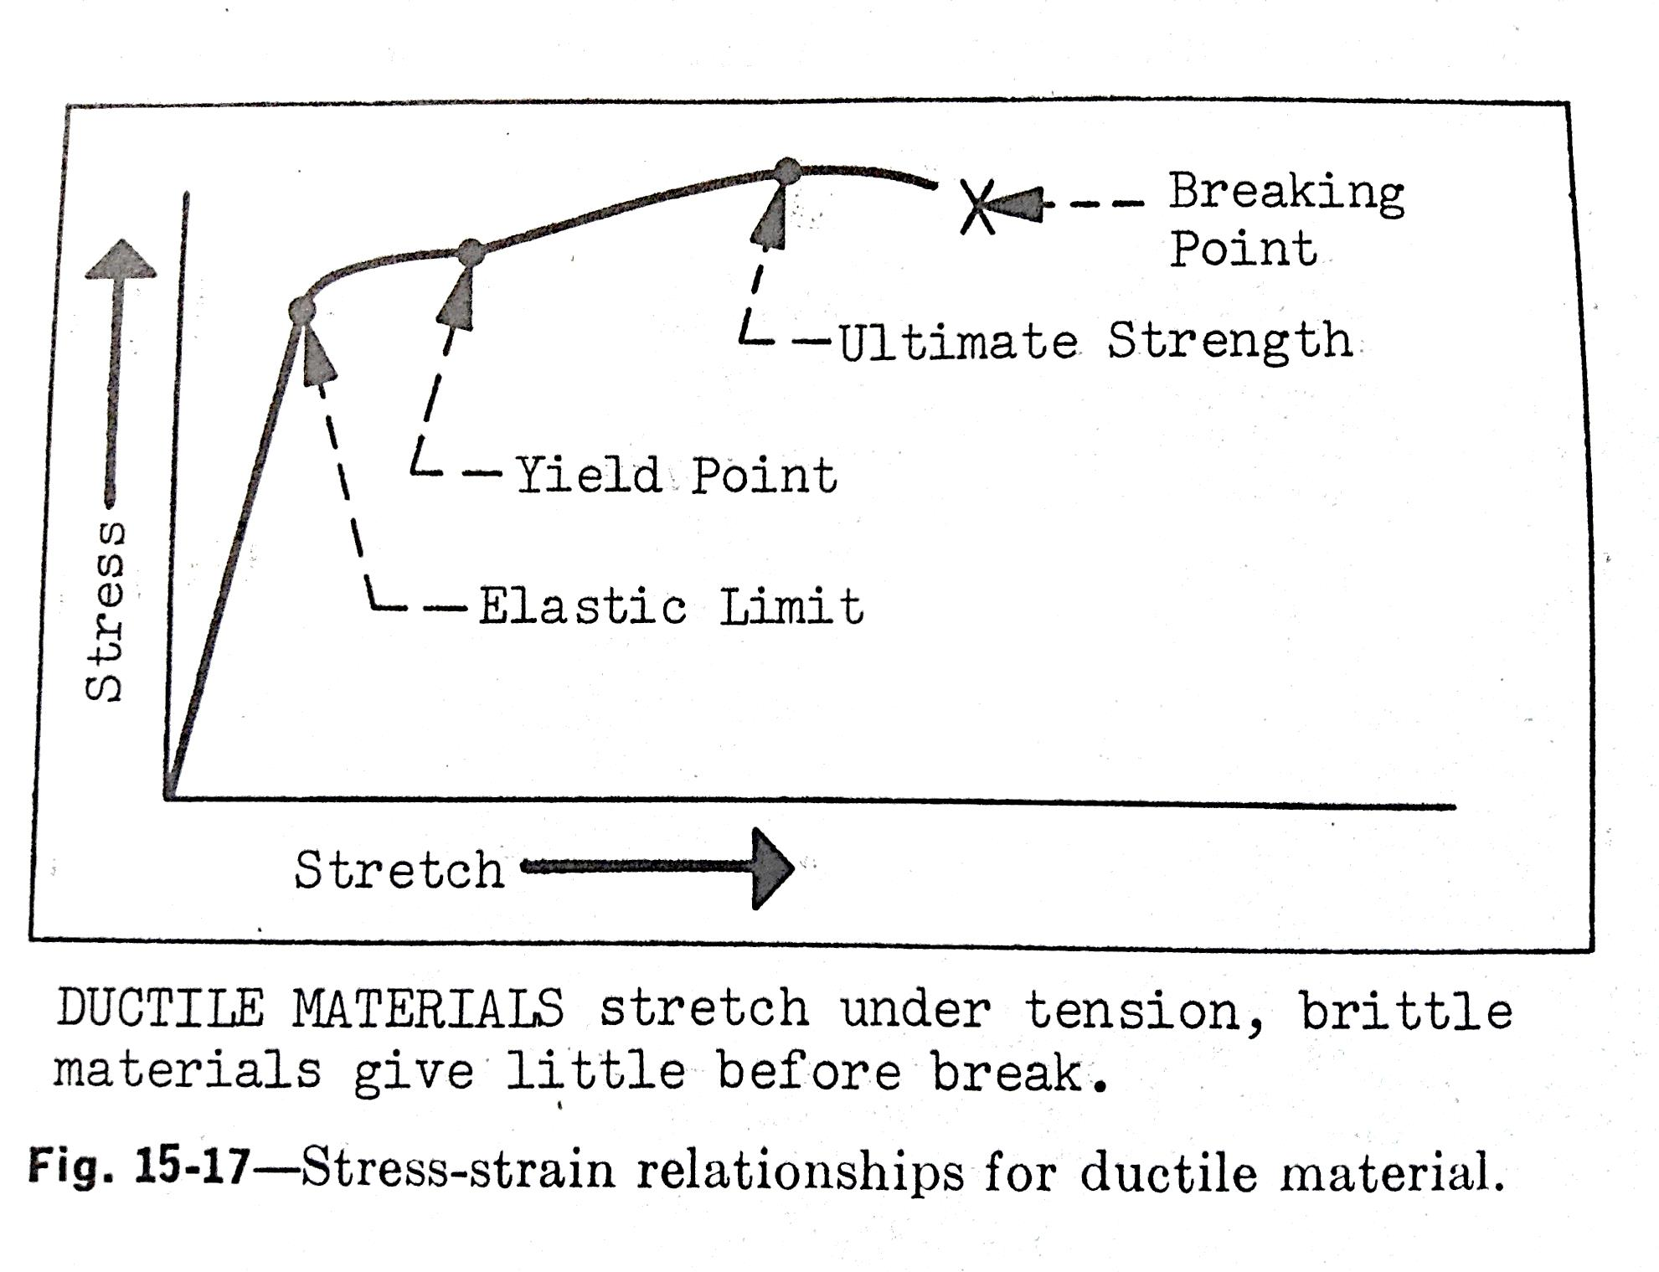
Effect of stretching wire-rope

Slide 32
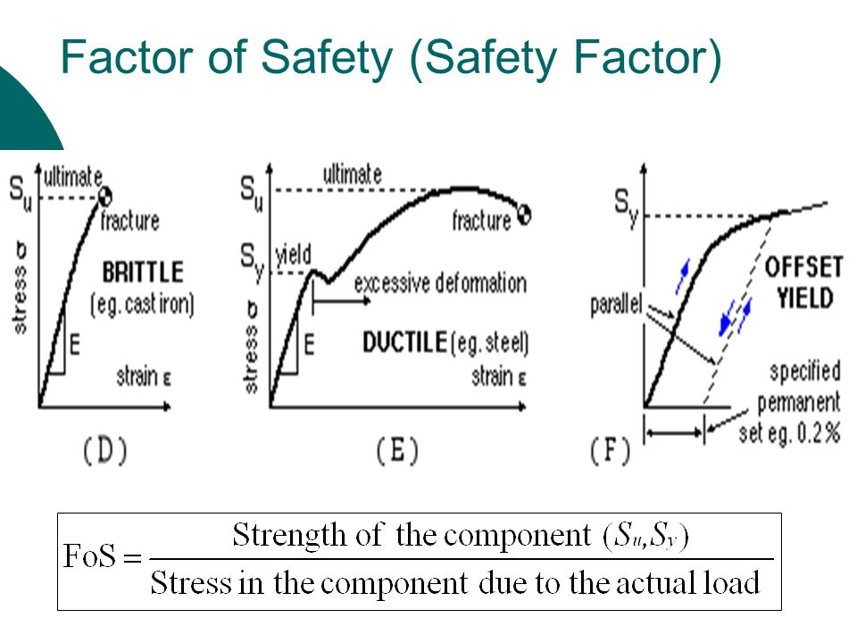

Slide 33
Hoisting Cycle
The relationship of time to distance in hoisting is referred to as the hoisting cycle.
Need to determine:
Acceleration time
Acceleration distance
Constant-velocity
Cycle time

Slide 34
Revision Questions
Describe the type of winder which is commonly used in the Zambian large scale underground mines.
a) Mathematically, define Factor of Safety.
  b) With the help of stress/strain curves, explain the importance of determining the wire rope factor of safety in a hoisting system.
Given coefficient of friction of 0.48, angle of
wrap of 210º and the rope tension side of 1.8, calculate the tension in the slack rope.
If the friction winder rope will slip at T₁ / T₂ ≤ 4.34,
calculate the angle of wrap in degrees, given the
coefficient of friction of 0.44.

