Slide 1
Stratigraphy and Geologic Time

Slide 2
PRINCIPLES OF STRATIGRAPHY
Definition:
Stratigraphy is the study of rock layers (strata) and their relationship with each other.
Stratigraphy provides simple principles used to interpret geologic events.
Principle of original horizontality
Principle of superposition
Principle of lateral continuity
Principle of cross-cutting relationships
Principle of fossil succession
Principle of inclusion

Slide 3
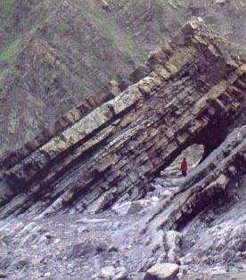
PRINCIPLE OF ORIGINAL HORIZONTALITY
The principle of original horizontality states that water-borne sediments are deposited in horizontal layers
Most layers of sediment are deposited in a nearly horizontal position. Thus, when we see inclined rock layers as shown, we can assume that they must have been moved into that position after deposition

Slide 4
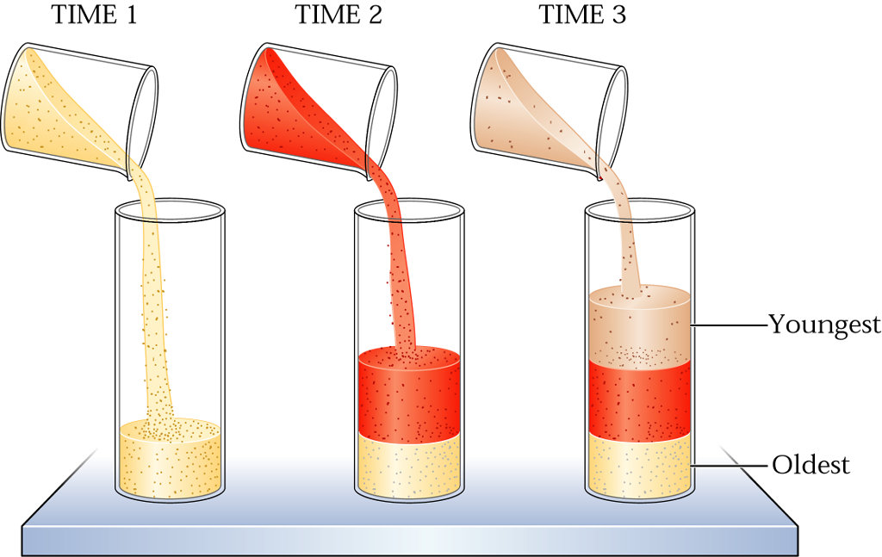
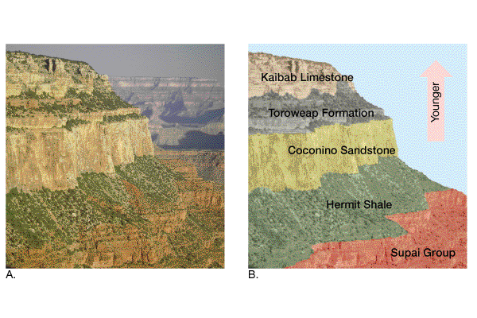
PRINCIPLE OF ORIGINAL SUPERPOSITION
Principle of superposition: states that in an undeformed sequence of sedimentary rocks, each bed is older than the one above and younger than the one below

Slide 5
PRINCIPLE OF LATERAL CONTINUITY
The principle of lateral continuity states that layers of sedimentary rock extend laterally in all directions until they thin and pinch out or terminate at the edge of the depositional basin

Slide 6
PRINCIPLE OF CROSS-CUTTING RELATIONSHIP
Principles of cross-cutting relationship states that: when a fault cuts through rocks, or when magma intrudes and crystallizes, we can assume that the fault or intrusion is younger than the rocks affected.

Slide 7
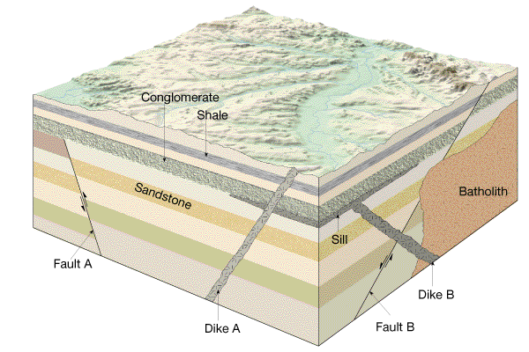
PRINCIPLE OF CROSS-CUTTING RELATIONSHIP
Cross-cutting relationships: An intrusive rock body is younger than the rocks it intrudes. A fault is younger than the rock layers it cuts

Slide 8
PRINCIPLE OF FAUNA SUCCESSION
The principle of fossil succession states that fossils in rock layers at the bottom of a sequence are older than those in layers at the top of a sequence. Thus fossils can be used to identify rocks of the same age in different areas

Slide 9
PRINCIPLE OF INCLUSIONS
The principle of inclusions states that inclusions, fragments of one rock within another, are older than the rock containing them. / If pieces of rock A are included in rock B, rock A formed before rock B

Slide 10
UNCONFORMITIES: MARKERS OF MISSING TIME
When layers of rock formed without interruption, we call them conformable.
An unconformity represents a long period during which deposition ceased and erosion removed previously formed rocks before deposition resumed. Therefore, Unconformity represents a buried surface of erosion; missing rock / time
Hiatus: amount of missing time
Diastem: small amount of missing rock / time
Types of unconformities
Angular unconformities
Disconformity
Nonconformity
Paraconformity

Slide 11
Angular unconformities:
An angular unconformity consists of tilted or folded sedimentary rocks that are overlain by younger, more flat-lying strata. It indicates a long period of rock deformation and erosion

Slide 12
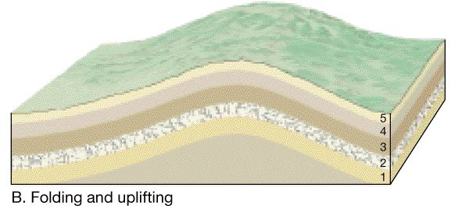
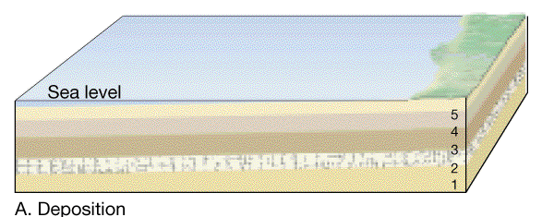
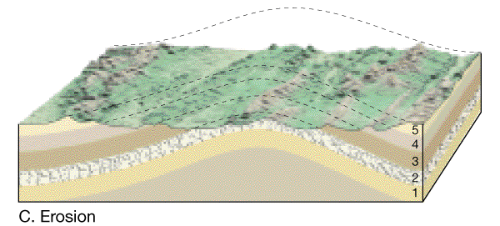
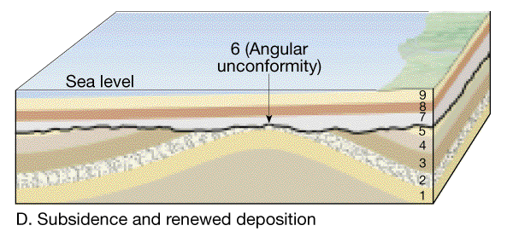
Formation of angular unconformity
An angular unconformity represents an extended period during which deformation and erosion occurred.

Slide 13
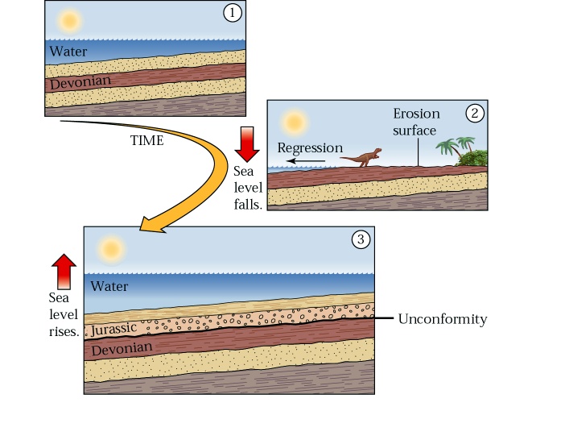
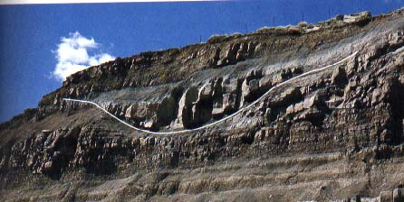
Disconformity:
A disconformity is a minor irregular surface separating parallel strata on opposite sides of the surface.
It indicates a history of uplifting above sea (water) level, undergoing erosion, and lowering below the sea level again
Disconformities do not show angular discordance, but an erosion surface separates the two rock bodies. The channel in the central part of this outcrop reveals that the lower shale units were deposited and then eroded before the upper units were deposited

Slide 14
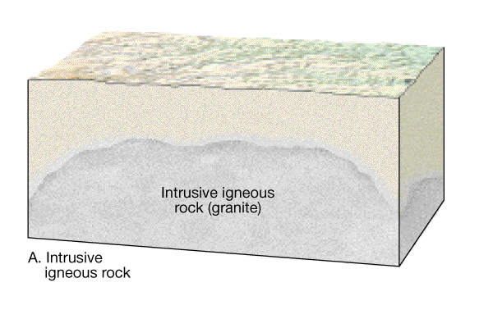
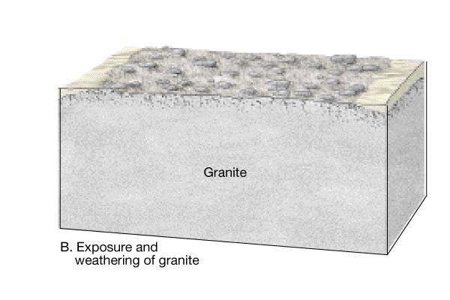
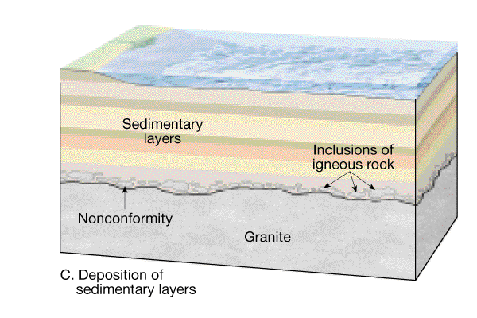
Nonconformity
A nonconformity is a break surface that developed when igneous or metamorphic rocks were exposed to erosion, and younger sedimentary rocks were subsequently deposited above the erosion surface.

Slide 15
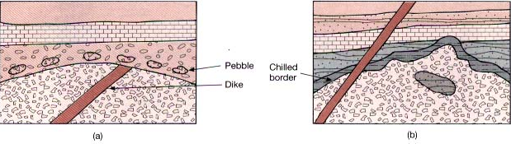

Slide 16
Distinguishing nonconformity and intrusive contact
Nonconformity:
The sedimentary rock is younger. The erosion surface is generally smooth. Dikes may cut through the igneous body but stop at the nonconformity.
Intrusive contact:
Intrusion is younger than the surrounding sedimentary rocks. The contact surface may be quite irregular. A zone of contact metamorphism may form surrounding the igneous body. Cross-cutting dikes may penetrate both the igneous body and the sedimentary rocks.

Slide 17
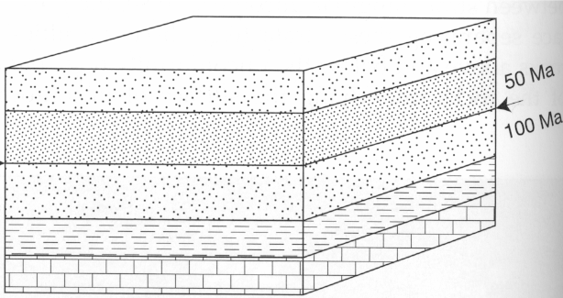
Paraconformity – sediments on sediments (same orientation) no obvious erosion surface
Notes:
The first type of unconformity is called a disconformity.
A disconformity has flat-lying layers of sedimentary rocks (rocks deposited at the earth’s surface as wind and water lay down pieces of sand, gravel, and mud, etc.)
Below the unconformity we find the same flat-lying sedimentary rocks.
You can see this might be easy to miss.

Slide 18
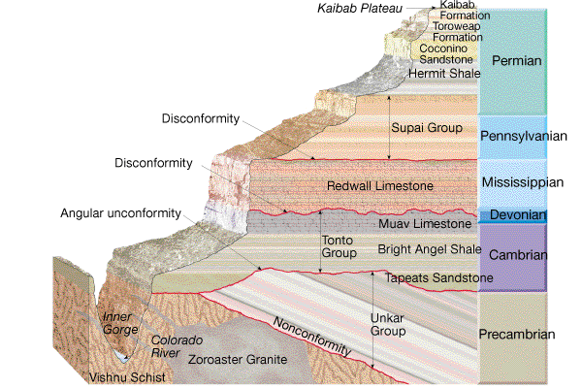
The three basic types of unconformities illustrated by this cross-section of the Grand Canyon.

Slide 19
Correlation of rock units
The method of relating rock units from one locality to another is called correlation.
One way of correlation is to recognize the rock type or rock sequence at two locations.
Another way of correlation is to use fossils. A basic understanding of fossils is that fossil organisms succeeded one another in a definite and determinable order, and therefore a time period can be recognized by its fossil content.

Slide 20
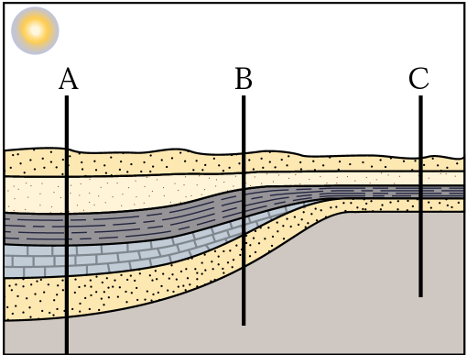
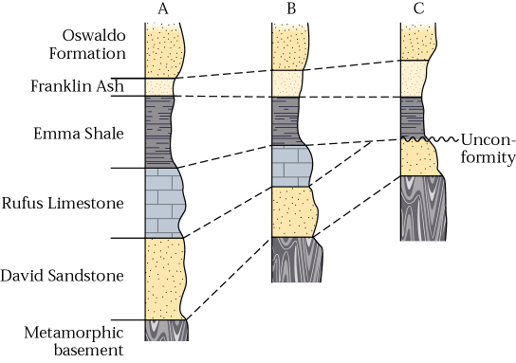
The principle of correlation of rock units. The rock columns can be correlated by matching rock types. (W.W. Norton)

Slide 22
