Slide 1
X-RAY: XRF & ELECTRON MICROPROBE

Slide 2
WHAT IS XRF?
X-ray fluorescence (XRF) is the emission of characteristic "secondary" (or fluorescent) X-rays from a material that has been excited by bombarding with high-energy X-rays or gamma rays
Emission of X-rays was discovered by Wilhelm Konrad Rontgen in 1895

Slide 3
The phenomenon is widely used for elemental analysis and chemical analysis, particularly in the investigation of:
  Metals
  Glass
  Ceramics
  Building materials
And for research in geochemistry, forensic science, archeology and art objects such as paintings

Slide 4
PHYSICS OF XRF
When materials are exposed to short-wavelength X-rays or to gamma rays, ionization of their component atoms may take place
Ionization consists of the ejection of one or more electrons from the atom, and may occur if the atom is exposed to radiation with an energy > its ionization energy

Slide 5
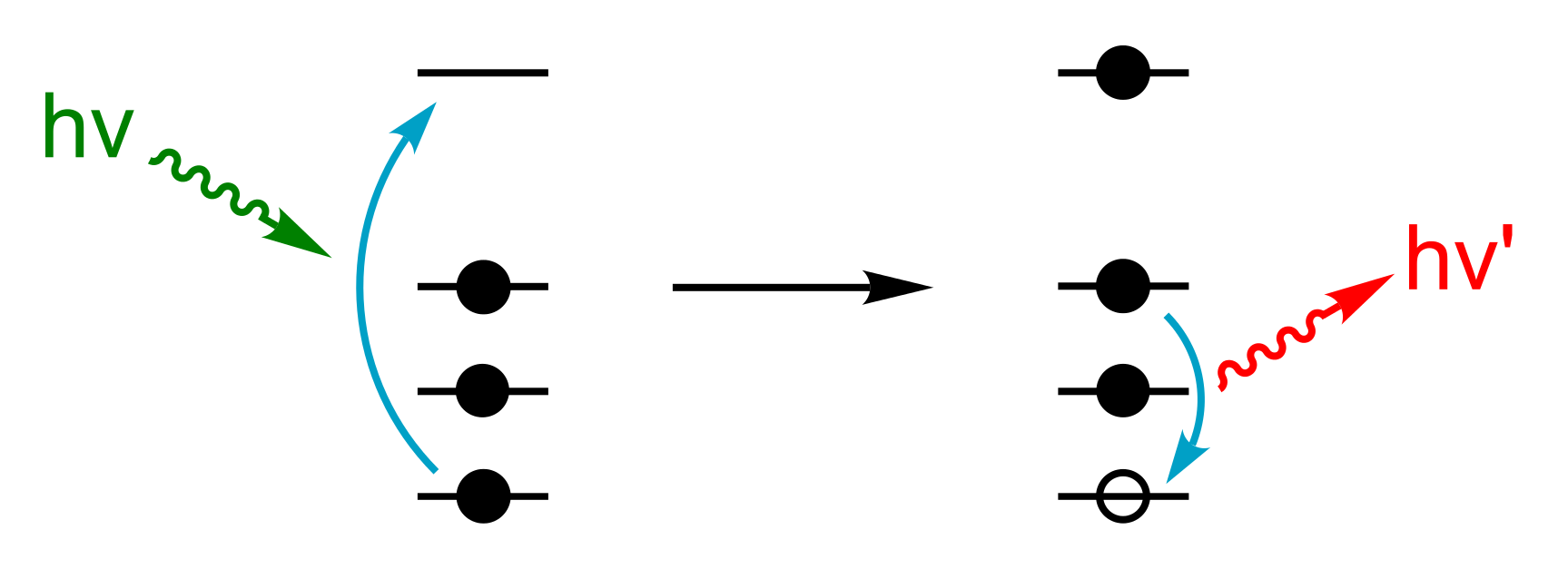
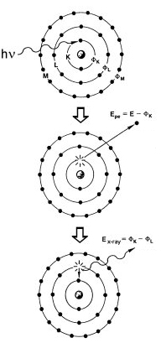
Physics of X-ray fluorescence in a schematic representation

Slide 6
X-rays and gamma rays can be energetic enough to expel tightly held electrons from the inner orbitals of the atom
The removal of an electron in this way makes the electronic structure of the atom unstable, and electrons in higher orbitals "fall" into the lower orbital to fill the hole left behind
In falling, energy is released in the form of a photon, the energy of which is equal to the energy difference of the two orbitals involved
Thus, the material emits radiation, which has energy characteristic of the atoms present

Slide 7
The wavelength of this fluorescent radiation can be calculated from Plank’s Law:
  λ = hc/E
λ is the wavelength of the fluorescent radiation
h is the Plank’s constant
c is the speed of light
E is the energy of the fluorescent radiation or energy emitted by the atom

Slide 8
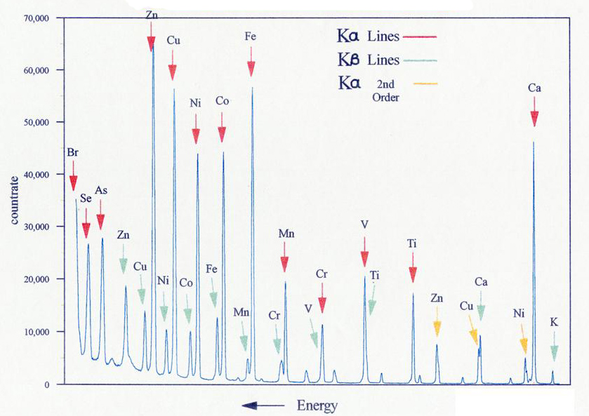
Typical wavelength dispersive XRF spectrum

Slide 9
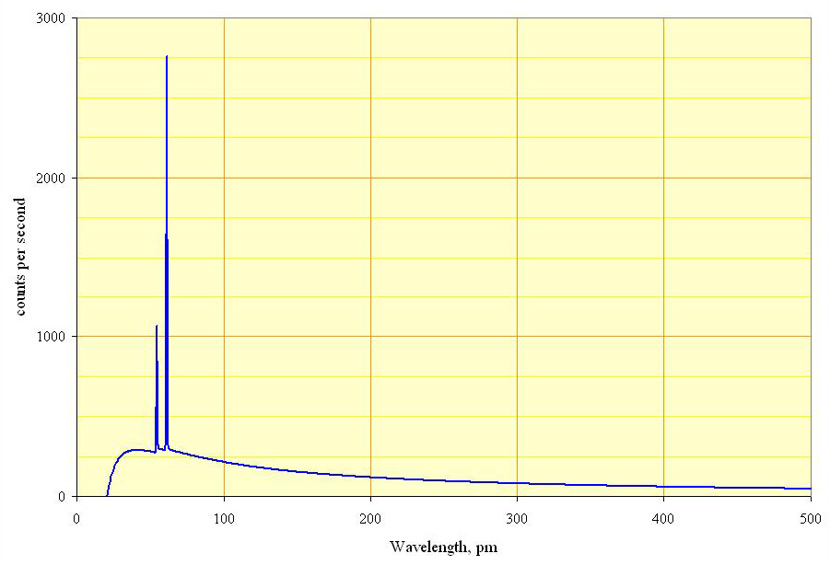
Spectrum of a rhodium target tube operated at 60 kV, showing continuous spectrum and K lines

Slide 10
SAMPLE PREPARATION
In order to keep the geometry of the tube-sample-detector assembly constant, the sample is normally prepared as a flat disc, typically of diameter 20–50 mm
This is located at a standardized, small distance from the tube window
Because the X-ray intensity follows an inverse-square law, the tolerances for this placement and for the flatness of the surface must be very tight in order to maintain a repeatable X-ray flux
Ways of obtaining sample discs vary: metals may be machined to shape, minerals may be finely ground and pressed into a tablet, and glasses may be cast to the required shape

Slide 11
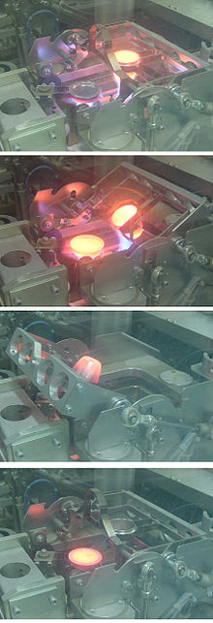
A glass "bead" specimen for XRF analysis being cast at around 1100 °C in a Herzog automated fusion machine in a cement plant quality control laboratory:
1 (top): fusing,
2: preheating the mould,
3: pouring the melt,
4: cooling the "bead"

Slide 12
ANALYSIS
The fluorescent radiation can be analysed either by sorting the energies of the photons (energy-dispersive analysis) or by separating the wavelengths of the radiation (wavelength-dispersive analysis)
Once sorted, the intensity of each characteristic radiation is directly related to the amount of each element in the material
This is the basis of a powerful technique in analytical chemistry

Slide 13
In energy dispersive analysis, dispersion and detection are a single operation, as already mentioned above
Proportional counters or various types of solid-state detectors (PIN diode, Si(Li), Ge(Li), Silicon Drift Detector SDD) are used
They all share the same detection principle: An incoming X-ray photon ionises a large number of detector atoms with the amount of charge produced being proportional to the energy of the incoming photon

Slide 14
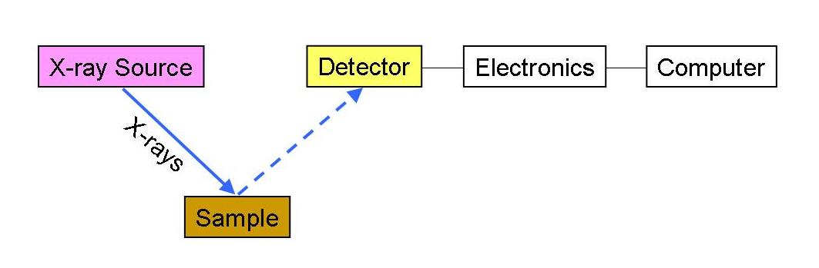
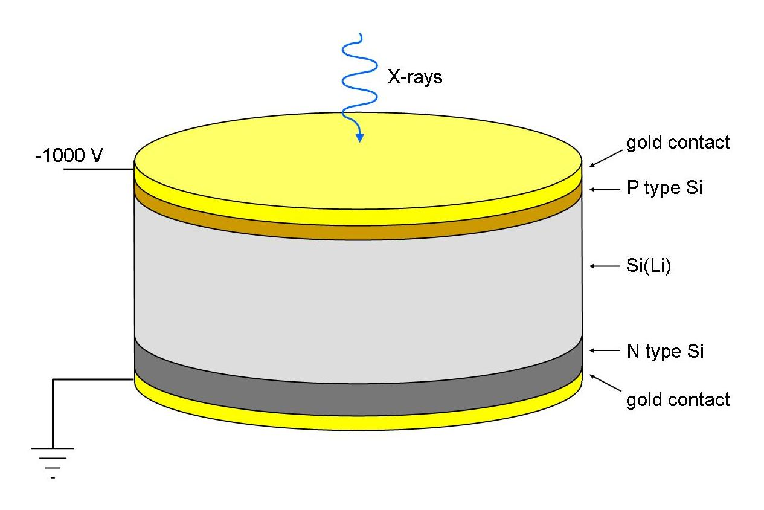
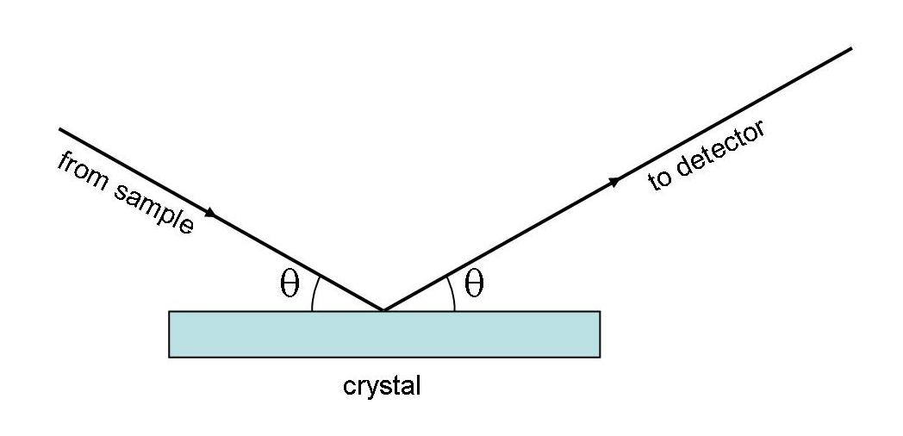
Schematic arrangement of EDX spectrometer

Slide 15
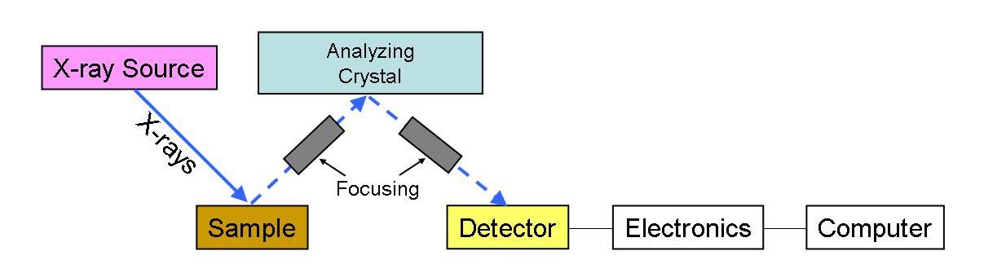
Schematic arrangement of wavelength dispersive spectrometer

Slide 16
RESULTS
Chemical analyses for silicate minerals are commonly reported in weight percentages of the oxides of the elements determined
Mineral formulae can be calculated from these results

Slide 17
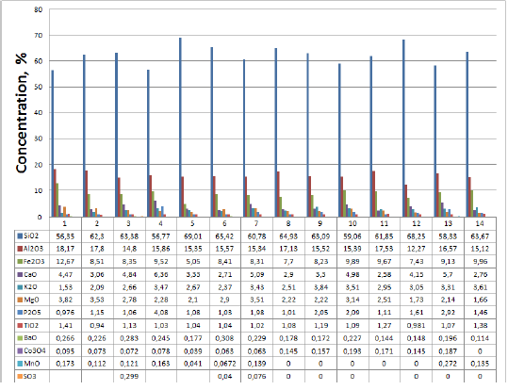
RESULTS OF XRF ANALYSIS FOR 14 SAMPLES FROM BVURAKAN

Slide 32
Al₂SiO₅ can be re-written as Al₂O₃.SiO₂ so that moles of SiO₂ and Al₂O₃ are 1 and 1 respectively; PFU is per formula unit

Slide 34
[60.086/162.049]*100 = 37.08wt%
[101.963/162.049]*100 = 62.92wt%
37.08 + 62.92 = 100.00

Slide 38
THE EXAMPLE GIVEN ABOVE FOR MINERAL FORMULAR CALCULATION IS MORE CLEARLY EXPLAINED IN THE ATTACHED SPREAD SHEET (FILE NAME – MINERAL FORMULAR CALCULATION FROM KNOWN OXIDE WEIGHT PERCENTAGES). THE 2.6430 IS OBTAINED BY DIVIDING 8 BY 3.0269. THE 2.643 IS MULTIPLIED BY MOLES OXYGEN & MOLES CATIONS RELATED OXYGEN MOLES IN OXIDES E.G. 2.2701*2.643*1/2 FOR Si = 3.00

Slide 39
(Mg_{1.4}Fe_{0.6})Si₂O₆ can be re-written as Mg_{1.4}O.Fe_{0.6}O.SiO₂.SiO₂ so that moles of MgO, FeO and SiO₂ are 1.4, 0.6 and 2 respectively

