Slide 1
MINERALOGY

Slide 2
WHAT IS A MINERAL?
A mineral is a naturally occurring solid with a highly ordered atomic arrangement and a definite (but not fixed) chemical composition
It is usually formed by inorganic processes

Slide 3
As of 2004 over 4,000 mineral species (natural and un-natural) were recognized by the International Mineralogy Association (IMA)
  150 species can be called "common,“
  50 are "occasional,“
  Rest are "rare" to "extremely rare"

Slide 4
WHAT IS MINERALOGY?
The study of the chemistry, atomic structure, physical properties, and genesis of minerals
A subject of geology specializing in the scientific study of chemistry, crystal structure, and physical (including optical) properties of minerals

Slide 5
Specific studies within mineralogy include:
  Processes of mineral origin & formation
  Classification of minerals
  Geographical distribution of minerals
  Utilization of minerals

Slide 6

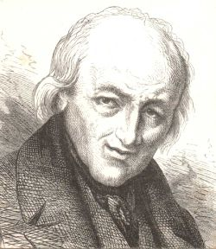
HISTORICAL PERSPECTIVE
Mineral science begins with Renaissance (Agricola, De Re Metallica 1556 Mining and Metallurgy Methods
Nicolas Steno (Danish: Niels Stensen) Constant crystal face angles 1669)
1700’s measurements of crystal geometry and symmetry René Just Haüy concept of unit cell
Early 1800’s precise measurements of crystal symmetry heralds the field of crystallography; analytical chemistry leads to chemical classification of minerals
Late 1800’s – creation of polarizing microscope opens field of petrography and the study of optical properties of minerals
Steno
René Just Haüy

Slide 7
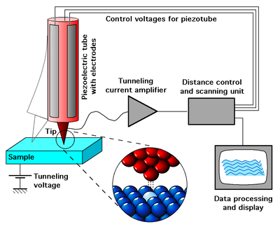
Early 1900’s - X-ray diffraction measurements allows for precise measurement of internal symmetry and structure of minerals, and geothermobarometry applied to metamorphic systems
1960 – development of the electron microprobe allows for accurate in situ analysis of mineral chemistry
1970 – development of transmission electron microscope allows for visualization of atomic structure and symmetry
1980 – ion microprobe allows for study of isotopic composition of minerals
1981 Scanning Tunneling Microscope for elements (cartoon on the right)
Early 2000’s to present - investigation of the role of acidic and basic fluids in metamorphism using high PT vessels

Slide 8
IMPORTANCE OF MINERALOGY
Mineralogy is fundamental to:
  Petrology – the origin of rocks, evaluating the structure, texture, and chemistry of their minerals.
  Geochemistry – study of the chemistry of minerals at the surface and at high P-T
  Structural Geology– Deformation of a rock and the orientation and crystal structure of its minerals
  Weathering – the study of how the biosphere, hydrosphere, and atmosphere interact with minerals
  Economic Geology – study of the origin and concentration of ore deposits

Slide 9
AREAS OF MINERALOGY
Physical Mineralogy
Chemical Mineralogy
Biomineralogy
Optical Mineralogy
Descriptive (Systematic) Mineralogy
Determinative (Analytical) Mineralogy

Slide 10
PHYSICAL MINERALOGY
Physical mineralogy focuses on physical attributes of minerals
Description of physical attributes is the simplest way to identify, classify, and categorize minerals, and they include:
  Colour
  streak
  Lustre
  Cleavage/fracture
  Hardness
  Specific gravity
  Crystal structure
  Crystal habit
  Twinning

Slide 11
CHEMICAL MINERALOGY
Chemical mineralogy focuses on the chemical composition of minerals in order to identify, classify, and categorize them, as well as a means to find beneficial uses from them
There are a few minerals which are classified as whole elements, including sulfur, copper, silver, and gold, yet the vast majority of minerals are chemical compounds, some more complex than others
In terms of major chemical divisions of minerals, most are placed within the isomorphous groups, which are based on analogous chemical composition & similar crystal forms
  A good example of isomorphism classification would be the calcite group, containing the minerals calcite, magnesite, siderite, rhodochrosite, and smithsonite

Slide 12
BIOMINERALOGY
Biomineralogy cuts across fields of mineralogy, paleontology and biology
It is the study of how plants and animals stabilize minerals under biological control, and the sequencing of mineral replacement of those minerals after deposition
It uses techniques from chemical mineralogy, especially isotopic studies, to determine such things as growth forms in living plants and animals as well as things like the original mineral content of fossils

Slide 13
OPTICAL MINERALOGY
Optical mineralogy focuses on aspects that applies sources of light as a means to identify and classify minerals
All minerals not part of the cubic system are double refracting, where ordinary light passing through them is broken up into 2 plane polarized rays that travel at different velocities and refracted at different angles
Mineral substances belonging to the cubic system contain one refractive index
Hexagonal and tetragonal mineral substances have two indices, while orthorhombic, monoclinic, and triclinic substances have three indices of refraction
With opaque ore minerals, reflected light from a microscope is needed for identification

Slide 14
DESCRIPTIVE MINERALOGY
Descriptive mineralogy summarizes results of studies performed on mineral substances
Scholarly and scientific method of recording the identification, classification, and categorization of minerals, their properties, and their uses
Classifications for descriptive mineralogy includes:
  Native elements
  Sulphides
  Oxides and hydroxides
  Halides
  Carbonates, nitrates and borates
  Sulphates, chromates, molybdates and tungstates
  Phosphates, arsenates and vanadates
  Silicates

Slide 15
DETERMINATIVE MINERALOGY
Determinative mineralogy is the actual scientific process of identifying minerals, through data gathering and conclusion
When new minerals are discovered, a standard procedure of scientific analysis is followed, including measures to identify a mineral's formula, its crystallographic data, its optical data, as well as the general physical attributes determined and listed

