Slide 1
Introduction to Mining Engineering
By
Dr. S. Kangwa
University of Zambia
School of Mines
E-mail: sam.kangwa@unza.zm

Slide 2
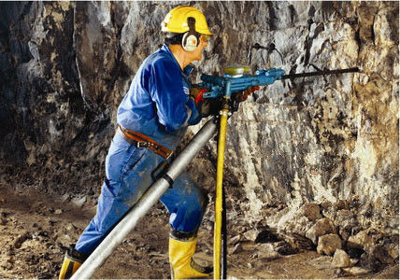
INTRODUCTION TO HARD ROCK DRILLING
IN THE MINING INDUSTRY
BASIC PRINCIPLES OF DRILLING

Slide 3
Production Unit Operations
Units operations employed to produce minerals from deposits are:
Drilling
Blasting
Loading
Hauling
Production cycle = drill + blast + load + haul

Slide 4
Drilling: Definition
A process of cutting or boring rock.
  It is mechanical rock penetration
Energy must be applied to the rock by direct or indirect means to fragment the rock
Drilling is the first unit operation employed to produce ore.

Slide 5
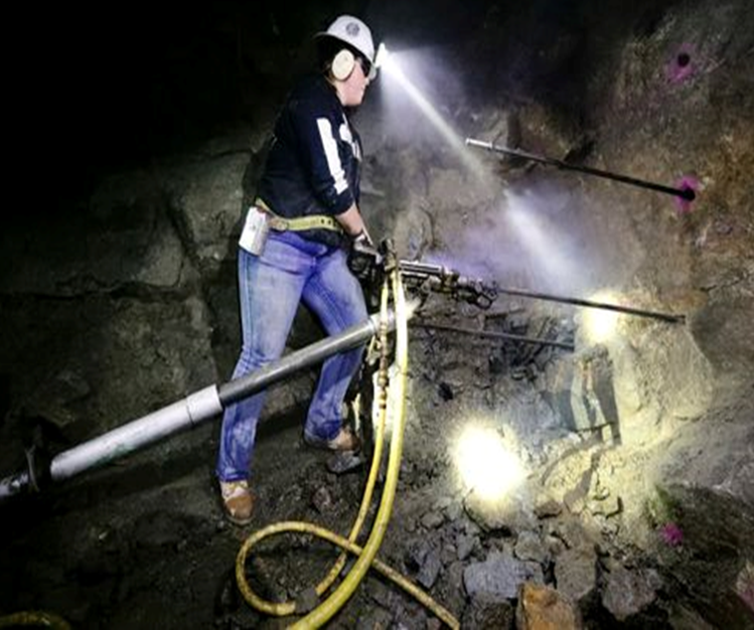
Types of Rock Drills

Slide 6
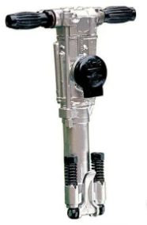
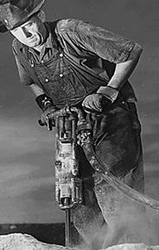
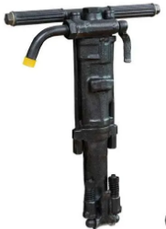
Held-held Drills

Slide 7
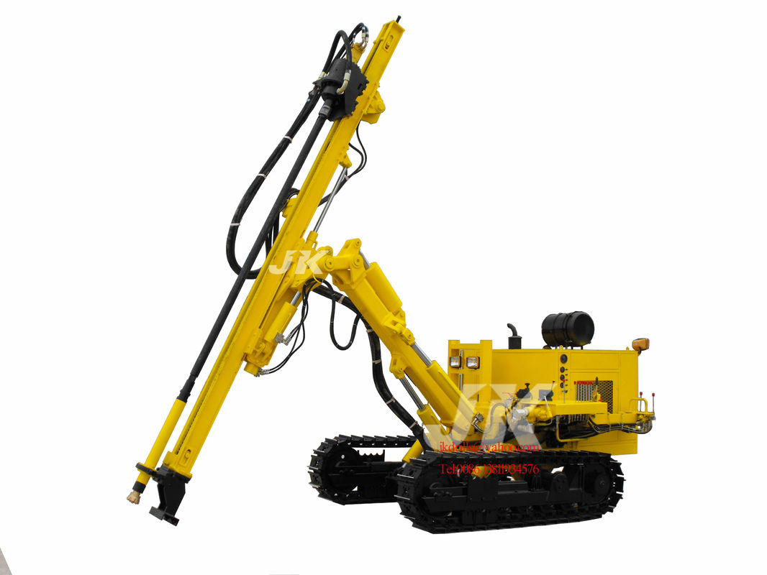
DTH Hydraulic Crawler Drill

Slide 8
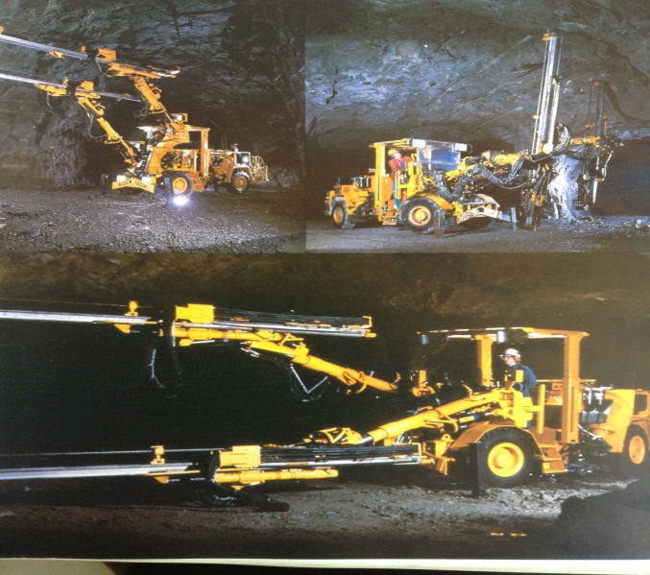
Boomer H120 Hydraulic Drilling Rig

Slide 9
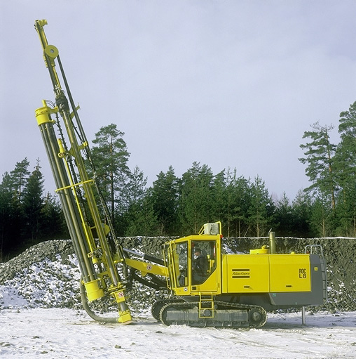
Rotary drill rig

Slide 10
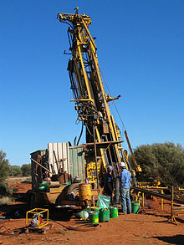
Core Drilling Machine

Slide 11
Purpose of Drilling
The general purpose of holes drilled include:
Prospecting
  Searching for minerals
Exploration
  Core drilling for evaluation of rock formations
  Drilling for geological information
  Estimation of ore tonnage and grade
Anchorage or support systems
Drainage
Blast holes

Slide 12
Drill Holes Characteristics
The drill holes are characterised by four factors:
Diameter
Length
Straightness
Stability

Slide 13
Trends in Drilling
Drilling Methods have advanced from rudemental methods to automated or computerized drilling.
Advantages of advanced drilling Methods are:
Higher productivity, low manpower and high pay load
Elimination of human factor
Rig orientates itself on its axis
Accurately collar and drill
Controls drilling parameters
Optimum drilling of pattern of holes

Slide 14
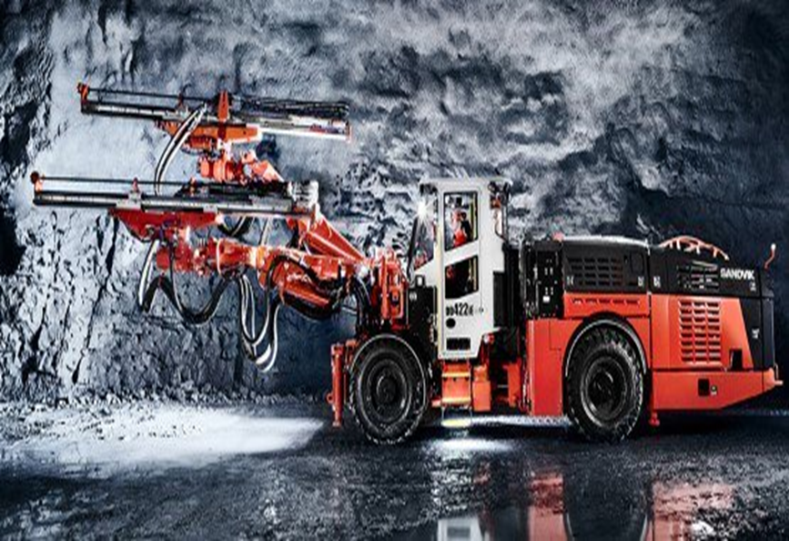
Automated Drilling rig

Slide 15
Functional Components of Drilling System
There are four components of a drilling system:
1. The rock drill
  It acts as a prime mover converting the original form of energy into mechanical energy to actuate the system
2. The rod (drill steel)
  It transmits the energy from prime mover to the bit;
  There are integral and extension drilling rods. Extension rods are connected using coupling sleeves

Slide 16
3. The bit
  It is the applicator of energy attacking the rock mechanically to achieve penetration
4. The circulation fluid
  It cleans the hole, cool the bit and at times stabilises the hole
  It supports the penetration through removal of cuttings
  Air, water or sometimes mud is used for this purpose

Slide 17
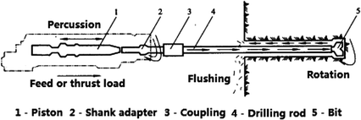
Drilling components

Slide 18
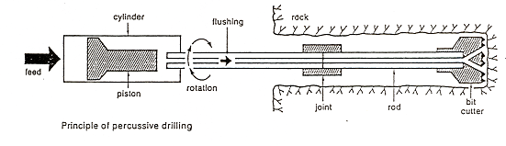
Functional Components of Drilling System

Slide 19
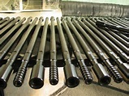
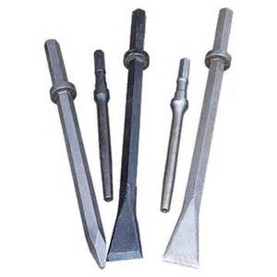
Drill Steels or Rods

Slide 20
Drill Steel or Rods
Drill steels or rods transmit the energy from prime mover (the drill) to the bit.
There are two types of drill steels:
Integral rods
Extension drilling rods.
Extension rods are connected using coupling sleeves.

Slide 21
Extension Drill Steels

Slide 22
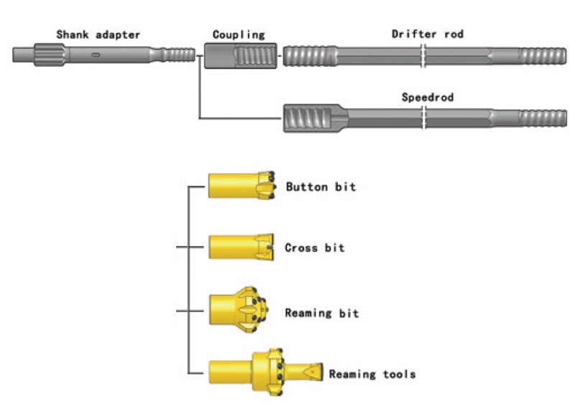
Drilling components

Slide 23
Rock Drill Bits
The bit is part of the drilling equipment that performs the crushing work.
It is the applicator of energy attacking the rock mechanically to achieve penetration

Slide 24
Types of Rock Drill Bits

Slide 25
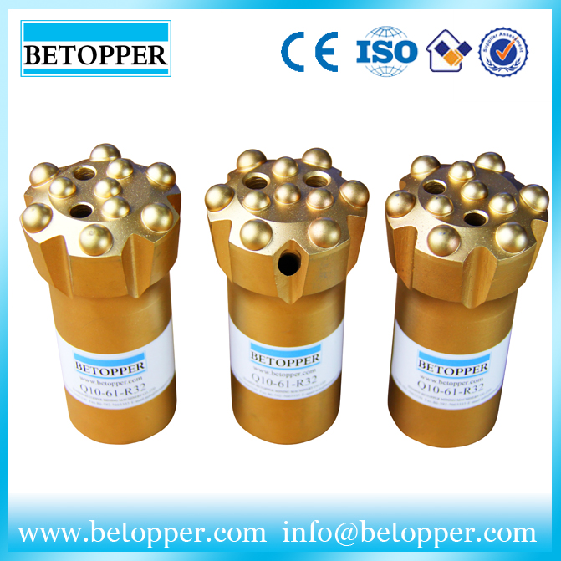
Button Bits

Slide 26
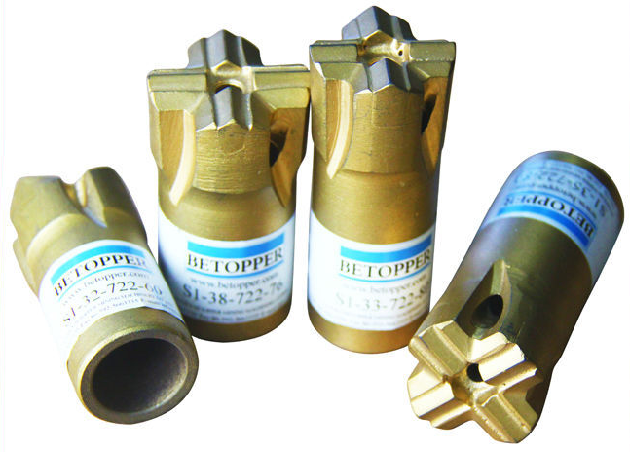
Insert (cross) Bits

Slide 27
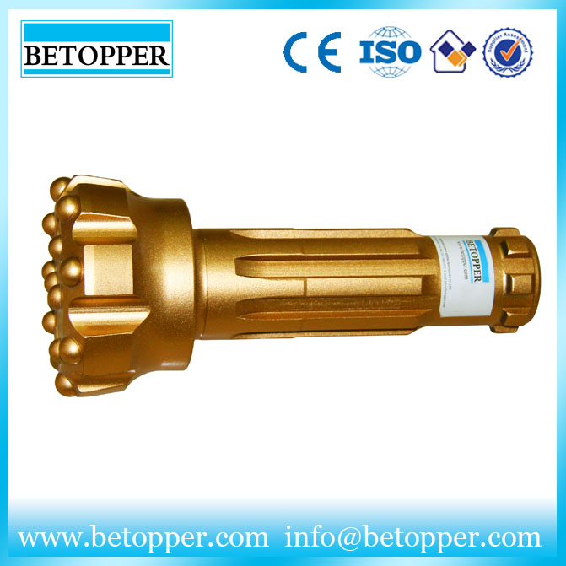
Copco Button Bits

Slide 28
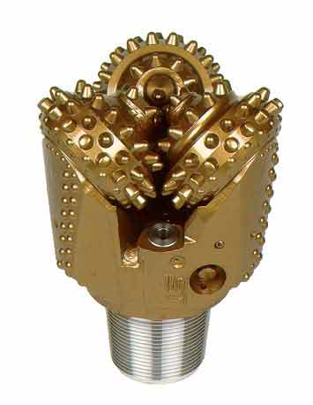
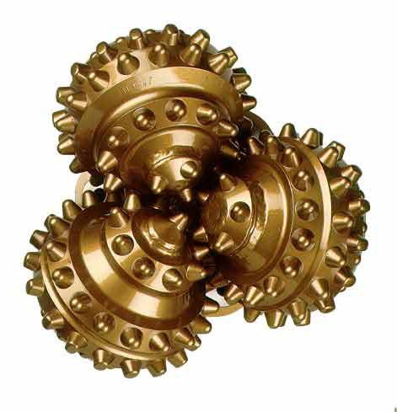
Tricone Rotary Drill Bits

Slide 29
Consumption of drilling components
Drilling components including bits, rods, coupling sleeves, shank adapters wear out and become obsolete. The life-span of drilling components depends on:
Rock hardness
Abrasiveness
Texture
Structure
Hole diameter and length

Slide 30
Principles of Rock Drilling
To appreciate the principles of drilling, one needs to understand:
Mechanics of rock penetration
Factors influencing penetration rate
Intrinsic environmental factors
Engineering properties

Slide 31
To understand mechanics of rock penetration, there is need to be familiar with the following:
Force
Friction
Angle of friction
Torque
Resistance
Energy ; kinetic energy,
Compressive strength
Modulus of elasticity
Tensile strength
Stress
Shear stress
Strain
Stress/strain curve
Theories of elasticity
Thrust
Hooke’s Law

Slide 32
Force is a push or a pull on an object with mass that can cause it to change its velocity (to accelerate). A force is a vector, which means it has both magnitude and direction
Friction is the resistance to motion of one object moving relative to another. Friction is the force resisting the relative motion of solid surfaces, fluid layers, and material elements sliding against each other – bit/rock interface resistance .
Thrust or feed is a pull-down force applied on the bit
Torque is a twisting (torsion) or turning force that tends to cause rotation around an axis – applied in rotary drilling.

Slide 33
Energy is the capacity for doing work. It may exist in potential, kinetic, thermal, electrical, chemical, nuclear, or other various forms – energy is required to break the rock.
Stress is the force per unit area applied to the rock.
Tensile stress
Compressive stress
Compressive strength is the capacity of a material or structure to withstand loads tending to reduce size, as opposed to tensile strength which withstands loads tending to elongate.

Slide 34
Young's modulus or modulus of elasticity is a measure of the ability of a rock or any material to withstand changes in length when under tension or compression. Young's modulus is equal to the longitudinal stress divided by the strain.
Hooke’s Law states that strain is proposal to the stress producing it.
Hertz theory gives relation between the load and the deformation of two contact bodies under force
For example between the bit and rock

Slide 35
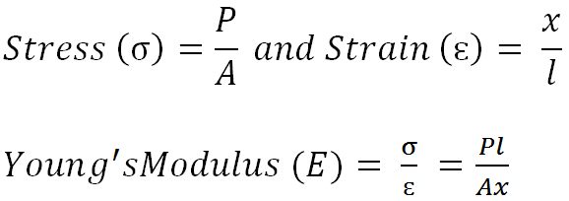
The force (P) acting on a bit of area A

Slide 36
Mechanics of rock penetration - for rock failure, energy is required
Basically the energy (ɛ₁) is required to penetrate or disintegrate the rock. The energy to overcome resistance should equal to the compressive strength per unit area
Compressive strength depends on Young’s modulus of a particular rock
Force is applied on the rock by the bit
Bit-rock interface - under stress

Slide 37
Fundamentals of mechanical rock penetration
Prime mover (drill) converts original form of energy into mechanical energy and the rod transmits the mechanical energy to the bit then to the rock:
Rotational effect creates torque
Percussive effect creates thrust
Torque and thrust create compressive stress
Bit and rock under compressive stress

Slide 38
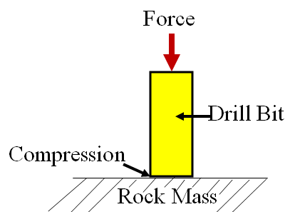
Principles of mechanical rock penetration

Slide 39
Principles of drilling
Percussive
Rotary
Rotary-percussive drilling

Slide 40
Percussive Drilling
This method uses rapid-action pneumatic hammer to transmit energy to the bit that drills the hole;
Used mostly in very hard rocks (e.g. granite) to drill holes;
Because of the impact, the rock is pulverize by the bit;
Compressed air is needed to drive this tool.

Slide 41
Percussive Drilling
Drilling motion is of hammering action.
The bit remains against the rock rebounding slightly at each blow (1500 to 3500 blows per minute).
The striking action causes the rock under the bit to fail.
The crushed rock (cuttings / chips) is then carried out of the hole by the flushing fluid.

Slide 42
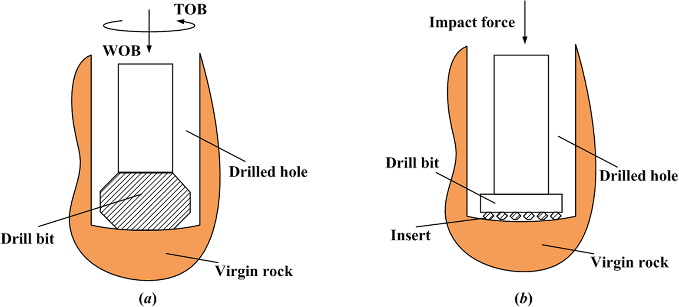
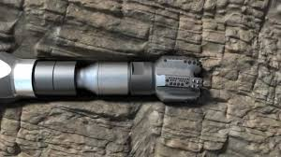
Bit-rock interface
Drill rod
Bit
Rock

Slide 43
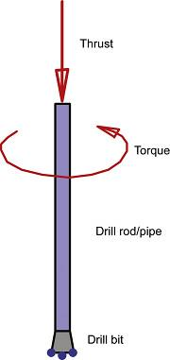
Rotary Drilling
In rotary drilling, the drill bit is rotated and crushes the rock. The downward thrust is achieved by the weight of the drill rig itself, and the rotation is applied at the end of the drill pipe.

Slide 44
Rotary drilling
This drilling technique has three drilling parameters, thus;
Rotation
Thrust, and
Flushing
When thrust advances bit inserts/buttons (e.g. cemented carbide buttons) into rock, torque will cause the bit to rotate in order to break the displaced rock in shear.

Slide 45
Rotation
For a given hole size, bit torque generally increases with increase in thrust on the bit and with increased rock penetration by bit buttons.
Normally, drills are designed to have a torque capability between 0.1356 and 0. 2712 per kg of thrust, although in rotary drilling this amount is rarely necessary.

Slide 46
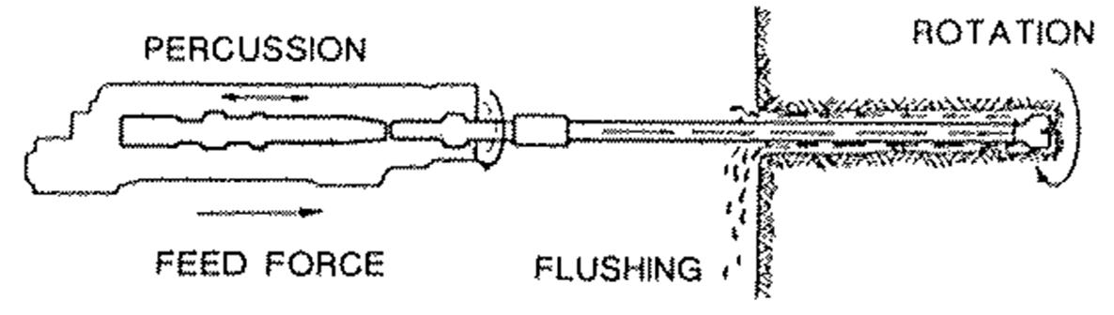
Fundamentals of rotary-percussive drilling
Percussion
Rotation
Feed or thrust load
Flushing

Slide 47
Principles of mechanical rock penetration
In mechanical rock penetration, the prime mover (drill) converts the original form of energy into mechanical energy. The energy actuate the system (force on the rock by the bit)
Force stress strain (rock failure)
Enough energy to overcome the rock strength
Rock strength depends on the rock properties

Slide 48
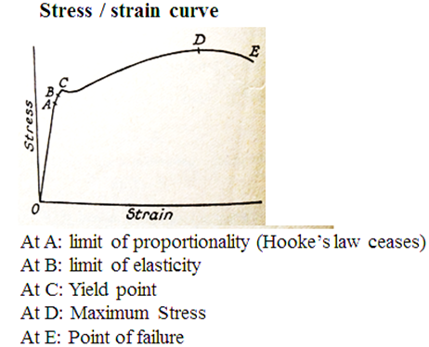

Slide 49
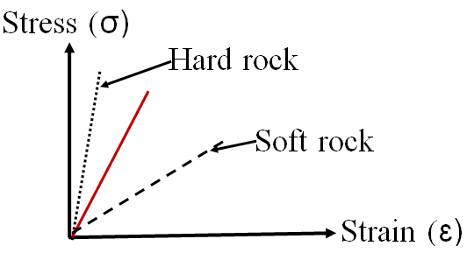
Rock is brittle material, therefore breaks (ruptures) at point C (yield point)
Hard rocks have higher Young’s Modulus therefore requires more energy to break than soft rock

Slide 50
The Flushing Fluid
The circulation fluid is the flushing medium which is supplied through the flushing-holes in the drill steel and distributed through flushing-holes in the bit front.
The front of the bit has space for flushing the cuttings or chips rearwards.
The flushing medium may be air, water or mud.

Slide 51
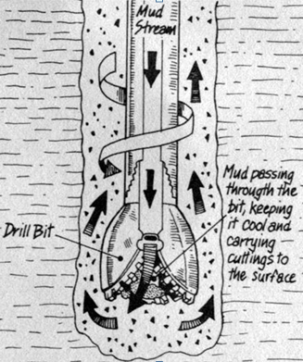
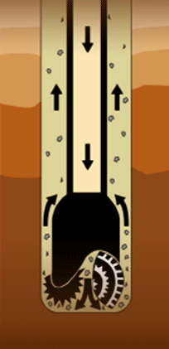
Principle of Drilling Fluid

Slide 52
The Circulation Fluid
Cleans the hole
Cools the bit and
Stabilises the hole
Supports the penetration through removal of cuttings
Air, water or sometimes mud is used for this purpose.

Slide 53
Tutorial Questions

Slide 54
Drilling technology has evolved from hand held pneumatic machines to automated drilling equipment. Explain how advanced drilling methods have affected the hole characteristics
Explain the principles of percussive and rotary drilling
Explain how uniaxial compressive strength and Young’s modulus affect rock penetration rate
With reference to mechanical rock penetration, describe the functions of:
  Drill
  Rod
  Circulation fluid

Slide 55
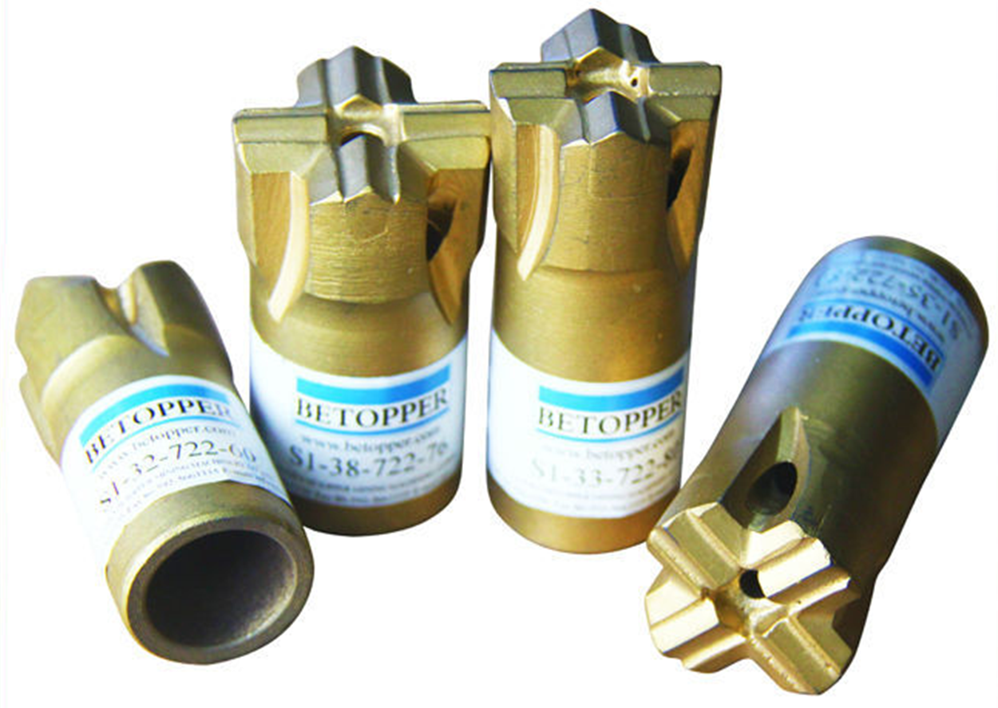

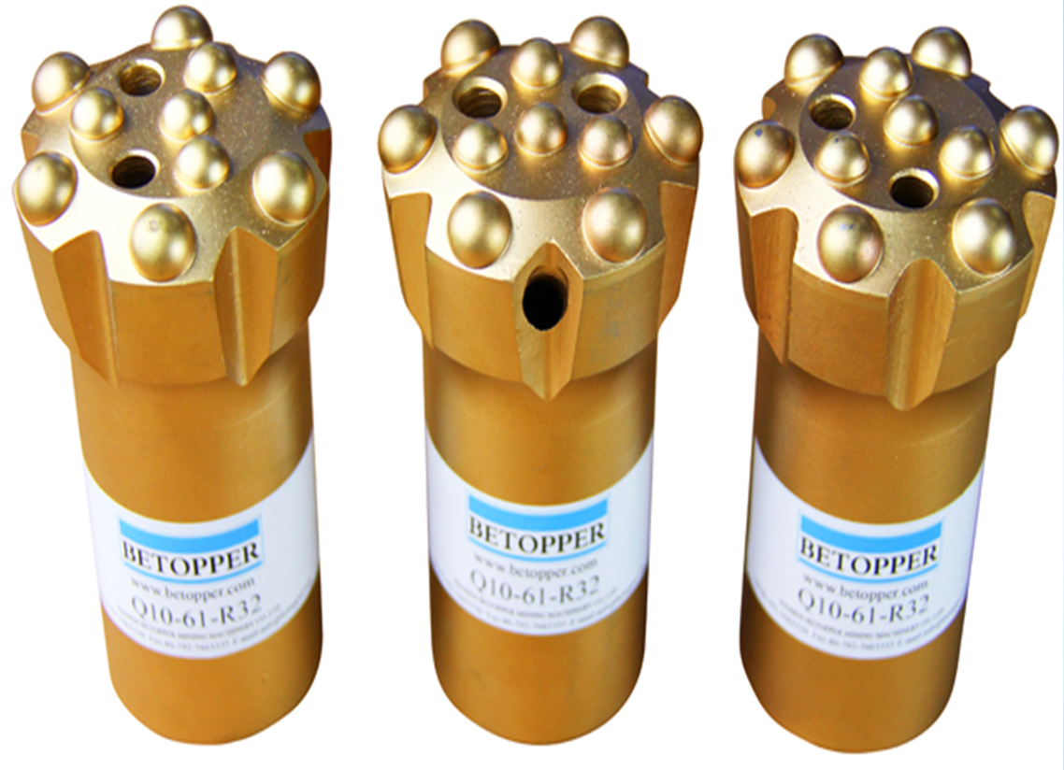
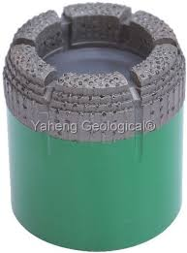
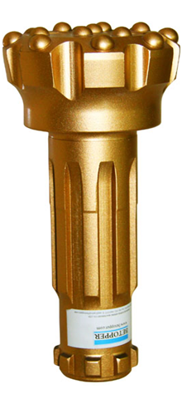
Q5. Name the following drilling bits
1 2 3 4 5

Slide 56
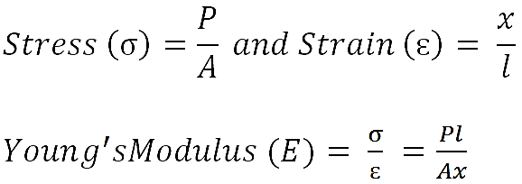
Q6. In rock drilling, force of 15kN is applied on two circular bits with diameters 0.15m and 0.3m, calculate:
The stresses produced by each bit on the rock
Make comments on stresses produced
Which bit has high penetration rate

Slide 57
Question 7.
Calculate the required bits, rods, coupling sleeves, shank adapters and production in tonnes given:
Tunnel length = 300m
Tunnel area = 40m²
Depth of round = 4.6m (with 95% advance)
Number of holes = 55 holes per round
Density = 1
Average service life:
45mm button bit = 300m
Coupling sleeves = 1,600m
R38 rods = 1,600m
Shank adapters = 2,500m

Slide 58
Q7: Solution
Total drilled metres = Tunnel length x holes per round + overdrill
Required bits = Total drilled metres/Average service life
Required sleeves =
Required rods =
Required adapters =
Production = Area x Length =
Tonnes = Production x Density

