Slide 1
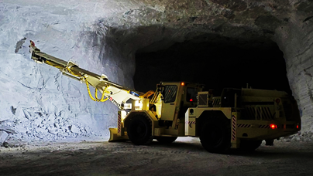
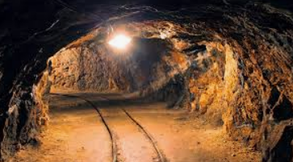
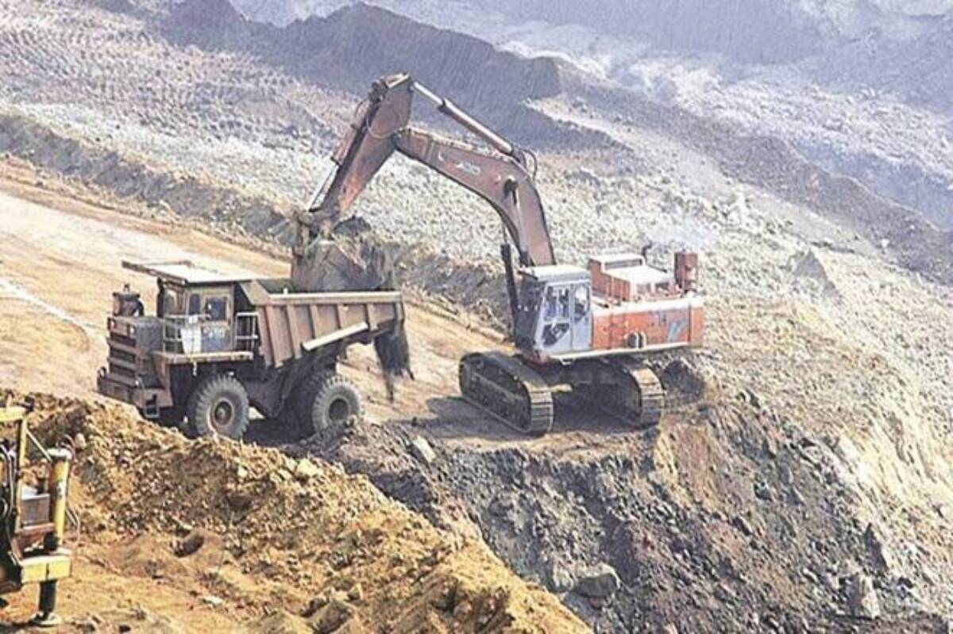
Introduction to Mining Engineering
Mine Excavation

Slide 2
What are mine excavation?
Excavation is the process of creating cavities or openings in the earth’s crust. It is the process of extracting rock.

Slide 3
Mine Excavations include:
Shafts
Levels
Portals
Crosscuts
Drives
Ramps
Raises
Beams
Ore passes
Pump chambers
Stopes
Open pits
Tunnels
Haulages
Winzes
Benches

Slide 4
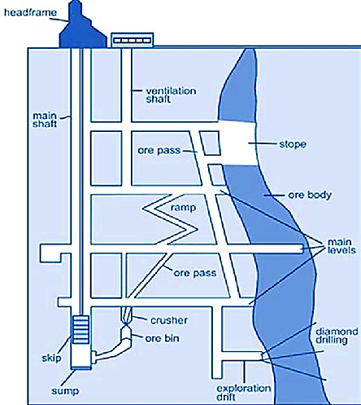
Underground Mine Excavations

Slide 5
Design of the mine excavation depends on:
1. The ground condition
  Stable
  Elastic or falling
  Squeezing
2. In-situ stresses
3. Rock mass strength

Slide 6
Designing Mine Excavation
Excavating in elastic and competent ground condition can face two situations:
Where no supports are required
  A self-supporting condition, and
Where supports are required for stability
  Non-squeezing condition.
Excavating through the squeezing ground condition is a very slow and problematic process.
Rock mass around the opening loses its inherent strength under the influence of in-situ stresses

Slide 7
There are mainly two excavation methods used in the mine:
Conventional method
  Drilling and blasting
Unconventional method
  Boring method - use of excavating machines like a raise-borer
  No drilling and blasting

Slide 8
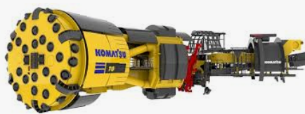
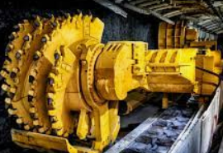
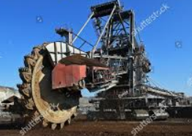
  Boring method - use of excavating machines like a raise-borer

Slide 9
Conventional Method
Conventional mine excavation involves cyclic operations of:
Drilling of blast holes
Charging with explosives
Blasting
Mucking – loading and transporting fragmented rock
Support work in unstable area

Slide 10
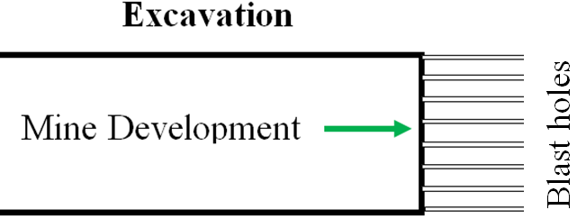
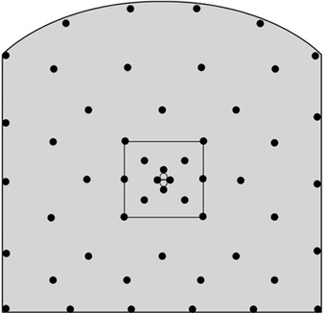
Conventional method involves drilling and blasting
Development End
(Marked Face)

Slide 11
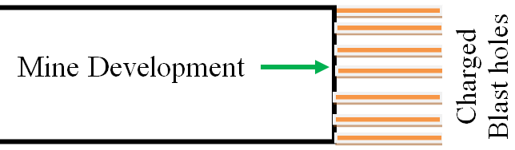
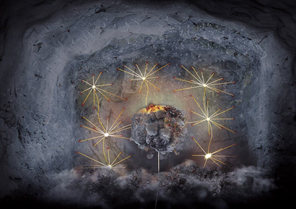
Conventional method involves drilling and blasting
Face of
Development End

Slide 12
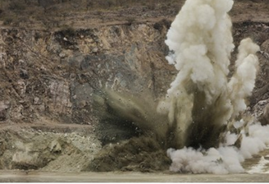
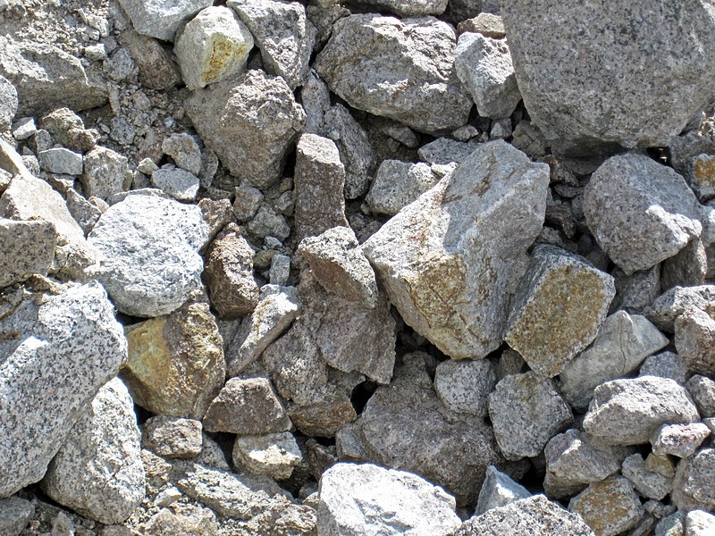
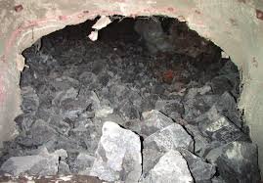
After charging, the end is blasted
Blasting
Muck Piles

Slide 13
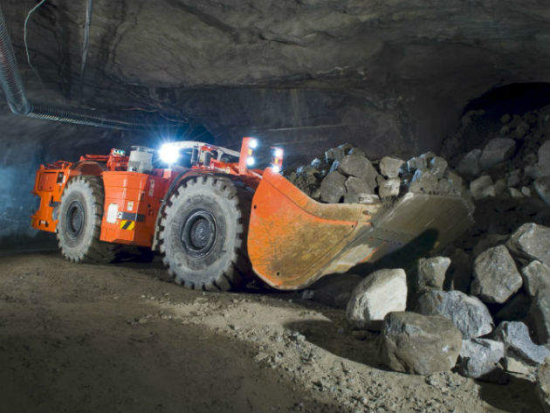
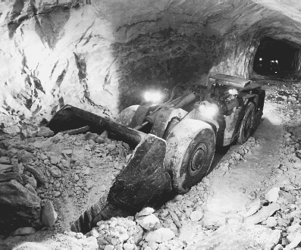
Mucking

Slide 14
Collapse of Mine Excavations
Stability of underground excavations is of great importance to an operating mine because it ensures the safety of the working people and operating equipment.
Collapse or failure of mine excavations depends on:
Mechanical properties of the rock including:
  Interaction between the joint orientation,
  Spacing and persistence of that rock mass.
Rock Quality Designation (RQD),
Volumetric Joint Count (Jv), and
Block Size Index (I_{b})

Slide 15
Causes of Collapse of Mine Excavations
Rock mass and material properties of the ground
Stress field
Size of the mine excavation
Shape of the mine excavation
Excavation method
  Drilling and blasting may cause vibration
Ground movement
Earthquakes
Seismic

Slide 16
Design and Stability of Mine Excavations
Designing of mine excavations requires knowledge of:
Stress field,
Stress concentrations around various shaped excavations,
Mechanical properties of the rock, and
Support system.
Stress and Strain
Rock Deformation

Slide 17
Stress - Pressure Applied to Rock
Rock can be subjected to several different kinds of stress including:
Lithostatic stress:
Rock beneath the earth's surface experiences equal pressure exerted on it from all directions because of the weight of the overlying rock.
Like the hydrostatic stress.

Slide 18
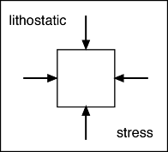
Lithostatic Stress

Slide 19
Stress - Pressure Applied to Rock
Differential (deviatoric) stress:
In many cases, rock may experience an additional, unequal stress due to tectonic forces.
There are three basic kinds of differential stress:
Tensional stress (stretching)
Compressional stress (squeezing)
Shearing stress (side to side shearing)

Slide 20
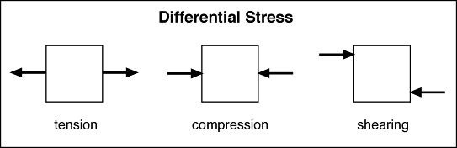
Differential (Deviatoric) Stress

Slide 21
Stress - Pressure Applied to Rock
Strain - rock deformation in response to Stress.
Rock responds to stress differently depending on:
Pressure,
Temperature (depth in Earth), and
Mineralogic composition of the rock.

Slide 22
Stress - Pressure Applied to Rock
Elastic deformation:
For small differential stresses, less than the yield strength, rock deforms like a spring.
It changes shape by a very small amount in response to the stress, but the deformation is not permanent.
If the stress could be reversed the rock would return to its original shape.

Slide 23
Stress - Pressure Applied to Rock
Brittle deformation:
Near the earth's surface rock behaves in its familiar brittle fashion.
If a differential stress is applied that is greater than the rock's yield strength, the rock fractures.
Note:
The part of the rock that didn't break springs back to its original shape.
This elastic rebound is what causes earthquakes (on a large scale).

Slide 24
Stress - Pressure Applied to Rock
Ductile deformation:
Deeper than 10-20 km
Enormous lithostatic stress
Nearly impossible to produce a fracture
High temperature makes rock:
  Softer,
  Less brittle, and
  More malleable.
Rock undergoes plastic deformation when a differential stress is applied that is stronger than its yield strength. It flows.

Slide 25
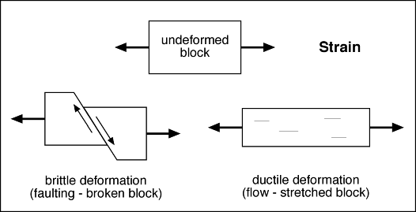
Stress - Pressure Applied to Rock

Slide 26
Stress - Pressure Applied to Rock
There are three mechanisms by which ductile deformation occurs depending principally on the temperature.
Plastic flow occurs,
Power law creep, and
Diffusion creep.

Slide 27
Plastic Flow Occurs
Plastic flow occurs at the relatively low temperatures in the lower crust and uppermost mantle.
Rock deforms by gradual creep along crystal grain boundaries and planes within crystal lattices.
This method leads to work hardening because crossing planes and grain boundaries soon lock the creep planes.

Slide 28
Power Law Creep
Power law creep occurs where the temperature is greater than 55% of the melting temperature for that depth (pressure).
Movement occurs along crystallographic planes and grain boundaries, as in plastic flow, but diffusion of ions/atoms at the higher temperatures allows for continuous and large deformation.
High stresses at locked points cause the atoms to diffuse to lower stress points.
This is called dynamic recrystallization.

Slide 29
Diffusion Creep
Diffusion creep occurs where the temperature is greater than 85% of the melting temperature for that depth (pressure).
Deformation/flow is largely accomplished by ionic/atomic diffusion and continuous recrystallization.

Slide 30
In-situ Stresses
Underground formations are confined and under stress.
The figure below illustrates the local stress state at depth for an element of formation.
The stresses can be divided into three principal stresses:
  σ₁ is the vertical stress
  σ₂ is the minimum horizontal stress
  σ₃ is the maximum horizontal stress

Slide 31
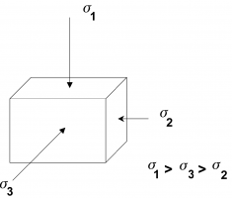
Three Principal Compressive Stresses

Slide 32
In-situ Stresses
These stresses are normally:
Compressive,
Anisotropic, and
Nonhomogeneous.
Compressive stresses on the rock are not equal and vary in magnitude on the basis of direction.

Slide 33
In-situ Stresses
The magnitude and direction of the principal stresses are important because:
They control the pressure required to create and propagate a fracture,
The shape and vertical extent of the fracture, The direction of the fracture, and
The stresses trying to crush and/or embed the propping agent during production.

Slide 34
Revision Questions
Explain how:
  Geological and hydrological rock conditions affect the selection of excavation method
  The level and extent of mine mechanisation affection the selection of excavation method
Describe five cyclic operations involved in mine excavation
Explain how stress field cause the mine excavation to collapse
Explain how lithostatic, deviatoric and principal stresses affect mine excavations.
Explain the advantages and disadvantages of conventional mine excavation method

Slide 35
Q6. Calculate the number of rounds and production (m³) given:
Tunnel length = 300m
Tunnel area = 40m²
Depth of round = 4.6m (with 95% advance)
If mucking is done by a loader with bucket capacity of 45m³, calculate the number of scoops for the whole tunnel.
Q7. If a 4.5m by 3.6m drive is to be excavated 150m long in pegmatite with 250MPa strength:
Calculate the tonnage of rock to be excavated, given specific gravity of 2.7
If the pegmatite has a swell factor of 0.15, estimate the number of scoops if the loader has 40 tonne-bucket capacity.
Describe the sequence of activities for excavating the drive

