Slide 1
COURSE: MIN 2019
INTRODUCTION TO MINING ENGINEERING
LECTURE 4

Slide 2
COURSE: MIN 2019
INTRODUCTION TO MINING ENGINEERING
LECTURE 4
UNDERGROUND MINING

Slide 3
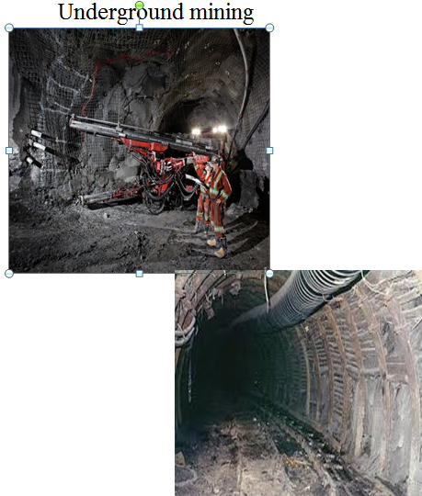
What is underground mining?
Underground mining is a technique or method applied to extract ore which is deep from surface
  (> 400m).
This includes pillar supported or unsupported, artificially or supported and caving mining methods.

Slide 4
Classification of Mining Methods
Based on feasibility studies, a mining method is selected for a particular ore-body
The mining methods are generically classified as:
Surface mining; and
Underground mining

Slide 5
Classification of Mining Method
Mining Method
Surface Mining
Techniques
Underground Mining
Techniques

Slide 6
The factors considered in determining surface or underground mining method include:
Spatial characteristics of deposit / ore body
  Depth
  Size
  Shape
  Attitude (dip)
Mining technology
Type of mining equipment available
Systems of materials handling
Production rate
Cost effectiveness
Safety and environmental controls

Slide 7
Classification of Mining Method
Mining Method
Surface Mining
Techniques
Underground Mining
Techniques

Slide 8
For underground mining, there is need to plan:
Mine layout
How to access the mineral deposit
How to provide adequate ventilation
How to carry out mining operations safely
How to provide mine support services

Slide 9
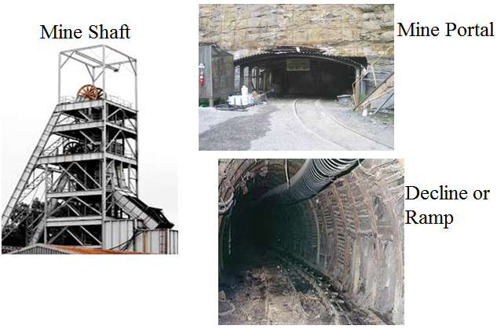
Accessing underground ore can be achieved via:

Slide 10
Underground Access
To access the ore body:
Levels are excavated horizontally off the decline or shaft to access the ore body.
Stopes are then excavated perpendicular (or near perpendicular) to the level into the ore

Slide 11
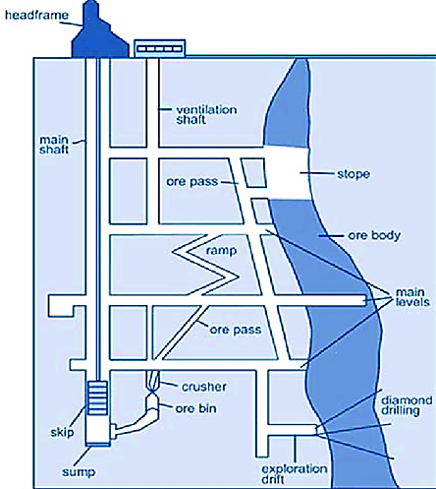
Underground Mine Layout

Slide 12
Underground Mining Terminology
Definitions of common mining terms

Slide 13
Shaft | Drive | Hanging-wall
Cage | Crosscut | Footwall
Skip | Ramp | Ore grade
Free face | Tramming | Cut-off grade
Winze | Country rock | Gangue
Raise | Haulage | Ore pass
Level | Adit | Slot
Dip | Development | Hole spacing

Slide 14
Stope | Recovery
Stopping | Dilution
Rock strength | Subsidence
Chain or crown pillar | Zone of fracture
Rib pillar | Rock deformation
Draw-point | Ground stress
Angle of draw | Stope

Slide 15
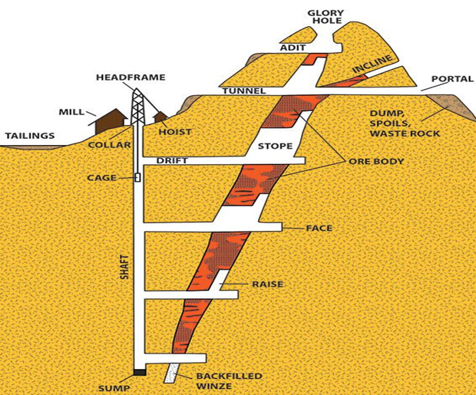
Underground Mining Terminology

Slide 16
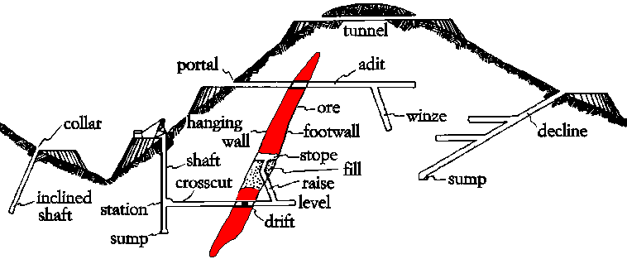

Slide 17
Underground Mining Methods

Slide 18
Underground Mining
Mining Method Techniques
Self supported
Artificially Supported
Caving or Unsupported

Slide 19
Underground Mining Techniques
Pillar supported or unsupported methods
Room and Pillar
Sublevel open stoping
Artificially Supported or supported methods
Cut and fill
VCR stoping
Caving methods
Block caving
Sublevel caving

Slide 20
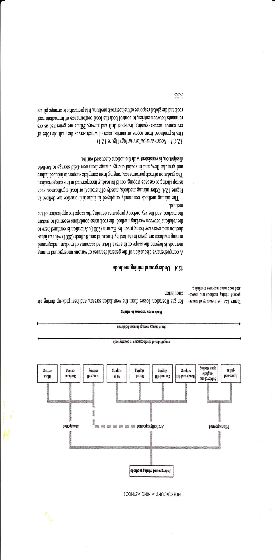

Slide 21
Characteristics of the deposit considered in selection of the underground mining methods
Ore strength
Rock strength
Shape of ore-body
Inclination or dip of the deposit
Type of ore-body (uniformity)

Slide 22
Main features for Self Supported Mining Methods
Ore strength | Moderate to strong
Rock strength | Moderate to strong
Deposit shape | Tabular
Deposit dip | Low to steep
Ore uniformity | uniform

Slide 23
Main features for Artificially Supported
Mining Methods
Ore strength | Weak to moderate
Rock strength | Weak
Deposit shape | Tabular or any
Deposit dip | Fairly steep
Ore uniformity | Variable

Slide 24
Main features for Caving Mining Methods
Ore strength | Weak to Moderate
Rock strength | Weak
Deposit shape | Tabular or massive
Deposit dip | Fairly steep
Ore uniformity | uniform

Slide 25
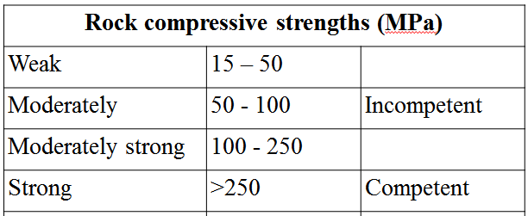
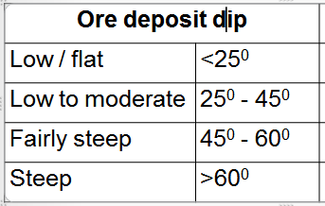

Slide 26
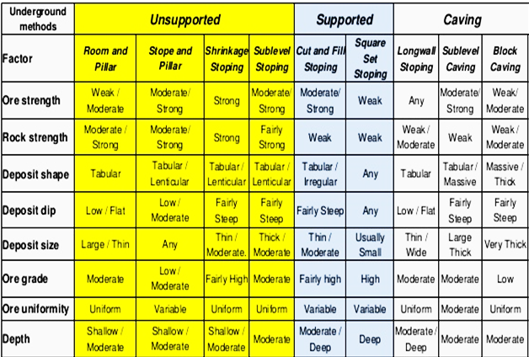
Main features for U/G Mining Methods

Slide 27
Some Common Mining Methods
Room and Pillar mining
Cut and Fill Mining
Vertical Crater Retreat (VCR) Mining
Block caving

Slide 28
Room and pillar mining:
Applied in flat or gently dipping bedded ore
bodies
  Fairly competent and tabular ore bodies
  Fair recovery (70%)
  Low dilution (<20%) if pillar are not recovered
Pillars are left in place in a regular pattern
Rooms are mined out
Higher recovery when pillars are mined out
  Roof to collapse and fill in the stope

Slide 29
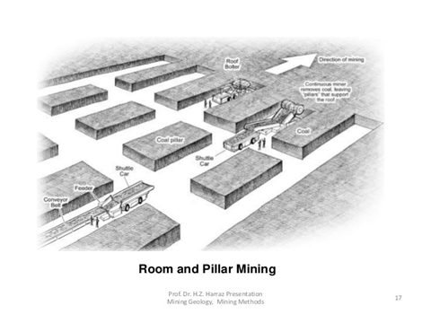

Slide 30
Cut and Fill Mining Technique
Requires properly defined ore body limits
  Hangingwall and footwall
Applied in fairly steeply dipping ore-bodies
Moderate ore strength
Weak rock strength
Tabular ore-body
Usually accessed by ramp
Crosscuts are driven through the ore

Slide 31
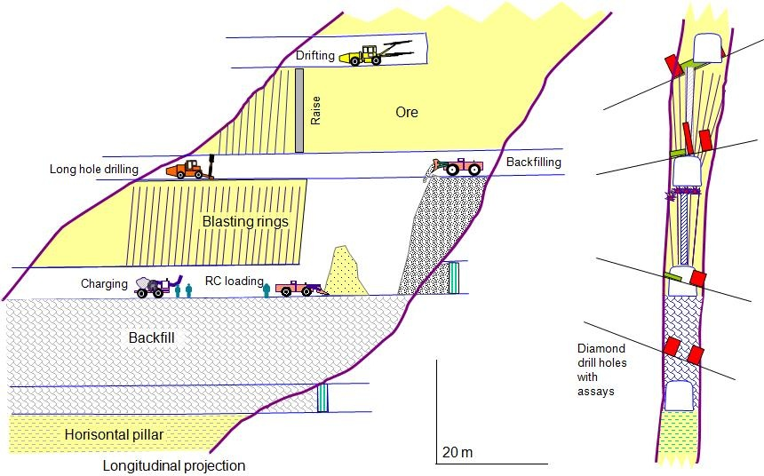
Cut and Fill

Slide 32
Vertical Crater Retreat (VCR) Mining
VCR stoping: applicable to steeply dipping deposits
The development for VCR mining requires both over-cut
and under-cut excavations which provide free face for the
blasting
The over-cut is needed in the first stope to accommodate the rig drilling the large-diameter (about 165mm) blast-holes and for access while charging the holes and blasting

Slide 33
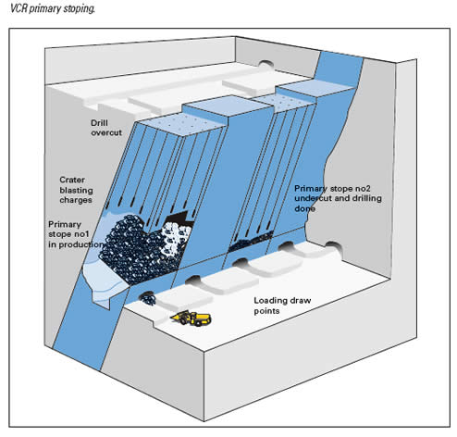
VCR Primary Stoping

Slide 34
Vertical Crater Retreat (VCR) Mining
Vertical long-holes are drilled from drives developed in the ore-body between two levels
Ore is then blasted using a charge that occupies a relatively short length of the hole, some distance from the bottom free-face
The blast creates downward facing craters and the broken ore is
drawn from the stope at the lower level
The stope is then backfilled

Slide 35
Main Features of Caving Mining Methods
Suitable conditions for caving mining:
Fairly steep ore bodies
Tabular or massive ore-bodies
Weak to moderately ore bodies
Readily break after being induced or under its own
weight
  Friable rock
Moderate to deep laying ore-bodies

Slide 36
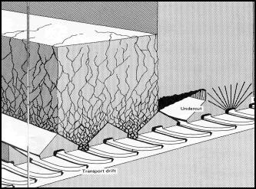
Aim of the block caving method is that the friable ore needs no blasting and continues to fracture and cave under its own weight.

Slide 37
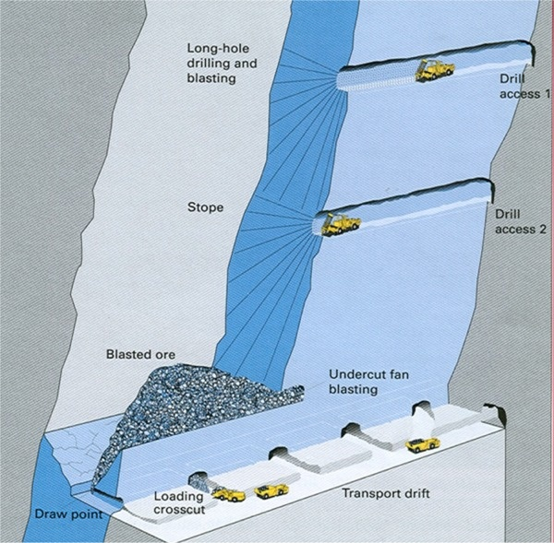
Induced caving – by minimal drilling and blasting

Slide 38
Main Features of Caving Mining Methods
Highly productive
Large-scale or bulk mining method
Suitable even for low grade ore bodies
Low operating cost
Involve caving of ore and/or the overlying rock
High recovery
Subsidence of the surface (normally occurs)
May cause rock bursts

Slide 39
Tutorial Questions

Slide 40
1. With reference to underground mining, write
brief notes on:
  Angle of draw
  Zone of fracture
2. How does ore recovery affected by pillar mining methods?
Why is dilution higher in Cut-and-Fill than in VCR mining
methods.

Slide 41
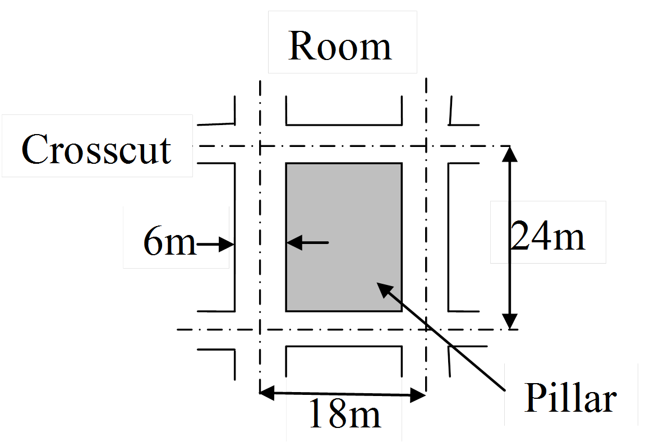
Q4. A portion of a panel in a room and pillar coal mine is shown in Figure below. All openings are 6.0m in width, and the mining height is regular. Rooms are driven on 18.0m centre and crosscuts on 24.0m centres. Calculate the percentage recovery in the panel:
Without pillar recovery
With recovery of chain pillars.

Slide 42
Q5. Select a suitable mining method given:
  Ore strength: Varying from 45 to 60 MPa
  Rock strength: varying from 45 to 70 MPa
  Deposit shape: massive
  Deposit dip: 52⁰
  Deposit size: very large areal extent
  Ore grade: low
  Ore uniformity: fairly uniform
  Depth: From 450m downwards

Slide 43
SELF TAUGHT TOPIC
- Dering the Term Break -

Slide 44
Underground Ventilation
One of the most important aspects of underground mining is ventilation. Underground mine ventilation provides a flow of air to the underground workings of a mine of sufficient volume.
Self taught topic : Underground Ventilation
Use the attached questions to guide you to learn about underground ventilation. Where necessary include well labeled diagrams.

Slide 45
What is the primary function of underground mine ventilation? Explain the two main ventilation systems.
With reference to mining regulations, explain a threshold limit value. List five toxic gases and their TLV.
Describe natural and artificial underground ventilation.
Explain the effect of air density, humidity, type of excavations and friction on the air flow rate.
Explain the sources and control measures of underground toxic gases, dust, heat and humid.

