Slide 1
Introduction to Mining Engineering
By
Dr. S. Kangwa
University of Zambia
School of Mines
E-mail: sam.kangwa@unza.zm

Slide 2
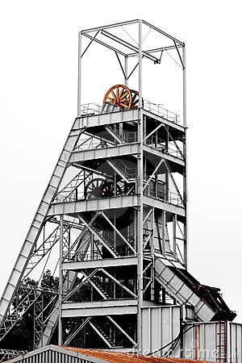
Mine Shaft

Slide 3
Classification of Mining Method
Mining Method
Surface Mining
Techniques
Underground Mining
Techniques

Slide 4
Underground Access
To access the ore body:
Levels are excavated horizontally off the decline or shaft to access the ore body.
Stopes are then excavated perpendicular (or near perpendicular) to the level into the ore

Slide 5
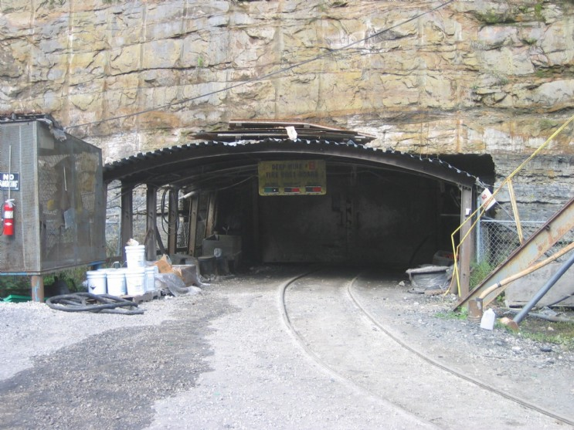
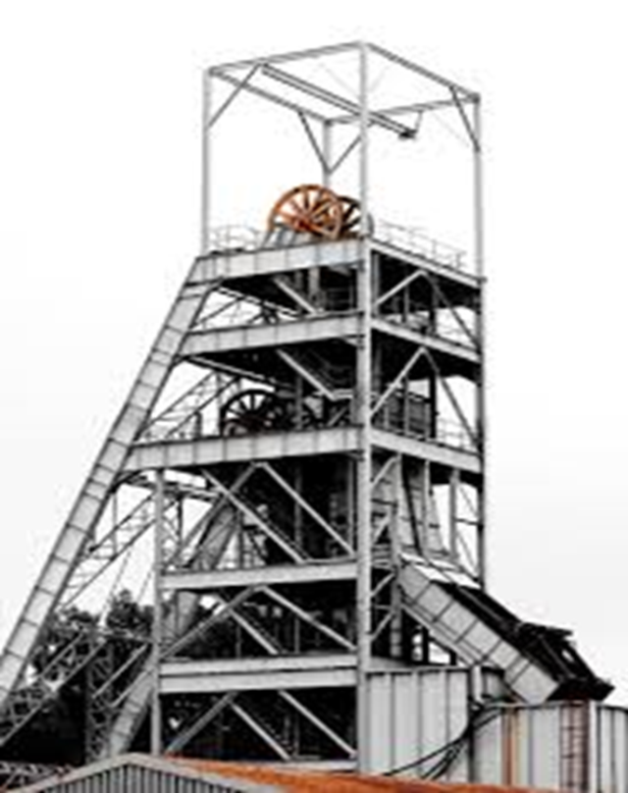
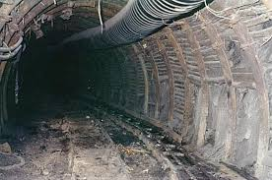
Accessing underground ore can be achieved via:
Mine Shaft
Mine Portal
Decline or Ramp

Slide 6
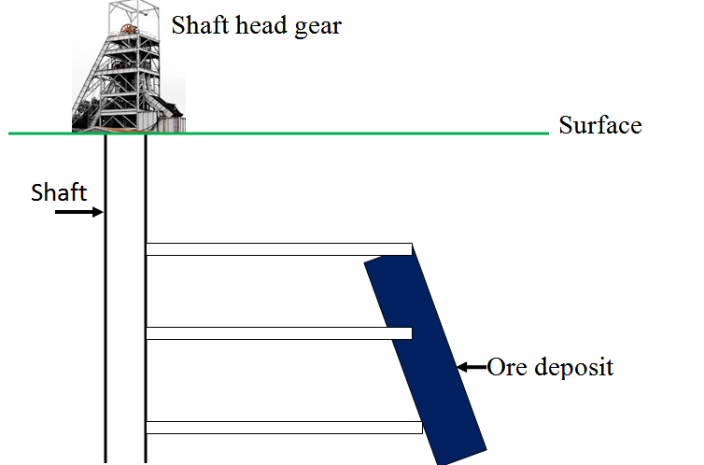

Slide 7
What is a Mine Shaft?
A mine shaft is vertical or inclined opening, giving access to and serving the various levels of a mine.
It is a primary vertical or near-vertical opening, connecting the surface with underground workings.
Stages in the life of a mine
Prospecting – Search for ore deposit
Exploration – Defining extent and value of ore
Development - opening up for production
  Access to the ore body
  Shaft as initial development for underground mining
4. Exploitation – Actual ore recovery
5. Reclamation – mine closure

Slide 8
Mine Shaft
Shafts play a major role in the general planning of mine development and in the life of an underground mine.
A hoist together with its associated plant for underground mine is the single most important and expensive element of the mine.
It is the most sophisticated mine plant.

Slide 9
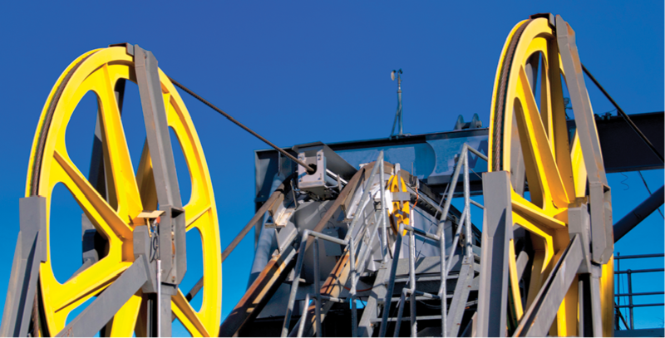
Shaft sheave wheels

Slide 10
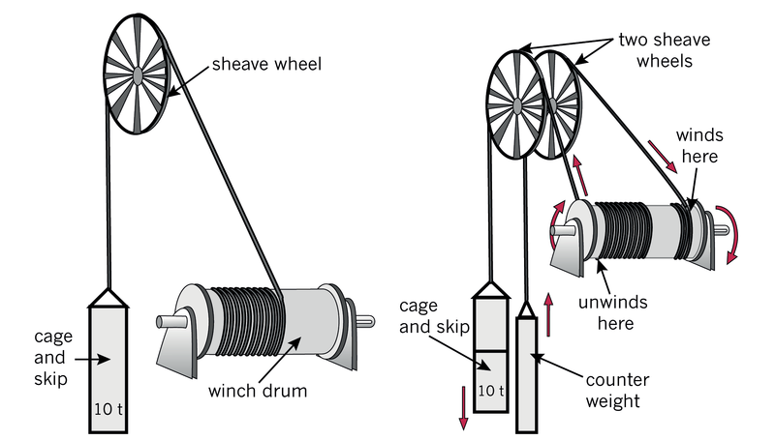
Shaft sheave wheels, drum and cage / skip

Slide 11
Considerations for Mine Shaft Site – shaft location
Mine Layout
Road networks
Offices
Plants
Parking sites
Permanent plant – life of a mine
Competent rock
  Less artificial support
Distance to the ore body
Source of energy
Maintenance space

Slide 12
A Mine shaft consists of:
Facilities for materials handling, such as ore and waste rock
Means of transport for mine workers
Arrangement for water lines, ventilation, drainage, power supply, and communication
For safety reasons materials handling compartment is separated from personnel compartment.

Slide 13
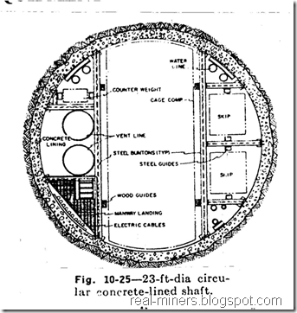

Slide 14
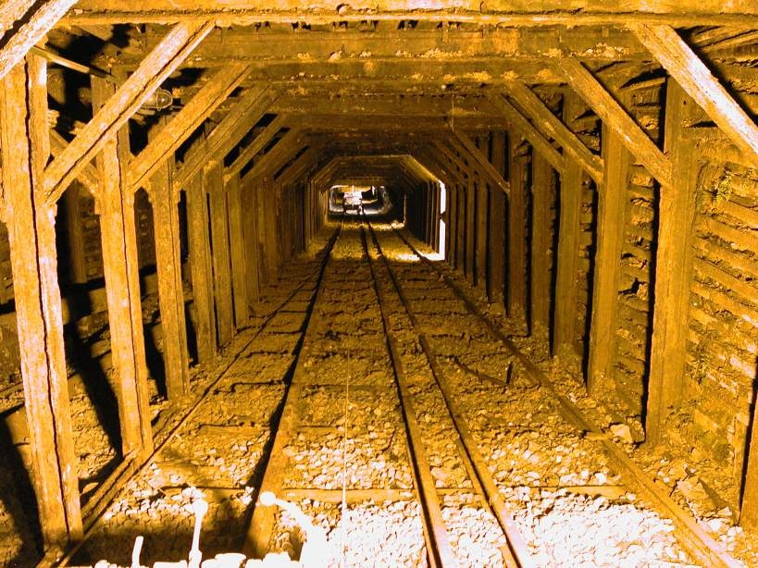

Slide 15
Functions of a mine shaft include:
• To access an ore body
• To transport men and materials to and from
underground workings
• For hoisting ore and waste from underground
• To serve as intake and return airways for the
mine ventilation

Slide 16
By mining law:
At least two shafts per mine
  To provide a second egress
  Alternative access to and from underground
  workings
Cages and skips
  To be suspended in the shaft by wire ropes
  To operate in balance
Ropes connected to the head gear

Slide 17
Shaft design parameters:
Depth of shaft
Ore and waste tonnage to be handled
Shift handling (work force)
General materials handling
Mining machinery handling
Ventilation requirements
Capital costs
Operating costs
Price of the mineral commodity

Slide 18
Classification of Mine Shafts
Mine shafts may be classified as:
Vertical shaft
Inclined shaft
Double staged shaft
Rectangular Shafts
Circular Shafts
Elliptical Shafts

Slide 19
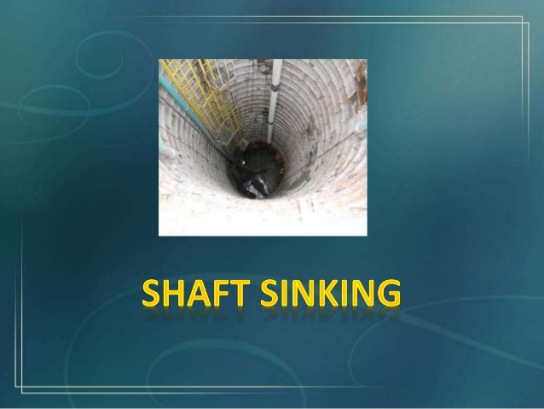

Slide 20
Shaft mining or shaft sinking refers:
To the method of excavating the shaft
Opening from the top down,
  Where there is initially no access to the bottom.
An important requirement in shaft sinking:
To provide optimum fragmentation
Quick removal of muck
  Congested shaft-face area.

Slide 21
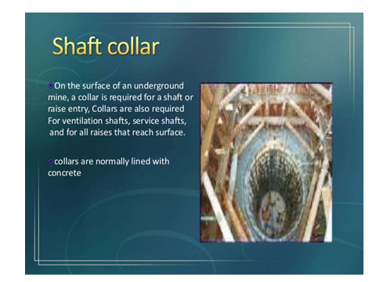
Mine Shaft Sinking
In shaft sinking, shaft collar is initially excavated
Shaft collar is the foundation of the shaft
Shaft collars are normally line with concrete.

Slide 22
There are different methods of shaft sinking.
The two generic methods are:
Conventional and Raise-boring methods
Conventional Method
In conventional method, a shaft is constructed by drilling holes and filling with explosives.
Using this method, drilling and blasting can sink around 5m to 7m in one blast.
The number of holes N required for sinking a shaft of cross section area A in m² is estimated by:
N = 2.5A + 22

Slide 23
Conventional Method
Disadvantages of conventional method include:
Labour intensive,
Unsafe
  Explosives
  Fumes
  Toxic gases
  Dust
  Falling objects
High running costs

Slide 24
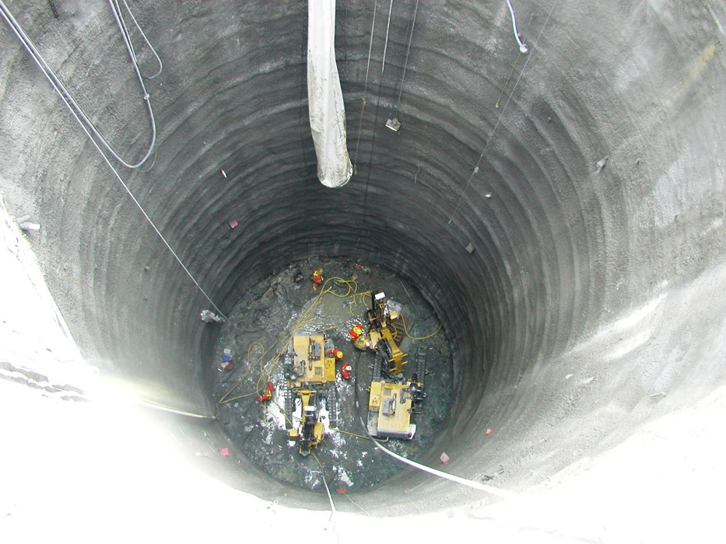
Conventional Method
Blasting operation is carried out against gravity, and the scatter of the broken rock is confined in the shaft.
It is common to use generous distribution of explosives throughout the rock using a large number of small diameter (35 – 42 mm) shot-holes.

Slide 25
Mucking
Mucking is an operation of loading broken rock or cuttings and hoisting up to surface
  Manually or machine loading
  Usually in shaft
Usually mucking requires some skip-hoisting, bucket-hoisting or clam-shell grab equipment

Slide 26
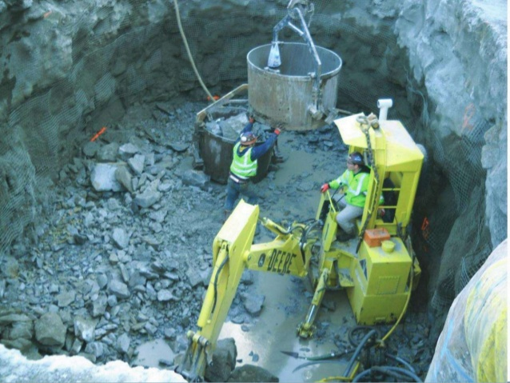
Mucking

Slide 27
Shaft Support systems
There are three major ways of supporting shaft walls:
Use of timber support,
Use of roof bolts, and
Use of wire mesh.

Slide 28
Rock strength classification | Strength range (MPa) | Typical rock types
Very weak | 10 – 20 | Weathered sedimentary rocks
Weak | 20 - 40 | Weakly-cemented sedimentary rockd
Medium | 40 – 80 | Competent sedimentary rock
Strong | 80 – 160 | Competent igneous rocks
Very strong | 160 - 320 | Dense fine-grained Quartzite or igneous rock

Slide 29
Revision Questions
Describe five (5) functions of a mine shaft
In comparison to raise-boring, explain three (3) advantages of conventional shaft sinking

Slide 30
Question 3
It is required to sink a 860m-deep circular shaft from surface to just below the ore body using a conventional method. The operations are being carried on a three-shift per day basis. The rock hardness is about 165MPa. If other auxiliary operations take a day every after 18m advance and 39 blast holes are drilled and blasted per shift:
Estimate the cross section area of the shaft
Estimate how long it will take to complete sinking the shaft if it takes 2 days per metre to set up a 20m shaft collar
Describe the support system suitable for this shaft
Explain three advantages of conventional method of shaft sinking.

