Slide 1
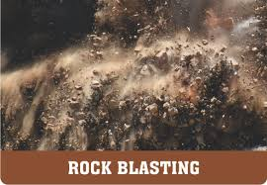
Basic Principles of Rock Blasting
By
Dr. S. Kangwa

Slide 2
Definition: Blasting is the action of breaking, displacing or fragmenting rock by means of explosives.
The purpose of blasting include:
Loosening the in-situ rock
Opening up - excavation
Extraction of ore from the ore-body
Easy movement of rock
Blasting operations include:
Drilling of blast-holes
Selecting of type of explosives and initiating devices
Charging process (inserting of explosives into blast-holes
Initiation.

Slide 3
Blasting Techniques
Blasting is used in open pit, underground mining, quarrying and civil engineering operations
Good blast design and execution are essential to successful mining operations
Improper or poor practices in blasting can have a severely negative impact on the economics of a mine.

Slide 4
Blast optimisation depends on principal parameters including:
The rock’s characteristics;
The properties and quantities of explosives;
Blast geometry;
Blast size;
The priming method; and
The initiation sequence.

Slide 5
Blasting Terminology

Slide 6
Free face:
This is an exposed rock surface towards which the explosive charge can break out.
Blast-hole diameter (D):
The relation between blast hole diameter and face height is approximately:
D = 0.001 to 0.02 H
Generally, the cost of drilling and blasting decreases as hole diameter increases.

Slide 7
Face height (H):
This is the vertical distance in metres between the top and floor of the bench.
Burden (B) :
This is the distance in metres from a blast hole to the nearest free face and has the following approximate relation:
B = 25D to 30D for hard rock
B = 30D to 35D for medium rock
B = 35D to 40D for soft rock.

Slide 8
Spacing (S):
This is the distance in metres between adjacent blast-holes and is measured perpendicular to the burden. Usually the relation between drilled burden and spacing is:
S = 1 to 1.8B
Hole angle (α ):
This is a hole inclination measured in degrees. If the strata conditions permit, inclined blast-holes allow better distribution of the explosives.

Slide 9
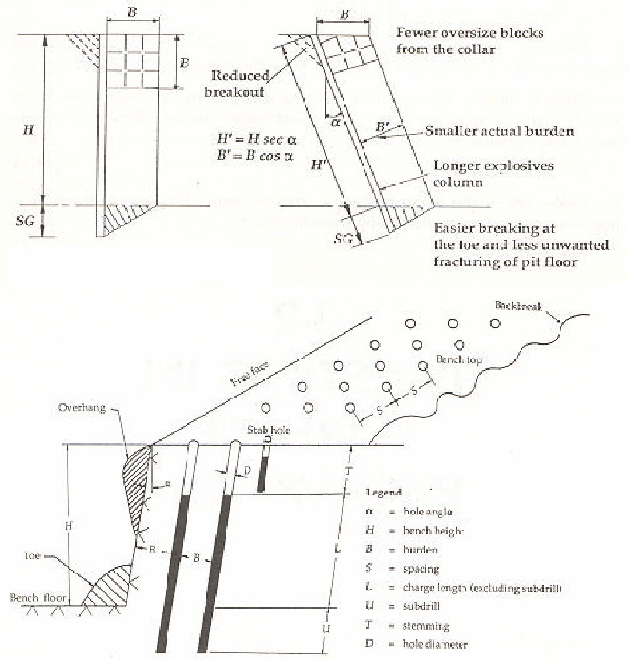
Blasting Terminology

Slide 10
Sub-drill (sub-grade drilling or over-drilling) (U): This is the extra depth drilled below the grade level to assure that the full face of the rock can be broken to the desired excavation level.
Usually U= 8 to 12D; alternatively it equals to B/3.
Charge length (L):
This is the explosive column in a blast hole and should be at least 20D in order to utilize fully the explosion-generated strain in the rock.

Slide 11
Stemming (T):
Stemming is a process applied to blast holes to prevent gases from escaping during detonation. A stemming material helps confine the explosive energy for a longer duration. Without stemming, up to 50% of the explosive energy can escape through the borehole.
This is the inert material filled between the explosive charge and the collar of the blast-hole to confine the explosion gases.
The stemming material could be drill cutting, sand, mud or crushed rock.
A stemming length shorter than 20D usually causes fly rock, cut-offs and over break problems.
The stemming length should not be less than the effective burden B

Slide 12
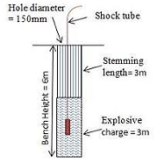
Stemming

Slide 13
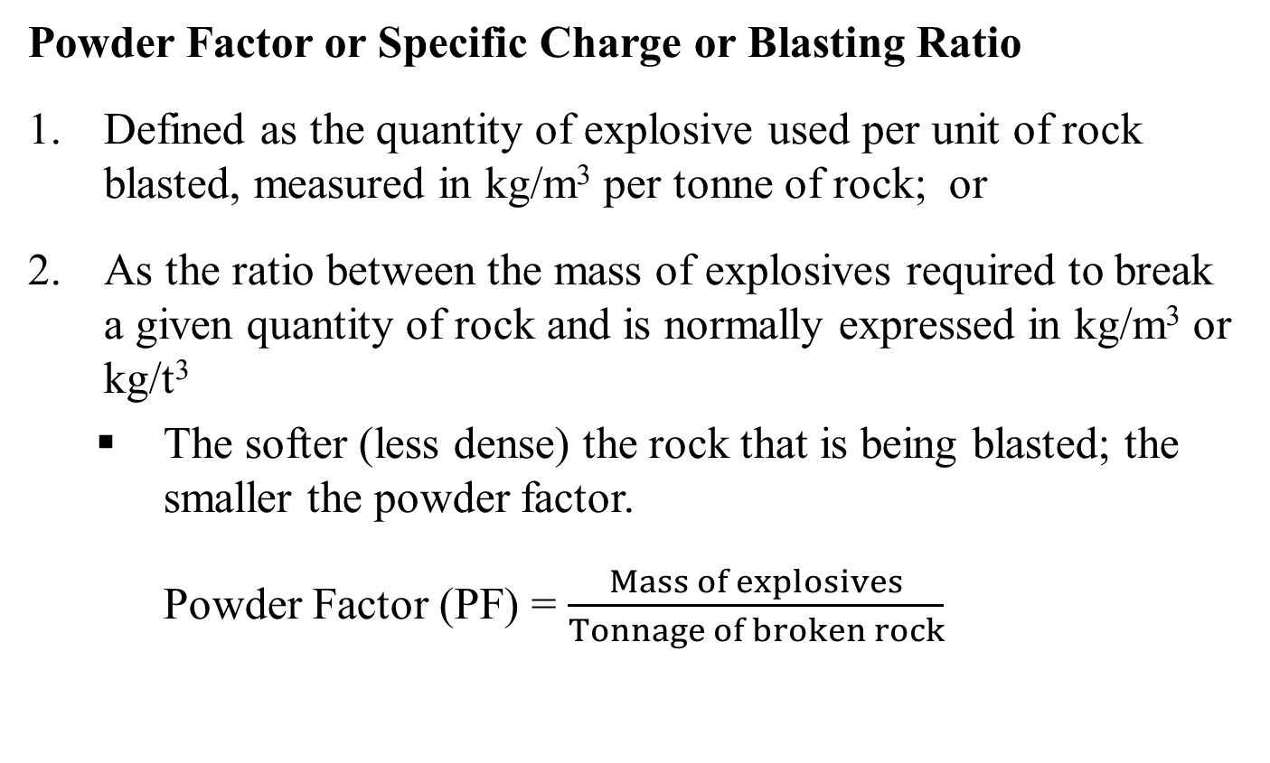
Powder Factor or Specific Charge or Blasting Ratio
Defined as the quantity of explosive used per unit of rock blasted, measured in kg/m³ per tonne of rock; or
As the ratio between the mass of explosives required to break a given quantity of rock and is normally expressed in kg/m³ or kg/t³
  The softer (less dense) the rock that is being blasted; the smaller the powder factor.
Powder Factor (PF) = $\frac{Mass of explosives}{Tonnage of broken rock}$

Slide 14
Decoupling ratio
Can be defined as the ratio of the diameters of an explosive column and the blast-hole and is usually expressed as a percentage
Firing Patterns
In normal blasting all holes do not blast at the same time. Blasting is normally carried out as short delay blasting. The firing pattern has to be designed so that each blast-hole has free breakage

Slide 15
Blast Design
The best use of explosives is made when a blast:
Produces a clean break,
Gives good fragmentation,
Avoids excessive fly-rock,
Avoids vibration,
Produces less toxic gases.
The success of achieving these goals depends significantly on good blast design.

Slide 16
Primary blasting
The initial action of breaking and displacing rock by means of explosives
Primary blasting is an initial fragmentation of in-situ rock mass
Secondary Blasting
Secondary blasting is a process of blasting oversize boulders. In primary blasting, whether on surface or underground, will leave some oversize boulders, which cannot be adequately handled by the standard loading and crushing equipment.

Slide 17
Misfire - A blast that fails to detonate completely after an attempt at initiation; also the explosive material itself that failed to detonate as planned.
Magazine - Any building, structure, or container, other than an explosives manufacturing building, approved for the storage of explosive material
Initiation - The act of causing an explosive material to detonate or deflagrate.
Initiator - A detonator or detonating cord used to start detonation in an explosive material.
Primer - A unit, package, or cartridge of explosives used to initiate other explosives or blasting agents, and which contains a detonator, or detonating cord to which is attached a detonator designed to initiate the detonating cord.

Slide 18

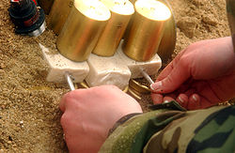
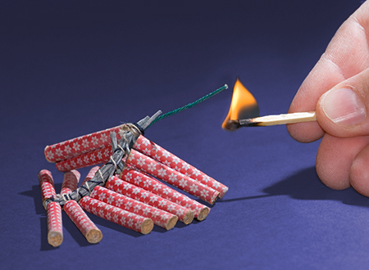
Explosives

Slide 19
What is an explosive?
1. An explosive is a substance or mixture of substances which, when initiated is rapidly converted into more stable substances, mostly gaseous, which occupy a much larger volume than the explosive in its original configuration.
2. An explosive is a compound or mixture of compounds which when initiated by an external impulse (heat, impact, friction, or shock, etc.) has the properties of forming an explosion and is very rapidly converted to gases at high temperature. Self-propagating exothermic reaction - gives off energy and pressure.

Slide 20
Properties of Explosives
The main explosive properties are:
Effective energy
Velocity of detonation
Density
Detonation pressure
Sensitivity
Water resistance
Fume characteristics
Storage life

Slide 21
Effective energy
Strength of an explosive is the relative effective energy.
Relative weight effective energy is defined as the energy of an explosive compared to the effective energy of an equal weight of standard ANFO
ANFO - Ammonium Nitrate (AN) + Fuel Oil (FO)
Ammonium nitrate (NH₄NO₃)

Slide 22
Velocity of Detonation
The velocity of detonation (VOD) is the rate at which the detonation wave travels along an explosive column.
The greater the VOD the greater the power or ‘shattering’ effect of an explosive.
High VOD explosives are more suitable in hard rock and low VOD in softer rock.
The VOD range in commercial explosives is 2500 -7500 m/s.

Slide 23
Density
The density of a explosive determines the charge weight per metre of hole. The density of an explosive is important because the explosives are purchased, stored and used on a weight basis
The density of the explosive determines amount of explosives
that can be loaded in a given hole diameter.
- The loading density

Slide 24
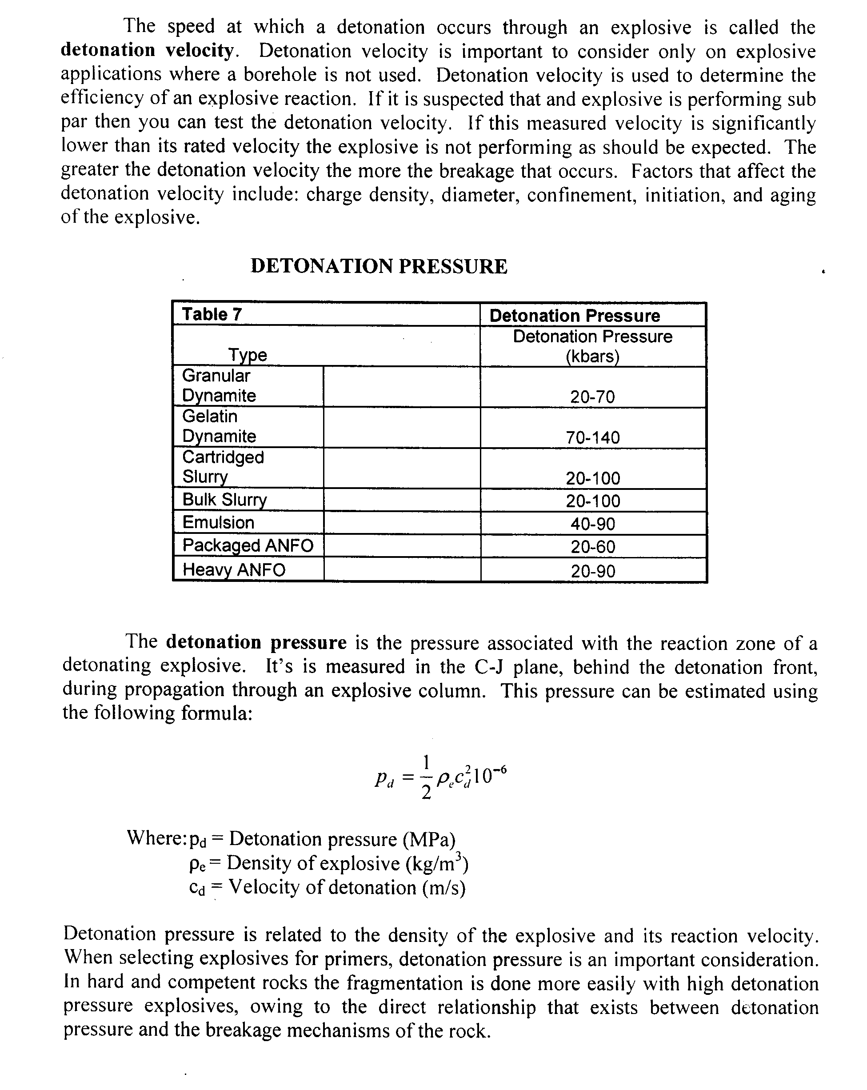
Detonation Pressure
The detonation pressure is the pressure associated with the reaction zone of a detonating explosive. It is measured behind the detonation front, during propagation through an explosive column. This pressure can be estimated using the following formula:
Where:
P_{d} = Detonation pressure (MPa)
ρ_{e} = Density of explosive (kg/m³)
C_{d} = Velocity of detonation (m/s)

Slide 25
Sensitivity to Initiation and Detonation Stability
The explosive should not be highly sensitive to initiation and detonation.
Normally, the explosive is initiated by the use of a detonator. Some explosives are initiated by using special primers consisting of an explosive with a high detonation velocity.
The detonation of an explosive must be stable.

Slide 26
Sensitivity
Safety in handling is demanded whenever, explosives are being transported
Explosives are subjected to extensive tests before they can be approved by appropriate authorities.

Slide 27
Water Resistance
Water resistance is the ability of an explosive to withstand water penetration.
The water resistance of an explosive depends on the packing as well as its inherent ability to repel water.
Explosives which have inherent water resistance properties can be used in water filled blast-holes if proper packaging material, such as plastics are used.

Slide 28
Fume Characteristics
Fumes produced contain:
Non- toxic e.g. CO₂, N & steam
Poisonous e.g. CO, Nox
Carbon monoxide (CO)
0.1 % extremely toxic, collapse,
1% immediate death
Colourless, odourless, tasteless
Preferred explosives produce less noxious gasses

Slide 29
Oxides of nitrogen
NO - Nitric oxide
N₂O - Nitrous oxide &
NO₂ - Nitrogen dioxide - Most toxic
At 100 ppm (0.01%) – coughing
At 200 ppm (0.02%) – Fatal

Slide 30
Storage Properties
Explosives deteriorate and shelf life is affected by climate and type of magazine
Therefore, explosive manufactures specify the storage properties or shelf life
Nitroglycerine products are the most susceptible to deterioration during storage

Slide 31
Oxygen balance of explosive substances
Oxygen balance (OB) is an expression that is used to indicate the degree to which an explosive can be oxidized.
If an explosive molecule contains just enough oxygen to form carbon dioxide from carbon, water from hydrogen molecules, all of its sulfur dioxide from sulfur, and all metal oxides from metals with no excess, the molecule is said to have a zero oxygen balance.

Slide 32
Calculation of Oxygen Balance – Traditional method
Consider the following explosive chemical reaction:
3NH₄NO₃ + CH₂ =
Complete the chemical reaction: Left side and right side
Balance equation: left side and right side
Consider some explosive properties
  Effective energy, VOD, Density, DP, Sensitivity and Fume characteristics

Slide 33
Example: 3NH₄NO₃ + CH₂ =
Products of chemical reaction of explosives (fumes produced):
Water or steam
Gases – noxious and less noxious gases
Therefore explosive (3NH₄NO₃ + CH₂) will produce:
H₂0, CO and N
Thus: 3NH₄NO₃ + C H₂ = (H₂0, CO and N)
Now balance the equation

Slide 34
Balancing explosive chemical reaction equation
Left side (3NH₄NO₃ + CH₂) |  | Right side (H₂0, CO and N)
Element | Number | Element | Number
N | 3 + 3 = 6 | H | 7 x 2 = 14
H | (3 x 4) + 2 = 14 | O | 7 + 2 = 9
O | 3 x 3 = 9 | C | 1
C | 1 | N | 3 x 2 = 6
Therefore right side: 7H₂0 + CO₂ + 3N₂

Slide 35
Balancing explosive chemical reaction equation
Balanced equation: 3NH₄NO₃ + CH₂ = 7H₂0 + CO₂ + 3N₂
Consider some explosive properties:
Fume characteristics: H₂0, CO₂ and N are less toxic
The reaction has balanced oxygen
The explosive has high density and detonation pressure and will produce more energy.

Slide 36
Zero Oxygen Balance (ZOB)
Consider the following explosives chemical reactions:
3NH₄NO₃ + CH₂ = 7H₂0 + CO₂ + 3N₂ + 930 kcal/kg
2NH₄NO₃ + CH₂ = 5H₂0 + CO + 2N₂ + 810 kcal/kg
5NH₄NO₃ + CH₂ = 11H₂0 + CO₂ + 4N₂ + 2NO + 600 kcal/kg

Slide 37
Types of Explosives and
Basic Blasting Theory

Slide 38
Classification of Explosives

Slide 39
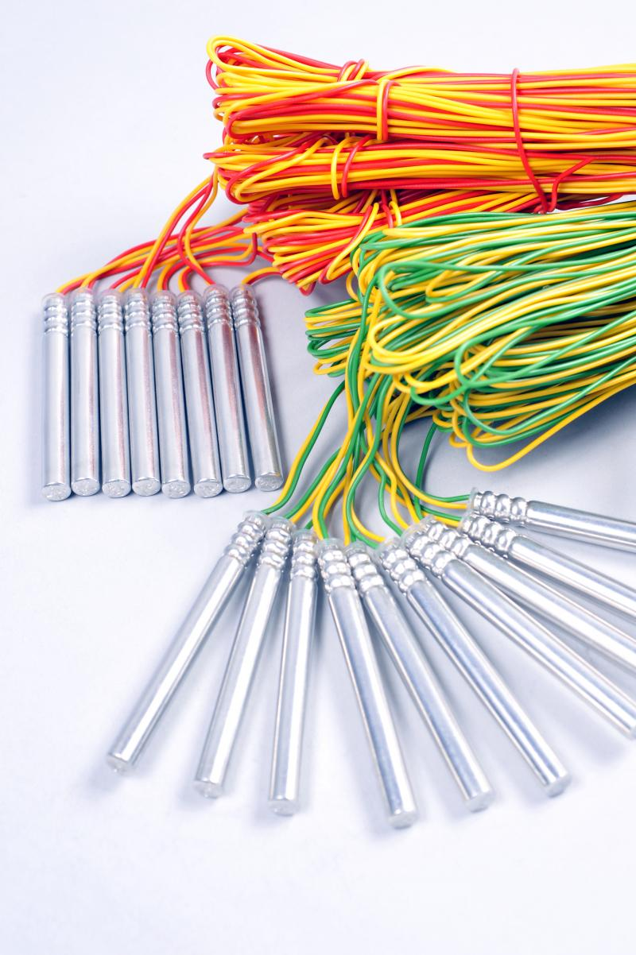
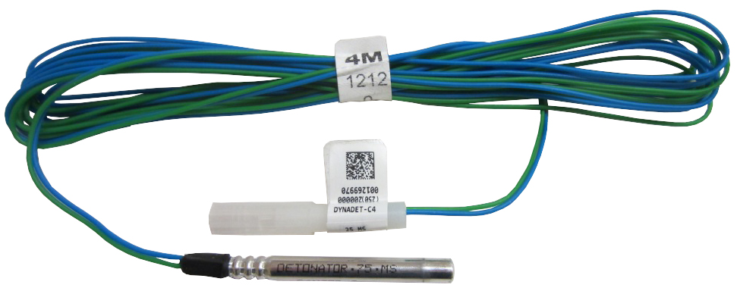
Initiating Explosives:
These are used only as a charge in detonators and detonating cord

Slide 40

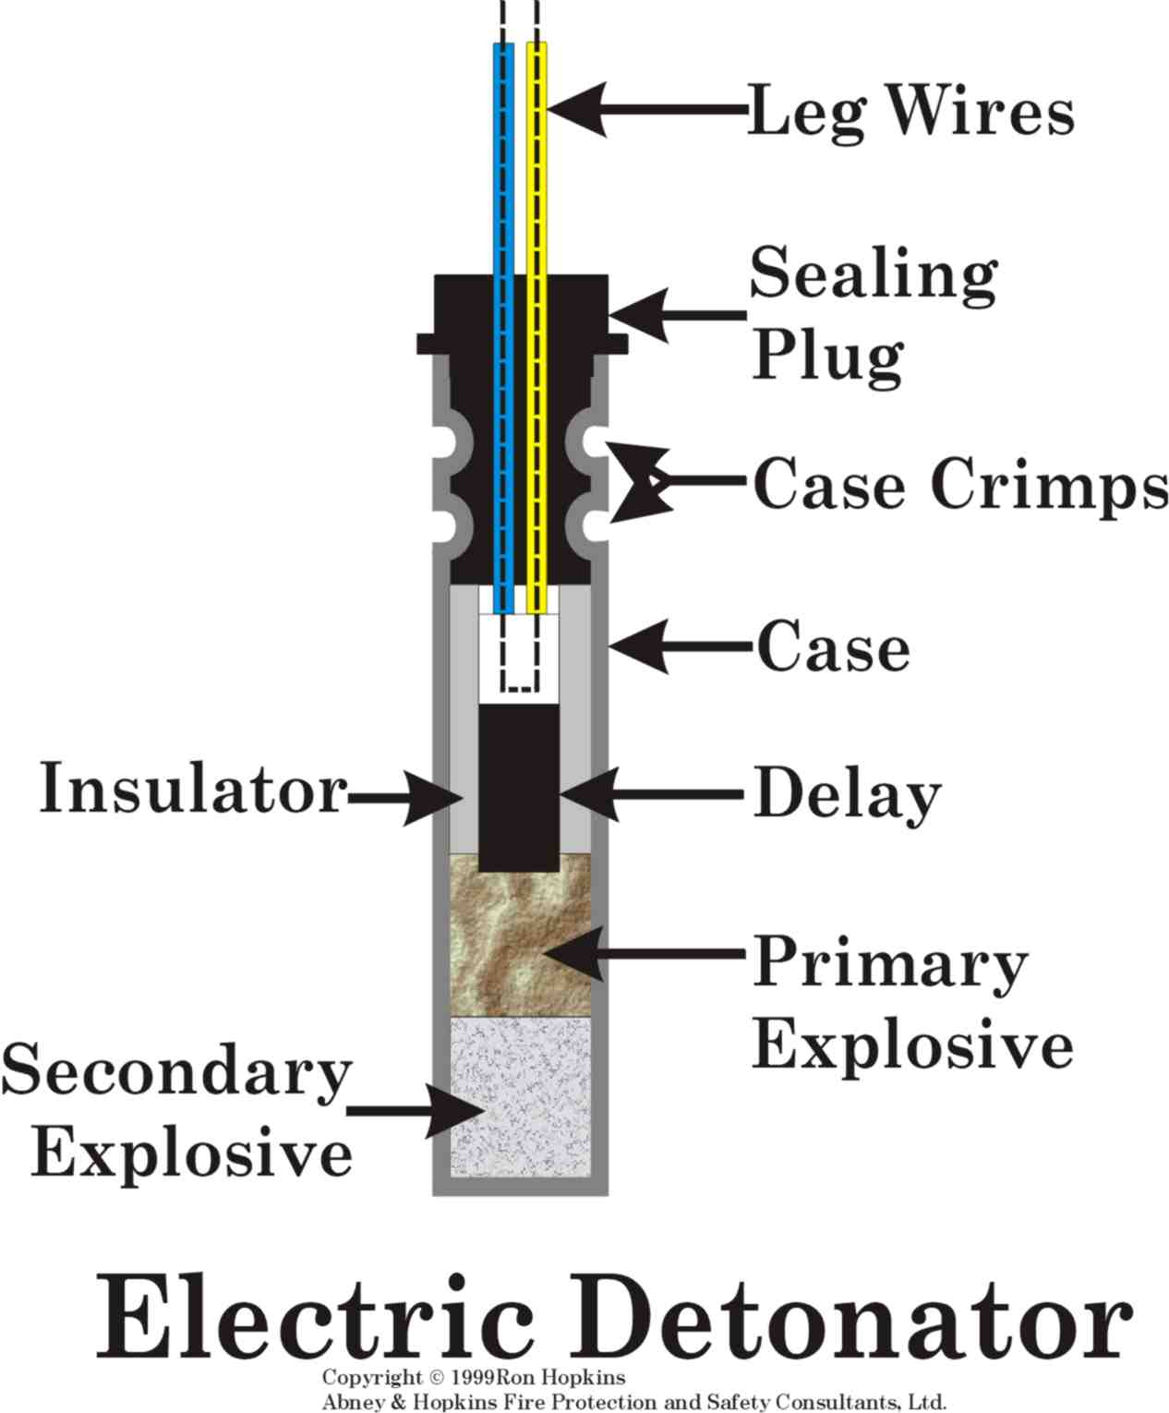

Example of Detonators

Slide 41
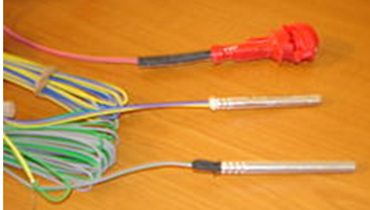
Nonel Detonator with 25ms Delay

Slide 42
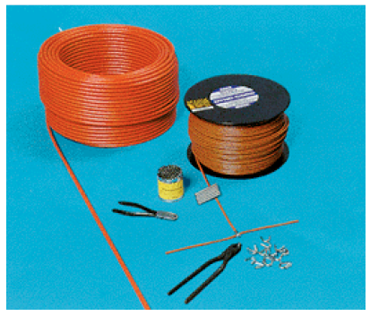

Detonating Cord
Detonating cord is a strong, flexible linear explosive which consists of a continuous core of high explosive, covered by a plastic ‘jacket’

Slide 43
High Explosives:
The reaction of these explosives is supersonic and generates a high pressure shock wave accompanied by rapid expansion of the reactive products.
Examples:
Trinitrotoluene (TNT);
Pentaerythritol tetranitrate (PETN)
Nitroglycerin, and
Dynamites.

Slide 44
Inserting detonators into Explosives - Priming
Trinitrotoluene (TNT);
Trinitrotoluene (TNT) High Explosives

Slide 45
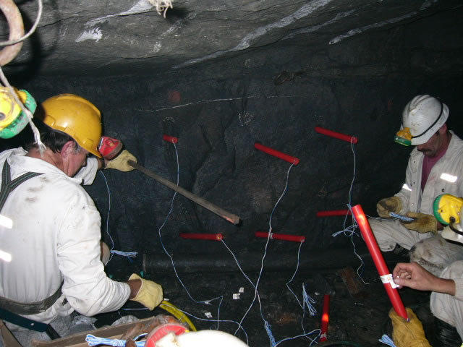
Charging Explosives – Placing Explosives in Blast-holes

Slide 46
Low explosives (deflagrating): - VOD < 2000 m/s
e.g. Gun powder and fireworks

Slide 47
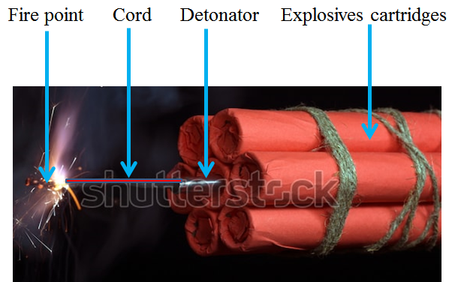
Mining Explosives

Slide 48
Blasting agents:
A blasting agent consists primarily of inorganic nitrates and carbonaceous fuels, and may contain additional non-explosive substances such as powdered aluminum.
Blasting agents include:
Ammonium nitrate fuel oil (ANFO)
Bulk emulsions
Slurries
Water gels

Slide 49

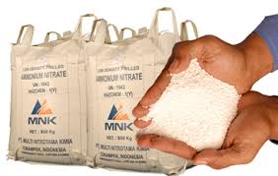
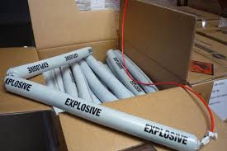

ANFO
Emulsion
Water gels
Slurries

Slide 50
Basic Blasting Theory

Slide 51
Detonation of an explosive
When an explosive detonates in a blast hole, it rapidly transforms into gases at very high temperature and pressure - exothermic reaction
The chemical reactions take place and travels along the explosive column faster than the acoustic velocity.
- Chapman-Jouget (C-J) process.
Creates a shock condition
Shock loading onto the blast hole wall
Result in compressive stresses and crush the rock

Slide 52
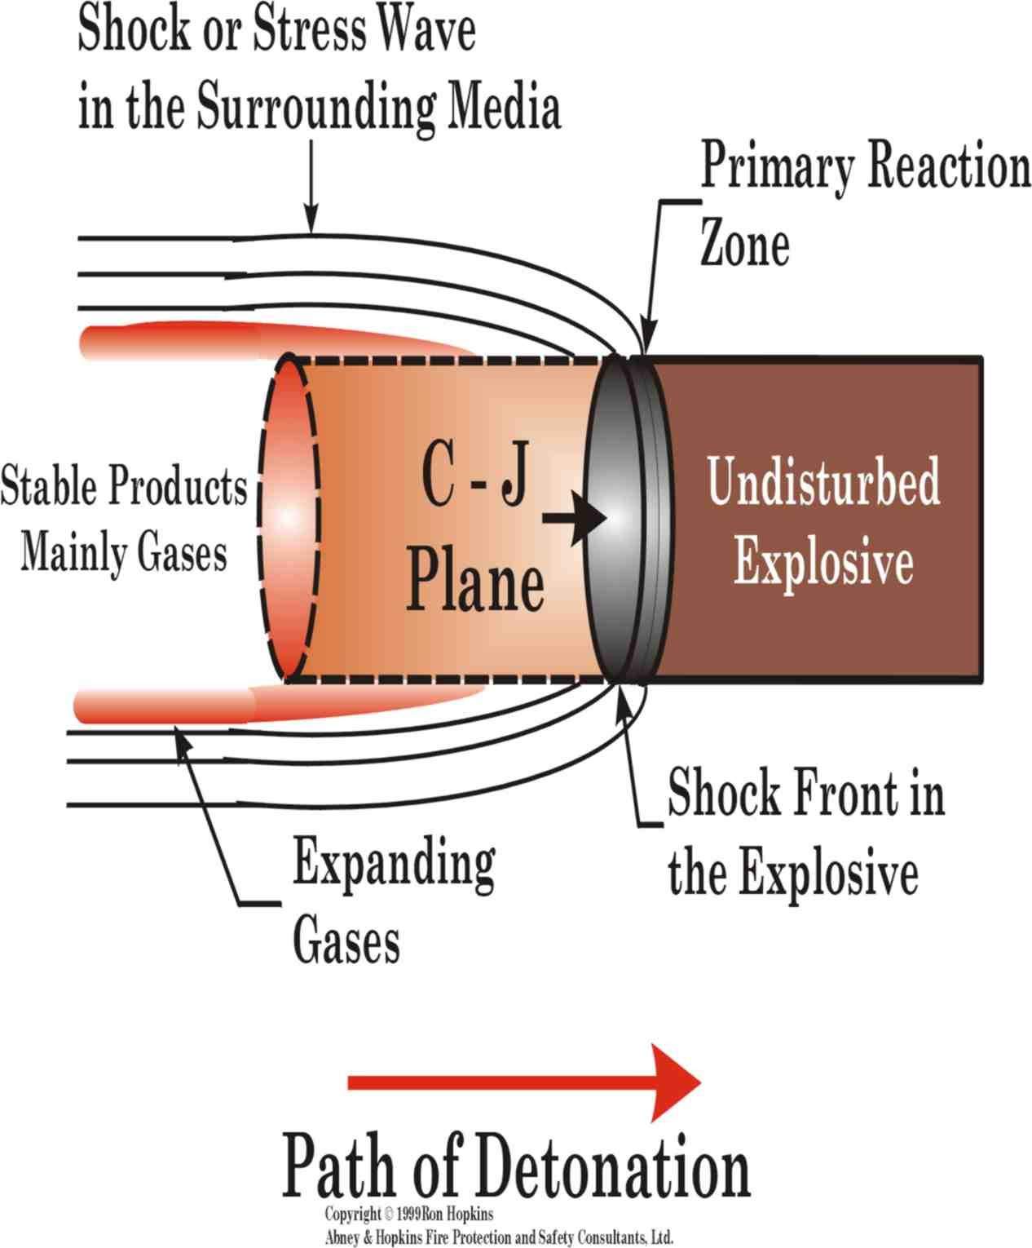

Slide 53
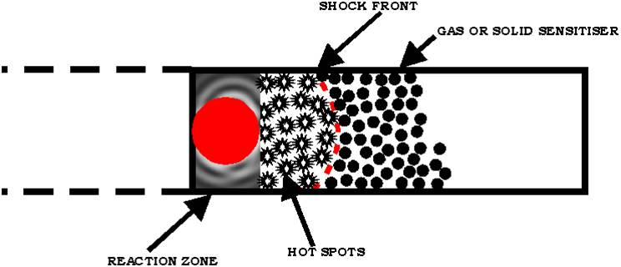

Slide 54
The energy liberated in the zone of chemical reaction continuously maintains a high pressure in the shock wave. Thus, detonation is a self-supporting process.
In an explosive charge, detonation creates an intense mechanical or thermal action

Slide 55
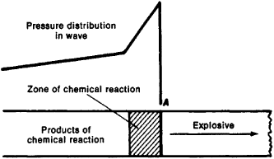
Diagram of a detonation wave: (A) shock wave front. The arrow shows the direction of propagation of the wave.

Slide 56

Blasting Theory – Three Principal Stages
1st stage:
After initiation, the blast-hole expands due to the high pressure upon detonation.

Slide 57
2nd stage:
Compressive stress waves emanate in all directions from the blast-hole with a velocity equal to the sonic wave velocity in the rock.
Upon reaching free face, compressive stress waves reflect causing tensile stresses in the rock mass between the blast-hole and the free face.

Slide 58
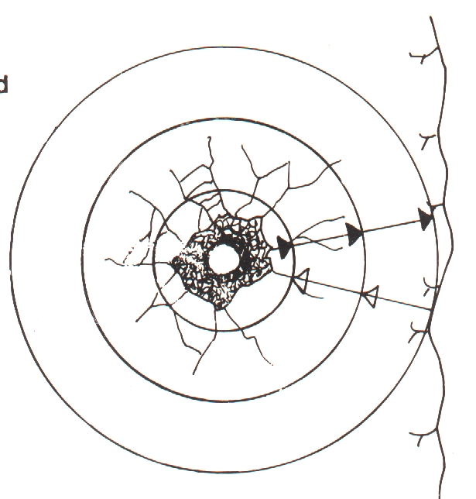
If the tensile strength of the rock is exceeded, the rock breaks in the burden area creating cracks.

Slide 59
3rd stage:
The released gas volume “enters” the cracks under high pressure - expanding the cracks.
If the distance between the blast-hole and the free face is correctly designed, the rock between the blast-hole and the free face will yield and be thrown forward.

Slide 60
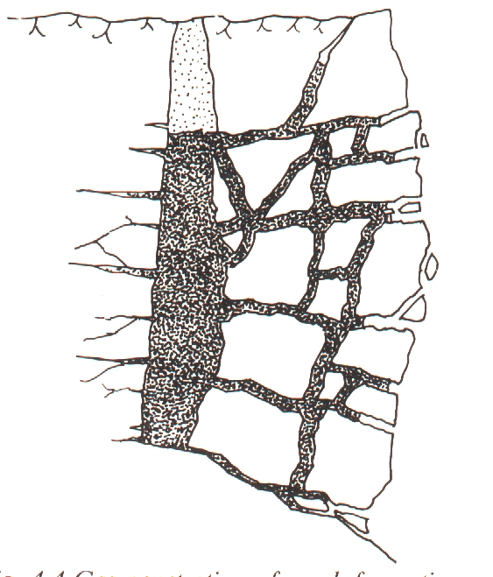
3rd Stage

Slide 61
Explosive Reaction
The explosives reaction in the blast hole is very fast and the effective work of the explosive is considered completed when the blast-hole volume has expanded to 10 times its original volume which takes approximately 5 milliseconds

Slide 62
Expansion of the blast-hole is related to time
From initiation of shockwave, the blast-hole expands to double its original volume (2Vo). The blast-hole will stay at this volume for relatively long time (0.1 to 0.4 ms) before radial cracks start to open.

Slide 63
Tutorial Questions

Slide 64
With reference to blasting, differentiate between:
  Primer and initiator
  Spacing and burden
  Primary and secondary blasting
  Exothermic and endothermic reactions
List five reasons why stemming is important in charging blast holes with explosives?
Explain why fume characteristic property is important when considering underground explosives
If an 88mm diameter hole is charged with 64mm diameter cartridges, calculate the decoupling ratio

Slide 65





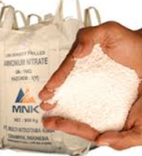

Q5. Name the following blasting accessories / explosives:
1
2
3
4
5
7
8
6

Slide 66
6. a) Given 70 Kilo-bars detonation pressure of emulsion
explosive and 230 m/s velocity of detonation, calculate density
of the explosive
b) With reference to your answer, explain the type of explosive
and rock shattering effect
7. A mine working on a rock of Andesite with an estimated
production of about 120,000 tonnes per month. What is the
estimated requirement of explosives per month? Assume that
the SG of Andesite is 2.7 and the powder factor for andesite
is 0.7 kg/m³
8. Complete the following explosive chemical reaction and
analysis it using explosives properties:
21NH₄NO₃ + 2C₆H₂CH₃(NO₂)₃ =

