Slide 1
COURSE: MIN 2019
INTRODUCTION TO MINING ENGINEERING
LECTURE 3

Slide 2
COURSE: MIN 2019
INTRODUCTION TO MINING ENGINEERING
LECTURE 3
SURFACE MINING

Slide 3
What is surface mining?

Slide 4
What is surface mining?
Surface mining is a technique or method applied to extract ore which is near the surface
  (< 500m).
This includes open pit mining, open cast and quarrying.

Slide 5
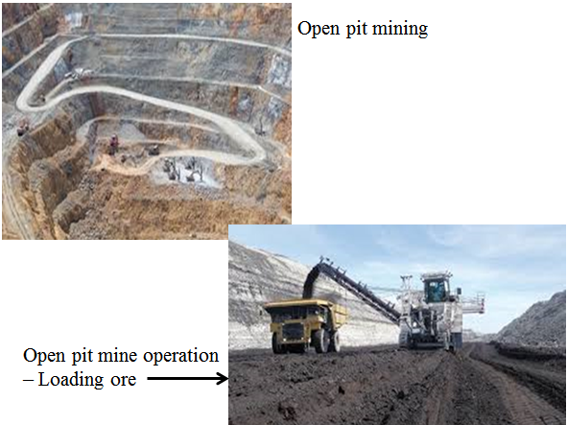
What is surface mining?
Surface mining is a technique or method applied to extraction of ore which is near the surface
  (< 500m).
This include open pit mining, open cast and quarrying.

Slide 6
Classification of Mining Method
Mining Method
Surface Mining
Techniques
Underground Mining
Techniques

Slide 7
Classification of Mining Method
Mining Method
Surface Mining
Techniques
Underground Mining
Techniques

Slide 8
Classification of surface mining methods:
Open pit mining
Open cast mining
Quarrying
Auger mining

Slide 9
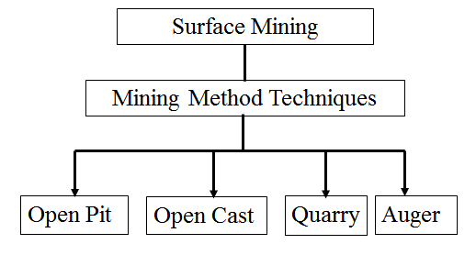

Slide 10
Sequence of surface mine development
Plant layout
Land clearing
  Take into consideration environmental impact
Provision of stockpiles and waste-disposal dumps
Stripping of overburden
  To gain access to the deposit

Slide 11
Surface Mining
Open pit and open cast methods employ a conventional mining cycle of operations to extract mineral:
Rock breakage
  Drilling and blasting
Materials handling
Quarrying and augering are specialised and less frequently used methods.

Slide 12
Open Pit Mining
In open pit mining, overburden is stripped and transported to a disposal area.
Both stripping and mining are conducted from one or a sequence of benches.

Slide 13
Quarrying
Quarrying of dimension stone
Quarries resemble open pits, but the benches (called faces) are lower and nearly vertical.
In overall appearance, the highwall of a quarry is often of imposing height and steepness, some attaining a vertical dimension.

Slide 14
Open Cast Mining
Open cast mining is a surface exploitation method, used mainly for coal.
Open cast resembles open pit.
In open cast, overburden is not transported to waste dumps for disposal but cast or hauled directly into adjacent mined-out panels.

Slide 15
Open Cast Mining
In open cast, materials handling consists of excavation and haulage (= casting), generally combined in one unit operation and performed by a single machine.

Slide 16
Auger Mining
Auger mining is a method for surface highwall or outcrop recovery of coal by boring or excavating openings into the seam beneath the overburden.
Recovering of coal from horizontal or nearly horizontal seams.
Auger mining is usually on small-scale
Low-cost mining method

Slide 17
Auger Mining
Auger drills are mounted with cutter heads
20 to 60m in length
0.5 to 2.5m in diameter
Thin-seam miner (TSM)
Modern machine used in auger mining method
Modification of surface auger miner
TSM is a continuous miner

Slide 18
Open Pit Mining
Common large-scale surface mining
  Mechanised surface mining
Mechanical extraction
Bulk production
Provision of multiple benches

Slide 19
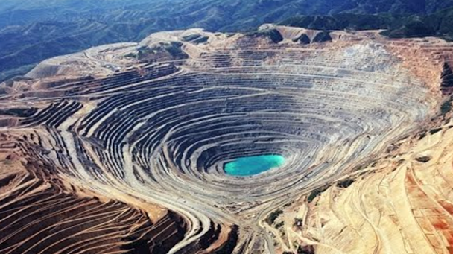
Open Pit mining

Slide 20
Open Pit Mining
The mining cycle of operations consists of:
Drilling
Blasting
Excavation
Haulage, and
Hoisting (for steep pits)

Slide 21
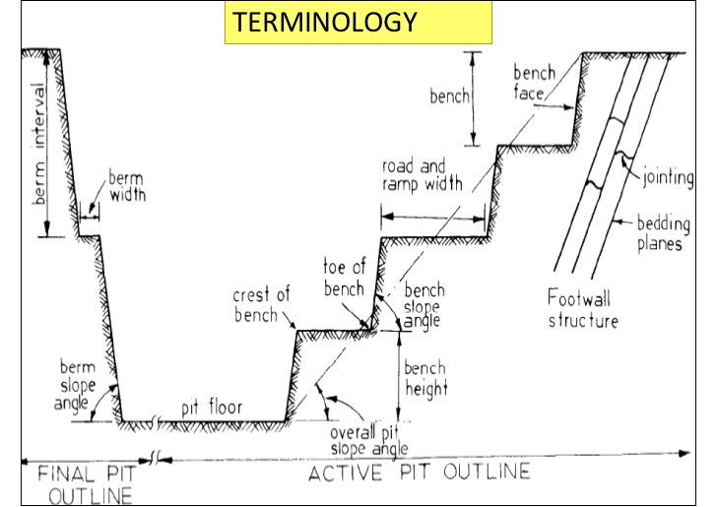

Slide 22
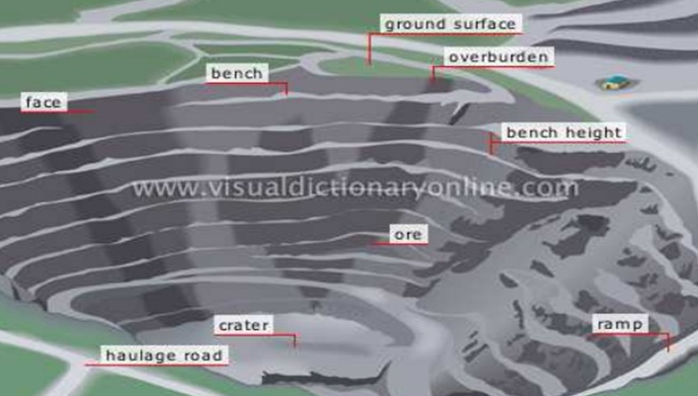
Open Pit Terminology

Slide 23
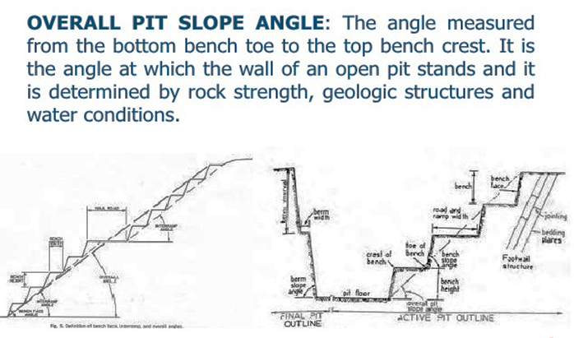
Open Pit Terminology

Slide 24
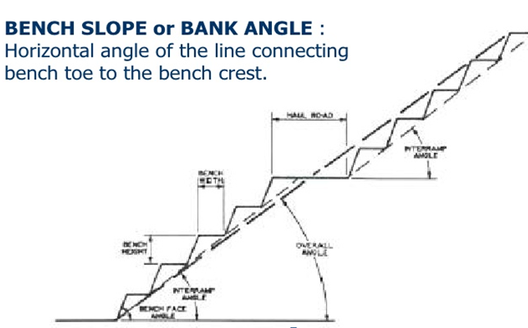

Slide 25
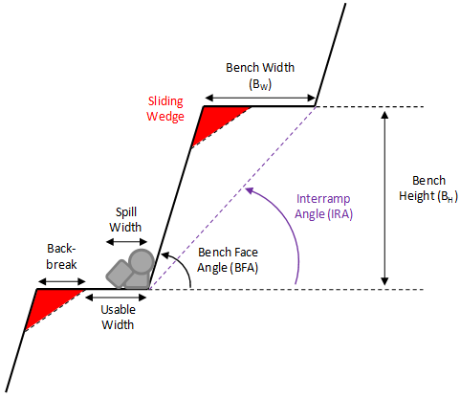
Terminology

Slide 26
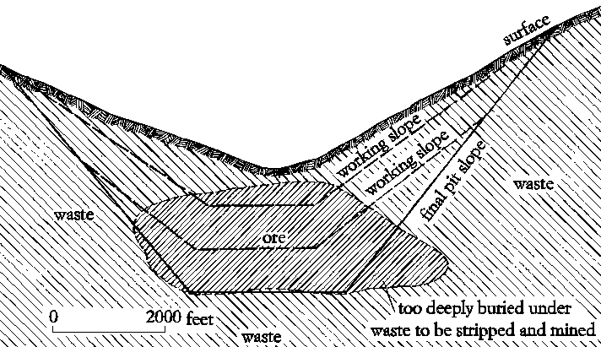
Terminology

Slide 27
Advantages of Open Pit Mining
High productivity
Low cost
High production rate
Early production
Low labour requirement
Relatively flexible
Suitable for large equipment
Simple development and access
Less support
Good health and safety

Slide 28
Disadvantages of Open Pit Mining
Limited by depth (<500m)
Limited by stripping ratio (0.8 to 4.0m³/tonne)
High capital investment
Large surface damage
Requires large deposit
Weather detrimental
Slope stability must be maintained
Must provide waste disposal

Slide 29
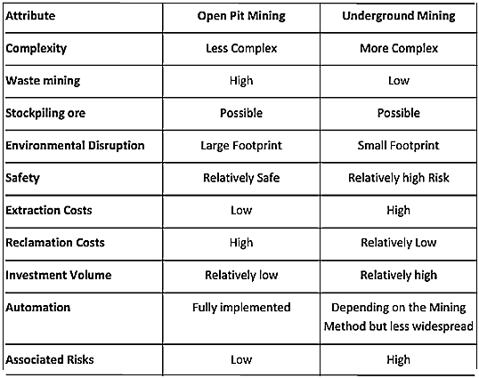
Characteristics of open pit vs underground mining

Slide 30
Factors considered in Pit Planning and Design include:
Geologic factors
Economic factors
Technological factors

Slide 31
Geologic factors:
Geologic conditions
Ore type
Hydrologic conditions
Topography
Metallurgical characteristics

Slide 32
Economic factors
Ore grade and tonnage
Stripping ratio
Cutoff grade
Operating cost
Investment cost
Production rate

Slide 33
Technological factors
Equipment
Pit slope
Bench height
Road grade
Pit limits

Slide 34
Stripping Ratio
A stripping ratio, is an important measurement related to the open-pit mining process.
It represents the amount of waste material, also known as overburden that must be moved in order to extract a given amount of ore.
Stripping ratio (SR) refers to the amount of waste that must be removed for a given quantity of ore in open pit mining.
SR = waste (volume) / Ore (volume) or
SR = overburden / ore or coal

Slide 35
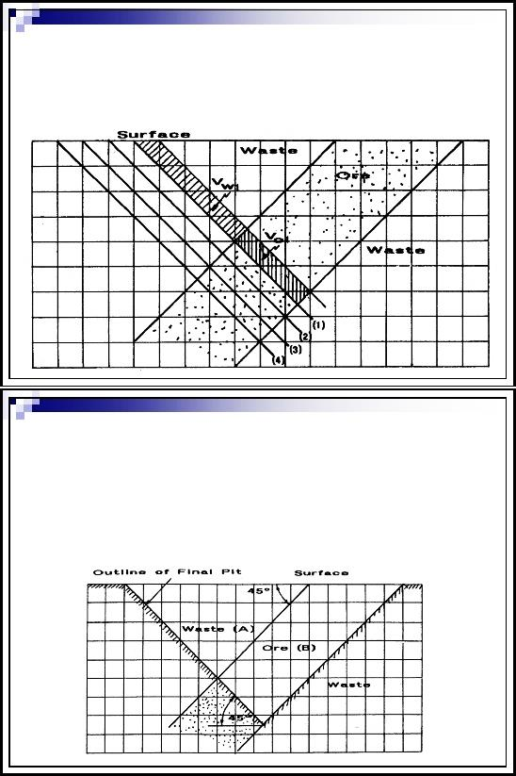
Open Pit Layout

Slide 36
Determining the maximum allowable stripping ratio
Break-even ratio
Based on economics
Establishes the pit limit
SR_{max} is defined as the ratio of overburden to ore at the ultimate boundary of the pit where profit margin is zero.
SR_{max} = (value of ore – production cost) / stripping cost

Slide 37
Maximum allowable stripping ratio (SR_{max}) enables:
To locate the ultimate pit boundary or pit limit for:
Prevailing economic conditions and
Existing physical and geometric conditions.

Slide 38
Tutorial Questions
With reference to open pit mining, differentiate between:
  Bench and berm
  Working pit slope and final pit slope
  Overall pit slope angle and bench slope angle
  Open pit and open cast mining
Describe geologic, economic and technological factors that are considered in open pit planning and designing
With reference to open pit mining and with help of diagrams, define the maximum allowable stripping ratio
Explain why surface mining is less complex than underground mining.

Slide 39
Question 5.
An open pit project has a cylindrical ore body
with 110m height and 20m diameter, calculate
the stripping ratio if the overburden is cone
shaped with 29m diameter and 160m height.
b) If the cost of removing waste is as same as the
  cost of extracting ore, comment on viability of
  the project.
With help of diagrams, explain how the profitability
of the project can be improved.

