Slide 1

THE UNIVERSITY OF ZAMBIA
SCHOOL OF MINES
DEPARTMENT OF MINING ENGINEERING
COURSE: GMM 2110
Lecture 1

Slide 2
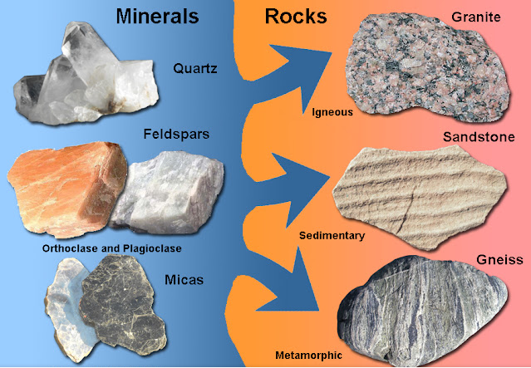
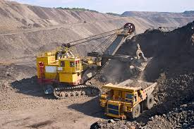
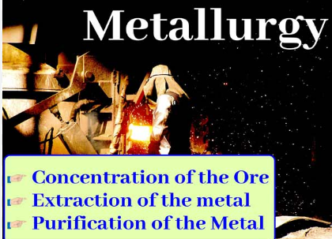
COURSE GMM 2110
INTRODUCTION TO GEOLOGY, MINING & METALLURGY

Slide 3
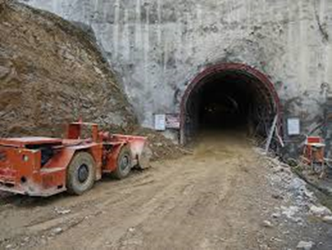
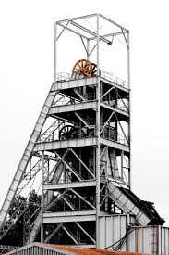
INTRODUCTION TO MINING
By
Dr. S. Kangwa
University of Zambia
School of Mines
E-mail: sam.kangwa@unza.zm

Slide 4
COURSE OUTLINE
Mining technology & distinctive features
Five Stages of the life of a mine
Mineral resources, grade & reserves estimations
Introduction to Mining Methods
Rock drilling and blasting
Excavation and development procedures
Support systems – mine support
Process of shaft sinking
Test or Quiz

Slide 5
References
Introductory Mining Engineering by Howard L. Hartman
SME Mining Engineering Handbook, volumes 1 & 2 by Cummins and Given
Thomas, L. J. An Introduction to Mining; Methuen of Australia and Son
Zambia Mining and Mineral Act
Guide to the mining regulations
Explosives regulations
Google – online research

Slide 6
Mining Technology & Distinctive Features

Slide 7
What is mining?
Mining is defined as the act, process or work of extracting minerals or coal from their natural environment and transporting them to the point of processing or use
Mining techniques are applied to extracting metallic minerals, such as ores of copper, zinc, lead or gold; and fuels such as coal, anthracite, lignite and tar; and nonmetallic minerals, such as limestone, sand and gravel, clay and stone, sulfur and salt
Mining therefore is the activity, occupation, and industry concerned with the extraction of minerals while Mining Engineering is the art and science applied to the processes of mining and the operation of mines

Slide 8
Mining is a business venture with emphasis on:
High productivity
Cost effective – less operational cost, high revenue
Safety – accidents are expensive and affect production
Environmental controls – depends on local laws
Since mining is a business venture, the mine owners are businessmen whose objective is to maximize profit

Slide 9
Mining Contribution to global civilization and development
Early domestic and industrial tools
Equipment and ornaments
Building material
Economic development

Slide 10
Contribution
Need or use | Purpose | Age
Tools and utensils | Shelter and domestic use | Prehistoric
Weapons | Hunting, defense, warfare | Prehistoric
Ornaments and decoration | Jewelry, cosmetics, dye | Ancient
Tools and equipment | Agriculture | Early
Currency | Monetary exchange | Early
Structures and devices | Shelter and transport | Early
Energy | Heat and power | Modern
Machinery/equipment | Industry | Modern
Nuclear fission | Power, warfare | Modern

Slide 11
Facet of the mining industry
Mining
industry
PESTLE
factors
Geology
Mining
Metallugy
Marketing
Sale & taxes

Slide 12
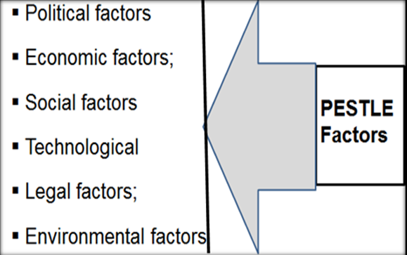
PESTLE Factors Affecting Mining

Slide 13
Mining Evolution
1. Traditional mining
  Use of crude methods
  Shallow trenches
  Application of rudimentary equipment
2. Basic mining
  Use of handheld tools –sacks, pick and shovel
  Animal transport
  Use of wagons
3. Artisanal mining
  Application some modern methods in small-scale mining
4. Modern mining
  Mechanised mining
  Use of high-tech equipment

Slide 14
Descriptive of common terms used in mining
Ore deposit - Minerals in sufficient concentration
Ore is mineral that can be extracted from the ground at a profit
Ore - naturally occurring mineral aggregate of economic importance,
from which one or more valuable constituents may be recovered by
treatment
Ore body is a mass of ore of any shape and characteristics which may include low-grade and waste as well as valuable minerals but is separate in form and character from the surrounding country rock.

Slide 15
Recovery - Mining Recovery is usually a percentage estimate of insitu ore recovered after mining has taken place.
It is frequently described as mining loss which is economic mineralisation that has been lost during the mining activity.
Mining Dilution is the percentage of material added to the insitu ore during mining.
It is a mass of ore of any shape and characteristics which ore recovery is defined as the ratio of the number of tonnes of ore drawn against the total amount of or blasted
Dilution is a portion of waste material incorporated into the ore during its extraction and transport to the processing plant, thus reducing the grades of ore previously estimated

Slide 16
Ore recovery and dilution are dependent on each other therefore achieving a certain recovery entails accepting a certain level of dilution
Ore dilution categories:
Internal dilution
External dilution and ore loss
Planned dilution
Unplanned dilution

Slide 17
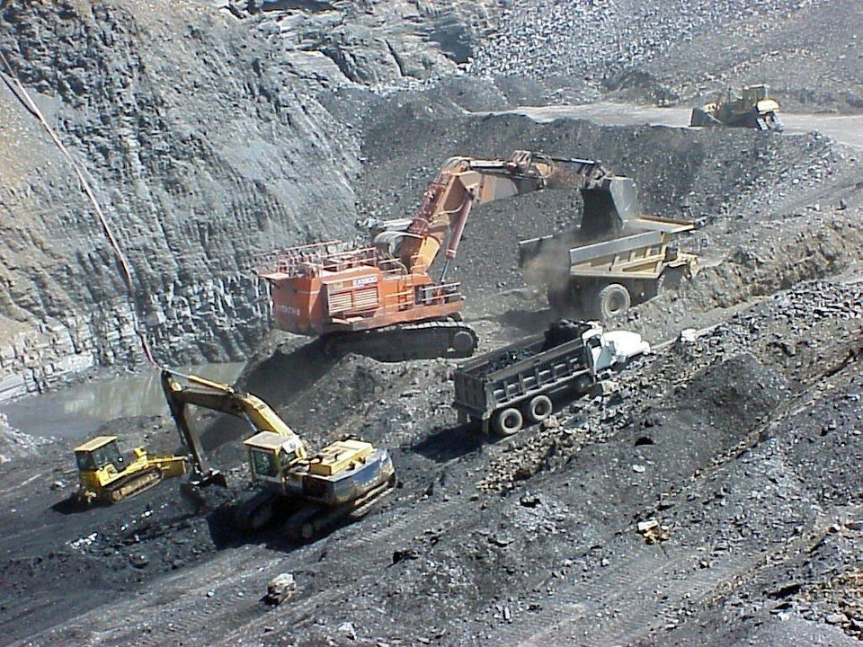
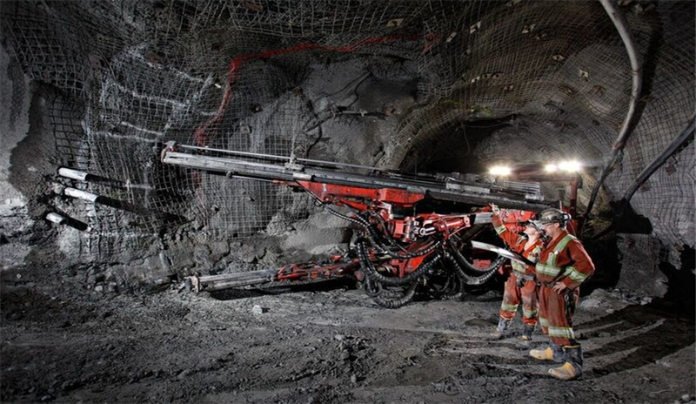
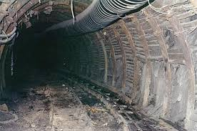

Slide 18
Definitions of common mining terms

Slide 19
Recovery | Grade | Hanging-wall
Dilution | Crosscut | Footwall
Free face | Ramp | Cut off grade
Shaft | Tramming | Country rock
Winze | Cut (blasting) | Gangue
Raise | Overburden | Ore pass
Level | Adit | Slot
Drive | Stripping Ratio | Hole spacing

Slide 20
Drift | Cage | Ring burden
Haulage | Skip | Underbreak
Development | Undercut | Overbreak
Drawpoint | Overcut | Ore chute
Ladderway | Stope | Beam
Chute | Muck / Mucking | Tramdrift
Pillar | Strike | Toe burden

Slide 21
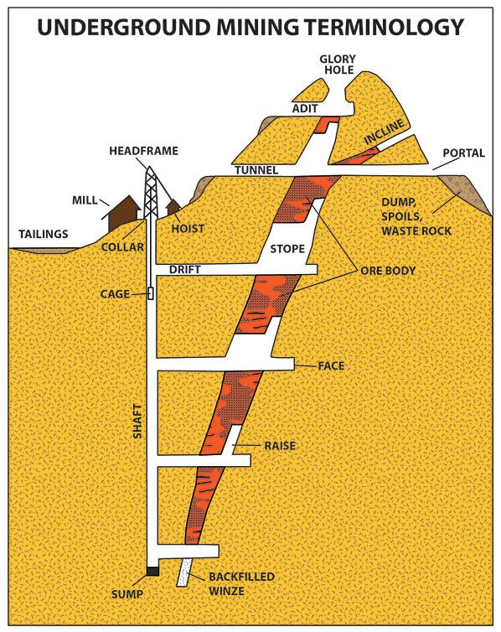

Slide 22
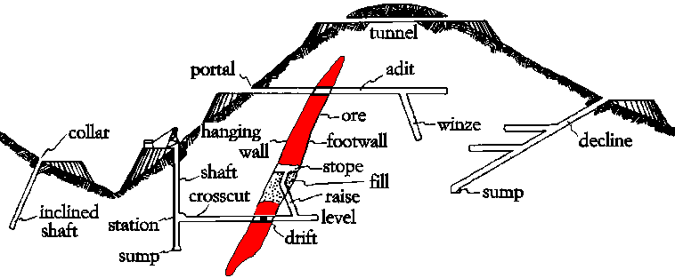

Slide 23
MINE LAYOUT
Before mining proper commences, there is need to determine and plan the locations (in relation to the ore body) of:
Shafts
Processing plants (Concentrator, Smelter, Refinery)
Effluent (dam)
Mine waste disposal sites (dumps)
Offices and workshops
Road network, and
Other operation sites

Slide 24
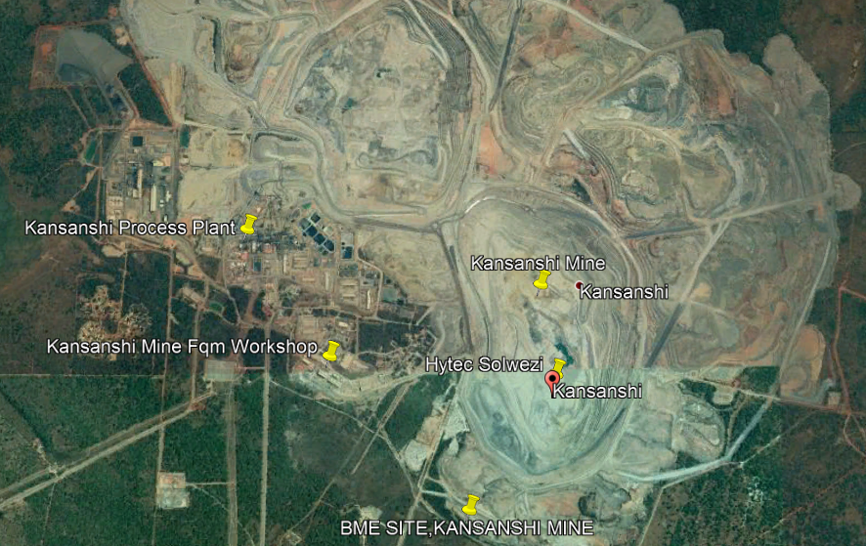
MINE LAYOUT

Slide 25
LIFE CYCLE OF MINE
Five stages of the life of a mine

Slide 26
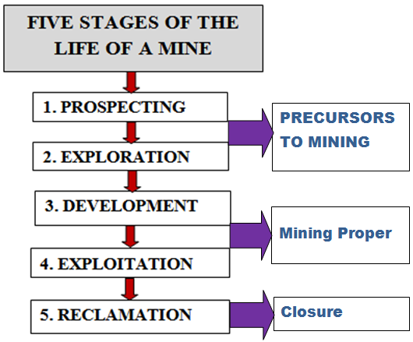

Slide 27
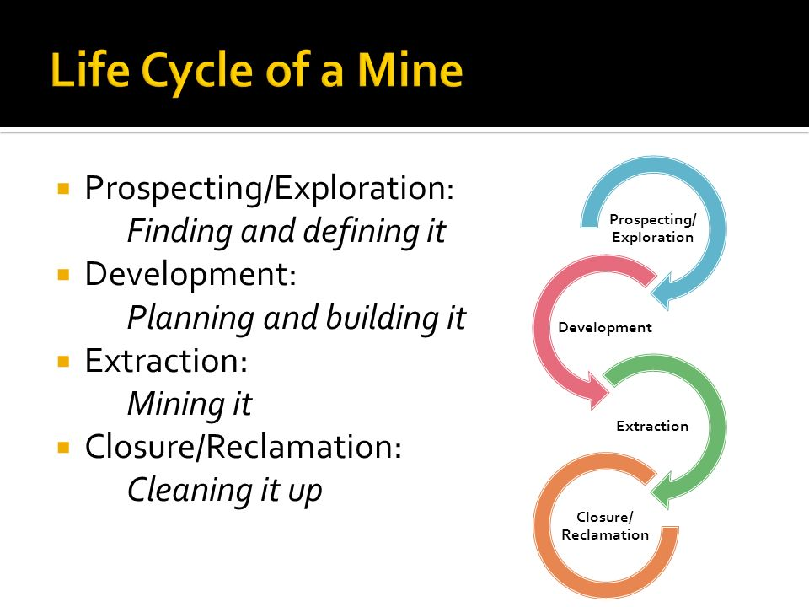

Slide 28
Prospecting – Search for ore (mineral deposit)
  Prerequisite of geologic maps
  Regional approach - natural setting
Exploration – Defining extent and value of ore
  Delineating and evaluation
  Mineral resources classification and reserve estimation
  To ascertain economic extraction
3. Development - opening up ore deposit for production
  Access to the ore body
  Provision for materials handling
4. Exploitation – Actual ore recovery
  Selection of mining methods
  Use of mining techniques
5. Reclamation – mine closure
  Environmental impact control
  Restoration of land disturbed by the mining activities

Slide 29
Mineral Resource Classification
Classification of mineral resources is based on their geologic certainty and economic value.
Mineral deposits can be classified as:
Mineral resources that are potentially valuable, and for which reasonable prospects exist for eventual economic extraction.
Mineral reserves or Ore reserves that are valuable and legally and economically and technically feasible to extract.

Slide 30
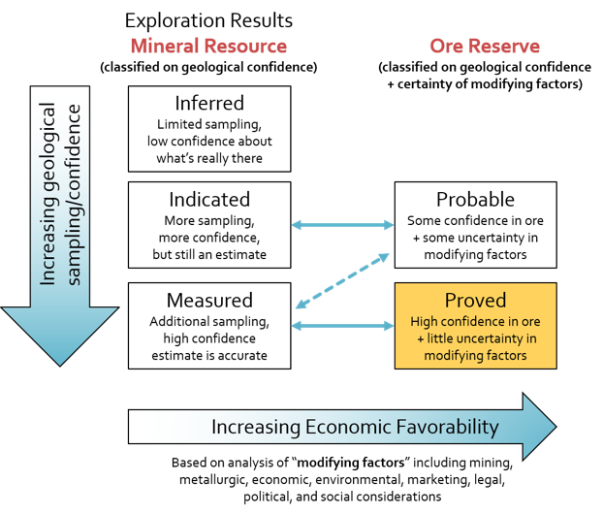

Slide 31
Resource into Reserves
Generally the conversion of resources into reserves requires the application of various modifying factors.
Modifying factors include:
Mining and geological factors
Sufficient knowledge of the geology of the deposit
Extraction and mine plans based on ore models
Sufficient geotechnical information

Slide 32
Ore Grade
Ore grade is the percentage of each valuable mineral in an ore.
The average grade of a block of ore is calculated from the average grades of the sampled openings which bound it.

Slide 33
Ore Grade
The concentration of a valuable mineral within an ore.
Grade is the percentage of each valuable mineral in an ore.
The average grade of a block of ore is calculated from the average grades.
The most important factor in the profitability of a mine is usually the price of the metal.

Slide 34
Reserve Estimates
Estimation of defined mineral resources and reserves:
Extent
Average grade
Tonnage
Mineral content
Data Required
Spatial raw data for reserve estimates derived from sampling of the deposit.
The average grade of the deposit is based on assay of samples.
The tonnage of an ore deposit is calculated from the measurements of area and volume and then converted to tonnage.

Slide 35
Estimation of reserves - Volume of ore body
Ore reserves estimation - The following methods may be applied:
Classical procedures - Polygon method
Triangle Method - modification of the polygon method
Section method - blocks of ore are outlined on regularly or evenly spaced cross sections of the ore body
Computer application in calculation of ore reserves and grade is used.
For regular ore deposit
The weight of a block of ore is estimated by first by calculating the volume and then applying a factor to convert volume into tonnage.
Volume = Thickness x Area.
Tonnage = volume x specific gravity

Slide 36
Computer Applications
Computer application in calculation of ore reserves and grade is used.
Use of computer software
Data entry
Analysis of data
Computation to calculate ore reserves and
grade

Slide 37
Volume of Ore Body
Volume
The weight of a block of ore is estimated by first calculating the volume and then applying a factor to convert volume into tonnage.
Volume is average thickness times area.
The average thickness will have been determined while computing the average assay.
Area is either calculated by mensuration or is measured on the longitudinal section by means of a planimeter.

Slide 38
Volume of Ore Body
Volume
If widths have been measured horizontally, the area is measured directly on a longitudinal section, but if true widths are used the area as shown on the longitudinal section needs to be divided by the sine of the dip in order to correct for the foreshortening in the projection.
Although the procedure just outlined is for ore on a steep vein, analogous methods would be used, of course, for a fiat-lying orebody depicted on a composite plan.
For the volumes of thick or pipe-like orebodies, it may be convenient to use the prismoidal formula

Slide 39
Tonnage
Conversion of volume into tonnage is very simple where metric measurements are in use.
All that is necessary is to multiply the volume in cubic meters by the specific gravity to get metric tons.
If the volume is expressed in cubic feet, divide it by the tonnage-volume factor (the number of cubic feet in a ton of ore).
This factor may be obtained in one of several ways:

Slide 40
Tutorial Questions

Slide 41
Q1. With reference to mining and with help of diagrams, differentiate between:
  Crosscut and drive
  Winze and raise
  Hangingwall and footwall
  Level and haulage
  Ring burden and toe burden
  Ore deposit and ore body

Slide 42
Q2. Explain the following mining terms:
    Ore grade
    Recovery
    Dilution
    Types of dilution
Q3. Explain factors that determine a cut off grade
Q4. Differentiate between:
    Prospecting and exploration
    Mineral resources and mineral reserves
Q5. Given a cylindrical-like ore body;
r = 164m, h = 387m and rock density of 2.5. Estimate the total tonnage of the ore-body.

Slide 43
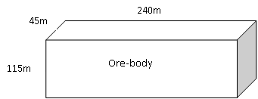
Q6.
With reference to the copper ore-body below, calculate the tonnage and grade if refined copper is 72,000T, take SG as 2.5.

Slide 44
Q7. Estimation of Profit
a) Estimate the unit profit in mining and processing of 0.6% copper ore deposit if the selling price of copper in concentrate is US$1.63 per kg and overall unit costs are US$7.50 per tonne. Overall recovery is 92%
b) Calculate the cut-off grade for the same copper deposit

