Slide 1
Lesson 2
Introduction to minerals

Slide 2
What is a mineral?
A solid with a highly ordered atomic arrangement and a definite (but not necessarily fixed) homogenous chemical composition.
Internal structural framework of atoms/ions arranged in a regular repeating geometric pattern. -> crystalline
Implies the composition of a mineral can be expressed by a specific chemical formula.
  e.g Quartz Si:O 1:2-> SiO2

Slide 3
Most minerals however, are solid solutions:
Composition can vary in certain limits: e.g.
  Olivine (Fe,Mg):Si:O 2:1:4 → (Mg,Fe)2SiO4
  but can be anything between the two end-members
  Forsterite Mg2SiO4 and
  Fayalite Fe2SiO4.
  In this case we have a complete solid solution between Fe and Mg.
On the other hand, other minerals show immiscibility (e.g. solvus) at certain conditions e. g.
  CaMgSi2O6 and Mg2Si2O6
Sometimes we have a solid solution between two types but not the third one

Slide 4
Why should we learn about minerals?
Minerals are the building blocks of rocks
Minerals record the formation and history of a rock,
Determine it’s physical and chemical characteristics
Mineral type, composition and shape define the rock type-> Geology

Slide 5
Mineral chemistry defines the chemical composition of a rocks-> Geochemistry
Mineral properties define the physical properties of rocks-> Geophysical/rheology
Note that two rocks can have the same chemical composition, but have different names (differences in grain size and how the grains are arranged)

Slide 6
Fusibility of minerals control the composition of a melt derived from a rock->igneous petrology
Minerals react to changing P,T conditions-> metamorphic petrology
Minerals control the composition of seawater through weathering input in the ocean, also from alteration of oceanic crust

Slide 7
So essentially minerals control everything, and
Without a solid understanding of minerals it is impossible to understand earth processes.
Bad news:
  there are about 4000 different minerals,
Good news:
  most rocks of the accessible earth are >95% made up by only a two handfuls of minerals.

Slide 8
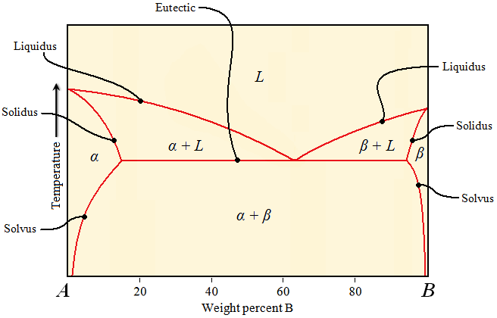

Slide 9
Types of minerals:
There are many different ways to describe types of minerals.
One common way is to describe them based on their anionic groups:
  Oxides (O²⁻),
  sulfides (S²⁻),
  sulfates SO₄²⁻,
  silicates (SiO₄⁴⁻),
  halites (F⁻,Br⁻,Cl⁻),
  carbonates (CO₃²⁻ )etc…

Slide 10
By far the most important groups are silicates, carbonates, oxides
Silicates: the principal building blocks of silicates are SiO₄⁴⁻ tetrahedra. There are numerous different ways to arrange the tetrahedra (show diagram from the book)
At this stage, I don’t expect you to know all the different silicate types in detail.
Understand the arrangement of these tetrahedra as well the chemical composition of the silicates as they control certain properties.

Slide 11
Depending on the way we arrange them we produce certain gaps between the tetrahedra that allow the mineral to incorporate different cations.
The “gaps” are called sites and are named differently.
The arrangements of the tetrahedra control certain physical properties of the minerals.

Slide 12
In summary, we can say for a fact that, each mineral is characterized by:
  A specific composition
  A specific crystal structure
  A specific stability range (Pressure und Temperature)
Diamond is pure carbon C,
as is graphite
Diamond has a dense, cubic structure

Slide 13
Systematic mineralogy
Separation of Minerals in Groups
Silicates
Silicates are the most common & important rock forming minerals on Earth
Silicates are composed of a combination of SiO⁴
Tetrahedrons and
Cations: K⁺, Na⁺, Ca²⁺, Mg²⁺, Fe²⁺ or Al³⁺

Slide 14
The SiO⁴ Tetrahedrons
Silicates are the most important rock forming minerals
They are composed of a very stable molecule made up of Silicon and Oxygen atoms
Those form through covalent bonds a SiO⁴ tetrahedron
These tetrahedra can be combined in multiple ways, e.g.
  they can be arranged by sharing an oxygen atom or
  through adding different cations

Slide 15
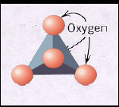

Structure of silicates
Soro-silicate [Si₂O₇]⁶⁻
Neso-silicate [SiO₄]⁴⁻

Slide 16
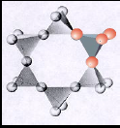
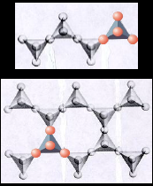
cyclo-silicate
Inosilicates, Phyllo-silicate, Single Chain-silicate, Double chain-silicates

Slide 17
Tecto-silicate[Al_{x}Si_{y}O₂(x+y)]^{x-}
Phyllo-silicate

Slide 18
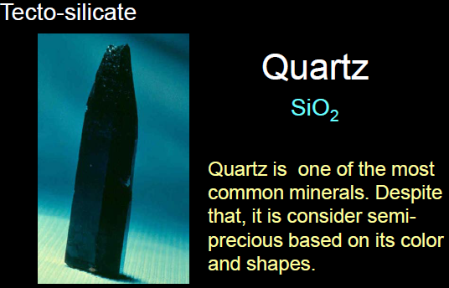

Slide 19
Quartz frequently forms
hexagonal prisms and
pyramids.
It is the hardest of the
most common minerals.

Slide 20
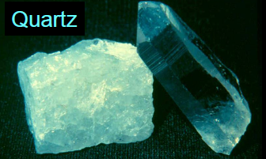
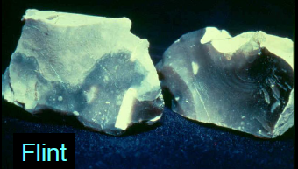
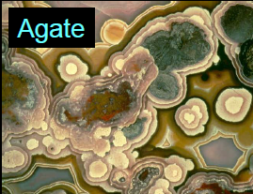
Tecto-silicate
Forms of Silica
Silica (SiO2) most
commonly occurs as
quartz.
It can however occur in
microcrystaline variaties:
  Flint,
  Chert and
  Agate
forms, which form from
low T fluids.

Slide 21
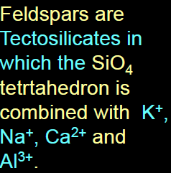
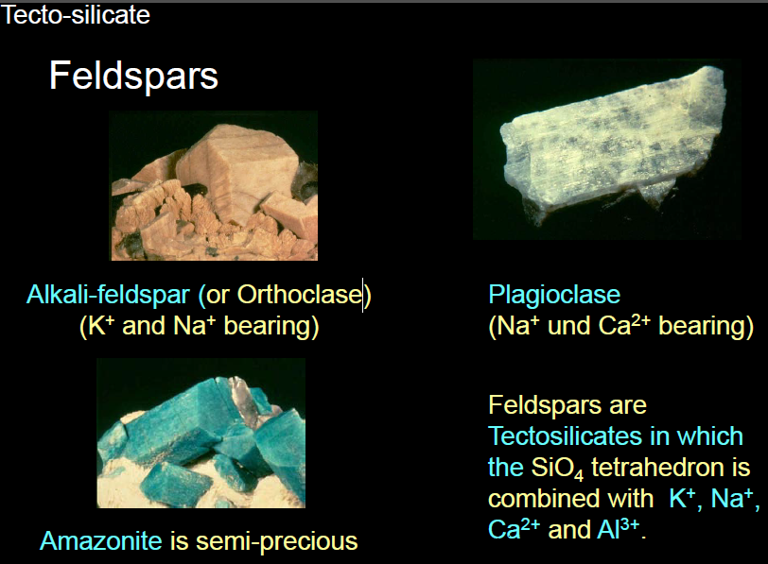

Slide 22
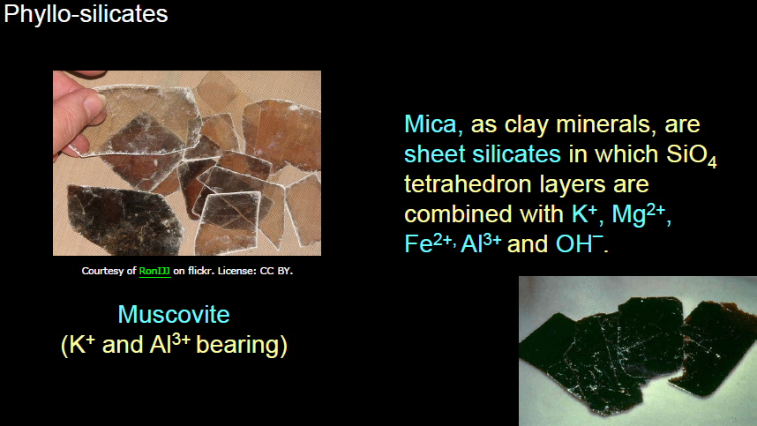


Slide 23
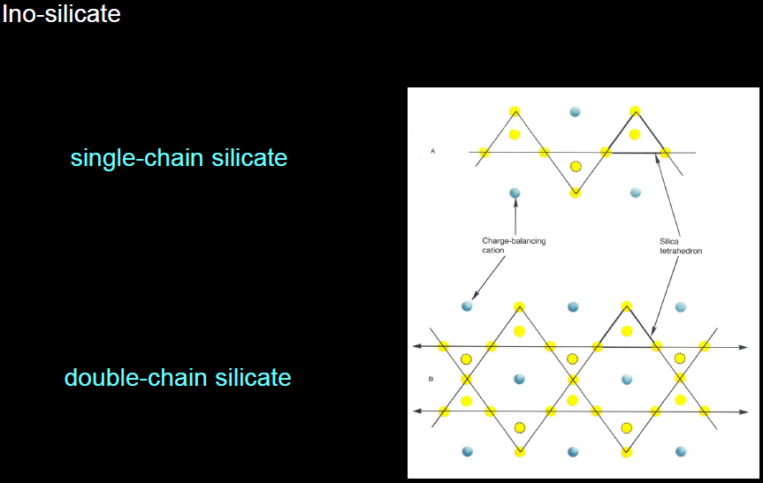

Slide 24
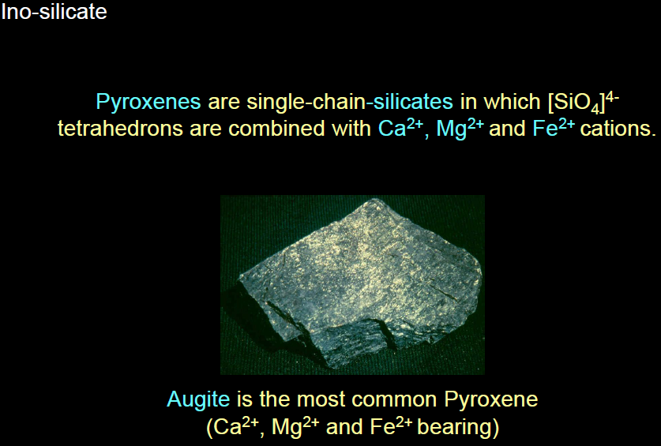

Slide 25
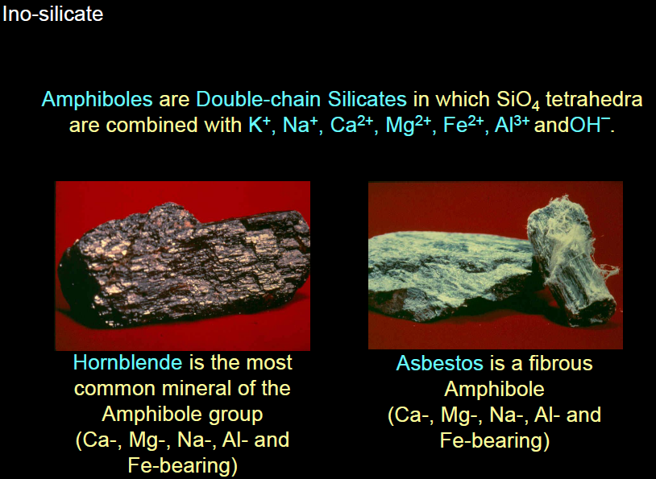
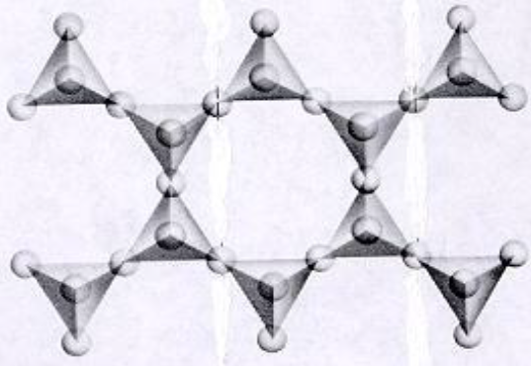

Slide 26
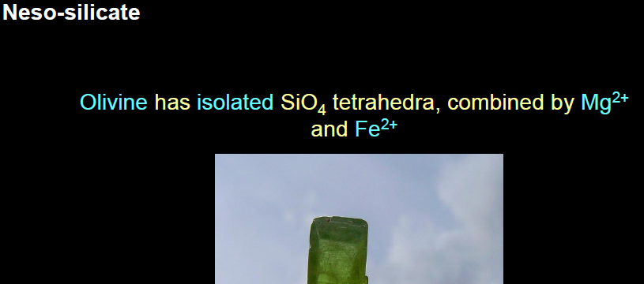

Slide 27
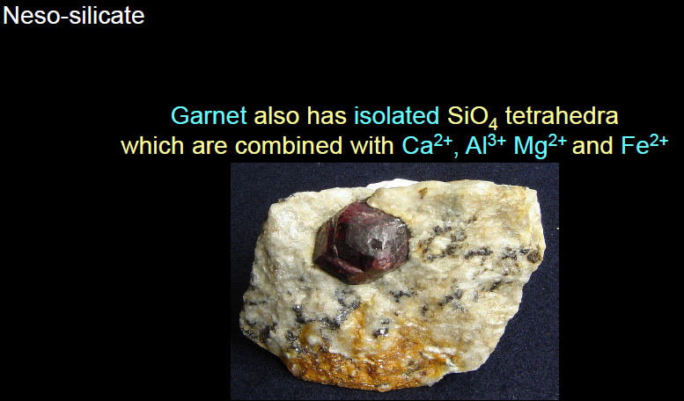
Garnet is common in metamorphic rocks formed under high pressure.

Slide 28
Non-silcate minerals
Luckily there aren’t that many which are of importance.
But those few are either Very common And play an important role in earth processes
Or
Are an important for economic reasons
The most important ones are:
  Carbonates
  Sulfates
  Oxides
  Fluorides
  Sulfides
  Phosphates
  Native minerals (elements)
economic reasons.

Slide 29
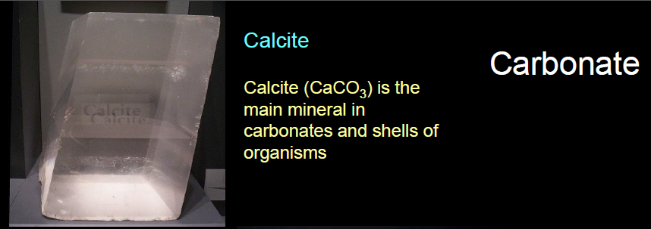
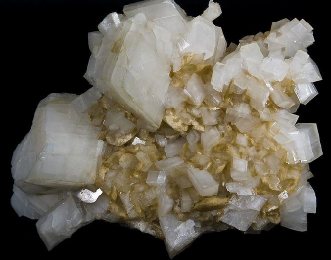
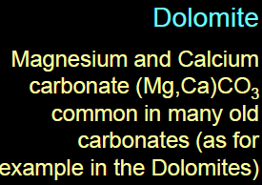

Slide 30
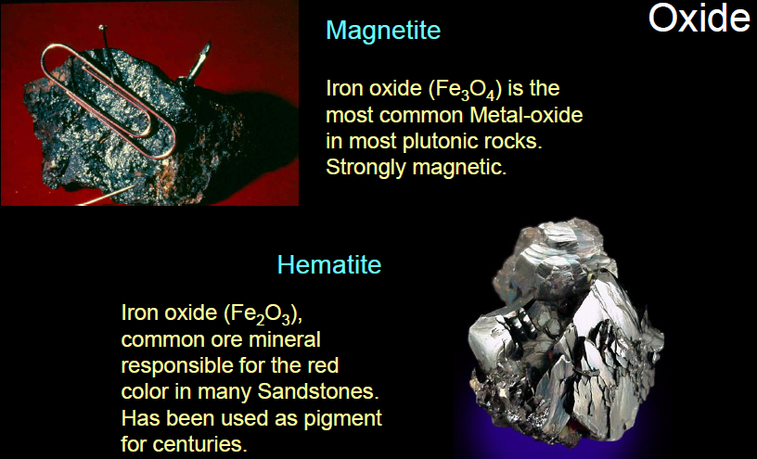

Slide 31
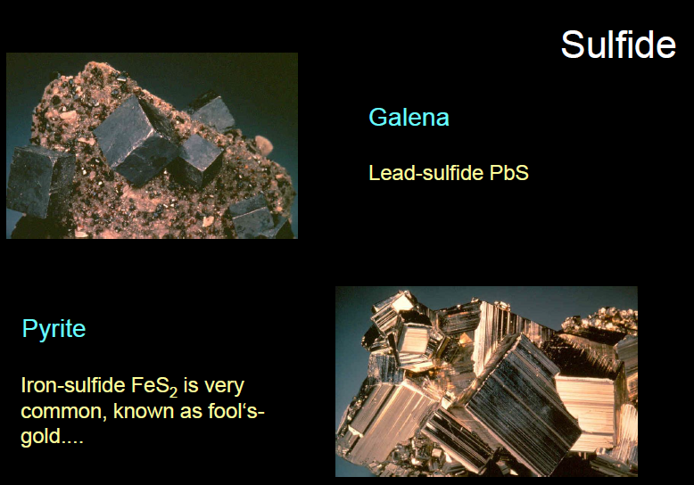

Slide 32
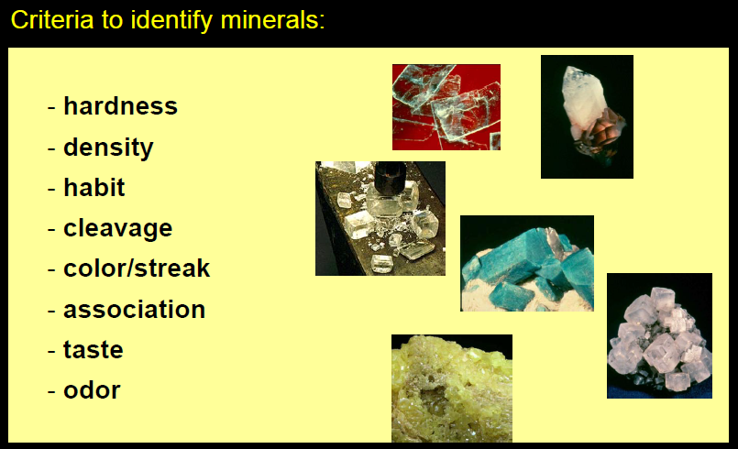

Slide 33
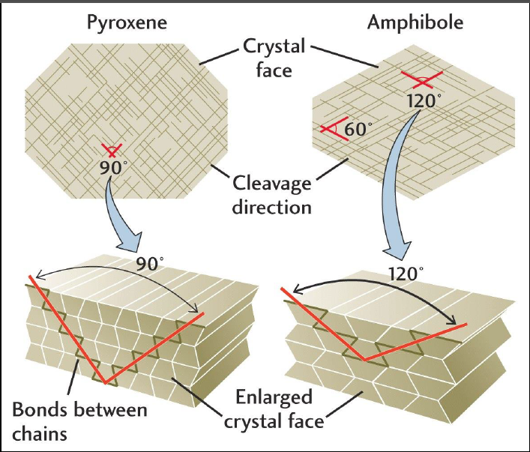
Cleavage

