Slide 1
Lesson 1

Slide 2
What is geology?
The study of the Earth
Geo – Earth
More detail : An Earth science concerned with the solid Earth;
  the rocks of which it is composed,
  and the processes by which they form and change over time.

Slide 3
The Earth – origin and evolution
How Did the Earth Form?
Let’s start with the Solar System
  Composed of a set of radically different types of planets and moons—
  from the gas giants Jupiter, Saturn, Uranus, and Neptune to the rocky inner planets.
  Centuries of studying Earth, its neighbouring planets, and meteorites have enabled the development of models of the birth of the Solar System.

Slide 4
The Earth – origin and evolution, conti…..
  Generally agreed that the Sun and planets all coalesced out of the same nebular cloud,
  But little is known about how Earth obtained its particular chemical composition,
  Or why the other planets ended up so different from Earth and from each other, e.g.
    why has Earth, unlike every other planets, retained the unique properties—such as the presence of water—that allows it to support life?
  New measurements of Solar System bodies and extrasolar planets and objects, will further advance understanding of the origin of Earth and the Solar System.

Slide 5
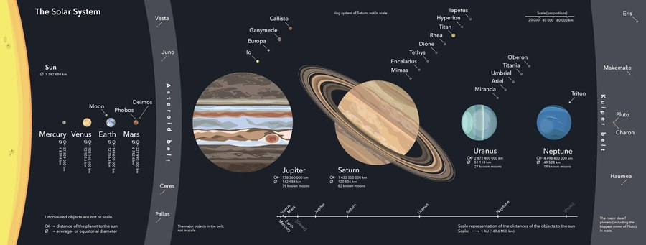

Slide 6
The Earth – origin and evolution, conti…..
The Earth
  Along with the other planets, is believed to have been formed 4.5 billion years ago
  As a solidified cloud of dust and gases left over from the creation of the Sun
  For perhaps 500 million years, the interior of Earth stayed solid and relatively cool, perhaps 1,100°C

Slide 7
The Earth – origin and evolution, conti…..
  The first 500 million years of Earth’s existence, known as the Hadean Eon.
  It is a critical missing link in understanding how the planet’s atmosphere, oceans, and differentiated layers of core, mantle, and outer crust developed.
  Scientists have almost no idea how fast the surface environment evolved
  How the transition took place, or
  when conditions became hospitable enough to support life.

Slide 8
The Earth – origin and evolution, conti…..
  Some clues are deduced from Earth’s oldest minerals (zircons),
  as well as from Earth’s Moon and other planets.
  These are allowing a clearer picture of the Hadean Eon to gradually emerge.
    The future is certain to provide additional breakthroughs.

Slide 9
The Earth – origin and evolution, conti…..
    The amount of information that can be extracted from even the tiniest samples of old rocks and minerals is increasing rapidly, and
    with concerted effort, it is expected that many more ancient rocks and mineral samples will be found.

Slide 10
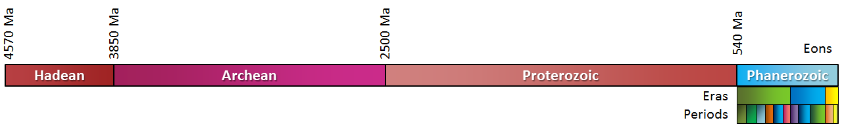
Broad geological time scale

Slide 11
The changing (evolving) earth
As already seen, the Sun and its family of planets formed when a cloud of dust and gas condensed about 4.5 billion years ago.
Several hundred million years after the Earth took form, an outer crust developed.
But these surface rocks are no longer available for study: they have disappeared into the interior of our dynamic planet.
Our only clues to how the Earth formed come from meteorites and the Moon because both formed simultaneously with the planets.

Slide 12
The changing (evolving) earth, conti……
As the Earth started to grow, the heavy iron sank to the centre, and the lighter silicates rose to the surface.
Heat generated from impacts of other bodies kept the early Earth molten.
It is believed that, the planet’s entire outer layer may have been liquid, an idea that came from studying the Moon.
Rocks of the lunar highlands are believed to have solidified from a similar ocean of molten rock, or magma.
Unlike the Earth, the Moon is geologically inactive; thus, the cold, solid crust of its magma ocean still exists.

Slide 13
The changing (evolving) earth, conti……
The most important clues about the early stages of the solar system come from meteorites.
Some are older than the formation of the Earth.
They reveal how smaller bodies coalesced to form planets, and how our own planet developed after it had formed.

Slide 14
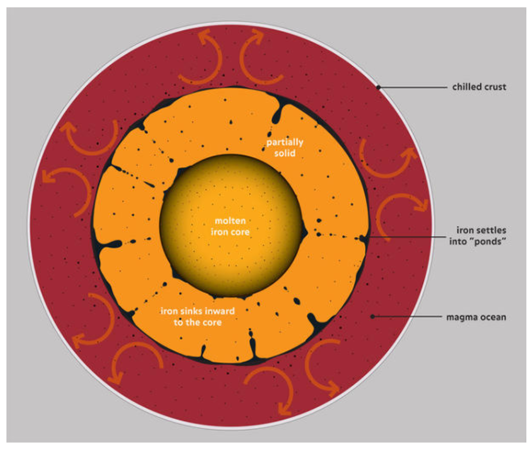

Slide 15
What is the Earth made of?
The great bulk of our planet is composed of:
  oxygen,
  iron,
  silicon, and
  magnesium.
Since the Earth formed relatively close to the Sun by the aggregation of smaller solid bodies, it is a rocky, solid planet whose atmosphere formed later.
These elements and others form the minerals that form the rocks that the Earth is made of.
The more remote, giant gas planets, from Jupiter to Neptune, formed predominantly from the lighter, more volatile elements, like hydrogen and helium.

Slide 16
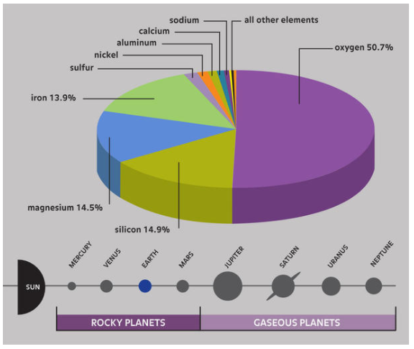
Chemical composition of the Earth

