Slide 1
Lesson 5
Principles of Plate Tectonics

Slide 2
Starting point – Layers of the Earth
• Crust
• Mantle
• Core

Slide 3
Crust (lithosphere) Plate Movement
The crust is broken into plates that move
Lithosphere is divided into plates that slide around on top of the slowly moving mesosphere (tectonic plates)
It occurred after the break-up of Pangaea, the Super continent, and since then the continents have drifted apart

Slide 4
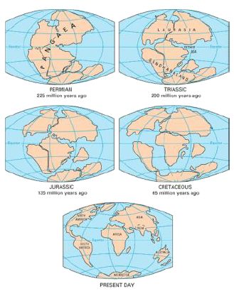
Diagram showing continental drifting theory from 225 million years ago to the present

Slide 5
Theory of Continental Drift
Proposed by Alfred Wegener in 1912
But not widely accepted until seafloor spreading was discovered in 1960
Evidence to support Continental Drift Theory:
  Similar plant and animal fossils on the shores of distant continents
  All land on earth fits together like a jigsaw puzzle
  Glacier deposits
  Mountain ranges from different continents align and are composed of the same materials

Slide 6
Alfred Wegner noted South America, Africa, India, Antarctica, and Australia have almost identical rocks and fossils

Slide 7
Continental drift became widely accepted when Dr. Harry Hess discovered seafloor spreading in 1960
Seafloor Spreading occurs at divergent plate boundaries which subsequently create mid-ocean ridges
New oceanic crust is formed through magma rising through the gap and cooling
As plates move, the new crust gradually moves away from the ridge
Seafloor spreading helps explain continental drift in the theory of plate tectonics.

Slide 9
How does continental drift work?
Plates collide = convergent boundary
• Plates separate = divergent boundary
• Plates slide past one another horizontally = transform boundary
• Subduction zone = one plate slides under another

Slide 10
Convergent Boundary/subduction zone
When both are continental plates, the plates push against each other, creating mountain ranges

Slide 11
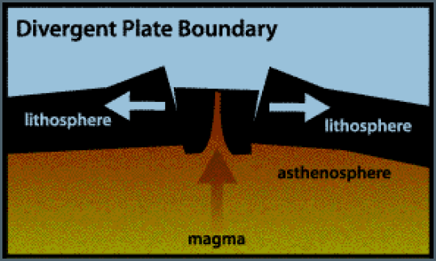
Divergent Boundary
• Plates separate
New crust is formed at Divergent Boundaries

Slide 12
Transform Boundary
Plates slide past one another horizontally

Slide 13
What happens when earthquakes happen in the ocean?
TSUNAMI wave that brings lots of water to the continents and causes major flooding!
Subduction Zone
One plate slides under another
Oceanic trench forms at the subduction zone
Volcanoes may form along this type of boundary

Slide 14
Driving force of Plate tectonics: CONVECTION CURRENTS

Slide 15
Rock does two things when stress is placed on it
  It can fold or fault (break)
  When plates push against one another, they form MOUNTAINS

Slide 16
Folded Mountains – made when rock is squeezed together and pushed upward
Fault – broken rock layers resulting from stress

Slide 17
Volcanic Mountains form along broken rock layers at convergent boundaries (continental and oceanic crust) –
  molten rock erupts to form new material on earth’s surface (Ring of Fire)

Slide 18
Nicholas Steno – Law of Superposition
Rock layers on the top layer of sedimentary rock are younger than the rock layers on the bottoms
Fossils on the bottom of sedimentary rock are older than fossils on the top layer

Slide 19
James Hutton – Law of Crosscutting
A geologic feature that cuts another is younger in age than the surrounding rock
Section D of rock would be younger than the surrounding rock

Slide 20
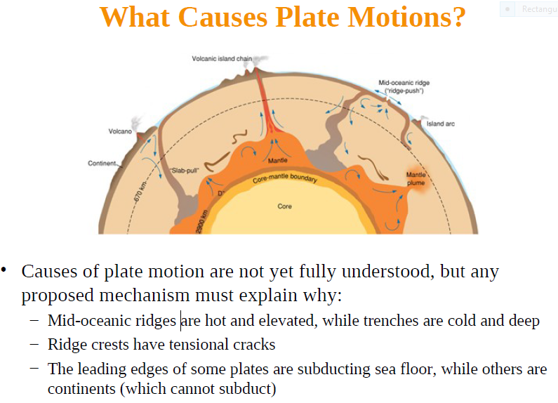
Summary

Slide 21
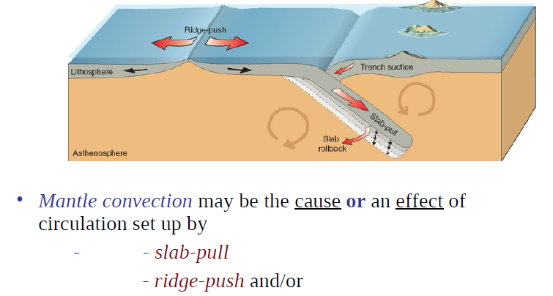

Slide 22
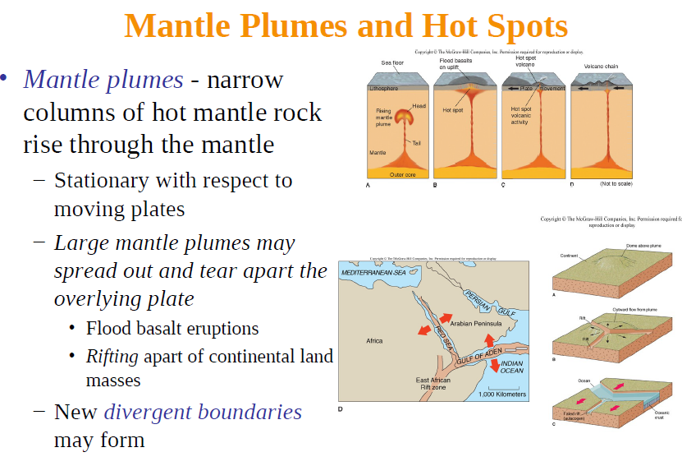

Slide 23
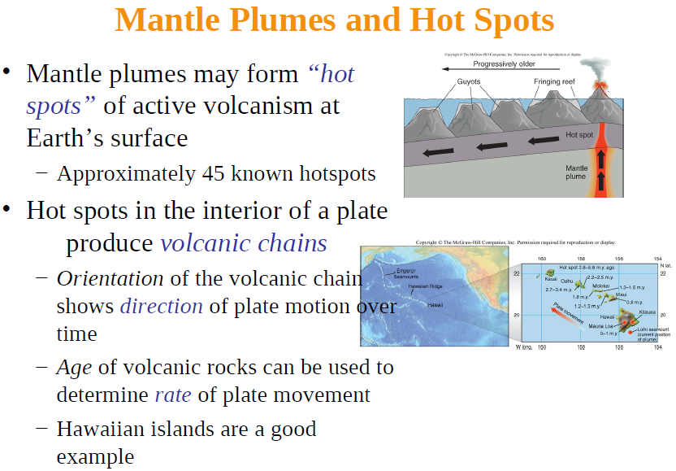

Slide 24
Thank you

