Slide 1
Lesson 4
Magmatism and magmatic systems

Slide 2
What is magma?
Magma is the molten or semi-molten natural material from which all igneous rocks are formed.
Magma is found beneath the surface of the Earth.
Evidence of magmatism has also been discovered on other terrestrial planets and some natural satellites.
When red-hot magma comes into contact with seawater, an explosion results

Slide 3
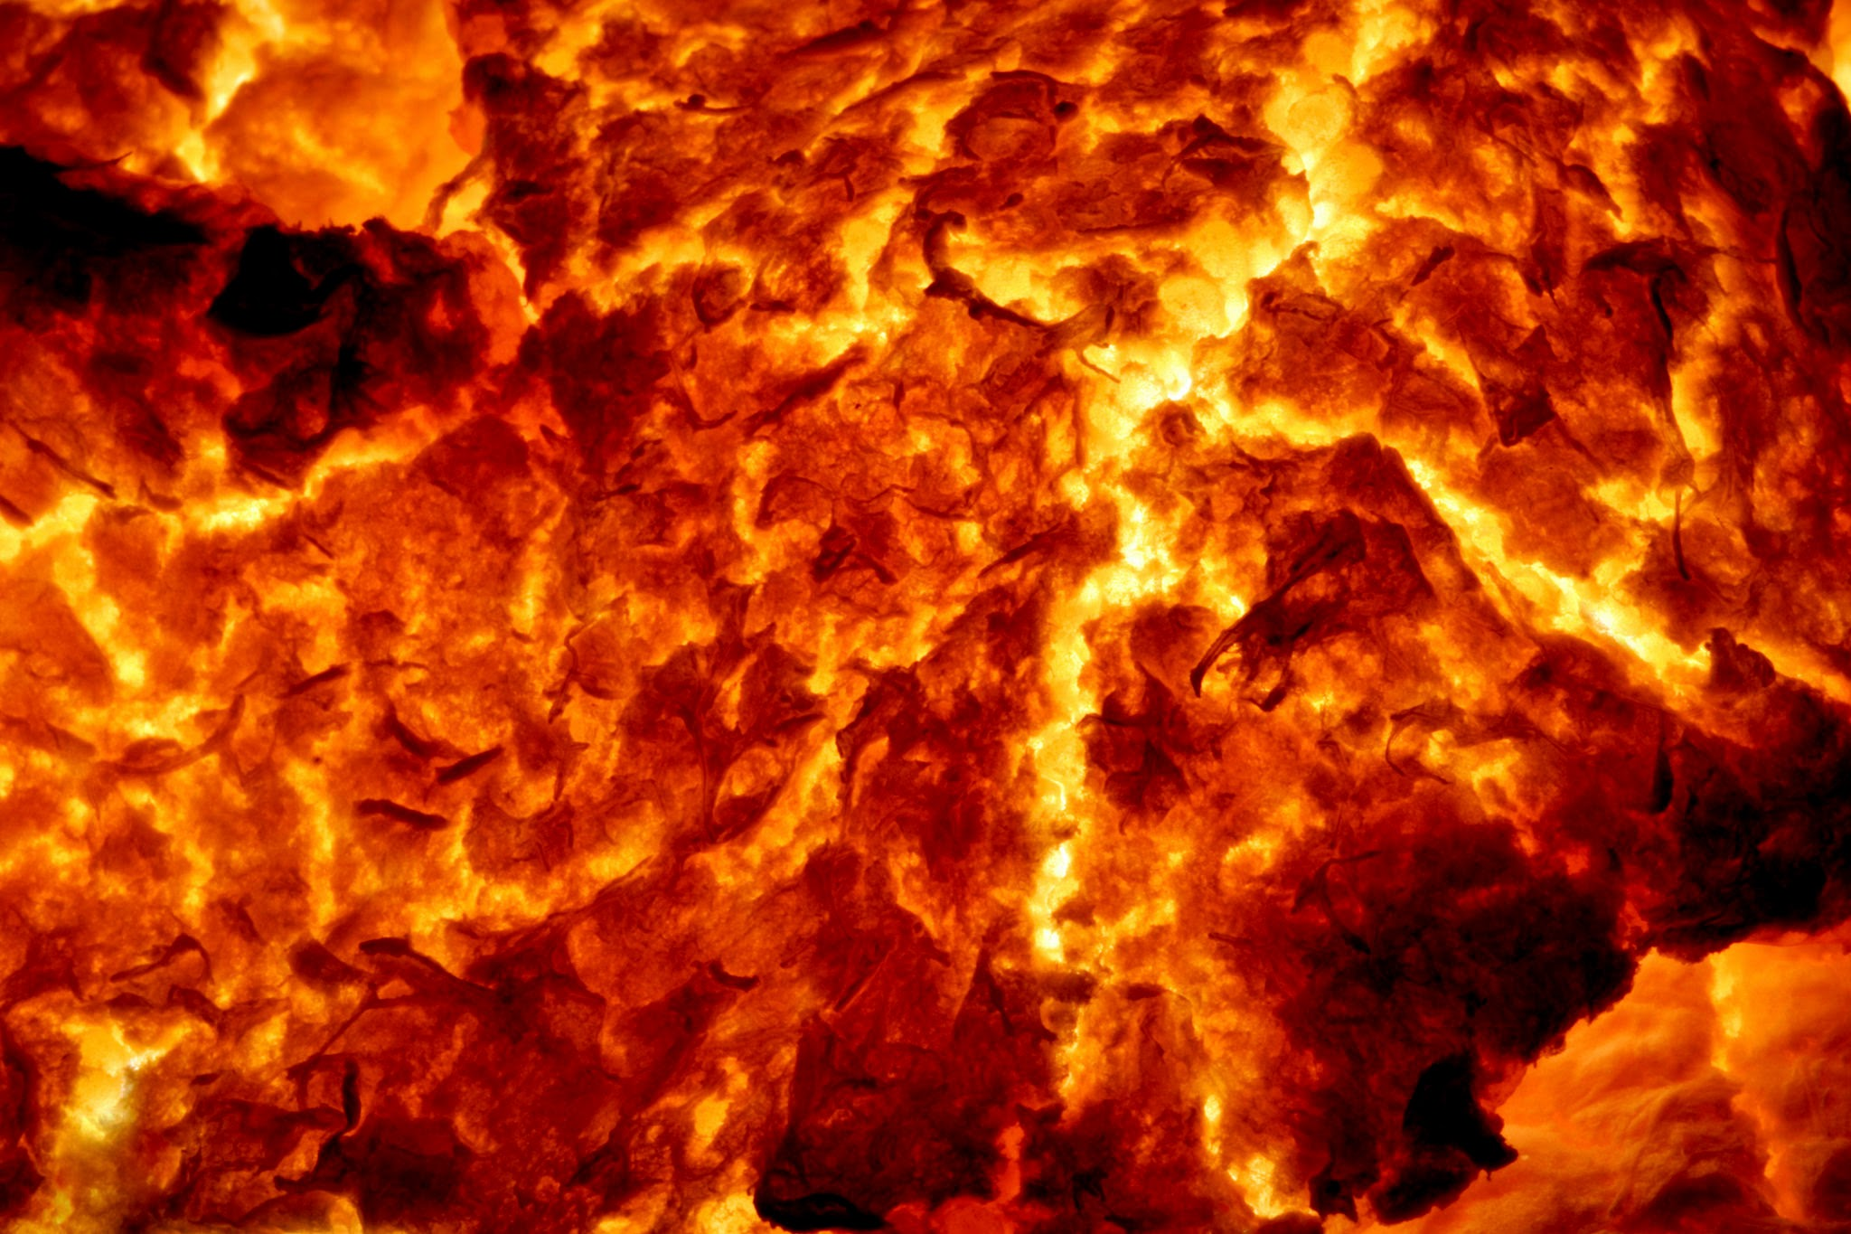
Red hot magma

Slide 4
What's the difference between magma and lava?
The distinction between magma and lava is all about location.
When geologists refer to magma, they're talking about molten rock that's still trapped underground.
If this molten rock makes it to the surface and keeps flowing like a liquid, it's called lava.
Magmas vary in their chemical composition, which gives them—and the volcanoes that contain them—different properties.

Slide 5
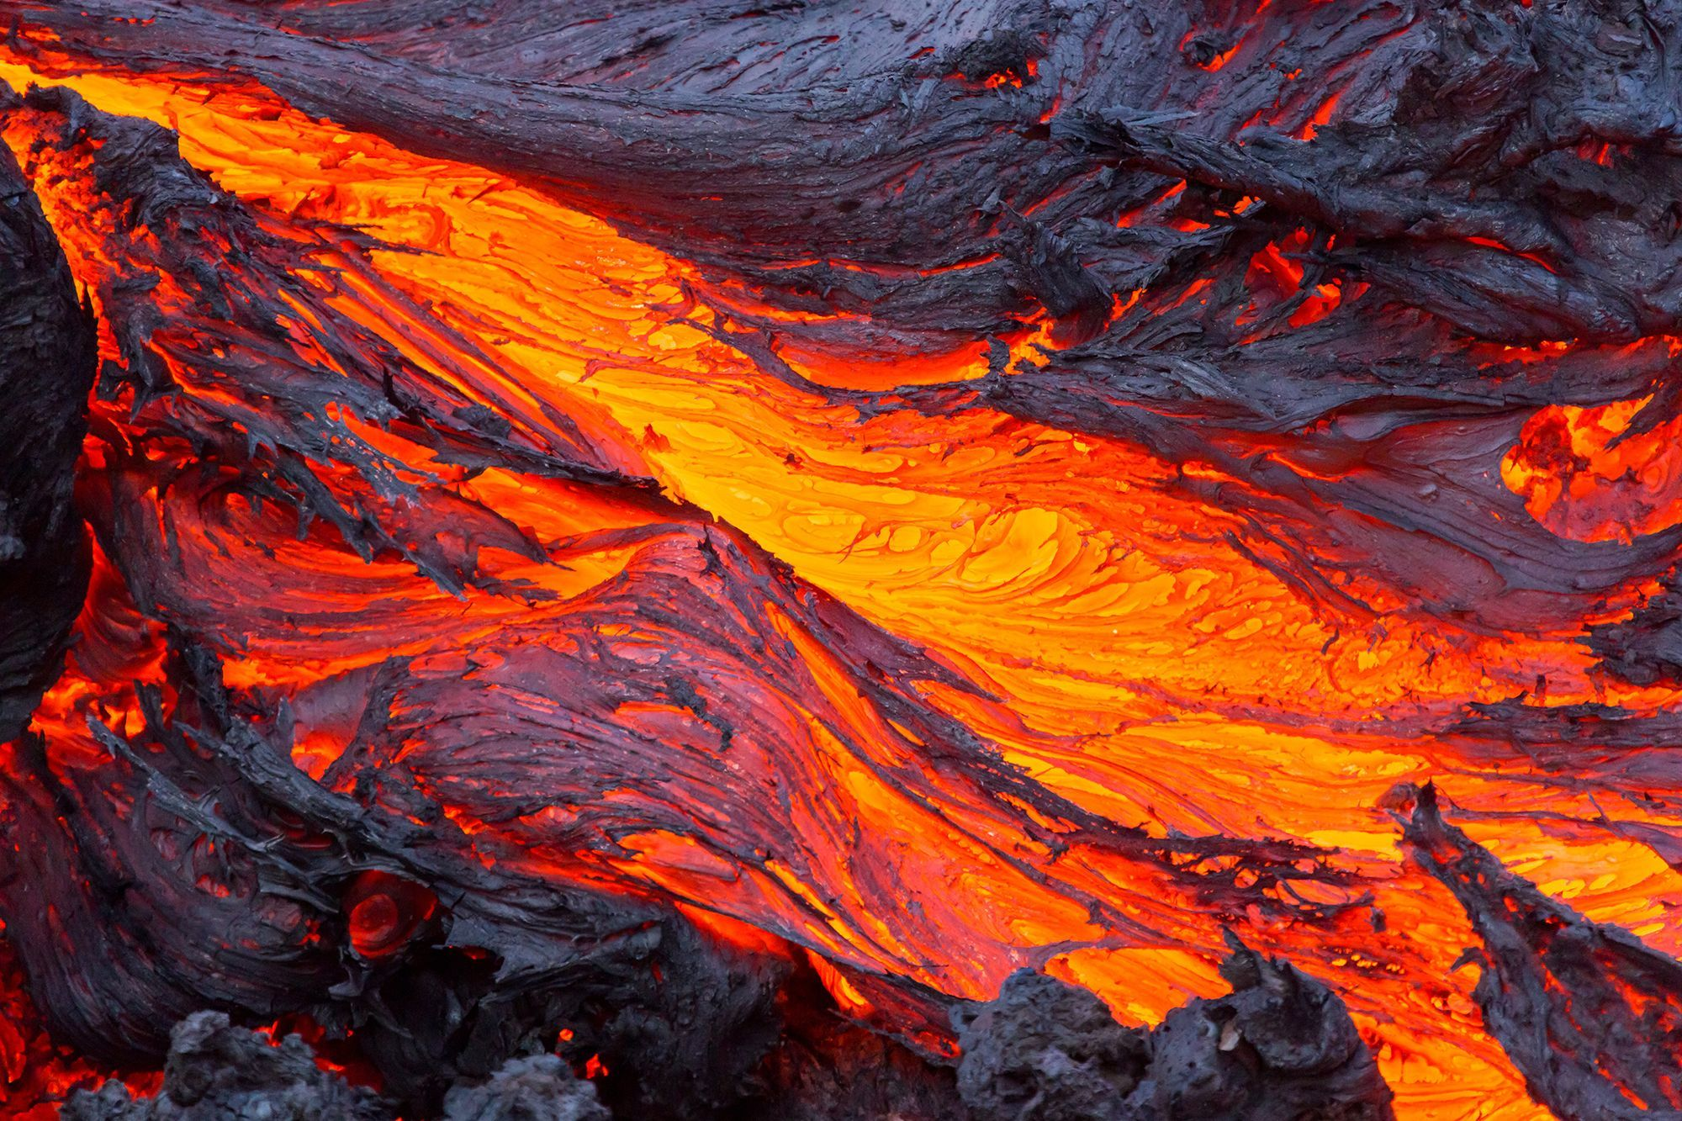

Slide 6
Mafic magmas like those in Hawaii tend to form when the heavier crust that forms the ocean floor melts.
They contain between 47 to 63 percent silica, the mineral that makes up glass and quartz.
As far as molten rocks go, mafic magmas are fairly runny, with viscosities ranging from molasses to peanut butter.
They're also the hottest variety of magma, reaching temperatures between 1,800 degrees to 2,200 degrees Fahrenheit.

Slide 7
Silicic magmas, on the other hand, tend to form when the lighter continental crust melts.
These magmas are more than 63 percent silica, which makes them more viscous:
At their runniest, silicic magmas flow about as well as lard or caulk—which is to say not well at all.
They're also cooler than mafic magmas.
Rhyolite, an especially silica-rich type of lava, hits temperatures between only 1,200 degrees to 1,500 degrees Fahrenheit.

Slide 8
When silicic magmas are no longer confined under sufficiently high pressure, the gases dissolved within them come out of solution and form bubbles
And just like opening a shaken-up can or bottle of fanta, the resulting rush of vapour triggers an explosive eruption
Iconic cone-shaped volcanoes called stratovolcanoes are loaded with silicic magmas

Slide 9
Hawaii's volcanoes, on the other hand, contain especially low-silica magmas made of basalt
Which means they have much less explosive…. no much dissolved gasses and water
Instead, they ooze and spatter, creating shield volcanoes, with gently sloped formations
These have become the islands' signature geologically

Slide 10
Magmatic systems
Magma and lava contain three components:
  melt,
  solids, and
  volatiles
The melt is made of ions from minerals that have liquefied
The solids are made of crystallized minerals floating in the liquid melt
These may be minerals that have already cooled

Slide 11
Volatiles are gaseous components dissolved in the magma, such as:
  water vapour,
  carbon dioxide,
  sulphur, and
  chlorine
The presence and amount of these three components affect the physical behaviour of the magma

Slide 12
Geothermal gradient
Below the surface, the temperature of the Earth rises
This heat is caused by residual heat left from the formation of Earth and ongoing radioactive decay
The rate at which temperature increases with depth is called the geothermal gradient
The average geothermal gradient in the upper 100 km of the crust is about 25°C per kilometre of depth
So for every kilometer of depth, the temperature increases by about 25°C

Slide 13
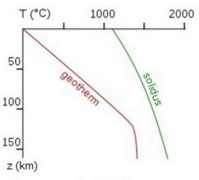
Pressure temperature diagram showing temperature in degrees Celsius on the x-axis and depth below the surface in km on the y-axis
The red line is the geothermal gradient and the green solidus line represents the temperature and pressure regime at which melting begins
Rocks at pressures and temperatures left of the green line are solid
If pressure/temperature conditions change so that rocks pass to the right of the green line, then they will start to melt

Slide 14
The depth-temperature graph illustrates the relationship between the geothermal gradient (geotherm, red line) and the start of rock melting (solidus, green line)
The geothermal gradient changes with depth (which has a direct relationship to pressure) through the crust into the upper mantle
The area to the left of the green line includes solid components;
  to the right is where liquid components start to form
The increasing temperature with depth makes the depth of about 125 km as the natural depth at which the geothermal gradient is closest to the solidus

Slide 15
The temperature at 100 km depth is about 1,200°C
At bottom of the crust, 35 km deep, the pressure is about 10,000 bars
A bar is a measure of pressure, with 1 bar being normal atmospheric pressure at sea level
At these pressures and temperatures, the crust and mantle are solid
To a depth of 150 km, the geothermal gradient line stays to the left of the solidus line
This relationship continues through the mantle to the core-mantle boundary, at 2,880 km

Slide 16
The solidus line slopes to the right because the melting temperature of any substance depends on pressure
The higher pressure created at greater depth increases the temperature needed to melt rock
In another example, at sea level with an atmospheric pressure close to 1 bar, water boils at 100°C
But if the pressure is lowered, water boils at a much lower temperature.

Slide 17
Partial melting
There are three principal ways rock behaviour crosses to the right of the green solidus line to create molten magma:
  1) decompression melting caused by lowering the pressure,
  2) flux melting caused by adding volatiles, and
  3) heat-induced melting caused by increasing the temperature
The Bowen’s Reaction Series shows that minerals melt at different temperatures
Since magma is a mixture of different minerals, the solidus boundary is more of a fuzzy zone rather than a well-defined line; some minerals are melted and some remain solid
This type of rock behaviour is called partial melting and represents real-world magmas, which typically contain solid, liquid, and volatile components

Slide 18
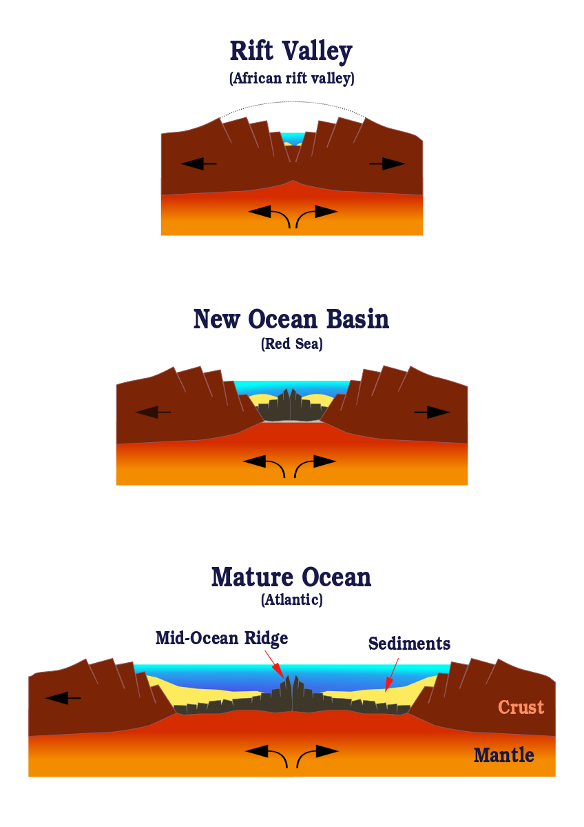
Decompression melting
Magma is created at mid-ocean ridges via decompression melting
Strong convection currents cause the solid asthenosphere to slowly flow beneath the lithosphere
The upper part of the lithosphere (crust) is a poor heat conductor, so the temperature remains about the same throughout the underlying mantle material
Where the convection currents cause mantle material to rise, the pressure decreases, which causes the melting point to drop

Slide 19
In this situation, the rock at the temperature of the geothermal gradient is rising toward the surface
Thus hotter rock is now shallower, at a lower pressure, and the rock, still at the temperature of the geothermal gradient at its old location
This shifts past the its melting point (shown as the red line crossing over the solidus or green line) and partial melting starts
As this magma continues to rise, it cools and crystallizes to form new lithospheric crust

Slide 20
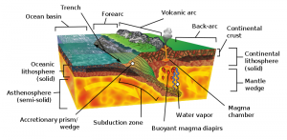
Flux induced partial melting

Slide 21
Flux melting or fluid-induced melting
Occurs in island arcs and subduction zones when volatiles, water and gases, are added to mantle material (see figure)
The subducting slab contains oceanic lithosphere and hydrated minerals and sediments
These hydrated mineral forms are created when water ions bond with the crystal structure of silicate minerals
As the slab descends into the hot mantle, the increased temperature causes the hydrated minerals to emit water vapour and other volatile gases
These are expelled from the slab-like water being squeezed out of a sponge

Slide 22
The volatiles dissolve into the overlying asthenospheric mantle and decrease its melting point
In this situation the applied pressure and temperature have not changed, the mantle’s melting point has been lowered by the addition of volatile substances

Slide 23
Heat-induced melting
This transforms solid mantle into liquid magma by simply applying heat
Is considered to be the least common process for generating magma
Occurs at the mantle plumes or hotspots
The rock surrounding the plume is exposed to higher temperatures,
The geothermal gradient crosses to the right of the green solidus line, and the rock begins to melt
The mantle plume includes rising mantle material, meaning some decompression melting is occurring as well
A small amount of magma is also generated by intense regional metamorphism
This magma becomes a hybrid metamorphic-igneous rock called migmatite

Slide 24
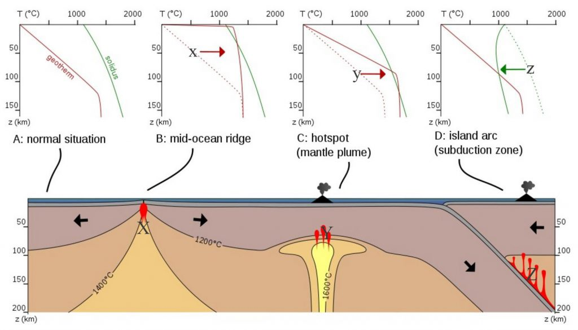
Summary of partial melting environments

Slide 25
The end

