Slide 1
Lesson 3
Rocks and Magmas

Slide 2
Rocks
What is a rock?
A rock is defined as a consolidated mixture of minerals
Hard and solid
A mixture of minerals implies:
  the presence of more than one mineral grain,
  but not necessarily more than one type of mineral
A rock can be composed of only one type of mineral (e.g., limestone is commonly made up of just calcite),
but most rocks are composed of several different types of minerals
A rock can also include non-minerals, such as the organic matter within a coal bed, or within some shales

Slide 3
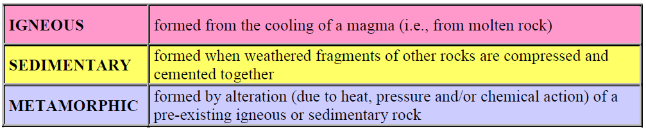
Three Main categories of rocks

Slide 4
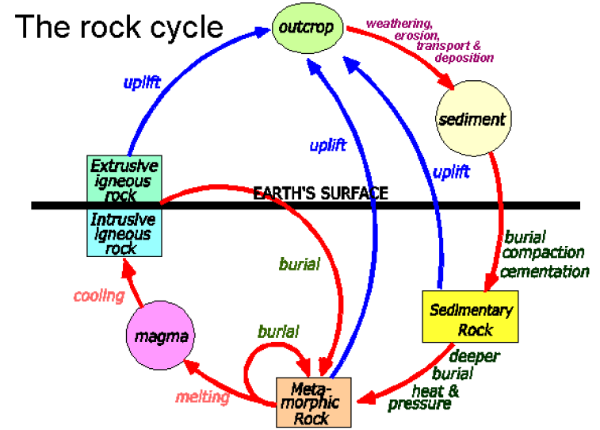
The rock cycle
The materials that make up the rocks of the crust are slowly but constantly being changed from one form to another
The inter-relationships between rock types can be summarized on what is known as the rock cycle diagram

Slide 5
Through the various processes of mountain building, all types of rocks are uplifted and exposed at surface
They are weathered, both physically and chemically, and the weathering products are eroded, transported and then deposited as sediments
The sediments are buried and compressed and become hardened and cemented into sedimentary rock
Through various means, largely resulting from plate tectonic forces, different kinds of rocks are buried deep within the crust where they are heated up, squeezed and chemically changed into metamorphic rock.
If the heat is sufficient, part or all of the rock may melt into magma.

Slide 6
Igneous rocks - formed from the cooling of a magma (i.e., from molten rock)
Magma can either cool slowly (over centuries to millions of years) within the crust—forming intrusive igneous rock,
or erupt onto the surface and cool quickly (within seconds to years)—forming extrusive igneous rock.

Slide 7
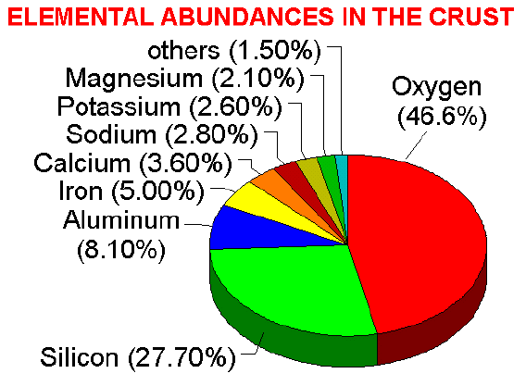
Magmas can have quite widely varying compositions, but they are all made up largely of only eight elements, in order of importance:
  oxygen,
  silicon,
  aluminium,
  iron,
  calcium,
  sodium,
  Magnesium, and
  potassium

Slide 8
  Magmas derived from recycled crustal material are dominated by oxygen, silicon, aluminium, sodium and potassium
  Magmas derived from the mantle material beneath the crust have higher levels of iron, magnesium and calcium, but they are still likely to be dominated by oxygen and silicon
  All magmas also have varying proportions of dissolved water as well as gases such as carbon dioxide and hydrogen sulphide

Slide 9
At temperatures of well over 1000º C magma will be entirely liquid because there is too much energy for anything to bond together
As the temperature drops, usually because the magma is moving upward into a cooler part of the crust, crystals will start to form
The minerals that make up igneous rocks crystallize at various different temperatures
This explains why a cooling magma can have some crystals within it, and yet remain predominantly liquid

Slide 10
The sequence in which minerals crystallize from a magma is known as the Bowen Reaction Series – which we have looked at.
Of the common silicate minerals, olivine normally crystallizes first
Olivine is followed by pyroxene, then amphibole and then biotite mica
At about the point where pyroxene begins to crystallize the plagioclase feldspars also begin to crystallize.
Calcium-rich plagioclase (anorthite) has the highest melting point, and
The more sodium-rich plagioclases have lower melting points

Slide 11
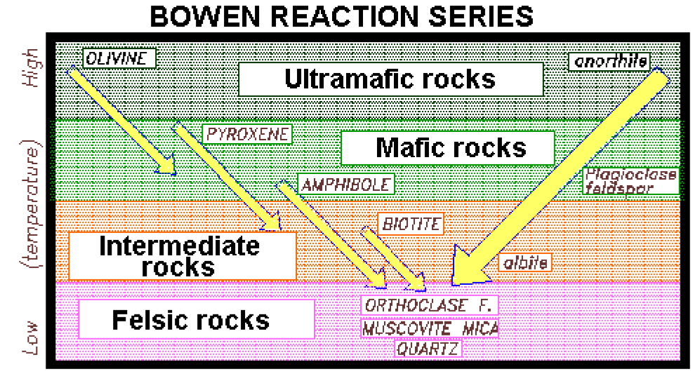

Slide 12
It’s called the Bowen Reaction Series because:
  once a mineral has crystallized it may continue to react with the remaining magma to form different minerals
  For example, as the temperature drops the olivine crystals might combine (react) with silica left in the magma to form pyroxene, and
  pyroxene may later combine with more silica to form amphibole
  Therefore, although olivine might have been the first mineral to crystallize out of a magma, when that magma is finally completely cooled it may contain no olivine

Slide 13
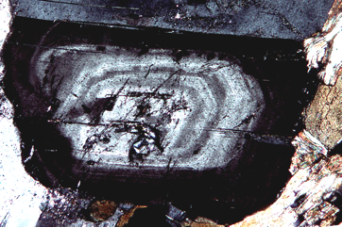
  The plagioclase series is described as a continuous series because a plagioclase crystal that forms early in the cooling sequence (when the magma is hot) will tend to be relatively anorthitic (calcium-rich).
  As the magma cools, plagioclase of progressively more albitic composition (sodium-rich) will form around the original crystal
  The result is that plagioclase crystals are commonly zoned, with a relatively calcium-rich core and a relatively sodium-rich rim

Slide 14
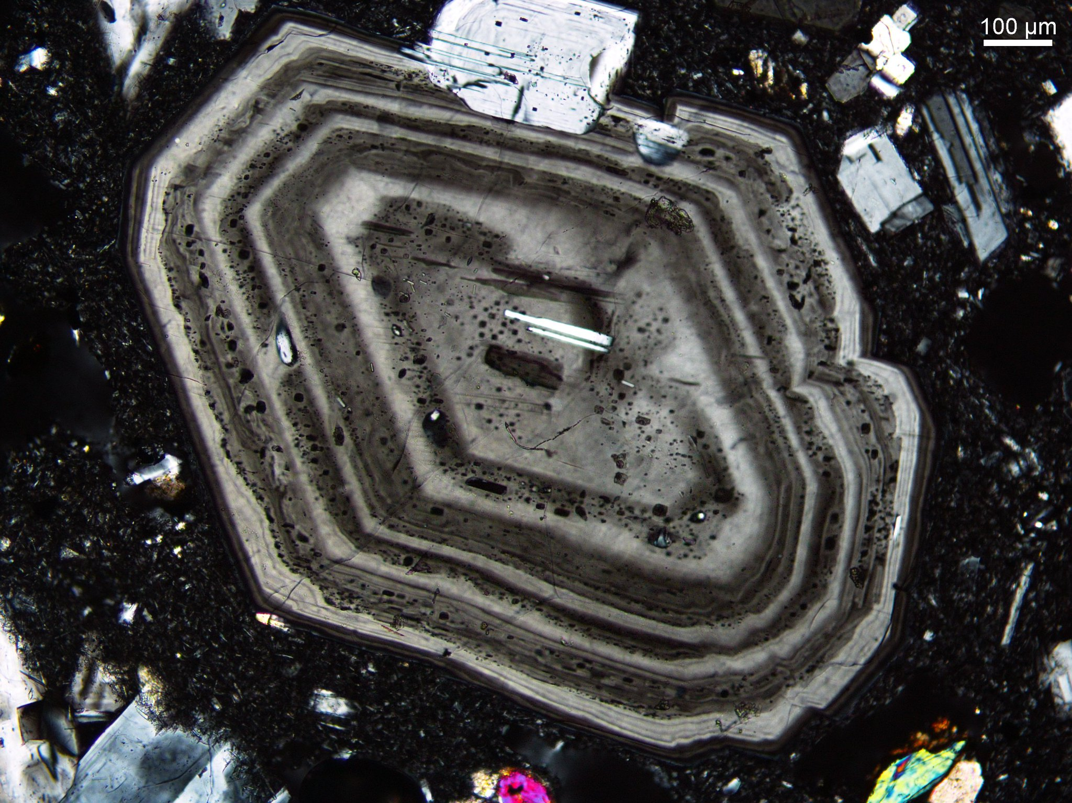

Slide 15
Some of the minerals which first crystallize are likely to be heavier than the magma, they may settle to the bottom of a magma chamber
This isolates them from the liquid magma – more so for relatively non-viscous mafic magma
Residual magma will progressively have different composition than the original magma - E.g. it will have less iron and magnesium, and
If some magma is then forced out of the magma chamber (into a dyke or as a volcanic eruption) it will produce rocks of different composition from the original magma
This process is known as fractional crystallization

Slide 16
Cooling rate and crystal size
If the cooling rate is slow, crystals will continue to form until the entire body is solid - resulting rock will be composed of relatively large crystals
If the cooling rate is rapid, as in the case of a volcanic eruption, crystals will not have time to form, and the resulting rock will be extremely fine-grained or even glassy

Slide 17
In some cases, some crystals will already have formed within a cooling body of magma when some of that magma is forced to the surface in a volcanic eruption
The extruded magma will cool very quickly and the uncrystallized material will harden into very fined grained rock
The result will be a rock that has the relatively large crystals originally present at the time of extrusion suspended in a fine matrix
This texture is called porphyritic

Slide 18
Classification of igneous rocks
Classified according to their texture and their composition
In describing texture we are generally referring to:
  the average size of the mineral grains present,
  the relative sizes (i.e., whether a mineral is present in large grains relative to other minerals) and
  the presence or absence of cavities

Slide 19
GLASSY - no mineral grains or crystals are actually present
APHANITIC - mineral grains are present, but they are too small to distinguish with the naked eye
PHANERITIC - individual mineral grains can be seen with the naked eye (average grain sizes range from fine (< 1 mm) to coarse (> 5 mm))
PEGMATITIC - most of the mineral grains are greater than 1 cm across
PORPHYRITIC - there are large crystals of one of more minerals set within a groundmass of finer-grained material
PYROCLASTIC - there are angular fragments of volcanic rock within a finer-grained matrix

Slide 20
  Intrusive rocks
  Intrusive igneous rocks are generally crystalline because they have had a long time to cool
  The crystals, which are large enough to see with the naked eye, are mostly angular or irregular in shape
  Intrusive porphyritic textures are formed in cases where some minerals have crystallized from a magma over a long period, and
  then the magma is pushed up closer to surface where the surrounding rock is cooler and the remaining crystals form quite quickly and are smaller

Slide 21
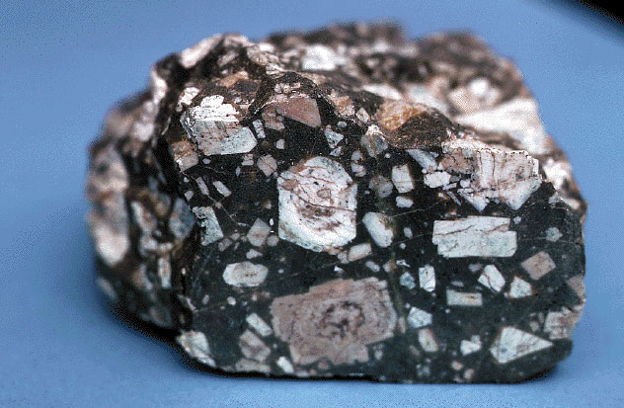
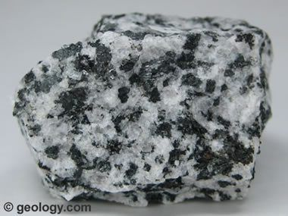
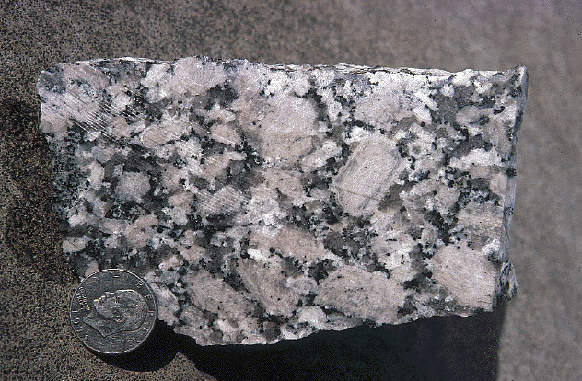
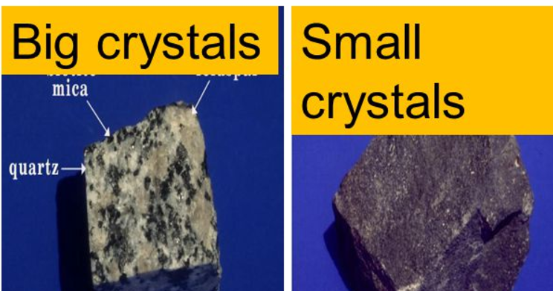
http://www.ux1.eiu.edu/~cfjps/1300/cg_granite.jpg

Slide 22
Intrusive igneous rocks are also known as plutonic igneous rocks
A pluton is any body of intrusive igneous rockPlutonic bodies can be:
  tabular,
  cylindrical or
  somewhere between equidimensional and irregular
Plutonic rocks are always intruded into pre-existing sedimentary, igneous or metamorphic rocks
The pre-existing rocks, into which the plutonic rocks have intruded, are referred to as country rocks

Slide 23
Tabular plutonic bodies are described as being:
  concordant if they lie parallel to the bedding (i.e., in layered sedimentary, metamorphic or volcanic rocks), or
  discordant if they are at some angle to the bedding (in layered rocks)
In rocks without any pre-existing layering (such as granite) all tabular plutons are considered to be discordant
Whether or not a tabular body is horizontal, inclined or vertical has no bearing on its designation as a dyke or a sill, the critical factor is its relationship to layering in the host rock

Slide 24
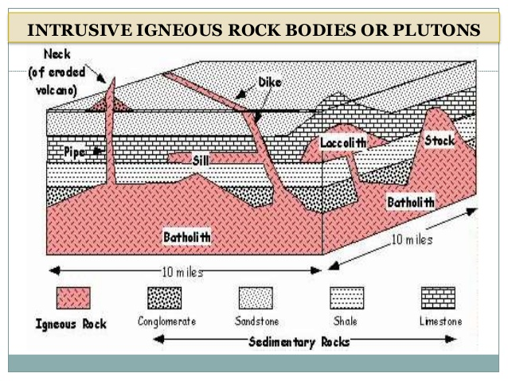

Slide 25
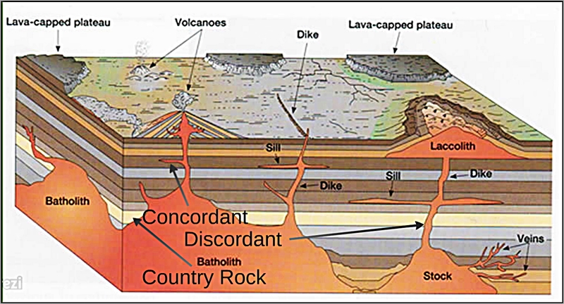

Slide 26
Plutonic bodies
Dykes (or dikes)
discordant tabular bodies intruded into faults and fractures
range in thickness from a few mm to over a km
are most commonly of mafic composition (largely because mafic magmas are less viscous than felsic magmas, and therefore can flow into smaller cracks)
when magma is intruded into a fracture in cool country rock, the magma cools down quite quickly, especially at its edges
effect of this rapid cooling is that the margin of the dyke will commonly be finer grained than the interior of the dyke
this is known as a chilled margin

Slide 27
Sill
Are concordant tabular bodies intruded along boundaries between sedimentary or volcanic layers
The magma actually pushes the layers apart
This could not happen at significant depth because the overlying weight would not allow the beds to be pushed apart
Thus sills are generally shallow features
Laccolith
Formed when a relatively viscous (i.e., felsic magma) is intruded between sedimentary or volcanic layers, and pushes up the overlying strata

Slide 28
Pipe
Cylindrical body that was probably a feeder conduit to a volcano or to another intrusive body
Batholiths and stocks
are large bodies of intrusive rock that are more equidimensional or irregular in shape than sills, dykes and pipes
distinction between "stock" and "batholith" is based on the area exposed at surface
  a batholith has a exposed surface area of at least 100 square km, while
  a stock has an area of less than 100 square km
most batholiths and stocks are granitic in composition, although dioritic bodies are not uncommon

Slide 29
A batholith forces its way upward by pushing the pre-existing rocks aside
This is possible at depth because the country rocks will be warm and relatively plastic
Near to the surface the upward force of the batholith breaks and dislodges the more brittle country rock, which is then incorporated into the magma
This process is known as stoping
Pieces of country rock that break off and fall into the magma are known as xenoliths

Slide 30
Extrusive rocks
Extrusive (i.e., volcanic) rocks can be glassy, aphanitic, porphyritic or pyroclastic
In many cases glassy volcanic rocks are also vesicular, which means that they are full of air cavities created by the gases in the magma
Extrusive porphyritic textures result when some minerals have crystallized from a magma over a long period, and then a volcanic eruption takes place, so that the rest of the magma suddenly cools and crystallizes
Pyroclastic textures result when fragments of rock and glass are ejected explosively during an eruption and then accumulate on the ground around the vent

Slide 31
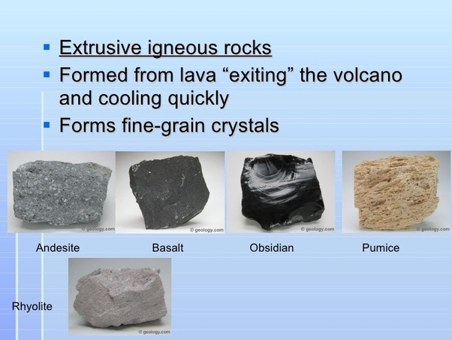

Slide 32
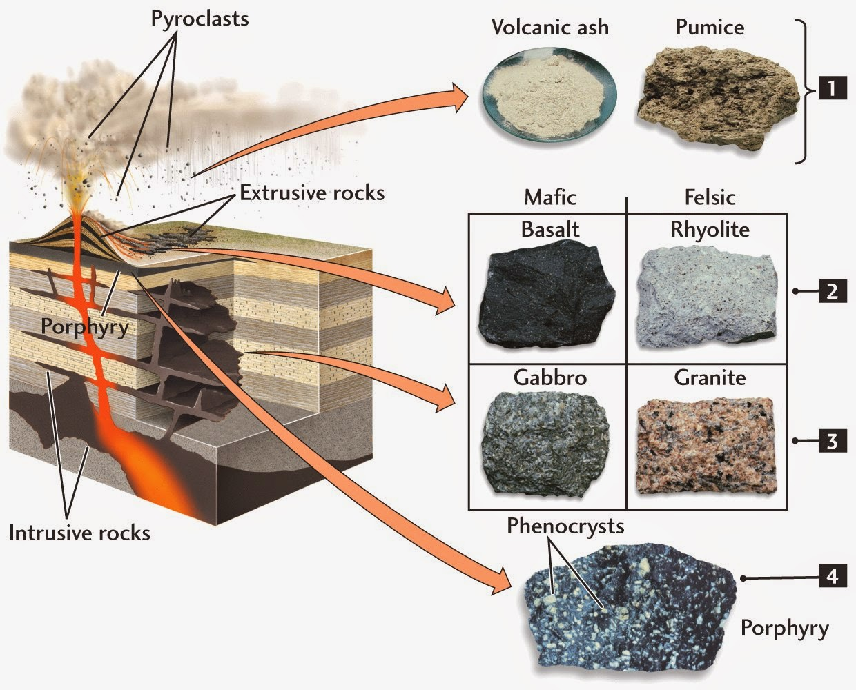
Some comparisons

Slide 33
Composition of igneous rocks
Is described on the basis of the minerals present
The broad compositional classes are:
  felsic => for rocks that are dominated by non-ferromagnesian minerals,
  mafic => for rocks that are dominated by ferromagnesian minerals.
  intermediate => for rocks with compositions between mafic and felsic, and
  ultramafic => for rocks with an overwhelming predominance of ferromagnesian minerals

Slide 34
felsic and intermediate rocks are also known as SIALIC - which refers to the predominance of silica and alumina,
mafic and ultramafic rocks are known as SIMATIC - referring to the predominance of magnesium and iron

Slide 36
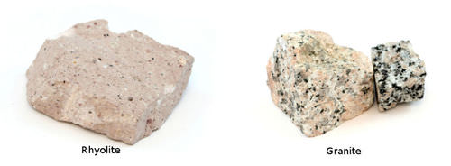
Felsic rocks are composed largely of:
  feldspar (either orthoclase feldspar (potassium-feldspar) or sodium-rich plagioclase feldspar (or both)),
  quartz, and
  up to 10% ferromagnesian minerals (either biotite or amphibole)
  examples are:
    granite (intrusive), and
    rhyolite (extrusive)

Slide 37
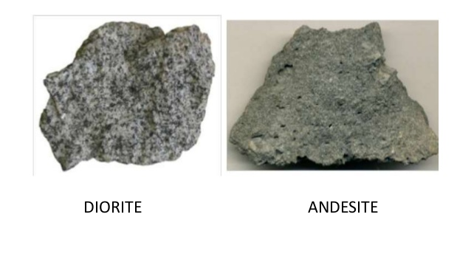
Intermediate rocks are dominated by:
  plagioclase feldspar,
  between 20 and 50% ferromagnesian minerals (usually pyroxene and amphibole)
  examples are:
    diorite (intrusive), and
    andesite (extrusive).

Slide 38
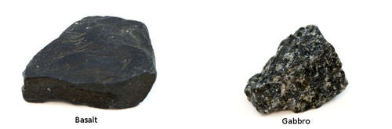
Mafic rocks are dominated by:
  plagioclase feldspar, and
  ferromagnesian minerals
  They have no quartz or orthoclase feldspar, but they can have up to 50% plagioclase and between 50 and 80% ferromagnesian minerals (primarily pyroxene, with some olivine)
  examples are:
    gabbro (intrusive), and
    basalt (extrusive)

Slide 39
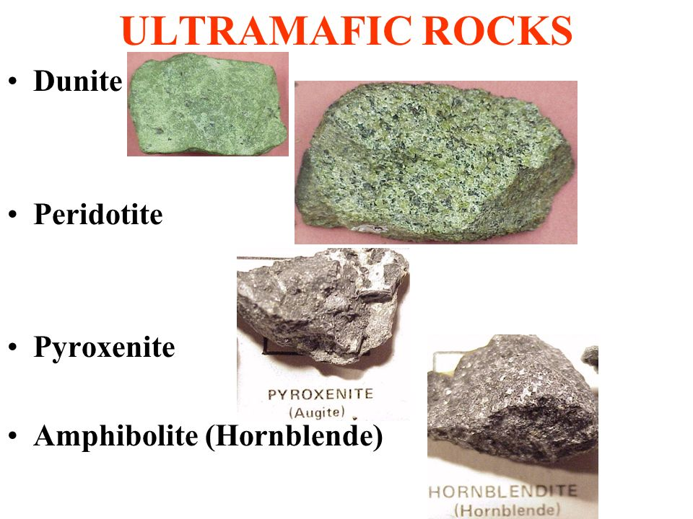
Ultramafic rocks are dominated by:
  pyroxene or olivine, and
  may contain a small amount of calcium-rich plagioclase
  examples are:
    dunite (olivine rock),
    pyroxenite (pyroxene rock), and
    periodotite (pyroxene and olivine rock), all of which are intrusive.

Slide 40
`Sedimentary rocks
Major Sediment/ Sedimentary Rock Types
Clastics
  Particles of preexisting rock
Chemical and biochemical
  Precipitated from solution
Clastics
  Particles of preexisting rock
  Effect of weathering
  Dominantly silicate minerals

Slide 41
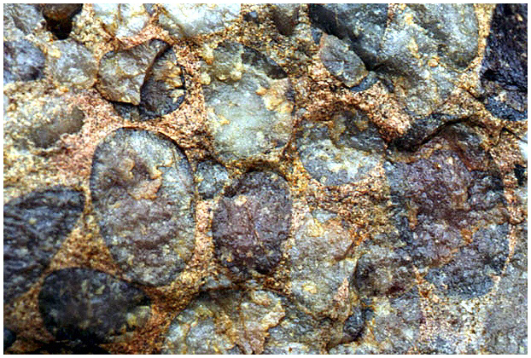
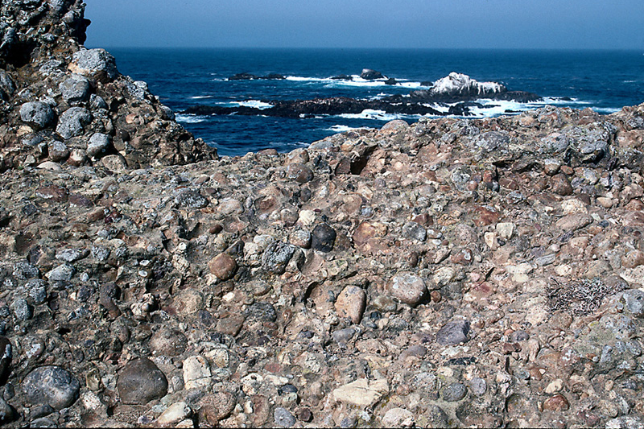
Gravel and conglomerate/breccia
  > 30% of grains > 2mm
  Conglomerate if rounded, breccia if angular
  Need strong currents

Slide 42
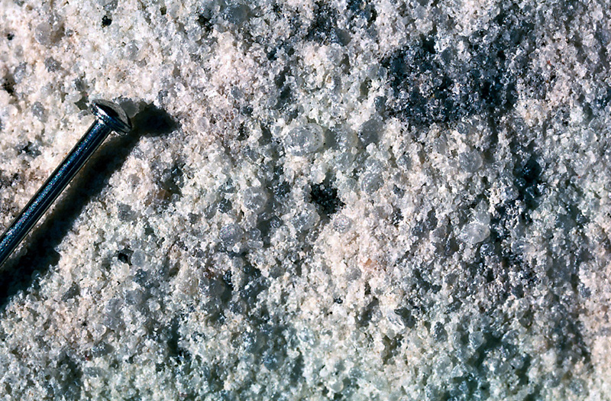
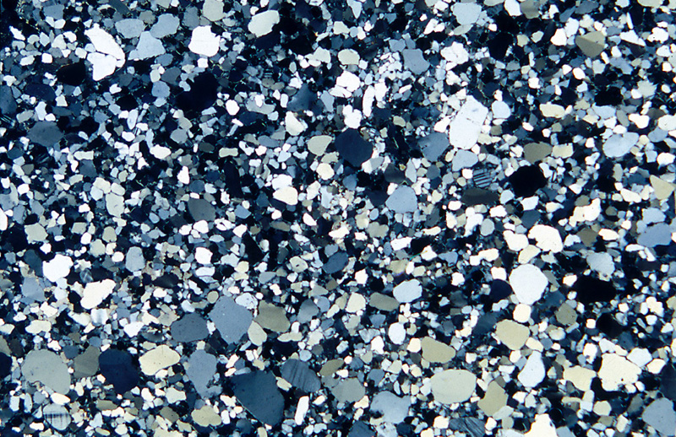
Sand and sandstone
Dominantly sand sized particles (.062 - 2 mm)

Slide 43
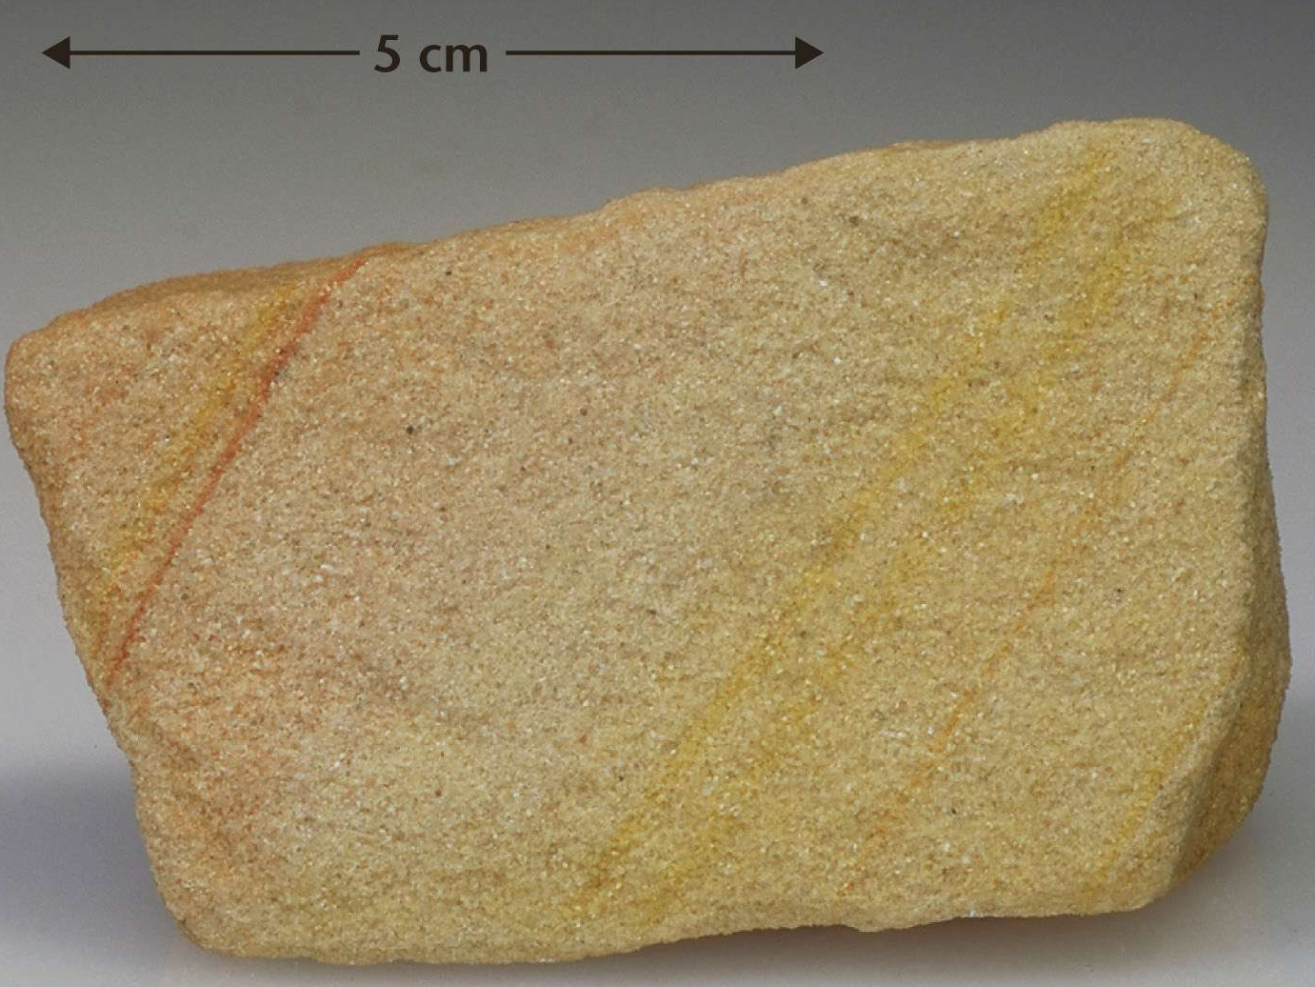
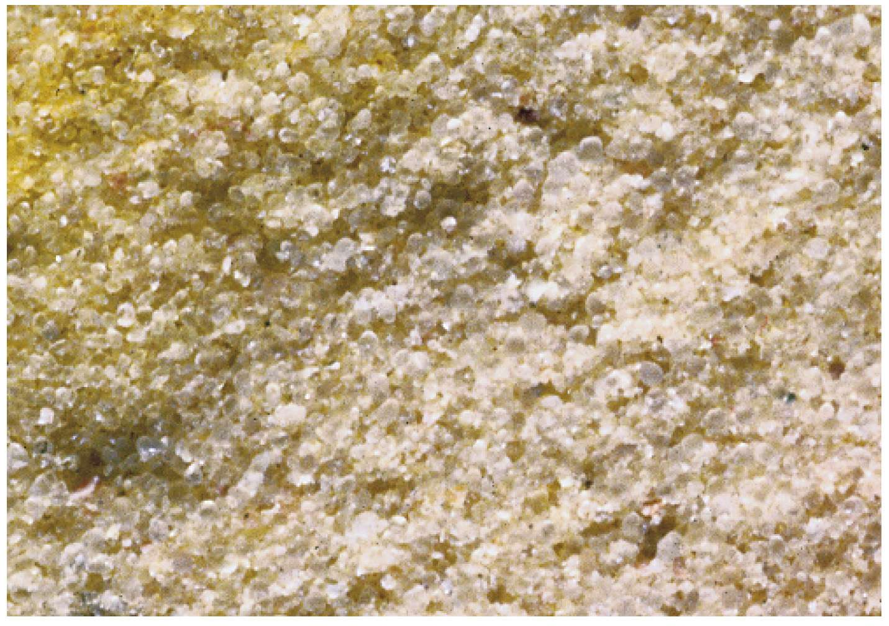
Major kinds of sandstones
  Quartz arenites (mainly quartz grains)

Slide 44
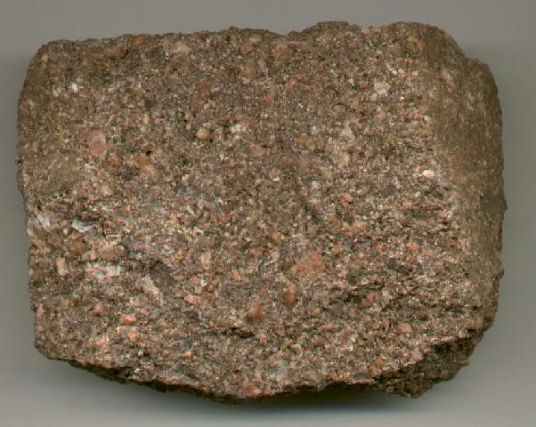
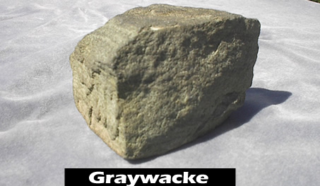
  Arkoses (quartz + feldspar grains)
  Lithic arenites (those that have small rock fragments)
    Graywacke (wacke)

Slide 45
Mud and mudrock
  Particles dominantly (<0.062)
  Silt and siltstone (0.062 - 0.004 mm)
  Clay and claystone (<0.004 mm)
  Weak to no currents

Slide 46
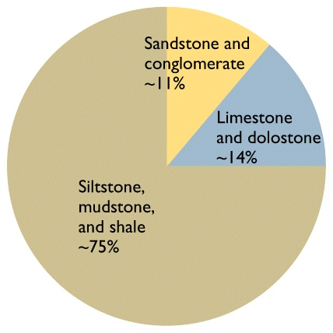

Slide 47
Chemical and biochemical
Precipitated from solution
  Formed at or near place of deposition
  Dominantly carbonates & evaporites
  Classified by chemical composition
Carbonates
  Limestone (CaCO₃)
  Dolostone (CaMg(CO₃)₂)

Slide 48
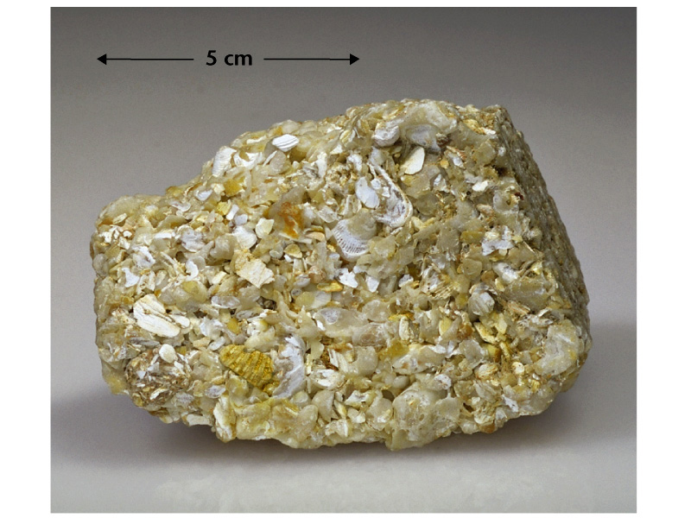

Slide 49
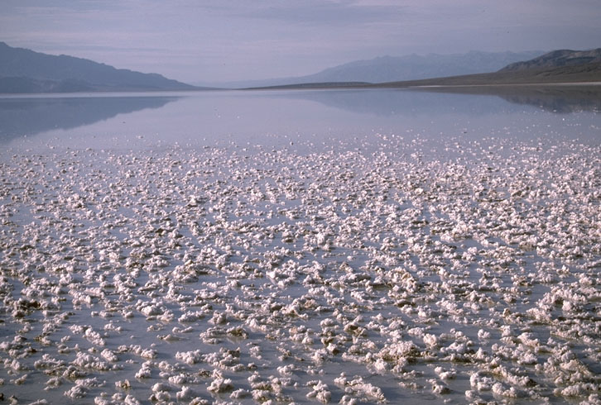
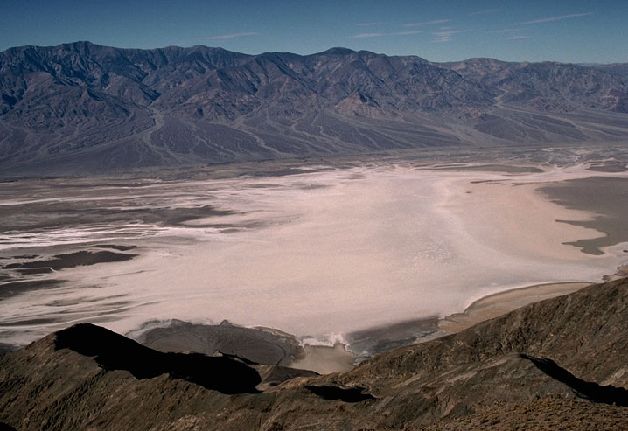
Evaporites
  Halite (NaCl)
  Gypsum (CaSO₄.2H₂O)

Slide 50
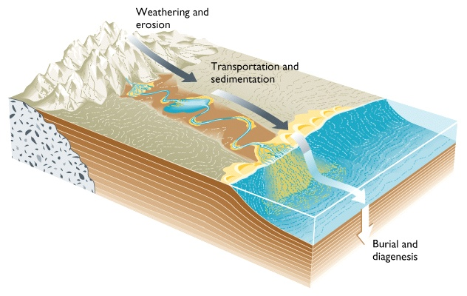
Transportation and deposition

Slide 51
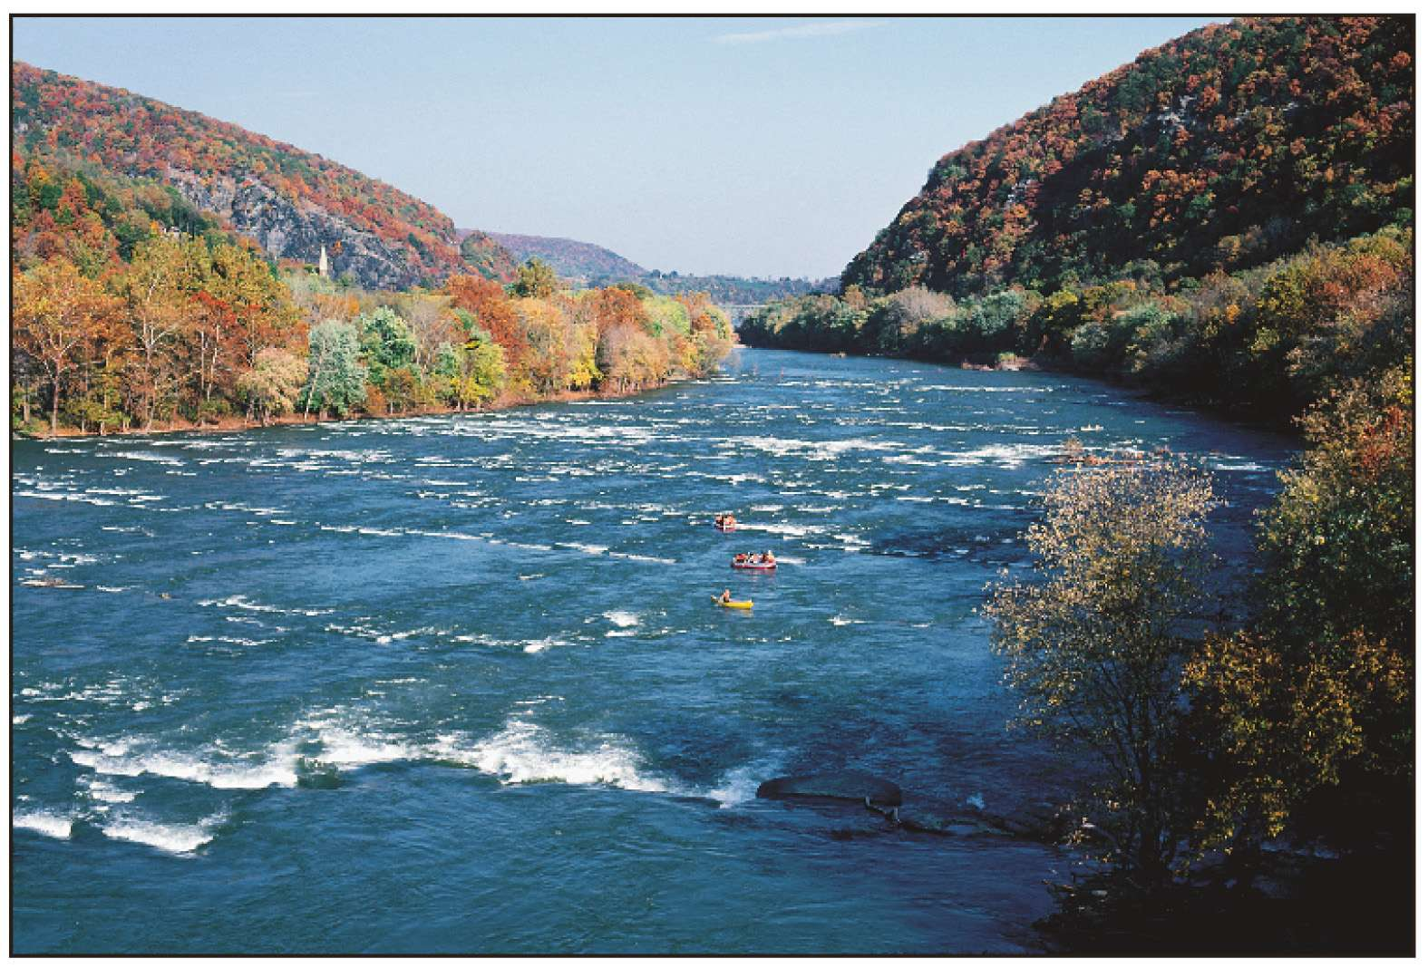
Currents
Air and water
The faster the current the larger the particles

Slide 52
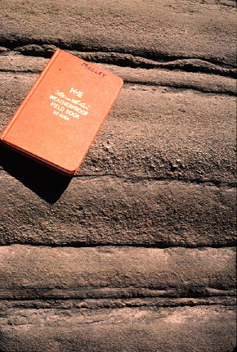
Settling velocity

Slide 53
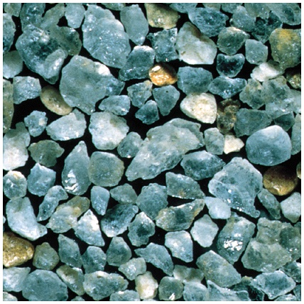
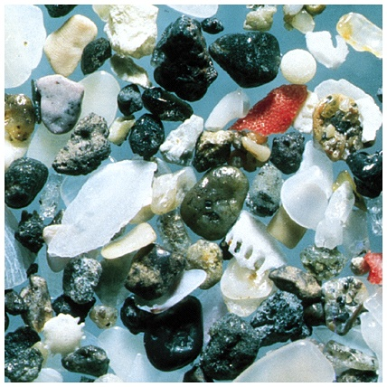
Sorting
Range in size of the particle sizes

Slide 54
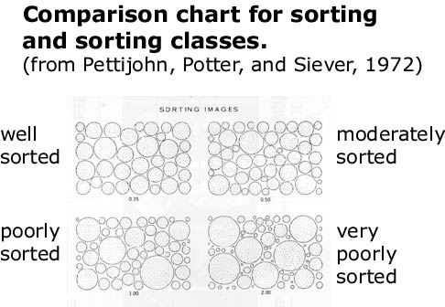

Slide 55
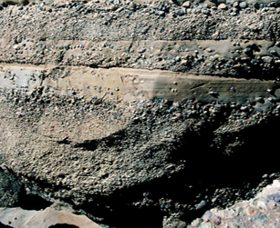
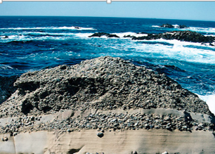

Slide 56
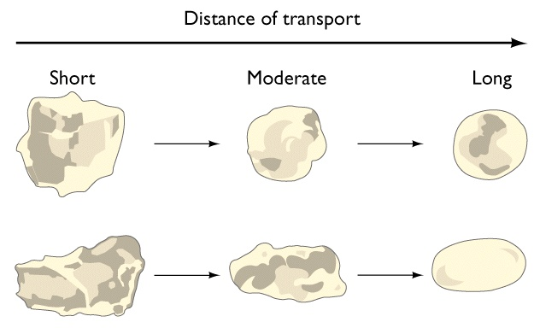
Rounding

Slide 57
Sedimentary Structures
Large-scale features of sedimentary rocks that
result from physical and/or chemical processes
Depositional
Erosional
Deformational
Chemical (diagenetic)

Slide 58
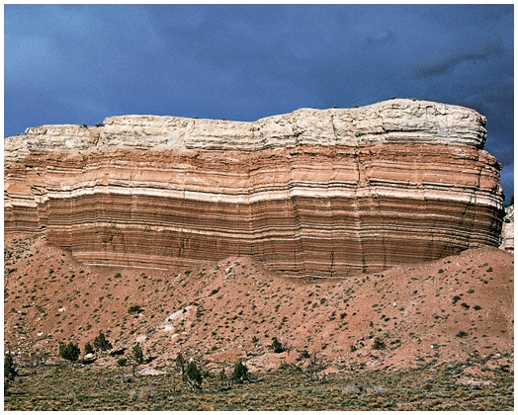
Depositional:
Stratification
  Bedding (> 1cm)
  Lamination (<1 cm)

Slide 59
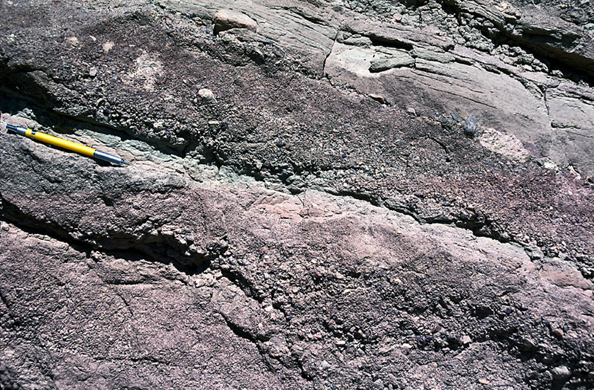
  Bedding

Slide 60
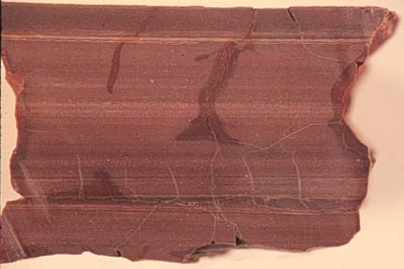
Laminated shale

Slide 61
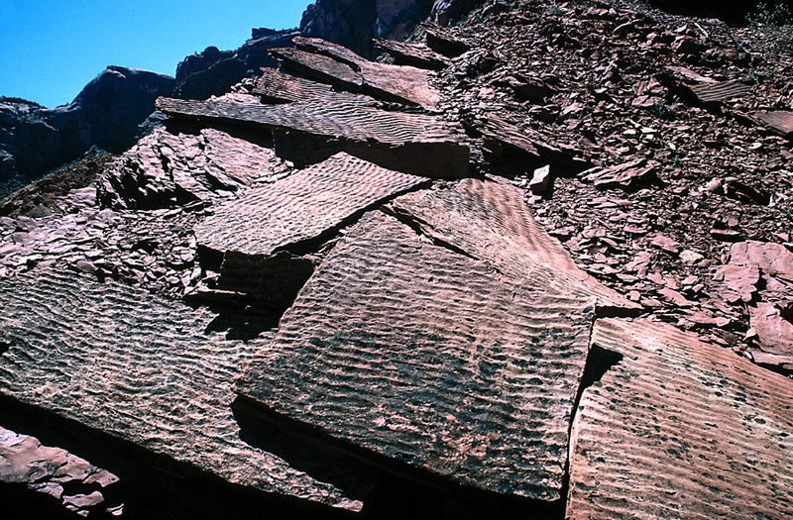
Ripple marks
Formed by currents:
Oscillatory (symmetrical)
Flowing (asymmetrical)

Slide 62
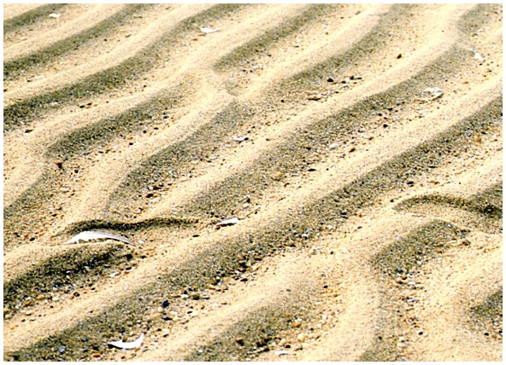
Symmetrical ripple marks

Slide 63
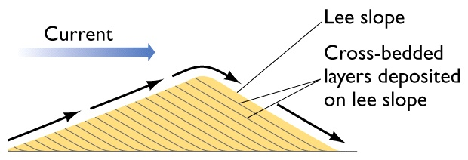
Current ripple marks and cross bedding

Slide 64
Depositional (Sedimentary) Environments
A geographic location characterized by a particular combination of geological processes and environmental conditions

Slide 65
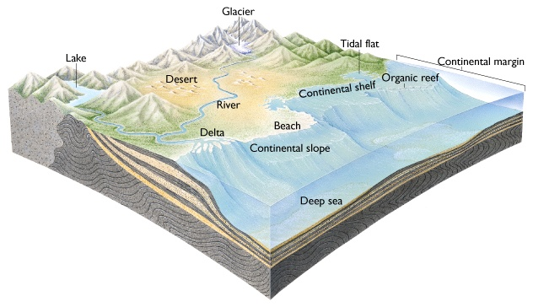

Slide 66
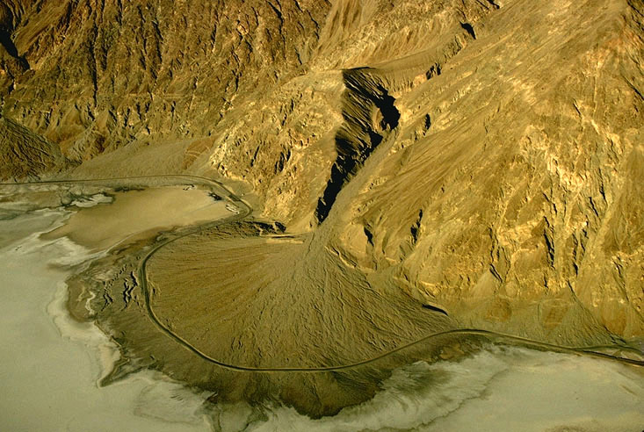
Fan

Slide 67
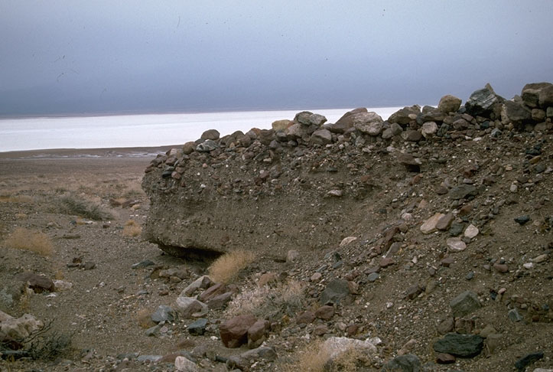

Slide 68
Diagenesis
All the changes sediment undergoes subsequent to deposition and prior to metamorphism
Physical (mechanical) diagenesis
  Fracturing
  Ductile deformation
  Grain rearrangement
Chemical diagenesis
  Mineral precipitation (cementation)
  Dissolution
    Grain
    Cement

Slide 69
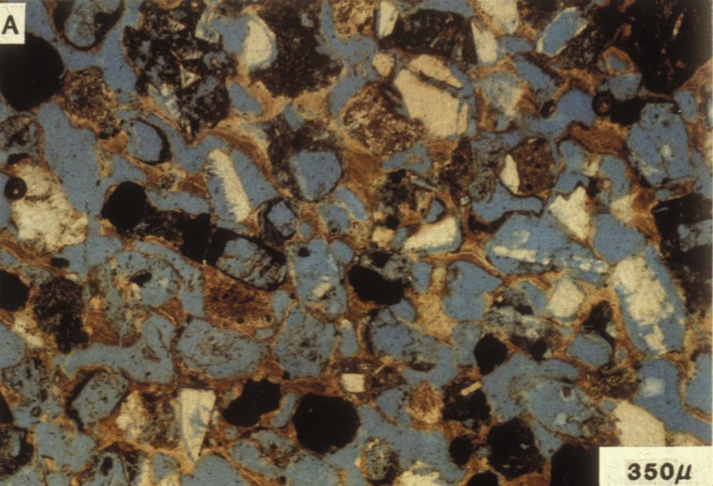

Slide 70
Lithification
The processes by which sediment is transformed into sedimentary rock

Slide 71
Metamorphic Rocks
Definitions
•
Metamorphic Rock
•
-
-
"Meta"= Change
(Grk)
-
-
"Morph"= form
(Grk)
-
a rock that has been changed
-
from its original form (
parent
) by
heat
,
pressure
, and
fluid activity
into a new rock
(Daughter)

Slide 72
Heat
Sources Include.....
Magma
temperature of magma
composition of magma
•
  Geothermal gradient
temperature increases with depth of burial
core of Earth is warmer than outer crust

Slide 73
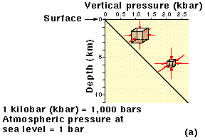

Uniform Pressure vs Directed Pressure
•
Lithostatic
•
-
"Lithos"= rock, static= unchanged (pressure)
-
-
-
uniform (non-directed)
-
-
equal intensity from all directions by rocks

Slide 74
Directed Pressure
one direction of squeezing is much stronger than the others
Minerals align themselves to reduce stress.

Slide 75
Types of Metamorphism
•
Contact
•
-
-
caused by igneous activity
•
Dynamic
•
-
-
cataclastic
-
-
associated with faults & earthquake zones
•
Regional
•
-
-
caused by tremendous pressures
associated with tectonic plate activity

Slide 76
Contact Metamorphism
•
Igneous Intrusions
•
-
-
size and type of magma important
>
>
mafic magma hotter than felsic
-
-
heat decreases away from magma
>
>
forms a zone of altered country rocks called
Aureoles

Slide 78

Dynamic Metamorphism
Dynamic Metamorphism
aka Cataclastic Metamorphism
•
aka Cataclastic Metamorphism
•
associated with Fault Zones
•
associated with Fault Zones
•
-
-
Places where the Earth's crust ruptured
Places where the Earth's crust ruptured
-
-
Rock pulverized
Rock pulverized
>
heat and pressure come from movement along the
>
heat and pressure come from movement along the
Fault
Fault
Mylonite
resultant rock is known as a
Mylonite
•
resultant rock is known as a
•

Slide 79
Regional Metamorphism
Regional Metamorphism
Most common form of metamorphism
•
Most common form of metamorphism
•
caused by large scale forces
•
caused by large scale forces
•
-
lithospheric plate collision
-
lithospheric plate collision
covers very large areas
•
covers very large areas
•
-
-
metamorphic belts or zones
metamorphic belts or zones
-
Zones are characterized by
Index Minerals
-
Zones are characterized by
Index Minerals
>
form under specific temperatures and pressures
>
form under specific temperatures and pressures
>
metamorphic facies
>
metamorphic facies
commonly associated with
•
commonly associated with
•
-
-
shields: stable areas of crystalline rocks
Shields and Mountains: areas of crystalline rocks

Slide 80
Metamorphic Textures
Metamorphic Textures
Foliated
•
Foliated
•
-
-
Folios = page or leaf-like
Folios = page or leaf-like
-
-
rock has distinct banding or layering
rock has distinct banding or layering
>
often not smooth like in sedimentary rocks
>
often not smooth like in sedimentary rocks
-
-
formed under directed pressure
formed under directed pressure
Non-foliated
•
Non-foliated
•
-
-
no distinct layering character
no distinct layering character
-
-
often a massive crystalline texture
often a massive crystalline texture
-
-
formed under uniform pressures
formed under uniform pressures

Slide 81

Foliated Texture
Foliated Texture

Slide 82
Foliated Textures
Foliated Textures
Slatey
•
Slatey
•
Schistose
•
Schistose
•
-
-
looks like blackboard
looks like blackboard
-
-
distinct bands of minerals
>
dull surface
>
dull surface
-
-
visible mineral grains
visible grains
-
-
smooth, thin layering
smooth, thin layering
>
garnets, staurolites
>
garnets, staurolites
-
-
breaks into flat slabs
breaks into flat slabs
-
-
may have shiny
may have shiny
>
referred to as slatey cleavage
>
referred to as slatey cleavage
appearance
-
-
no mineral grains visible
no mineral grains visible
>
due to mica minerals
>
due to mica minerals
Phyllitic
•
Phyllitic
Gneissic
•
•
Gneissic
•
-
-
looks like waxed surface
-
looks like waxed surface
-
larger grains
larger grains
>
has a "sheen" to it
>
has a "sheen" to it
-
-
may look like igneous rock
may look like igneous rock
-
-
may have little "waves" on
may have little "waves" on
-
-
may have crude banding
may have crude banding
surface
surface
>
intensely distorted
>
intensely distorted
>
referred to as
crenulations
>
referred to as
crenulations
-
-
different minerals than
different minerals than
-
-
some small grains visible
some small grains visible
schistose
schistose

Slide 83
Foliated MM Rocks
Foliated MM Rocks
phyllite
slate
phyllite
slate
gneiss
schist
gneiss
schist
MM Rocks that could form as a shale (sedimentary) parent rock is
MM Rocks that could form as a shale (sedimentary) parent rock is
exposed to increasing directed pressure and temperature
exposed to increasing directed pressure and temperature

Slide 84


Non-foliated Rocks
Non-foliated Rocks
•
Marble:
-
metamorphosed
limestone
Quartzite:
•
Quartzite:
•
-
-
metamorphosed
metamorphosed
quartz sandstone
quartz sandstone

Slide 85
Metamorphic Zones
Metamorphic Zones

Slide 86

Metamorphic Facies
Metamorphic Facies
distinctive metamorphic lithologies that occur in well
•
distinctive metamorphic lithologies that occur in well
•
defined areas and named after the key rocks found
defined areas and named after the key rocks found

Slide 87

Metamorphic Zones
Metamorphic Zones
•
Metamorphism is common along most plate boundaries like this.

