Slide 1
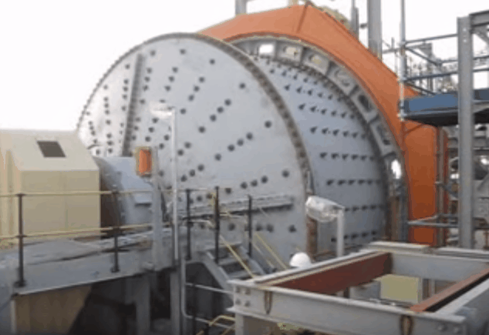
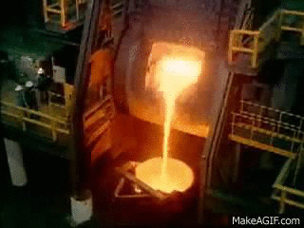

GMM 2110: Introduction to Geology, Mining and Metallurgical Engineering
By
Marthias SILWAMBA (PhD)
Metallurgical Engineering Department
Marthias.silwamba@unza.zm

Slide 2
Lecture 1
Introduction to metallurgy

Slide 3
Lecture of objective(s)
By the end of the lecture students are expected to
  Understand and know basic definitions of metallurgy and its branches

Slide 4

1.1. Introduction
Geologist
Mine Engineer
Metallurgical engineer
ore deposits are discovered & evaluated by the Geologist.
The Mining Engineer do the planning and extracts the minerals out of the ground etc.,
The Metallurgist concentrates, extracts or refines mined ores to pure metals & alloys, respectively. Its possible to also work in most chemical processing plants

Slide 5
1.2. Metallurgy
The term metallurgy has many definitions as below;
  The practice & science of extracting metals from their ores,
  The science that explains methods of refining and extracting metals from their ores and preparing them
  Refining of crude metals,
  Study production of alloys and their properties,
  Study of the alloy constitution, structure and properties,
  Study of the relationship of the physical and mechanical properties to thermal and mechanical treatment of metals & alloys, etc.

Slide 6
1.2. Metallurgy (cont.)
Metallurgy
Mineral Procesing
Extractive Metallurgy
Physical Metallurgy
Hydrometallurgy
Pyrometallurgy
Non-ferrous Pyro-metallurgy
Ferrous Pyro-metallurgy

Slide 7
1.2. Metallurgy (cont.)
Mineral Processing
  Main objective: Separation of ore minerals from gangue minerals without changing mineral compounds chemically.
Hydrometallurgy
  Main objective: Extraction of metals from their ores by processes involving solutions (aqueous solutions).
Non-ferrous Pyrometallurgy
  Main objective: Non-ferrous metal extraction from their ores by high-temperature processes (i.e., extraction of metal where heat is used to melt the charged materials).
Ferrous Metallurgy
  Iron extraction from iron ores by processes involving the effects of heat & the production of steel & alloys.
Physical Metallurgy
  Main objective: Production of alloys, study of the alloy constitution, structure & properties

Slide 8
1.3. Classification of metals
Metals can broadly classified as ferrous and non-ferrous metals.
Ferrous are iron and steel (Fe alloy where Fe is the principal alloying element) metals
Metals
Ferous
Non-ferrous
Iron
Steel
Aluminium
Titanium
Copper
Nickel
Cobalt
Zinc

Slide 9
1.3. Classification of metals (cont.)
Metallurgy is traditionally divided into two:
  Ferrous Metallurgy (deals with iron & steel)
  Non-ferrous metallurgy (deals with all other metals)
Classification of non-ferrous metals is based mainly on;
  Metal properties &
  Utilization
Examples of common classifications:
  Precious metals – Au, Ag, Pt-metals
  Noble metals – Above H₂ in electrochemical series ( they’ve a higher ‘standard reduction Eh’), e.g., Cu, Hg, precious metals
  Heavy metals – Cu, Pb, Zn, Sn, Ni
  Light metals – Al, Ti, Mg, Ca
  Base metals – Those that are used essentially on their own, e.g. Cu, Pb, Zn, Sn, Ni, Al.

Slide 10
1.3. Classification of metals (cont.)
  Alloying metals – Steel properties improvers: Ni, Cr, Co, Mn, Mo, W, V, etc.
  Reactive metals – Have high affinity to oxygen, i.e., They are very low in the electrochemical series (they have a very low std reduction Eh, i.e., a high oxidation Eh
Classifications overlap;
  E.g., Copper is a noble metal, heavy metal, base metal & a non-reactive metal.

Slide 11
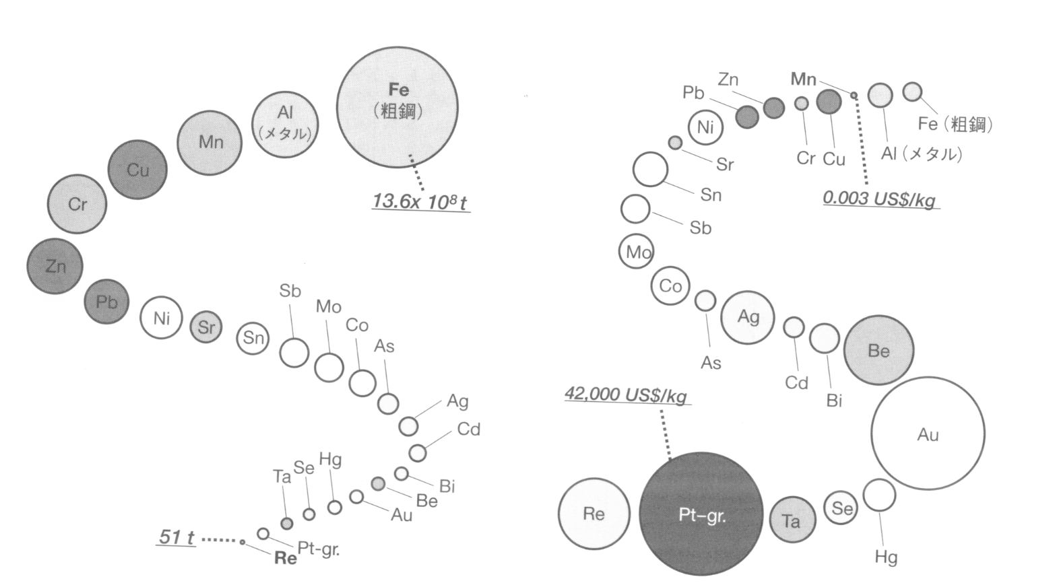
1.3. Classification of metals (cont.)
Iron (Fe) is the fourth most abundant element in the earth crust after oxygen, silicon and aluminum in that order.
Production
Market price

Slide 12
End of Lecture 1

