Slide 1
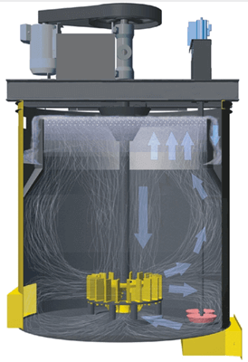
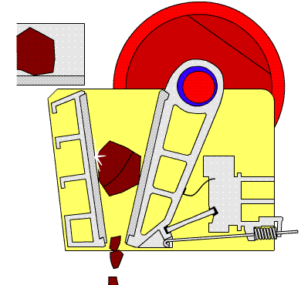


GMM 2110: Introduction to Geology, Mining and Metallurgical Engineering
By
Marthias SILWAMBA (PhD)
Metallurgical Engineering Department
Marthias.silwamba@unza.zm

Slide 2
Lecture 2
Introduction of Mineral Processing and comminution-crushing
MS© 2021

Slide 3
Lecture of objective(s)
By the end of the lecture students are expected to:-
Understand the main objective of mineral processing
Understand liberation of particles.
Know and understand crushing mechanisms.
Understand and describe different crushing circuits and crushing theories.
Know the types of crushers
MS© 2021

Slide 4
Lecture content
2.1. Introduction
2.2. Liberation
2.3. Crushing
2.4. Crushing mechanism
2.5. Types of crusher
2.6. Crushing equipment: Jaw crusher
2.7. Crushing equipment: Gyratory crusher
2.8. Crushing equipment: Cone crusher
2.9. Crushing equipment: Roll crusher
2.10. Crushing equipment: Impact/hammer crusher
2.11. Crushing stages and circuit
MS© 2021

Slide 5
Lecture content
2.1. Introduction
2.2. Liberation
2.3. Crushing
2.4. Crushing mechanism
2.5. Types of crusher
2.6. Crushing equipment: Jaw crusher
2.7. Crushing equipment: Gyratory crusher
2.8. Crushing equipment: Cone crusher
2.9. Crushing equipment: Roll crusher
2.10. Crushing equipment: Impact/hammer crusher
2.11. Crushing stages and circuit
MS© 2021

Slide 6
2.1. Introduction
Mineral is defined as naturally occurring inorganic solids consisting of one or more elements in specific proportions.
Ore (rock) is a naturally occurring aggregate or combination of one or more minerals.
Mineral processing ( also called mineral dressing/ore dressing/minerals engineering/mineral beneficiation/ore preparation) is the first treatment step after the mining of the ore.
Main objectives of mineral processing:
Separate (concentrate) valuable minerals from gangue minerals without
changing the mineral compounds chemically.
MS© 2021

Slide 7
2.1. Introduction (cont.)
Mineral processing involves three major steps
(i) liberation of a valuable mineral (mineral of interest) from gangue minerals,
(ii) classification, and
(iii) concentration.
To achieve this individual mineral grains must be liberated (freed from each other) by comminution (or size reduction) of the ore. Comminution involves coarse crushing followed by fine grinding.
Mineral separation produces an enriched concentrate containing most of the valuable minerals and disposable tailings containing most of the gangue.
MS© 2021

Slide 8
2.1. Introduction (cont.)
MINING
Run-of-mine (ROM) ore
COMMINUTION
Crushing (coarse)
Grinding (fine)
Liberation
Fresh water
CONCENTRATION
Use solely or combination of
Froth flotation
Gravity separation
Magnetic separation
Electrical separation
Mineral Processing
Concentrate (valauble minerals)
Tailings (gangue minerals)
Mineral separation
DEWATERING
Thickening
Filteration
Recycled water
THICKENING
CLARIFICATION
Concentrate to pyro/hydro-metallurgy
Tailings to dump
MS© 2021
Waste water

Slide 9
Lecture content
2.1. Introduction
2.2. Liberation
2.3. Crushing
2.4. Crushing mechanism
2.5. Types of crusher
2.6. Crushing equipment: Jaw crusher
2.7. Crushing equipment: Gyratory crusher
2.8. Crushing equipment: Cone crusher
2.9. Crushing equipment: Roll crusher
2.10. Crushing equipment: Impact/hammer crusher
2.11. Crushing stages and circuit
MS© 2021

Slide 10

2.2. Liberation
In order to be able to separate valuable minerals in mined ores (concentration) from gangue minerals, the individual mineral particles have to be liberated.
Concentrate
Comminution
Crushing/grinding
Valuables mineral
Separation (concentration)
Non-valuables
(gangue minerals)
Liberated minerals
(i.e., valuable mineral particles are liberated from gangue mineral particles)
Tailings
MS© 2021

Slide 11
2.2. Liberation (cont.)
Liberation of valuable mineral from the gangue minerals is achieved by size reduction of mined ore (breaking down ore particles-comminution).
The degree of size-reduction required is different for a given mined ore.
It is determined mainly by the characteristics of the ore (interlocking, dissemination) and by economic considerations (comparing the cost of further size-reduction to the additional recovery that can be achieved).
As stated earlier, the objective of mineral processing, regardless of the methods used, is always the same, i.e., to separate the minerals into two or more products with the values in the concentrates, the gangue in the tailings, and the “locked” particles in the middlings.
MS© 2021

Slide 12
2.2. Liberation (cont.)
Valuable mineral
Liberated particles
(valuable minerals)
Crushing
Unliberated particles
Ore
Non-valuable mineral
Unliberated particles: middling, locked particles
Liberated particles (waste rocks)
MS© 2021

Slide 13
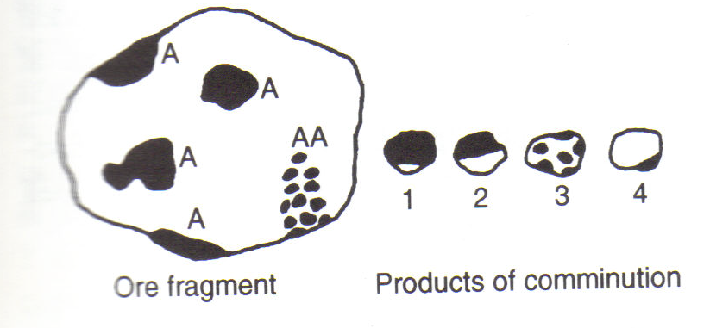
2.2. Liberation (cont.)
Lets consider the following case
Regions A represent valuable mineral, and region AA is rich in valuable mineral, but is highly intergrown with gangue mineral.
Comminution produces a range of fragments, ranging from fully liberated mineral and gangue particles, to those illustrated.
MS© 2021

Slide 14
2.2. Liberation (cont.)
Liberation (cont.)
Particles of type 1 are rich in valuable minerals and are graded as concentrate as they have an acceptable degree of locking with gangue, which limits the concentrate grade.
Particles of type 2 and 3, however, would probably be classed as middlings, although the degree of regrinding needed to promote economic liberation of mineral from particle 3 would be greater than in particle 2.
Particles of type 4 would likewise be classed as tailings, the small amount of mineral represents reducing the recovery of the valuable minerals into concentrate.
MS© 2021

Slide 15
Lecture content
2.1. Introduction
2.2. Liberation
2.3. Crushing
2.4. Crushing mechanism
2.5. Types of crusher
2.6. Crushing equipment: Jaw crusher
2.7. Crushing equipment: Gyratory crusher
2.8. Crushing equipment: Cone crusher
2.9. Crushing equipment: Roll crusher
2.10. Crushing equipment: Impact/hammer crusher
2.11. Crushing stages and circuit
MS© 2021

Slide 16
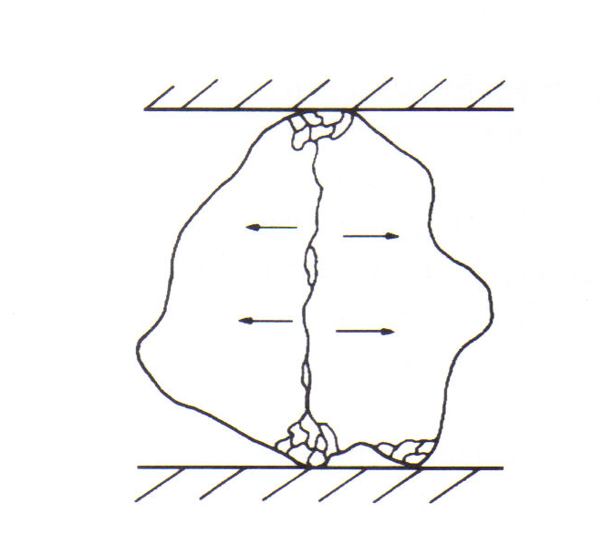
2.3. Crushing
Crushing is defined as the operations, required to reduce run-of-mine ore to the size, suitable for handling and feeding grinding mills.
Ore fracture by crushing
MS© 2021

Slide 17
2.3. Crushing (cont.)
Crushing operations are normally carried out in stages as shown below
Stage Size particle size range
1. Primary coarse from R.O.M to 15 cm
2. Secondary Intermediate 15 cm to 2.5–5 cm
3. Tertiary Fine 5 cm to 1–0.5 cm
MS© 2021

Slide 18
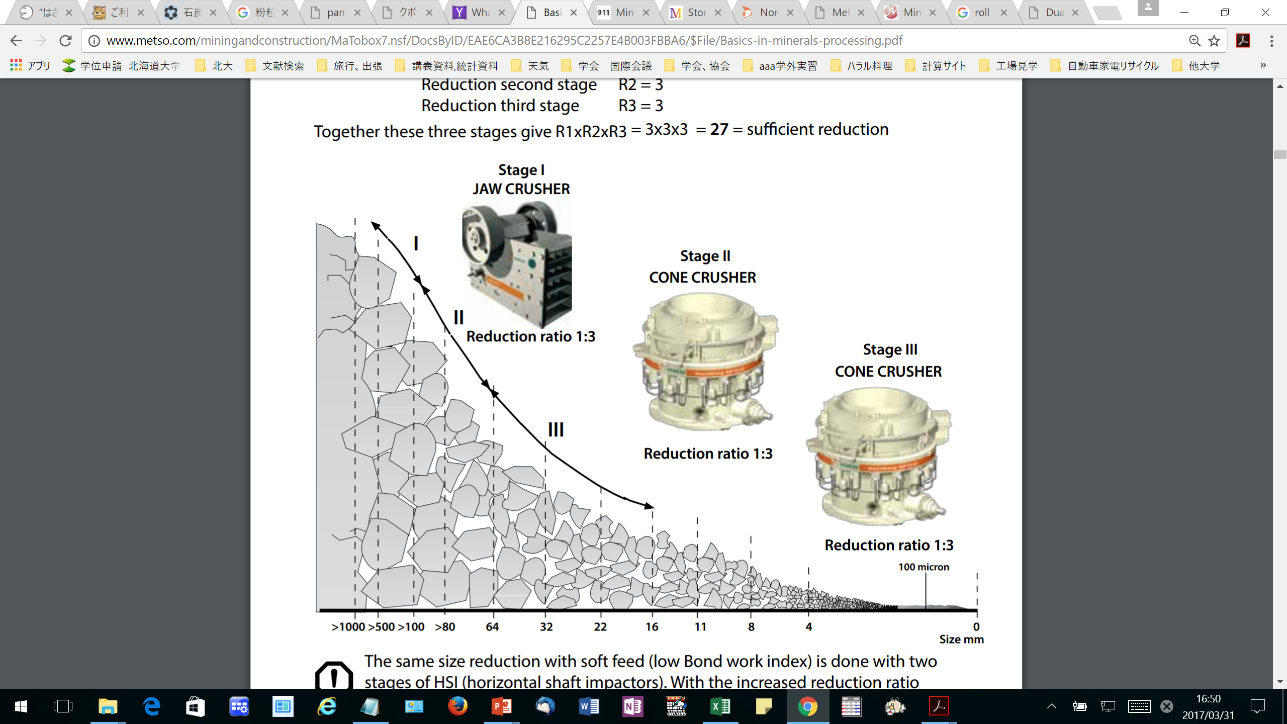
2.3. Crushing (cont.)
Crushing operations are normally carried out
MS© 2021
http://www.metso.com/miningandconstruction/MaTobox7.nsf/DocsByID/EAE6CA3B8E216295C2257E4B003FBBA6/$File/Basics-in-minerals-processing.pdf

Slide 19
Lecture content
2.1. Introduction
2.2. Liberation
2.3. Crushing
2.4. Crushing mechanism
2.5. Types of crusher
2.6. Crushing equipment: Jaw crusher
2.7. Crushing equipment: Gyratory crusher
2.8. Crushing equipment: Cone crusher
2.9. Crushing equipment: Roll crusher
2.10. Crushing equipment: Impact/hammer crusher
2.11. Crushing stages and circuit
MS© 2021

Slide 20
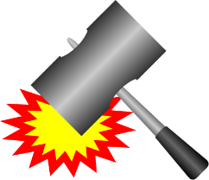
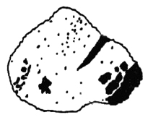
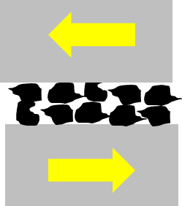
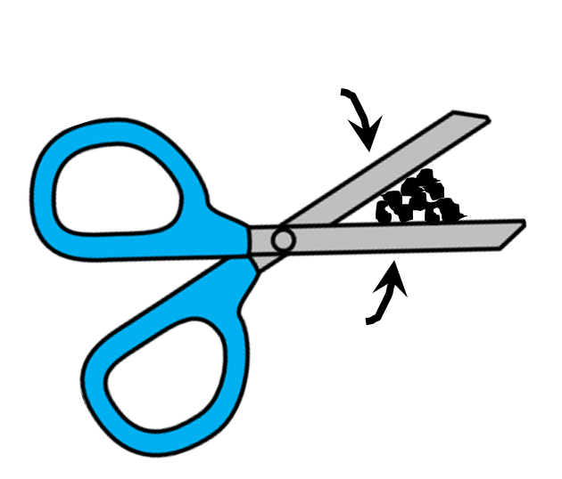
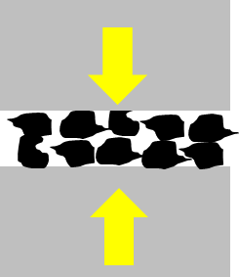
2.4. Crushing mechanism
Crushing mechanism
Impact, refers to the sharp, instantaneous collision of one moving object against another
Attrition, is a term applied to the reduction of materials by scrubbing it between two hard surfaces.
Shear, consists of a trimming or cleaving action rather than the rubbing action associated with attrition.
Compression, gradual application of forces at the two opposite sides of an object.
MS© 2021

Slide 21
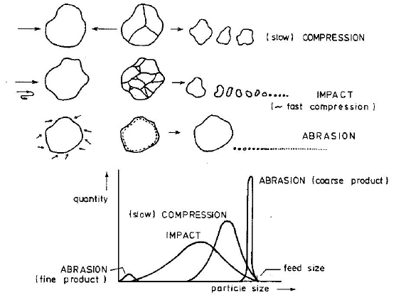
2.4. Crushing mechanism (cont.)
Different sizes from different crushing mechanism
MS© 2021

Slide 22
Lecture content
2.1. Introduction
2.2. Liberation
2.3. Crushing
2.4. Crushing mechanism
2.5. Types of crusher
2.6. Crushing equipment: Jaw crusher
2.7. Crushing equipment: Gyratory crusher
2.8. Crushing equipment: Cone crusher
2.9. Crushing equipment: Roll crusher
2.10. Crushing equipment: Impact/hammer crusher
2.11. Crushing stages and circuit
MS© 2021

Slide 23
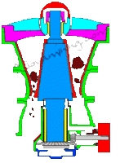
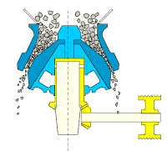
2.5. Type of crushers
Types of crushers
(1) Jaw crusher
(2) Gyratory Crusher
(3) Cone Crusher
MS© 2021
Primary Crusher
Secondary Crusher

Slide 24
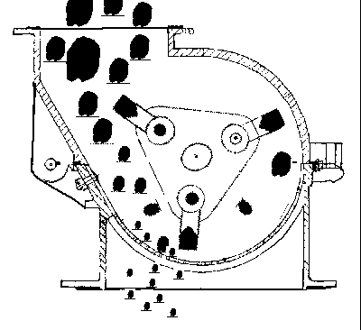
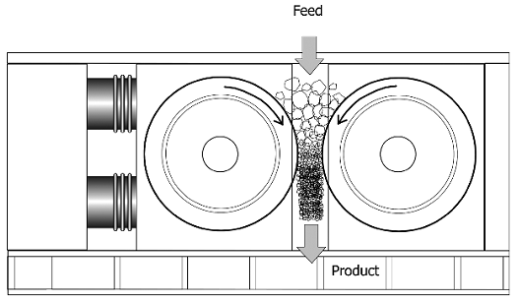
2.5. Type of crusher and crushing mechanism (cont.)
Types of crushers (cont.)
(4) Impact (5) High Pressure Grinding Roll
MS© 2021
Secondary/tertiary Crusher

Slide 25
Lecture content
2.1. Introduction
2.2. Liberation
2.3. Crushing
2.4. Crushing mechanism
2.5. Types of crusher
2.6. Crushing equipment: Jaw crusher
2.7. Crushing equipment: Gyratory crusher
2.8. Crushing equipment: Cone crusher
2.9. Crushing equipment: Roll crusher
2.10. Crushing equipment: Impact/hammer crusher
2.11. Crushing stages and circuit
MS© 2021

Slide 26
2.6. Crushing equipment: Jaw crusher
The general principle of the most commonly used jaw crusher (Blake-type or double-toggle jaw crusher) is as follows:
  The crusher consists essentially of two crushing surfaces set at a small angle convergent downward.
  The one surface is fixed to the main frame, the other is moveable and is caused to approach and recede from the fixed surface alternately.
  This movement is caused by the action of the toggle-plates and the pitman, actuated by the eccentric.
  In the Blake crusher, the moveable jaw is pivoted on a shaft at the top of the crusher. The jaws are protected by replaceable jaw plates.
MS© 2021

Slide 27
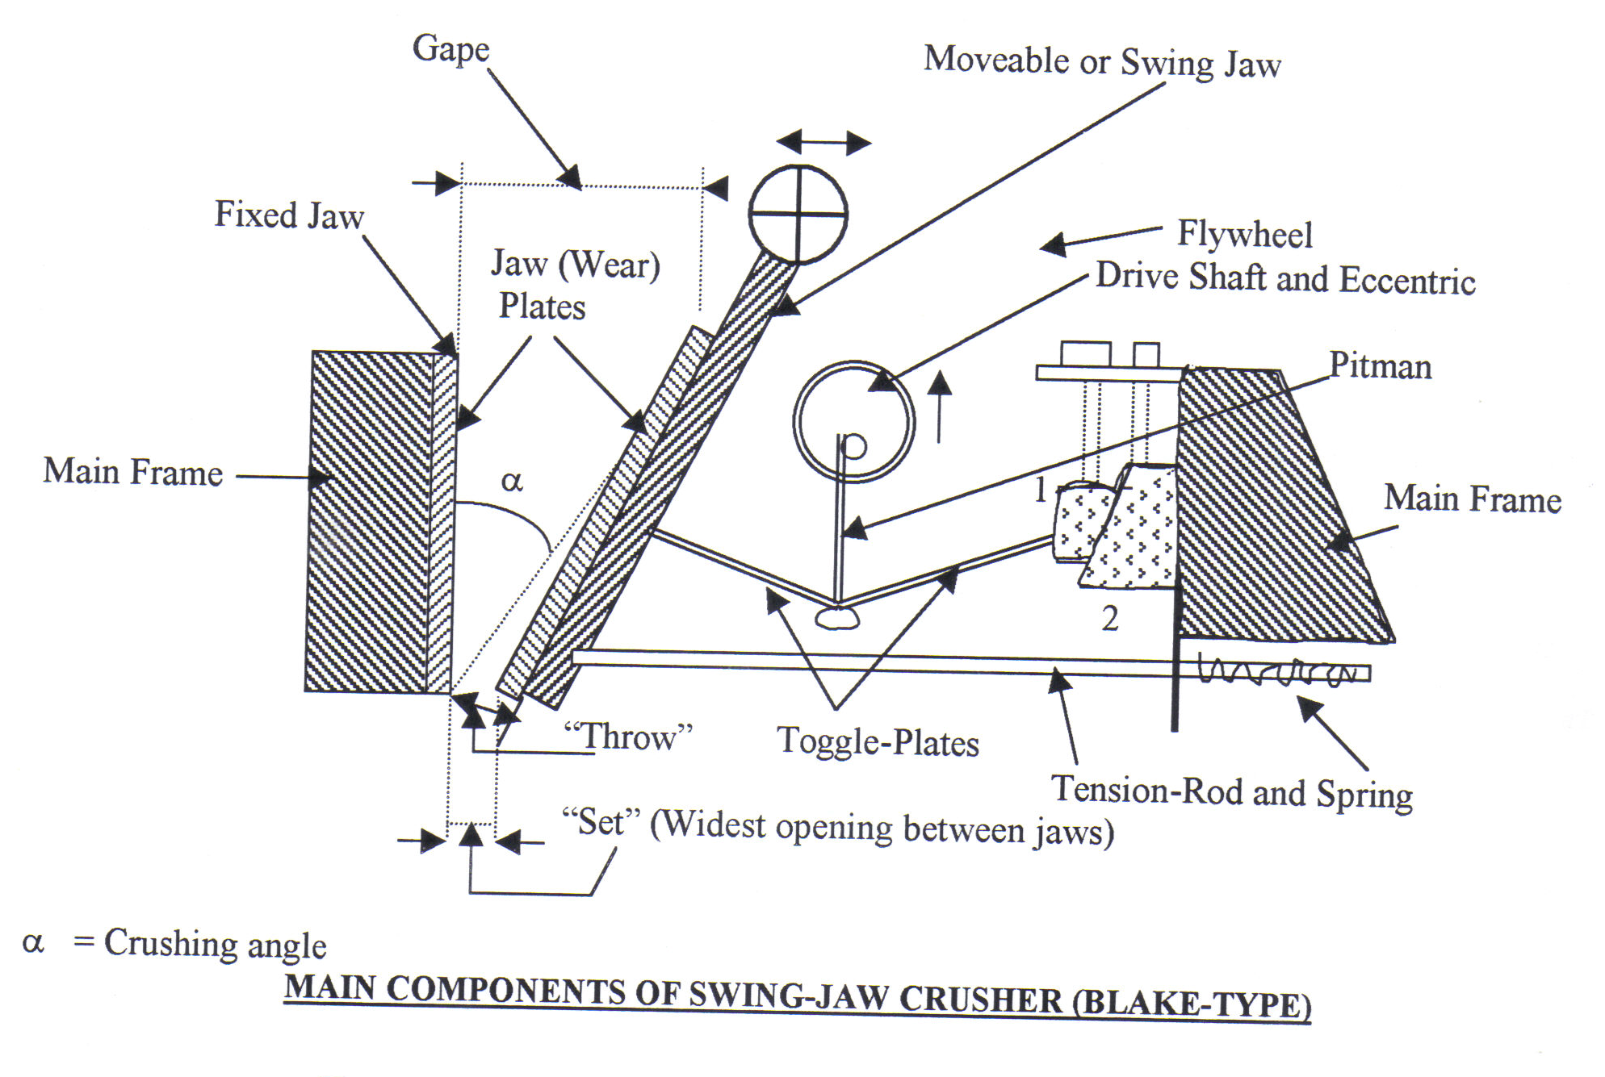
2.6. Crushing equipment: Jaw crusher (cont.)
Jaw crusher
The “set” of this crusher is the maximum opening between the jaws at the discharge point. It is the maximum size (in one dimension) that a particle should have when it leaves the crushing zone.
The gape indicates the maximum size of the rocks that can be accepted as feed to the crusher
MS© 2021

Slide 28
Lecture content
2.1. Introduction
2.2. Liberation
2.3. Crushing
2.4. Crushing mechanism
2.5. Types of crusher
2.6. Crushing equipment: Jaw crusher
2.7. Crushing equipment: Gyratory crusher
2.8. Crushing equipment: Cone crusher
2.9. Crushing equipment: Roll crusher
2.10. Crushing equipment: Impact/hammer crusher
2.11. Crushing stages and circuit
MS© 2021

Slide 29
2.7. Crushing equipment: Gyratory crusher
The suspended-spindle type is the most commonly used gyratory crusher. Its general principle is as follows:
  A conical breaking head is suspended on a spindle (the main shaft) from a two-armed “spider”, mounted on the main frame.
  The main frame consists of an upper and lower shell.
  The upper shell is an inverted conic frustrum with concave liners.
  The head is given an eccentric gyration by an eccentric sleeve, which is rotated by a bevel gear and pinion, driven by a countershaft, which is coupled to the drive.
  The gyrating head and the stationary concave are the crushing media. Just as concave liners protect the shell, the head is protected by a wear-resistant mantle.
MS© 2021

Slide 30
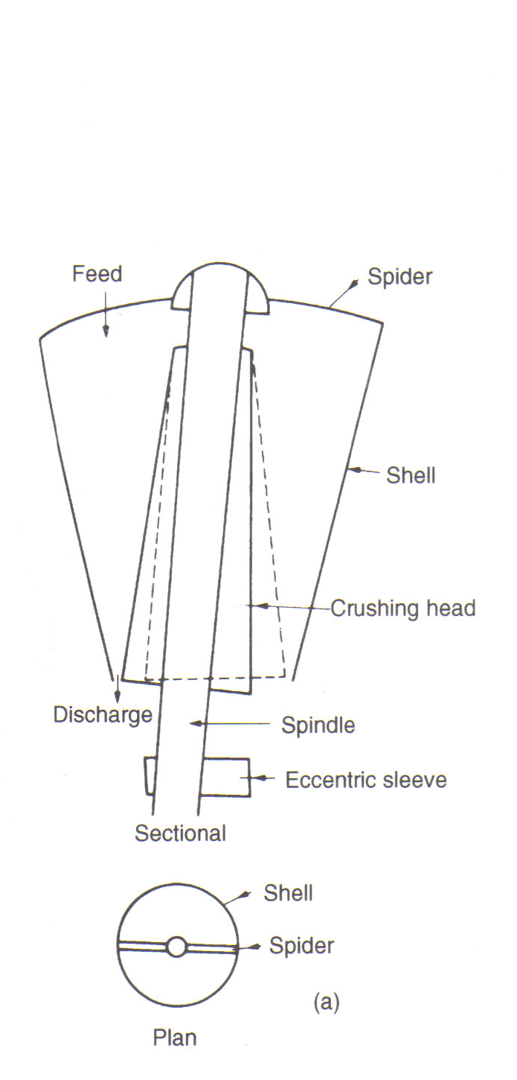
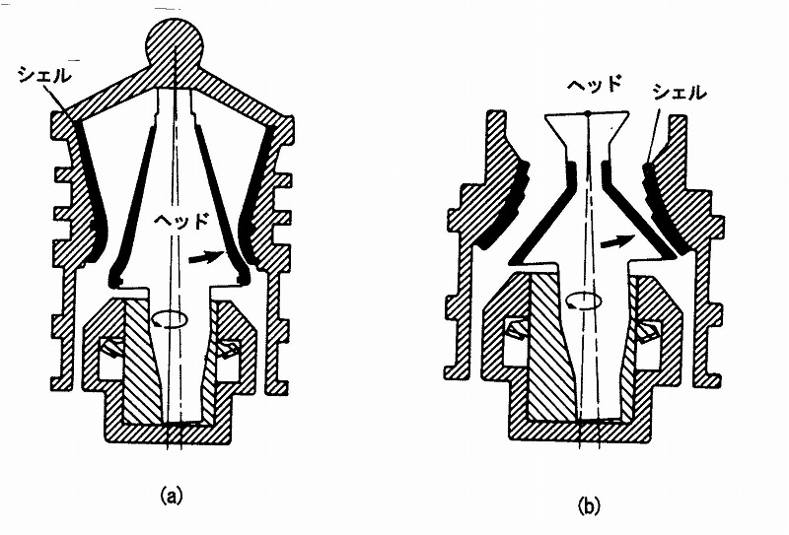
2.7. Crushing equipment: Gyratory crusher (cont.)
Gyratory crusher (cont.)
MS© 2021

Slide 31
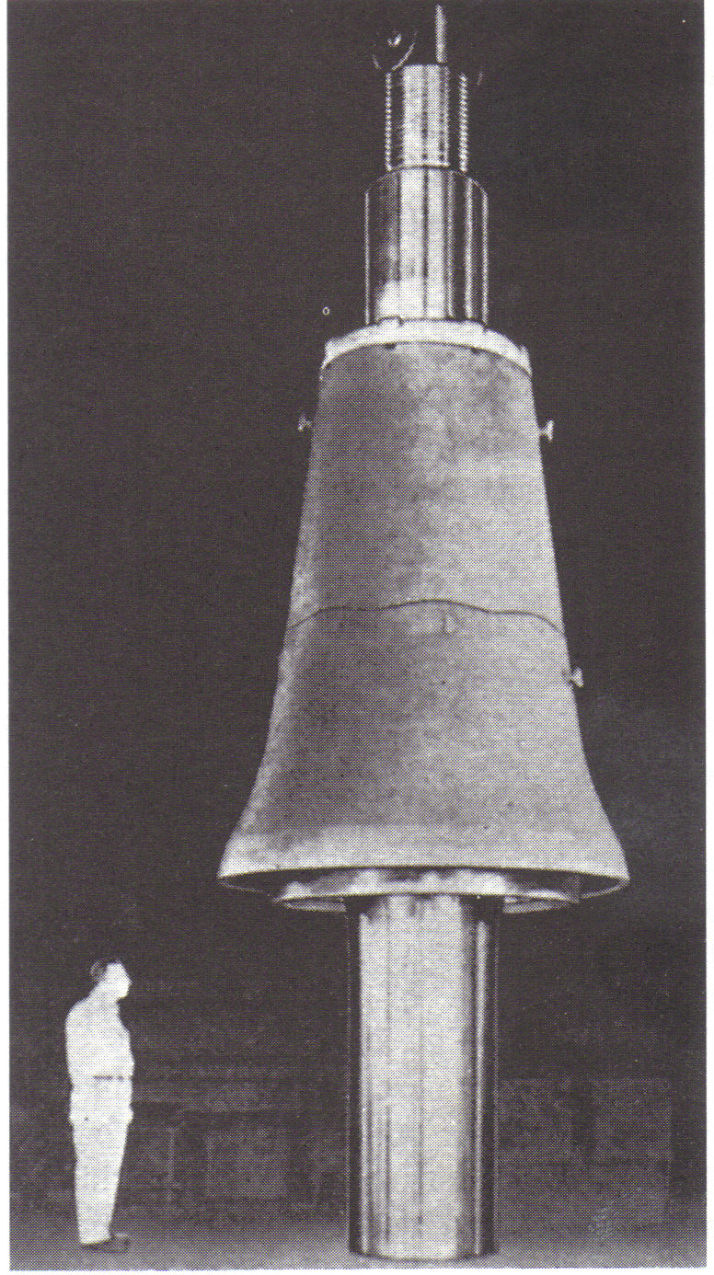
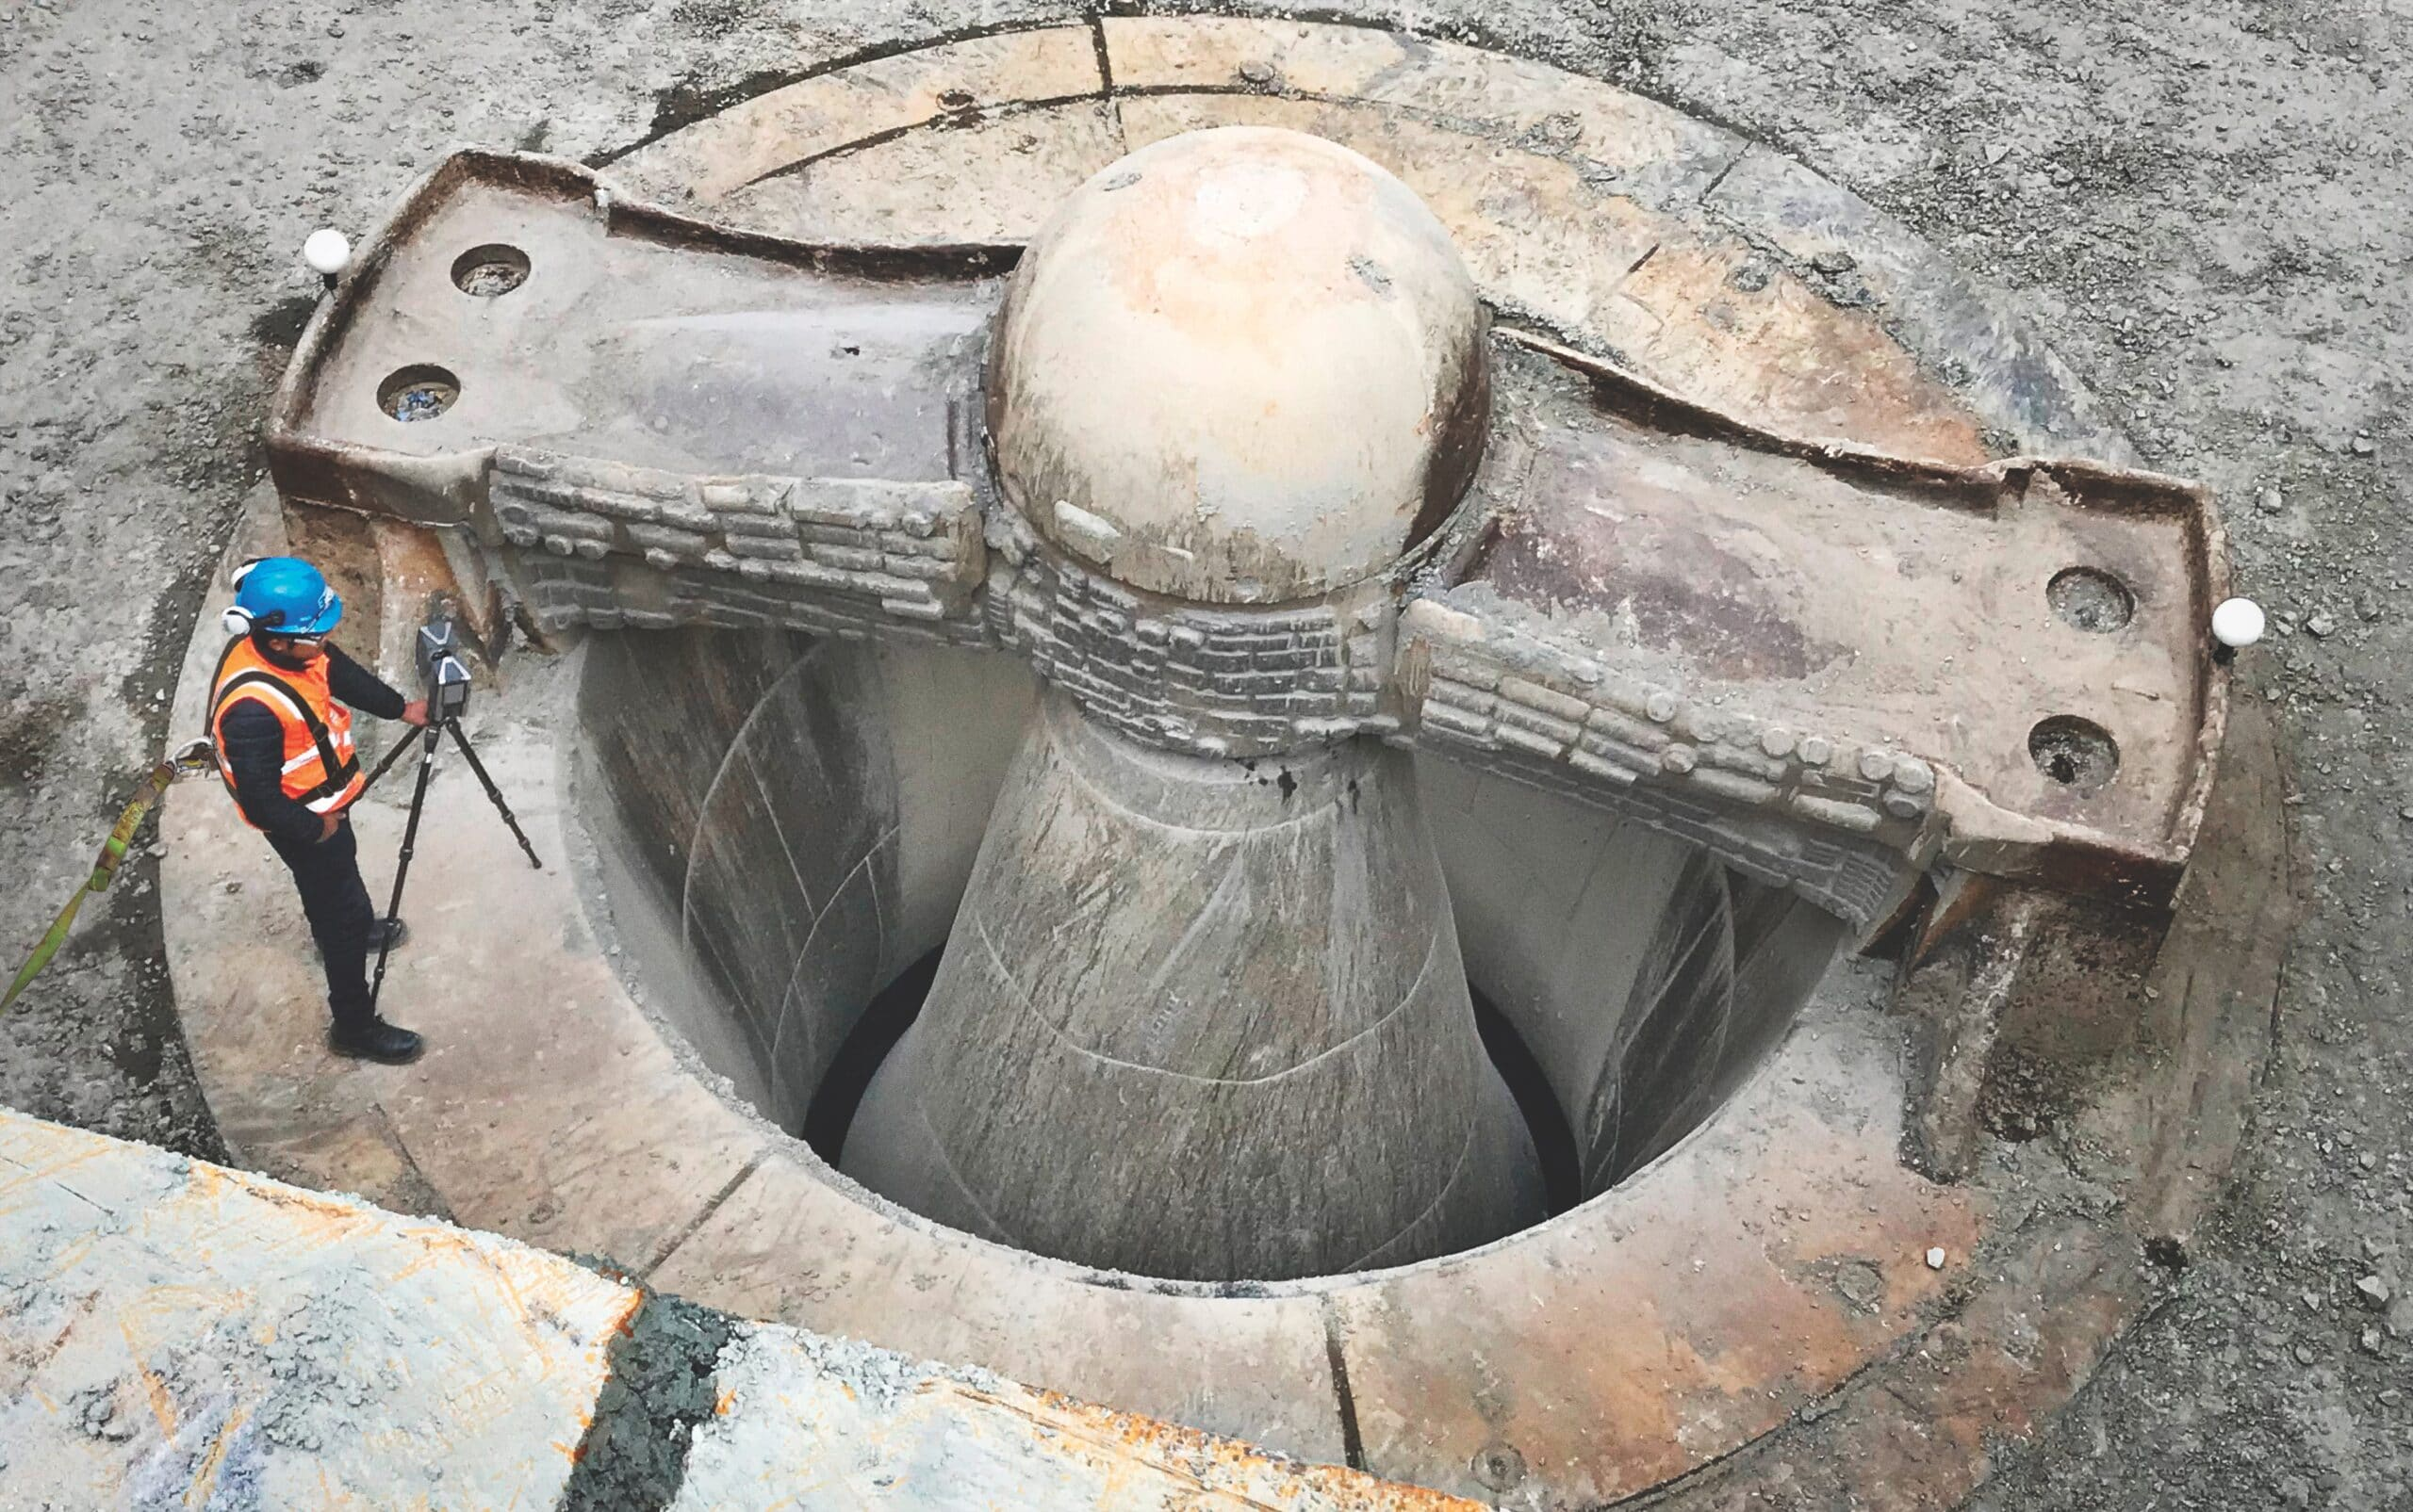
2.7. Crushing equipment: Gyratory crusher (cont.)
MS© 2021

Slide 32
Lecture content
2.1. Introduction
2.2. Liberation
2.3. Crushing
2.4. Crushing mechanism
2.5. Types of crusher
2.6. Crushing equipment: Jaw crusher
2.7. Crushing equipment: Gyratory crusher
2.8. Crushing equipment: Cone crusher
2.9. Crushing equipment: Roll crusher
2.10. Crushing equipment: Impact/hammer crusher
2.11. Crushing stages and circuit
MS© 2021

Slide 33
2.8. Crushing equipment: Cone crusher
The crushing mechanism of the cone crusher is similar to gyratory crushers.
The difference is between gyratory and cone crusher is that the latter has shorter head, receives finer feed and produces finer products.
Shell
Head
Shell
Gyratory Crusher
Cone Crusher
Head
Head
150-–800mm ⇒25–250mm
25–250mm ⇒ 5–40mm
MS© 2021

Slide 34
Lecture content
2.1. Introduction
2.2. Liberation
2.3. Crushing
2.4. Crushing mechanism
2.5. Types of crusher
2.6. Crushing equipment: Jaw crusher
2.7. Crushing equipment: Gyratory crusher
2.8. Crushing equipment: Cone crusher
2.9. Crushing equipment: Roll crusher
2.10. Crushing equipment: Impact/hammer crusher
2.11. Crushing stages and circuit
MS© 2021

Slide 35
2.9. Crushing equipment: Roll crusher
Crushing rolls consist essentially of two horizontally mounted cylinders, which are rotated in opposite directions, inward and downward.
The feed should be nipped between the approaching roll faces and be drawn down between the rolls.
In all modern roll crushers, one of the rolls is rigidly mounted and the other spring-loaded, as a protection against damage caused by the passage of an uncrushable object (tramp iron).
The distance (“set”) between the rolls is determined by the number of spacers between the moveable roll and the solidly mounted roll.
Adjustment of the set and compensation for wear can be made by changing the number of spacers.
MS© 2021

Slide 36
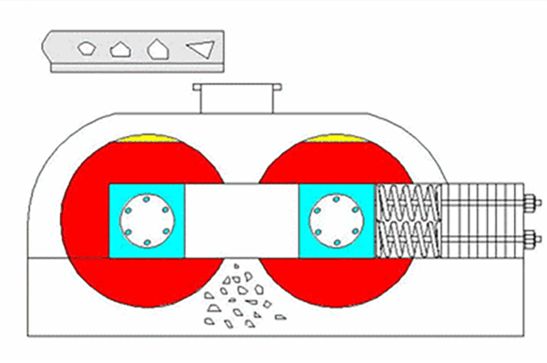
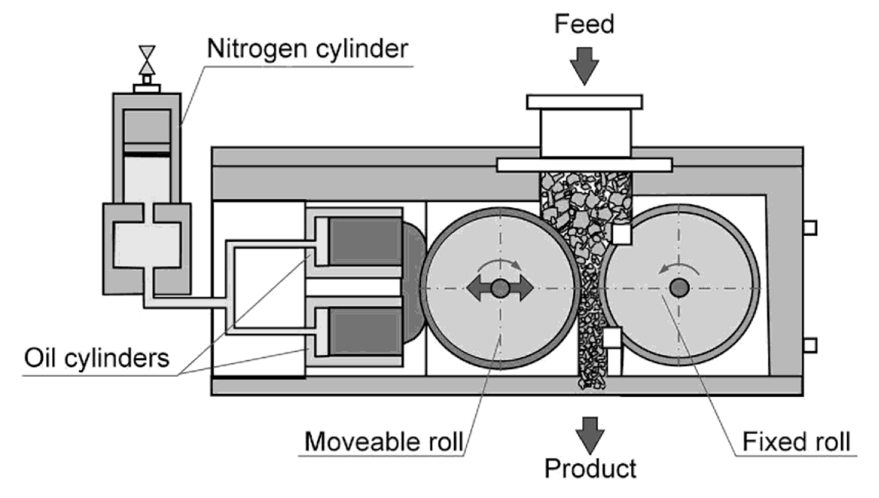
2.9. Crushing equipment: Roll crusher (cont.)
MS© 2021

Slide 37
2.9. Crushing equipment: Roll crusher (cont.)
The diameter of the rolls should be large in comparison with the feed size and therefore crushing rolls are limited to fine crushing only and the speed of rotation is relatively low (80-120 rev min⁻¹).
Higher speeds become dangerous, in particular with large, heavy rolls. Crushing rolls are generally superseded by shorthead cone crushers and rod mills, but still find application in smaller plants and laboratories.
Because of their uneven product size, crushing rolls are usually operated in closed circuit with a screen.
The circulating load is normally high (up to 600 %). To avoid production of too much fines, “graded crushing” can be practised.
MS© 2021

Slide 38
Lecture content
2.1. Introduction
2.2. Liberation
2.3. Crushing
2.4. Crushing mechanism
2.5. Types of crusher
2.6. Crushing equipment: Jaw crusher
2.7. Crushing equipment: Gyratory crusher
2.8. Crushing equipment: Cone crusher
2.9. Crushing equipment: Roll crusher
2.10. Crushing equipment: Impact/hammer crusher
2.11. Crushing stages and circuit
MS© 2021

Slide 39
2.10. Crushing equipment: Impact/hammer crusher
Hammer mills (impact crushers) reduce from a large size to very fine in one operation.
A great many forms exist, but the common principle is that a set of beaters (flailing hammers) spins round inside a stationary casing, with a large grid at the bottom as discharge. The size of the openings in the grid determines the product size. The crushing forces are applied instantaneously. The rock particles are broken either by impact from the hammers or by impact against the casing or against other particles.
Hammer mills are best suitable for rather soft and friable material, because they wear rapidly. They are used in particular on clayey ores, that would clog reciprocating (i.e. with a to-and-fro movement of the crushing media) crushers as jaw crushers and particularly gyratory and cone crushers.
MS© 2021

Slide 40
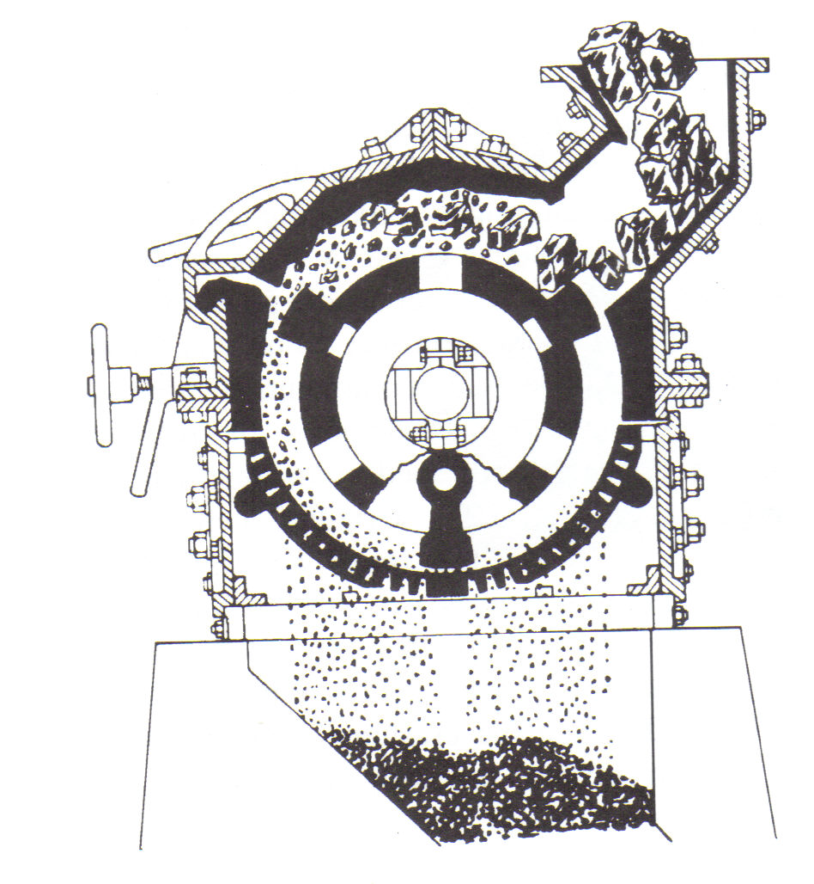
2.10. Crushing equipment: Impact/hammer crusher (cont.)
MS© 2021

Slide 41
Lecture content
2.1. Introduction
2.2. Liberation
2.3. Crushing
2.4. Crushing mechanism
2.5. Types of crusher
2.6. Crushing equipment: Jaw crusher
2.7. Crushing equipment: Gyratory crusher
2.8. Crushing equipment: Cone crusher
2.9. Crushing equipment: Roll crusher
2.10. Crushing equipment: Impact/hammer crusher
2.11. Crushing stages and circuit
MS© 2021

Slide 42
2.11. Crushing stages and circuit
The efficiency of a crusher is greater when the reduction ratio is smaller; hence more crushing stages are desirable.
However, when the throughput is small, the equipment will be under-utilised and in such a case the installation of additional equipment for more crushing steps is not justified.
Therefore, we often find only two crushing stages and one grinding stage in small plants, while only large plants can afford to have three crushing stages.
In most cases, the operating stages are run in closed circuit, i.e. the product is sized (on a screen or other sizing device), wherefore the portion, which is sufficiently fine (the “undersize”) passes on to the next stage and the “oversize”, which is still too coarse, is returned to the breaker.
MS© 2021

Slide 43
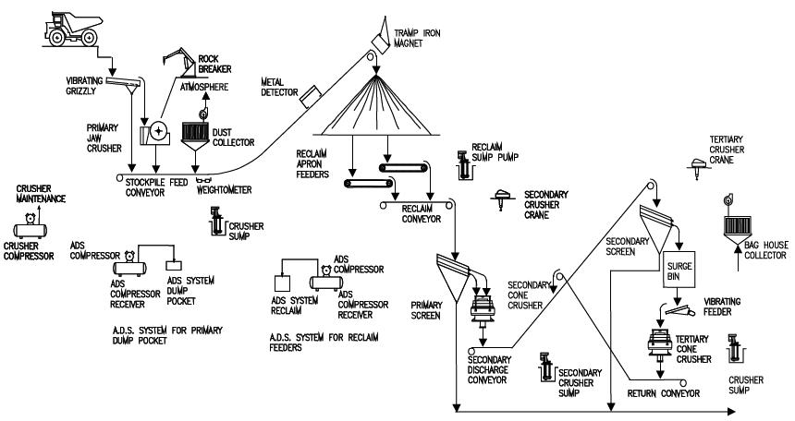
2.11. Crushing stages and circuit (cont.)
Primary
Jaw crusher
Seconday
Cone/gyratory crusher
Tertiary
Cone crusher
MS© 2021

Slide 44
2.11. Crushing stages and circuit (cont.)
Typical crushing stages: open circuit
Feed, ROM
Primary crusher
Double deck screen
Secondary crusher
Open circuit
Next stage
Product
MS© 2021

Slide 45
2.11. Crushing stages and circuit (cont.)
Typical crushing stages: closed circuit
Feed
Primary crusher
Double deck screen
Closed circuit
Secondary crusher
Next stage
Product
MS© 2021

Slide 46
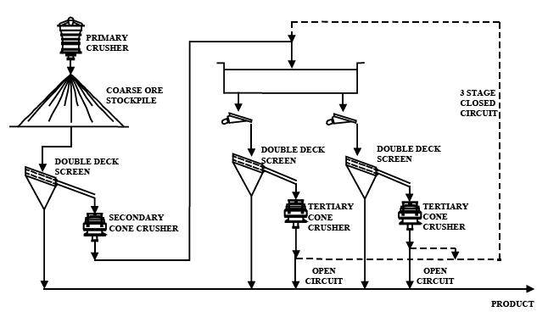
2.11. Crushing stages and circuit (cont.)
Typical crushing stages: open/closed circuit
Feed
MS© 2021

Slide 47
2.11. Crushing stages and circuit (cont.)
Difference between closed and open circuit
Closed circuit
Open circuit
Feed
Feed
Primary crusher
Secondary crusher
Primary crusher
Secondary crusher
（+）
（+）
Screen
Screen
（ー）
（ー）
Separation process or
fine grinding
Separation process or
fine grinding
MS© 2021

Slide 48
2.11. Crushing stages and circuit (cont.)
In open-circuit operation, the material passes straight through the breaker/crusher and the entire product passes on to the next stage.
In closed-circuit operation, material from the breaker/crusher is recirculated back to the screen . As long as the feed does not alter drastically (i.e., size, hardness etc., do not change), the circulating load in closed circuit operation will be fairly constant.
Circulating loads (CL) in closed circuit operation are normally expressed as a percentage of the new feed coming in.
In most crushing operations, circulating loads are relatively small (much less than 100%).
Determination of circulating loads is an important task for the metallurgical staff on the concentrator. This will be tackled in depth later.
MS© 2021

Slide 49
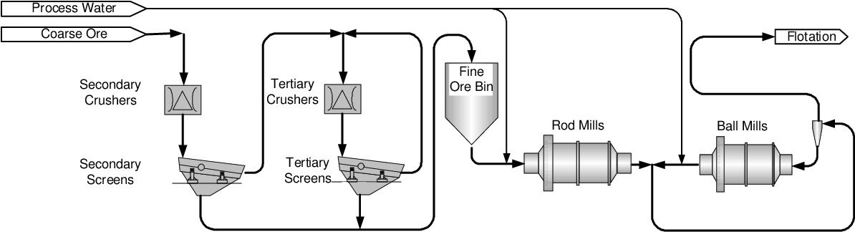
2.11. Crushing stages and circuit (cont.)
Very often the new feed to a crusher is screened to remove the material, which is already sufficiently fine to pass on to the next stage, and only the screen oversize passes through the crusher.
In the case of several stages in closed circuit, the crusher product is usually screened on the same screen.
MS© 2021

Slide 50
2.11. Crushing stages and circuit (cont.)
This “scalping” of new feed (i.e., screening of the new feed before feeding the crusher) gives the following advantages:
  Removal of undersize reduces the amount of material passing through the crusher, hence increases its capacity;
  Effective utilisation of energy in crusher in the absence of fines;
  Improved throughput (i.e., feed rate) to the crusher in the absence of most fines;
  Less dust from the crushing state and wear to the crusher.
Run-of-mine ore is sometimes screened on a “grizzley” (a very coarse screen, consisting of heavy parallel bars, e.g. old rails) which prevents very large rocks from entering and damaging the crusher.
MS© 2021

Slide 51
2.11. Crushing stages and circuit (cont.)
During mining, steel pieces from equipment or from the primary crusher or even screen may be mixed with the haulage/conveyed ore.
These steel pieces should be removed from the ore before feeding secondary crushers as these crushers have relatively small discharge openings that should be protected against large pieces of “tramp” metal which lead to crusher jamming.
These steel metals are removed by magnate or magnetic pulley positioned on conveyor systems. In some instances, metal detectors are installed in the conveyor system.
MS© 2021

Slide 52
Revision questions
Explain briefly how valuable copper minerals are liberated from gangue minerals
State four mechanisms that results in rock size reduction in a jaw crusher?
Classify the following crushing equipment into primary, secondary and tertiary crushing stages; cone crusher, hammer/impact crusher, jaw crusher, and gyratory crusher.
Compare and contrast between a cone crusher and a gyratory crusher.
With the aid of diagrams compare and contrast between open circuit and closed circuit of crushing stage.
Think about others…

Slide 53
End of Lecture 2

