Slide 1

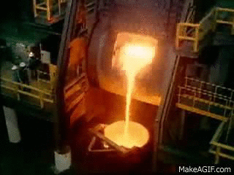
MET 2419: Introduction to Mineral Sciences
By
Marthias SILWAMBA (PhD)
Metallurgical Engineering Department
Marthias.silwamba@unza.zm

Slide 2
Lecture 7
Principles of extractive hyrometallurgy
MS© 2021

Slide 3
Lecture of objective(s)
By the end of the lecture students are expected to:-
Understand principles of hydrometallurgical processes.
Understand basics principle of pregnant solution purification/concentration
Understand basics of valuable metal recovery from pregnant solution.
MS© 2021

Slide 4
Lecture content
7.1. Introduction
7.2. Leaching of ore/concentrate
7.2.1. Heap leaching
7.2.2. In-situ leaching
7.2.3. Agitation leaching
7.3. Lechate Purification and concentration
7.3.1. Precipitation
7.3.2. Ion exchange
7.3.3. Solvent extraction
7.4. Metal recovery from the pregnant leach solution
MS© 2021

Slide 5
Lecture content
7.1. Introduction
7.2. Leaching of ore/concentrate
7.2.1. Heap leaching
7.2.2. In-situ leaching
7.2.3. Agitation leaching
7.3. Lechate Purification and concentration
7.3.1. Precipitation
7.3.2. Ion exchange
7.3.3. Solvent extraction
7.4. Metal recovery from the pregnant leach solution
MS© 2021

Slide 6
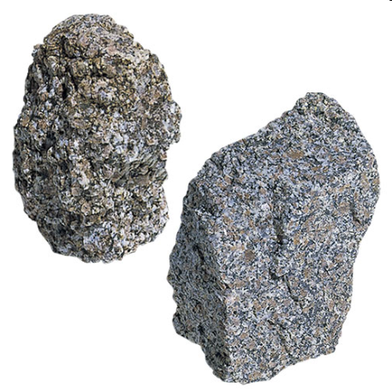
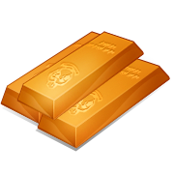
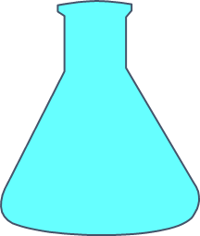
7.1. Introduction
Hydrometallurgy is a brunch of extractive metallurgy using aqueous chemistry.
Metals are extracted from solid phase (ores, concentrates, and recycled materials) to aqueous solution, then the extracted metal ions are recovered as a solid materials by reduction or precipitation.
Precipitation or Reduction
Leaching
MO, MS
M, MX
M^{n+}
MS© 2021

Slide 7
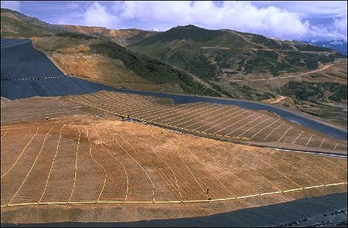
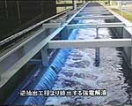
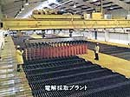
7.1. Introduction (cont.)
General Outline of Hydrometallurgical Processes
Metals in ore are extracted as ions in aqueous phase.
Valuable product of leaching is called pregnant solution. It is separated from insoluble leach residue by thickening, followed by filtration.
e.g.,
Leaching
Heap Leaching
Concentration of valuable mineral and removal of impurity (ex. Fe）from aqueous phase.
Solution purification & concentration can be done by chemical precipitation but more often by ion exchange.
e.g.,
Purification
Solvent Extraction
Metal ions in aq. are recovered by reduction or precipitation
Metal recovery can be done by chemical precipitation as a compound or by electrolytic (electrowinning) and reductive precipitation (i.e., cementation and H₂ reduction).
e.g.,
Recovery
Electro Winning
MS© 2021

Slide 8
Lecture content
7.1. Introduction
7.2. Leaching of ore/concentrate
7.2.1. Heap leaching
7.2.2. In-situ leaching
7.2.3. Agitation leaching
7.3. Lechate Purification and concentration
7.3.1. Precipitation
7.3.2. Ion exchange
7.3.3. Solvent extraction
7.4. Metal recovery from the pregnant leach solution
MS© 2021

Slide 9
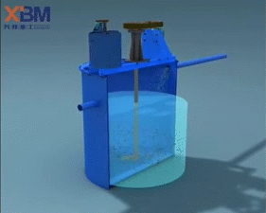
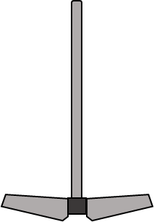
7.2. Leaching of ore/concentrate
  Leaching is the first step of hydrometallurgical processes
  Valuable metal ions are ‘selectively’ extracted from solid ore or mineral to leachate (aqueous solutions), and non valuable matter are remained in solid residue.
  In real process, gangue elements co-dissolve during leaching and these are removed during purification stage.
Me^{n+}
Me^{n+}
MS© 2021

Slide 10
7.2. Leaching of ore/concentrate (cont.)
Leaching methods
Method | Unit size | Extraction time | Yield | Particle size | Control | Cost
In-situ | > 10⁶ t | Years | low | Fractured | low | low
Dump | > 10⁵ t | Med.years | low | Fractured | low | low
Heap | > 10⁴ t | Months | low | Crushed | low | low
Vat | > 10³ t | Days | medium | Crushed | low | medium
Agitation | > 10² t | Hours | High | Ground fine | high | high
Pressure | > 10 t | Minutes | High | Ground fine | high | high
MS© 2021

Slide 11
7.2. Leaching of ore/concentrate (cont.)
Several solvents (lixiviants) may be used but sulphuric acid is more common
Sulphuric acid is widely used since
[1] it is cheap (often produced as a by-product)
[2] it can be regenerated
However, sulphuric acid is corrosive and not selective (leaches too many metals), so purification of leach solution is often necessary.
Ammonia is less corrosive but more selective and is used in several applications in preference to sulphuric acid. Its more expensive but can be regenerated & remainder often used as a fertilizer
NaOH is the only lixiviant used to leach bauxite. NaCN is the only lixiviant used to leach gold ores
MS© 2021

Slide 12
Lecture content
7.1. Introduction
7.2. Leaching of ore/concentrate
7.2.1. Heap leaching
7.2.2. In-situ leaching
7.2.3. Agitation leaching
7.3. Lechate Purification and concentration
7.3.1. Precipitation
7.3.2. Ion exchange
7.3.3. Solvent extraction
7.4. Metal recovery from the pregnant leach solution
MS© 2021

Slide 13
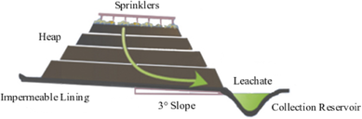
7.2.1. Heap leaching
Large heaps of low-grade are placed on previously prepared impervious pads.
The lixiviant is sprayed on the heaps with a system of pipes and trickles (percolates) through the ore, dissolving the metal on its way
MS© 2021

Slide 14
Lecture content
7.1. Introduction
7.2. Leaching of ore/concentrate
7.2.1. Heap leaching
7.2.2. In-situ leaching
7.2.3. Agitation leaching
7.3. Lechate Purification and concentration
7.3.1. Precipitation
7.3.2. Ion exchange
7.3.3. Solvent extraction
7.4. Metal recovery from the pregnant leach solution
MS© 2021

Slide 15
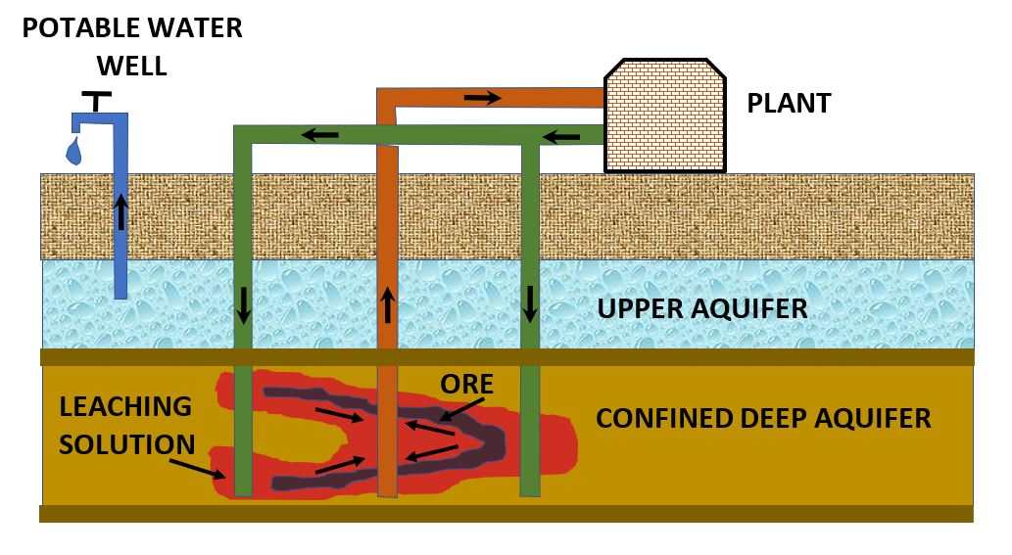
7.2.2. In-situ leaching
Lixiviant is introduced from the surface to just above the level of the underground orebody and percolates through the broken ore.
The resulting pregnant solution is very impure. The method is used in some worked out mines containing already broken rocks
Source: http://www.infinitpipe.com/solution-mining.htm
MS© 2021

Slide 16
Lecture content
7.1. Introduction
7.2. Leaching of ore/concentrate
7.2.1. Heap leaching
7.2.2. In-situ leaching
7.2.3. Agitation leaching
7.3. Lechate Purification and concentration
7.3.1. Precipitation
7.3.2. Ion exchange
7.3.3. Solvent extraction
7.4. Metal recovery from the pregnant leach solution
MS© 2021

Slide 17
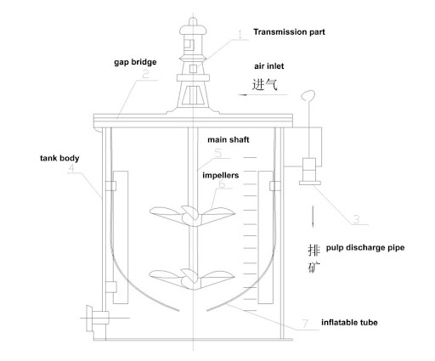
7.2.3. Agitation leaching
Leaching is done in mechanically agitated tanks with impellers or in air-agitated tanks (pachucas).
Particles of concentrates, roast calcines are mixed with lixiviants and kept in suspension by agitation
Me^{n+}
Me^{n+}
Source: http://www.infinitpipe.com/solution-mining.htm
MS© 2021

Slide 18
Lecture content
7.1. Introduction
7.2. Leaching of ore/concentrate
7.2.1. Heap leaching
7.2.2. In-situ leaching
7.2.3. Agitation leaching
7.3. Lechate Purification and concentration
7.3.1. Precipitation
7.3.2. Ion exchange
7.3.3. Solvent extraction
7.4. Metal recovery from the pregnant leach solution
MS© 2021

Slide 19
7.3. Lechate Purification and concentration
Due to impurities that solubilize with the desired metal in solution;
  These impurities can be removed from the solution or
  The valuable metal can be transferred to another solution, leaving the impurities behind
Metals can be removed from solution by precipitation or ion exchange
MS© 2021

Slide 20
Lecture content
7.1. Introduction
7.2. Leaching of ore/concentrate
7.2.1. Heap leaching
7.2.2. In-situ leaching
7.2.3. Agitation leaching
7.3. Lechate Purification and concentration
7.3.1. Precipitation
7.3.2. Ion exchange
7.3.3. Solvent extraction
7.4. Metal recovery from the pregnant leach solution
MS© 2021

Slide 21
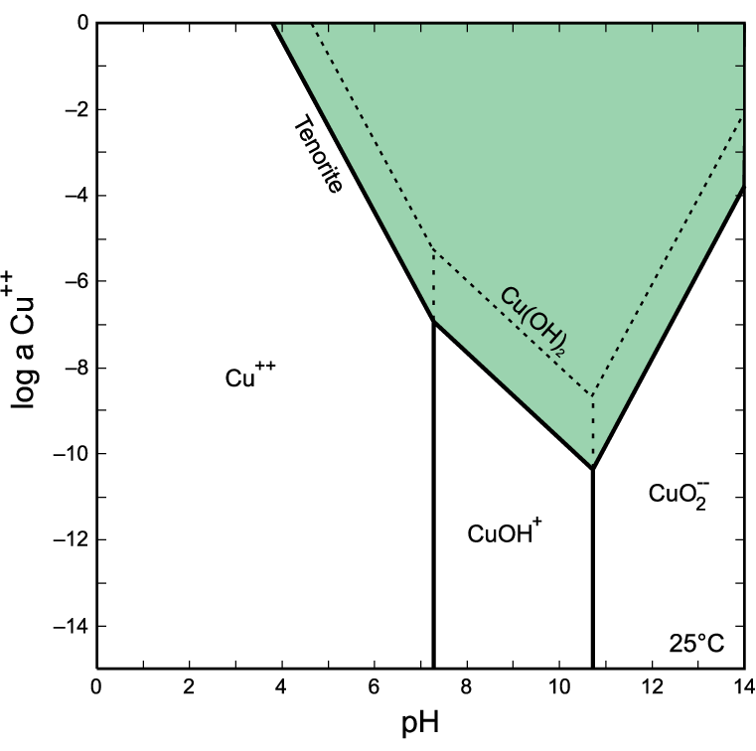
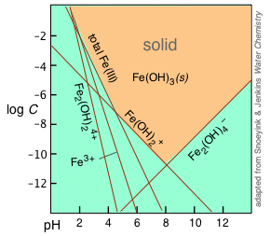
7.3.1. Precipitation
Precipitation
Because different metal hydroxides have different solubility products, they will precipitate at different pH and a fairly selective precipitation is possible.
Ca(OH)₂, i.e., lime, is cheap and therefore most commonly used for raising pH and effecting such selective precipitation.
Fe³⁺ can easily be separated from Cu²⁺
MS© 2021

Slide 22
Lecture content
7.1. Introduction
7.2. Leaching of ore/concentrate
7.2.1. Heap leaching
7.2.2. In-situ leaching
7.2.3. Agitation leaching
7.3. Lechate Purification and concentration
7.3.1. Precipitation
7.3.2. Ion exchange
7.3.3. Solvent extraction
7.4. Metal recovery from the pregnant leach solution
MS© 2021

Slide 23
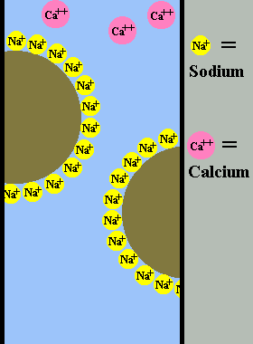
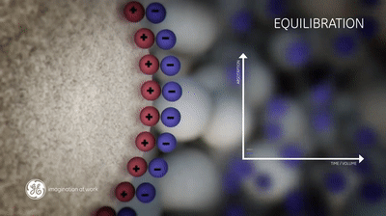
7.3.2. Ion exchange
Ion Exchange
An extractant is used that is selective for a particular metal ion. Here extractant is contacted with a solution of the desired metal under suitable conditions;
The metal joins the extractant in exchange for another type of ion that moves into solution. This is the extraction or loading or sorption
Loaded extractant is next contacted with an eluent or strip solution under different conditions.
MS© 2021

Slide 24
7.3.2. Ion exchange (cont..)
This drives the metal ion out of the extractant into the strip solution in exchange for another ion from this solution
ion exchange methods include
  ion exchange using solid exchange resins
  ion exchange using activated charcoal
  liquid-liquid ion exchange or Solvent Exchange
Solvent Extraction was successfully developed for the extraction of copper
MS© 2021

Slide 25
Lecture content
7.1. Introduction
7.2. Leaching of ore/concentrate
7.2.1. Heap leaching
7.2.2. In-situ leaching
7.2.3. Agitation leaching
7.3. Lechate Purification and concentration
7.3.1. Precipitation
7.3.2. Ion exchange
7.3.3. Solvent extraction
7.4. Metal recovery from the pregnant leach solution
MS© 2021

Slide 26
7.3.3. Solvent extraction
Solvent Extraction
SX (or SEX) uses a liquid extractant that is immiscible with an aqueous solution.
The extractant is dissolved in an organic diluent (e.g.kerosene), also immiscible with an aqueous solution.
This gives about equal proportions of the organic & aqueous phases such that vigorous agitation will give good contacting of the two phases
The phases are allowed settle so that they can disengage;
  Barren solution is called raffinate & is recycled to the leach circuit.
  The loaded organic proceeds to the stripping circuit
MS© 2021

Slide 27
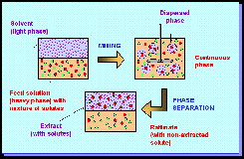
7.3.3. Solvent extraction (cont..)
Solvent
(light phase)
Well dispersed organic solvent in aqueous phase
Well dispersed organic solvent in aqueous phase
Aqueous
(heavy phase)
Extractant
Target metal ions
Other metal ions
MS© 2021

Slide 28
7.3.3. Solvent extraction (cont..)
Equilibrium reaction is given by;
RH_{n} + Me^{n+} = RMe + 2H⁺ where R = organic extractant
(Organic) (Aqueous) (Organic) (Aqueous)
Equilibrium depends on pH;
[1] At relatively high pH (low H⁺ ion concentration), the reaction proceeds to the right ( extraction)
[2] At low pH (high H⁺ ion concentration), reaction proceeds to the left (stripping)
MS© 2021

Slide 29
Lecture content
7.1. Introduction
7.2. Leaching of ore/concentrate
7.2.1. Heap leaching
7.2.2. In-situ leaching
7.2.3. Agitation leaching
7.3. Lechate Purification and concentration
7.3.1. Precipitation
7.3.2. Ion exchange
7.3.3. Solvent extraction
7.4. Metal recovery from the pregnant leach solution
MS© 2021

Slide 30

7.4. Metal recovery from the pregnant leach solution
1. Cementation
Metals dissolved in solution can be precipitated by solid metals that have a lower reduction potential (higher oxidation potential)
Metal with a higher oxidation potential goes into solution and the more noble metal precipitates out
Fe = Fe²⁺ + 2e⁻ (oxidation)
Cu²⁺ + 2e⁻ = Cu (reduction)
--------------------------------------------------------------
Cu²⁺ + Fe = Cu + Fe²⁺ (overall reaction)
Cementation is widely used to recover copper cheaply from impure & dilute leach solutions
e⁻
M_{les}
^{n–}
MeX_{m}
e⁻
^{n+}
M_{les}
MS© 2021

Slide 31
7.4. Metal recovery from the pregnant leach solution (cont..)
2. Electrowinning
Metals dissolved in the electrolyte are made to precipitate onto the cathode while the anode is inert
Electric current carries metal cations to the cathodes where they discharge & precipitate onto the cathodes as pure metal
Anode reactions are different for each process. In general, water is dissociated to give to oxygen
e.g Cathode rxn: Cu²⁺ + 2e⁻ = Cu
Anode rxn: H₂O = H⁺ + OH⁻ = ½ O₂ + 2H⁺ + 2e⁻
----------------------------------------------------------------------------------------------------------------------------------------
Overall: Cu²⁺ + H₂O = Cu + ½ O₂ + 2H⁺
Mass of metal deposited at the cathode is proportional to the quantity of electricity passed (current density)
Current efficiency = actual mass of metal deposited divided by the theoretical amount, this is about 75 -95 %. Current losses occur due to short circuits, resistances etc.
MS© 2021

Slide 32
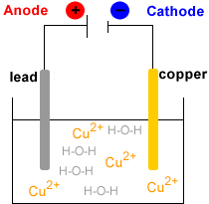
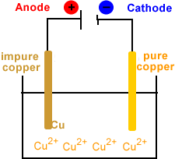
7.4. Metal recovery from the pregnant leach solution (cont..)
Difference between electrorefining and electrowinning
Electrorefining
Electrowinning
MS© 2021

Slide 33
End of Lecture 7

