Slide 1
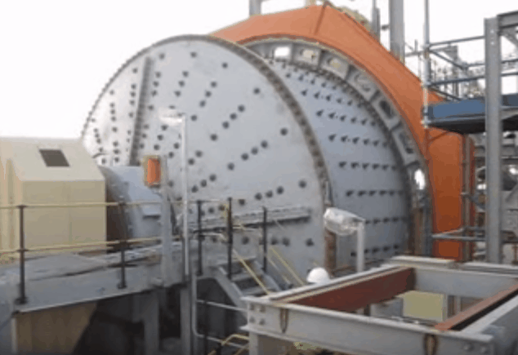
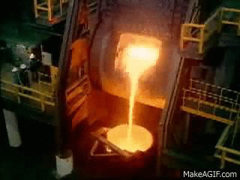

GMM 2110: Introduction to Geology Mining and Metallurgy
By
Marthias SILWAMBA (PhD)
Metallurgical Engineering Department
Marthias.silwamba@unza.zm

Slide 2
Lecture 6
Principles of extractive pyrometallurgy
MS© 2021

Slide 3
Lecture of objective(s)
By the end of the lecture students are expected to:-
Understand purpose and principles of pyrometallurgical pretreatment.
Understand basics of sulphide concentrate smelting
Understand basics of oxide concentrate reductive smelting.
MS© 2021

Slide 4
Lecture content
6.1. Introduction
6.2. Pretreatment: Roasting
6.2.1. Pretreatment: Oxidizing roasting
6.2.2. Pretreatment: Sulphation Roasting
6.2.3. Pretreatment: Reduction roasting
6.2.4. Pretreatment: Chloridising roasting
6.3. Smelting of sulphide concentrate
6.3.1. Smelting of sulphide concentrate: Smelting (Flash Smelting Furnace)
6.3.2. Smelting of sulphide concentrate: Converting (Peirce-Smith Converter)
6.3.3. Smelting of sulphide concentrate: Fire refining and anode casting
6.3.4. Smelting of sulphide concentrate: Electro-refining
6.4. Smelting of oxide concentrate (reductive smelting)
MS© 2021

Slide 5
Lecture content
6.1. Introduction
6.2. Pretreatment: Roasting
6.2.1. Pretreatment: Oxidizing roasting
6.2.2. Pretreatment: Sulphation Roasting
6.2.3. Pretreatment: Reduction roasting
6.2.4. Pretreatment: Chloridising roasting
6.3. Smelting of sulphide concentrate
6.3.1. Smelting of sulphide concentrate: Smelting (Flash Smelting Furnace)
6.3.2. Smelting of sulphide concentrate: Converting (Peirce-Smith Converter)
6.3.3. Smelting of sulphide concentrate: Fire refining and anode casting
6.3.4. Smelting of sulphide concentrate: Electro-refining
6.4. Smelting of oxide concentrate (reductive smelting)
MS© 2021

Slide 6
6.1. Introduction
Pyrometallurgy is the branch of metallurgy that deals with the use of high temperature to extract metals of interest from mineral/concentrate/metallurgical ore and purification of the extracted metal.
Non-ferrous (i.e., Cu, Ni, Pb etc.,) pyrometallurgy involves the high-temperature extraction and separation of extracted metal via multiple sulfide oxidizing stages.
The smelting process produces three products as below
  Metal of interest is concentrated in one phase (matte or hot metal) until considered sufficiently pure
  Impurities are concentrated in the slag
  Some impurities are expelled as a gas (called off-gas)
MS© 2021

Slide 7
6.1. Introduction (cont.)
Slag is molten mixture of metal oxide and silicates.
They are formed in smelting of ores or in the refining of crude metals.
The function of slag is to contain the largely unwanted constituents in the furnace, such as gangue from the ore/concentrate during smelting , and impurity elements oxidized from valuable metal during refining.
Mate is an important intermediate product in Cu and Pb smelting processes.
In sulphide smelting, matte is composed of Cu₂S, Ni_{３}S₂, FeS containing minor components like PbS, ZnS, Au, and Ag.
In oxide reductive smelting, e.g., Fe-metallurgy, hot metal is the intermediate product.
MS© 2021

Slide 8
6.1. Introduction (cont.)
Various fluxes are used to:-
    Lower the melting point of slag &
    Improve the fluidity of slag
Fuel used that are are include coke, oil, or natural gas.
Two uses of fuel:-
    Provides the required heat,
    Takes part in the chemical reactions as a reducing agent
MS© 2021

Slide 9
6.1. Introduction (cont.)
CONCENTRATE
PYROMETALLURGY
SULPHIDE PYROMETALLURY
OXIDE PYROMETALLURGY
SLAG
TO DUMP
METAL
METAL
MS© 2021

Slide 10
Lecture content
6.1. Introduction
6.2. Pretreatment: Roasting
6.2.1. Pretreatment: Oxidizing roasting
6.2.2. Pretreatment: Sulphation Roasting
6.2.3. Pretreatment: Reduction roasting
6.2.4. Pretreatment: Chloridising roasting
6.3. Smelting of sulphide concentrate
6.3.1. Smelting of sulphide concentrate: Smelting (Flash Smelting Furnace)
6.3.2. Smelting of sulphide concentrate: Converting (Peirce-Smith Converter)
6.3.3. Smelting of sulphide concentrate: Fire refining and anode casting
6.3.4. Smelting of sulphide concentrate: Electro-refining
6.4. Smelting of oxide concentrate (reductive smelting)
MS© 2021

Slide 11
6.2. Pretreatment: Roasting
Roasting involves changes in chemical composition of ores by the reaction with furnace atmosphere at high temperature (500~1000℃).
Roasting type
For sulfide | For oxide
Oxidizing roast | Reduction roast
Sulphation roast | Sulphation roast
Chloridising roast | Chloridising roast
MS© 2021

Slide 12
Lecture content
6.1. Introduction
6.2. Pretreatment: Roasting
6.2.1. Pretreatment: Oxidizing roasting
6.2.2. Pretreatment: Sulphation Roasting
6.2.3. Pretreatment: Reduction roasting
6.2.4. Pretreatment: Chloridising roasting
6.3. Smelting of sulphide concentrate
6.3.1. Smelting of sulphide concentrate: Smelting (Flash Smelting Furnace)
6.3.2. Smelting of sulphide concentrate: Converting (Peirce-Smith Converter)
6.3.3. Smelting of sulphide concentrate: Fire refining and anode casting
6.3.4. Smelting of sulphide concentrate: Electro-refining
6.4. Smelting of oxide concentrate (reductive smelting)
MS© 2021

Slide 13

6.2.1. Pretreatment: Oxidizing roasting
Conversion of sulfide to oxide by oxidation.
Dead roasting (complete oxidation) of ZnS, PbS before carbon reduction (or acid leaching of ZnO).
2 ZnS + 3 O₂ = 2 ZnO + 2 SO₂(g)
Partial roasting of CuFeS₂, Ni₃S₂ before matte smelting
4CuFeS₂ + 7O₂ = 2Cu₂S +FeS +Fe₃O₄ + 5 SO₂(g)
O₂
SO₂
Heat
MS
MO
MS© 2021

Slide 14
Lecture content
6.1. Introduction
6.2. Pretreatment: Roasting
6.2.1. Pretreatment: Oxidizing roasting
6.2.2. Pretreatment: Sulphation Roasting
6.2.3. Pretreatment: Reduction roasting
6.2.4. Pretreatment: Chloridising roasting
6.3. Smelting of sulphide concentrate
6.3.1. Smelting of sulphide concentrate: Smelting (Flash Smelting Furnace)
6.3.2. Smelting of sulphide concentrate: Converting (Peirce-Smith Converter)
6.3.3. Smelting of sulphide concentrate: Fire refining and anode casting
6.3.4. Smelting of sulphide concentrate: Electro-refining
6.4. Smelting of oxide concentrate (reductive smelting)
MS© 2021

Slide 15
6.2.2. Pretreatment: Sulphation Roasting
Conversion of oxide to sulfate prior to hydrometallurgical treatment (sulfate is easier to dissolve in water than oxide).
1/2 O₂ (g) + SO₂ (g) = SO₃(g)
MO (s) + SO₃(g) = MSO₄ (s)
SO₃
MO
MSO₄
MS© 2021

Slide 16
Lecture content
6.1. Introduction
6.2. Pretreatment: Roasting
6.2.1. Pretreatment: Oxidizing roasting
6.2.2. Pretreatment: Sulphation Roasting
6.2.3. Pretreatment: Reduction roasting
6.2.4. Pretreatment: Chloridising roasting
6.3. Smelting of sulphide concentrate
6.3.1. Smelting of sulphide concentrate: Smelting (Flash Smelting Furnace)
6.3.2. Smelting of sulphide concentrate: Converting (Peirce-Smith Converter)
6.3.3. Smelting of sulphide concentrate: Fire refining and anode casting
6.3.4. Smelting of sulphide concentrate: Electro-refining
6.4. Smelting of oxide concentrate (reductive smelting)
MS© 2021

Slide 17
6.2.3. Pretreatment: Reduction roasting
Conversion of oxide to metal (or reduced oxide)
  NiO + H₂ = Ni + H₂O
  3 Fe₂O₃ + CO = 2 Fe₃O₄ + CO₂ (Magnetization for separation)
  2 As₂O₅ + 2 CO = As₂O₃ + 2CO₂ (Higher volatility to remove)
  MnO₂ + CO = MnO + CO₂ (Higher leachability)
CO or H₂
CO₂ or H₂O
MO
M or
MO_{x-1}
MS© 2021

Slide 18
Lecture content
6.1. Introduction
6.2. Pretreatment: Roasting
6.2.1. Pretreatment: Oxidizing roasting
6.2.2. Pretreatment: Sulphation Roasting
6.2.3. Pretreatment: Reduction roasting
6.2.4. Pretreatment: Chloridising roasting
6.3. Smelting of sulphide concentrate
6.3.1. Smelting of sulphide concentrate: Smelting (Flash Smelting Furnace)
6.3.2. Smelting of sulphide concentrate: Converting (Peirce-Smith Converter)
6.3.3. Smelting of sulphide concentrate: Fire refining and anode casting
6.3.4. Smelting of sulphide concentrate: Electro-refining
6.4. Smelting of oxide concentrate (reductive smelting)
MS© 2021

Slide 19
6.2.4. Pretreatment: Chloridising roasting
Conversion of oxide to volatile chloride
As Cl source, Cl₂,NaCl or CaCl₂ is used.
MO + Cl₂ = MCl₂↑ + 1/2O₂
MS© 2021

Slide 20
Lecture content
6.1. Introduction
6.2. Pretreatment: Roasting
6.2.1. Pretreatment: Oxidizing roasting
6.2.2. Pretreatment: Sulphation Roasting
6.2.3. Pretreatment: Reduction roasting
6.2.4. Pretreatment: Chloridising roasting
6.3. Smelting of sulphide concentrate
6.3.1. Smelting of sulphide concentrate: Smelting (Flash Smelting Furnace)
6.3.2. Smelting of sulphide concentrate: Converting (Peirce-Smith Converter)
6.3.3. Smelting of sulphide concentrate: Fire refining and anode casting
6.3.4. Smelting of sulphide concentrate: Electro-refining
6.4. Smelting of oxide concentrate (reductive smelting)
MS© 2021

Slide 21
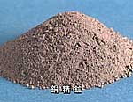
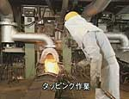
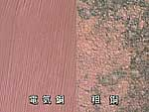
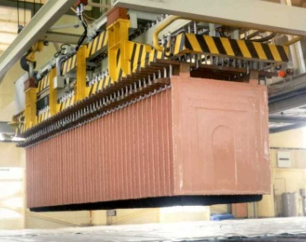
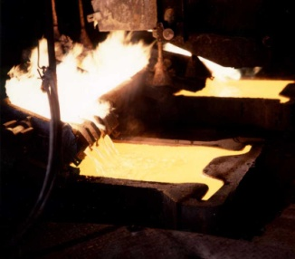
6.3. Smelting of sulphide concentrate
Converting
Smelting
Converting
Concentrate（20-40%)
Matte
（50-60%)
Removal of major impurities (Fe, S）
Blister Cu
（>98.5%)
Removal of minor impurities（O, Pb etc.)
Fire-refining
Electro-refining
Cu（>99.99%)
Anode（>99.5%)
MS© 2021

Slide 22
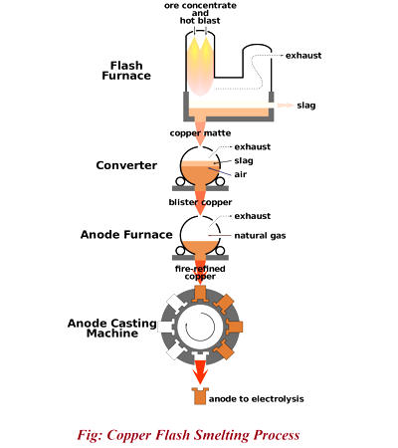
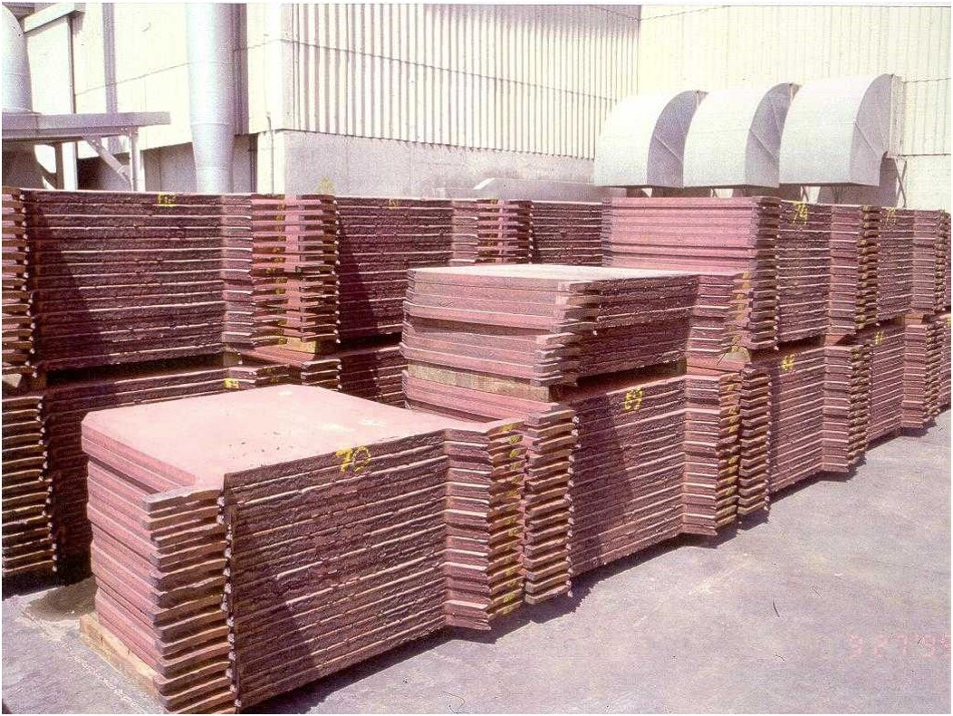
6.3. Smelting of sulphide concentrate (e.g., CuFeS₂)
MS© 2021

Slide 23
Lecture content
6.1. Introduction
6.2. Pretreatment: Roasting
6.2.1. Pretreatment: Oxidizing roasting
6.2.2. Pretreatment: Sulphation Roasting
6.2.3. Pretreatment: Reduction roasting
6.2.4. Pretreatment: Chloridising roasting
6.3. Smelting of sulphide concentrate
6.3.1. Smelting of sulphide concentrate: Smelting (Flash Smelting Furnace)
6.3.2. Smelting of sulphide concentrate: Converting (Peirce-Smith Converter)
6.3.3. Smelting of sulphide concentrate: Fire refining and anode casting
6.3.4. Smelting of sulphide concentrate: Electro-refining
6.4. Smelting of oxide concentrate (reductive smelting)
MS© 2021

Slide 24
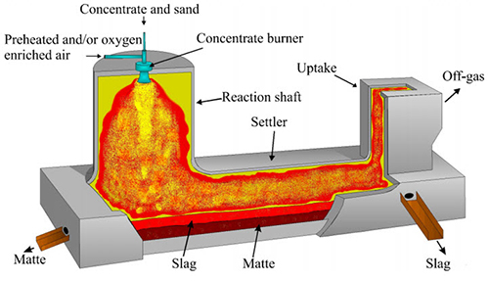
6.3.1. Smelting of sulphide concentrate: Smelting (Flash Smelting Furnace)
CuFeS₂,SiO₂
Instant ignition and melting by exothermal oxidation of Fe and S
Phase separation of Matte and Slag by Specific gravity difference
Matte,Cu₂S
Slag, FeO・SiO₂ (acidic slag)
Removal of Fe in CuFeS₂ as slag (FeO・SiO₂)
2CuFeS₂ + 2SiO₂ + 4O₂ → Cu₂S + 2FeO・SiO₂ + 3SO₂
MS© 2021

Slide 25
Lecture content
6.1. Introduction
6.2. Pretreatment: Roasting
6.2.1. Pretreatment: Oxidizing roasting
6.2.2. Pretreatment: Sulphation Roasting
6.2.3. Pretreatment: Reduction roasting
6.2.4. Pretreatment: Chloridising roasting
6.3. Smelting of sulphide concentrate
6.3.1. Smelting of sulphide concentrate: Smelting (Flash Smelting Furnace)
6.3.2. Smelting of sulphide concentrate: Converting (Peirce-Smith Converter)
6.3.3. Smelting of sulphide concentrate: Fire refining and anode casting
6.3.4. Smelting of sulphide concentrate: Electro-refining
6.4. Smelting of oxide concentrate (reductive smelting)
MS© 2021

Slide 26
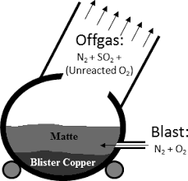
6.3.2. Smelting of sulphide concentrate: Converting (Peirce-Smith Converter)
Removal of S from Matte（Cu₂S）
Cu₂S + O₂ → 2Cu + SO₂ （Reduction）
MS© 2021

Slide 27
Lecture content
6.1. Introduction
6.2. Pretreatment: Roasting
6.2.1. Pretreatment: Oxidizing roasting
6.2.2. Pretreatment: Sulphation Roasting
6.2.3. Pretreatment: Reduction roasting
6.2.4. Pretreatment: Chloridising roasting
6.3. Smelting of sulphide concentrate
6.3.1. Smelting of sulphide concentrate: Smelting (Flash Smelting Furnace)
6.3.2. Smelting of sulphide concentrate: Converting (Peirce-Smith Converter)
6.3.3. Smelting of sulphide concentrate: Fire refining and anode casting
6.3.4. Smelting of sulphide concentrate: Electro-refining
6.4. Smelting of oxide concentrate (reductive smelting)
MS© 2021

Slide 28
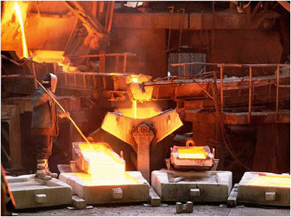
6.3.3. Smelting of sulphide concentrate: Fire refining and anode casting
The molten blister copper is refined in anode furnaces to anode copper (purity > 99.5％) after oxidation by air blowing and reduction by oil combustion.
MS© 2021

Slide 29
Lecture content
6.1. Introduction
6.2. Pretreatment: Roasting
6.2.1. Pretreatment: Oxidizing roasting
6.2.2. Pretreatment: Sulphation Roasting
6.2.3. Pretreatment: Reduction roasting
6.2.4. Pretreatment: Chloridising roasting
6.3. Smelting of sulphide concentrate
6.3.1. Smelting of sulphide concentrate: Smelting (Flash Smelting Furnace)
6.3.2. Smelting of sulphide concentrate: Converting (Peirce-Smith Converter)
6.3.3. Smelting of sulphide concentrate: Fire refining and anode casting
6.3.4. Smelting of sulphide concentrate: Electro-refining
6.4. Smelting of oxide concentrate (reductive smelting)
MS© 2021

Slide 30
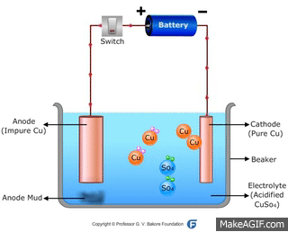
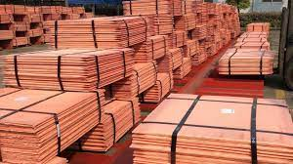
6.3.4. Smelting of sulphide concentrate: Electro-refining
Anode Cu → Cu²⁺ + 2e⁻
Cathode Cu²⁺ + 2e⁻ → Cu
Anode Cu → Cu²⁺ + 2e⁻
Cathode Cu²⁺ + 2e⁻ → Cu
＋ Anode Cu
－ Cathode Cu
Cu²⁺
Zn²⁺
Base metals do not plate on cathode
Nobel metals precipitate as slim
Au
High purity Cu (>99.99％) is produced using the redox potential difference !
MS© 2021

Slide 31
Lecture content
6.1. Introduction
6.2. Pretreatment: Roasting
6.2.1. Pretreatment: Oxidizing roasting
6.2.2. Pretreatment: Sulphation Roasting
6.2.3. Pretreatment: Reduction roasting
6.2.4. Pretreatment: Chloridising roasting
6.3. Smelting of sulphide concentrate
6.3.1. Smelting of sulphide concentrate: Smelting (Flash Smelting Furnace)
6.3.2. Smelting of sulphide concentrate: Converting (Peirce-Smith Converter)
6.3.3. Smelting of sulphide concentrate: Fire refining and anode casting
6.3.4. Smelting of sulphide concentrate: Electro-refining
6.4. Smelting of oxide concentrate (reductive smelting)
MS© 2021

Slide 32
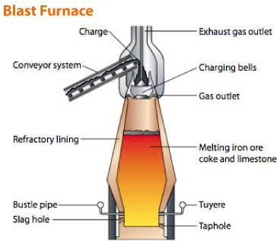
4.4. Smelting of oxide concentrate (reductive smelting)
Reactions:
2C + O₂ = 2CO
MO + CO = M + CO₂
M: Fe, Pb, Sn etc.
Feed:
Ore (MO + SiO₂, Al₂O_{3 etc})
Cokes (C)
Flux (CaO)
Products:
Crude Metal + Slag (basic slag)
MS© 2021

Slide 33
6.4. Smelting of oxide concentrate (reductive smelting) (cont.)
In Blast furnaces
  The charge or burden i.e. ore/concentrate/roast calcine, fuels & fluxes are charged from top
  pre-heated air (blast) is blown in from the bottom
An iron blast furnace produces a slag & an impure Pig Iron.
A lead blast furnace produces a slag & an impure lead bullion.
Common fluxes are silica (in copper smelting) as well as limestone & dolomite (used in Fe & steelmaking).
Slags can be acidic (high in SiO2) or basic (high in CaO & MgO).
MS© 2021

Slide 34
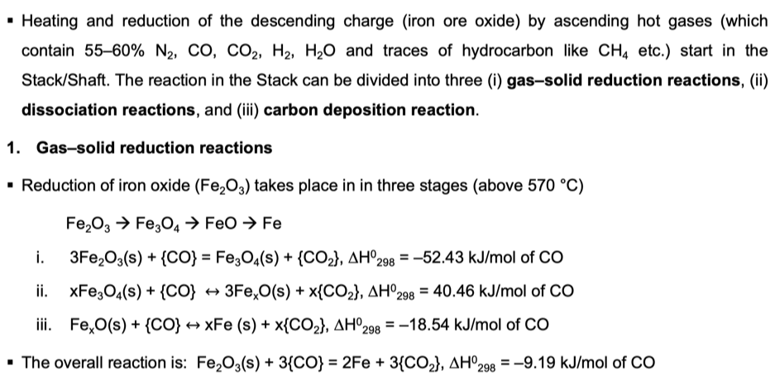
6.4. Smelting of oxide concentrate (reductive smelting) (cont.)
Reduction Smelting of Iron oxide ore/mineral in Blast Furnace
CO
CO₂
FeO_{3–y}
Fe₂O₃
MS© 2021

Slide 35
End of Lecture 6

