Slide 1
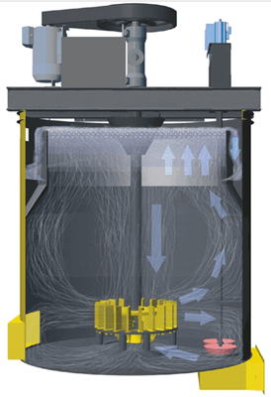
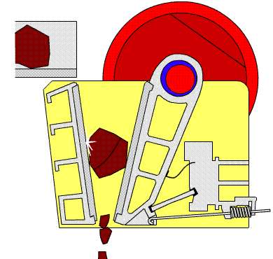
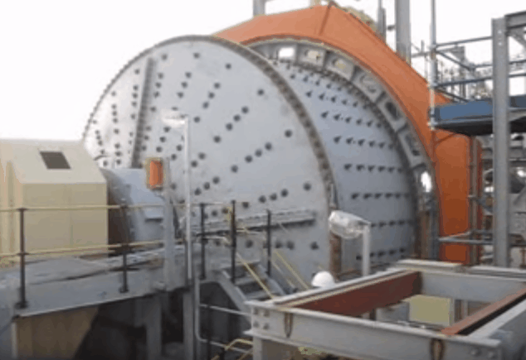

CME 1025: Introduction to mineral science
By
Marthias SILWAMBA (PhD)
Metallurgical Engineering Department
Marthias.silwamba@unza.zm

Slide 2
Lecture 4
Classification
MS© 2021

Slide 3
Lecture of objective(s)
By the end of the lecture students are expected to:-
Know the types and working principles of classifiers
MS© 2021

Slide 4
Lecture content
4.1. Introduction
4.3. Types of classifiers
MS© 2021

Slide 5
Lecture content
4.1. Introduction
4.3. Types of classifiers
MS© 2021

Slide 6
4.1. Introduction
Classification is a method of separating mixtures of minerals into two or more products on the basis of the velocity with which the grains fall through a fluid medium.
It takes advantage of the principle that particles of the same density but of different sizes settle in fluid at different rates (velocities).
Meanwhile, particles of the same sizes but different densities will equally settle in fluid at different velocities.
Exploring the difference in the settling rates allows for the separation of particles based on size and density.
In mineral processing, classification is generally applied to mineral particles that are considered too fine to be sorted (classified/sieved) efficiently by screening.
MS© 2021

Slide 7
Lecture content
4.1. Introduction
4.3. Types of classifiers
MS© 2021

Slide 8
4.2. Types of classifiers
Classifiers used for industrial sizing of fine particles in grinding circuits.
These classifiers are categorized in three main groups:
  Hydraulic classifiers
  Mechanical classifiers
  Hydrocyclones
As you will see, the above classes can be in two broad classes depending on the orientation.
  Horizontal current classifiers such as mechanical classifiers are essentially of the free-settling type and accentuate the sizing function.
  Vertical current or hydraulic classifiers are usually hindered-settling types and so increase the effect of density on the separation.
MS© 2021

Slide 9
4.2. Types of classifiers (cont.)
Hydraulic classifiers
These are vessels with ‘sorting columns’ in which the particles are made to settle against a rising current of water.
They give a sharp size separation, but their capacity is low and they use much water.
They are characterised by the use of water additional to that of the feed pulp, introduced so that its direction of flow opposes that of the settling particles.
The operation of the hydraulic classifiers is as shown in the next slide.
MS© 2021

Slide 10
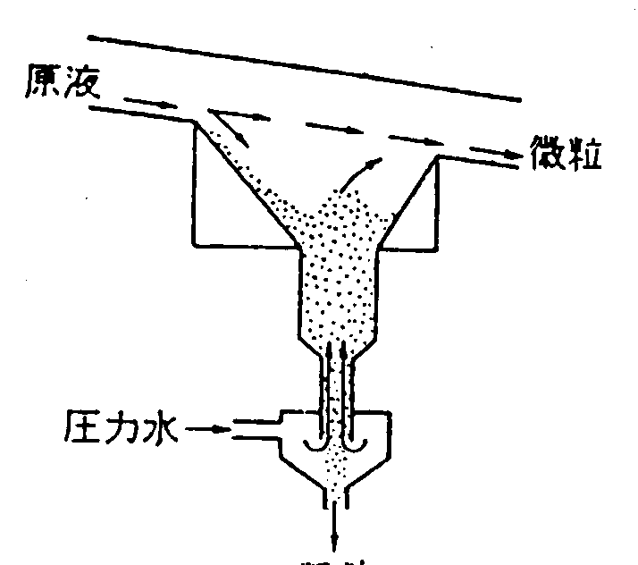
4.2. Types of classifiers (cont.)
Hydraulic classifiers (cont.)
Feed
Smaller particles
Pressured water
粗粒
Larger particles
MS© 2021

Slide 11
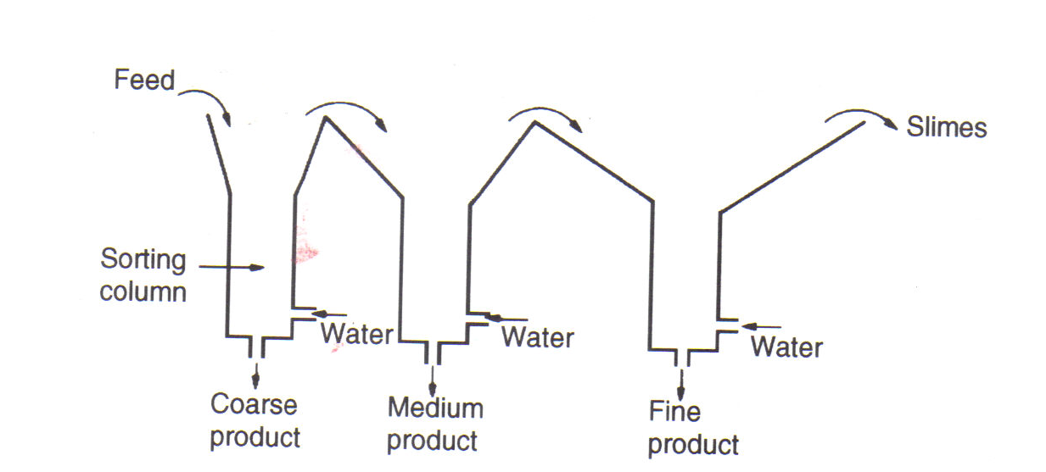
4.2. Types of classifiers (cont.)
Hydraulic classifiers (cont.)
They normally consists of a series of sorting columns through each of which a vertical current of water is rising and particles are settling out
MS© 2021

Slide 12
4.2. Types of classifiers (cont.)
Hydraulic classifiers (cont.)
The greatest use for hydraulic classifiers in the mineral industry is for sorting the feed to certain gravity concentration processes.
Since the ratio of sizes of equally settling particles is high, the classifier is capable of performing a concentrating effect, and the first spigot product is normally of higher grade than the other products
MS© 2021

Slide 13
4.2. Types of classifiers (cont.)
Hydraulic classifiers: Settling cones
These are the simplest form of hydraulic classifier, in which there is little attempt to do more than separate solids from the liquid, i.e. They are sometimes used as dewatering units in small-scale operations.
They are often used in the aggregate industry to de-slime coarse sands products.
The pulp is fed into the tank as a distributed stream at F, with the spigot discharge S initially closed.
When the tank is full, overflow of water and slimes commences, and a bed of settled sand builds up until it reaches the level shown.
MS© 2021

Slide 14
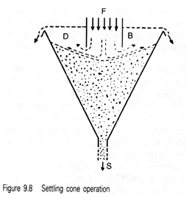
4.2. Types of classifiers (cont.)
Hydraulic classifiers: Settling cones (cont.)
Feed
Feed
Smaller particles
MS© 2021

Slide 15
4.2. Types of classifiers (cont.)
Mechanical classifiers
Several forms of classifier exist in which the material of lower settling velocity is carried away in a liquid overflow, and the material of higher settling velocity is deposited on the bottom of the equipment and is dragged upwards against the flow of liquid by some mechanical means.
Mechanical classifiers have widespread use in closed-circuit grinding operations and in the classification of products from ore-washing plants. In washing plants they act more or less as sizing devices, as the particles are essentially unliberated, so are of similar density. In closed circuit grinding they have a tendency to return small dense particles to the mill, causing overgrinding.
MS© 2021

Slide 16
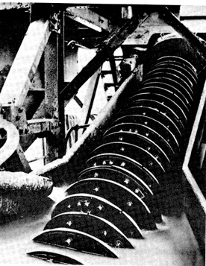
4.2. Types of classifiers (cont.)
Mechanical classifiers (cont.)
Feed
Slurry pool
Screw
Overflow
(smaller particles)
Lift up
Underflow
(larger particles)
Coarse
Fine
MS© 2021
Settling velocity of particles in fluid

Slide 17
4.2. Types of classifiers (cont.)
Hydrocyclone
This is a continuously operating classifying device that utilises centrifugal force to accelerate the settling rate of particles.
It is widely used in closed circuit grinding operations but has found many other uses, such as de-sliming, degritting, and thickening.
A typical hydrocyclone consists of a conically shaped vessel, open at its apex, or underflow, joined to a cylindrical section, which has a tangential feed inlet.
The top of the cylindrical section is closed with a plate through which passes an axially mounted overflow pipe.
The pipe is extended into the body of the cyclone by a short, removable section known as the vortex finder, which prevents short-circuiting of feed directly into the overflow.
MS© 2021

Slide 18
4.2. Types of classifiers (cont.)
Hydrocyclone (cont.)
The feed is introduced under pressure through the tangential entry which imparts a swirling motion to the pulp.
This generates a vortex in the cyclone, with a low-pressure zone along the vertical axis.
An air core develops along the axis, normally connected to the atmosphere through the apex opening, but in part created by dissolved air coming out of solution in the zone of low pressure.
MS© 2021

Slide 19
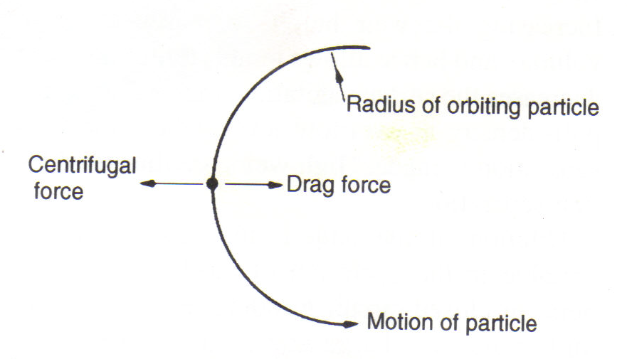
4.2. Types of classifiers (cont.)
Hydrocyclone (cont.)
The classical theory of hydrocyclone action is that particles within the flow pattern are subjected to two opposing forces–an outward centrifugal force and an inwardly acting drag force.
MS© 2021

Slide 20
4.2. Types of classifiers (cont.)
Hydrocyclone (ccont.)
The centrifugal force developed accelerates the settling of the particles (there is evidence to show that Stokes’ law applies with reasonable accuracy to separations in cyclones of conventional design), thereby separating the particles according to size and specific gravity.
Faster settling particles move to the wall of the cyclone, where the velocity is lowest, and migrate to the apex opening.
Due to the action of the drag force, the slower-settling particles move towards the zone of low pressure along the axis and are carried upward through the vortex finder to the overflow.
MS© 2021

Slide 21
4.2. Types of classifiers (cont.)
Hydrocyclone (cont.).
Overflow:
Smaller particles + water
Particles +water
Typical trajectory of a smaller particle
Inner region: upward flow
Feed: introduced under pressure through the tangential entry
Centrifugal force
Drag force
Motion of particle
Typical trajectory of a larger particle
Outer region: downward flow
Underflow:
Larger particles + water
MS© 2021

Slide 22
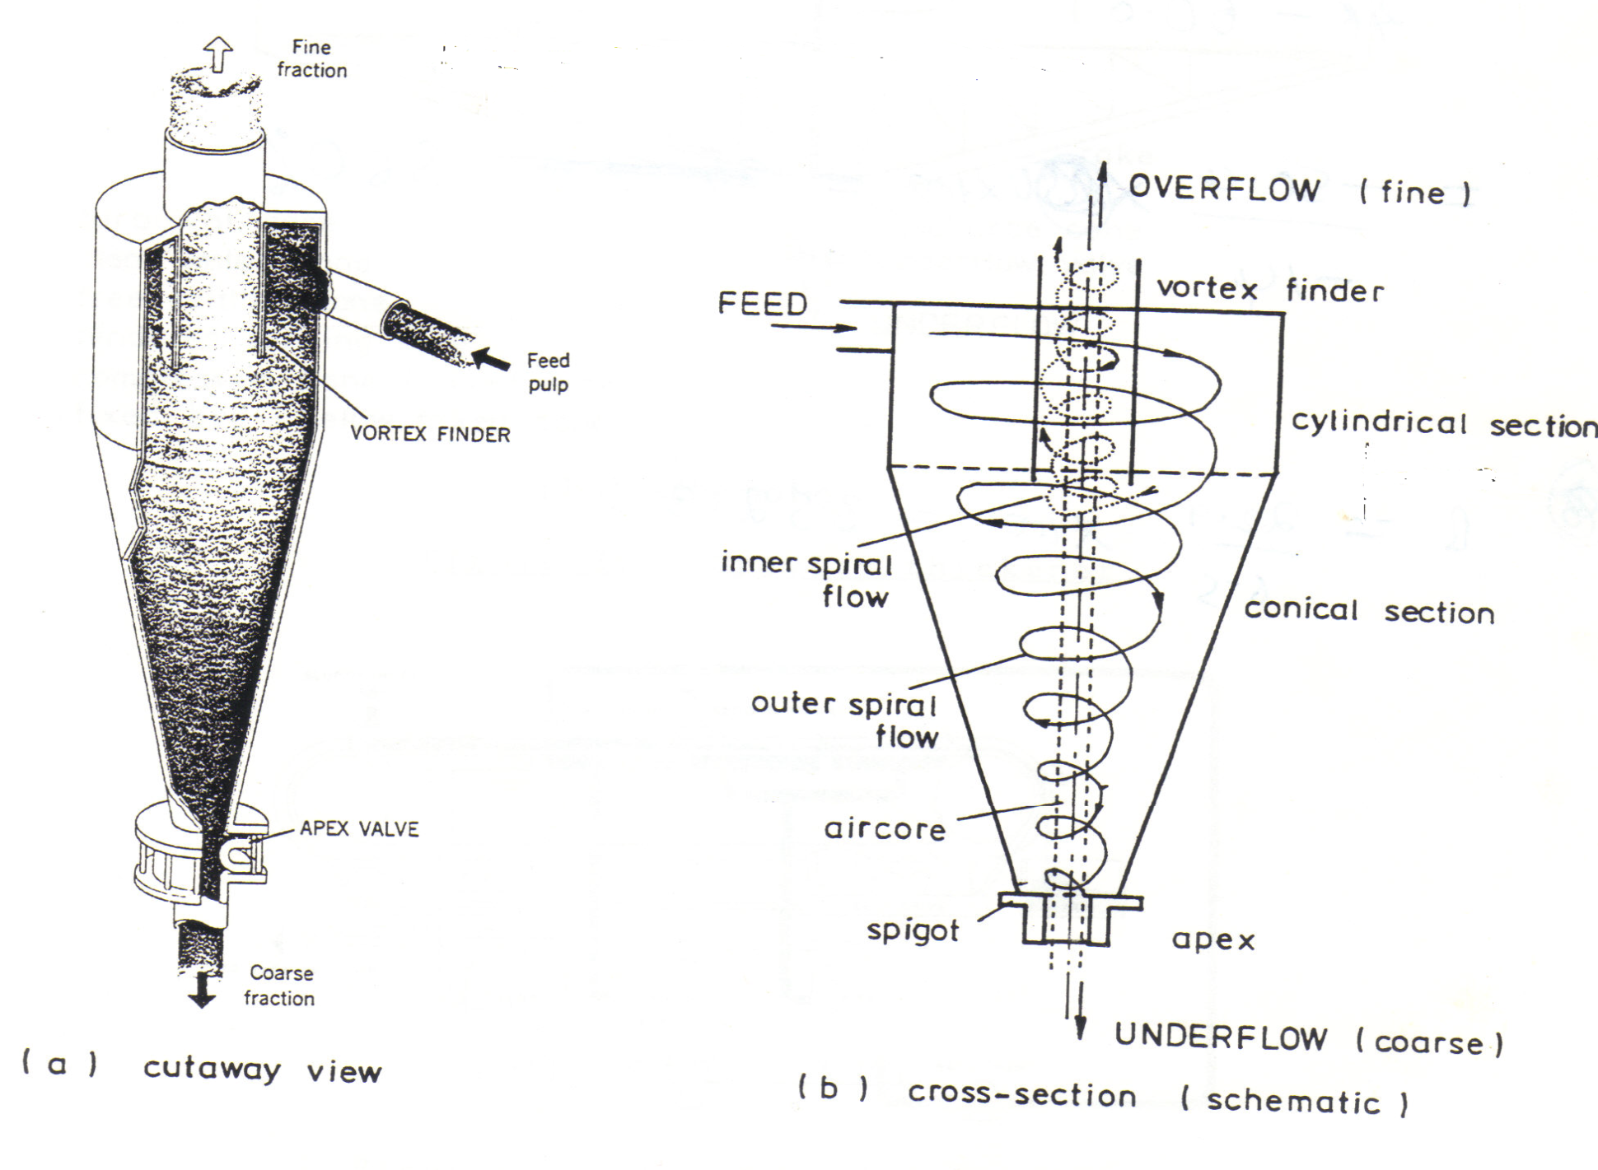
4.2. Types of classifiers (cont.)
Hydrocyclone (cont.).
MS© 2021

Slide 23
4.2. Types of classifiers (cont.)
Operating parameters: Hydrocyclone
The main operating parameters are the pulp density of the feed and the size of the apex opening.
In general, when only one of these variables is changed at a time:
Increasing the pulp density increases the separating size (the overflow becomes coarser);
Increasing the apex opening decreases the separating size (the overflow becomes finer).
MS© 2021

Slide 24
Revision questions
Define classification?
Compare and contrast screening (sieving) and classification
Name three types of classifiers

Slide 25
End of Lecture 4

