Slide 1
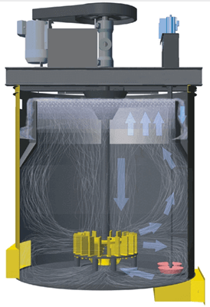
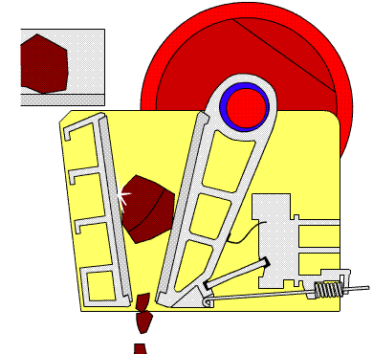


CME 1025: Introduction to mineral science
By
Marthias SILWAMBA (PhD)
Metallurgical Engineering Department
Marthias.silwamba@unza.zm

Slide 2
Lecture 3
Comminution: grinding
MS© 2021

Slide 3
Lecture of objective(s)
By the end of the lecture students are expected to:-
Know different types of grinding mills.
Understand mechanism of comminution by griding
Understand factors that operation of grinding mills
MS© 2021

Slide 4
Lecture content
3.1. Introduction
3.2. Types of grinding mills
3.3. Mechanism of comminution by grinding
3.4. Factors affecting the operation of grinding mill
3.5. Grinding circuit
MS© 2021

Slide 5
Lecture content
3.1. Introduction
3.2. Types of grinding mills
3.3. Mechanism of comminution by grinding
3.4. Factors affecting the operation of grinding mill
3.5. Grinding circuit
MS© 2021

Slide 6
3.1. Introduction
Grinding is the last stage in the comminution process; in this stage, the particles are reduced in size by a combination of impact and abrasion, either in dry or wet conditions by adding water (wet grinding is by far more common).
It is performed in rotating cylindrical steel vessels known as tumbling mills.
These contain a charge of loose crushing bodies – the grinding medium – which is free to move inside the mill, thus comminuting the ore particles.
The grinding medium may be steel rods, or balls, hard rock, or, in some cases, the ore itself.
In grinding, particles between 5 and 250 mm are reduced in size to between 10 and 300 μm.
MS© 2021

Slide 7
3.1. Introduction (cont.)
All ores have an economically optimum mesh of grind, which will depend on many factors, including the extent to which the values are dispersed in the gangue, and the subsequent separation process to be used.
It is important to do close control of the mill product size and, for this reason, correct grinding is often said to be the key to good mineral processing.
Undergrinding of the ore will, of course, result in a product, which is too coarse, with a degree of liberation too low for economic separation; poor recovery and enrichment ratio will be achieved in the concentration stage.
Overgrinding needlessly reduces the particle size of the subsequently liberated major constituent (the gangue) and may reduce the particle size of the minor constituent (usually the mineral value) below the size required for the most efficient separation.
MS© 2021

Slide 8
Lecture content
3.1. Introduction
3.2. Types of grinding mills
3.3. Mechanism of comminution by grinding
3.4. Factors affecting the operation of grinding mill
3.5. Grinding circuit
MS© 2021

Slide 9
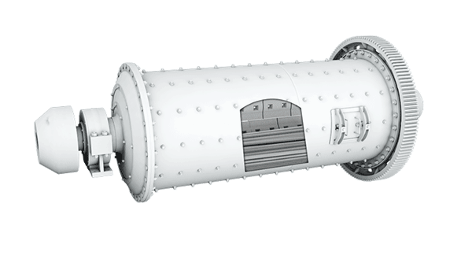
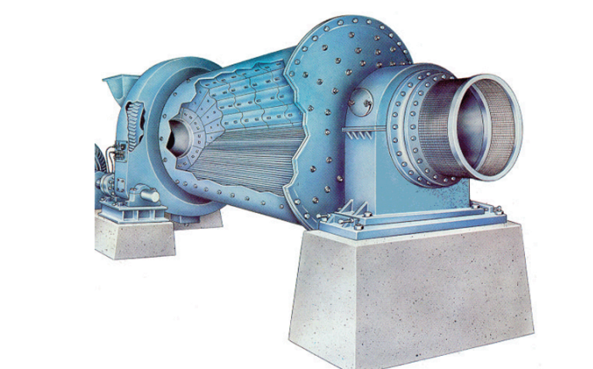

3.2. Types of grinding mills
Grinding is always done in tumbling mills, i.e., horizontal revolving cylinders.
The cylinder is loaded to nearly half of its volume with grinding media which could be steel balls, steel rods or pebbles.
Rod mills
Rod
https://www.911metallurgist.com/blog/rod-mill-working-principle
MS© 2021

Slide 10
3.2. Types of grinding mills (cont.)
Rod mills (cont.)
These may be considered as either fine crushers or coarse grinding machines.
They are capable of taking feed as large as 50 mm and making a product as fine as 300 µm, with reduction ratios normally being in the range of 15 – 20: 1.
They are often referred to as fines-crushing machines when the ore is “clayey” or damp, thus tending to choke the crushers.
The distinctive feature of a rod mill is that the length of the cylindrical shell is between 1.5 and 2.5 times its diameter.
This ratio is important because the rods, which are only a few centimetres shorter than the length of the shell, must be prevented from turning so that they become wedged across the diameter of the cylinder.
MS© 2021

Slide 11
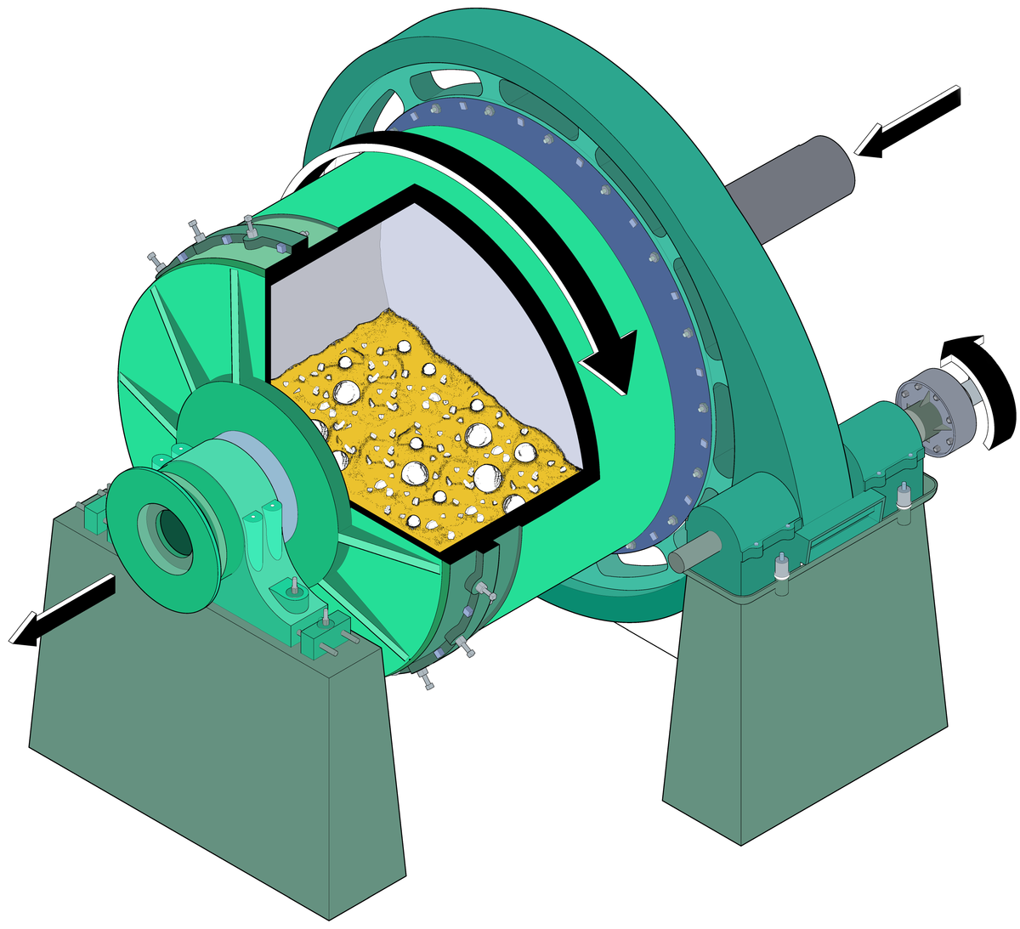

3.2. Types of grinding mills (cont.)
Autogenous (AG) and semi-autogenous (SAG) mills
For an autogenous mill, there is no use of the grinding steel media, instead, the ore itself acts as the grinding media.
Semi-autogenous milling refers to grinding methods using a combination of ore and a reduced load of steel balls as the medium.
MS© 2021

Slide 12
3.2. Types of grinding mills (cont.)
Autogenous (AG) and semi-autogenous (SAG) mills (cont.)
Where the proportion of coarse fraction in the feed is too low, pebble milling is sometimes used.
In this method, the coarsest fraction of the feed is separated, by screening, and the remainder is crushed in conventional machinery to a considerably smaller size.
This crushed material and the coarse fraction are then put into pebble mills for completion of fine grinding.
Several tests have shown that ores ground autogenously float faster and with better selectivity than if ground conventionally in rod mills followed by ball mills.
MS© 2021

Slide 13
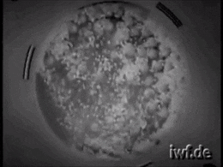
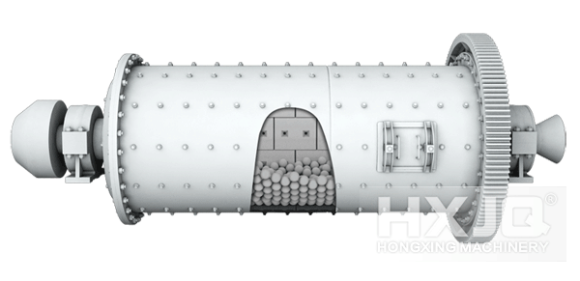
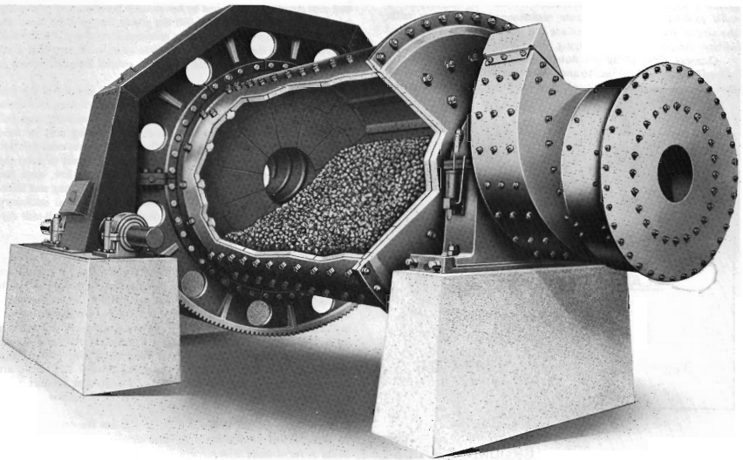
3.2. Types of grinding mills (cont.)
Ball mills
The final stages of comminution are performed in a tumbling mill using steel balls as the grinding medium and so designated ball mills.
Since ball mills have a greater surface area per unit weight than rods, they are better suited for fine finishing.
https://www.911metallurgist.com/blog/ball-mill
MS© 2021

Slide 14
3.2. Types of grinding mills (cont.)
Ball mills (cont.)
The simple closed circuit of ball mill with the classifier looks as below. We will discuss the classification of particles in details next lesson.
Fine: to separation
Ball mill
Cyclone size classifier
mm ⇒ μm
MS© 2021
Notes:
without any respect to the particle size distribution curve

Slide 15
Lecture content
3.1. Introduction
3.2. Types of grinding mills
3.3. Mechanism of comminution by grinding
3.4. Factors affecting the operation of grinding mill
3.5. Grinding circuit
MS© 2021

Slide 16
3.3. Mechanism of comminution by grinding
Grinding is achieved by many mechanism as shown below
(1) Cataracting or water fall
(High rotation speed)
MS© 2021
Source: Wills‘ Mineral Processing Technology 7th edition p147
Notes:
without any respect to the particle size distribution curve

Slide 17
3.3. Mechanism of comminution by grinding (cont.)
The forces on the ore for each mechanism is as shown here
Compression
Shear
Attrition
(a)
(b)
(c)
MS© 2021

Slide 18
Lecture content
3.1. Introduction
3.2. Types of grinding mills
3.3. Mechanism of comminution by grinding
3.4. Factors affecting the operation of grinding mill
3.5. Grinding circuit
MS© 2021

Slide 19
3.4. Factors affecting the operation of grinding mill
Speed of the mill
The speed of the mills affects both efficiency of action of grinding media as well as grinding capacity.
The speed must be as high as possible without centrifuging the charge.
During the rising of grinding media, there is very little grinding.
As the speed of the mill is increased, work input increases at first in proportion to the speed and then slippage increases with a slow increase of work input compared to speed.
The work input increases until a critical speed is reached, beyond, which the power input, decreases rapidly to the vanishing point.
MS© 2021

Slide 20
3.4. Factors affecting the operation of grinding mill (cont.)
Speed of the mill (cont.)
Under this condition, the solids are centrifuged on the shell of the mill and no work is done by the mill.
Where as at low speeds, the grinding media will roll and slide over one another in a mass near the bottom of the mill, giving an action called cascading action.
At intermediate speeds, the grinding media will be carried up to a certain extent and then fall on the material at the bottom of the mill, this action is called cataracting action.
MS© 2021

Slide 21
3.4. Factors affecting the operation of grinding mill (cont.)
Speed of the mill (cont.)
At critical speed angular velocity is equal to gravity force:
    mRw²=mg
mRω²
R(radius)=(D - d) / 2,
w(angular velocity)=2πN/60 (N[rpm])
centrifugal force
Rotation Speed: 80% of the critical speed
D: inner diameter of drum
d: diameter of medium
D - d
mg
gravity force
Optimum rotation Speed: 80% of the critical speed
MS© 2021

Slide 22
3.4. Factors affecting the operation of grinding mill (cont.)
Load of Grinding Media and Material
Increasing the load of grinding media and material will require more power until the maximum value is reached and then power requirement decreases with increasing load as the centre of gravity of the load approaches the axis of rotation.
In the case of a ball mill, the mill should be slightly more than half-full with material and balls.
MS© 2021

Slide 23
3.4. Factors affecting the operation of grinding mill (cont.)
Load of Grinding Media and Material (cont.)
The typical optimum load is as below
  Media volume: 30 - 40% of the drum volume
  Ore amount: 80 vol% (dry) or 100 vol% (wet) of the media space
Ball：30-40 vol%
Dry
Wet

Slide 24
3.4. Factors affecting the operation of grinding mill (cont.)
Solid to liquid ratio (pulp density)
The pulp dilution also influences the grinding efficiency and power input.
The energy input is maximum for a certain critical range of the solid-liquid ratio of the pulp, which is usually obtained in a pulp consisting of 60-75% solids.
However, this range depends on the chemical composition, particle size, and specific gravity of the ore.
For efficient use of energy in grinding, the ore particles should form a coating on liners and grinding media.
At the same time, the pulp should be sufficiently fluid to flow steadily through the mill.
MS© 2021

Slide 25
3.4. Factors affecting the operation of grinding mill (cont.)
Solid to liquid ratio (cont.)
With too thin a pulp, the solids tend to settle and centrifuge outward, and the coatings on the grinding media become patchy to non-existent, so the grinding force is washed as the grinding media hit the grinding media.
If water is too little, the charge becomes sluggish and pasty. In this case, the kinetic energy will be wasted in overcoming viscosity instead of being available for grinding and the ore will remain sandwiched between two grinding bodies instead of giving away for a fresh feed.
MS© 2021

Slide 26
3.4. Factors affecting the operation of grinding mill (cont.)
Return/ circulating load
Any attempt to reduce all the feed to finishing size in one operation would result in wasteful over-grinding.
This difficulty can be overcome by building up the circulating load in a closed circuit.
More effective grinding in terms of output and least over-grinding, can be obtained by a faster rate of ore passing through the mill and a higher capacity of the classifier.
The practical limit is usually in between 5 : 1 to 6 : 1, as a ratio between return (circulating) sand and the new feed in case of primary grinding.
MS© 2021

Slide 27
3.4. Factors affecting the operation of grinding mill (cont.)
Return/ circulating load (cont.)
The ratio is lower in secondary grinding due to the limited sorting speed of the classifier. Increased circulating load results in the following effects:
  Mean size of entering feed becomes lower.
  Amount of nearly finished material is increased in circulating load.
  The retention time and overgrinding of finished material are reduced.
  Range of ball sizes is reduced.
  Close adjustment of solid-liquid ratio is possible.
MS© 2021

Slide 28
3.4. Factors affecting the operation of grinding mill (cont.)
Presence of fine materials
The presence of excessively fine material such as primary slime, clay, overground friable sulphide or gangue in the mill charge may create problems.
Since the surfaces of grinding media become coated with a film of fine material, which acts as a lubricant resulting in slip and reduction in impact grinding.
MS© 2021

Slide 29
Lecture content
3.1. Introduction
3.2. Types of grinding mills
3.3. Mechanism of comminution by grinding
3.4. Factors affecting the operation of grinding mill
3.5. Grinding circuit
MS© 2021

Slide 30
3.5. Grinding circuit
Open circuit
In an open circuit the material is fed into the mill at a rate calculated to produce the correct product in one pass
Mill
Feed
Product
Mill
MS© 2021

Slide 31
3.5. Grinding circuit (cont.)
Open circuit
This type of circuit is rarely used in mineral processing applications as there is no control over the product size distribution.
The feed rate must be low enough to ensure that every particle spends enough time in the mill to be broken down to product size.
As a result, many particles in the product are overground, which consumes energy needlessly, and the product may subsequently be difficult to treat.
MS© 2021

Slide 32
3.5. Grinding circuit (cont.)
Closed circuit
Grinding in the mining industry is almost always in closed circuit, in which material of the required size is removed by a classifier, which returns the oversize to the mill.
Product (cyclone overflow)
Feed
Mill
Cyclone
Recycled load (cyclone underflow)
MS© 2021

Slide 33
3.5. Grinding circuit (cont.)
Closed circuit (cont.)
The material returned to the mill by the classifier is known as the circulating load, and its weight is expressed as a percentage of the weight of the new feed.
Closed-circuit grinding reduces the residence time of particles in each pass, and so the proportion of finished sizes in the mill, compared with open-circuit grinding.
This decreases over-grinding and increases the energy available for useful grinding as long as there is an ample supply of unfinished material present.
As the tonnage of new feed increases, the tonnage of circulating load increases, since the classifier underflow becomes coarser, but the composite mill feed becomes finer due to this increase in circulating load.
MS© 2021

Slide 34
Revision questions
How is griding different from crushing in mineral processing?
State fours types of grinding mills used in mineral processing
State four factors that affect operations of grinding mills.
With the aid grinding circuit explain the difference between closed grinding circuit and open grinding circuit.

Slide 35
End of Lecture 3

