Slide 1
Business Environment
(Law Students)
Lecture 2
An Assessment of the Environment
(Micro – Task / Operating)
Ms. Faith Moono Simwami
Email: mo.simwami@gmail.com

Slide 2
THE MEANINING OF THE EXTERNAL BUSINESS ENVIRONMENT
The external environment is everything outside an organization that might affect it. An organization's external environment consists of two layers:
The task environment - refers to those specific organizations or groups that are likely to influence an organization. It consists of competitors, customers, suppliers, regulators, unions and owners.
The general environment - refers to those nonspecific dimensions and forces in an organization's surroundings that might affect its activities. It includes all PEST factors.

Slide 3
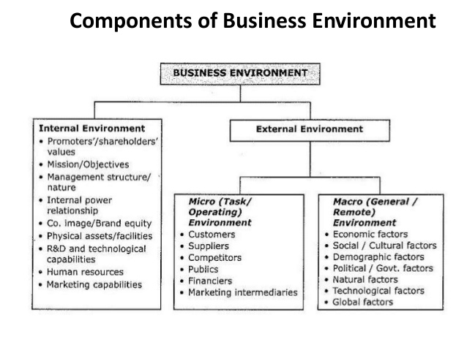

Slide 4
THE TASK ENVIRONMENT
The task environment consist of seven dimensions
1. Competitors
An organization's competitors are other organizations that compete with it for resources.
The most obvious resources that competitors via for are customers. Customers include whomever pays money to acquire an organization's products or services.
Other competitors include those who produce similar or substitutes products that perform a similar function or solve the problem or eliminate it in a dissimilar way.

Slide 5
2. Customers
Customers can be individuals or organizations.
Understanding customers is an important factor in the success of any business organization.
Consumers have rights and they include:
The right to choose freely –variety of goods
The right to be informed-Education on product information.
The right to be heard –Express displeasure
The right to be safe- Product safety

Slide 6
CUSTOMERS
Customers are the reasons for the existence of an organization.
Customers bring money to the business, provide new product ideas and they are marketing agents for the organization.
The customers interests in the organization include; quality goods and services, fair prices, consistency of supply and full information on products.

Slide 7
3. Suppliers
Suppliers are organizations or individuals that provide resources for other organizations.
Suppliers for manufacturing firms include the suppliers of raw materials and those that sell machinery and other equipment.
Banks and lending agencies are both suppliers of capital for businesses.
Other suppliers provide human resources for the organization.

Slide 8
SUPPLIERS
Suppliers of production inputs to the organization are major sources of competitive advantage.
The suppliers interested in payment for the various supplies they make.
They are also interested in lasting business relationships with the organizations they supply to.

Slide 9
4. Regulators
Regulators are units that have the potential to control, regulate, or influence an organization's policies and practices.
There are two important kinds:
Regulatory agencies that are created by the government, and
Interest groups formed by their own individual members to attempt to influence business.

Slide 10
GOVERNMENT
Government is major buyer of various goods and services.
The Government enacts laws and makes regulations that should be respected and obeyed even if it is not in the interest of the company.
The Government is interested in Tax revenues for the implementation of various government projects. The government also expects organizations to create employment for the citizens.

Slide 11
5. External Labour
Organizations must also concern themselves with labour especially when it is organized into unions.
The Industrial Relations Act requires organizations to recognize and bargain with a union.
That union has to be legally established and should be a mother body of the organization's employees.

Slide 12
COMMUNITY
Customers of the business are part of the community and contribute to the growth of the business.
The community expects an organization to engage corporate social responsibilities and create employment for the community.
Communities have expectations of good corporate citizens to be good to the community publics in areas such as promoting sport, education and other social programs

Slide 13
6.Owners
Owners (shareholders) are also becoming a major concern of managers in many businesses.
Until recently, stockholders of major corporations were generally happy to sit on the sidelines and let top management run their organizations.
Lately, however, more and more of them are taking active roles in Influencing the management of companies they hold stock in.

Slide 14
SHAREHOLDERS (STOKEHOLDERS)
Shareholders are the providers of capital in a business.
These are the owners of a business their interest is getting a reasonable return on their investment.
They are also interested in the profitability of the business and ensuring that their wealth is growing.

Slide 15
7. Strategic Allies
Strategic allies are two or more organizations working together in a joint venture or similar arrangement.
Strategic alliances help companies get from other companies the expertise they may lack.
They also spread the risk. Managers must be careful, however, not to give away sensible competitive information.

Slide 16
THE ORGANIZATION AND IT’S STAKEHOLDERS
Introductions and definitions
Organizations operate in an environment that is dynamic and affects the interests of various business associates called stakeholders.
Stakeholders are those individuals, institutions etc who have a stake in the future development of the organization.
DEFINITION
Organizational stakeholders may be defined as individuals or groups of people who have an interest in or are affected by the operations of an organization.

Slide 17
THE INTERNAL ENVIRONMENT
An organization's internal environment consists of conditions and forces within the organization.
Its major components include:
1. Board of Directors
2. Employees
3. Culture

Slide 18
1. Board of Directors
A board of directors is elected by the stockholders and is charged with overseeing the general management of the firm to ensure that it is being run in a way that best serves the stockholder's interests.
The board plays a major role in helping set corporate strategy and seeing that it is implemented properly.
The board also reviews all important decisions made by top management and determines compensation for top managers.

Slide 19
2. Employees
Employees do exert a lot of influence on organizations by way of demanding for good conditions of service.
If employees demand more higher pay and other benefits than they produce, an organization will be affected.
A second challenge for business is harnessing human skills and talents for productive work while protecting human dignity and health at the same time.

Slide 20
KEY STAKEHOLDERS OF THE ORGANIZATION
EMPLOYEES
Employees are the most important assets of the organization and the employees and the organization need each other.
Organizations have social contracts with the employees where employees expect the employer to treat them fairly.
The employees’ interests in the organization include; better conditions of service, Secure job, career advancement etc.

Slide 21
3. Culture
The culture of an organization is the set of values that help its members understand what the organization stands for, how it does things and what it considers important.
Culture plays a major role in shaping managerial behavior and practice.
Most successful foreign firms, such as Toyota are known to have a strong and clear culture that contribute to their effectiveness.
Culture is a powerful force in organizations, one that can shape the firm's overall effectiveness and long-term success.

Slide 22
IMPORTANCE OF ENVIRONMENTAL STUDY
Development of broad strategies and long-term policies of the firm.
Development of action plans to deal with technological advancements.
To foresee the impact of socio-economic changes at the national and international levels on the firm’s stability.
Analysis of competitor’s strategies and formulation of effective counter-measures.
To keep oneself dynamic.

Slide 23
TASK
In Groups of no more than FOUR (4), you will be assigned a component of the Task Environment.
Required:
  Research this component
  Select a type of business/industry as a case
  In no more than 5 minutes present to the class how your respective component can both positively and negatively affect the profitability of a business

