Slide 1
COMPETITIVE ANALYSIS TOOL-PORTER’S FIVE FORCES

Slide 2
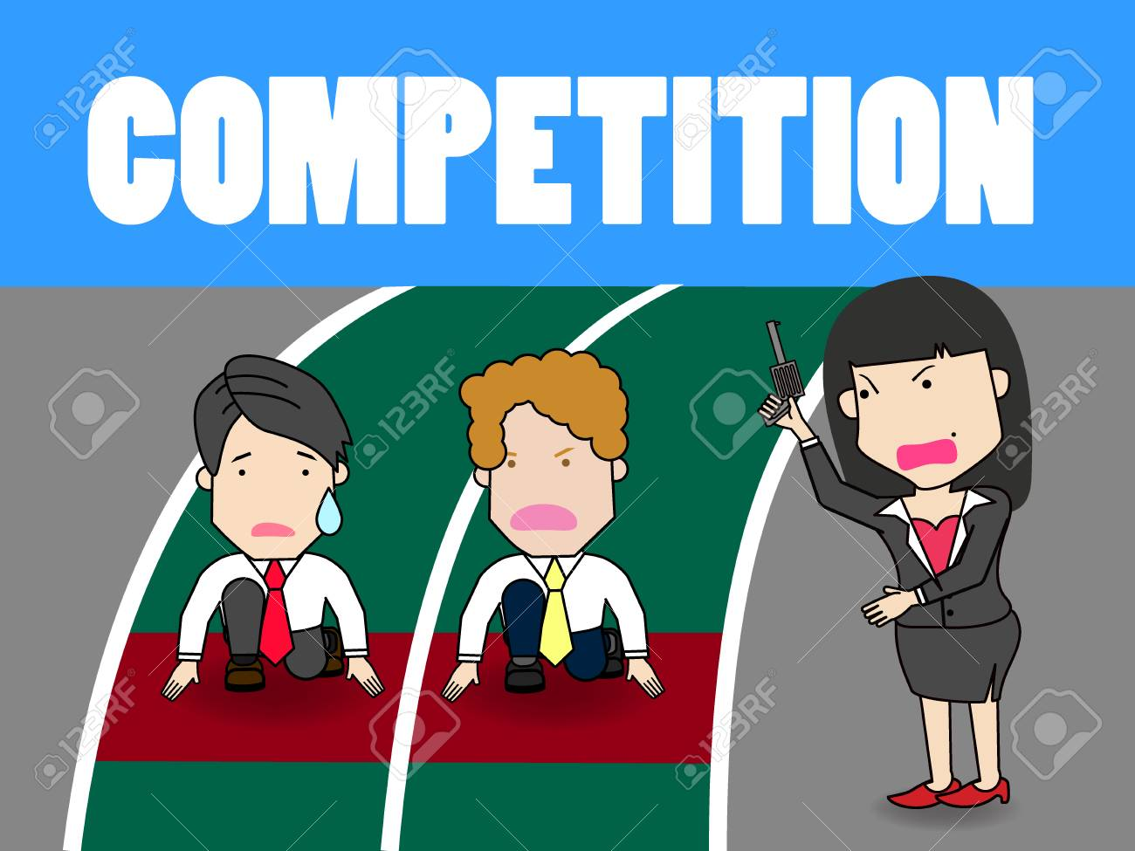
IS COMPETITION GOOD OR BAD? DISCUSS.

Slide 3
The competitor to be feared is one who never bothers about you at all, but goes on making his own business better all the time. Henry Ford

Slide 4
Competition is all around and affects virtually all businesses as well as individuals;
            Interviews
            Promotion
            Awards

Slide 5
Competitive Analysis
Competition is one of the biggest threats to businesses be it a start up or established.
Who is your competition?
How are their actions in the marketplace going to affect your current bottom line and future planning?
How do you as a business counter your competitors move?

Slide 6
REMEMBER…….
No one strategy is best for all companies – each company must determine what makes the most sense given its position in the industry and its objectives, opportunities, and resources.
In a market there will be the following;
      Market leader- this is the firm with the biggest market share in an industry.
      Market challengers – a runner-up firm in an industry that is fighting hard to increase its market share.
      Market follower – a runner-up firm in an industry that wants to hold its share without rocking the boat.
      Market nicher – A firm in an Industry that serves small segments that the other firms over look or ignore.

Slide 7
PROTECTING MARKET SHARE
POSITION DEFENSE – Build fortifications around its current position. (rarely works)
FLANKING DEFENSE – Check all flanks and protect the weaker ones.
PRE-EMPTIVE DEFENSE – striking competitors before they can move against the company.
COUNTER OFFENSIVE DEFENSE – When attacked despite its flanking or pre-emptive efforts.
CONTRACTION DEFENSE – when resources are spread too thinly and competitors are nibbling away on several fronts.

Slide 8
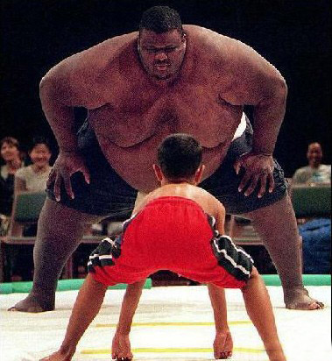
What strategies should this little boy use to win the fight?

Slide 9
Competitor attack strategies
4 Bypass attack
2 Flanking attack
C
O
M
P
A
N
Y
C
O
M
P
E
T
I
T
O
R
1 Frontal attack
5
Guerilla attack
3 Encirclement
attack

Slide 10
CHOOSING AN ATTACK STRATEGY
How can the market challenger best attack the chosen competitor and achieve its strategic objective?
1.FRONTAL ATTACK
The Challenger matches the competitor’s product; advertising, price and distribution efforts. It attacks competitor’s strengths rather than weaknesses.
The outcome depends on who has the greater strength and endurance. If the market challenger has fewer resources than the competitors, a frontal attack makes little sense. Even great size and strength may not be enough to challenge a firmly entrenched, resourceful competitor successfully.

Slide 11
2.FLANKING ATTACK
Rather than attacking head on, the challenger can concentrate its strength against the competitor’s weaker flanks or on gaps in the competitor’s weaker flanks or on gaps in the competitor’s market coverage .
Flank attacks make good sense when the company has fewer resources than the competitor.

Slide 12
3.ENCIRCLEMENT ATTACK
This involves attacking from the front, sides and rear at the same time.
The encirclement strategy makes sense when Challenger has superior resources and believes that it can break the competitor’s hold on the market quickly.

Slide 13
4.BYPASS ATTACK
Here, the challenger bypasses the competitor and targets easier markets. It might diversify into un related products, move into new geographic markets, or leapfrog into new technologies to replace existing products.
With technological leap-frogging, instead of copying the competitors products and mounting a costly frontal attack, the challenger passes by the competitor with the next technology.

Slide 14
5. GUERRILLA ATTACKS
For smaller or poorly financed challengers, this attack is ideal. These are small, periodic attacks to harass and demoralize the competitor, with the goal of eventually establishing permanent footholds.
The Challenger might use selective promotional out bursts, or assorted legal actions. Specific guerrilla actions can be cheap, but continuous guerilla campaigns can be expensive. And they eventually must be followed up by stronger attacks if the challenger wishes to gain ground against competitors.

Slide 15
CONCLUSION
For an organization to maintain market leadership, it needs to:-
Prevent or fix weakness that provide opportunities for competitors
Keep Costs down
Keep its prices in line with the value the customers see in their brands
Leader should “plug holes” so that competitors do not jump in
Best defense is a good offense
Best response is continuous innovation
The leader should refuse to be content with status quo and always leads in new product, customer service distribution effectiveness and cost cutting.

Slide 16
Michael Porter’s Five Forces Competitive Model
Competitive Analysis tool developed by Michael Porter in 1979
This theory is based on the concept that there are five forces that determine;
  Competitive intensity and attractiveness of a market,
  Where power lies in a business situation,
  Whether or not a business can be profitable, based on other businesses in the industry.
  Competitive strength and position of business organisations
  Whether new products or services are potentially profitable.

Slide 17
APPLICATION OF PORTERS’ FIVE FORCE THEORY
Actions to take / Dos | Actions to Avoid / Don'ts
Use this model where there are at least three competitors in the market Consider the impact that government has or may have on the industry Consider the industry lifecycle stage – earlier stages will be more turbulent Consider the dynamic/changing characteristics of the industry | Avoid using the model for an individual firm; it is designed for use on an industry basis

Slide 18
Porter Competitive Model
Potential
New Entrants
Bargaining
Power
of Suppliers
Intra-Industry
Rivalry
Strategic Business Unit
Bargaining
Power
of Buyers
Substitute
Products
and Services
Source: Michael E. Porter
“Forces Governing Competition in Industry
Harvard Business Review, Mar.-Apr. 1979

Slide 19
THREAT OF NEW ENTRANTS
Examines how easy or difficult it is for competitors to join the marketplace in the industry being examined.
The easier it is for a competitor to join the marketplace, the greater the risk of a business's market share being depleted.

Slide 20
Profitable markets attract new entrants, which erodes profitability.
Unless incumbents have strong and durable barriers to entry, for example;
        patents
        economies of scale
        capital requirements
        access to inputs
        government policies

Slide 21
Questions Asked….
How much does it cost and how long does it take to enter your market?
What are the barriers to entry (e.g. patents, rights, etc.)?
What does it take to make the business scalable?
Have you protected your key technologies?
How strictly is your market regulated?
If competitors can enter your market with little money and effort, you will need to adapt your strategy to handle any potential rivals.

Slide 22
Threat of substitute products
A substitute good is a good that can be used in place of another.
Consumer perceives substitutes as similar or comparable, so that having more of one product makes them desire less of the other product.
Examines how easy it is for consumers to switch from a business's product or service to that of a competitor.
Where close substitute products exist in a market, it increases the likelihood of customers switching to alternatives in response to price increases.
This reduces both the power of suppliers and the attractiveness of the market.

Slide 23
Substitute is high when;
Consumer switching costs are low
Substitute product is cheaper than industry product
Substitute product quality is equal or superior to industry product quality
Substitute performance is equal or superior to industry product performance

Slide 24
Questions Asked……
What are the differentiators between your product/service and the substitute?
How many substitute products are available in this market?
What is the cost of switching to a substitute product?
How difficult would it be to make the switch?
What products or services can you offer that might substitute a market leader?

Slide 25
Bargaining power of Buyers
Analyses the power of the consumer to affect pricing and quality, how easy is it to drive down prices.
Consumers have power when there are not many of them, but lots of sellers, as well as when it is easy to switch from one business's products or services to another.
Buying power is low when consumers purchase products in small amounts.
If a business has just a few powerful buyers, they are often able to dictate terms.

Slide 26
Questions Asked……
How many buyers control your sales?
How large are the orders you receive?
Could your buyers switch suppliers—and how much would it cost for them to switch?
How important is your product/service to your buyers (i.e. what is the ROI of your product/service)?

Slide 27
Bargaining power of suppliers
Analyses how much power a business's supplier has and how much control it has over the potential to raise its prices, which, in turn, would lower a business's profitability.
The fewer the suppliers , the more power they have.
Businesses are in a better position when there are a multitude of suppliers.

Slide 28
Questions Asked……
How many suppliers does your business have?
How unique is the product or service that they provide?
How many alternative suppliers can you find? How do their prices compare to your current supplier? How expensive would it be to switch from one supplier to another?

Slide 29
COMPETITIVE RIVALRY
Examines how intense the competition is in the market
Main driver is the number and capability of competitors in the market.
Many competitors, offering undifferentiated products and services, will reduce market attractiveness.

Slide 30
Rivalry competition is high when;
there are just a few businesses equally selling a product or service,
when the industry is growing
when consumers can easily switch to a competitor's offering for little cost.
When rivalry competition is high, advertising and price wars can ensue, which can hurt a business's bottom line.

Slide 31
Questions Asked……
How many competitors do you have?
Who are your biggest competitors?
How does the quality of their products or services compare with yours?
What distinguishes your company from the competition?
What will it cost one of your customers to switch to a competitor?

Slide 32
END

