Slide 1
Lecture 5
An Assessment of the External Environment
PORTERS FIVE FORCES
Business Environment
(Law Students)
Ms. Faith Moono Simwami
Email: mo.simwami@gmail.com

Slide 2
Industry Analysis

Slide 3
Porter Competitive Model
Potential
New Entrants
Bargaining
Power
of Suppliers
Intra-Industry
Rivalry
Strategic Business Unit
Bargaining
Power
of Buyers
Substitute
Products
and Services
Source: Michael E. Porter
“Forces Governing Competition in Industry
Harvard Business Review, Mar.-Apr. 1979
Figure 3-1

Slide 4
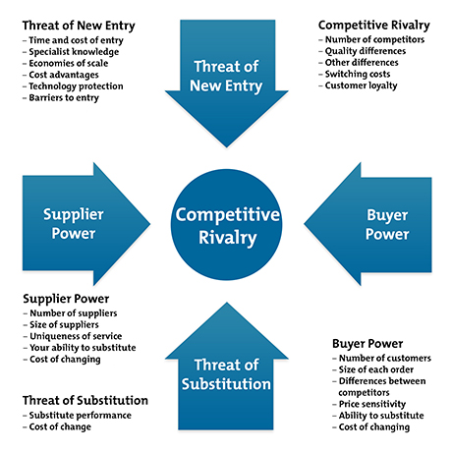

Slide 5
Threat of New Entrant
An existing company or a startup that has not previously competed with the SBU in its geographic market. It can also be an existing company that through a shift in business strategy begins to compete with the SBU.
Threat of New Entry: Power is also affected by the ability of people to enter your market. If:
It costs little in time or money to enter your market and compete effectively
There are few economies of scale in place
You have little protection for your key technologies..
…then new competitors can quickly enter your market and weaken your position.
If you have strong and durable barriers to entry, then you can preserve a favorable position and take fair advantage of it.
Notes:
Economies of scale: the cost advantages that enterprises obtain due to size, output, or scale of operation, with cost per unit of output generally decreasing with increasing scale as fixed costs are spread out over more units of output

Slide 6
Questions Asked In Analysis
How easy is it for another company to do what I am doing?
How hard or costly is it for another company to setup a company like mine?
How easy is it for my potential rival to gain economies of scale – cost of machinery, supplier relationships etc…?
Am I able to protect my brand either through patents, copyrights or trademarks? Or is what I do too general?

Slide 7
Substitute Product or Service
An alternative to doing business with the SBU. This depends on the willingness of the buyers to substitute, the relative price/performance of the substitute and/or the level of the switching cost.
Threat of Substitution: This is affected by the ability of your customers to find a different way of doing what you do – for example:
If you supply a unique software product that automates an important process, people may substitute by doing the process manually or by outsourcing it. If substitution is easy and substitution is viable, then this weakens your power.
Notes:
Not all substitutes are direct. Debonairs and Pick n Pay

Slide 8
Questions Asked In Analysis
Are there alternative options to my product? Original vs Chinese?
Who are my competitors? Direct & Indirect?
What would make my customers opt for the alternative? Cheaper? Same performance?
What does it cost my customers to swap from my product to the next? Location? Convenience? Marketing/press?

Slide 9
Industry Rivalry
Likelihood?
Profit margins.
Industry growth rate and potential.
A lack of capacity to satisfy the market.
Competitor concentration and balance.
Diversity of competitors.
Existing brand identity.
Switching costs.
Exit barriers.
Fixed costs.
Competitive Rivalry: What is important here is the number and capability of your competitors. If you have many competitors, and they offer equally attractive products and services, then you'll most likely have little power in the situation, because suppliers and buyers will go elsewhere if they don't get a good deal from you. On the other hand, if no-one else can do what you do, then you can often have tremendous strength.

Slide 10
Questions Asked In Analysis
Who are my competitors?
How many people are doing the same thing I am?
Is my product/service different enough from others?
How well am I meeting the demand on the market & is there need for more companies?
Are all other businesses who are in my SBU in the same geographic region?

Slide 11
Power of the Buyer
Buyer Power: Here you ask yourself how easy it is for buyers to drive prices down. Again, this is driven by the number of buyers, the importance of each individual buyer to your business, the cost to them of switching from your products and services to those of someone else, and so on. If you deal with few, powerful buyers, then they are often able to dictate terms to you.

Slide 12
Questions Asked In Analysis
Is there a large, concentrated buying power that enables buyers to gain volume discounts and/or special terms or services?
Is the product being bought standard or undifferentiated and are there multiple alternative sources?
Is there strong potential to backward integrate? i.e. acquire ownership over one’s supply chain, reducing supplier power and reducing input costs?
Is the quality of the product unimportant to the buyers’ options?
Notes:
Backward Integration – Starbucks buying a coffee farm. Amazon printing books. Ice cream company buying cows/dairy farm.

Slide 13
Power of the Supplier
Supplier Power: Here you assess how easy it is for suppliers to drive up prices. This is driven by the number of suppliers of each key input, the uniqueness of their product or service, their strength and control over you, the cost of switching from one to another, and so on. The fewer the supplier choices you have, and the more you need suppliers' help, the more powerful your suppliers are.

Slide 14
Questions Asked In Analysis
Are there only a few domination suppliers?
Is the product unique or differentiated?
How low or high are the built up switching costs?
Are benefits gained through geographic proximity to its customers?
How easy is it for a supplier to forward integrate?
Have suppliers maintained a long lasting relationship with its buyers?
Notes:
Forward integration – finding ways of moving up the supply chain and closer to the end user. I.e. a manufacturing company opening an online marketing site to sell to the end user.

Slide 15
Example
Martin Johnson is deciding whether to switch career and become a farmer – he's always loved the countryside, and wants to switch to a career where he's his own boss. He creates the following Five Forces Analysis as he thinks the situation through:

Slide 16
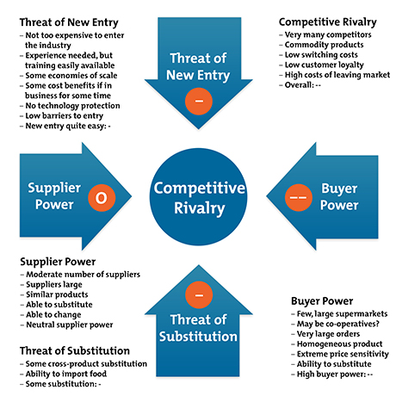

Slide 17
This worries him
The threat of new entry is quite high: if anyone looks as if they're making a sustained profit, new competitors can come into the industry easily, reducing profits.
Competitive rivalry is extremely high: if someone raises prices, they'll be quickly undercut. Intense competition puts strong downward pressure on prices.
Buyer Power is strong, again implying strong downward pressure on prices.
There is some threat of substitution.
Unless he is able to find some way of changing this situation, this looks like a very tough industry to survive in. Maybe he'll need to specialize in a sector of the market that's protected from some of these forces, or find a related business that's in a stronger position.

Slide 18
STRATEGY FOR MARKET ENTRY
- CHONGWE -
Zambeef Shoprite Unilus
Trade Kings Bata Protea Hotel Lafarge Cement Autoworld O’Hagans Zesco KFC
InterContinental Hotel South African Airways
Notes:
Tour of Roland Imperial Tobacco Plant

Slide 19
Questions?

