Slide 1
Lecture 3
An Assessment of the Environment
(External/Macro)
Business Environment
(Law Students)
Ms. Faith Moono Simwami
Email: mo.simwami@gmail.com

Slide 2
So what is THE
BUSINESS ENVIRONMENT?
Environment refers to all external forces, which have a bearing on the functioning of business. Environment factors “are largely if not totally, external and beyond the control of individual industrial enterprises and their managements. The business environment poses threats to a firm or offers immense opportunities for potential market exploitation.

Slide 3
IMPORTANCE OF ENVIRONMENTAL STUDY
Development of broad strategies and long-term policies of the firm.
Development of action plans to deal with technological advancements.
To foresee the impact of socio-economic changes at the national and international levels on the firm’s stability.
Analysis of competitor’s strategies and formulation of effective counter-measures.
To keep oneself dynamic.

Slide 4
Assessment of the Environment
The analysis of strengths and weaknesses of organizations should follow the formation of objectives.
The task involves more than just identifying and evaluating an organization’s strengths and weaknesses.
It requires capturing a sense of how those strengths and weaknesses combine to help an organization position itself in the market.
This process of matching possibilities with capabilities is basic to the development of strategies for achieving objectives.

Slide 5
Standard Techniques
The following techniques are used to assess the internal and external environment:
1. PEST / STEP Analysis - used to analyze the external environment
2. SWOT Analysis - used to analyze both the internal and external environment
3. Porter's Five Forces Model - used to analyze an industry in which an organization operates.

Slide 6
THE MEANINING OF THE EXTERNAL BUSINESS ENVIRONMENT
The external environment is everything outside an organization that might affect it. An organization's external environment consists of two layers:
The general environment - refers to those nonspecific dimensions and forces in an organization's surroundings that might affect its activities. It includes all PEST factors.
The task environment - refers to those specific organizations or groups that are likely to influence an organization. It consists of competitors, customers, suppliers, regulators, unions and owners.

Slide 7
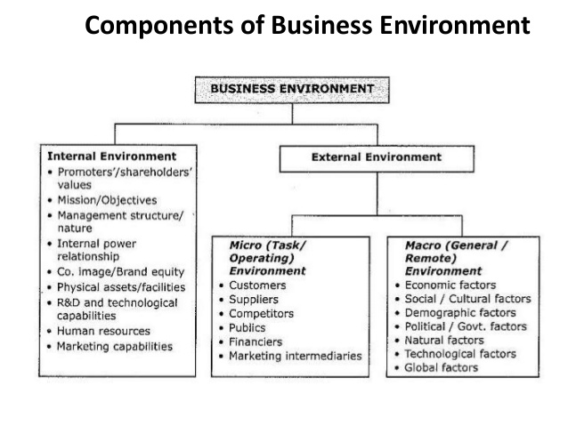
THE EXTERNAL ENVIRONMENT

Slide 8
GENERAL ENVIRONMENT
POLITCAL
ECONOMIC
SOCIAL/CULTURAL
TECHNOLOGICAL

Slide 9
Business Analysis Models
-PEST Analysis-
What is PEST Analysis?
PEST analysis is an analysis model examining the external environment and the global factors that may affect a business.
It can provide a quick understanding of the external pressures facing a business and their possible constraints on its strategy.
It is usually divided into four external influences on a business – Political, Economic, Social and Technological.
Created by Harvard professor Francis Aguilar in 1967, PEST can work alone or be used in combination with other tools, such as Porter's Five Forces and SWOT analysis, to determine an organization's overall outlook.
Notes:
READ THROUGH PEST WRITING

Slide 10
POLITICAL
The political/legal environment consists of the law and interpretation of laws that require firms to operate under competitive conditions and to protect consumer rights.
Ignorance or noncompliance with the laws, could result in fines.
Operating within the legal framework is both socially responsible and ethical.

Slide 11
Issues That Must Be Considered Include:
Tax guidelines
Copyright and Property Law Enforcement
Political stability
Trade Regulations
Social and Environmental Policy
Employment laws
Safety regulations.
Companies should also consider their local and federal power structure, and discuss how anticipated shifts in power could affect their business.

Slide 12
The Political/Legal Environment Cont’d
Organizations can attempt to influence the legal structure through:
  Lobby groups / Trade Associations
  Campaign Contributions
The central and local government have established regulatory agencies to enforce laws i.e. CCPC, ZRA, NAPSA etc…

Slide 13
Business Analysis Models
-Illustrations for PEST Analysis Models
Purposes:
To find how political development, locally, nationally, internationally affect the strategy of a business.
Areas to be considered:
Consumer laws and regulation
Political pressures,
Government views on certain business activities, including local, national and international government political issues affecting a business
Political
© PhotoDisc

Slide 14
ECONOMIC
The economic and competitive forces in the marketing environment influence both marketers and customers' decision and activities.
The overall state of the economy fluctuates in all countries.
The health of the economy influences how much consumers spend and what they buy.
These changes in general economic conditions affect (and are affected by) the forces of supply and demand, buying power, willingness to buy, expenditure levels and the intensity of competitive behaviour.

Slide 15
The Consumption Patterns of their Potential Customers are Affected by Economic Forces such as:
Interest rates
The availability of credit for consumer purchases or investment purposes
The rate/policies of unemployment
The size of disposable personal income.
Economic growth
Exchange rates
Economic stability
Anticipated shifts in commodity and resource costs
The rate of inflation

Slide 16
Business Analysis Models
-Illustrations for PEST Analysis Models
Purposes:
To find how economic factors may affect on the business.
Areas to be considered:
Consumer activities, such as spending patterns
Economic conditions, such as inflation, unemployment, growth, etc.
Government policies, such as fiscal, monetary, exchange rates, etc.
The changes in production and labor market …
Economic

Slide 17
SOCIAL
As businesses broaden their operations both locally and internationally, the need to be aware of social/cultural factors becomes more and more important.
This issue analyzes the demographic and cultural aspects of the company's market. These factors help businesses examine consumer needs and determine what pushes them to make purchases.

Slide 18
Among the items that should be examined are:
Demographics
Population Growth Rates
Age Distribution
Attitudes Toward Work
Job Market Trends
Religious
Ethical Beliefs
Lifestyle Changes
Educational and Environmental issues
Health consciousness

Slide 19
Business Analysis Models
-Illustrations for PEST Analysis Models
Purposes:
To find what competitive advantage a business may gain by social changes.
Areas to be considered:
Aging population trend, which may increase services for old people
Birth rate increase, which may affect baby product markets
Security condition, e.g. increase in crime may cause a business to increase insurance costs
Pressure groups, such as environmental groups, local community groups, etc. which may prevent a business from polluting a river…
Social
© PhotoDisc

Slide 20
TECHNOLOGICAL
The technological environment represents the application of knowledge based on discoveries in science, inventory and innovations.
New technology results in new products and services for consumers, improved existing products and often lower prices through the development of more cost-efficient production and distribution methods.
Technology can quickly make products obsolete

Slide 21
Among the Specific Items That Need to be Considered Are:
Technological advancements
Government spending on technological research
The role of the Internet and how any changes to it may play out
Speed of service delivery
Product innovation – phone-watch, virtual education
  Eg. Barcodes, emails, packaging & delivery,

Slide 22
Business Analysis Models
-Illustrations for PEST Analysis Models
Purposes:
To find how new technologies might affect the business activities.
Areas to be considered:
The rate of technological change
The development of IT
The wide use of Internet
The creation of new materials for production …
Impacts:
All these technological changes will lead to some effects on the business, such as the product of the business may be replaced by new products or its production methods may have become out of date.
Technological
© PhotoDisc

Slide 23
Example
Political factors: Government regulations regarding employee hygiene, health and food regulations, food standards, etc. Government policies regarding the restaurant industry and managing eateries. These may include licenses, inspections by health and food departments, etc.
Economic factors: Interest rates would affect the cost of capital, the rate of interest being directly proportionate to the cost of capital. Rate of inflation determines the rate of remuneration for employees and directly affects the price of the restaurant's products. Again, the proportion between the inflation rate and wages/prices is direct. Economic trends act as an indicator of the sustainability and profitability of your business in the chosen region and help you in deciding your marketing strategy.

Slide 24
Example
Social factors: Eating habits of the people in your chosen business environment may, and certainly will, affect your marketing decisions. Ratio of people preferring to eat out regularly.
Technological factors: A good technical infrastructure would lead to better production, procurement and distribution logistics, resulting in reduced wastage and lower costs. Effective technology may be a decisive factor for food technology innovation, better presentation, more effective business marketing, etc.

Slide 25
Adapting to the Technological environment
Adopting technology may be the means by which a firm remains competitive.
Applying new technology also gives organizations the opportunity to improve customer service e.g. 24 hours banking due to ATMs.
New technology can lead to increased productivity and operating efficiency e.g. CAD and CAM speed up the production process in manufacturing companies.

Slide 26
International Forces
Environment forces within the international business include:
  Language differences
  Changing currency exchange rates
  Different national laws affecting economic activity, political risks and stability,
  Tax laws of different nations, and
  Social/cultural differences between nations.

Slide 27
TASK 2
Choose an industry sector in Zambia with which you are familiar and identify the elements in the firms’ macro environment that may affect their profitability during the next ten years.
Use the PESTEL Model for your analysis.

Slide 28
END OF LECTURE SLIDES
QUESTIONS?????

