Slide 1
CORPRATE SOCIAL RESPONSIBILITY

Slide 2
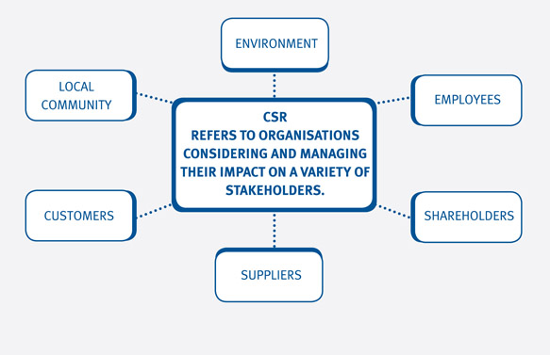
BUSINESS AND STAKEHOLDERS
Business cannot escape from society, and society cannot exist without business.
Businesses are part of societies (locally, nationally, globally) therefore have a duty to act within their expectations and norms.
By doing so they are able to operate successfully without harming the societies, communities and environments in which they operate (Sethi, 2003).

Slide 3
CORPORTAE SOCIAL RESPONSIBILITY DEFINITION
  Corporate Social Responsibility is the continuing commitment by business to behave ethically and contribute to economic development while improving the quality of life of the workforce and their families as well as of the local community and society at large’. (World Business Council For Sustainable Development)
  “Corporate social responsibility is essentially a concept whereby companies decide voluntarily to contribute to a better society and a cleaner environment. (The Commission of the European Communities (2001, p.4)

Slide 4
CSR is the commitment of business to contribute to sustainable economic development-working with employees, their families, the local community and society at large to improve the quality of life in ways that are both good for business and good for development” (World Bank, 2008).
“CSR is a commitment to improve community well-being through discretionary business practices and contributions of corporate resources”(Kotler & Lee, 2005).
“Social responsibility of business is to encompass the economic, legal, ethical and discretionary expectations that society has of organizations at a given point in time” (Carroll, 1979).

Slide 5
WHY CSR…………
Business allegations…
    Little concern for the consumer
    Cares nothing about the deteriorating social order
    Has no concept of acceptable ethical behavior
    Indifferent to the problems of minorities and the environment
What responsibility does business have to society?

Slide 6
Business Criticism/
Social Responsibility Cycle

Slide 7
Factors in the Societal Environment
(have led to)
Criticism of Business
Increased Concern
for the Social Environment
(which has resulted in)
A Changed
Social Contract
Business Assumption of
Corporate Social Responsibility
Social Responsiveness, Social
Performance, and Corporate Citizenship
A More Satisfied Society
Fewer Factors Leading to
Business Criticism
Increased Expectations
Leading to More Criticism

Slide 8
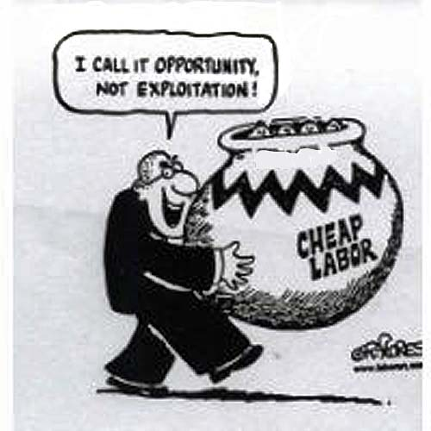
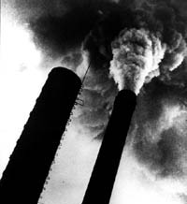
KEY ISSUES IN CSR
Labour rights:
  child labour
  forced labour
  safety and health
Environmental conditions
  water & air emissions
  climate change
Poverty Alleviation
  job creation
  public revenues
  skills and technology

Slide 9
APPROACHES TO SOCIAL RESPONSIBILITY
TRADITIONAL APPROACH
Businesses are accountable to their shareholders, the owners of the corporation.
This view is associated with economist Milton Friedman and others who believe that society creates firms to pursue two primary purposes; to produce goods and services efficiently and maximise profits, so long as the business stay within the rules of the game.
Thus management's sole responsibility is to serve the shareholders' interests by managing the company to produce profits from which shareholders benefits.

Slide 10
STAKEHOLDER SOCIAL RESPONSIBILITY
According to this philosophy, managers must be responsible to certain groups that are affected by, or can affect, the company's objectives and interests.
Such groups include shareholders, customers, government agencies, competitors, unions, employees, trade associations, important suppliers, protest groups and others.
What is good for the company, it is argued, is good for society. The stakeholder philosophy also makes the accumulation of capital a management priority.

Slide 11
AFFIRMATIVE SOCIAL RESPONSIBILITY
This philosophy holds that managers have a responsibility to promote the mutual best interests of the firm and its various stakeholders, including the general public.
It obligates managers to anticipate changes in the social environment in which they operate, and it requires them to blend the goals of the company with the general and diverse interests of society as a whole.
Management that adopts this philosophy must address the concerns of a wide range of groups as well as plan for the future needs of society.

Slide 12
NATURE OF SOCIAL RESPONSIBILITY
FOUR CONSTITUENTS OF CSR BY CARROLL
Economic – the duty of managers, as agents of the company owners, to maximize stockholder wealth
      Shareholders demand a reasonable return.
      Employees want safe and fairly paid jobs.
      Customers demand quality at a fair price.
Legal- the firm’s obligations to comply with the laws that regulate business activities
    The law is a base line for operating within society.
    It is an accepted rule book for company operations.

Slide 13
Ethical – the company’s notion of right and proper business behavior. This relates to doing what is right, just and fair.
    Actions taken in this area provide a reaffirmation of social legitimacy.
    This is naturally beyond the previous two levels.
Discretionary – voluntarily assumed by a business organization.
    Relates to discretionary behaviour to improve the lives of others.
    Charitable donations and recreational facilities.
    Sponsoring the arts and sports events.

Slide 14
HOW BUSINESSES RESPOND TO SOCIAL PRESSURE
Carroll suggests four possible strategies: reaction, defence, accommodation
proaction.
Reaction
The corporation denies any responsibility for social issues.
Defence
The corporation admits responsibility but fights it, doing the very least that
seems to be required.
Accommodation
  The corporation accepts responsibility and does what is demanded of it by
relevant groups.
Pro-action
The corporation seeks to go beyond industry norms.

Slide 15
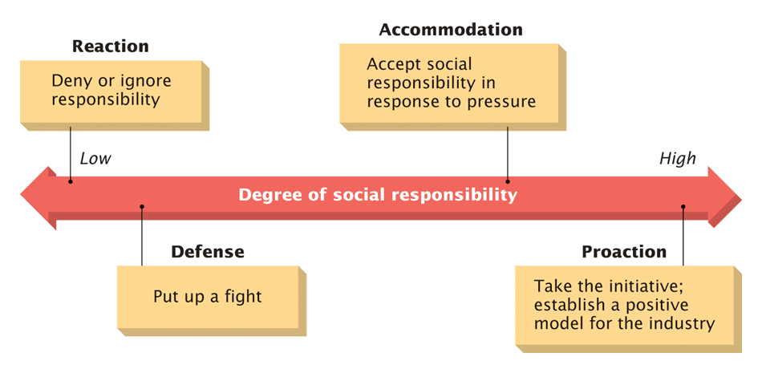
A Continuum of Social Responsibility Strategies

Slide 16
ARGUMENTS FOR AND AGAINST SOCIAL RESPONSIBILITY
ARGUMENTS FOR
ARGUMENTS AGAINST
  Business enterprises contribute to many of society's social problems.
  Business has the resources to tackle today’s complex societal problems.
  A better society means a better environment for doing business.
  Limits future government interventions
  Restricts the free market goal of profit maximization
  Businesses are very likely to add the costs incurred on social programmes to the prices of their products, thereby hurting society.
  Combining social activities with economic activities will give business firms excessive power.
  Business is not equipped to handle social activities
  Because business managers are not elected, they are not directly accountable to the people.

Slide 17
BENEFIT OF CSR
Corporations perceived as ethically sound are rewarded with
extra customers.
Corporations which are ethically unsound are boycotted.
Employees are more attracted to work for, and are more committed to socially responsible companies.
Voluntarily committing to social actions and programmes may forestall legislation and promote independence from government.
Positive contribution to society is a long-term investment in safer, better educated and more equitable community creating a more stable context in which to do business.

Slide 18
END

