Slide 1
BUSINESS ENVIRONMENT
BBA 140
LECTURE 1
LLB MAJORS
MS FAITH MOONO SIMWAMI
mo.simwami@gmail.com

Slide 2
Course Overview
Business as a System
  Business Organisations
  Meaning of Business
  Assessment of both the internal and external environment
    SWOT ANALYSIS
    PORTER’S MODEL
    PESTLE ANALYSIS
  Managing Environmental elements
Economic Environment & Business
Socio-Economic Environment & Business
Technological Environment & Business
Political Environment & Business
Business Ethics, Social Responsibility & Legal Compliance
Society & Multinational Business

Slide 3
Assessment Criteria
Assignment - 10%
Class Test - 10%
Mid-Term Exam - 20%
Final Exam - 60%

Slide 4
CLASSROOM EXPECTATIONS
Attendance
Communication
Feedback
Course Assessment
Course Work Requirements
Cell Phones
Preparation – notes, homework etc…

Slide 5

Recommended Reading
The Business Environment. Adrian Palmer & Bob Hartley. 7th Edition, 2012. McGraw-Hill Education.
The Business Environment. Ian Worthington and Chris Britton. 6th Edition, 2009. Pearson education. Great Britain.
Management. 9th Edition. S.P. Robins, M. Coulter, 2007. Pearson Prentice Hall.
Mastering business communication. L.A. Wolcott, W.R. Unwin. Palgrave.
The international business environment. I. Brooks, J. Weatherston, G. Wilkinson. 2004. Financial Times/ Prentice Hall.
Business and its Environment. 5th Edition. D.P. Baron. 2007. Prentice Hall.

Slide 6
Chapter 1
Business Organizations

Slide 7
WHY DO LAW STUDENTS TAKE BUSINESS ENVIRONMENT???

Slide 8
Introduction
A Business is any legal entity that may be owned by one person as a Sole Proprietor or by two or more people thereby creating a Partnership or Corporation.
The main aim of many business operation is to make a profit either in the short or long term.
A Business Activity does not only involve trading activities i.e. buying and selling, but can include other forms of business activities like:
Banking Manufacturing Educational
Insurance Providing services Internet services
Transportation both passenger and cargo, etc…
Notes:
Who/How many of you run businesses…?
Tell us about what it is you do?

Slide 9
Introduction Cont’d
Business: is a fundamental and universal feature of human existence and yet the concept of business is difficult to define with any degree of precision.
Most business activities take place within an organizational context and reveals a wide variety of organizations ranging from the small local supplier of a single good or service to a multibillion dollar multinational corporation.

Slide 10
BUSINESS GOALS
Profit –
  Making profit is the primary goal of any business enterprise.
Growth –
  Business should grow in all directions over a period of time.
Power –
  Business houses have vast resources at its command. These resources confer enormous economic and political power.
Employee satisfaction and development -
  Business is people. Caring for employee satisfaction and providing for their development has been one of the objectives of enlightened business enterprises.

Slide 11
BUSINESS GOALS
Market Leadership –
  To earn a niche for oneself in the market, innovation is the key factor.
Challenging –
  Business offers vast scope and poses formidable challenges.
Joy of creation –
  It is through business strategies new ideas and innovations are given a shape and are converted into useful products and services.
Service to society –
  Business is a part of society and has several obligations towards it.
Quality Products and Services –
  Persistent quality of products earns brand loyalty, a vital ingredient of success.

Slide 12
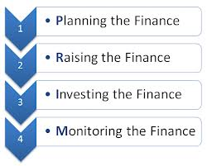
What is the Goal of the Firm?
Financial Goals:
  Avoid bankruptcy and financial distress
  Minimize costs
  Maximize sales
  Maximize profits
The best goal of a publicly traded firm:
  Maximize share price (Maximization of Shareholder Wealth)
  Value creation occurs when we maximize the share price for current shareholders.

Slide 13
Types of Business Organizations
A business may be owned by one person as a Sole Proprietor or can be owned jointly with another person or partner as a Partnership.
Another way in which a business could be owned is through the establishment of a Limited Liability Company.
A limited company can be privately or publicly owned.

Slide 14
            Sole Proprietor
This is a business owned by only one person who provides all the capital needed to set up and manage the organization and takes profit as his reward.
Main features of Sole Proprietorship are as follows;
It is a business owned by only one person who provides all the needed capital and manages it alone.
It is the simplest and most common type of business enterprise.
The business tends to be small in size although it is not always so.
This type of business enterprise is not confined to retail trade.

Slide 15
A Sole Proprietor
ADVANTAGES
DISADVANTAGES
The business is easy to set up, control and manage.
It requires a small amount of capital to set up; as a result many people are able to run this type of business.
The owner makes independent and quick operational decisions.
Business affairs are kept private except when completing Tax returns.
  The law provides that the sole proprietor shall pay tax.
The personal assets are at risk because the business has unlimited liability.
It is more difficult for a Sole Trader to source outside finance because in most cases they lack collateral.
The sole trader is entirely responsible for all aspects of the business (Marketing, Production, Finance etc…)
Difficulty of continuing business after death or disability and bankruptcy of the proprietor.
The Sole Trader is responsible for all the debts of the business.

Slide 16
  A Partnership
  A partnership exists when at least two, and usually not more than twenty (20) persons agree to carry on a business together. The Partnership Act, 1890, defines a partnership as a relationship which subsists between persons carrying on business in common with a view to profit. There are two distinct types of Partnerships, namely General Partnership and Limited Partnership.
General partnership is the most common type of partnership that involves all partners working together on a daily basis sharing all privileges, benefits, and liabilities of the partnership.
Limited partnership is the type of partnership in which some partners contribute in raising capital but do not take part in the management of the business. This type of a partner is sometimes referred to as a “Silent Partner.”
A partnership Agreement is a document specifying and regulating the running of the business. It contains the duties, responsibilities, rights, penalties and general functions of partners towards the business.

Slide 17
A Partnership
ADVANTAGES
DISADVANTAGES
Few formalities are required to set up this type of business.
Sharing of partners’ knowledge and skills.
Sharing of general management of the business.
No obligations to publish Accounts and affairs of the business to the public.
Sharing of profits (or losses) of the business.
Each partner is liable for the debts of the partnership, even if caused by the actions of other partners.
Personality clashes can affect the business greatly if not checked.
The death or bankruptcy of one partner will automatically dissolve the partnership unless otherwise provided for in a partnership agreement.
Less operational management flexibility

Slide 18
  Limited Companies
A Company may be defined as an association where two or more people come together for a common business goal.
A Company has what is termed as “Corporate Personality”.
It has all the rights that are in some cases as those of a human individual and is always treated by Law as a “Separate person”.
When a Limited company fails, its members or shareholders are only required to meet their debts up to the nominal value of their shares. This is the limited liability of persons investing in business ventures. Limited companies are either private or public.

Slide 19
PRIVATE LIMITED COMPANY
A private company is any registered company formed and owned by individuals other than the public.
It’s name will always end with the word Limited abbreviated as Ltd.
The minimum number of shareholders required for a private company is two (2) and can have shareholders up to fifty (50).

Slide 20
Advantages of a Private Limited Company
It is a legally separate entity or personality from the owners.
The liability of the Shareholders is limited, so their personal assets are not at risk.
Shareholders have direct control over the company’s affairs.
It can easily raise more capital by selling shares though not publicly.
The company has sure continuity, as it does not depend on one person.

Slide 21
Disadvantages of a Private Company
There are too many legal formalities to comply with.
Accounts should be audited annually hence the need to engage services of External Auditors.
The company is less flexible compared to a sole proprietorship.
It is a costly exercise to form a Limited liability than that of a sole proprietorship.

Slide 22
Public Limited Company
A public company states in its Articles of Association that it is a Public Company mostly abbreviated as Plc. This type of company is one that advertises inviting the public to buy shares in it. It also lists its shares on the stock exchange market.
Characteristics of a Public Limited Company
It is a company formed by at least two (2) persons without a maximum number.
The shareholders or members of the company elect a Board of Directors to control it.
The day to day running of the business is in the hands of the Managing Director.
The Board of Directors deal with the Managing Director on Policy issues.
It is a separate legal entity and is registered with the Registrar of Companies.
Notes:
The interaction of a public company and the pucblic

Slide 23
Advantages of a Public Limited Company
The company is a separate legal entity and as such the liability of shareholders is limited to the amount of shares they hold in the company.
It can raise more capital by the sale of shares on the stock exchange (i.e. LUSE).
It can employ professionals in such fields like Marketing, Accounting, Human Resource Management etc, which makes it more efficient.
Its size makes it possible for the company to buy modern equipment and technology.
It has assured continuity.

Slide 24
Disadvantages of a Public Limited Company
It has to comply with many regulations set to protect Employers, Employees and other Stakeholders. i.e. Dividends
There is little secrecy, as its accounts must be published annually. This is a legal requirement.
Decisions tend to be delayed because of the amount of administration or bureaucracy involved such as those that require the Board’s approval. – Eg. 25 year old Accountant
The risk of takeover bids by other companies because shares of a public limited company can easily be bought on the stock exchange.

Slide 25
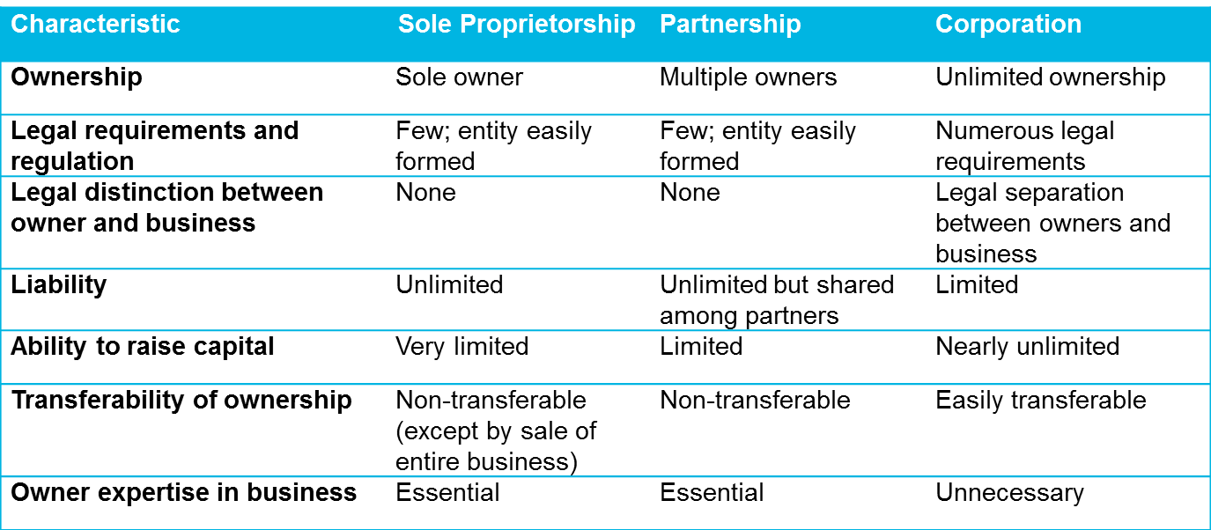
Forms of Business and
Conflicts of Interest

Slide 26
HOMEWORK
READ EXTENSIVELY ON THE FOLLOWING AREAS
If a PUBLIC or PRIVATE company wants to raise funds, they can do so in two ways:
  Debt – borrowing
  Equity – Stocks/Shares
Shares – a claim to ownership
  Classifications
    Preferential Shares
    Common Shares
  Obligations/Expectations
    Depending on which shares are owned, shareholders have various rights i.e. fixed payments, right to vote etc..
Lusaka Stock Exchange (LUSE) – market where shares are bought and sold
Brokers – serve as intermediaries between the market and investors
  They charge a fee for their service
  In Zambia, you can not purchase shares without a broker
Payout Methods to shareholders
  Dividends
  Capital Gains
Shares do not expire. For as long as the company is in operation, shares bought have no maturity period.
How does one set up a sole proprietor, partnership, private and public company?

Slide 27
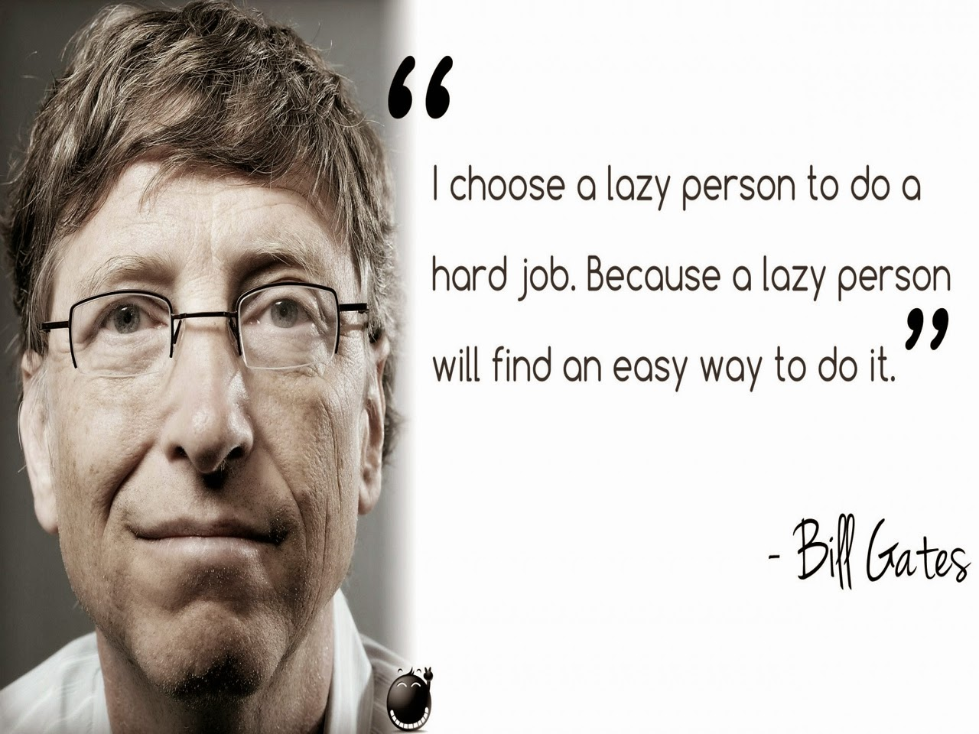
END OF LECTURE SLIDES

