Slide 1
THE ECONOMIC ENVIRONMENT
BBA 140 – BUSINESS ENVIRONMENT
MS. FAITH MOONO SIMWAMI
MO.SIMWAMI@GMAIL.COM

Slide 2
INTRODUCTION…
Every business is affected by the environmental changes and influences. One of the most important of the environmental forces which react with a business organization stems from the workings of the economic system.
An economic system allocates a nation's resources known as factors of production among its citizens.
Factors of production are the basic resources a business uses to produce goods and services. They include:
General economic conditions Capital Entrepreneurs
Natural resources Labour
Other forces which affect a business include government's monetary and fiscal policies, markets, customers and competitors.
Allocating Scarce Economic resources among competing ends is a problem.
Nations must chose which factors of production to deploy
Nations may opt for different methods, these methods are termed economic systems.

Slide 3
INTRODUCTION …
Nearly every economic system has the following goals:
  Stability - in economic terms, stability is a condition in which the balance between money available and goods produced remains about the same.
    As a consequence, prices for consumer goods, interest rates and wages paid to workers change very little.
    Stability helps maintain equilibrium and predictability for business people, consumers and workers.
  Full employment - this is a situation in which all those who want work have jobs.
  Growth - is an increase in the amount of goods and services produced by our resources.
  To assess the effectiveness of an economic system objectively, it is important to consider the society's goals and the extent to which an economic system meets these goals.

Slide 4
ECONOMIC SYSTEMS…
1. Market or Capitalist Economy
2. Planned Economies
3. Mixed Economies

Slide 5
1. Market or Capitalist Economy…
A market economy - An economic system in which individuals control all or most factors of production and make all or most production decisions. In market economy such as capitalism found in the U.S.A, markets decide what, when, and for whom to produce.
For this reason capitalist systems are also called market economies.
Capitalism is characterized by private ownership of the factors of production and by a need for entrepreneurship.
They follow the laws of supply and demand

Slide 6
1. Market or Capitalist Economy...
Adam Smith and other members of the individualist school believed that the uses to which scarce resources should be put are best determined by the market mechanism - the laws of supply and demand.
It was Smith's belief that there should be little state intervention in economic affairs. His philosophy, described as laissez-faire economies, was to let the market i.e. the laws of supply and demand, dictate the solution to the economic problem.

Slide 7
1. Market or Capitalist Economy…
ADVANTAGES
DISADVANTAGES
Freedom of choice - capitalism offers individuals great freedom of choice in what work they do and where they do it.
Profits motivate entrepreneurs to use resources efficiently and to produce goods that consumers most want.
Market forces, if not controlled, can produce economic hardships for sections of the community particularly the poor and the unskilled.
The profit motive sometimes becomes so strong that business harm the society in which they operate.
  For example, some businesses have increased profits by dumping pollutants into nearby rivers or by eliminating competitors or by making extravagant but untrue claims about their products.
  The free enterprise is not keen to supply certain goods and services of a public utility- nature.

Slide 8
2. Planned or Command Economy
  A Planned Economy –
  An economic system in which government controls all or most factors of production and makes all or most production decisions.
  Under this system, the state has a larger role than operating as "watchdog" for employment and the provision of important public services.
  In the planned or command economy the government has great influence over how much shall be produced (the volume of production), what type of goods and services will comprise the volume of production, what types of work each citizen will undertake and how each citizen will be rewarded for his efforts.
  Planned economies are found in communist and socialist countries.

Slide 9
2.1 Communism
Communism –
  A kind of planned economy in which the government owns and operates all industries.
  A system in which all economic resources of a country are collectively not individually owned.
  Countries like the Russia, China, Cuba, Korea and Vietnam are communists.
  Owing to lack of incentives of profits and the risk-taking of entrepreneurs, communist nations have been characterized by failure to innovate and inefficient production of goods and services.
  In recent years, these problems have prompted some communist countries to experiment with elements of a market economy.
    For example, China has removed price controls from most items and altered its once rigid wage system to provide incentives for increased production.

Slide 10
2.2 Socialism
Socialism –
  A kind of planned economy in which the government owns and operates the main industries, while individuals own and operate less crucial industries.
  Thus, the government may control banking, communications, transportation, and industries that produce basic products such as oil and steel. But real estates and smaller businesses such as clothing, stores and restaurants are privately owned.
In socialist countries the government establishes national goals for using the nation's resources. High priority is normally given to equitable distribution of income and assurance that all citizens receive medical care and other social services they need.
Although workers in socialist countries are usually allowed to choose their occupations or professions, a large proportion generally work for the government.

Slide 11
2. Planned or Command Economy
ADVANTAGES
DISADVANTAGES
Provision of social services - the basic social services are provided
There is equitable distribution of income.
Government operated enterprises are inefficient since government positions are frequently filled on political consideration rather than ability.
Extensive public welfare systems have also resulted in very high taxes.
Because of these factors, socialism is generally declining in popularity

Slide 12
3. Mixed Economies
A Mixed Economy –
  An economic system with elements of both a planned economy and a market economy.
  Most of the world's countries have a mixed economy, one economic system dominates but elements of the other systems are present as well
There is no country in the world today that is purely communistic, socialistic, or capitalistic economy.
The western nations such as UK and USA have developed mixed economies in which most economic activity takes place within a free enterprise system with some measure of state control or intervention.
  The reason for this trend is that left entirely to itself, the free enterprise might not be keen to supply certain goods and services of a public utility nature.

Slide 13
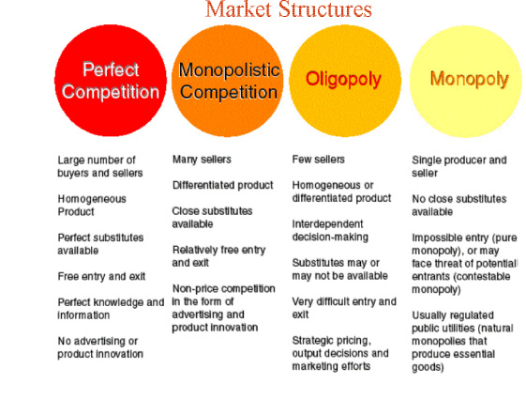
MARKET STRUCTURES

Slide 14
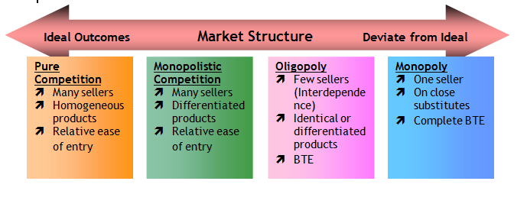
THE 5 Types of Competition

Slide 15
1. Perfect (pure) Competition
Perfect competition is a market system characterized by many different buyers and sellers. In the classic theoretical definition of perfect competition, there are an infinite number of buyers and sellers. With so many market players, it is impossible for any one participant to alter the prevailing price in the market. If they attempt to do so, buyers and sellers have infinite alternatives to pursue.
Perfect (pure) competition is the opposite of a monopoly, in which only a single firm supplies a particular good or service, and that firm can charge whatever price it wants because consumers have no alternatives and it is difficult for would-be competitors to enter the marketplace.

Slide 16
2. Monopoly
A monopoly is the exact opposite form of market system as perfect competition. In a pure monopoly, there is only one producer of a particular good or service, and generally no reasonable substitute. In such a market system, the monopolist is able to charge whatever price they wish due to the absence of competition, but their overall revenue will be limited by the ability or willingness of customers to pay their price.

Slide 17
3. Oligopoly
An oligopoly is similar in many ways to a monopoly. The primary difference is that rather than having only one producer of a good or service, there are a handful of producers, or at least a handful of producers that make up a dominant majority of the production in the market system.
While oligopolists do not have the same pricing power as monopolists, it is possible, without diligent government regulation, that oligopolists will collude with one another to set prices in the same way a monopolist would.

Slide 18
4. Monopolistic Competition
Monopolistic competition is a type of market system combining elements of a monopoly and perfect competition. Like a perfectly competitive market system, there are numerous competitors in the market. The difference is that each competitor is sufficiently differentiated from the others that some can charge greater prices than a perfectly competitive firm.
An example of monopolistic competition is the market for music. While there are many artists, each artist is different and is not perfectly substitutable with another artist.

Slide 19
5. Monopsony
Monopsony market systems are not only differentiated according to the number of suppliers in the market. They may also be differentiated according to the number of buyers. Whereas a perfectly competitive market theoretically has an infinite number of buyers and sellers, a monopsony has only one buyer for a particular good or service, giving that buyer significant power in determining the price of the products produced.

Slide 20
Analysing the Economic Factors
General economic factors
Customers

Slide 21
1. General Economic Factors
These changes in general economic conditions affect (and are affected by) the forces of supply and demand, buying power, willingness to buy, expenditure levels and the intensity of competitive behaviour
Fluctuations in the economy follow a general pattern that is often referred to as the Business Life Cycle Stages:
  Prosperity
  Recession
  Depression and
  Recovery

Slide 22
a) Prosperity
Unemployment is low and aggregate income is relatively high
Assuming a low inflation rate, this combination causes buying power to be high
The economic outlook remains prosperous, consumers generally are willing to buy
Organisations respond by expanding their product/services mixes to take advantage of the increased buying power
Capture a larger market share by intensifying distribution and promotion efforts

Slide 23
b) Recession
Unemployment rises during recession
Total buying power declines - many consumers become more price and value conscious
  People ordinarily reduce their consumption of the more expensive convenience foods and
People save their money
Organisations would consider some revision to their marketing activities
  Reducing the size of their product line
  Increasing promotional outlays to stimulate demand.
Promotional efforts should emphasize value and utility.

Slide 24
c) Depression
Extremely high unemployment
  Wages are very low
Total disposable income is at a minimum – consumer spending lowest
Governments use both monetary and fiscal policies to try and offset the effects of recession, depression and inflation
  Monetary policies are employed to control the money supply which in turn influences spending, saving and investment by both individuals and business.
  Through Fiscal policies, the government can influence the amount of savings and expenditures by altering the tax structure and by changing the levels of government expenditure.

Slide 25
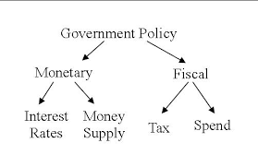
NOTE:
Research on how the Fiscal and Monetary Policies can be used to monitor the economy…
Monetary policy is one of the ways that the government attempts to control the economy. If the money supply grows too fast, the rate of inflation will increase; if the growth of the money supply is slowed too much, then economic growth may also slow.
In economics and political science, fiscal policy is the use of government revenue collection (mainly taxes) and expenditure (spending) to influence the economy.

Slide 26
d) Recovery
The economy moves from recession to prosperity
During this period:
  High unemployment rate begins to decline
  Total disposable income increases
  Consumers ability to buy increases, but their willingness to buy is more cautious
  They may be more likely to save than spend or buy on credit
As the recovery strengthens:
  Consumers start spending more, buying higher-priced goods and services such as house cleaning and lawn care
Recovery is a difficult stage for marketers. Because of the difficulty to ascertain:
  How quickly prosperity will return
  How quickly consumers will make the psychological transition from recession to prosperity
Organizations should maintain a high flexibility in their strategies in order to be able to make the needed adjustments as the economy stabilises

Slide 27
2. Customers
Economic production is undertaken so as to satisfy effective demand; hence customers form a potent influence on the organization.
Customer's ability to spend is affected by a number of factors such as:
  Level of employment
  People's purchasing power
  People's ability to save and spend
  An organization which exists to satisfy consumer demand is affected directly by variations in these aggregates

Slide 28
A. Level of Employment
Level of employment affects earning and spending capacity as well as demand

Slide 29
B. Consumer Demand & Spending
Organisations must understand the factors that determine what, where and when people buy. The following aspects of buying behaviour should be analysed:
Buying power - one of the requirements for a market is that people have buying power. The strength of a person's buying power depends on both the size of the resources available and the economy
The resources that make up buying power are:
  Goods
  Services
  Financial holdings The state of the economy affects
The economic state influences price levels
  During inflationary periods, when prices are rising, buying power decreases because more dollars are required to buy products
  Conversely, in periods of declining prices, the buying power of a given set of resources increases.

Slide 30
B. Consumer Demand & Spending
The major financial sources of buying power are:
  Income
  Credit and
  Wealth

Slide 31
1. INCOME
Income – the amount of money received through wages, rents, investments, pensions and subsidy payments for a given period, such as a month or a year.
Normally this money is used for three purposes: paying taxes, spending and saving.
The remaining income after tax deductions is called disposable income, used for spending or saving. When taxes rise, disposable income declines, when taxes fall, disposable income increases.
Disposable income that is available for spending and saving after an individual has purchased the basic necessities of food, clothing, and shelter is called discretionary income.
Use discretionary income to purchase: entertainment, vacations, automobiles, education, furniture, appliances, and so on.

Slide 32
2. CREDIT
Credit transactions enable people to spend future income now or in the near future.
Credit increases current buying power at the expense of future buying power.
Interest rates affect consumer's decisions to use credit, especially for expensive purchases such as home appliances and automobiles.
  When credit charges are high, consumer are more likely to delay buying expensive items.
Credit usage is also affected by credit terms, such as the size of the down payment and the amount and number of monthly payments.

Slide 33
3. WEALTH
A person can have a high income and very little wealth. Wealth is the accumulation of past income, natural resources and financial resources.
It may exist in many forms, including cash securities, savings, accounts, jewellery, antiques and real estates.
The significance of wealth to marketers is that as people become wealthier, they gain buying power in three ways :
  they can use their wealth for current purchases
  use it to generate income and also
  use it to acquire large amounts of credit

Slide 34
Conclusion: Income, Credit & Wealth
Organisations need to analyse buying power because of its tremendous impact on consumers reaction to firms' marketing strategies.
Income, wealth and credit equip consumers to purchase goods and services.
Organisations should be aware of current levels of expected changes in buying power in their own markets because buying power directly affects the types of quantities of goods and services that consumers purchase.

Slide 35
C. Consumers' willingness to spend
Just because consumers have buying power does not mean that they will buy. Consumers must also be willing to use their buying power.
People's willingness to spend is to some degree related to their ability to buy. However, a number of other elements also influence willingness to spend. Price of produces and services influence consumers. Such as:
  Price of substitute products
  The amount of satisfaction currently received or expected in the future from a product already owned
Factors that affect consumers' general willingness to spend are:
  expectations about future employment, income levels, prices, family size and general economic conditions
  Expectations of rising prices in the near future may also increase the willingness to spend.
  Family size affects buying power
  Perceptions of future economic conditions influence willingness to buy.

Slide 36
QUESTIONS…?

Slide 37
TASK
As an economist, tasked with role of advisory on Zambia’s goals, which of the three economic goals would you focus on? Why this specific goal? How would you make the difference?
Define & justify the Zambian economic system, providing justification and at least 4 advantages and disadvantages of such a structure.
Provide at least 3 examples of companies operating under: Perfect Competition, Oligopoly, Monopolistic Competition and Monopoly. Choosing one company from each category, explain how these companies affect the economy in which it is operating in –should the market be more open or closed?
List the various Business cycle stages. Which stage is Zambia in? Justify.

