Slide 1
BUSINESS ENVIRONMENT
INTERNAL AND EXTERNAL
ENVIRONMENTAL ANALYSIS TOOLS

Slide 2
KNOWLEDGE IS KNOWING THAT A TOMATO IS FRUIT, WISDOM IS NOT PUTTING IT INTO A FRUIT SALAD

Slide 3
SWOT ANALYSIS
SWOT is an acronym which stands for Strengths, Weaknesses, Opportunities and Threats. It is used to analyse both the internal and external environment
Strengths and weaknesses are internal to the company, meaning they’re things that you as a business owner have the power to change.
Opportunities and threats are external issues that are outside the scope of your control but which can impact your operation for better or worse.

Slide 4
APPLICATION OF SWOT ANALYSIS
A SWOT analysis helps to conduct a quick analysis of a business’s current position so that it can help the business to develop or plan a direction of development or a proper strategy in future.
It is used to analyze the possible internal advantages and problems that a business has, and helps determine the external factors of the business which may affect its strategy
  Complete an objective analysis
  Allows business owners to evaluate their position in the marketplace
  Identify sources of competitive advantage as well as potential liabilities
  Evaluate investment worthiness of the company

Slide 5
STRENGTHS
Internal attributes and resources that support a successful outcome
What advantages does your organization have?
What do you do better than anyone else?
What unique or lowest-cost resources can you draw upon that others can't?
What do people in your market see as your strengths?
What factors mean that you "get the sale"?
What is your unique selling point?

Slide 6
WEAKNESSES
Internal attributes and resources that work against a successful outcome
What could you improve?
What should you avoid?
What are people in your market likely to see as weaknesses?
What factors lose you sales?

Slide 7
OPPORTUNITIES
External factors that the entity can capitalize on or use to its advantage
What good opportunities can you spot?
What interesting trends are you aware of?

Slide 8
THREATS
External factors that could jeopardize the entity's success
What obstacles do you face?
What are your competitors doing?
Are quality standards or specifications for your job, products or services changing?
Is changing technology threatening your position?
Do you have bad debt or cash-flow problems?
Could any of your weaknesses seriously threaten your business?

Slide 9
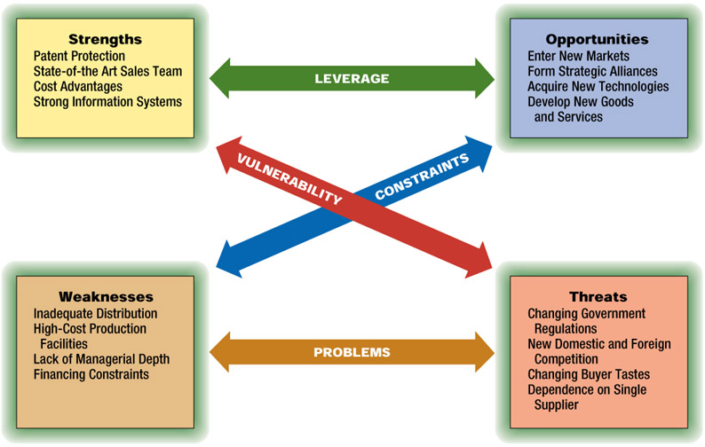
Elements of SWOT Analysis

Slide 10
Business Analysis Models
-Examples or Illustrations for SWOT Analysis Models
Good brand image
Well-known name
Good reputation
Cost advantage in production
High market share
Confidence in the market
Customer loyalty or repeat business
More advanced technology and R & D
Strengths
© PhotoDisc

Slide 11
Business Analysis Models
-Examples or Illustrations for SWOT Analysis Models
Ineffective in production
Falling profit
Falling sales of the product
Declining age of the life cycle of a product
Poor reputation
Lack of innovation and change
Lack of adequate capital or having some financial problems
Customers’ losing confidence or increasing complaints on the business
Poor management or inefficient organizational structure
Weaknesses
© PhotoDisc

Slide 12
Business Analysis Models
-Examples or Illustrations for SWOT Analysis Models
Possible development of new products
Expansion into new markets
Development of a global brand
Joint –development with other companies
Possible growing demand for a product in the market
Possible government policies encouraging the growth of the business and its certain products
New sources of profit or income
Opportunities
© PhotoDisc

Slide 13
Business Analysis Models
-Examples or Illustrations for SWOT Analysis Models
Changes in law or regulations.
Growing competition from local companies
Increasing competition from foreign competitors
New products developed by other companies which may replace the product of the business
Marketing activities or strategies which will be implemented by competitors
Threats
© PhotoDisc

Slide 14
PERSONAL ASSESSMENT USING SWOT
Question for your critical thinking:
Based on the Analysis Model discussed, in 10 minutes, Conduct a brief SWOT analysis on yourself.

Slide 15
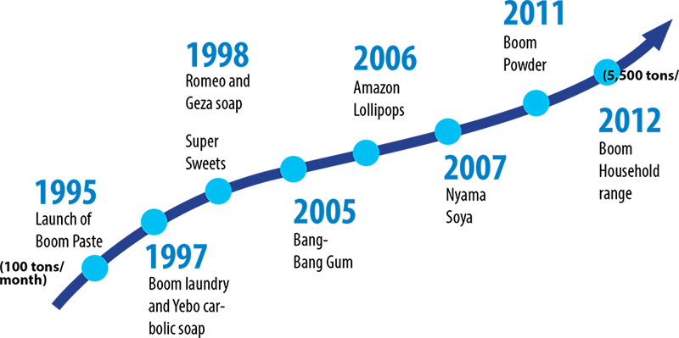
TRADE KINGS STORY

Slide 16
CLASS EXERCISE
Trade Kings Zambia, has recruited you as a management trainee. The Business Development Manager working with Production Department is thinking of introducing a new product on to the market. As the newly recruited management trainee, under his jurisdiction, he has tasked you with the responsibility of conducting a SWOT analysis to ascertain the organisation’s readiness for this new product and how this new product will impact on the business performance.

Slide 17
GROUP EXERCISE
In smaller groups of six conduct a swot analysis on the following companies;
Shoprite
Lafarge
ZNBC
Zambeef
Protea Hotels
UTH
Small grocery store outside Unilus gate
Airtel

Slide 18
END

Slide 19
MANAGING ENVIRONMENTAL ELEMENTS
Managers have three major options in attempting to manage environmental uncertainty and its potential impact:
1 Adapt to the existing environmental elements
2 Attempt to influence environmental favorability
3 Shift the domain of operations away from threatening environmental elements towards more beneficial ones.

Slide 20
1. Adaptation
The adaptation approach involves changing internal operations and activities-.to- make the organization more compatible with its environment.
Four common approaches used by organizations to adapt to environmental fluctuations are:
  Buffering
  Smoothing
  Forecasting
  Rationing

Slide 21
Adaptation Techniques
Buffering
The use of buffering involves stockpiling either inputs into or outputs from a production or service process in order to cope with environmental fluctuations (demand).
Smoothing
Smoothing involves taking actions aimed at reducing the impact of fluctuation given the market. For example, utilities often, discount their energy rates in designated slow-demand periods.
Forecasting
Forecasting is the systematic effort to estimate future conditions. For example, grocery stores frequently hire part-time cashiers to supplement regular staff during busy periods.

Slide 22
Adaptation Techniques Cont’d
Rationing
Rationing involves providing limited access to a product or service that is in high demand. For example, many universities and colleges ration slots for popular programs by establishing program pre-requisites.
Rationing has the advantage of allowing the organization to avoid costs of expanding capacity.
Rationing has the disadvantage of denying a consumer a product or service, while the organization is forced to turn away potential business.

Slide 23
2. Favorability Influence
The favorability influence approach involves attempting to alter environmental elements in order to make them more compatible with the needs of the organization.
Major methods that the organization use in attempting to influence significant elements in the environment are:
Advertising and Public Relations
Negotiating contracts, co-opting
Joint ventures, joining Trade associations and engaging in political activities.

Slide 24
Advertising and Public Relations
Advertising is the use of communications media to gain favourable publicity for particular products and services. Public Relations involves the use of communications media and related activities to create a favourable overall impression of the organisation among the public.

Slide 25
Boundary Spanning
Boundary spanning involves creating roles within the organization that interface with important elements in the environment.
Examples of boundary spanning roles include:
  Salespersons
  Purchasing specialists
  Personnel recruiters
  Admissions officers
  Shipping and receiving
  Agents, receptionists, scientists and Lawyers.

Slide 26
Recruiting
Recruiting involves attracting job candidates who meet the needs of the organization.
This tool can be used for environmental influence when organizations seek job candidates who have a knowledge of and close ties to a significant element of the environment.
For example, companies often hire executives from specific companies because of their environmental knowledge and connection.

Slide 27
Negotiating contracts
Negotiating contracts aims at seeking favorable agreements on matters of importance to the organization.
Specific agreements with customers and suppliers are one common means of creating environmental favorability

Slide 28
Co-opting
Co-opting is the process of absorbing key members of important environmental elements into the leadership or policy-making structure of an organization.
A common example of co-optation is the addition of key members of the environment to boards of directors.
For instance, some universities have prominent individuals on the council.
These individuals often help the universities deal more effectively with environmental elements, particularly in the area of raising funds from business.

Slide 29
Trade Associations
Trade associations are organizations composed of individuals or firms with common business concerns.
Because they represent the pooled resources of many organizations, trade associations are frequently in an enhanced position for conducting public relations campaigns affecting favorability of the environment within which their members operate

Slide 30
Political Activity
The use of political activity involves attempts by organizations to enhance their competitive situation.
This is achieved through influencing the legislator or the behavior of government regulatory agencies.

Slide 31
3. Domain Shifts
Domain shifts involve making changes in the mix of products and services offered.
One major approach is to move out of a current product, service or geographic area into a more favorable domain.
A second domain shift approach is to expand current domains through diversification, i.e. the expansion of products and services offered or the development of new and different products or services.

Slide 32
Questions?

