Slide 1
SOCIO-ECONOMIC ENVIRONMENT & BUSINESS

Slide 2
DEFINING THE SOCIO-ECONOMIC ENVIRONMENT
Socio-economics borders on examining the social and economic factors of an environment and how they both influence it.
Socio-economic factors are associated with quality of life and determine the behaviours, tastes, preferences, attitudes and lifestyles of people living within a society.

Slide 3
Socio-economic Factors
Socio economic factors have a high impact on businesses.
This is because the consumers are often at the heart of businesses and tend to affect growth of all ventures.
Businesses need to look out for socio economic factors if they are to excel and compete effectively in an ever changing market.

Slide 4
1. Income Capacity
Determines how much consumers can spend on certain products.
If citizens in a country have access to high incomes from employment and personal business ventures, they are more likely to spend on luxurious products.
This is because they can easily afford the products and also have a taste for good things.
On the other hand, low income earners may not be able to afford basic commodities, let alone the luxurious products.

Slide 5
1. Income Capacity
Determines how much consumers can spend on certain products.
If citizens in a country have access to high incomes from employment and personal business ventures, they are more likely to spend on luxurious products.
This is because they can easily afford the products and also have a taste for good things.
On the other hand, low income earners may not be able to afford basic commodities, let alone the luxurious products.

Slide 6
1. Income Capacity cont…
It is important for a business to consider the income capacities of the consumers before setting up the business.
For high end products, a business would set up in an up market area with access to high income earners.
For basic commodities, a business would look for cheap suppliers and set up near low income earners.

Slide 7
2. Occupation
Occupation of consumers is largely related to the income they earn. E.g. Low skilled labourers do not earn the same as corporate managers.
The differences in occupations determine the income gaps of the consumers.
Businesses must conduct research on occupations of their prospective consumers.

Slide 8
3. Education Levels
Education levels influence the type of occupation a person can get and ultimately their income level.
Consumers with higher education tend to be skilled and also have better jobs and incomes as compared to those without education.
Education is determined by the opportunities presented to the consumers and can influence how much a consumer can afford.

Slide 9
3. Education Levels cont…
Educated consumers have different tastes for products in comparison to the uneducated ones.
The educated consumers are not only more conscious about the contents of products but may also be more demanding compared to the less educated ones.
A business may have to work harder to fulfil the demands of these consumers as compared to when dealing with the less educated who are less demanding.

Slide 10
4. Economic Growth
Economic growth and development of a country can also have an impact on the social status of its citizens.
Emerging economies such as China and India have proved that if a country experiences high economic growth then the citizens may have better access to incomes and also the middle class and upper class may grow.

Slide 11
4. Economic Growth cont…
This may also attract more investors into the country and increase employment rates.
Inevitably positive economic growth rates will increase spending and help businesses to grow.

Slide 12
Core Cultural Values
Core cultural values are a set of guiding organizational principles or values that employees know and live by.
These guide the behaviour of employees as they interact with each other and with others outside the organization.
They also support the company’s vision and reflect its identity.

Slide 13
Core Cultural Values cont…
Achieving success as an organization begins with employees understanding what the organization stands for.
Every organization must define its core cultural values.
If well defined, they assist in positioning the organization for success in its business operations.

Slide 14
Sub Cultures
Culture in an organization is the shared values and goals embraced by an organization.
Over time due to employees sharing workspace and tasks, organizations develop small groups that share their own values.
When values of subcultures align with organizational values, this contributes to the success of the organization.

Slide 15
Secondary Cultures
The set of norms, beliefs, values and customs that exist within a population of a nation.
International organizations develop practices in accordance with the national culture they are operating in.
It is very important for international organizations to have deep knowledge of practices and customs applied in global business.

Slide 16
Secondary Cultures cont…
National culture as an example of secondary culture strongly influences business strategies.
The impact that national culture has on business strategy eventually results in the failure or success of a business.
National culture ultimately affects core functions of a business such as human resource management and marketing.

Slide 17
MORE ON SOCIO-ECONOMIC ENVIRONMENT

Slide 18
Economic Business Cycles

Slide 19
SOCIETY’S ECONOMIC GOAL
Every Society has three economic goals;
Promote economic growth
Prevent unemployment
Limit inflation- price stability

Slide 20
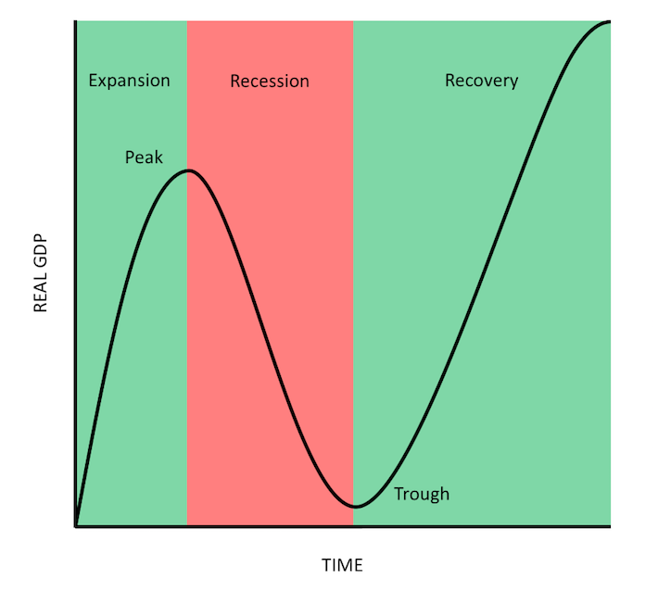
STAGES OF ECONOMIC BUSINESS CYCLE
Notes:
Business Cycle is the visualisation of the economic conditions, a graph showing us how businesses are meeting society goals
Economic business cycle is measured by two components, GDP(Total output produced by an economy) and Time
Fluctuations in the economy(ups and downs)
GDP increase-economy is growing(Expansion)
GDP Decrease- economy is shrinking(Contraction/Recession)
Fluctuations continue overtime for months, quarters or years

Slide 21
PROSPERITY(EXPANSION)
CHARACTERISTICS
Unemployment is low
Aggregate income is relatively high
Assuming a low inflation rate- this combination causes buying power to be high

Slide 22
The economic outlook remains prosperous, consumers generally are willing to buy
Organisations respond by expanding their product/services mixes to take advantage of the increased buying power
Capture a larger market share by intensifying distribution and promotion efforts

Slide 23
RECESSION
CHARACTERISTICS
Unemployment rises during recession
Total buying power decline-many consumers become more price and value conscious
People ordinarily reduce their consumption of the more expensive convenience foods and save their money (e.g. grow own food, discount purchasing)
Organisations would consider some revision to their marketing activities
  Reducing the size of their product line
  Increasing promotional outlays to stimulate demand.
Promotional efforts should emphasize value and utility.

Slide 24
DEPRESSION(TROUGH)
CHARACTERISTICS
Extremely high unemployment
Wages are very low, total disposable income is at a minimum, and consumer spending is lowest
Consumers lack confidence in the economy.
Governments use both monetary and fiscal policies in an attempt to offset the effects of recession, depression and inflation

Slide 25
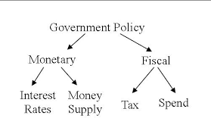
Monetary policies are employed to control the money supply which in turn influences spending, saving and investment by both individuals and business
Through fiscal policies, the government can influence the amount of savings and expenditures by altering the tax structure and by changing the levels of government expenditure

Slide 26
Recovery
The economy moves from recession to prosperity
During this period:
  High unemployment rate begins to decline
  Total disposable income increases
  Consumers ability to buy increases, but their willingness to buy is more cautious
  They may be more likely to save than spend or buy on credit
As the recovery strengthens:
  Consumers start spending more, buying higher-priced goods and services such as house cleaning and lawn care
Recovery is a difficult stage for marketers. Because of the difficulty to ascertain:
  How quickly prosperity will return
  How quickly consumers will make the psychological transition from recession to prosperity
Organizations should maintain a high flexibility in their strategies in order to be able to make the needed adjustments as the economy stabilises

Slide 27
END

