Slide 1

Information Technology
&
The Business Environment

Slide 2

What is Information Technology?
It is the application of computers and telecommunications equipment to store, retrieve, transmit and manipulate data.

Slide 3

What are the Advantages of I.T?
Social / Personal Perspective

Slide 4
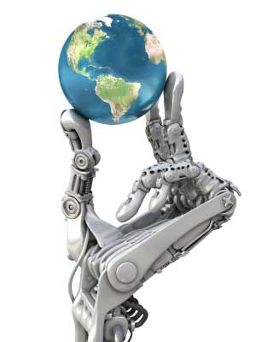
Business Perspective
Effective Decisions
Better Coordination
Transparent Facilities Control
Safer Storage for Sensitive Information
International Corporate Culture
Unlimited Research Opportunity
Mobility of Business
Cost Effective and Diverse
Evolving of Industry : Programmers, System Analysts, Marketers & Web Designers

Slide 5
What are the Disadvantages of I.T?
Social / Personal Perspective

Slide 6
Business Perspective
Little or No body language is involved in digital communication
Dependency on technology has brought a reduction in human self reliance
High decrease in Human Self reliance
Less Value in Human Workers

Slide 7

Impact of I.T on the Business Environment
Revolutionised the phase of business around the world
I.T has changed the dynamic of communication
I.T has changed the storage infrastructure in organizations
Efficiency in workmanship due to a high increase in on-the-go devices.

Slide 8
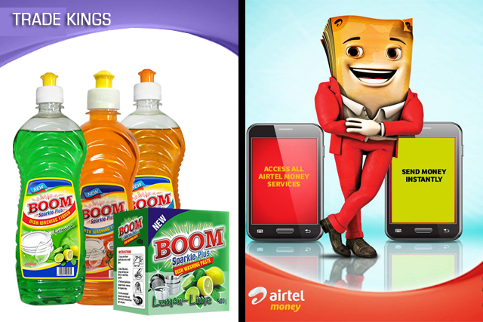
Diversity of Information Technology (Zambian Perspective)

Slide 9
Similarities and Differences
Technological Advancement
Unlimited Research Platforms
Marketing Diversity
Marketing Ideas

Slide 10
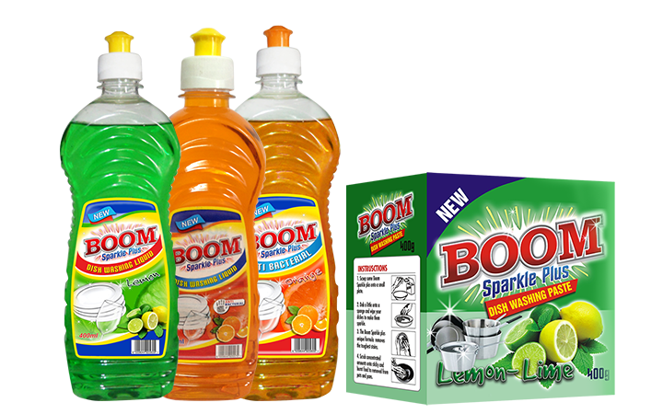


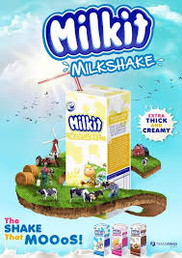

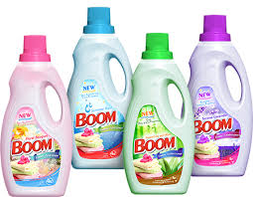
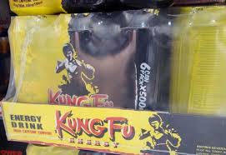
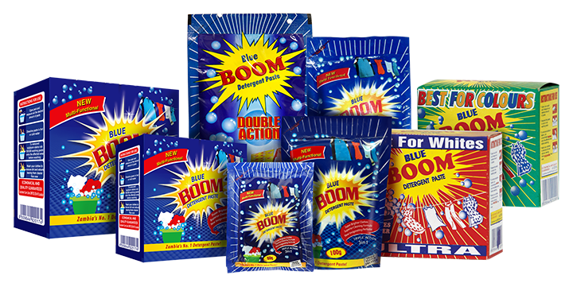
Technological Advancement
At trade kings, technological advancement has brought about diversity in the product range and has seen a rise in products such as:

Slide 11


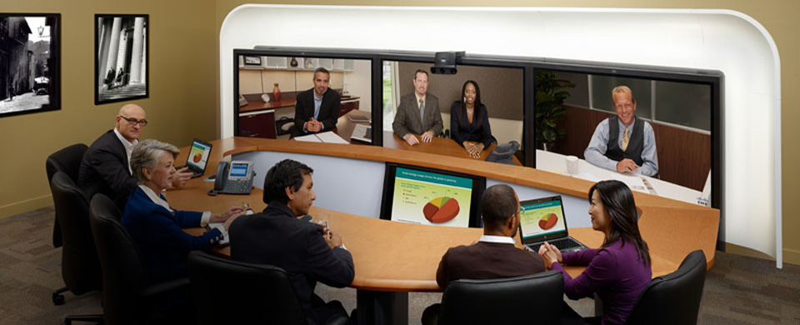

Technological Advancement
At Airtel, technological advancement has brought about diversity in the product range and has seen a rise in products such as:

Slide 12

Unlimited Research Platforms
How come Airtel and Trade Kings do not go out of Business?
I.T has brought stiff competition in the Business Environment, however, due to robust research and availability of information about their competitors, both Airtel and Trade Kings remain vibrant in the market.

Slide 13
Marketing Ideas & Capabilities
Advancement in production and display equipment has also made it easier for both companies to create adverts of catchy and organized fashion.
This has made it possible for products to be competitive and recognised on the international market.

Slide 14
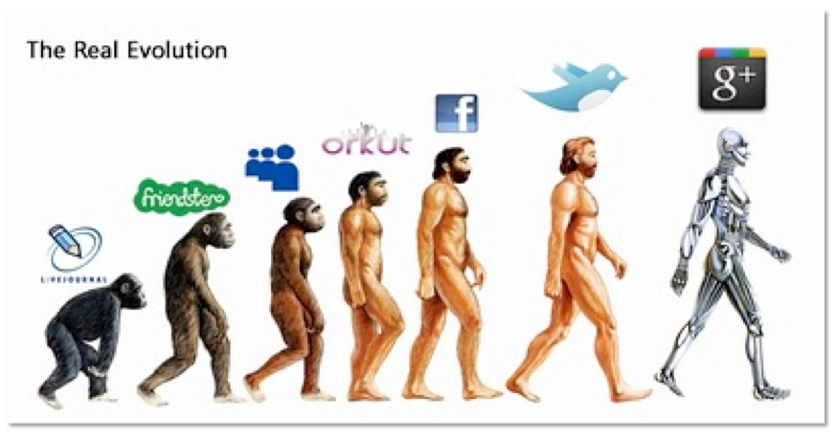
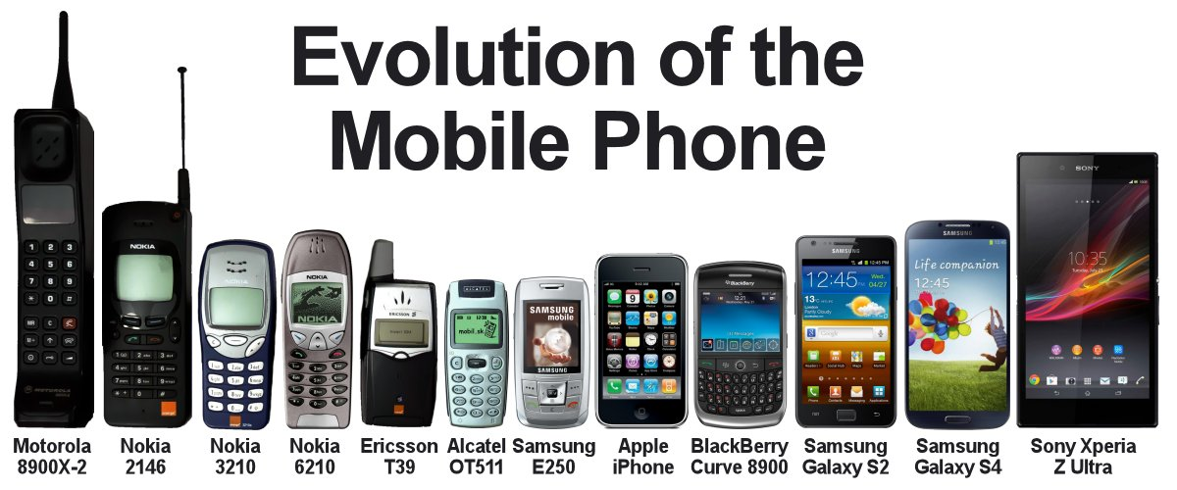
What is Next in the Digital Age?

