Slide 1
THE ECONOMIC ENVIRONMENT

Slide 2
WHAT IS THE ECONOMIC ENVIRONMENT?
Refers to all economic factors, which have a bearing on the functioning of a business.
Business depend on the economic environment for all needed inputs and sell of finished goods.

Slide 3
International Forces
Importance of Economic Environment:
  Better investment choices
  Better competitive strategies
  Forecasting of marketing trends
  Adjusting economic analysis and interpretation
  Help managers predict events that might affect company’s future performance.

Slide 4
ELEMENTS IN ECONOMIC ENVIRONMENT
GROSS NATIONAL INCOME: income generated by total domestic production and international production activities of national companies.
GROSS DOMESTIC PRODUCT: total value of all final goods and services produced in a country in a given year (total consumer, investment, and government spending, plus value of exports, minus the value of imports).

Slide 5
ELEMENTS IN THE ECONOMIC ENVIRONMENT
FOREIGN EXCHANGE
Exchange rate tells how many units of currency it takes to buy one US dollar.
Estimating the value of a universal basket of good and services that can be purchased with one unit of a country’s currency.

Slide 6
ELEMENTS IN THE ECONOMIC ENVIRONMENT
INFLATION
Rise in price measured against a standard level of purchasing power
It results when demand grows faster than supply
It affects cost of living, exchange rates, interest rates

Slide 7
ELEMENTS IN THE ECONOMIC ENVIRONMENT
UNEMPLOYMENT
Number of workers who want to work but do not have jobs
Results in low economic growth, creates social pressures and provokes political uncertainty
Companies think twice before they hire new employees.

Slide 8
ELEMENTS IN THE ECONOMIC ENVIRONMENT
DEBT
Sum of borrowing from its’ population, foreign organizations and government.
The larger the debt, the more uncertain country’s economy.
Internal Debt- When government spends more than it collects.
External Debt- When government borrows money from foreign lenders.

Slide 9
ELEMENTS IN THE ECONOMIC ENVIRONMENT
POVERTY
Condition where person or community lacks essentials for minimum standard of well being and life.
Throughout the world people struggle for basic necessities.
Growth of economy of business depends on alleviating poverty.

Slide 10
ANALYSING THE ECONOMIC ENVIRONMENT
Labour
Capital
Entrepreneurs
Customers

Slide 11
Economic Business Cycles

Slide 12
SOCIETY’S ECONOMIC GOAL
Every Society has three economic goals:
Promote economic growth
Prevent unemployment
Limit inflation- price stability

Slide 13
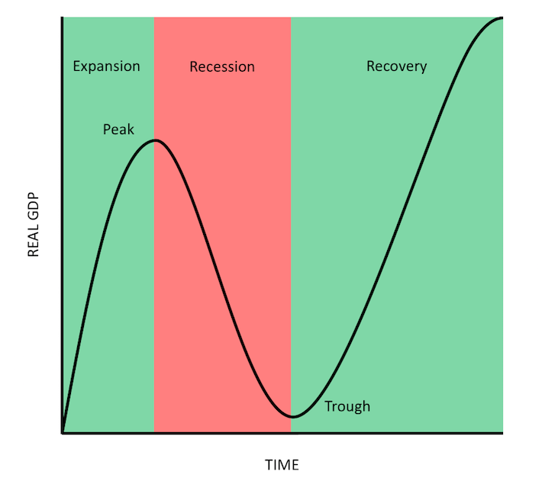
STAGES OF ECONOMIC BUSINESS CYCLE
Notes:
Business Cycle is the visualisation of the economic conditions, a graph showing us how businesses are meeting society goals
Economic business cycle is measured by two components, GDP(Total output produced by an economy) and Time
Fluctuations in the economy(ups and downs)
GDP increase-economy is growing(Expansion)
GDP Decrease- economy is shrinking(Contraction/Recession)
Fluctuations continue overtime for months, quarters or years

Slide 14
PROSPERITY(EXPANSION)
CHARACTERISTICS
Unemployment is low
Aggregate income is relatively high
Assuming a low inflation rate- this combination causes buying power to be high

Slide 15
The economic outlook remains prosperous, consumers generally are willing to buy
Organisations respond by expanding their product/services mixes to take advantage of the increased buying power
Capture a larger market share by intensifying distribution and promotion efforts

Slide 16
RECESSION
CHARACTERISTICS
Unemployment rises during recession
Total buying power decline-many consumers become more price and value conscious
People ordinarily reduce their consumption of the more expensive convenience foods and save their money (e.g. grow own food, discount purchasing)
Organisations would consider some revision to their marketing activities
  Reducing the size of their product line
  Increasing promotional outlays to stimulate demand.
Promotional efforts should emphasize value and utility.

Slide 17
DEPRESSION(TROUGH)
CHARACTERISTICS
Extremely high unemployment
Wages are very low, total disposable income is at a minimum, and consumer spending is lowest
Consumers lack confidence in the economy.
Governments use both monetary and fiscal policies in an attempt to offset the effects of recession, depression and inflation

Slide 18
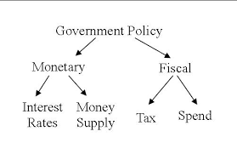
Monetary policies are employed to control the money supply which in turn influences spending, saving and investment by both individuals and business
Through fiscal policies, the government can influence the amount of savings and expenditures by altering the tax structure and by changing the levels of government expenditure

Slide 19
Recovery
The economy moves from recession to prosperity
During this period:
  High unemployment rate begins to decline
  Total disposable income increases
  Consumers ability to buy increases, but their willingness to buy is more cautious
  They may be more likely to save than spend or buy on credit
As the recovery strengthens:
  Consumers start spending more, buying higher-priced goods and services such as house cleaning and lawn care
Recovery is a difficult stage for marketers. Because of the difficulty to ascertain:
  How quickly prosperity will return
  How quickly consumers will make the psychological transition from recession to prosperity
Organizations should maintain a high flexibility in their strategies in order to be able to make the needed adjustments as the economy stabilises

Slide 20
FISCAL POLICY
Deliberate changes in government spending and tax in order to achieve full employment, control inflation and encourage economic growth.
Role of Fiscal Policy
Fiscal policy provides government with a tool for managing the level of Aggregate Demand through changes in taxation and government spending.
Certain types of government spending and tax policies can promote increases in aggregate supply, and thereby contribute to long-run economic growth:

Slide 21
Fiscal Policy Tools
Infrastructure spending: When government supports a modern infrastructure, including for transportation and communications, the private sector is given the resources it needs to grow and succeed in the long-run
Education spending: Human capital is perhaps the most important resource a nation requires for long-run economic growth. Public, government funded schools and programs to improve skills in the labor can contribute to long-run growth.

Slide 22
Fiscal Policy Tools cont
Research and development: Government-funded research and development can lead to scientific, technological, and medical breakthroughs that may spur new industries and promote growth across the private sector.
Incentives for private investment: Creating a tax policy that rewards innovation and entrepreneurship in an economy will encourage private businesses to invest and thereby help the economy grow.

Slide 23
MONETARY POLICY
Monetary policy is how central banks manage liquidity to create economic growth. Liquidity is how much there is in the money supply.
That includes credit, cash, checks, and money market mutual funds.
Role of Monetary Policy
The goals of monetary policy are to promote maximum employment, stable prices, and moderate long term interest rates.
By implementing effective monetary policy, the government can maintain stable prices and support conditions for long term economic growth.

Slide 24
Monetary Policy Tools
Reserve requirement: Portions of deposits that banks must maintain in their vaults. Tells banks how much of their money they must have on reserve each night.
Open market operations: Primary tool used in influencing the supply of banks. Buying and selling of Treasuries and other securities from its member banks. This changes the reserve amount that banks have on hand without changing the reserve requirement.
Discount Rate: Interest rate charged by Government Reserve Banks to repository institutions on short term loans. A raised discount rate makes it more expensive for banks to borrow and must be the last resort for a commercial bank.

Slide 25
ANALYSIS OF ECONOMIC ENVIRONMENT

Slide 26
MARKET STRUCTURES
Definition of market:
A market is a social arrangement that allows buyers and sellers to discover information and carry out a voluntary exchange of goods or services.
The market structure (also known as market form) describes the state of a market with respect to competition.

Slide 27
TYPES OF MARKET STRUCTURES
Four types of market structures: Perfect competition, Monopoly, Monopolistic competition and Oligopoly.
The differences in the number, type and size of firms in the market, as well as the nature of the product itself is what affects the type of competition and extent to which companies can control price.

Slide 28
PERFECT COMPETITION
Perfect competition is a state of affairs where suppliers and consumers essentially have no control over prices.
This occurs because there are so many suppliers and consumers, and the market is very competitive.
CONDITIONS FOR PERFECT COMPETITION
The following conditions should apply for perfect competition;
HOMOGENEUOS PRODUCTS
The products in this market are identical in every way. The buyer is indifferent to which supplier he buys the goods from as long as they conform to any description adopted by and understood in the market.

Slide 29
CONDITIONS FOR PERFECT COMPETITION Cont’d
PERFECT INFORMATION AND COMMUNICATION
All consumers in the market must have the same information. Suppliers must have access to the same information about production factors and the technical conditions of production.
No producer is in a more favored situation than any other.
PRICE IS ESTABLISHED BY MARKET FORCES
No producer or buyer is able to influence the price by his or her own actions, nor by the actions agreed with other producers or buyers.
EASY ACCESS TO ENTRY AND EXIT
New firms can enter the market freely. This implies that economies of scale do not exist. Existing firms can just easily stop production and exit the market.

Slide 30
DISADVANTAGES OF PERFECT COMPETITION
It prevents producers from making the profit necessary to provide funds for investment and research to find better ways of producing goods.
Competition can be wasteful, as the resources of each of the competitors are doing the same things.
Firms dislike perfect competition because there is no price stability since prices follow changes in demand and supply.

Slide 31
MONOPOLY
Monopoly is the opposite extreme to perfect competition.
It exists when there is only one supplier or producer for a particular product and there are no close substitutes for that product.
The firm has complete control over prices.
Many state owned organizations are monopolies.
The amount of power a monopoly has depends on the number of close substitutes that are available.

Slide 32
SOURCES OF MONOPOLY
Monopoly can arise in three ways;
LAW
Some countries can grant a company the right to be sole supplier of a product or service (i.e. Telephones or communication) in return for some measure of state inspection and control.
POSSESSION OF A UNIQUE FEATURE
Individuals have monopoly control over the supply of their own skills and this may be a source of considerable profit
MARKET CONTROL
A monopolist’s output is the total market supply and the demand for its product is the total market demand.

Slide 33
Is Monopoly Good?
Arguments in favor of monopoly are based on the economies of scale in production that very large firms may experience.
The monopolist’s size and ability to produce for the whole market enables it to achieve economies of scale.
The monopolist employs professional managers who make more efficient use of available resources.
Monopolies can grow a market which did not exist previously i.e. the success of Microsoft in standardizing the PC market which allowed for its phenomenal growth from the 1980s.
The monopolist does not always maximize profits, but is content with just a satisfactory level of profit.

Slide 34
Supernormal Profit
In perfect competition, firms are restricted in the amount of profit that they can make.
In a monopoly there is no competition, allowing the monopolist to set the price and make substantial profits.
It may then use those profits for R & D and investment, as mentioned in the last point above, or it may simply take the profits for the benefit of the owners.
A monopoly may not have the incentive to be super efficient as is the case with firms in perfect competition who must survive.
The monopoly has no competition in the market place, but it can still make substantial profit without operating at high efficiency.

Slide 35
The case against monopolies
We can summarize the disadvantages of monopoly as follows:
Higher prices than in competitive markets due to excess profit
The cost savings due to economies of scale are outweighed by cost increases due to inefficiency
Wasteful expenditure on R & D and low productivity of R & D expenditure due to inefficiency
No incentive to innovate because of high monopoly profit and absence of competition from other firms.
Lack of customer focus –limited choice and poor product quality due to lack of customer focus.

Slide 36
MONOPOLISTIC COMPETITION
Monopolistic competition has many of the same characteristics as perfect competition:
● unrestricted entry to and exit from the market
● good (but not perfect) communication and transport conditions
● motivation by economic considerations only
● perception by buyers that the products of the various firms are good substitutes for each other.

Slide 37
Characteristics Cont’d
Although the products are considered to be good substitutes, they are not the same (i.e. homogeneous).
Buyers do express preference for one seller's product as opposed to another's.
It is, therefore, the buyer’s perception of the substitutes that differentiates monopolistic competition from perfect competition.
Although the product may be effectively the same, it is the branding which alters the buyer’s perception of the substitute as being equivalent.
Sellers use marketing to increase this preference and grow brand loyalty.
This enables them to increase the price.

Slide 38
Arguments Against Monopolistic Competition
The negative perception of monopolistic competition is that it is not really in the best interests of either consumers or business firms:
Price is higher and output lower than in perfect competition
The firm is not efficient (wastes a lot of resources)
Profits are confined to the normal minimum to keep firms in the market
Firms cannot achieve the profits needed for investment and research or the high output levels necessary for economies of scale.

Slide 39
OLIGOPOLY
Oligopoly is the market structure where supply is controlled by a few firms that are large in relation to the market size.
As a result of their being so few firms they will observe the actions taken by each other very closely and react accordingly to protect their market share.
Oligopolistic firms are therefore interdependent.
Very often the firms are also large, by any standards and are likely to be oligopolists in several markets.
Oligopoly is common in the advanced industrial countries but there is no single model which can be held to apply under all circumstances.

Slide 40
Oligopoly and Anti-Competitive Behavior
Oligopolistic firms compete with each other for the same customers in trying to increase their market share–through marketing or product development, after sales service and so on.
However, at the same time, they will try to keep the price high and/or hinder entry to their market by new firms.
One means of doing this is by colluding with each other –in effect acting as if they are (together) a monopoly.
This type of action is most commonly called price fixing and is illegal in many countries.

Slide 41
Collusion and Cartels
Oligopolistic firms that collude in formal price fixing arrangements are said to be part of a cartel.
The oil industry is a very good example of this where OPEC (the Organization of Petroleum Exporting Countries) is the most powerful cartel in modern history.
Members of a cartel meet at regular intervals to decide on the price that they will sell their product in the particular market.
This can be done to regulate supply for the purposes of ironing out fluctuations in price caused by changes in demand and supply.
It may also be seen as a mechanism to conserve the supply of a scarce product.
However, given this position, a cartel can also operate to charge higher prices than would be possible under competitive conditions.

Slide 42
Conditions Favoring Collusions and Cartels
Collusion between firms in a cartel is more likely when:
There are only a few firms who know each other well
Firms are willing to share reliable information on general and production costs
They produce similar products using closely related processes
There is a dominant firm in the market
Barriers to entry are high
The market is stable with no huge fluctuations in demand or production costs
No government measures exist to prevent collusion.

Slide 43
END

